Slide 1
My emotions and Me

Slide 2
We experience a lot of emotions every day
Some are nice emotions
Some emotions are more challenging
Some we may not be aware of while we are experiencing them
Some we “feel” very strongly while we are experiencing them

Slide 3
Understanding Emotions: Emotion Messages
The most important thing to understand about emotions is that they all have a purpose – they are designed to give us information, what we call emotion messages.
These messages are supposed to bring our attention to important things that are happening in our lives; whether it is a big event (e.g. the birth of a child), or something smaller and more day-to-day (e.g. getting a parking ticket). For example, intense feelings of love tell us we need to care for our child. Anger about a parking ticket tells us to avoid that situation in the future.
Inside Out: Guessing the feelings. (youtube.com)

Slide 4
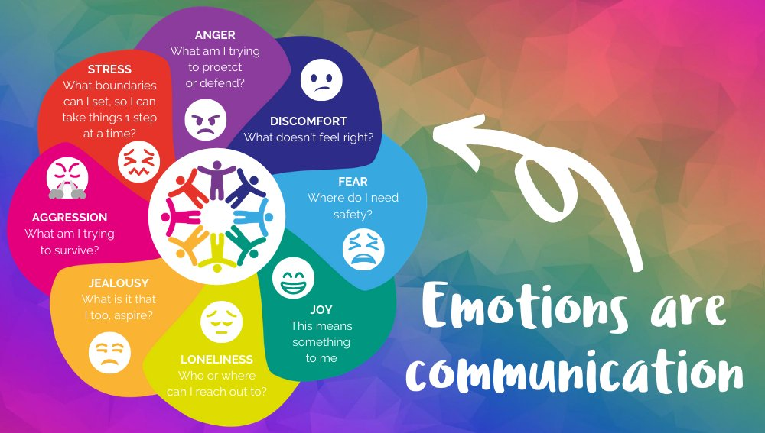
The Emotions triangle
Emotions are our brain communicating with us about how we feel
Whether are emotions are enjoyable or challenging, these emotions move through our body and we experience them physically as well as emotionally. This is how we learn to recognise what emotion we are feeling
Sometimes these feelings are difficult to experience or to control

Slide 5
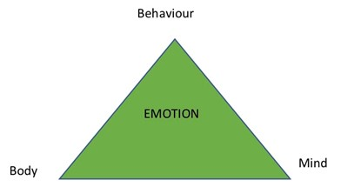
Emotion messages and the Emotion Triangle
Emotion messages get through to us in three different ways, through –
our body (physical sensations)
our mind (thoughts, memories, imagination)
our behaviour (urges and actions)

Slide 6
Why do we need to be able to identify different emotions?
One big part of emotional awareness is being able to name your emotions and tell them apart.
This is a skill called labelling and it is an important first step in managing your emotions effectively.
This is very useful to know because we can learn to tune-in to our emotions better by focusing on these three areas. Think of it as a bit like being a detective – looking for clues in these three areas (body, mind, behaviour) to figure out what we are feeling.
It isn’t always easy to learn how to tune-in and identify the specific emotion(s) we are feeling, but it is something we can learn to do and get better at with practice by reflecting on what is happening to our bodies when we are experiencing an emotion

Slide 7
The Emotion Triangle
When we experience an emotion, we can sense it in three ways

Slide 8
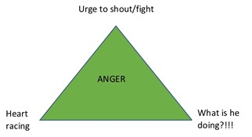
Anger
For example, when we feel angry at someone
our thoughts may get stuck on what the person is doing (mind)
we feel our heart rate increase (body) and
we feel an urge to confront the situation (behaviour).

Slide 9
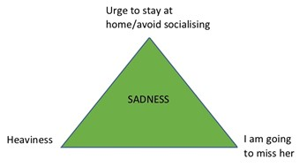
Sadness
We might feel sad about a friend moving away -
we are drawn to think about what we have lost (mind)
our bodies slow down (body)
and we feel an urge to withdraw (behaviour).

Slide 10
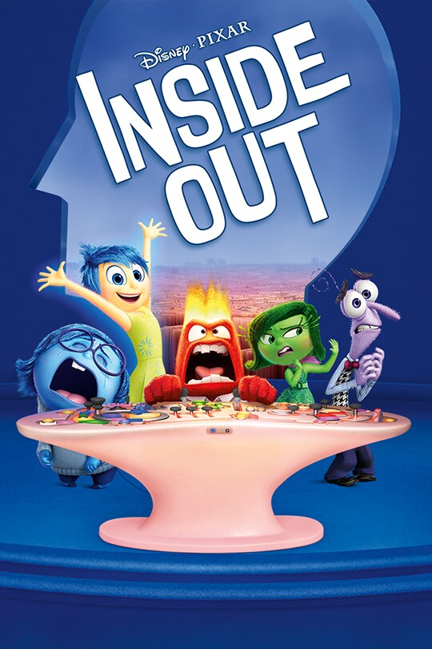
Why do we need to be able to identify the different emotions we are feeling?
Learning to become more aware of our emotions is important. After all, they are trying to give us messages to help us survive or get-by in life.
If we don’t recognise and respond to our emotions well, they can get more intense over time. This is because the emotion is still trying to get the right message through to us.

Slide 11
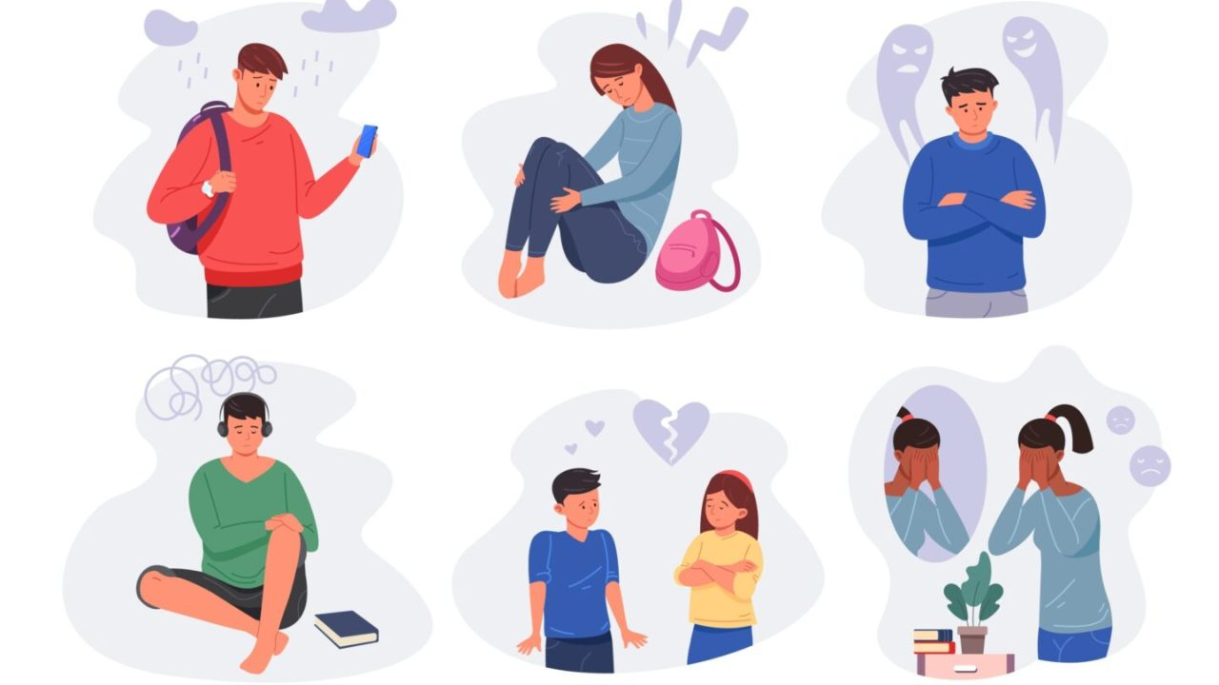
Reflection
The next time you feel a strong emotion, try to pause for a moment to notice how your body is reacting.
Also notice what you feel like you want to do – and take a moment to think whether that is a good thing to do

