Slide 1
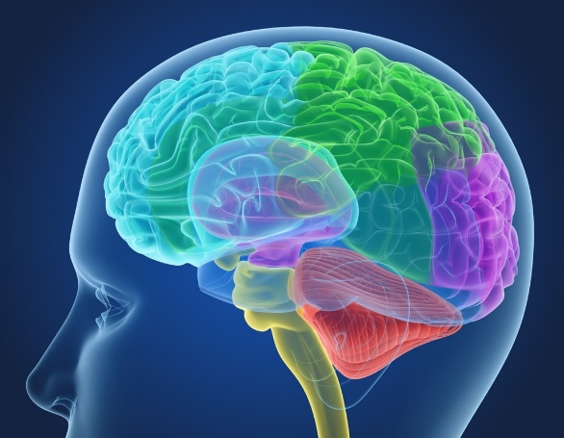
Mental Health Awareness
How to train your brain so you can manage your worries better

Slide 2
Watch the clip
https://www.youtube.com/watch?v=CwudXhyZwNU

Slide 3
What is neuro plasticity?
the ability of the brain to form and reorganise neural connections, especially in response to learning or experience
Our brain repeats patterns of neural connections until “trained” to do it differently, or an experience changes it

Slide 4
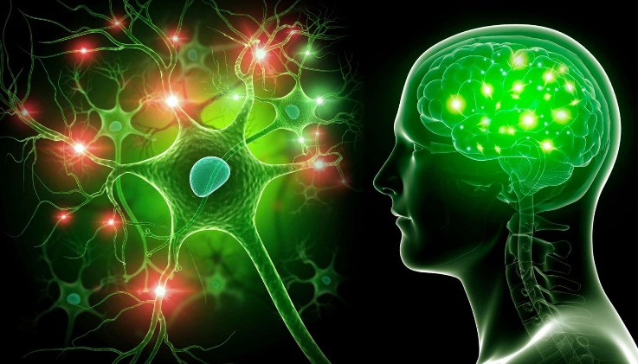
Neuro plasticity and anxiety
Every time we avoid a situation that causes us stress the brain says, “let’s avoid that again”. This makes you more anxious about it so that you will remember to avoid it next time It rewires the neural pathways, making you MORE anxious.
Avoidance feeds anxiety

Slide 5
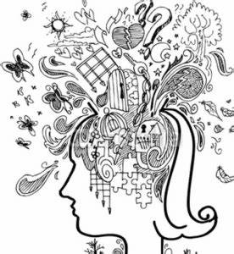
Busy brains
We also have to process 5x more information than people did in the 1980’s
We’re all busy multitasking – checking social media or messages while trying to complete tasks that require concentration.
Our brains are too busy and we need to train them to focus on being in the moment

Slide 6
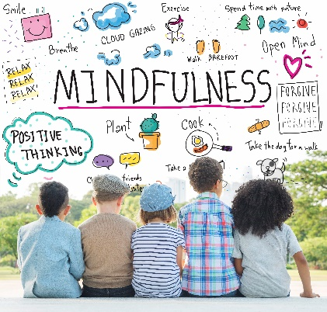
What is mindfulness?
the quality or state of being conscious or aware of something:
a mental state achieved by focusing one's awareness on the present moment, while calmly acknowledging and accepting one's feelings, thoughts, and bodily sensations, used as a therapeutic technique.

Slide 7
What does mindfulness mean for me?
It means training your brain to
Concentrate
Keep attention
You do this by becoming aware of / noticing your body and senses and thoughts for about 10 minutes a day
Mindfulness practice reduces the size of the amygdala and stops it sending out “panic” or avoidance “messages”. Your brain makes stronger neural pathways to the frontal cortex – emotional regulation
Mindfulness practice won’t stop you feeling anxiousness or worry, but it will mean you can redirect your thoughts and manage these feelings better

Slide 8
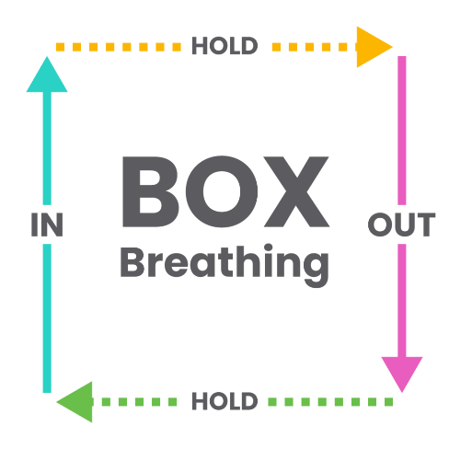
Easy mindfulness
Breathing techniques
Just become aware of your breathing. Focus on it, if your mind wanders, bring it back to focus on your breathing
Box Breathing (last week’s ppt)
Belly buddies –get a small cuddly toy. Lie down. Put it on your belly, watch your belly move up and down with your breathing. If your mind wanders, re focus it back onto your cuddly toy
Doing this for 5-10 minutes a day is really good for you

Slide 9
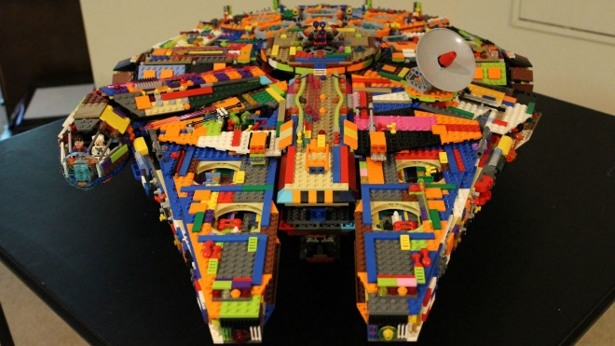
Easy mindfulness
Spend time in nature – notice it – the colours or smells or sounds
Cook – notice the smells and tastes
Garden –notice the smells and colours
Simple crafting or model making

Slide 10
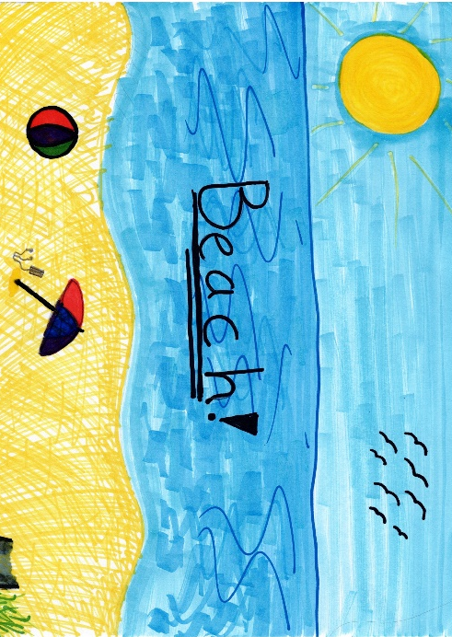
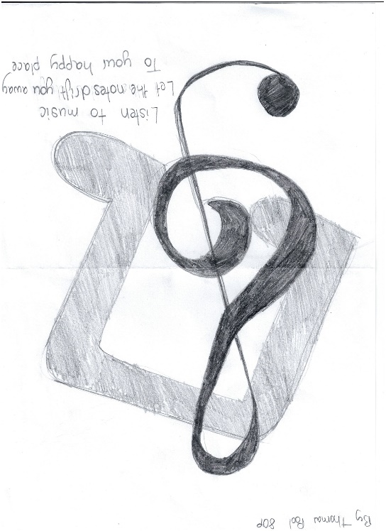
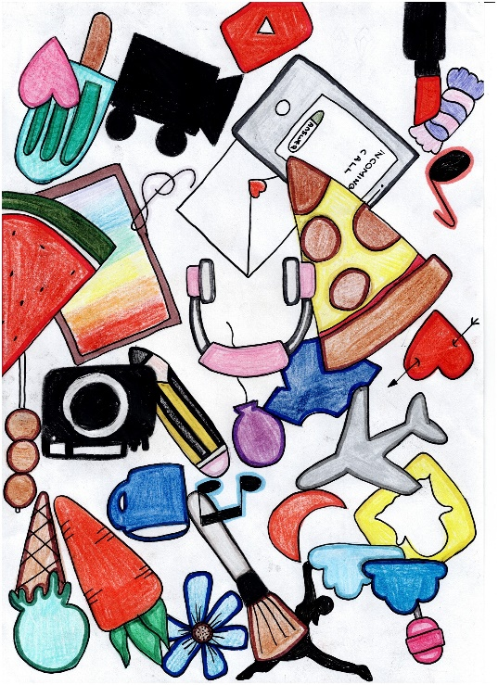
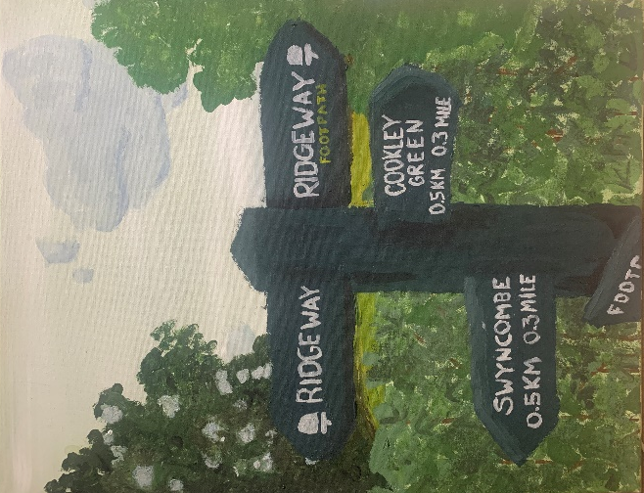
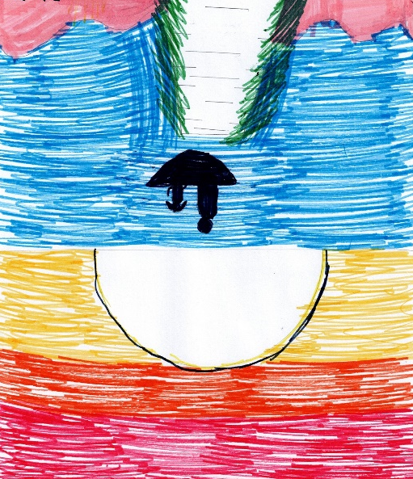
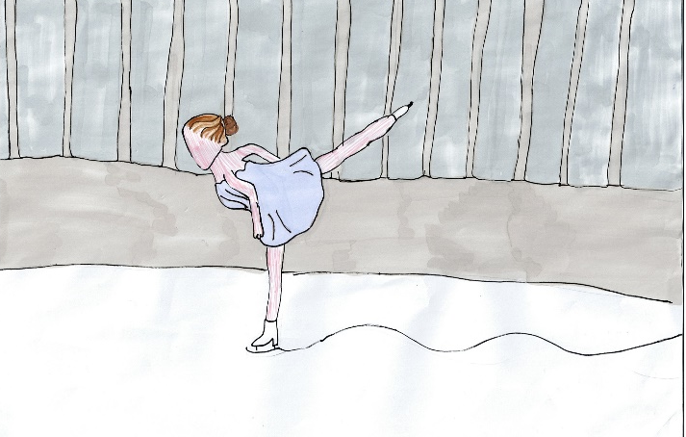
Competition entries –amazing thankyou!
Here are some examples:

Slide 11
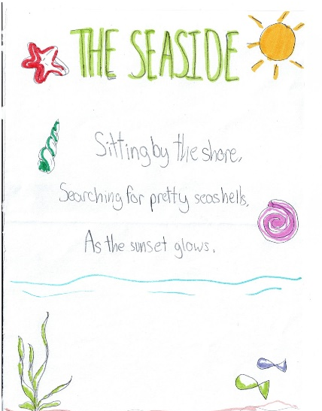
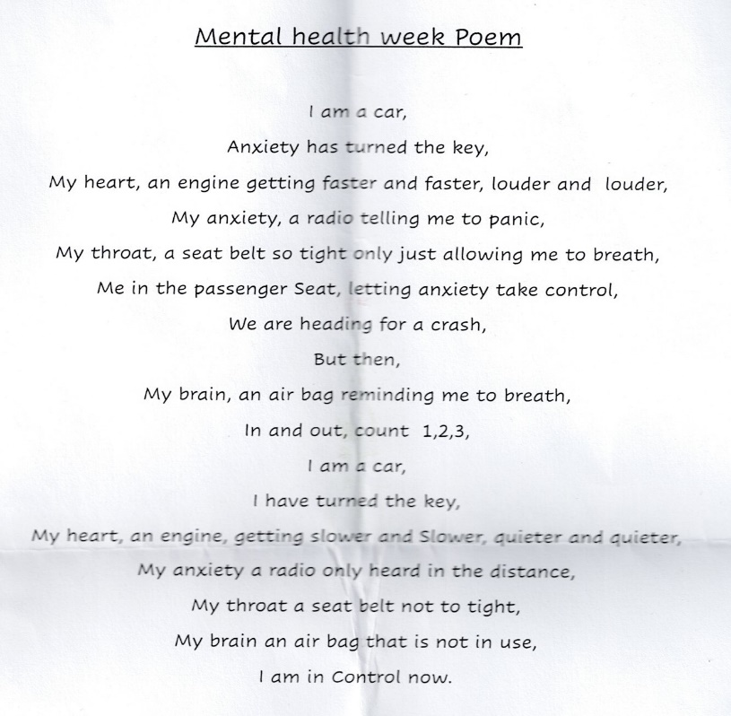
Competition entries –amazing thankyou!
Burnout on the balcony
My back to the wall I sit,
Watching pebbles on the rooftop,
Cheesy music in my ears,
A dizzy ache in my head,
Feelings that don’t really make sense.
The sun is reflected in my neighbour’s window,
And their little blow up garden flamingo,
Is covered in raindrops and dents.
All the veins in a leaf on the tulip tree,
Are staring lazily back at me,
Waving gently because they know.
Makes me feel better about tomorrow.
Here are some examples:

Slide 12
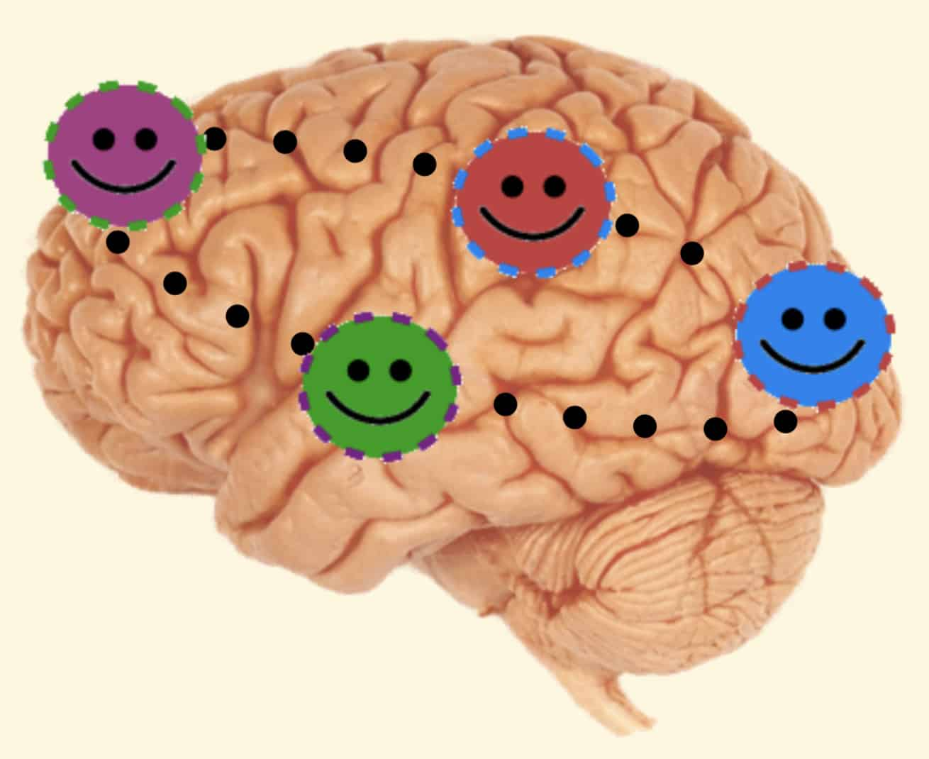
Mental Health Awareness
You can train your brain so you can manage your worries better
What can we do to cope with feelings of anxiety? | Mental Health Foundation

