Slide 1
Personal statements
Ryan Martin
Student Recruitment Officer

Slide 2
Aims
Understand how universities use personal statements
Explore what should be included in a personal statement
Understand how to talk about your skills and experiences
Notes:
Go through the aims of the presentation – this is what students should be able to do by the end of the session.
Get students to be thinking of questions to ask at the end

Slide 3
University selection processes

Slide 4
University selection processes
UCAS Application process
Research courses & universities
- open days
Apply via UCAS*
Possible invites to interview
Offers made
Start university
Results day
Select firm & insurance choice
*you may be required to sit Additional Admissions tests for certain courses before submitting your UCAS form
Notes:
University application process:
Begins during year 12 when it’s important to start researching different university courses – online and in prospectuses and league tables.
During the summer of year 12 and beginning of year 13 is generally when universities hold their open days – this is your opportunity to visit the university campus, department you’re looking to study in and accommodation options.
Beginning of year 13 is when the application process with UCAS takes place – more details on next slide. After you’ve sent off your UCAS form you may get invited to interviews and have offers made.
Around May you will have to make a decision about which offers you want to accept – you get to choose a first choice and a back up.
In August provided you get the results required for the course you selected you will be able to start studying in September time.

Slide 5
University selection processes
UCAS application form
Academic achievements
Subject-specific requirements
Compelling personal statement
Strong teacher reference
Notes:
Briefly explain that there are three main components to the UCAS application form that universities will use to assess an application (don’t go into too much detail as more covered in the next slide)

Slide 6
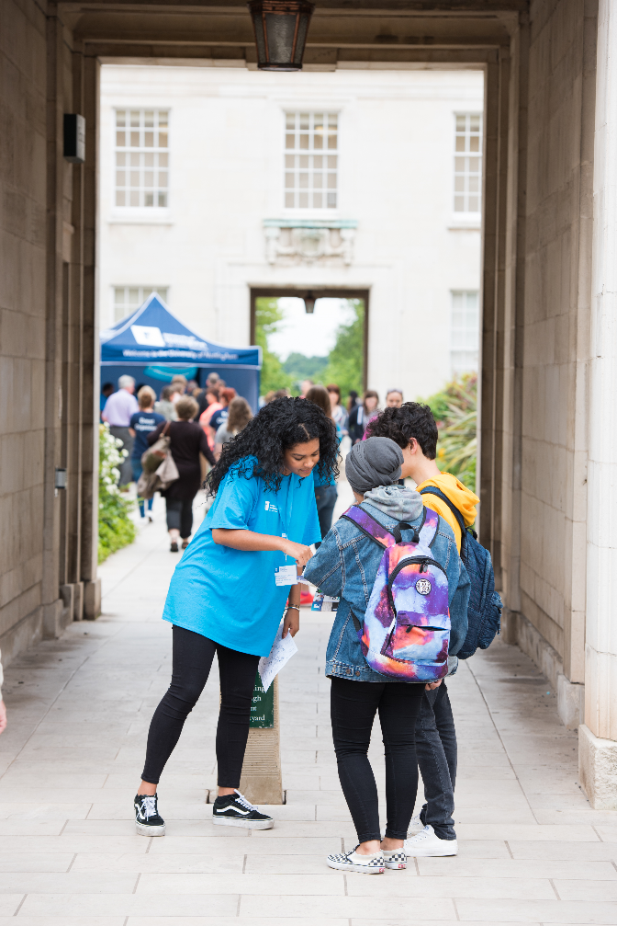
University selection processes
Application assessment
GCSEs
A Levels
National admissions tests
Personal statement
Reference
Interviews
Notes:
Explain that you will submit one UCAS application for all of your course choices, but not every course/university scores applications the same way. So it’s important to do your research and check HOW each university scores the UCAS application.
For really popular courses, universities may look at and score their GCSE requirements and they may be looking for specific grades.
They may score their predicted A Level grades and they may need students to be studying particular subjects at A level.
Depending on the course applied to, students may also need to sit an admissions test, there are national ones for courses in Med, dent, vet and Law but each university may also have another admissions test, these are normally executed during an interview process.
The first four things will form an academic score, you will need to make sure that you meet the entry requirements as a the bear minimum.
The university might also score the personal statement and the reference as part of the process, content for these are really important and you need to tailor these to the interest of the University.
Depending on the course will depend on whether or not you will be interviewed, it might be the case that the score at interview might lead to the offer that you are made.

Slide 7
Personal statement quiz

Slide 8
How many personal statements can you submit?
A. Only one for all five choices
B. One for each of my five choices
C. Two, but only if applying for a joint honours course
Notes:
Answer
Only one for all five choices.
Although if you are applying for two very different courses, it might be possible to contact the relevant university Admissions departments and enquire about submitting an additional statement.

Slide 9
Universities might make your application unsuccessful based upon your personal statement?
A. True
B. False
Notes:
Answer:
True

Slide 10
The maximum number of characters you can use within the personal statement is…
A. 4,000 characters
B. 4,500 characters
C. 5,000 characters
Notes:
Answer
A. 4,000 characters

Slide 11
This 4,000 character limit is equivalent to…
A. 21.75 tweets
B. 14.28 tweets
C. 18.5 tweets
Notes:
Answer
B. 14.25 tweets
(Twitter increased character limit from 140 to 280 per tweet in November 2017)

Slide 12
Your statement may be flagged as plagiarised if…
A. it has 20% similarity to another statement
B. it has 15% similarity to another statement
C. it has 10% similarity to another statement
Notes:
Answer
C. 10% similarity to another statement
UCAS plagiarism service is called Copycatch.
Copycatch identifies sentences in a personal statement that are matched to other personal statements already held in the Copycatch system including sample statements collected from websites and other sources such as paper publications. Your personal statement will not be compared to your earlier applications, if you have applied in previous cycles or schemes.
Any statements showing a level of similarity of 10% or more are reviewed by members of the UCAS Similarity Detection Service Team who decide whether you and the institutions you are applying to need to be informed that similarity has been found.
Applicants, universities and colleges are notified at the same time by email when an application has similarities confirmed.
Admissions tutors at individual universities and colleges decide what action, if any, to take regarding reported cases.
The Copycatch process ignores commonly used words that many applicants use in their statements such as 'and', 'so' and 'with'. Copycatch also ignores a selection of commonly used words and phrases including 'Duke of Edinburgh' and 'football'.
Detailed information can be found on the UCAS website (link on next slide)

Slide 13
What is the most common way to open your personal statement?
A. I am applying for this course because
B. From a young age I have been
C. For as long as I can remember I have
Notes:
Answer
B. From a young age I have been
Used by 1,779 applicants in one year according to a 2016 article by UCAS.
Taken from UCAS Article in 2016.
2) For as long as I can remember I have.. (used 1,451 times)
3) I am applying for this course because (used 1,370 times)
4) I have always been interested in (927 times)
5) Throughout my life I have always enjoyed (310)
6) Reflecting on my educational experience (257)

Slide 14
What are universities looking for?

Slide 15
What are universities looking for?
Personal statement
A genuine interest for the subject(s)
Intellectual curiosity
Engagement with the subject outside of the curriculum
A well-rounded individual (evidence of extra-curricular activities)
Notes:
Briefly cover what universities are wanting students to convey through their personal statements.
Extracurricular activities – be careful here, not all universities are looking for this, ask if there is anyone interested in applying to Oxbridge in the audience. If there is, ask them to tailor the statement to talk about these activities in an academic way.

Slide 16
What are universities looking for?
Examples are key
Demonstrate
Give specific examples and evidence what you are saying.
Evaluate
Express your opinion concerning any research/reading/work experience you have done.
Do you agree or disagree with a particular argument or hypothesis?
Do you think a particular approach in a working environment is successful/ethical/cost effective?
How does this apply to your course?
How will you use it?
Are you keen to learn more – is there a module that will focus on this topic?
Notes:
Explain that universities are looking for you to demonstrate and evaluate in your personal statement.
Ask the students what they think it means to demonstrate something – then reveal answer
Ask the students what they think it means to evaluate something – then reveal answer
Explain that this sounds easy, but it is a key element that many students fail to get right.

Slide 17
How to start your personal statement

Slide 18
How to start your personal statement
Experience
Academic
History assignment
Research skills Analytical skills Presentation skills
Notes:
Ask students to suggest a few skills they think relate to the experience before revealing the answers.

Slide 19
How to start your personal statement
Experience
Extracurricular
Drama club
Creativity CommunicationConfidence
Notes:
Ask students to suggest a few skills they think relate to the experience before revealing the answers.

Slide 20
How to start your personal statement
Experience
Volunteering
Primary school
Responsibility Communication Leadership
Notes:
Ask students to suggest a few skills they think relate to the experience before revealing the answers.

Slide 21
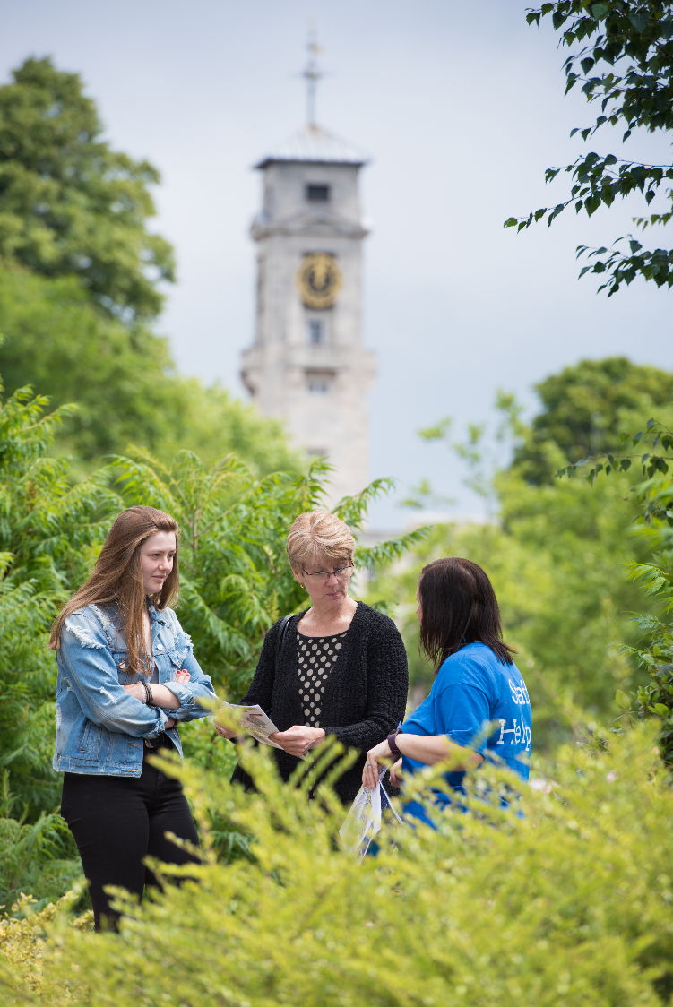
How to start your personal statement
Activity 1 – Mind map
1.) Mind map your experiences from last 2 years
2.) List relevant skills you might need for the course/career
3.) Match your experiences to the list
This will help you to demonstrate.
Notes:
Now you have had chance to think about some of the skills that might be linked to different types of experiences, here is an exercise that can help you to start identifying the most relevant experiences for your course choice by focussing on the specific skills needed to study that particular subject.
Mindmap – you current subjects and activities, think about things that you have done over the last two years
Relevant skills – think about what skills you might need for the course, i.e if you are applying to English courses you would need the ability to think critically.
Match your experiences to the skills, use the mindmap to then match this up to the skills needed for a particular course area, i.e you could develop critical thinking skills as part of your English coursework for your A Level.
Suggest they use different coloured highlighters/pens to circle and match up the skills and experiences – this will highlight which experiences are most relevant to the course they are applying for. It is useful to chose experiences that cover multiple relevant skills, especially as they have a limited word count!

Slide 22
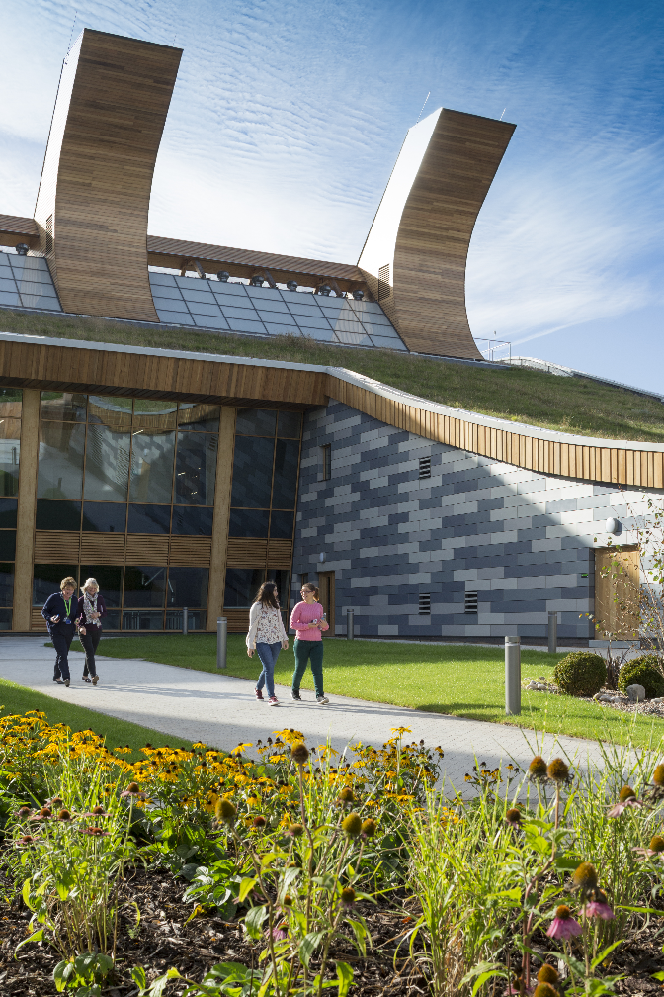
How to start your personal statement
Questions to ask yourself…..
What are my main reasons for wanting to study this course?
What skills have I gained from my current studies?
What further reading have you done/could you do?
What ways could you gain an insight into the course/career?
What hobbies other interests do you have?
Notes:
Another starting point could be to start answering some of these key questions – they might like to jot these down or take a photo of the screen so they can start getting some of their ideas on paper later.
The first question is essential to consider early on when making your UCAS application – you should have a clear idea of why you want to study a particular subject (not because your friends/family/teachers want you to study it!), and this should come across in your personal statement. By taking some time to seriously think about this, you will also ensure that you are making the right choice for you.
The next exercise will help you to start thinking about this and will help you to ensure it comes across in your personal statement in a specific and succinct manner.

Slide 23
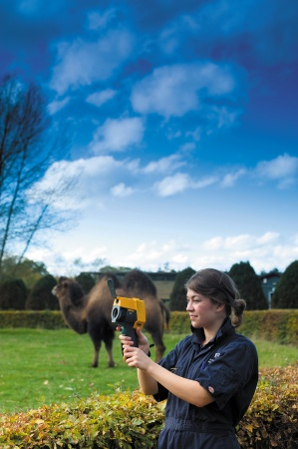
How to start your personal statement
Subject choice
Think about the subject you’d like to study at university
Write down a few bullet points with your reasons, but do not mention the subject by name!
E.g. I find helping people is rewarding, I enjoy the challenges of volunteering with dementia patients…
Notes:
Example provided for healthcare/nursing/medicine type course
After a few minutes, Ask for volunteers to read out what they have written down/ get them to swap papers with a partner.
What they have written should be as specific as possible, and the presenter/partner should be able to guess which subject they are applying for.
Personal statements should be very specific and not filled with wishy-washy statements such as ‘I want to help people’. This activity will help them develop the skills to become succinct in their writings.

Slide 24
Subject choice
I am really interested in how engines function and how this can power a multitude of vehicles.
From my experiences in mathematics, I like to apply equations to understand the functioning of materials.
Mechanical engineering
Notes:
This activity can replace the other guess my subject activity if you have a large group, parents or your are struggling to engage the audience:
The text statement will first appear.
Ask for suggestions from the audience about the subject that is mentioned
Once you have the right answer click for subject and picture to appear
Ask the audience why they thought it was this subject area

Slide 25
Subject choice
By studying population predictions from different countries in the form of population pyramids and the demographic transition model, I was able to understand how population was going to change in different parts of the world and how this would affect the area they live in.
Geography
Notes:
This activity can replace the other guess my subject activity if you have a large group, parents or your are struggling to engage the audience:
The text statement will first appear.
Ask for suggestions from the audience about the subject that is mentioned
Once you have the right answer click for subject and picture to appear
Ask the audience why they thought it was this subject area

Slide 26
Subject choice
I also have a particular interest in American Literature, with Fitzgerald's portrayal of the disappointment and devastation caused by the American dream in 'The Great Gatsby' being among my favourites. One of the most inspiring novels I have encountered is 'To Kill a Mockingbird', and I find Harper Lee's depiction of the social inequality fascinating
English
Notes:
This activity can replace the other guess my subject activity if you have a large group, parents or your are struggling to engage the audience:
The text statement will first appear.
Ask for suggestions from the audience about the subject that is mentioned
Once you have the right answer click for subject and picture to appear
Ask the audience why they thought it was this subject area

Slide 27
Subject choice
At school I composed a Christmas carol which was subsequently performed at the school carol concert by the choir. I had the chance to direct the rehearsals and I found it rewarding and exciting to hear it performed. I learnt directional skills and many lessons about vocal composition, which I have recently put to use in setting a Kyrie
Music
Notes:
This activity can replace the other guess my subject activity if you have a large group, parents or your are struggling to engage the audience:
The text statement will first appear.
Ask for suggestions from the audience about the subject that is mentioned
Once you have the right answer click for subject and picture to appear
Ask the audience why they thought it was this subject area

Slide 28
Subject choice
I particularly admire Louis Kahn's work - most notably the National Assembly in Dhaka, where he recreated a sense of ancient monumentality in a modern building. I wonder: How did he manage to give a physical structure a spiritual quality?
Architecture
Notes:
This activity can replace the other guess my subject activity if you have a large group, parents or your are struggling to engage the audience:
The text statement will first appear.
Ask for suggestions from the audience about the subject that is mentioned
Once you have the right answer click for subject and picture to appear
Ask the audience why they thought it was this subject area

Slide 29
Structure and content

Slide 30
Structure and content
Personal statement structure
Your main reasons for wanting to study a particular course
Analysis of a specific area of interest, related to the course
Analysis of academic and careers based activities
Analysis of extra-curricular activities
The emphasis of your statement will depend on your course choice
Notes:
Once you have done some of the previous exercises and started to get your ideas on paper, you will want to start structuring your examples as above.
Analysis of a specific area of interest, related to the course – this is your chance to show you have done your research and extra-curricular reading – look at module options and show the admissions tutors you have a genuine interest to learn more about a particular topic they offer.
The emphasis will differ between individual statements – for example if someone is applying for an English degree they are likely to focus on analysis of academic skills whereas someone applying for Nursing may put a greater emphasis on work experience (it will all depend on how the universities you are applying to mark the application – which is why you need to do your research so you have a good idea of the areas they will be scoring).
Analysis – means to give a detailed examination of something. So make sure you demonstrate and evaluate all your examples and remember that one strong detailed example is better than listing 10 things you have done – you will need to be selective and choose your best and most relevant examples.
LINK TO NEXT SLIDES - Based on this structure, there are three main types of content that you will want to include in your personal statement;
Academic
Careers
Extracurricular
The next few slides are going to cover these in more detail in terms of specific content you might want to consider.

Slide 31
Structure and content
Academic
Evidence of further reading and research
Academic skills
Masterclasses / MOOCs / Taster lectures / Summer schools
Remember to demonstrate and evaluate
Notes:
This content is important, here you are demonstrating the skills and abilities that make you suitable for an academic course area.
Further reading – this is essential but it does not have to be long text books it can be journal articles, recent news stories, magazines (referring to current or topical issues in your subject area will help to demonstrate your interest). Evaluate what you have learnt how this has inspired you not a list of everything that you have read.
Academic skills – think about your current studies, how have you developed the skills needed for your course area, provide us with examples about how you have developed skills
Other good things to mention are taster days, summer schools, lectures or webinars, Masterclasses or MOOCs about the subject area that you are interested in, we need to understand that you have a passion for the subject.
Evaluate – this is key, think about how these skills, interests, knowledge will give you the skills needed for the course

Slide 32
Structure and content
Careers
Skills and knowledge gained from work experience
Demonstrate skills relevant to the profession
Showcase your insight into the career area
Remember to demonstrate and evaluate
Notes:
For most professional courses, this is really important.
What we do not want to see is a list of everything that you have completed, for most courses, they want you to have exposure to the career in practice and an understanding of what to expect from a career in this area.
This about the skills and knowledge gained from this experience, what did this show you? What did you learn? How can this help you on the course.

Slide 33
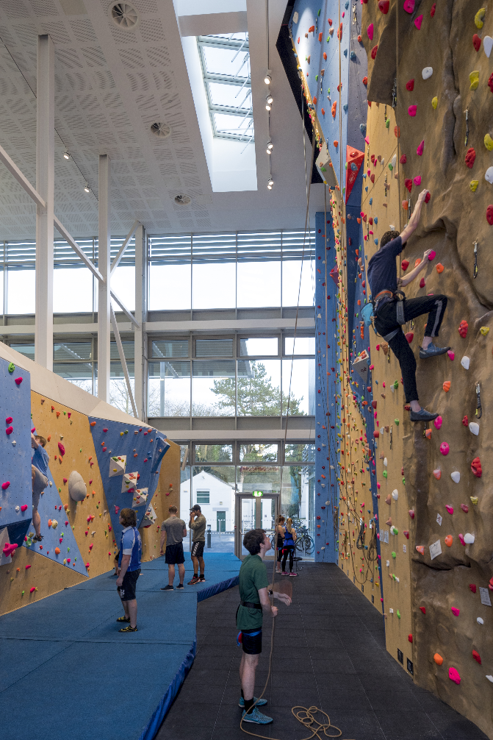
Structure and content
Extracurricular
Skills gained from clubs, societies, sports, hobbies, volunteering, etc.
Link to your course where possible
Be selective
Remember to demonstrate and evaluate
Notes:
Universities do like to see well-rounded individuals who are likely to get involved in many aspects of university life so don’t be afraid to mention extracurricular activities in your statement. However, the way to add value to these experiences is to talk about the skills and qualities you gained or developed and try to explain how this might help you in an academic context.
Match up skills gained from extracurricular activities with skills needed for the course. Putting it in an academic context will provide you with relatable skills that would appeal to a wider set of universities
Don’t forget to be specific about how you gained these skills – talk about a specific activity or task, don’t be tempted to generalise about a whole area. E.g. ‘When coaching a group of 5-6 year olds, I broke down the move into 3 steps, I repeated the instructions and I gave positive feedback, this demonstrated…..’ as opposed to ‘As a football coach I demonstrate……..’
Remember to be selective here – no more than 20% of your statement should focus on extracurricular activities so choose your best and most relevant examples.

Slide 34
How to talk about your skills and experiences

Slide 35
How to talk about your skills and experience
Situation Whilst volunteering at a primary school
Task I worked with students as a tutor and mentor, providing mathematics support for students
(Demonstrate)
Action I worked with small groups of primary school students, using resources and materials to provide an overview of a topic. Through using these resources, I developed communication skills, breaking down a subject and providing examples.
(Demonstrate and Evaluate)
Result The students improved their understanding of subject areas, resulting in them achieving higher marks in the maths test.
(Evaluate)
Notes:
The next few slides are going to demonstrate how to bring all these ideas together into strong written examples that you can use in your final personal statement.
Firstly, we will be covering the STAR method which will really help you to talk about each of your examples in enough detail and ensure you are demonstrating and evaluating, then I am going to get you to step into the shoes of an admissions tutor and ask you to feedback your thoughts on some extracts that have been taken from personal statements.
Situation – keep this short but specific
Task – Again keep this short and as specific as possible – the more specific you can be here, the more likely you will be specific in the following two parts which are the most important.
The first two points are scene setting and should be no more than one or two sentences combined – but the key is to make them specific.
Action – This should form the majority of your example – this is what the admissions tutor wants to know – what did YOU do, give specifics and remember to link to relevant skills for your course.
Result – The result is a key opportunity to evaluate – how did it go? What was the outcome? How will this help you with the course you are applying to? What did you learn? Don’t be afraid to talk about positives AND negatives – if things went wrong, that’s OK, the important thing is to show how you have learnt from this.

Slide 36
How to talk about your skills and experiences
Choose a school subject, hobby, part-time job or other activity that you are involved in
Demonstrate and evaluate the skills you have gained using the STAR method – try to relate skills to the degree subject
S - Situation
T - Task
A - Action
R - Result
Notes:
So now it is your turn to have a go at using the STAR method - This activity can be done on pen and paper or discussed in a group.

Slide 37
How to talk about your skills and experience
Introduction
Since I was a child, I have found myself to be utterly fascinated by how science works. I do not have to look far to find the source of my love for science. Just glancing around the living room my eyes fall upon a whole host of fascinating organisms, seen and unseen they create a brilliant miniature ecosystem with billions of tiny processes and reactions for me to sit and unpick
My main reason for wanting to study Natural Sciences is the enjoyment I take from grappling with new and complex ideas. In Physics, I am particularly drawn to the atomic scale and have developed an interest in quantum models which move beyond my current syllabus. In Biology, I enjoy analysis on a larger scale; my curiosity is fired by experimental questions such as how to model the distributions of species on islands.
My main reason for wanting to study Natural Sciences is the enjoyment I take from grappling with new and complex ideas. In Physics, I am particularly drawn to the atomic scale and have developed an interest in quantum models which move beyond my current syllabus. In Biology, I enjoy analysis on a larger scale; my curiosity is fired by experimental questions such as how to model the distributions of species on islands.
Notes:
GET THE STUDENTS’ FEEDBACK ON THE EXTRACTS
In the first extract, the student has fallen into two traps. The frequent "since I was a child" opening is combined with what one admissions tutor terms the "faulty lightbulb" moment. Research shows that enthusiasm for a subject needs to be supported by detail and precise evidence not vast generalisations about "billions of tiny processes and reactions".

Slide 38
How to talk about your skills and experience
Academic skills
I am especially fascinated by all aspects of human rights law and am passionate about bringing justice to people who are not able to represent themselves. Human rights are a key part in making society fair and this part of the law shows how it can be a glue that holds society together
I have developed an interest in human rights law and read up on the recent case of two women who were challenging the new law that immigrants wished to join their spouses had to pass a "pre-entry" English language test. One of the main legal issues centred on whether the new policy breached the appellants' right to a family life. I was struck by the level of uncertainty in the wording of the final judgement. Although the appeal failed, the judges stated that a "significant number" of future cases, for example, those in which immigrants had learning difficulties, would be likely to breach human rights. My research led me to reflect on the fact that the application of specific laws depends on very subtle differences in the circumstances of different cases.
I have developed an interest in human rights law and read up on the recent case of two women who were challenging the new law that immigrants wished to join their spouses had to pass a "pre-entry" English language test. One of the main legal issues centred on whether the new policy breached the appellants' right to a family life. I was struck by the level of uncertainty in the wording of the final judgement. Although the appeal failed, the judges stated that a "significant number" of future cases, for example, those in which immigrants had learning difficulties, would be likely to breach human rights. My research led me to reflect on the fact that the application of specific laws depends on very subtle differences in the circumstances of different cases.
Notes:
GET THE STUDENTS’ FEEDBACK ON THE EXTRACTS
The student who wrote the first paragraph is trying to impress the admissions tutor through their passion for the subject. Unfortunately, there is no evidence to show that the student's passion involves actually reading and researching a specific topic of interest. The result is a bland and generalised section about "all aspects of human rights law" and vague reflections on the role of law in society. Research indicates that these types of assertion do nothing to improve a candidate's chances of being offered a place.

Slide 39
How to talk about your skills and experience
Work experience
I recently set up and completed a week-long work experience placement at a local graphic design company. The experience gave me a real insight into the graphic design industry and reinforced my desire to study the subject at university
During a work experience placement with a graphic design company, I was particularly interested in the challenges of creating clear infographics. To emphasize the most important information, I experimented with combining different hooks with a range of typographic fonts. I found that the most effective solution depended on creating a clear "narrative" within the image itself.
During a work experience placement with a graphic design company, I was particularly interested in the challenges of creating clear infographics. To emphasize the most important information, I experimented with combining different hooks with a range of typographic fonts. I found that the most effective solution depended on creating a clear "narrative" within the image itself.
Notes:
GET THE STUDENTS’ FEEDBACK ON THE EXTRACTS
Research shows that students find it difficult to analyse work experience placements and other academic activities effectively. In the first extract, the student makes the common mistake of saying that their experience gave them an "insight" but not saying what the insight was. The pattern is often repeated when students reflect on additional academic activities such as university outreach programmes or take part in other enrichment activities. Students simply state they have completed a project or attended and lecture and draw no dividend for their personal statement.

Slide 40
How to talk about your skills and experience
Extra-curricular
Outside of the classroom, I have completed the Duke of Edinburgh Silver award. This helped me to develop a number of skills. I am passionate about swimming and have been a member of the school team since Year 11. During my GCSEs I was also a member of the netball team. Swimming at a high level has provided a perfect training in managing pressurised situations. As a school prefect, I help to organize events such as our recent talent show, I also take parents around the school for tours. For two years, I have worked in a busy local shop and this has developed my abilities to work with people. I feel confident interacting with people from all walks of life and backgrounds.
In completing my Duke of Edinburgh Silver award, I have developed skills in planning tasks and leading a team. I speak two different languages - English and Portuguese - and this has given me a valuable perspective in understanding different cultures. During my A-Levels, I worked in a busy shop and swam for the school team – by balancing these commitments with my studies, my ability in organising and managing my time has improved significantly
In completing my Duke of Edinburgh Silver award, I have developed skills in planning tasks and leading a team. I speak two different languages - English and Portuguese - and this has given me a valuable perspective in understanding different cultures. During my A-Levels, I worked in a busy shop and swam for the school team – by balancing these commitments with my studies, my ability in organising and managing my time has improved significantly.
Notes:
GET THE STUDENTS’ FEEDBACK ON THE EXTRACTS
Understandably, students want to talk about their extra-curricular activities in detail. There is a danger that students can over-emphasise these activities including several paragraphs which attempt to make the statement more "personal". In the first extract, the student goes into unnecessary detail about swimming and does not specify the actual skills that they have developed while completing the Duke of Edinburgh award.

Slide 41
Top tips
Start early and research
Do multiple drafts – make each line count.
Complete further reading and activities
Refer to current issues in your subject area
Provide specific examples, avoid generalisations
Notes:
Provide a summary of the presentation highlighting key points

Slide 42
Ryan Martin
Student Recruitment Officer
Experience our award winning UK campuses in 360 degree images and videos
nottingham.ac.uk/virtualnottingham
@uniofnottingham
Notes:
Any Questions?

