Slide 1
October 10th World Mental Health Day
At Wallingford School, we continue to work to learn more about our mental health, how to have good mental health, how to support each other and where to get help if we need it
Last year, we focused on the difference between anxiety and anxiousness – when it is normal to be nervous about something

Slide 2
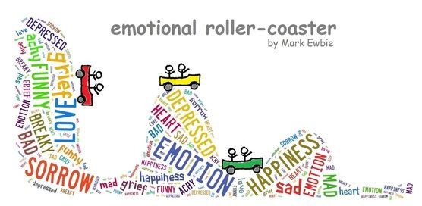
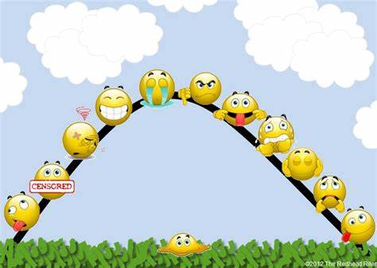
Theme 2023-24
My Emotions and Me

Slide 3
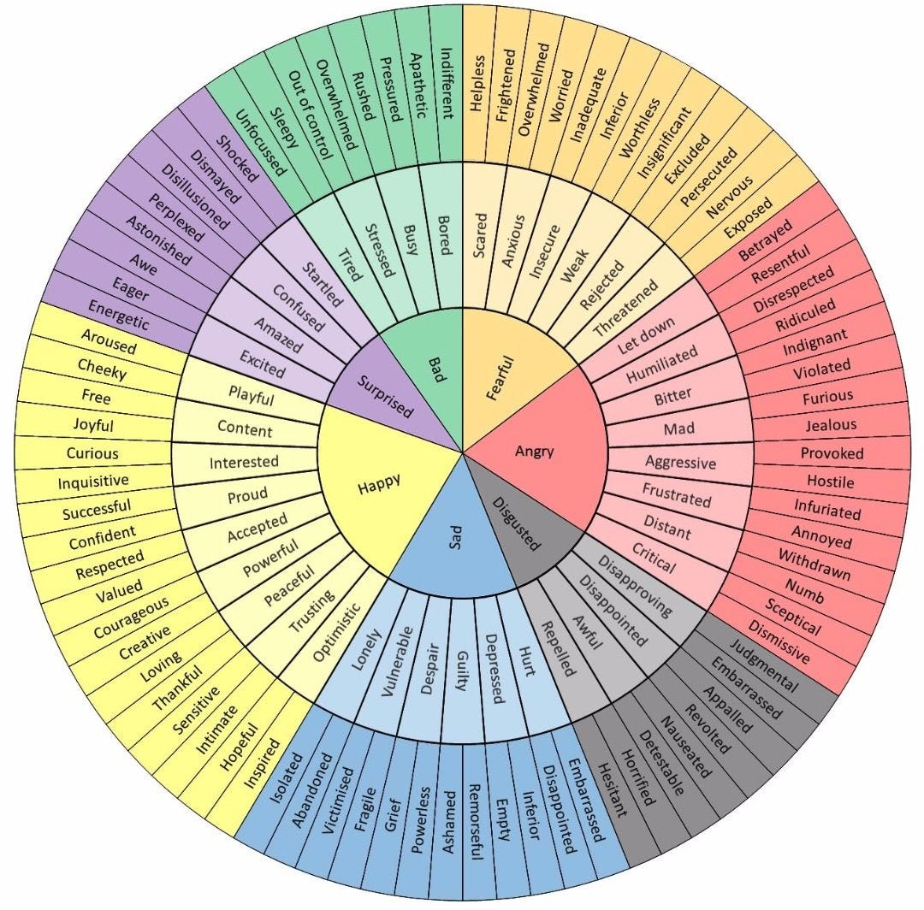
There are a lot of emotions that we can feel, both positive and challenging.
Sometimes, these emotions take us by surprise

Slide 4
My emotions and me
By the end of the year you will have:
An understanding of why your brain reacts the way it does and why your emotions can change a lot over a short period of time
To understand how emotions pass through your body
A toolkit of how to manage your emotions…
- Ways to recognise when your emotions may be becoming unsettled and things you can do to reduce this before it happens
- when your emotions have got unsettled, ways to rebalance your emotions
- places and people to help you manage your emotions
- Learning how to express different emotions in different contexts – such as with different people or in different places

