Slide 1
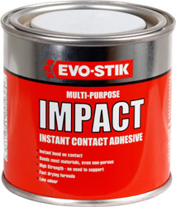
Contact adhesive
Materials it can be used on:
Wood, plastic, metal.
Use:
The adhesive is waterproof. Ideal for plastic laminates to chipboard for kitchen worktops.
Strength :
Gives a medium strength joint.
Form:
Comes in a liquid form and is applied using a spreader.
How to use:
A thin layer is applied to both surfaces. Then the surfaces are left to “touch dry”, then they are pressed together.
Drying time:
Instant.

Slide 2
Materials it can be used on:
Wood.
Use:
Widely used by woodworkers can be used in the construction of furniture.
Strength :
Gives a strong joint.
Form:
Comes in a liquid form and is applied using a brush or can be used straight from the bottle. Dries clear.
How to use:
Put on joint then joint must be held together while glue dries.
Drying time:
4-24 hours.
PVA
(Polyvinyl acetate)

Slide 3
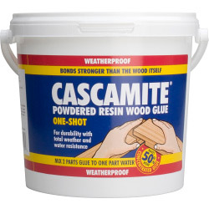
Materials it can be used on:
Wood.
Use:
The adhesive is waterproof. Used by woodworkers can be used in the construction of furniture.
Strength :
Gives a strong joint.
Form:
Comes in a powered form and then mixed with water, it is applied using a brush. Dries an tan colour.
How to use:
Put on joint then joint must be held together while glue dries.
Drying time:
6-8 hours.
Synthetic resin
“Cascamite” “Extramite”

Slide 4
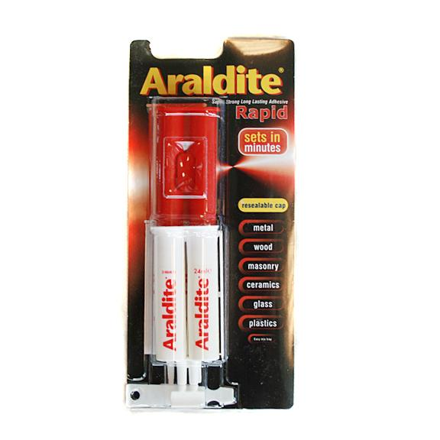
Epoxy resin
“Araldite”
Materials it can be used on:
Wood, plastic, metal.
Use:
The adhesive is waterproof. Can be used as adhesive and can also be mixed with a filler to bridge/fill gaps.
Strength :
Gives a strong joint.
Form:
Comes in two tubes, a hardener and a resin.
How to use:
Equal amounts of hardener and resin need to be mixed together and applied with a spreader. Joint must be held together while glue dries.
Drying time:
½-6 hours

Slide 5
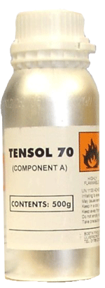
Liquid solvent cement
“Tensol”
Materials it can be used on:
Thermoplastics.
Use:
The adhesive is waterproof. Form joining plastics such as Acrylic and High Impact Polystyrene.
Strength :
Gives a medium strength joint.
Form:
Comes in a liquid form and is applied using a brush.
How to use:
Put on joint then joint must be held together. Tensol does not “glue” plastics together, it dissolves the surfaces “fusing” the surfaces together.
Drying time:
3-24 hours

Slide 6
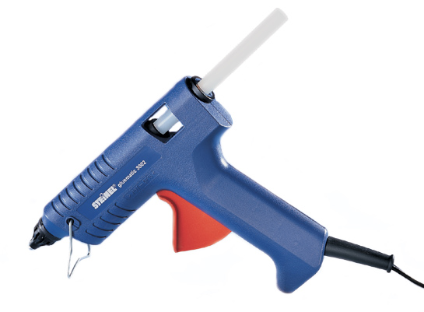
Materials it can be used on:
Wood, plastic, metal.
Use:
The adhesive is waterproof. Only used for modelling or temporary fixings.
Strength :
Gives a weak joint.
Form:
Comes in a solid stick of glue with turns into a liquid when heated.
How to use:
Heated in special gun and applied directly to the joint from the nozzle.
Drying time:
On cooling.
Hot glue stick

Slide 7
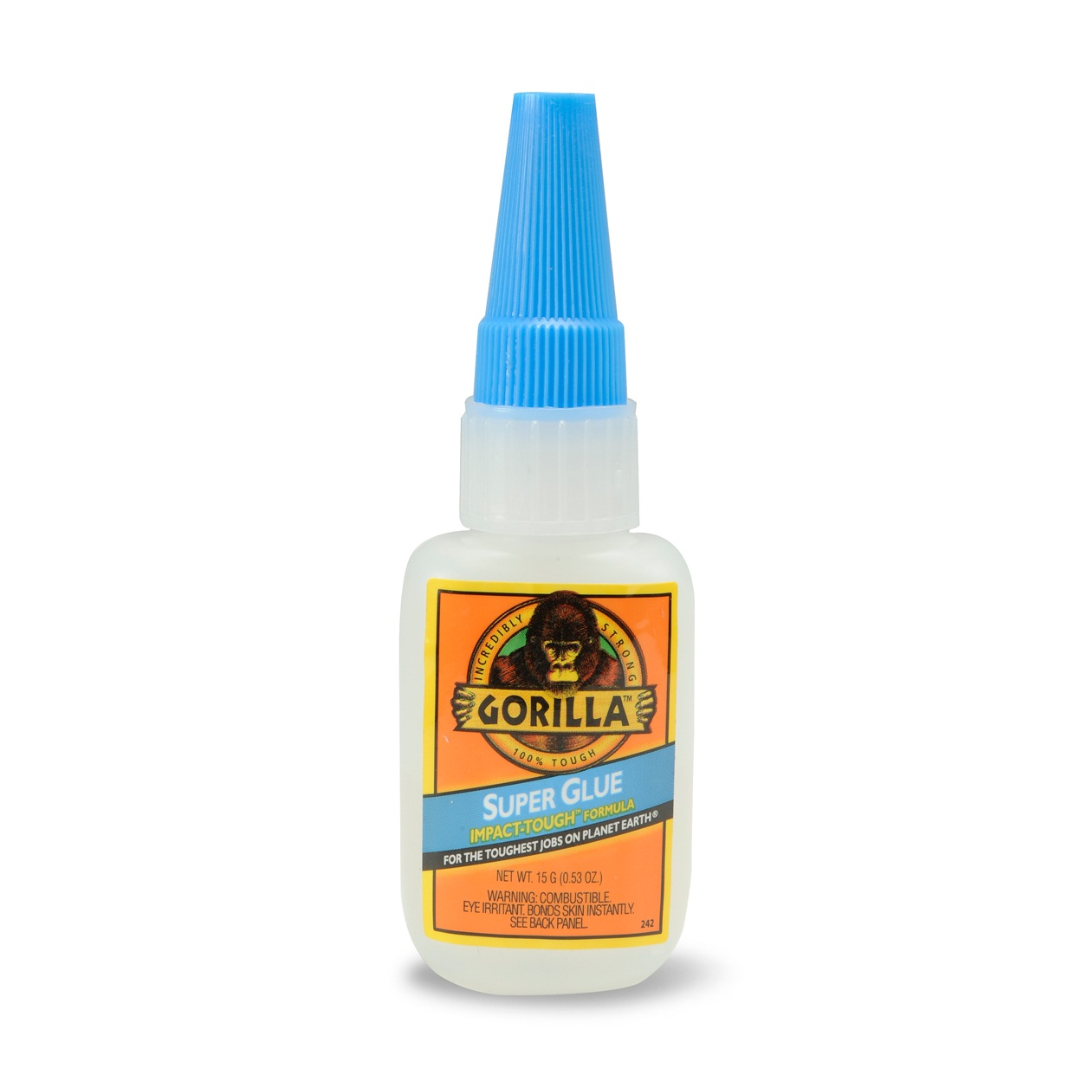
Cyanocrylate “Super glue”
Materials it can be used on:
Wood, plastic, metal.
Use:
The adhesive is waterproof. Commonly used to fix breakages around the house.
Strength :
Gives a medium strength joint.
Form:
Comes in a liquid form and is applied direct from the nozzle.
How to use:
Put on joint then joint must be held together while glue dries.
Drying time:
Instant.

