Slide 1
Unit F523 Design, Make and Evaluate
5 Testing and Independent Evaluation of the Final Product
Exemplar standard in content, approach and/or skills shown

Slide 2
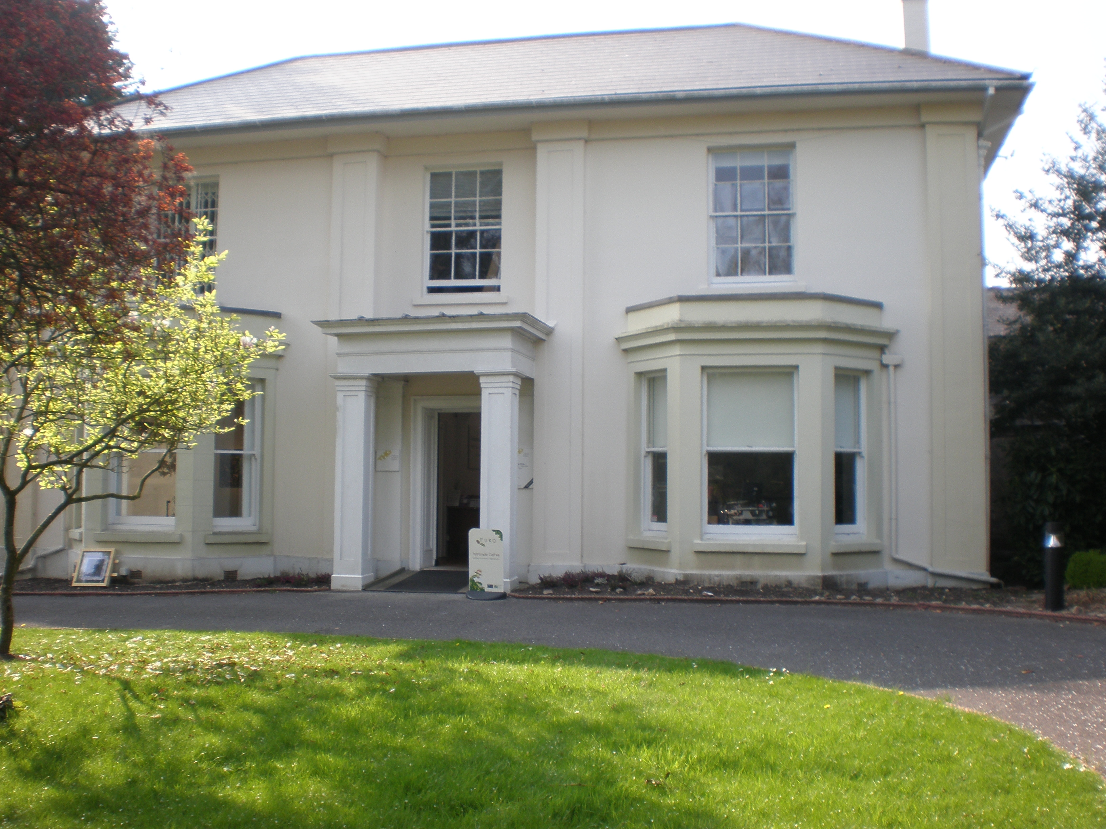
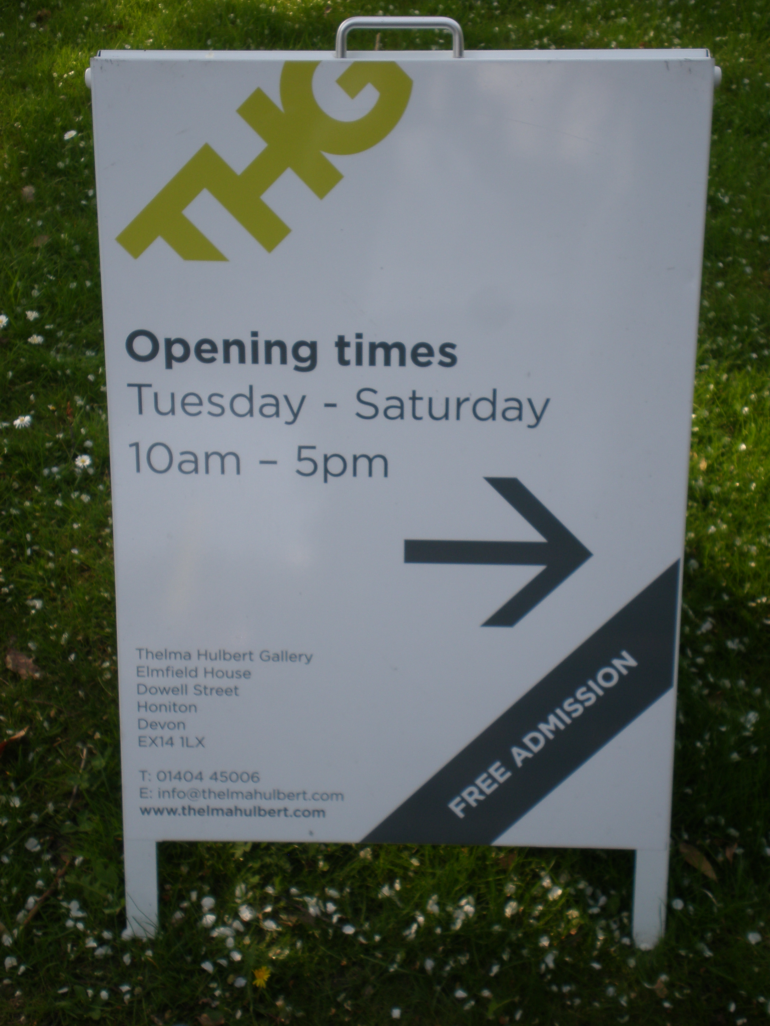
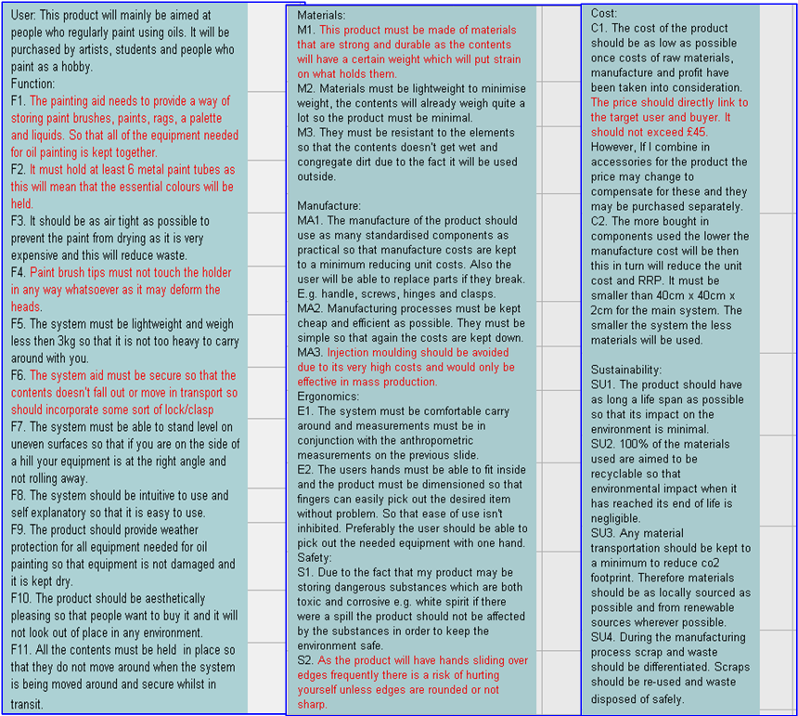
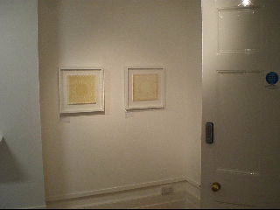
Testing:
Plan For Testing:
Primarily to test my product I will show it to people and gain feedback from what they say as they use it; removing items, putting them back in and opening/closing it. As my product is art related there is quite a limited number of people I can ask locally. I aim to find at least two artists and one retailer to look and first hand test my product. I will contact them by email or telephone. The artists I ask will be looked at under user testing, however they are somewhat experts in the field. The retailer will be in the expert field of testing.
Secondly I will do function testing against the specification for example it is supposed to be able to be used in all weather conditions so I will get it wet and see if it keeps the contents dry. See if the finishes are easily cleaned. Some things will be difficult to test for example how long the product will last; as you can on guesstimate on how long it takes for something to wear out. This also would depend on how well the product is treated, where it is stored etc.
I also plan to test how strong the manufacturing methods are that I have used, this will give me a better idea how long the product may last and its’ life span.
I will also prepare a questionnaire for both users and experts to fill out as well as videoing them.
User / Independent
Evaluation: Angela Blackwell
I arranged to meet Angela Blackwell a local Devon artist, who is curator of the Thelma Hulbert Gallery. She was happy to test my product for me and the videos are shown below. As both an artist and curator she understands a lot about the painting process.
Click to view video:
Click to view video:
Positive Aspects Outlined?
Overall very aesthetically pleasing and nice to look at. The wooden finish fits in with the image of oil painting.
Good Design and not like anything on the market.
Well Made and looks like it would be hard wearing.
The costs have been kept down by using ply and the price is good.
Really easy to use; taking out paints and brushes and putting them back in.
Definitely enough room for hands inside and good anthropometrics / lots of space.
Negative Aspects / Possible improvements Outlined?
Bit heavy however she wanted to keep the wooden look.
Inside could be lacquered like the outside as it is more easily cleaned.
Handle on top so there is an option of carrying by hand or using the strap.
Could have a plastic version for perhaps acrylic paint or water colours.
Foam may wear out over time?

Slide 3
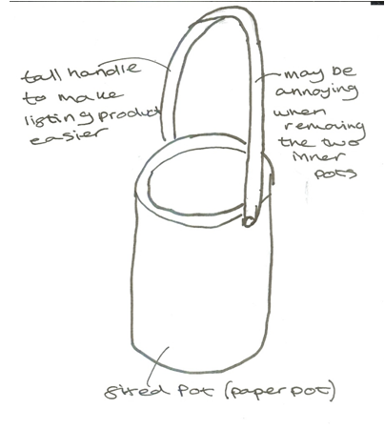
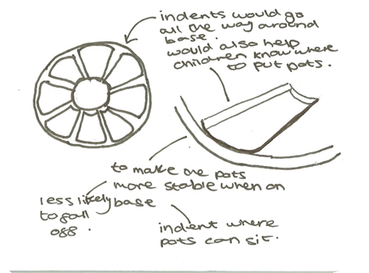
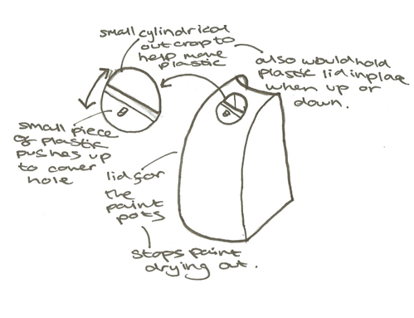
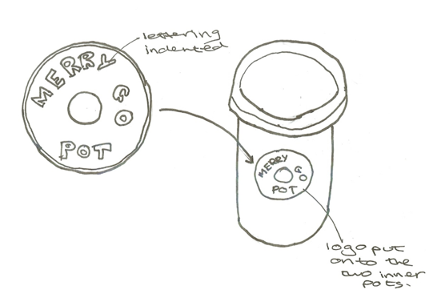
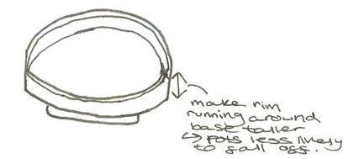
TESTING AND EVALUATION
Strengths and Weaknesses
Strengths:
My product does exactly what my client wanted it to do → it holds pens, pencils, paint, paintbrushes and paper in a compact and neat way
Easy to clean → all parts can be put into a dishwasher and the plastic finish makes it easy to wipe off any paint spillages.
The whole product spins → when on the art table at Playgroup 5-6 children where able to access the product from all sides
It is aesthetically pleasing to both children and staff. The ladybird design made it fun for the children to use and the function with all pots in one unit proved helpful.
The translucent sides on the paint pot allow staff members to see when the paints need filling up
Being modular is cost effective
Weaknesses:
the pots aren't secure enough when on the base → likely to fall off if product spun too quickly.
The paints are likely to dry up when pots left over night due to no lid.
No handle → product would be easier to lift if one was present
Paint and pen pots have sharp corners
No logo → might be a good idea to brand it.
Modifications
Product becomes branded

Slide 4
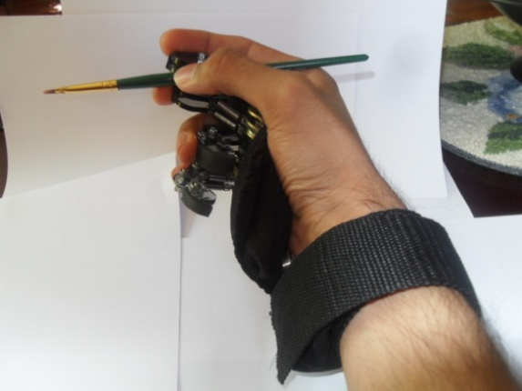
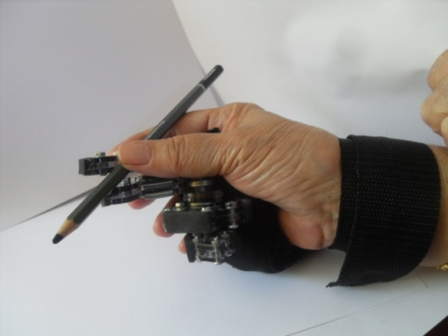
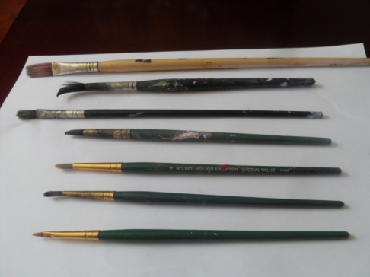
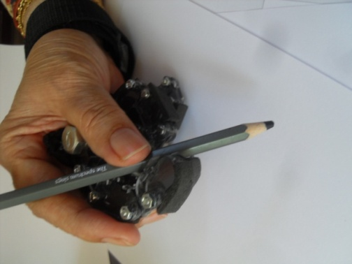
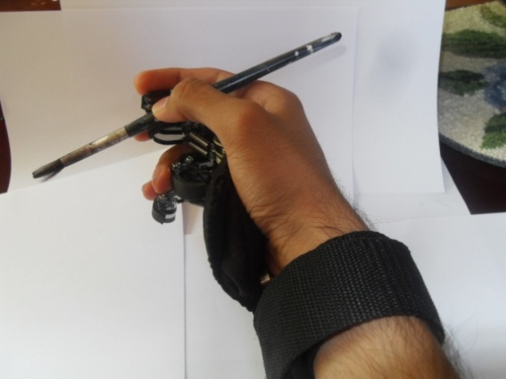
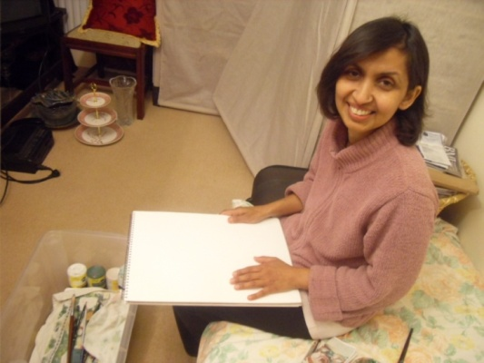
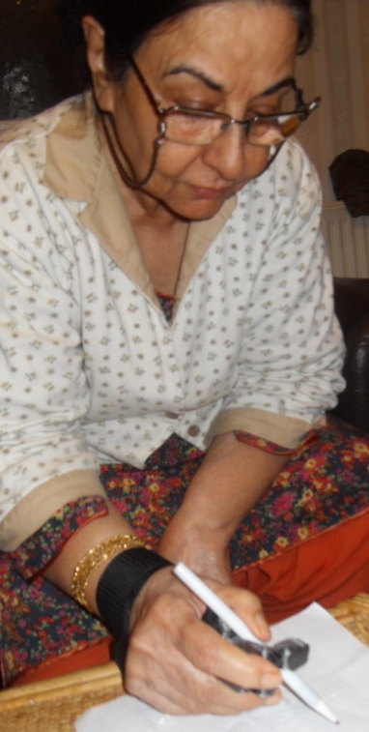
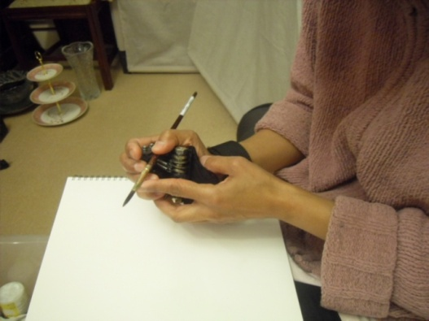
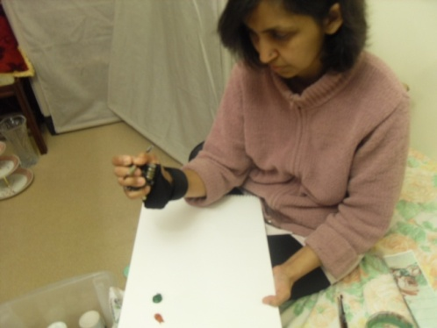
ARTHRITIS AID - TESTING – STAGE 1
On the left, you can see me using the different sized brushes (the red indicates the size). Following the check of whether my product supports different sized equipment, I decided to complete my STAGE 1 testing by recording a video (Video 1) to show the product being put on. This test is important because the user will have difficulties in the wrist and hand therefore the product mustn't be too complicated to put on as that would put the user off the product as well as risk safety, fortunately the video shows the product is easy to wear and quick to put on.
VIDEO 5
My aim in testing was to get as much information about my product in action as I could. By this I mean I wanted to see my product in real life situations and consider real life problems attached with it. During the first stage of my testing, I used a variety of art brushes and a sketching pencil to see whether or not my product would work with them. On the right you can see two different sized brushes being handled easily in the product.
3
Stage 3 testing
During Stage 3 testing I met another client, Asra Chaudhry, 62, (Neighbour) who enjoys drawing and writing as a hobby. I felt this was a good opportunity to get input from a casual worker. She suffers from RSI and has been recommended by her doctor to limit the amount she writes and draws. Although not a painter, I gave her my brush to see if she could work with it and video 5 represents this. Video 4 is a better example because it shows a quick study of a flower done with the product. This also shows to people of different sizes and ages using the product comfortably.
10
8
8
7
6
5
4
3
CLICK Video 1
STAGE 2 TESTING
This is Mrs. Izzah Azhar, 45, she is an artist and was introduced to me by Dr. Amjad. She suffers from frozen shoulder which affects her whole arm, including wrist and hand, which leads to pain. Her doctor has advised her to take breaks every 15 minutes from her artwork. During my meeting with her, I first gave her the products so I could record the stages by which she uses it. The arrow represents the timeline, from our initial meeting, to her arranging the fingers in the product to fit her style and finally her about to use the product, on the right is a video of her using the product.
Meeting
Fitting the product
Using the producer
Video 1
Finally, Video 3 was an interview, in which she highlights her problems elating to her wrists and also gives her opinion of the product
VIDEO 4
Video 2
Video 3

Slide 5
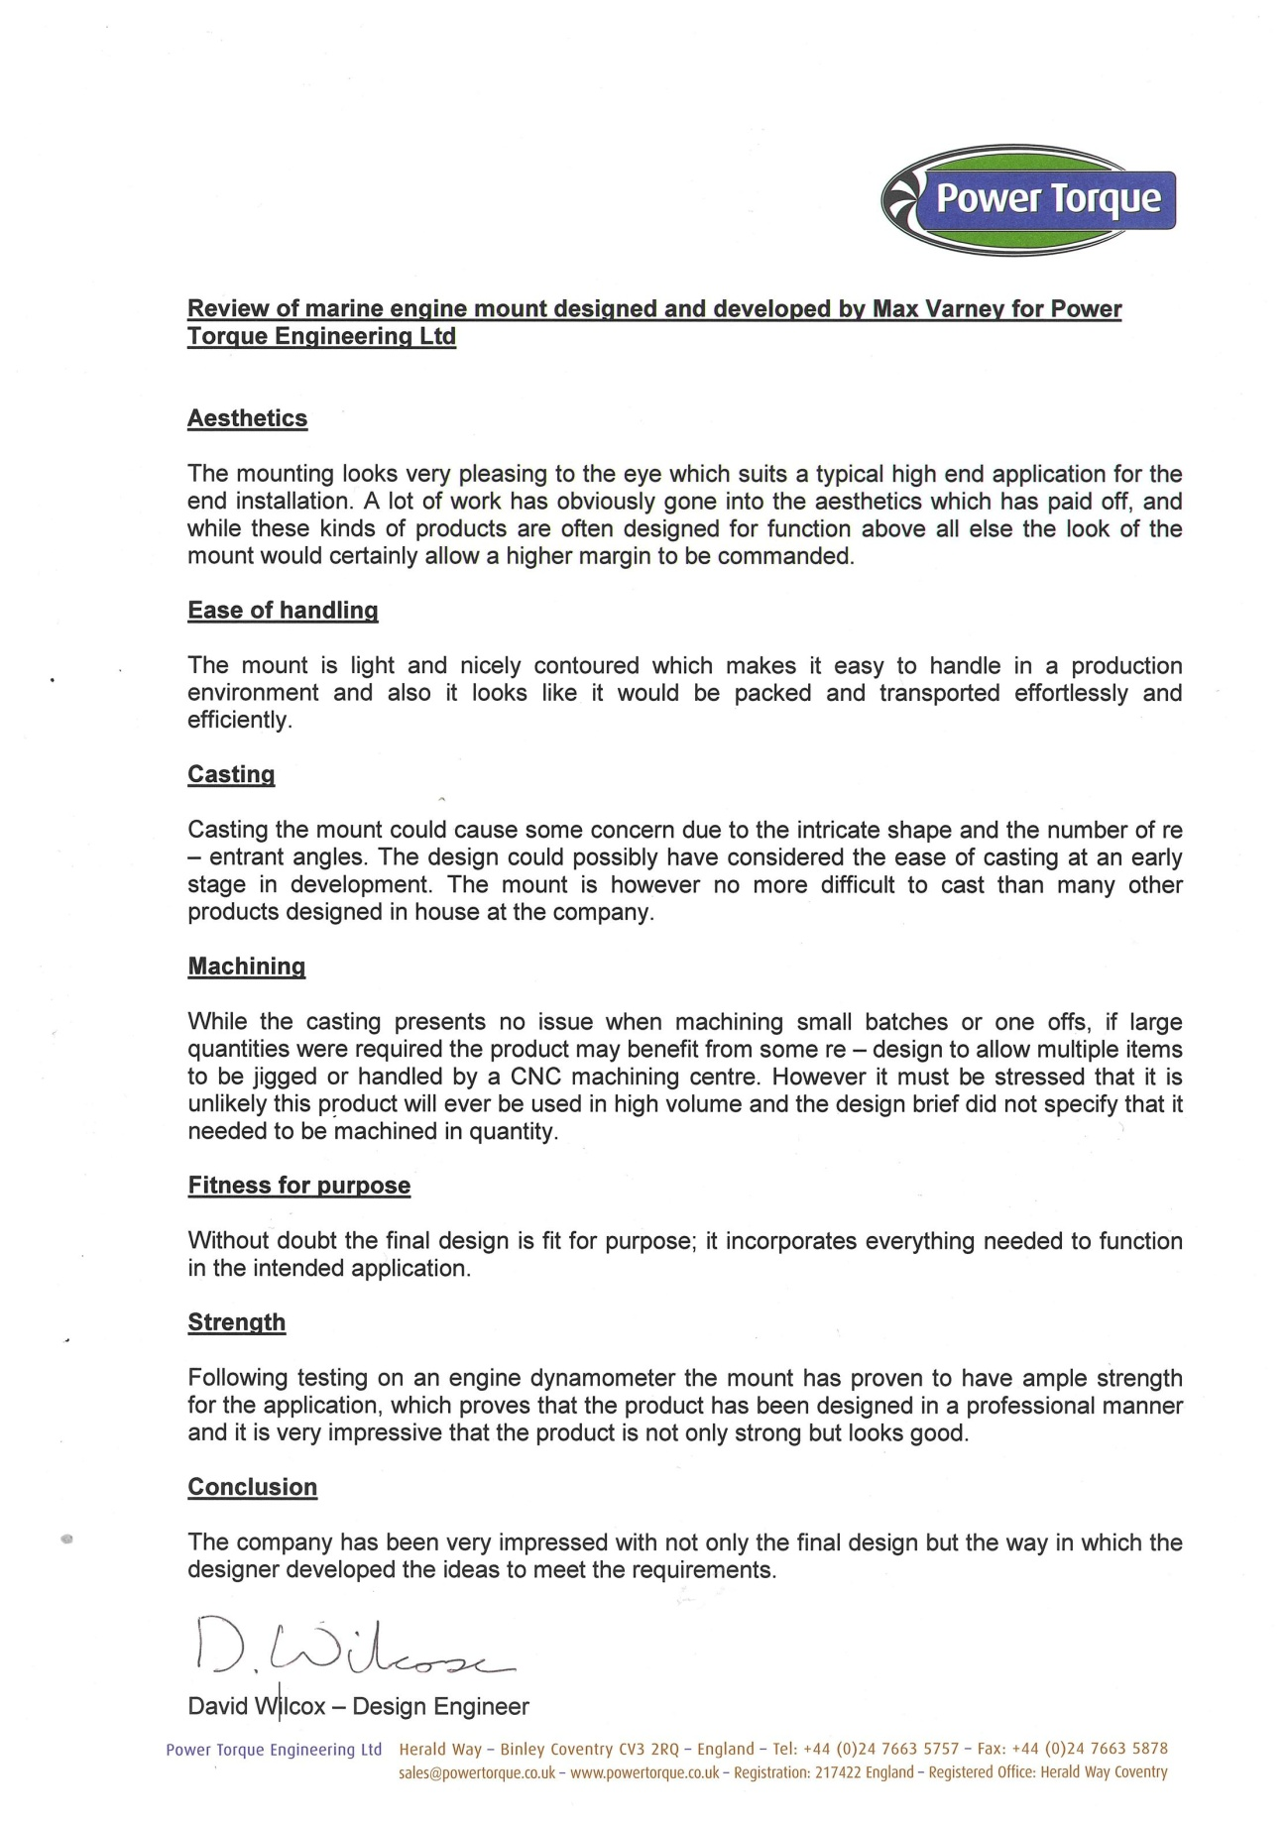
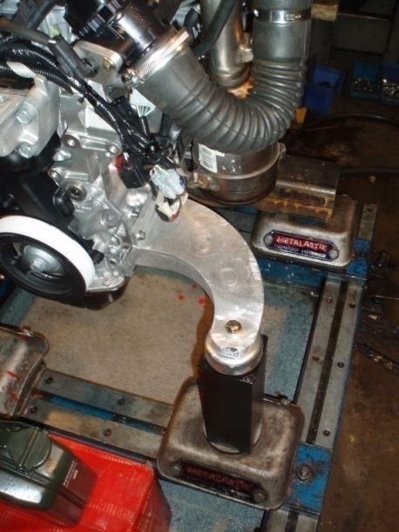
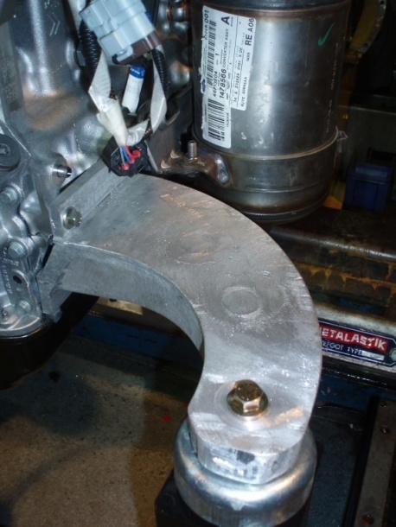
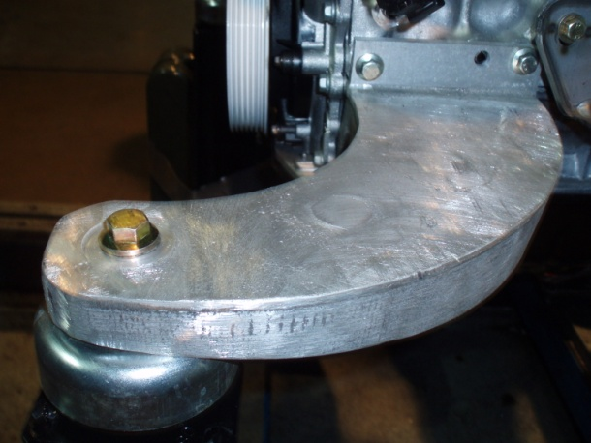
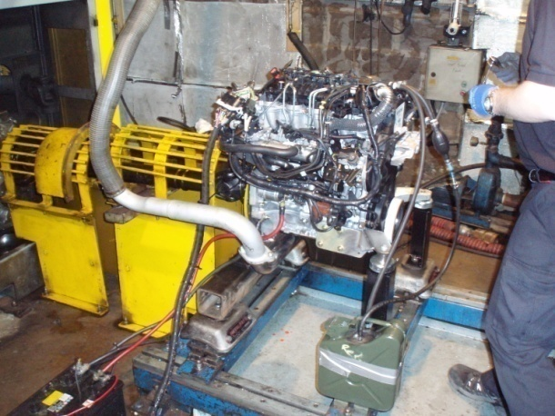
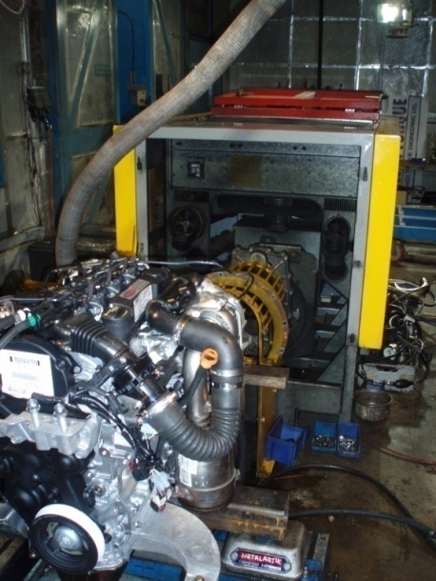
Testing and Independent Evaluation
To properly test my engine mount it needed to be run while it was on the engine (and this had to be done before I made any alterations to bit added on or painted as they would likely fall off or not produce a flat edge which would corrupt any data taken) so Mr Wilcox and Mr Sage kindly set up the Tiger engine on their dyno test bed in allow the engine to run for any period of time that was needed of anything up to 3000 revs (as that is the maximum rated speed for the dyno). This meant that I could, and did, run the engine for about 25 mins at 1000 rpm. This allowed to prove that the mount would stand up to the test of running and if it can take start up torque on a diesel engine then it will be fine in more or less any situation. While it was running I also took some readings with a dial test indicator at two points on the mounting foot (which you will see in the video) and managed to get values of 0.7mm of movement (from the point measured furthest from the engine) and 0.8mm and the point measured closest to the engine.
Please click the link below for the video to the engine running for about one minute with a split screen of the dial test indicators as well
CLICK Engine being run at 1000rpm
Above is an image of the letter that Dave Wilcox (from Power Torque) has sent to me regarding my engine mount and what he thinks of it (it was painted and had the lugs on at the time). The only things he came back with as being negative are the difficulties to cast in large quantities and the difficulty to machine them in large quantities which will be mentioned in my design strengths and weaknesses.

Slide 6
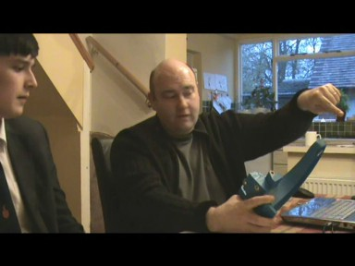
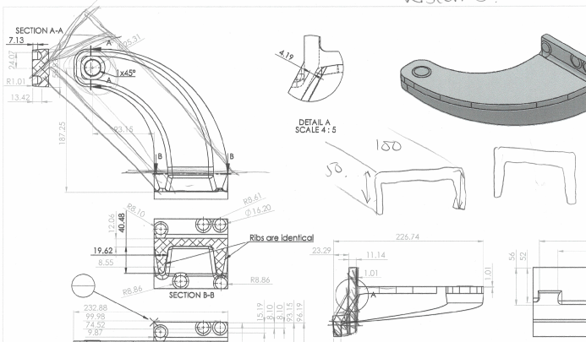
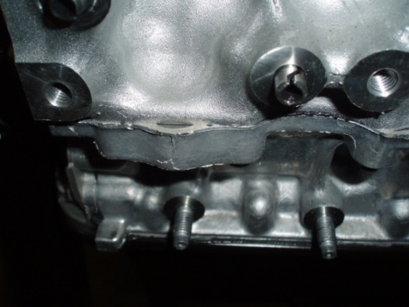
Independent Evaluation
For my independent evaluation I had to get someone from outside of Power Torque, Mermaid Marine and outside of school to do my evaluation.
Thankfully Mr Dale lives nearby and agreed to do the independent evaluation with me on video. I will be showing him drawings, my prototype and discussing with him the pros/cons of my design. I shall also be asking him about what he thinks the tolerances should be and other ways that the mounting could be non-destructively or destructively test.
The video on the right hand side is on the stiffness of the ribs being (bd^3)/12
CLICK ON THE PICTURE FOR THE VIDEO INTERVIEW
On the left is the purposed design changes that could be made to the mount if it were to be made by steel fabrication with a U channel and various bosses added on.
On the left is the calculation he did to show what the stiffness would equal and on the right is the proof that tensile force is roughly double the sheer strength.
Marks Comments | My Response
The split pin should be used as a location point to make sure that the mount can only fit on one way, it should then also be used to increase the shear strength of the bracket. The internal diameter should be exactly the same as the external diameter of the split pin to make sure that it would fit. May also need tapping with a mallet to make sure that it will go onto the engine |  | I will go and make sure that I go back to Ford or Power Torque and find the external diameter of the pin so that when I go and change the hold size to make sure that it will locate.
Have you thought about the use of locking nuts and anti-vibration washers to make sure that the mount doesn’t come un-done? (Brian also gave me two documents Schnoor Staytite Both are forms of locking device where it is important that they stay locked over period of vibration. | All I thought about was using spring washers to keep a force applied to the nut to keep it tight but apart from that I hadn’t thought of anything at all, I shall suggest these to Power Torque and see if I can specify the use of these products.
Why did you put lots of gaps in-between the lugs? If I were you I would just have one straight bit which is flush to the back mounting face which would save on machining costs.. | That can easily be factored into the design and wouldn’t make much different and as you say, would make it cheaper and more efficient to cast.
Aluminium is a funny material because of how it responds to load, Steel deforms elastically until its yield point but aluminium doesn’t have a yield point so to speak to it deforms plastically all the time no matter what load you put on it. So why choose aluminium and not go straight in for the steel fabrication? | During the stages of basic prototypes, cad models and FEA testing I had decided that the bent steel idea was far to heavy for the purpose, however I do know see how that the fabricated steel bracket would be far cheaper to manufacture.

Slide 7
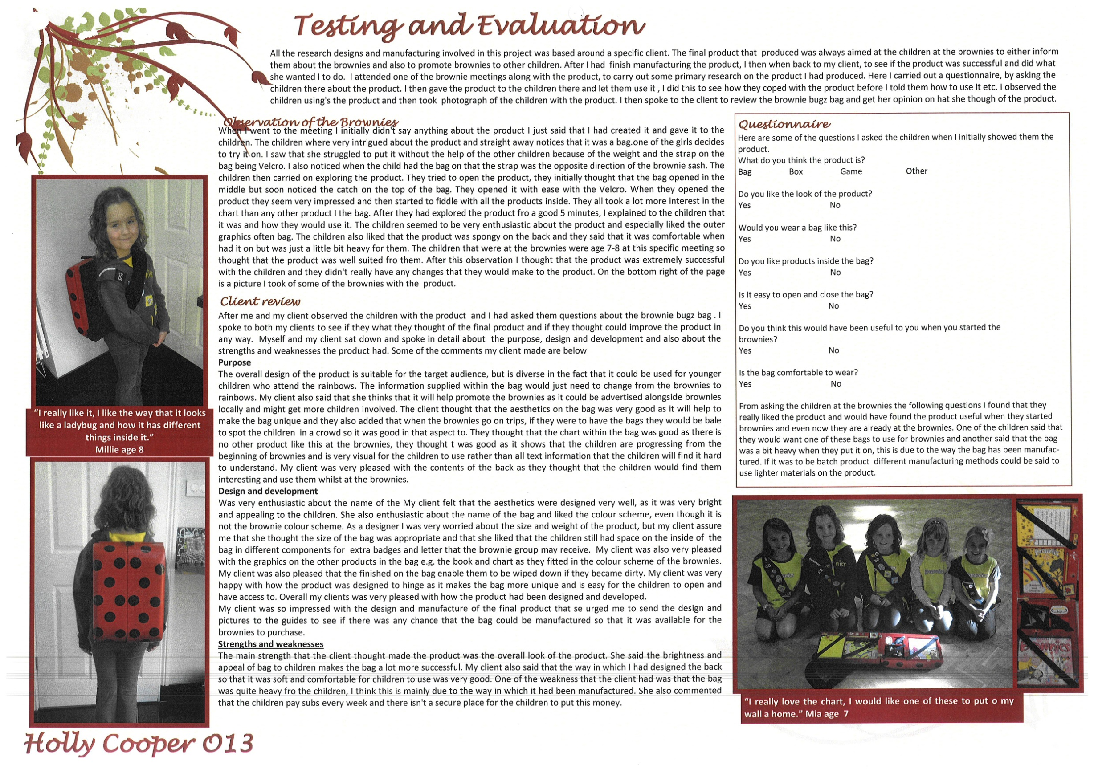

Slide 8
‘Surfsim’ testing video (click centre of slide)

Slide 9
‘See-Saw’ testing video (click centre of slide)

Slide 10
‘Paint Pod’ testing video 1 (click centre of slide)

Slide 11
‘Paint Pod’ testing video 2 (click centre of slide)

Slide 12
‘Pacific Pod’ testing video 1 (click centre of slide)

Slide 13
‘Pacific Pod’ testing video 2 (click centre of slide)

Slide 14
Fire pit testing video 1 (click centre of slide)

Slide 15
Fire pit testing video 2 (click centre of slide)

