Slide 1
My emotions and Me

Slide 2
Tutor session 1
We experience a lot of emotions every day
Some are nice emotions
Some emotions are more challenging
Some we may not be aware of while we are experiencing them
Some we “feel” very strongly while we are experiencing them

Slide 3
Being able to manage our emotions is called “emotion regulation”.
Tutor session 1
Managing emotions includes our ability to:
Be aware of our emotions
Accept and tolerate unpleasant emotions
Identify specific emotions we are feeling, and tell the difference between them
Recognise and understand patterns in our emotional reactions
Manage our emotional reactions in ways that work well in the long-term

Slide 4
Being able to manage our emotions is called “emotion regulation”.
Tutor session 1
If we develop problems in managing our emotions we call this “emotional dysregulation” and it can lead to a range of different problems.

Slide 5
Understanding Emotions: Emotion Messages
Tutor session 1
The most important thing to understand about emotions is that they all have a purpose – they are designed to give us information, what we call emotion messages.
These messages are supposed to bring our attention to important things that are happening in our lives; whether it is a big event (e.g. the birth of a child), or something smaller and more day-to-day (e.g. getting a parking ticket). For example, intense feelings of love tell us we need to care for our child. Anger about a parking ticket tells us to avoid that situation in the future.

Slide 6
Understanding Emotions: Emotion Messages
Tutor session 1
Imagine what would happen without these messages! It’s common for people to think of emotions as “good” or “bad” or “positive” and “negative”, but that just isn’t the case. All emotions have a helpful role to play, though they can be pleasant or unpleasant.
e.g.
What is the situation? | What is the emotion? | What is the message from the emotion
You think about when you were shouting at someone when you were angry. You replay what happened in your mind, criticise yourself, feel agitated and heart racing, want to hide away | Guilt | “You have done something wrong!”

Slide 7
Task: Which emotion is it? And what is the “message” these emotions are trying to send us?
Tutor session 1
What is the situation? | What is the basic emotion? | What is the “message” from the emotion?
You think about when you were shouting at someone when you were angry. You replay what happened in your mind, criticise yourself, feel agitated and heart racing, want to hide away | Guilt | “You have done something wrong!”
Someone jumps the queue in front of you at the supermarket. Start thinking how annoying and unfair it is, feel hot and tense, feel an urge to confront them.
You make a new friend that you have a lot in common with. Think about doing things together, feel motivated, an urge to make plans.
You are lying in a sunny garden. Reflecting on how good life seems right now, feel calm and content to stay where you are for a while longer.
You misplace a favourite piece of jewellery. Start thinking about the person who gave it to you, feel tired, get an urge to be alone.
Notes:
Option 1 – students discuss and work out what emotions might go in here and what the message is. Option is to print out the slide
Option 2 – do matching exercise from next slide

Slide 8
What is the situation? | What is the basic emotion? | What is the “message” from the emotion?
You think about when you were shouting at someone when you were angry. You replay what happened in your mind, criticise yourself, feel agitated and heart racing, want to hide away | Guilt | “You have done something wrong!”
Someone jumps the queue in front of you at the supermarket. Start thinking how annoying and unfair it is, feel hot and tense, feel an urge to confront them.
You make a new friend that you have a lot in common with. Think about doing things together, feel motivated, an urge to make plans.
You are lying in a sunny garden. Reflecting on how good life seems right now, feel calm and content to stay where you are for a while longer.
You misplace a favourite piece of jewellery. Start thinking about the person who gave it to you, feel tired, get an urge to be alone.
Tutor session 1
Anger
Happiness / joy
Contentment
Sadness / Regret
“I have lost something important”
“Everything is OK”
“ That’s not fair!”
“This is important to me”

Slide 9
Task: Which emotion is it? And what is the “message” these emotions are trying to send us? (answers)
Tutor session 1
What is the situation? | What is the basic emotion? | What is the “message” from the emotion?
You think about when you were shouting at someone when you were angry. You replay what happened in your mind, criticise yourself, feel agitated and heart racing, want to hide away | Guilt | “I have done something wrong!”
Someone jumps the queue in front of you at the supermarket. Start thinking how annoying and unfair it is, feel hot and tense, feel an urge to confront them. | Anger | “ That’s not fair!”
You make a new friend that you have a lot in common with. Think about doing things together, feel motivated, an urge to make plans. | Joy/ Happiness | “This is important to me”
You are lying in a sunny garden. Reflecting on how good life seems right now, feel calm and content to stay where you are for a while longer. | contentment | “Everything is OK”
You misplaced a favourite piece of jewellery. Start thinking about the person who gave it to you, feel tired, get an urge to be alone. | Sadness / regret | “I have lost something important”

Slide 10
Tutor session 1
We experience a lot of emotions every day
Some are nice emotions
Some emotions are more challenging
Some we may not be aware of while we are experiencing them
Some we “feel” very strongly while we are experiencing them
But emotions are important as they are messages to us about what is happening
We need to understand what they feel like so we can manage them

Slide 11
My emotions and Me
Tutor session 2

Slide 12
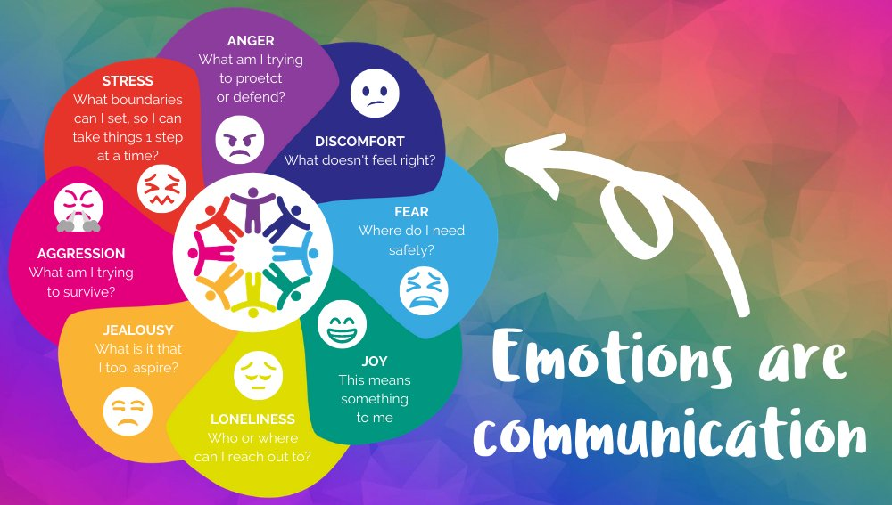
The Emotions triangle
Tutor session 2
Emotions are our brain communicating with us about how we feel
Whether are emotions are enjoyable or challenging, these emotions move through our body and we experience them physically as well as emotionally. This is how we learn to recognise what emotion we are feeling
Sometimes these feelings are difficult to experience or to control

Slide 13
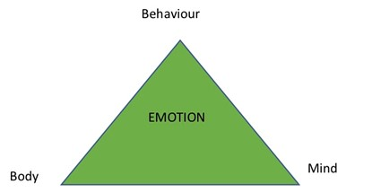
Emotion messages and the Emotion Triangle
Tutor session 2
Emotion messages get through to us in three different ways, through –
our body (physical sensations)
our mind (thoughts, memories, imagination)
our behaviour (urges and actions)

Slide 14
Why do we need to be able to identify different emotions?
Tutor session 2
One big part of emotional awareness is being able to name your emotions and tell them apart.
This is a skill called labelling and it is an important first step in managing your emotions effectively.
This is very useful to know because we can learn to tune-in to our emotions better by focusing on these three areas. Think of it as a bit like being a detective – looking for clues in these three areas (body, mind, behaviour) to figure out what we are feeling.
It isn’t always easy to learn how to tune-in and identify the specific emotion(s) we are feeling, but it is something we can learn to do and get better at with practice by reflecting on what is happening to our bodies when we are experiencing an emotion

Slide 15
The Emotion Triangle
Tutor session 2
When we experience an emotion, we can sense it in three ways

Slide 16
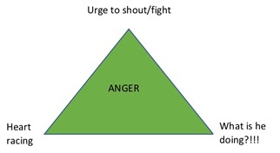
Anger
Tutor session 2
For example, when we feel angry at someone
our thoughts may get stuck on what the person is doing (mind)
we feel our heart rate increase (body) and
we feel an urge to confront the situation (behaviour).

Slide 17
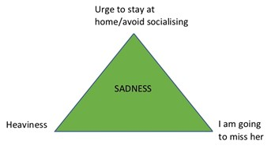
Sadness
Tutor session 2
We might feel sad about a friend moving away -
we are drawn to think about what we have lost (mind)
our bodies slow down (body)
and we feel an urge to withdraw (behaviour).

Slide 18
Work out how these emotions might affect your mind, body and behaviour
Tutor session 2
Emotion | Mind | Body | Behaviour
Fear
Anger
Sadness
Guilt
Joy/Happiness
Contentment
Notes:
Can be done individually, in pairs, or assign one emotion to different groups of students

Slide 19
Work out how these emotions might affect your mind, body and behaviour
Tutor session 2
Emotion | Mind | Body | Behaviour
Fear | Thoughts race, imagine the worst, mind goes blank | Sweating, heart races, muscles tense, breathing rapid. | Avoid
Anger | Thoughts race, imagine the worst, mind goes blank | Sweating, heart races, muscles tense, breathing rapid. | Confront
Sadness | Thoughts slowed, think in circles, focused on the negative | Heavy, empty, numb, tired | Withdraw
Guilt | Critical focus on self and others’ opinion of self | Sweating, heart races, muscles tense, breathing rapid, heavy, empty, numb, tired | Hide
Joy/Happiness | Thinking fast, focused on the positive | Energised | Approach
Contentment | Focused on the moment | Calm and relaxed | Stay
Notes:
Can be done individually, in pairs, or assign one emotion to different groups of students

Slide 20
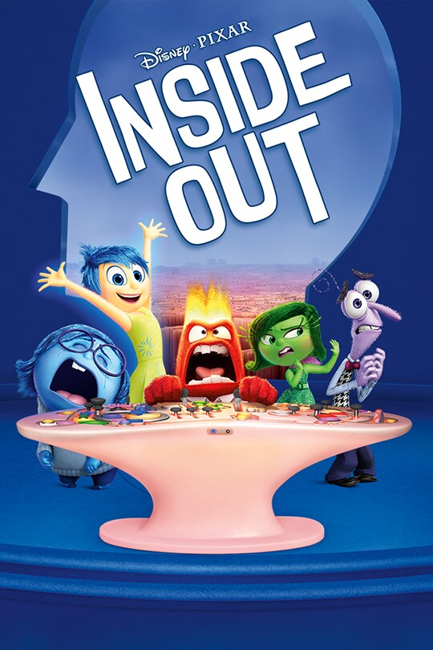
Why do we need to be able to identify the different emotions we are feeling?
Tutor session 2
Learning to become more aware of our emotions is important. After all, they are trying to give us messages to help us survive or get-by in life.
If we don’t recognise and respond to our emotions well, they can get more intense over time. This is because the emotion is still trying to get the right message through to us.

Slide 21
My emotions and Me
Tutor session 3
Ways we can respond to our emotions; instead of reacting to them

Slide 22
Tutor session 3
So far this year we have looked at how to name our emotions and also how to make links between our emotions and the thoughts they can create in our minds.
We have also looked at the Emotions Triangle, of thoughts, feelings and behaviours.
In this next session, we will look at some tools to help develop ways of responding to our emotions, rather than reacting to them straight away. These tools can help us to understand and manage our emotions more effectively.

Slide 23
What is the difference between responding and reacting? Think, pair, share ☺
Tutor session 3
Reacting
– acting as soon as you feel an emotion
Responding
–when you feel an emotion, taking a deliberate pause and giving yourself time to choose an appropriate response for the situation you are in
Notes:
Ask students to think about the difference between responding and reacting – first on their own, then with a partner. Then reveal the definitions.

Slide 24
Tutor session 3
We experience a lot of emotions every day
Some are comfortable emotions
Some emotions are more challenging
Some we may not be aware of while we are experiencing them
Some we “feel” very strongly while we are experiencing them
Notes:
This slide is a reminder of what we have covered so far and is here as a refresher for the students

Slide 25
Being able to manage our emotions is called “emotion regulation”.
Tutor session 3
Today we will be focusing on some tools to help us:
manage our emotional reactions in ways that work well in the long-term
grow our capacity to respond to emotions, rather than always react to them

Slide 26
Tutor session 3
In the classroom, it can feel really difficult when we are experiencing a strong emotion.
Imagine a teacher has asked you to stop talking and focus, but you know that they have chosen the wrong student and it was your friend who was talking.
You might feel anger in this moment. You also have a choice as to what to do about feeling angry:
You can react to your anger straight away OR
You can try to pause, and try to calm your emotions before responding.
Talk to your partner – what could happen if you react to your emotion (choice 1)? And what could happen if you try to respond to your emotion (choice 2)?
Notes:
Extension: ask students to come up with more classroom scenarios which could generate strong emotions e.g. receiving exam feedback, being asked to move in the seating plan, being given a detention for lateness, getting a disappointing score on a test, being teased by a classmate
Can students generate a list of reactions Vs responses for each scenario?

Slide 27
Responding and reacting
Tutor session 3
It is completely natural to feel a strong urge to react when we feel a strong emotion.
Sometimes this strong urge to react keeps us safe, for example if we are in danger and need to remove ourselves from a situation quickly.
However, sometimes a quick reaction to a strong emotion can have more negative consequences, for example, getting us into trouble because we didn’t take time to stop and think before we acted on how we felt in the moment.

Slide 28
Situation | Reaction | Response
A child breaks something valuable in the house whilst they are playing
During an argument between two people, one begins yelling at the other
Another student damages your work by scribbling on it
The second person does not yell, but waits for the other person to calm down and then states their opinion
You keep calm, start a new page in your book and decide to speak to the teacher later in the lesson
A parent explains calmly that the item is valuable and the consequences of it being broken
The second person begins yelling aswell, which makes the argument more heated
A parent shouts at the child and tells them off for breaking something precious
You grab the other student’s work and scribble on theirs aswell
Tutor session 3
Notes:
Students can work in pairs or groups to match the reactions and responses to the correct situation.
Option to print this slide for your tutor group

Slide 29
Tutor session 3
Situation | Reaction | Response
A child breaks something valuable in the house whilst they are playing | A parent shouts at the child and tells them off for breaking something precious | A parent explains calmly that the item is valuable and the consequences of it being broken
During an argument between two people, one begins yelling at the other | The second person begins yelling aswell, which makes the argument more heated | The second person does not yell, but waits for the other person to calm down and then states their opinion
Another student damages your work by scribbling on it | You grab the other student’s work and scribble on their work to get your own back | You keep calm, start a new page in your book and decide to speak to the teacher later in the lesson
Notes:
Go over the answer slide with students to check their matching was correct

Slide 30
Tutor session 3
Over to you!
Now you have discussed a few scenarios with your pair or your class, can
you reflect on two more scenarios on your own?

Slide 31
Tutor session 3
You forget your book and get told off by your teacher for not bringing it to school. You feel it’s unfair as you struggle with organization.
What would a reaction look like to this situation?
How could you respond instead?

Slide 32
Tutor session 3
You arrive at your lesson and the teacher reminds you there was a test but you have forgotten to revise.
What would a reaction look like to this situation?
How could you respond instead?

Slide 33
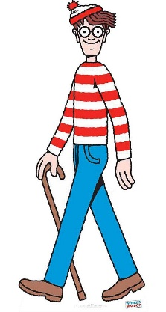
Tutor session 3
Some things we can do to grow our capacity to respond rather than react are:
Counting slowly (1..2..3..)
Taking five deep breaths
Asking to take a break if you can
Asking to speak to an adult you trust if you can
Colouring or drawing
Getting a drink
Talking to a peer supporter at lunchtime
Listening to music
Extension: Can you think of any more of our own ways of calming yourself down so you can respond rather than react?
Notes:
Explain to students that these are some simple tools to grow our capacity to respond. Some of them we can do at home, some in the classroom and some at break or lunchtime.
Emphasize that we are all human and that we will often react to difficult situations, but if we can think about ways of responding instead, we might just improve the outcome of the situation we are finding challenging.

Slide 34
Tutor session 3
Thank you for thinking about this topic as a tutor group - we hope you can try out some of the tools to help you respond more often than you react.

