Slide 1
Unit F523 Design, Make and Evaluate
6 Marketing Presentation
Exemplar standard in content, approach and/or skills shown

Slide 2
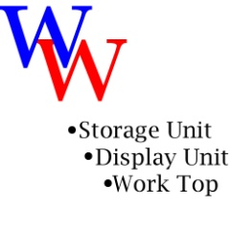
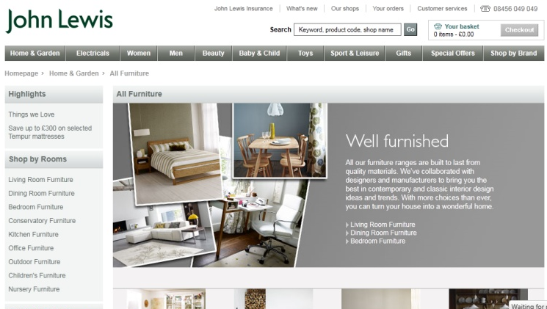
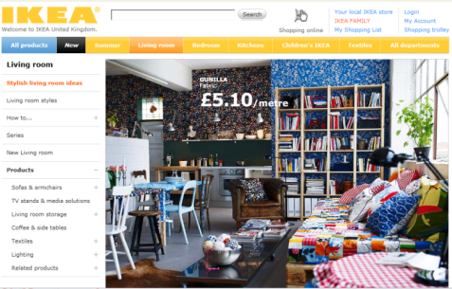
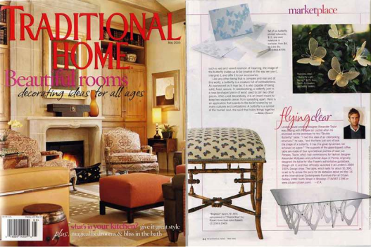
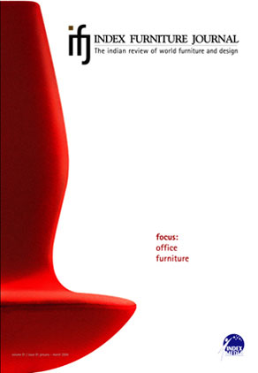
Marketing Presentation – student room furniture
Promotion
There are several areas in which I can promote my unit. In my design brief, I stated that I wished to produce a product that can be used as a desk as its main function. But it is able to be broken down into 3 smaller sections. And two of these sections can either be used for a display unit or a means of extra storage. So it is quite hard for me to target my piece of furniture in one particular market. However, this does mean that I am able to target it towards three different types of markets. However, this has now changed to be a storage unit. So I am not able to narrow down on the market.
My main target market is university students. This is because students can then either use my furniture for either of its three functions whereas other age groups may only single down on one function. I have had a look around some university accommodation for myself whilst planning on going to university. Whilst doing this, I found that a lot of the accommodation is very small. This means that for most first years, there might not be enough room for my product. However, they are still able to use one of the ‘storage legs’ to save some space in their room. However, there are some halls which offer bigger rooms. So there may still be some students who wish to use the whole unit once they are at university.
One of my main selling points is the amount of compact storage my unit offers. This should appeal to most household owners as they will all wish to store objects away. The other main selling point is more targeted towards students. This is because my unit should save some space for them as item can be stored away inside it, or rest on top.
Retail Stores
Because of these points above, I feel that selling through stores is going to be the most effective way of generating sales. For advertising, I will produce a booklet with all the necessary information that the store would need. I will produce a few large copies. Then I will also produce a large number of simpler versions for the stores to hand out to customers. This is a good way to advertise the product. With these booklets, I will also produce stickers with my logo on it with the website to increase awareness.
Internet
I think the internet is a good way to increase the advertising of the sales. It will also help generate sales. Online, I plan to allow various bank cards. American express, Visa, e.t.c. This should make some more sales as some companies only allow certain types of cards. I have provided a website with all the details provided about the unit. This provides pictures of products. Step by step of how I produced the storage unit. I will provide sections on the website such as ‘DIY repairs’, ‘More products’ and I will also include a ‘Forum’ for the unit. This will benefit myself and other. Because the customers can discuss the product. It also gives me a chance to improve my design. This will all be provided through www.wwproduct.com, The customers are able to find all necessary links through this website. I am now currently in dealing with John Lewis and IKEA. Two of the most popular furniture retailers. So from this a lot of sales should be generated through their advertising.
Furniture Magazines
I am also able to produce my product in several various furniture magazines. The articles should provide strong colours with striking pictures. This should make my product stand out amongst the rest. In order to do this, I would have to pay a fee of £180. But I should hopefully generate more revenue that that from the sales received through the magazine advertising.
My ways of advertising.
Promote these images on websites, shops, magazines.
storage
www.wwproduct.com
Marketing Strategy

Slide 3
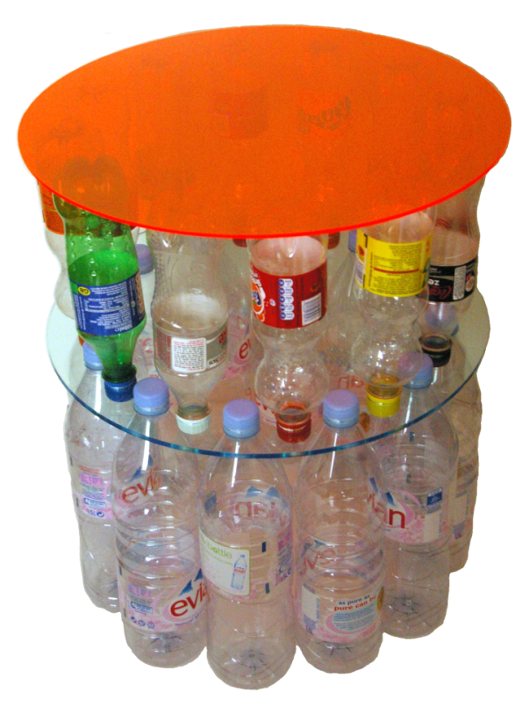
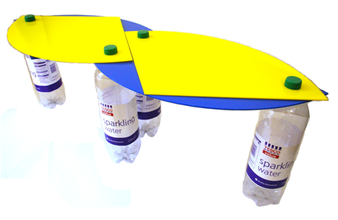
Table(s) from recycled materials - Unique Selling Proposition
Consumer can decide how tall they want the table by simply either using only one layer of bottles for a lower table, or two layers for a taller table
Table changes form to take up less space
Large range of colours available; simple neutral colours for more sophisticated look, and bright colours to appeal to children
More pieces can be bought for the consumer to create any shape they can with the pieces, or for children to play with; much like a giant puzzle
Extremely unusual shape
100% recyclable materials
Unusual, modern shape- round
The way in which the bottle are attached to the acrylic- making use of the original design of bottles
The bottles build up the main structure of the table
Does not require any extra construction components such as screws, nuts and bolts etc. does not require a screw driver or anything of the sort; extremely easy to construct
90% of materials used in this table are reused bottles
Bought flat-packed to be constructed at home
Only required 4 bottles, if one does not consume much bottled water
Constructed from very few materials; just two sheets of acrylic
Cheap as there is little cost for transportation and few materials need to be bought
Great self-satisfaction; the consumer must collect the bottles and construct the table themselves
The main advantage of this table is how simple it is to construct without the difficulty of spanners, screw drivers, Allen keys etc.
It is very personal, using the consumer’s own bottles; each individual table will look different as not everyone will have the same bottles. This prevents people from having the same table, common products can often put people off from buying certain products.
It is very cheap due to the small number of materials required to manufacture the product, the manufacturing process is also very easy when using CAD/CAM, it can be flat-packed so transportation is also cheap, therefore the product is accessible to anyone and everyone
If consumers have more money and do not like to be seen with ‘cheap’ furniture, there is also an option for them to have a design or words engraved into the table. This takes further the personalisation of the table.

Slide 4
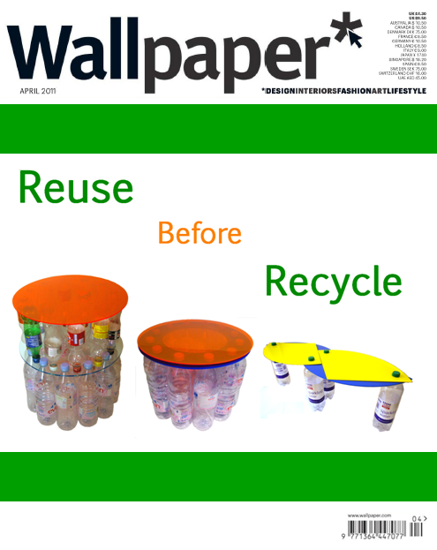
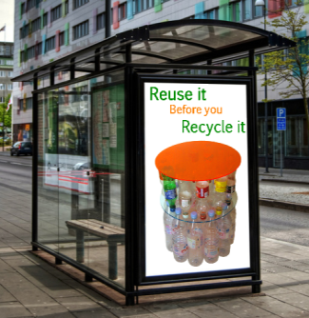
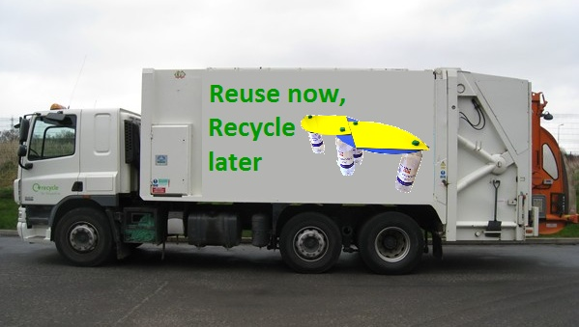
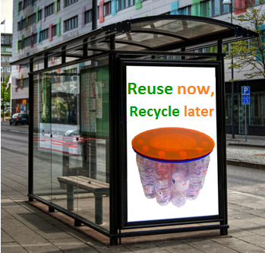
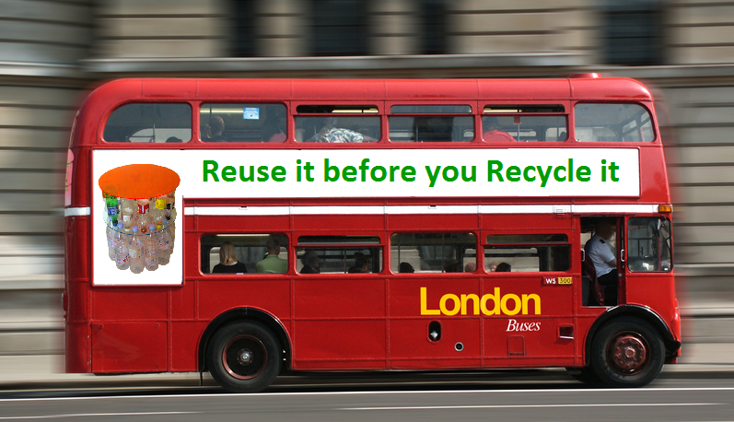
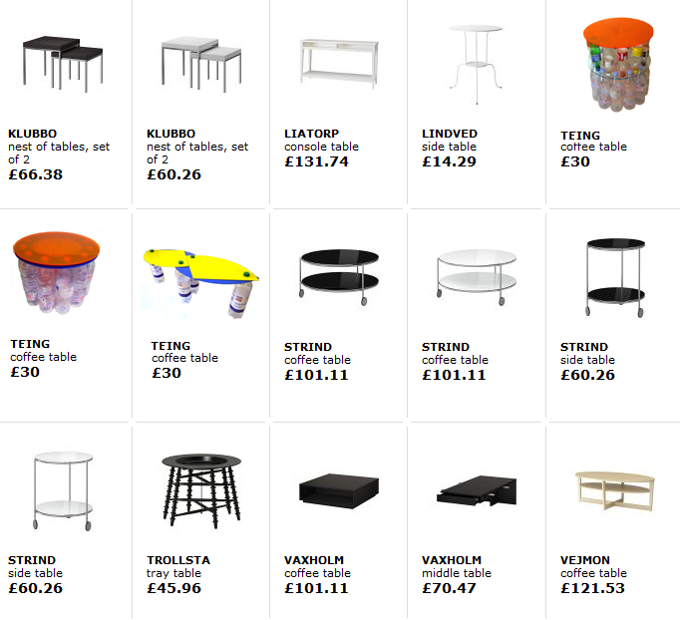
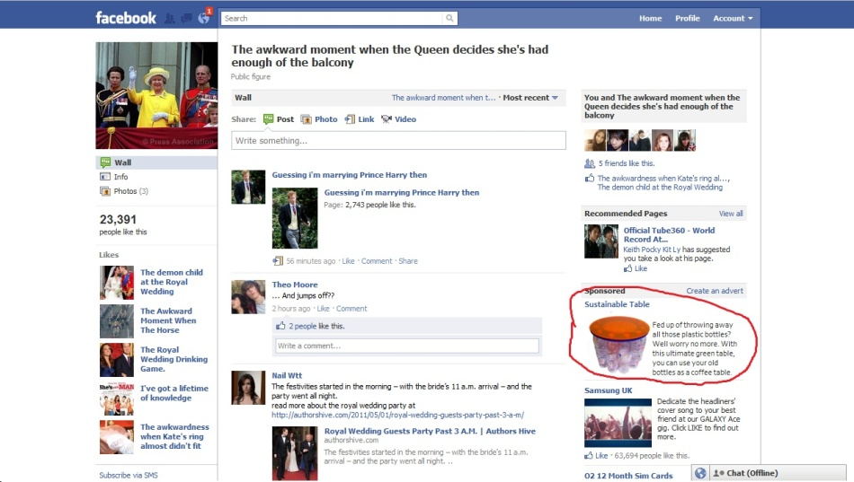
Advertising the Product
As there is such a wide target market for the coffee table, the product should be advertised where many people will see it, such as:
Posters- bus stops, billboards, on busses
Internet- youtube, spotify, social networking sites e.g. Facebook, Myspace.
Magazines & Newspapers- Wallpaper, Surface, Grazia, Elle, The Evening Standard, The Metro
I have created some examples of how the product could be advertised.
Included, is an image of how the coffee tables could be sold by IKEA, and shown on their website.

Slide 5
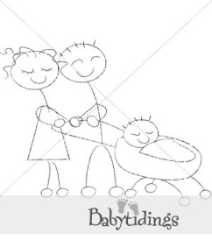
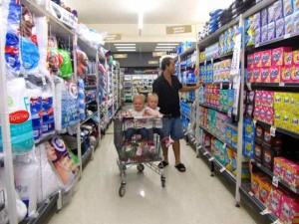
Marketing Presentation 1
Stepping Stones
Distribution of the BABY CHANGING MAT/BAG
The product will be distributed and sold nationally in all large department store chains (for example Mothercare and Babies ’R’ Us). The product will also be available to order online from the company website and the departments store’s sites.
www.stepping-stones.co.uk
Logo Design & Company Name
The logo was designed to attract and relate to the users of the product (parents and child):
Using simple geometric shapes ensures the users attention isn’t distracted away from the product, yet the bold primary colours, bold fonts and the name ‘Stepping Stones’ clearly show that the product is related to children. The phrase ‘stepping stones’ is regularly used when talking about early childhood development where it means taking small steps to achieve highly, so the name is easily relatable with the educational device within the product.
The drawing of parents and a young child also show the target market and provide a design that can easily be related to the brand.
Brand Image
The brand must relate to my target market in that it is modern, fashionable, and appeals to both parent and child. I think that the use of abstract shapes and simple text results in a modern and contemporary looking brand. The use of bold colours delivers a ‘fun’ aspect, which connects with the child. The brand image will be built up with the use of the same shapes, font and colour scheme that is used in the logo being used in all packaging, labelling, promotion and future products by the brand. This helps the products to become easily identified and will help build up their reputation.
Unique Selling Proposition
The product’s ability to transform to be used for several different functions.
Minimises the need to buy multiple products for babies, costing the user in general a lot less.
Minimises the environmental impact by the use of natural fibres.
Incorporates an educational device, e.g. the use of different textures and sounds, to help encourage the child’s early development.
Easy to use, with all fastenings and assembly being very clear and simple.
Overall aesthetically pleasing, with the use of a fashionable print and modern design of the bag.
Price
Compared to existing changing bags on the market (slide2) my product can perform many more functions and minimises the need to buy additional items such as a play mat or baby gym.
Manufacturing costs will be relatively low. In the batch production process the initial cots of machinery will be quite high but will have a very long lifespan and so this cost will be overshadowed.
The materials used are relatively cheap, but still of high quality, with all joints and fabrics being strong and durable, so my product should have a relatively long life span (at least throughout the child’s first year, which is the product’s target market).
The price of my product will be £48.99 as this reflects both the strong multifunctional selling point, the long life span and the fact that relatively inexpensive materials and processes are used.
Promotion
The product will be given out as free samples to reporters from popular ‘mother and child’ magazines and reviewers from newspapers. This will hopefully publicise the product in a positive way and boost sales and the build up of the brand. The trials should also provide valuable feedback on the product’s function and it’s comparison to similar products.

Slide 6
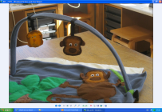
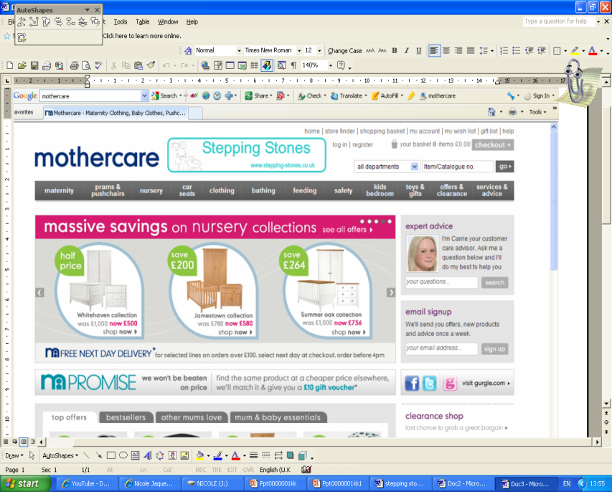
Marketing Presentation 2
Assembly Instructions Leaflet
When bought the product will include a leaflet that will guide the user on how to assemble the product to perform different functions.
The leaflet is very clear and simple, using easy to understand language and diagrams for the user to follow. This helps to ensure that the product meets specification point twelve (the changing bag must be able to adapt its aesthetic properties and the components must be able to be put on and removed easily and quickly) as the instructions will help the user to change the function of the product quicker and easier.
Posters
Using posters as a form of advertisement is ideal for branching out to the general public. Posters of my product will be used on public transport, (such as bus stops, buses, trains) and community centres (where anti-natal and mother and toddler classes would take place). This will help to promote the product to the target market.
Online Advertising
Marketing PowerPoint
A PowerPoint presentation will be included in a promotional pack that will be distributed nationally to baby fairs, mother and toddler classes and to all baby product retailers, encouraging customers and retailers to sell and buy the product. The presentation will be distributed on a customised Stepping Stones memory stick. The pack will also include leaflets and a poster.
Click here to view the PowerPoint presentation.
An example of how the poster would be displayed.
Examples of advertisements for the product on popular baby product websites. The bold colours used for advertisement stands out clearly, so would attract the customer’s attention and draw them in. As the product will be sold in Mothercare and Babies ‘R’ Us stores, it will also be available to be purchased online. This will help the product to be accessed and seen by many, boosting sales.
Snap shots of two slides.

Slide 7
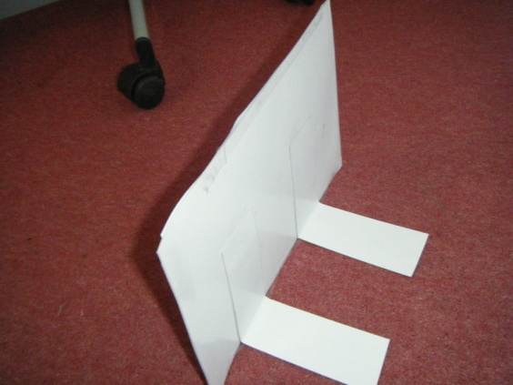
Marketing Presentation 3
Stepping Stones will have its own website where the product can also be purchased. The website will also include information for the customer such as; company information, contact details and spin off products. Below is an snapshot of the websites’ homepage.
Identifying my product on the market
During retail the product will have a swing ticket attached, with a bold photo of the logo on, helping the product to be quickly and easily identified by consumers. The swing tickets will also include important additional information including washing instructions, price, website address and fabric information. The CE mark, will also feature to assure the user that the product is safe and performs well. The swing tickets will have a string attached which will tie onto one of the metal loops that the handle clips onto. This means that no damage will occur to the product when labelled, which may have happened if the tickets were attached by a labelling gun, where a hole is created in the item. The tickets will be laminated to protect them from water damage and to give them more strength as they will be thicker.
Company Website
Company Logo
Company Name
Hyperlinks to other pages that give the customer additional information about the products and the company.
Fabric information
Care Instructions
Contact information if any problems with the product.
Barcode
PHOTO OF SWING TICKET ON BAG
Information about the company. This includes the aim and the marketability of the products. Key words are enlarged to emphasis importance.
CE mark to assure user of product safety,
Shop display signs
In order for my product to catch the customers attention and attract them in stores, a bold sign display for my product will be needed. I have produced a mock up of a possible sign that can be placed around the product in stores.
Model of how the product will stand.
Contact details
Photos of the products

Slide 8
Back to Index
Back to Marketing Index
FILTH FM – Marketing – Identifying Your Target Audience
Website Statistics Analysis
Location
One of the most important things about marketing, is knowing exactly what who your target audience is. If you don’t know who your target audience is, you could end up marketing Zimmer frames to teenagers, which would prove a waste of time. For FILTH.FM, it is important that we address the correct audience when marketing our branded merchandise. We have to very strong methods of working out our target audience. Our Facebook page, which currently has over 19,000 follows, tracks statistics on our followers, and is able to generate graphs showing the most popular statistics. Below we have the Gender and Age demographic. As you can see our main target audience is the 18-24 male demographic. This shows us that when using marketing methods, we should aim our campaigns at males aging from 13-34, but mainly 18-24 year olds.
When marketing a campaign, it is important to know the place in which you will receive the maximum exposure when marketing to a large audience. You could be the biggest clothing brand in Slovenia, but when you market your product online to a US audience, your marketing efforts become very ineffective. As the place in which we market our product is online, technology allows us to target our advertising to maximise the leads generated. I will go on to explain some of the online advertising we use, and how we can customise our campaigns to target certain audiences. The two images below show statistics that are gathered from our website. These statistics are gathered from one months website views, and they show the number of visits the website has received, most importantly this shows us where our target audience is, by showing the number of views received from a particular country. We can see that 38% of our views are from users in the united states, and 21% are from the United Kingdom. It also shows us the statistics for every country that has had inhabitants view our website. We would show this, but there are users visiting the website from over 100 countries worldwide. This information is very helpful, as todays technology allows us to target our campaigns to only address users from one of our top 5 viewing countries.
21st centaury survey
How successful are our campaigns?
Before the internet came along, the best way to find out about your product was to write a survey and cold call members of the public, hoping they would answer your survey. This could turn out to take a very long time, and may take longer to evaluate all of the data. Due to technology at hand, I can create a survey using our Facebook.com page. This was a question I asked our fans, regarding their favourite DJ on the radio station. As you can see, we received almost 1000 replies, and gathered a very accurate idea of who are most popular DJS are. This can be used for many different applications, and also allows users to enter their own answer, and other users can vote on it.
You can never know how many people see your billboard, sure you know how many people walk past it a day on average, but you will never know how many looked at it for more than a second, or whether they went home that night and searched you on google.com because of the billboard. But thanks to the technology available to developers like myself on the internet, you can know exactly what is going on. This image on the right shows an ad campaign I ran as a test for a few days. It shows how many views it received, and how much money it made, based upon the profit made from the merchandise sold. This system is completely automated, and is calculated for me, giving me precise statistics to which advertising campaigns are the most successful and which are least.

Slide 9
Back to Index
Back to Marketing Index
More than 500 million active users
50% of our active users log on to Facebook in any given day
Average user has 130 friends
People spend over 700 billion minutes per month on Facebook
There are over 900 million objects that people interact with (pages, groups, events and community pages)
Average user is connected to 80 community pages, groups and events
Average user creates 90 pieces of content each month
More than 30 billion pieces of content (web links, news stories, blog posts, notes, photo albums, etc.) shared each month.
FILTH FM – Marketing – Social Marketing
Social Marketing
As you can see above, Facebook.com is one of the largest, and most viewed websites on the planet. Statistically, it is ranked by the highly prestigious Alexa.com as the second most viewed website on the planet, second to Google.com. It statistically has a reach of just over 40% of the internet population. In layman terms, 40% of people who use the internet, view Facebook every single day. You might question why I mention these statistics, and what relevance they hold to the marketing of my product. When looking at the Marketing Mix, Place is an important factor, and where your product is marketed can heavily decide the success of the campaign at hand. Facebook offer extremely in depth campaign management for advertising on their site, and I will be explaining how advertising on facebook.com is on of the best ways to reach our target audience effectively.
Creating A Successful Advertising Campaign on Facebook.com
Creating an ad campaigns using Facebook's system could not be easier. The system is very straight forward, and it allows you to very easily create a string of effected ads, which you can deploy to the homepages of users across the globe. I have created a video which shows the process in which I go through, and I have also talked over the video to explain how effective the entire system is due to the complexity and integration used by the Facebook Platform.
FILTH FM Social Bar
Tweet Button
New Ticker
Facebook
Notifications
About
The news ticker is a very powerful tool in the sense that it gathers the 5 most recent Facebook/Twitter posts, and 5 most recent Blog posts, and then combines them together, and periodically posts them on to the Ticker. When scrolled on, the ticker opens a box which tells you more about the particular information. This is great for getting news out, and also promoting products across platforms.
The Facebook Button is a very clever button indeed. What this does, is open a window, that is built into the site, that shows the recent activity on the Facebook Page. It also gives you the option to post onto the Facebook page and read the recent comments. This is also great as it spreads information that we have posted across multi platforms. The ability to integrate the site with Facebook enables ease of use with the 40% of internet users that are actively using Facebok.com every day.
The notifications button automatically opens when a user goes on the page. This automatically posts news articles that w e have chosen to post through it. This is very helpful for promoting new products, as when a user joins the site, they are greeted with an advert, showcasing our latest stock.
The FILTH FM Social Bar is a new addition to the site. The bar brings the many social aspects of filth.fm to one place, and sits upon the pedestal of Facebook’s social bar system. The Social Bar unites all social networking, and integrates it into the filth.fm site. The bar is supplied by a site called Wibiya.com, whose clients stretch from the far corners of the corporate world. I came across the bar on a business studies blog, when I saw it’s potential, and instantly signed up. They offer many packages, so I chose their second highest ‘Max’ package, which offered me the full ability to customise the bar as I wish. Matching it’s theme to that of FILTH FM. The bar has many features which I will show using arrows and text boxes so that you can full understand the potential and also the benefits the bar can offer.
The Tweet button allows you to tweet about the page you are viewing, or tweet about FILTH FM, or just tweet in general.
Share Button
The Share button allows your to share the page you are viewing on the site with your friends using almost every social network or blog network. You can even email the page to your friends.
Facebook Like Button
Connect Button
The Like button is one of the most powerful buttons on the bar. This button likes the website for all users who are logged into Facebook. The second it is pressed, the user is added to our Facebook Page and will receive our updates that are pushed through that page.
The connect button is a very easy to use social application. You can log in using your Facebook, Twitter, LinkedIn, Yahoo or MySpace account. Once logged in, you can update your status on one, or all of these social networks at the same time.

Slide 10
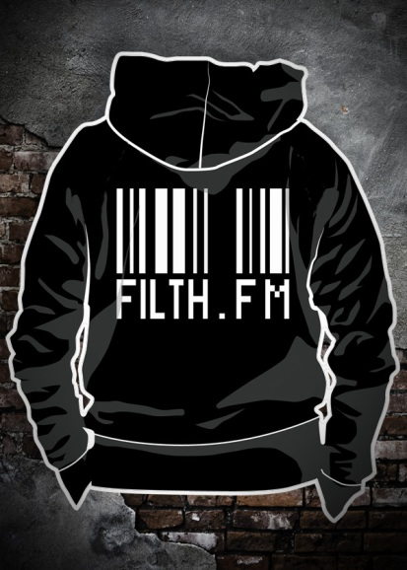
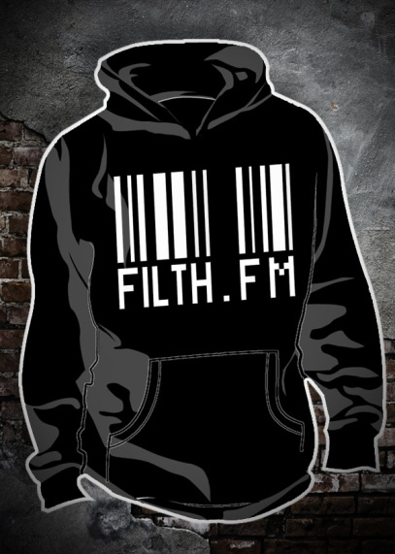
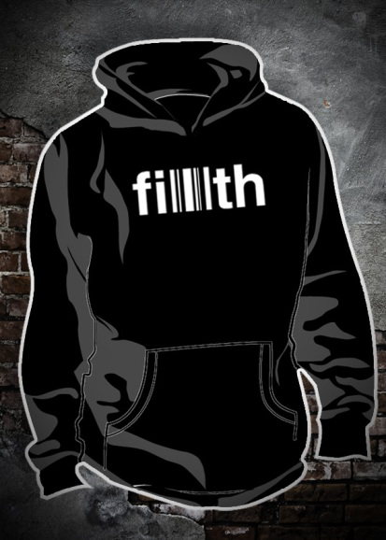
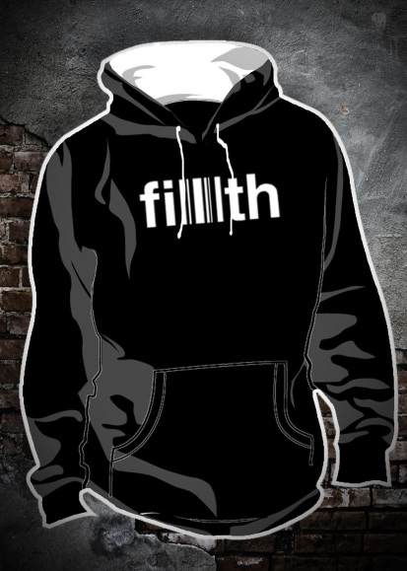
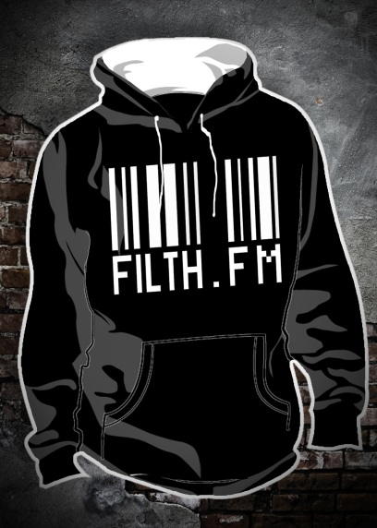
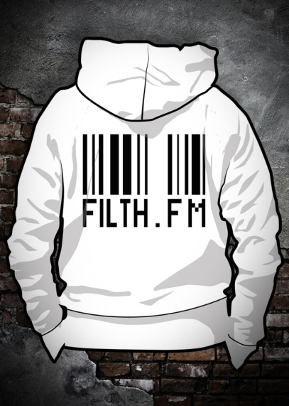
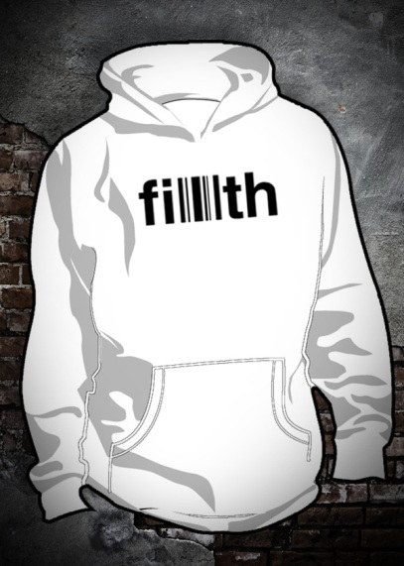
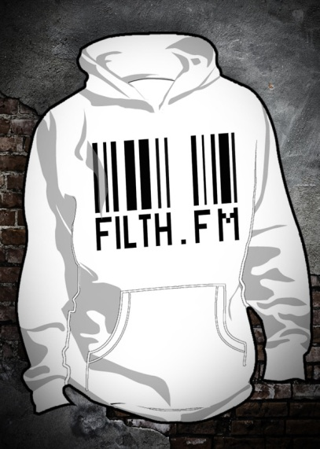
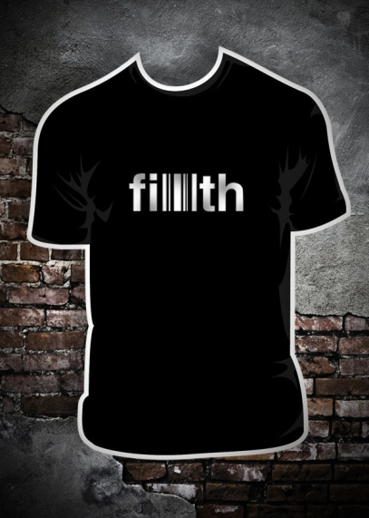
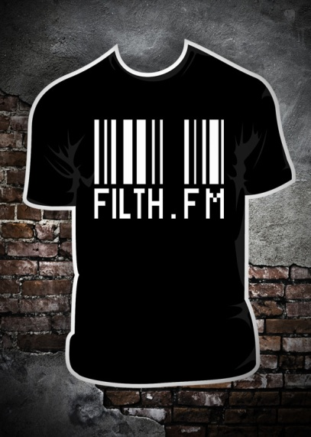
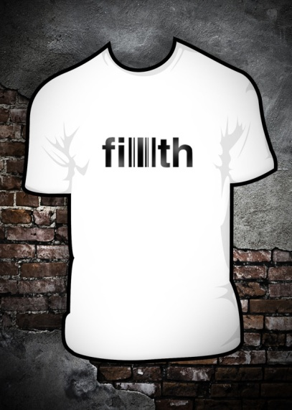
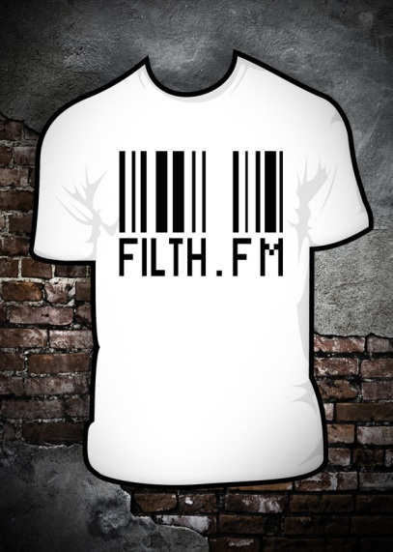
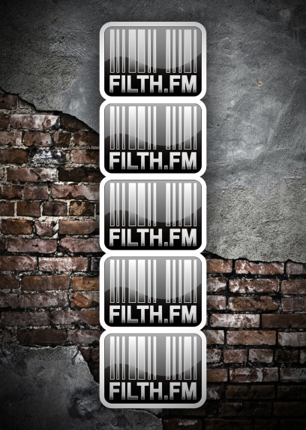
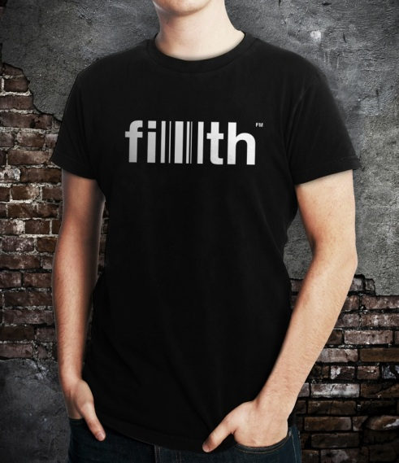
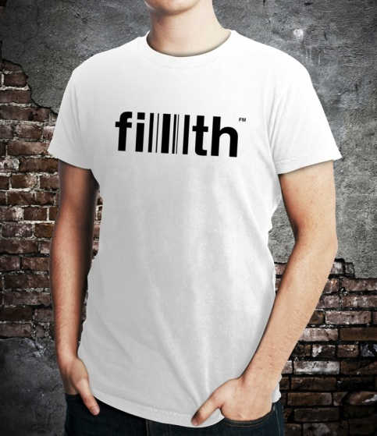
Back to Index
Back to Marketing Index
FILTH FM – Marketing – Effectively Marketing Merchandise
Displaying The Products Online – The Complete Range
This is the complete product range, as you would see it on the store. I have made the products look uniform as it looks smart and also fits with the sites look. This is the complete collection of products available from FILTH FM.
Displaying The Products – FILTH Tees
Earlier on in the PowerPoint, I discussed how I think the store needs models displaying the products whilst being worn. This is an expensive thing to do, as you need a professional photographer, models, screens, backdrops etc. and it all gets a little out of hand for a Radio Station Store. The instant solution was to find a way to do it on a small budget. I was able to get a friend to photograph another friend, and then I was able to touch up the rest of the photo in Photoshop. The images defiantly give a more realistic feel to the store, and thus promote the T-Shirts better than a vector art image can. People want to see the shirts on, not drawn. I will look forward to starting an Ad campaign with the new shirts, and hopefully they will prove more successful then current ads.

Slide 12
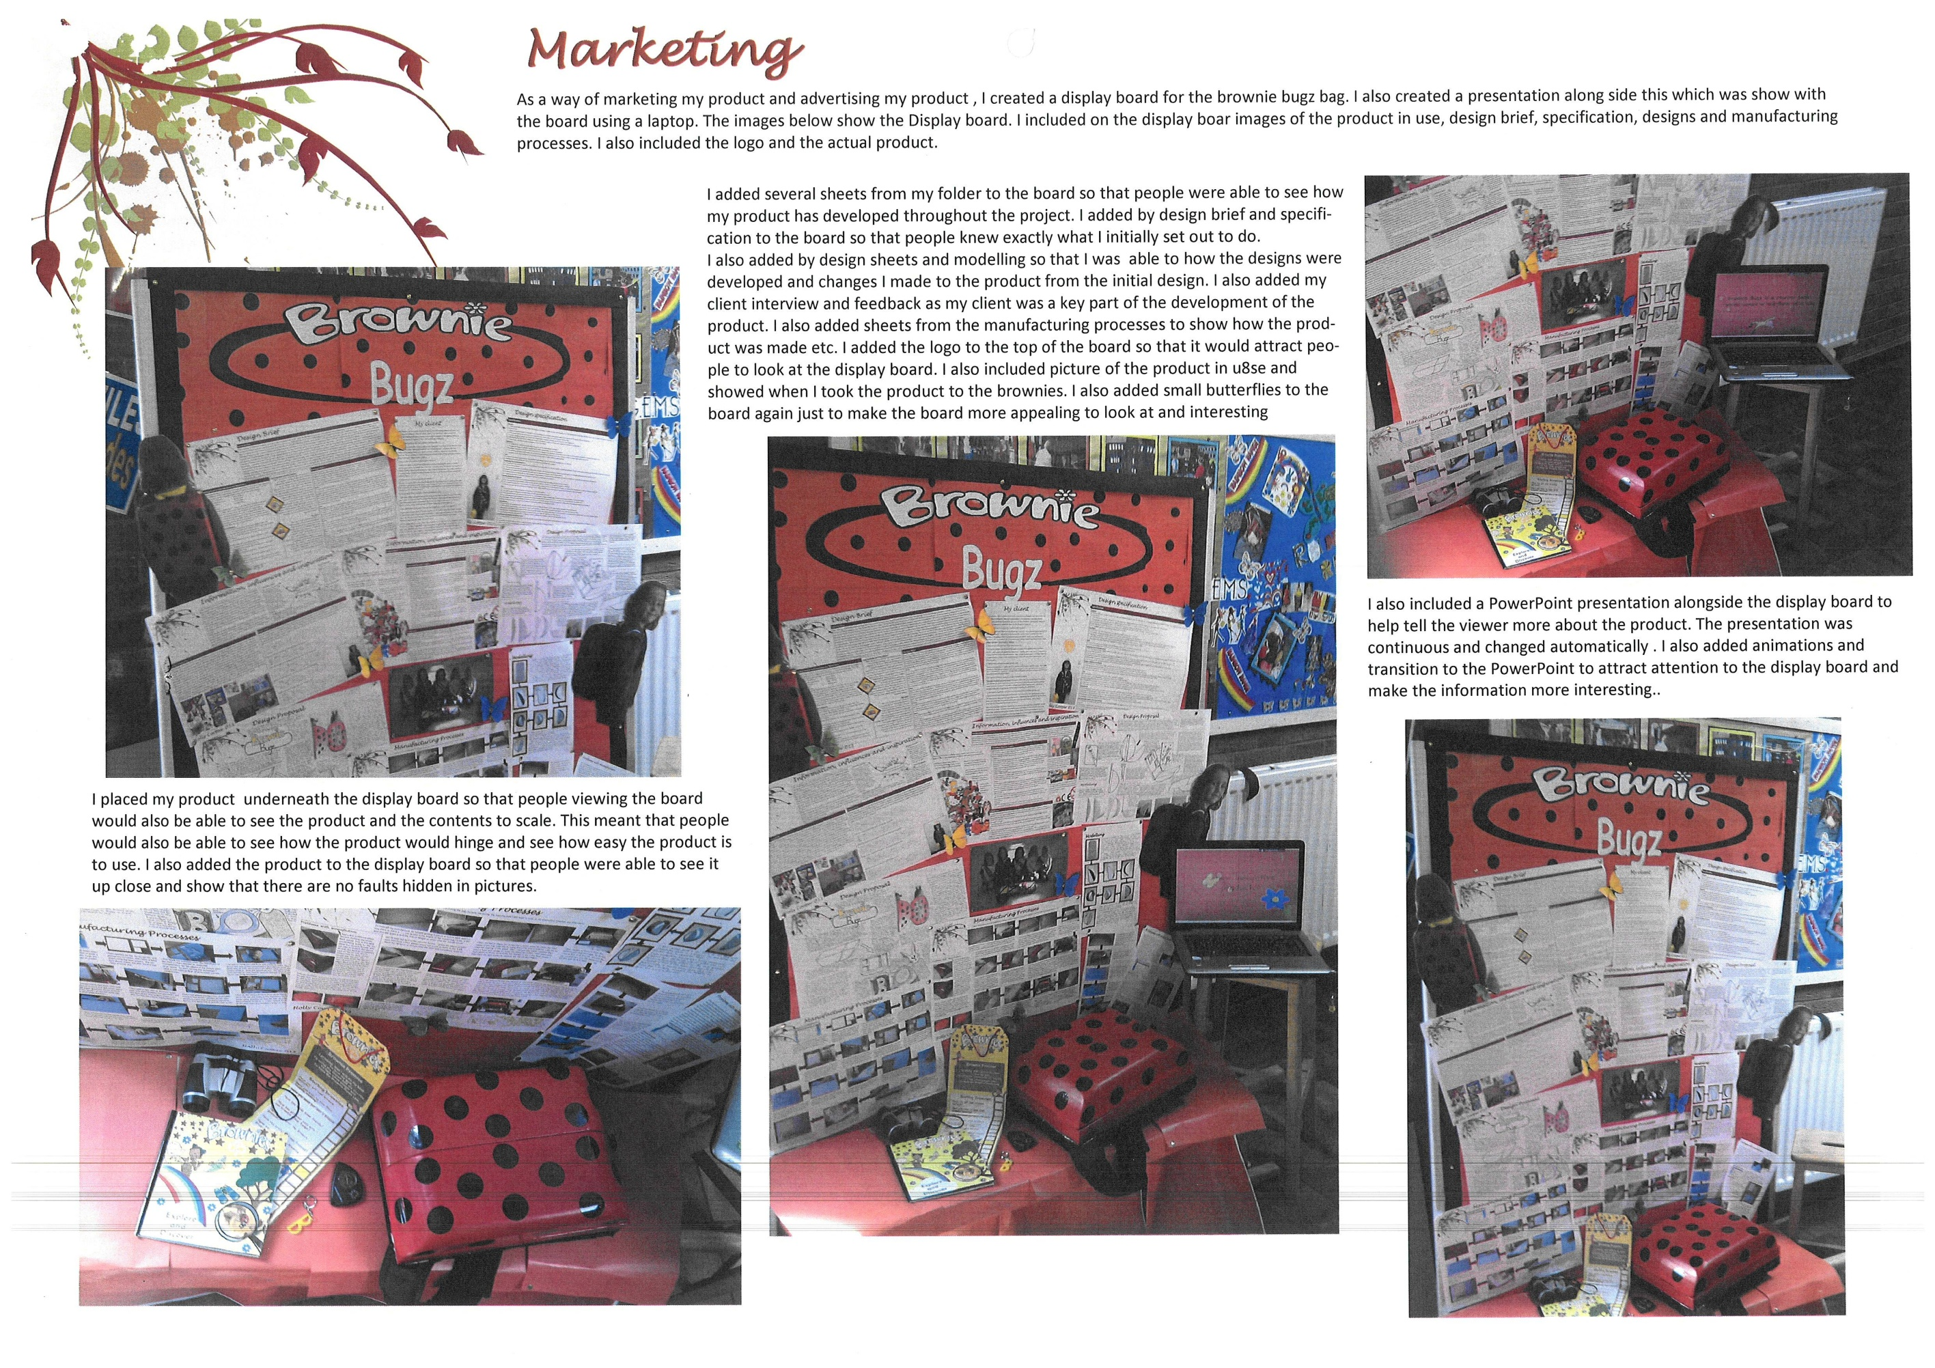

Slide 13
Lotus Petal Pad promotional video (click centre of slide)

Slide 14
Grease Monkey promotional video (click centre of slide)

Slide 15
Vortex Viper promotional video (click centre of slide)

Slide 16
Paint Pod promotional video (click centre of slide)

Slide 17
MAX Engineering promotional video (click centre of slide)

Slide 18
ROBO TT promotional video (click centre of slide)

