Slide 1
Revision Strategies Year 10
Making a revision timetable

Slide 2
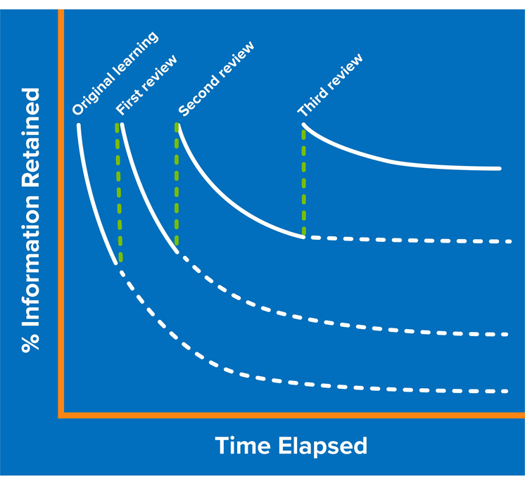
What’s the point in revising?
Notes:
Explain the forgetting curve to students – we know if we do not revisit topics, they will likely be permanently forgotten. We can overcome this by planning to revisit topics frequently. The sooner we start revisiting topics, the more successful we are in committing it to long term memory.

Slide 3
Why is making a revision timetable a good idea?
Gets you organised
Makes you more likely to commit to revision
An opportunity to plan for things to look forward to
More manageable

Slide 4
Tips for a good revision timetable
First mark in important events eg birthdays / trips
Next mark in your clubs / fixtures / work commitments
Write a list of subjects you need to revise
Aim to complete at least 2 hours revision every day in half term
You should cover 2 – 3 different subjects each day

