Slide 1
Student Finance and Managing your Money

Slide 2
What will we cover today
1. Student finance
2. Student loans repayment quiz
3. Support from universities
4. Managing your money

Slide 3
What will it cost?
Tuition fee (£9,250 per year):
Covers all essential course costs
Maintenance costs:
Accommodation
Study materials
Food and drink
Social activities
Notes:
So what will it cost?
Tuition fee - £9,250 per year
Maintenance costs – including accommodation/rent, study materials, food and drink, social activities, and any bills you have.

Slide 4
Support from the government
Notes:
Firstly I’m going to talk about how Student Finance works in the UK.
One thing I’d like to mention first of all is that funding for HE gets confirmed year on year by the government and even though we can’t predict the future, one thing we can always guarantee, is that support will always be in place so that students can go to university.
So the information that I am going to present to you today is based on the most up to date information we have at the moment.

Slide 5
Tuition fee loans
You won’t pay anything upfront
Not based on your household income
The government will always cover the full cost of your tuition fee each year.
So if the fee rises once you have started your course, the loan will rise to match this.
Notes:
So for your tuition fee loan …
You receive the set amount to cover the amount your university has set out as their fee amount. You don’t physically receive this money, it goes straight to the university to pay off the fee every year of your course.
You don’t have to pay anything upfront and the money is not linked to household income or where you live.

Slide 6
Maintenance loans
To cover maintenance costs:
Accommodation
Utility bills
Food
Based on your household income
Different based on location (London)
Different based on whether you live at home (with parents/ guardians), or elsewhere (at university)
Notes:
Then as I mentioned previously, you receive a maintenance loan and this counts towards your living costs.
So your maintenance loan is based on household income, unlike the tuition fee loan. Your receive this money in 3 instalments – 1. at the start of your course 2. around Christmas and 3. at Easter.
This money contributes towards your accommodation, travel, books etc and everyone who attends university gets something, however you may find that it does not cover it all. You will be able to check the amount of Maintenance Loan you’re eligible for, depending on your household income, on the Student Finance website, or when you make you application for Student Finance online.
One thing I’d like to mention, if you choose you study abroad or do a year in industry as part of your degree, your tuition fee is reduced and you will still receive your maintenance loan.

Slide 7
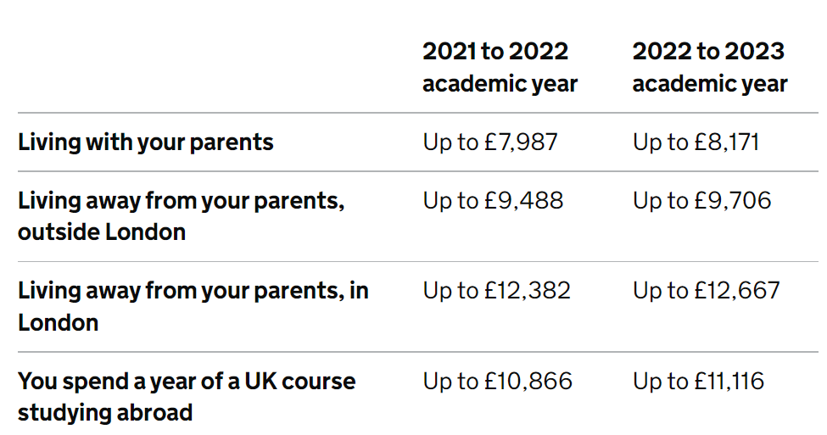
Maintenance loans in England 2022/23
Notes:
Looking at the right hand column, these are the maximum amounts of Maintenance Loan you can receive, depending on where you live whilst studying.
So for example, studying outside London, and not living with parents, for 2022/23 entry students can get a maximum of £9,706, for their Maintenance Loan, depending on their household income.
There are criteria that may make you eligible to receive more Maintenance Loan, for example, if you have a disability and qualify for support, or if you’re a single parent, and more (check the website for full details).
Table from GOV website: https://www.gov.uk/student-finance/new-fulltime-students

Slide 8
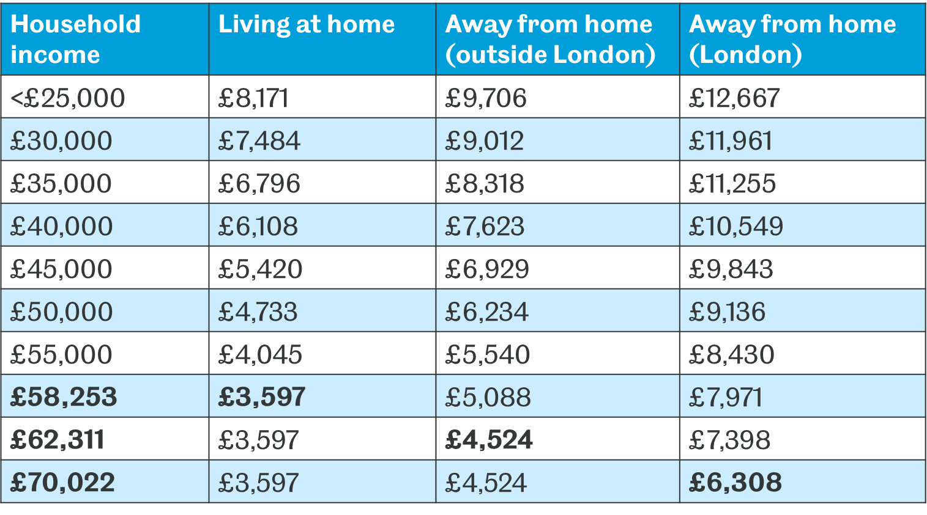
Maintenance loans in England 2022/23
Notes:
These are the maintenance loan figures for 2022/23 entry.
It depends on your household income and where you live whilst studying. So for studying at Sheffield, we’d be looking at the first two columns (some students will live at home in Sheffield, but many will live away from home, outside London, which is the middle column). Then it depends on your household income as to how much Maintenance Loan you receive.
Data from student finance calculator: https://www.gov.uk/student-finance-calculator

Slide 9
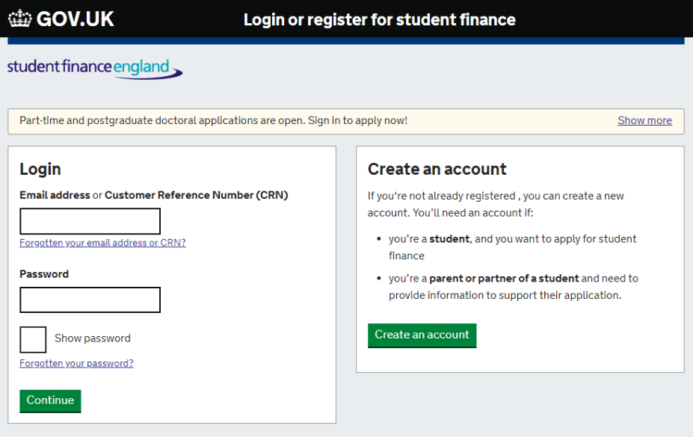
Applying for Student Finance
Notes:
You apply for your student loan through the student finance England website and not through UCAS. You complete your application online around the March before your year of entry. Applications open in April 2023.
The system is very straight forward and much simpler to what it was say 5 years ago. Even if you are not sure about if or when you want to go to university, you still need to make your application as you are not tied into anything if you choose not to attend that year. Don’t forget!
Important to meet the deadline too = SFE guarantee to have all your finance in place by the time you start your course
You do not need to have a firm place at a university to student finance- apply earlier
DSA- Currently it is talking 3 months+ to process a DSA application

Slide 10
Student loan repayment
Repayment start:
The April after you leave university
When you are earning over £25,000 a year
Interest will be generated on a student loan when the first installment is paid.
Anything unpaid after 40 years is written off
Tuition fee loan
+
Maintenance loan
= Student loan
Notes:
So your student loan is made up of your tuition fee loan and your maintenance loan combined at the end of your degree.
Repayments start the April after you leave university and only when you are earning over £25,000. This means that for whatever reason in your working life your salary goes under the threshold amount, you will stop paying your student loan.
When you start to repay your student loan, there will be interest charged however it is important to mention that the interest rate is much lower than a bank loan.
And anything that is unpaid after 40 years is written off.

Slide 11
Interest
Interest is charged on your student loan from when the first installment is paid. The interest rate is set at RPI.
RPI is currently 1.5%.
This is much lower than in previous years where interest has been much higher.
Notes:
Interest is charged from the day the Student Loans Company makes your first payment to you or your university or college, until your loan is repaid in full or cancelled.
The interest rate is based on the Retail Price Index or RPI, which measures changes to the cost of living in the UK. The interest rate is updated once a year in September, using the RPI from March of that year.
RPI (retail price index) is essentially a measure of inflation

Slide 12
Interest
This means that graduates will no longer repay much more than they have borrowed. A student entering a three-year course could see their debt reduced by up to £11,500 at the point at which they become eligible to repay
This is updated every September, using the RPI from the previous March.
The amount of interest you’re charged doesn’t affect the amount you’ll repay each month.
Notes:
The interest rate is based on the Retail Price Index or RPI, which measures changes to the cost of living in the UK. The interest rate is updated once a year in September, using the RPI from March of that year.
RPI (retail price index) is essentially a measure of inflation
It’s important to remember that the amount of interest you’re charged doesn’t affect the amount you’ll repay each month. How much interest you’re charged depends on your circumstances.

Slide 13
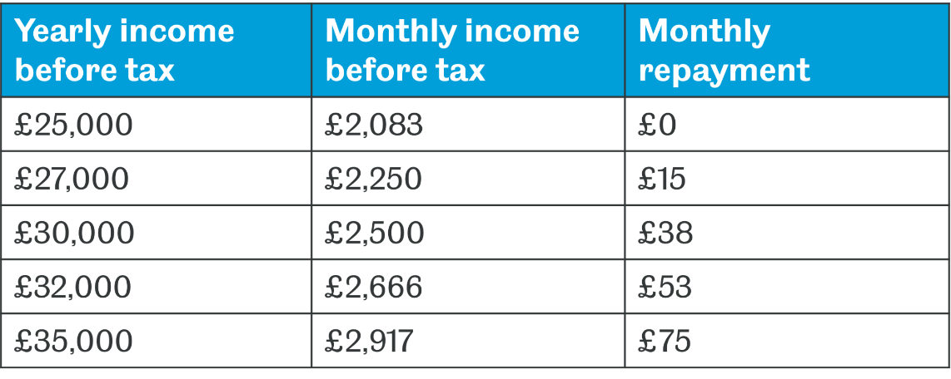
Repayments
Repayments are calculated as 9% of anything earned above £25,000
Repayments are always based on what you earn- not what you owe. Most people never pay it all back.
Notes:
Your student loan is designed to be affordable and the amount you pay is in reflection to the amount you earn. Therefore if you wage increases – your loan will increase. Likewise, if your wage reduces, your loan will reduce.
So if you earned £28,000 per year, with a monthly income of £2,333 before tax, you would pay £5 per month for your student loan repayments.

Slide 14
How will I pay?
Monthly student finance repayments are managed by your employer.
The money will come out of your wages before they even get to you.
If you’re self employed, HMRC will work out how much you need to pay from your tax return, and you’ll pay at the same time you pay your tax.

Slide 15
Can I pay if off early?
Yes you can, but you need to ask yourself if it’s really a wise use of your money
The majority of people will never pay off their student loan, and as it is a manageable deduction from your wages you may barely even notice you’re paying it off.
You can make a repayment to the Student Loans Company at any time, with no penalty for early repayment.
There are no debt collectors for student loans!

Slide 16
Student loan repayments
In a Which? Survey, less than 3% of respondents with a student loan got all of these questions correct.
Notes:
Student loan repayments – quick quiz. True or False…

Slide 17
True or false?
Your student loan debt is wiped after 40 years
Notes:
Your student loan debt is wiped after 40 years
True or False?
True – Any remaining balance is completely written off after 40 years.
* For 2023/24 this may increase to 40 years

Slide 18
True or false?
Your student loan debt is wiped after 40 years
True

Slide 19
True or false?
You will need to repay your loan if you’re working abroad
Notes:
You will need to repay your loan if you’re working abroad
True or False?
True – If you leave the UK for more than 3 months, you will need to tell the Student Loans Company (SLC). They will work out if you have to repay while you’re not in the UK and if so, how much you need to pay. The rules for repayment are the same as in the UK, apart from differing repayment thresholds for each country.

Slide 20
True or false?
You will need to repay your loan if you’re working abroad
True
Notes:
You will need to repay your loan if you’re working abroad
True or False?
True – If you leave the UK for more than 3 months, you will need to tell the Student Loans Company (SLC). They will work out if you have to repay while you’re not in the UK and if so, how much you need to pay. The rules for repayment are the same as in the UK, apart from differing repayment thresholds for each country.

Slide 21
True or false?
You will need to start repaying your loan as soon as you graduate if you’re earning over £23,725
Notes:
You will need to start repaying your loan as soon as you graduate if you’re earning over £23,725.
True or False?
False – You’ll only start repaying when your income is above the repayment threshold, which currently is £25,000 a year. If you earn less than that figure when you graduate, you won’t start to repay your loan. But if you do graduate and go straight into a job earning £25,000 or more per year, you will start repaying your loan.

Slide 22
True or false?
You will need to start repaying your loan as soon as you graduate if you’re earning over £23,725
False
Notes:
False – You’ll only start repaying when your income is above the repayment threshold, which currently is £25,000 a year. If you earn less than that figure when you graduate, you won’t start to repay your loan. But if you do graduate and go straight into a job earning £25,000 or more per year, you will start repaying your loan.

Slide 23
True or false?
The interest on your loan starts accruing once you’ve graduated
Notes:
The interest on your loan starts accruing once you’ve graduated.
True or False?
False – Interest is charged from the day the Student Loans Company makes your first payment to your university or college, until your loan is repaid in full or cancelled.

Slide 24
True or false?
The interest on your loan starts accruing once you’ve graduated
False
Notes:
False – Interest is charged from the day the Student Loans Company makes your first payment to your university or college, until your loan is repaid in full or cancelled.

Slide 25
What are some other sources of income whilst studying?
Notes:
Firstly I’m going to talk about how Student Finance works in the UK.
One thing I’d like to mention first of all is that funding for HE gets confirmed year on year by the government and even though we can’t predict the future, one thing we can always guarantee, is that support will always be in place so that students can go to university.
So the information that I am going to present to you today is based on the most up to date information we have at the moment.

Slide 26
Part time work
Scholarships
Money
Disabled students allowance
Bursaries
Work for the University

Slide 27
Support from the university
Bursaries
Scholarships
Access to the Careers Service for a lifetime after graduating
This support is specific to the University of Sheffield for 2023
Notes:
So that was the support made available by Student Finance England. You will always receive different forms of support from the university you attend.
Lifetime support unless you are studying at another institution after graduating

Slide 28
Additional funding
There are a wealth of other funding streams available that can support students at university.
A lot of academic departments have their own awards (often based on academic merit).
See more at: www.sheffield.ac.uk/undergraduate/fees-funding/additional
This support is specific to the University of Sheffield for 2023 entry

Slide 29
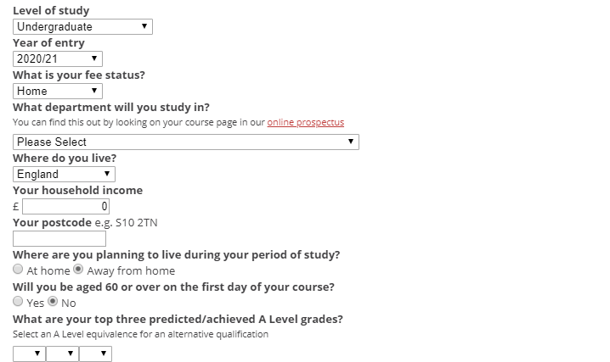
How much will you get?
sheffield.ac.uk/funding/calculator
Notes:
An easy way to check for what you are eligible for is to complete the student finance calculator using the link above.
This will give you an idea of how much you will get if you do choose to come to university

Slide 30
a
Part- time work
Income and invaluable experience plus confidence
The Student Jobshop can help students find part time work
The University is also a regular employer of students
Supplement the student loan
Notes:
If you are concerned about having enough money during your time at university, another great way to get extra cash is to get a part time job alongside your studies. A large number of students will look to supplement their student loan with part-time work. Not only does it provide an income stream, but it also provides invaluable experience and confidence. The Student Jobshop can help students find part time work during term time, vacations and for placement years. The University is also a regular employer of students in a variety of roles with generous pay.
Most courses enable you to do this and it is something that is encouraged in order to gain experience and confidence to add these experiences to your CV.
The Student Jobshop can help students find part time work during term time, vacations and for placement years.
The University is a regular employer of students too and pay generously for work to be carried out to work around your studying and exams at uni.

Slide 31
Managing your money
Notes:
Apart from tuition, what else do you need to pay for?

Slide 32
Apart from tuition, what do you need to pay for at university?

Slide 33
Contents insurance
Gas/Electric
Rent
TV license
Bills
Internet
Council Tax
Phone
Water

Slide 34
Toiletries
Food and drink
Course materials
Essential items
Household items
Laundry
Transport

Slide 35
Societies
Gym
Nights out
Extras
Hair and Beauty
Shopping/ Entertainment
Sports
Eating out
Subscriptions

Slide 36
Holidays
Freshers week
Birthdays
Christmas
Big extras
One-off purchases
Festivals
Shopping/entertainment

Slide 37
Managing your money
Incoming | Guaranteed outgoings
Maintenance loan Bursaries/scholarship Parental support | Rent Bills/ subscription
The most important factor is knowing what money you have coming in, and what money is guaranteed to go out
Notes:
The key is to make sure you do this BEFORE you go to university!
You will know all of these figures before you pack up your things and head to your new home – you want to know how much you can realistically afford to spend each month.
If this calculation doesn’t leave you with much to spend, you need to seriously consider getting part time work, which can be a very positive part of your university experience providing you don’t work so much that it negatively affects your studies.

Slide 38
Managing your money
Managing your money is not as daunting as it may seem. You just need to find out the method that works best you!
Spreadsheet
Mobile apps
Direct debit “wage”
Notes:
Apps like monzo can be a good way to track spending

Slide 39
How much?

Slide 40
£374
£50
Weekly shop
Weekly public transport
Freshers week
Cost to join a society
Weekly rent
Monthly utility bills
£32
£15
£8
£95
Notes:
Average weekly shopping cost - £32 (I spent more… and/or bought lunch at uni too)
Average spend on Freshers week – £374
Average weekly spend on public transport - £8
Average weekly rent - £95
Average cost to join a society - £15
Monthly bills - £50

Slide 41
The Key Message
If you go to university without a plan for your money, it will more than likely catch up on you at some point
Budgeting is a skill for life, not just for student life, so the sooner you get good at it, the better!

Slide 42
Access +
You may be eligible for additional support through Access+ if:
You live in an area with a low rate of participation in higher education
You’re a care leaver
You’re care experienced
You’re estranged from family
You’re a carer
You’re a forced migrant
You have parenting responsibilities
You’re entitled to free school meals
To check eligibility criteria visit: https://www.sheffield.ac.uk/access-sheffield/eligibility

Slide 43
As an Access+ student, you’ll be eligible for wraparound support:
financial support; Funded Open Days, IT & Equipment Bursaries, Sheffield Bursary
a dedicated team on hand to answer your questions about university
help with study skills and revision
A reduced grade offer equivalent to one grade below the standard A Level entry requirements e.g. if the formal entry requirements for your course are ABB and you meet the criteria, you’ll receive an alternative offer of BBB.

Slide 44
@sheffielduni
The University of Sheffield
@theuniversityofsheffield
Any questions?
Taster Sessions
Chat to current students
Sheffield Live
Insight into career opportunities, study skills and support. Our team will be on hand.
Experience what it’s like to study your chosen subject at The University of Sheffield
Start a conversation with our student ambassadors and staff

