Slide 1
Unit F523 Design, Make and Evaluate
7 Review and Reflection
Exemplar standard in content, approach and/or skills shown

Slide 2
REVIEW AND REFLECTION
WIDER IMPLICATIONS OF MY PRODUCT
How decisions were made: At the very start of my project I set out to design a product simply to store only felt tip pens. I felt like this was too limiting so decided to expand it to store art materials in general, and then research began from then on. During research I realised that there was a lack of small child art storage products which could hold a number of, making me quite confident that there was a gap in the market for a product like mine. When designing I had to keep the designs fun for the children, but they also had to provide a high degree of function for the market (staff members). I found this easy enough to do. Discussions with my client helped me make informed decisions about which design ideas I would carry through to development. When designing the main aspect I had to remember was to make sure there were no small areas where fingers could get trapped.
Value of my client: Having a client was very helpful. She was able to provide my project with direction. I really enjoyed designing and making something to meet the needs of a specific person/playgroup. Mary Rose’s impact just before the development stage helped me the most, since I did at first find it difficult to choose and develop one or two ideas. Her positivity throughout the project was very rewarding.
Setbacks: I had quite a few set backs, but all of which I was able to over come:
Creating the male and female mould due to my design curving across two planes. My initial design for the moulds were a good starting point, but because the curve s all had to join up to make a circle on way but then a dome the other, modifications to my former design were undertaken but adding extra slats of wood and all purpose filler. After numerous test pieces, my former was finally complete to use to make the real thing.
Getting the pots to touch to make a circle. I wasn’t able to achieve this, but in the long run I think how my final product has turned out is better than my design. The spaces between the pots mean that they are easier to remove from the unit.
The Lazy Susan to spin. This did take me a while to understand, so I wasted time. I should have tested it better in the development stage and I wouldn’t have lost so much time. However I did manage to get it to work in the end.
The importance of the various stages of designing and making: The most important thing to do was to make numerous mock up models (full size) of the whole product, modelling each component. If things started to go wrong, I was able to revert back to my foam board mock up and see where I had gone wrong, and quickly resolving it and getting back to manufacturing. As mentioned in my setbacks, I should have modelled the spinning mechanism, in order to not have wasted any more time
Quality control in making process: for most pieces I drew up on Techsoft I printed out and stuck onto pieces of foam board of the correct thickness so test it thoroughly before laser cutting the final pieces. I did this numerous times for the sides and base of the pain/pen pots. I also kept re-softening the curve piece until I was completely satisfied with the way it came out after forming. Any tensol cement which was visible was removed by using white spirit
Significance of the use of ICT: ICT was very important throughout my project. First, the videos and photos of interactions with other products, my client , my models and testing my final product has enhanced my e-portfolio remarkably. The video of client feedback on my initial designs I found the most helpful throughout the development process as it helped me stick to what my client wanted. The use of CAD allowed me to easily draw up parts and edit if need be. I was able to draw components of my product to scale, allowing me to have an idea of how it would look like. I also enjoyed exploring new packages (such as Sketckbook Pro for iPad) to enhance my design further.
Social implications
My product makes putting art materials on the table for child use easier for members of stuff. This therefore reduces the time needed to put down and pick up many products as everything is now as together in one unit, allowing staff to turn their attention to the children and to carry on with other jobs around the playgroup.
Environmental implications
My product requires no energy in usage, so will not waste energy and valuable resources. The whole product can be recycled, but plastic is difficult to separate before recycling, e.g. all parts are made from polypropylene but the components are sealed together with tensol cement so therefore slightly more difficult to disassemble. The use of plastic for this whole unit is not very environmentally friendly as it uses precious resources (oil) to be created. However the product would also have implications if it were made from wood.
The product is modular, so after initially buying the whole unit, users can go onto purchase more pots if they feel a need to do so. Therefore this reduces waste, as people are able to replace parts if they become damaged, rather than throwing away the whole unit, and purchasing another.
Moral and ethical implications
The product is safe to use for both children and adults. There are no small parts or small gaps where children could trap their fingers in. All children between ages 2.5 upward will be able to use the product with no help from an elder. It is big enough for them to see what goes where and what does what without having to be told and patronised. Children are able to remove the pots independently for themselves and spin the product round. There is no bias towards either left or right handed people. Both will equally be able to use the product to its full extent.
Economic implications
Plastic is quite economical (cheap), so this will have an effect on the price that the product is marketed at.
If the product was to be completely injection moulded theoretically production of the product would be cheaper but its level of sustainability challenged, as injection moulding requires a lot of energy = more money spent
LIFE CYCLE ANALYSIS
Acquisition of raw materials: My whole product it made out of plastic, which isn’t a very sustainable resource as oils and natural gases have to first be extracted to begin the process of creating plastic – this requires a lot of energy i.e. burning and using up fossil fuels which are becoming more and more limited.
Transporting the raw materials: If the raw materials are acquired internationally from the country in which the product will be made, there will be a significant environmental impact in transportation. Transportation could be for a long period of time, with the modes of transport emitting pollution into the atmosphere. For example plastics are manufactured in China, but then shipped over for production in England so atmospheric pollutant gases may be produced such as Carbon Dioxide. Too much of this gas with contribute towards Global Warming.
Processing and manufacturing raw materials: In commercial manufacture, parts of my product could be injection moulded and other parts cut out on a large scale router. Both require large amounts of energy for the machines to be run – fossil fuels being used = pollution
Transportation from factory to shop: Energy and fuel used in transportation. However this is significantly reduced if manufactured in England.
Using the product: No energy is required when using my product so no burning of fossil fuels
Disposal: Very easy to recycle since the whole product is made out of one and the same material (plastic).

Slide 4
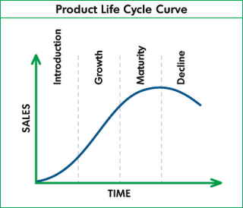
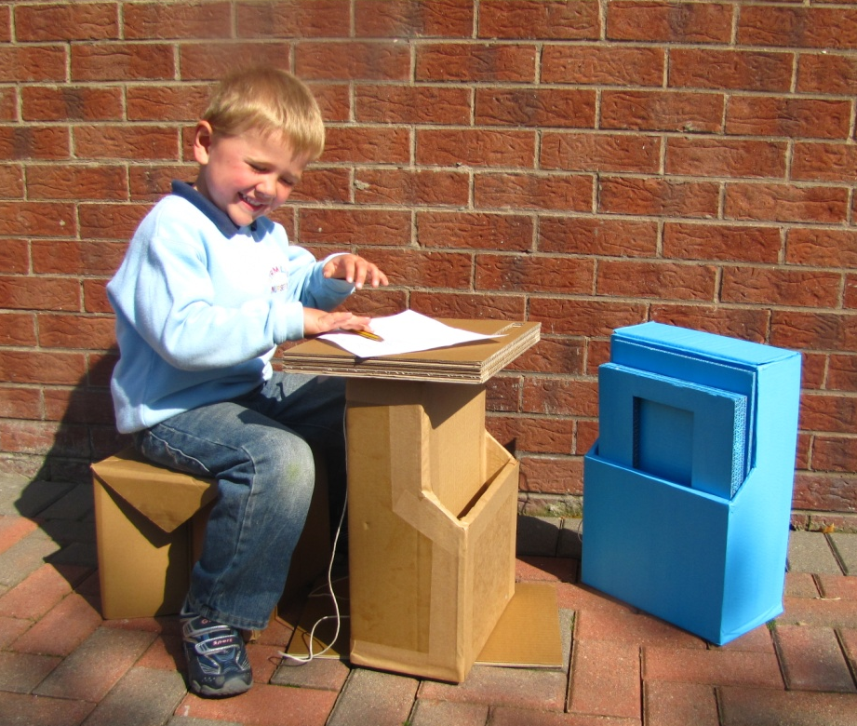
REVIEW & REFLECTION
WIDER IMPLICATIONS (CONTINUED)
WIDER IMPLICATIONS
COST
My model was manufactured using the laser cutter by the help from Frederick Jones Packaging company in Belfast. The manufacturing costs are really low and also the use of materials is also really relatively cheap. Throughout this design task I was really careful with the use of materials and how much materials are wasted etc. This has hugely helped me because I want to be able to manufacture the product up to the highest standard as possible, but is produced in a cheaper way.
SAFETY
There are always health and safety rules put in place to protect anyone in the workplace. I found working with cardboard particularly interesting as there was a lot of differences working with cardboard rather than paper or other solid materials such as wood, metal etc.
There are always safety logos (such as the British Kite Mark, etc) on the product and this is use to show the target users who buying this product, that the product has been tested accurately. This is used to ensure that the product is safe to use for the user especially young students or children.
THE ENIVRONMENT
The environment always has to be considered in the design, manufacture, and finishing of any product. Every aspect has to be considered to ensure that the product is as environmentally friendly as possible. This includes trying to reduce material waste and even material use (trying to use as little material to manufacture you product as possible). I tried as much as possible to keep the “Ed Mate” as environmentally friendly as I could. This is why originally chose cardboard.
The environment must also be considered during manufacture. A manufacturing process that takes a long time with large machinery using large amounts of electricity will obviously be less friendly to the environment than a process that is quick and uses less electricity.
SAVE LIVES / REBUILDING LI VES
The biggest implication of my product is the main reason why I chose such a complex project. My product saves and also rebuild lives. Disasters such as Haiti or Japan earthquake/tsunami, all the people including children gets injured or died. The buildings are damaged even the schools, and also homes which means that the young children wont be able to learn to be educate. My product aims to improve the children’s lives and also aims to educate them in order for them to have a career in their future.
My projects aim was to try to improve the lives in Developing Countries such as Haiti, Japan etc. as I already mentioned in my design brief that the education in developing countries is very poor as most of the children cant go to school because they need to work to help their family to survive. I am trying to aim this product to encourage these children to go to school and have education to help strengthen their skills for the future I would be ecstatic. Having researched this area so much I feel that more investment is needed to aid the people employed to look after them and their health.
PRODUCT LIFESPAN
The products lifespan would be a big factor in buying the product for any students or employees etc. any products put into use by the Delta Packaging are rigorously tested before going into use, however they are truly tested when they are put into use. The product must withstand all the everyday abuse that it will be use aftermath of the disasters such as earthquake in Haiti or Japan. If there is another quake occurs in the future the product will be dropped, based and exposed to immense heat within buildings collapsing. Although I could not test my product under these rough conditions I did design it as best as possible to cope with the “rough and tumble” of everyday use.
I am happy that my product will have a good life in service. However when the sales of the product are considered it is unlikely to have a common life sale cycle (as pictured above). The product is likely to take a long time to make initial sales and then after a slow phase of small orders, if the product performs as well as I hope, multiple orders will be placed as success grows and the product starts use in many different school or public environments worldwide. The product is unlikely to have a decline phase, as school desk products are used for long periods of time and there is not much competition from other products in this area.

