Slide 1
Year 7 Tutor Evening
Wallingford School
Able and Qualified
Head of Year 7: Miss E Hearn
hearne@wallingfordschool.com

Slide 2
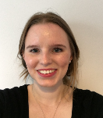
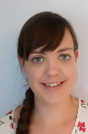
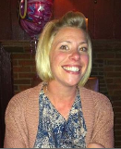
Tutors
Miss Weston FWE – K3
Miss Smette VSE – K15
Ms Ladbrook
RLA - M6
Miss Atkinson
NAT - S2
Miss Isaac DI – T5
Mr Richards SRI – T8
Miss Twyford RTW – B2
Mr Dodson
SDO – B8

Slide 3
Important Parts to the Year (in no particular order!)
Year 7
School production
KS3 assessment weeks (Dec and end of year)
Celebration evening
House matches
Whole Year Group trip
#GetReading

Slide 4
Wallingford School
All students will receive a first class education and leave us ‘able and qualified’
We believe every student deserves to be challenged and inspired and our teachers deliver our knowledge rich curriculum.
We place great emphasis in supporting our young people to find their place in society and encourage them to play an active party in our school community – through house competitions, enrichment activities and a variety of trips.

Slide 5
Curriculum Information
Broad and balanced
All lessons are mixed ability
Homework set regularly using Satchel:One
Targets
Progress Reports
Preparation for assessments
Reflection on progress

Slide 6
Assessment, Feedback and Reflection
Feedback
Reflection
Assessment

Slide 7
Assessment, Feedback and Reflection
Feedback
Reflection
Assessment
Progress Reports
Feedback Evening
End of Year
Assessment Scores

Slide 8
Assessment, Feedback and Reflection
Feedback
Reflection
Assessment
Progress Reports
Feedback Evening
End of Year
Assessment Scores

Slide 9
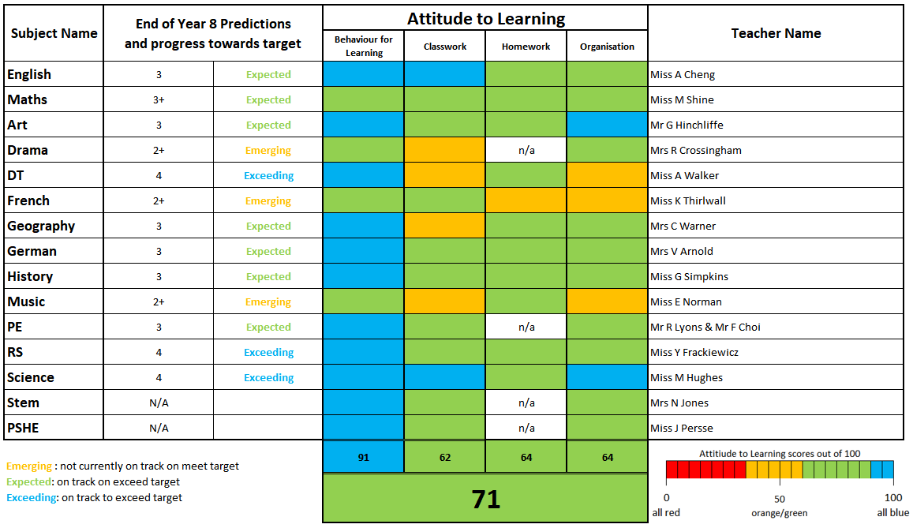
Progress Reports

Slide 10
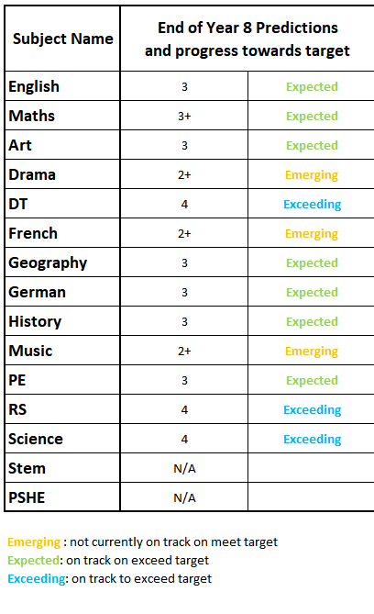
Progress Reports
*End of Year Predictions for each subject
*Indication of Progress made

Slide 11
Targets: How are these calculated?

Slide 16
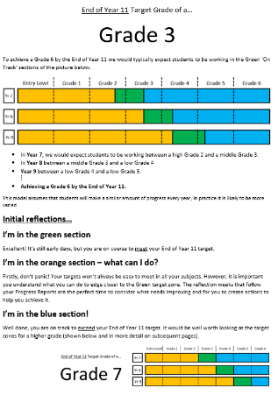
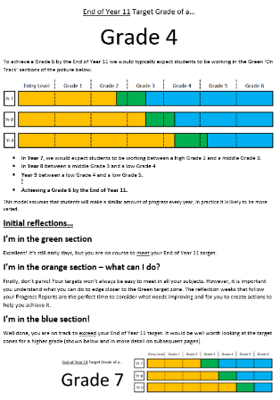
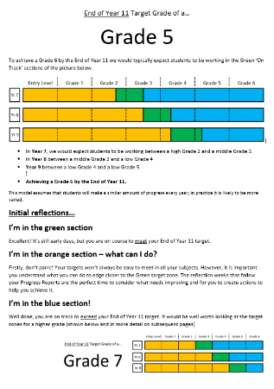
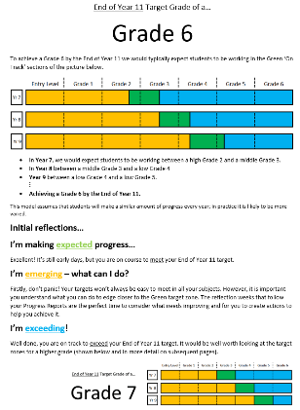
Individual End of Year 11 Targets:
Maths Target – Grade 6
English Target - Grade 7
Other Subjects – Grade 6

Slide 17
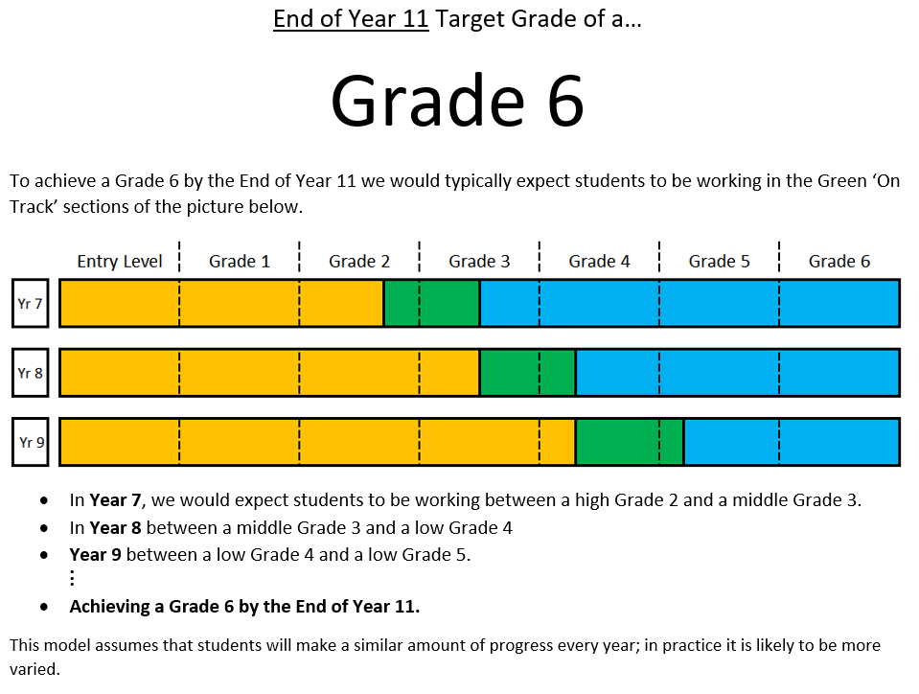

Slide 18
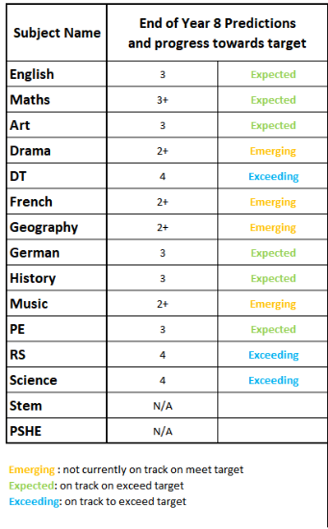
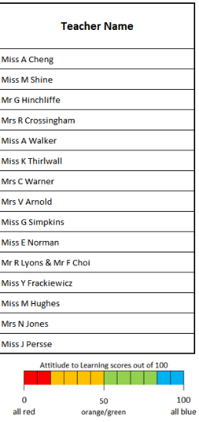

Slide 19
Individual End of Year 11 Targets:
Maths Target – Grade 6
English Target - Grade 7
Other Subjects – Grade 6

Slide 20
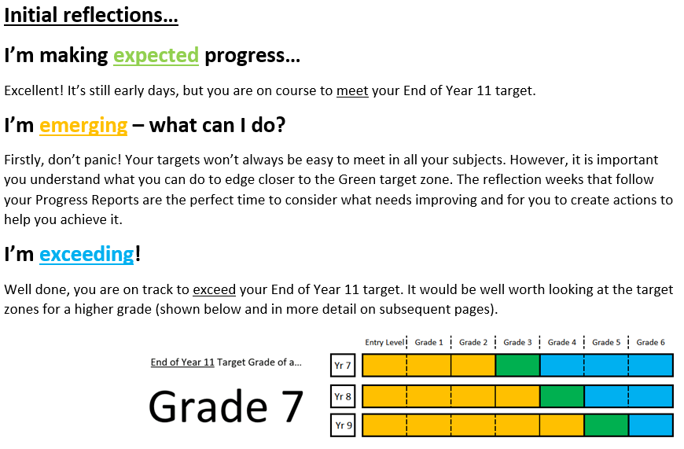

Slide 22
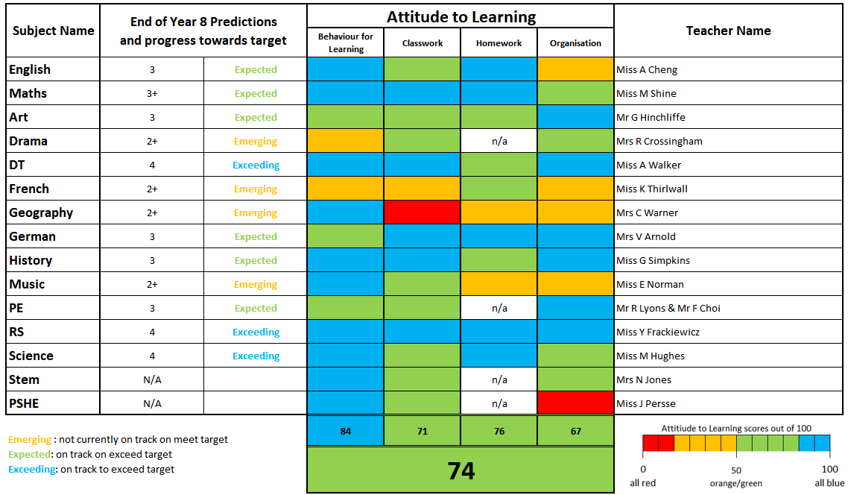

Slide 24
Tutors
Miss Weston FWE – K3
Miss Smette VSE – K15
Ms Ladbrook
RLA - M6
Miss Atkinson
NAT - S2
Miss Isaac DI – T5
Mr Richards SRI – T8
Miss Twyford RTW – B2
Mr Dodson
SDO – B8

Slide 25
Welcome to 7RTW …
Miss R Twyford
Twyfordr@wallingfordschool.com

Slide 26
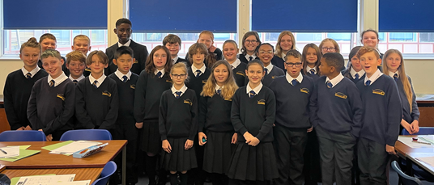
Welcome to 7RLA …
Ms R Ladbrook
ladbrookr@wallingfordschool.com

Slide 27
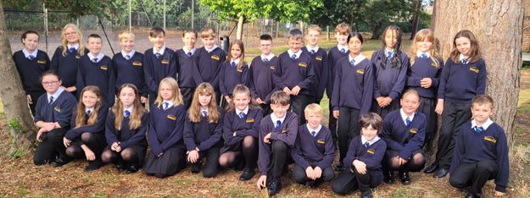
Welcome to 7SDO …
Mr S Dodson
dodsons@wallingfordschool.com

Slide 28
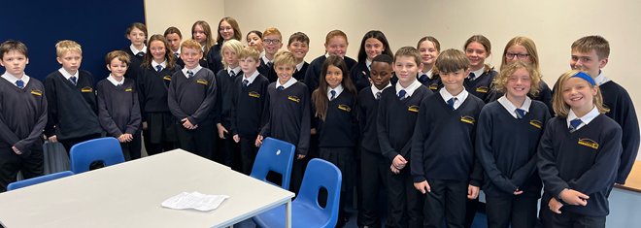
Welcome to 7SRI …
Mr S Richards
Beardall-richardss@wallingfordschool.com

Slide 29
Welcome to 7DI …
Miss D Isaac
isaacd@wallingfordschool.com

Slide 30
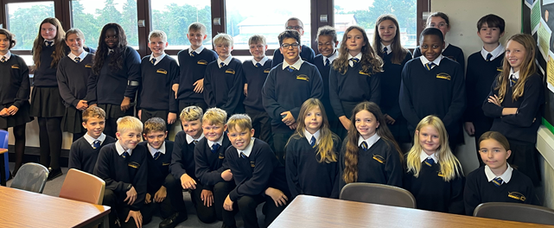
Welcome to 7VSE …
Miss V Smette
smettev@wallingfordschool.com

Slide 31
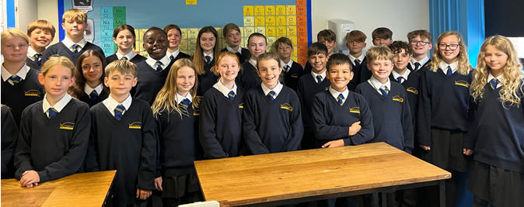
Welcome to 7NAT …
Miss N Atkinson
atkinsonn@wallingfordschool.com

Slide 32
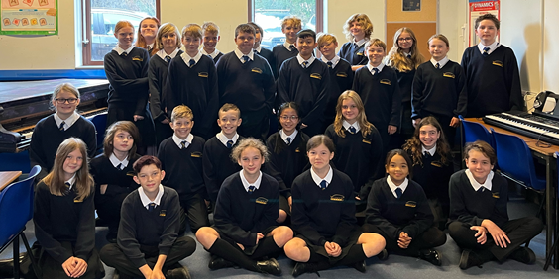
Welcome to 7FWE …
Miss F Weston
westonf@wallingfordschool.com

Slide 33
The role of the form group
Tutor time – a good start to the day
#GetReading
First point of contact
PSHE
Reflection on progress report
Support and challenge

Slide 34
Healthy habits
Attend school regularly and on time
Get into a term time routine
Limit devices in bedrooms / overnight
Encourage your child to complete and hand in homework on time
Talk to your child about what they are learning

Slide 35
Our expectations
Attendance – at least 95% (did you know 90% attendance means you end up missing a whole half term over 2 years?)
Punctuality – school starts at 8.35am
Uniform

Slide 36
Homework will be set over the course of the week. We suggest the following days for pupils to complete the work. This may help pupils and their families organise and plan their work across the week.
Monday - English
Tuesday - Maths
Wednesday – Science
Thursday – Humanities (History, Geography & Religious Education)
Friday – Modern Foreign Languages (Year 7 either French or German, years 8 and 9 French and German)
Design & Technology, Music, Art & Drama may also be set on any day of the week but is unlikely to be set on a weekly basis. PE and STEM homework will not be set.
How much?
Each homework set should take approximately 20-50 minutes.
Pupils should expect to receive no more than 7 hours homework per week (1 hour per day across the full week), but typically we would expect approximately 3-6 hours per week, increasing as pupils progress through Key Stage 3.

Slide 37
Mobile phones
Mobile phones switched off and in bags during lessons.
The only time your phone should be out during a lesson if a teacher has given you permission to use it. Otherwise teachers can, and will, confiscate them.

Slide 38
What do I do if there is a problem?
Contact me!
Contact the head of year (Miss Hearn)
Use the get help button on the school website
Encourage your child to talk to a member of staff at school

