Slide 1
Student launch

Slide 2
What is Unifrog?
Unifrog is a one-stop-shop where students can easily explore their interests, then find and successfully apply for their next best step after school.
Unifrog will help you to explore your key interests and what career paths you can take to reach your goals!

Slide 3
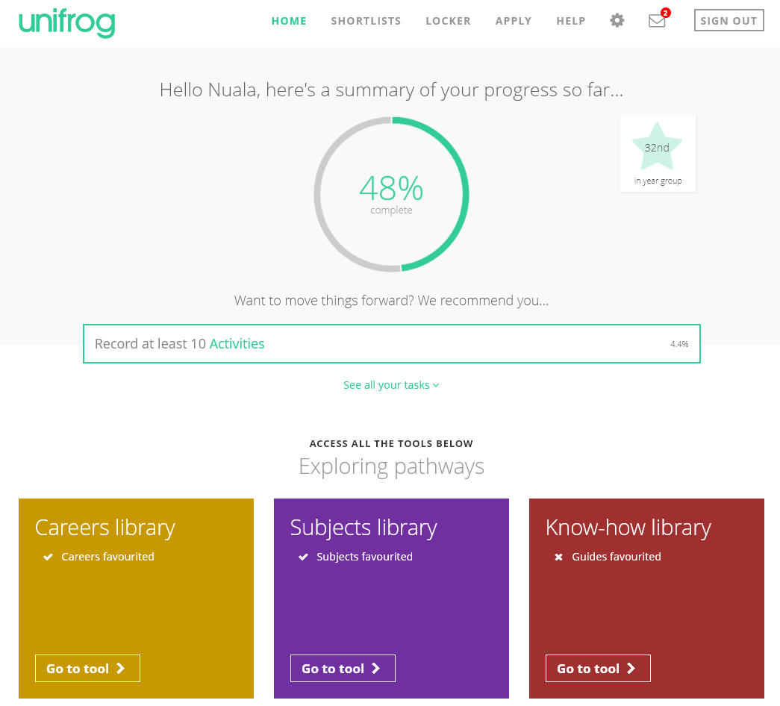
By the end of today’s session, we will:
Understand how Unifrog can support your future decision-making and career options
Explore some of the exciting features of the platform
Create your very own personal Unifrog accounts!

Slide 4
Available resources
Exploring pathways
Recording what you’ve done
Searching for opportunities
Drafting application materials
Making applications
Careers library
Activities
UK universities
Personal Statement
Post 16/18 Intentions
Subjects library
Competencies
US universities
CV / Resumé
Locker
Know-how library
Interactions
European
Teacher References
Applications list
MOOC
Oxbridge
Common App Essay
Personality profile
Apprenticeships
College/ Sixth Form
Canadian universities
Asia
Australasia
Special Opportunities

Slide 5
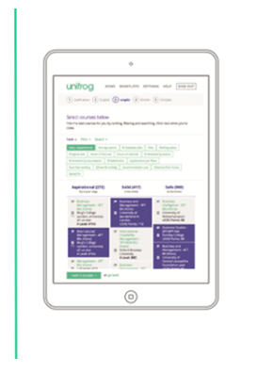
Exploring pathways
Use the tools in the Exploring pathways section to research the types of exciting options available to you after school
Careers library
Subjects library
Know-how library
MOOC
Personality profile

Slide 6
Searching for opportunities
UK universities
Use the tools in the Searching for opportunities section to compare universities, degree options and special opportunities around the world
US universities
European
Oxbridge
Apprenticeships
College/ Sixth Form
Canadian universities
Asia
Australasia
Special Opportunities

Slide 7
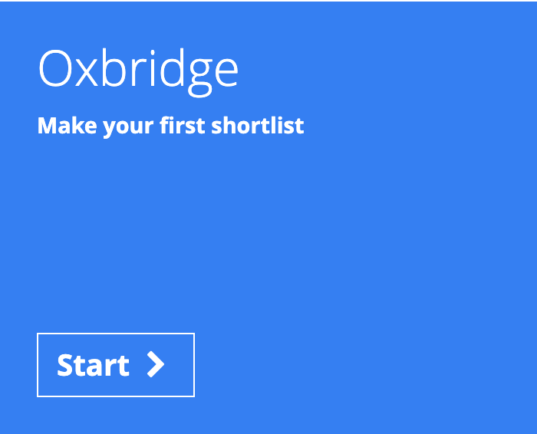
Searching for opportunities

Slide 8
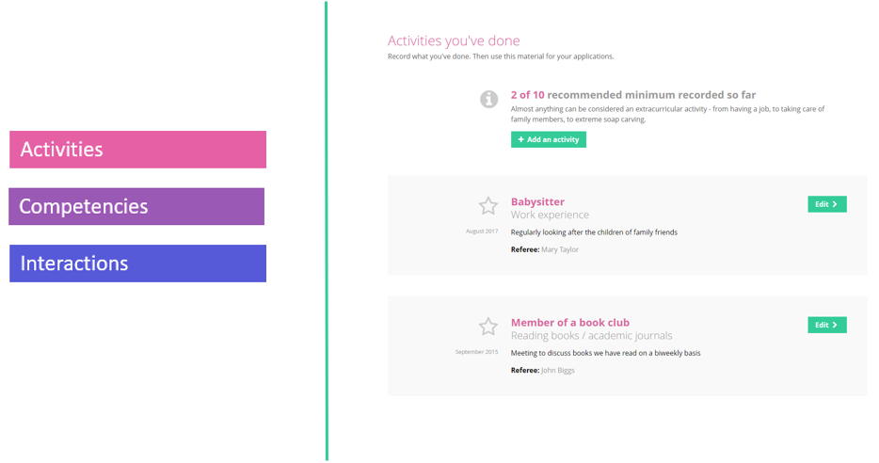
Recording what you have done
Use the tools in this section to start Recording what you have done, using guidance and examples to prepare yourself for making applications

Slide 9
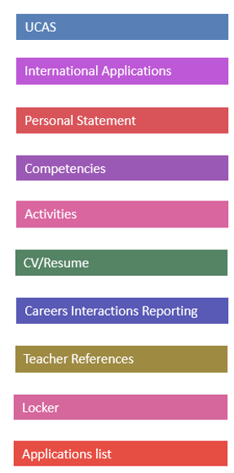
Building applications
Helps you build successful applications
Enables your teachers to give you fast feedback
Helps you manage the key parts of your application materials

Slide 10
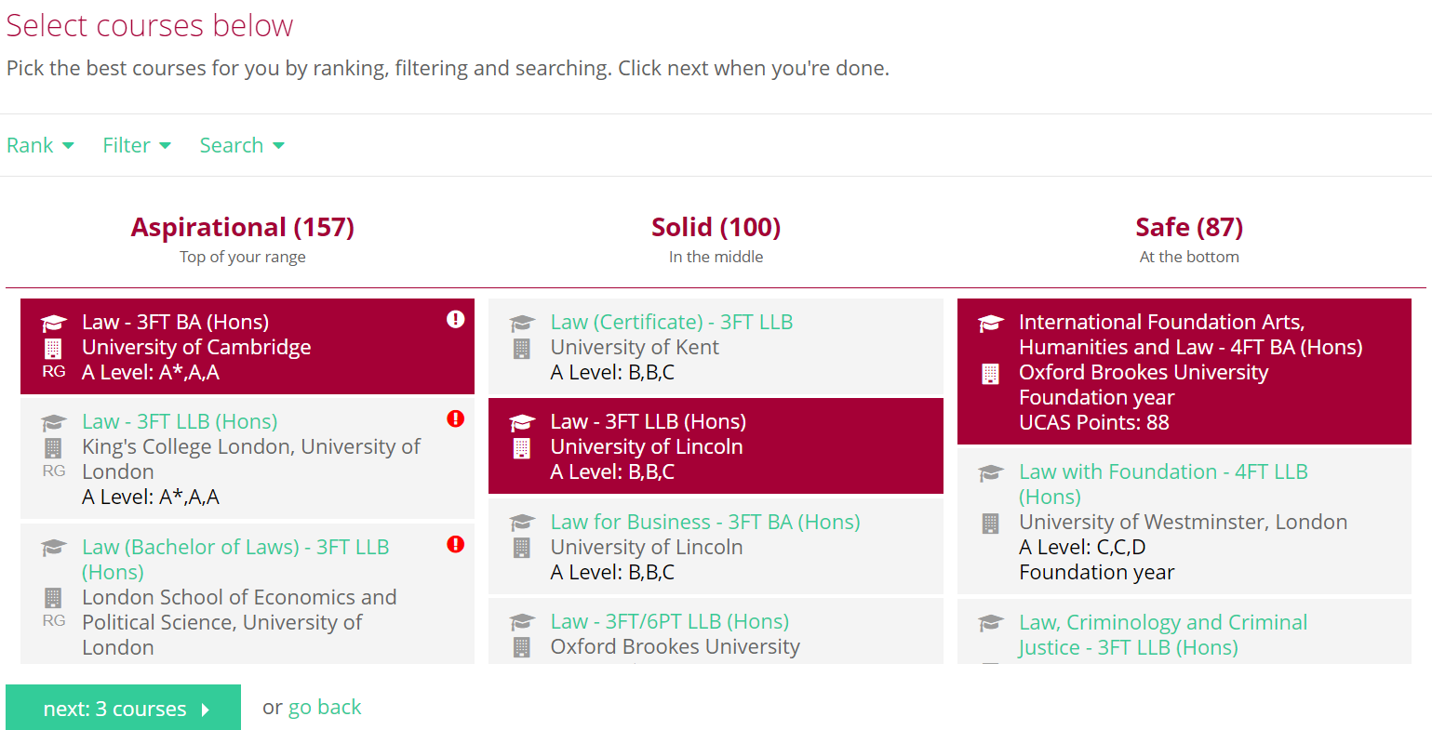
Search Unifrog to find the best university courses for you

Slide 11
Use the ranking and filtering tools to narrow down your university searches

Slide 12
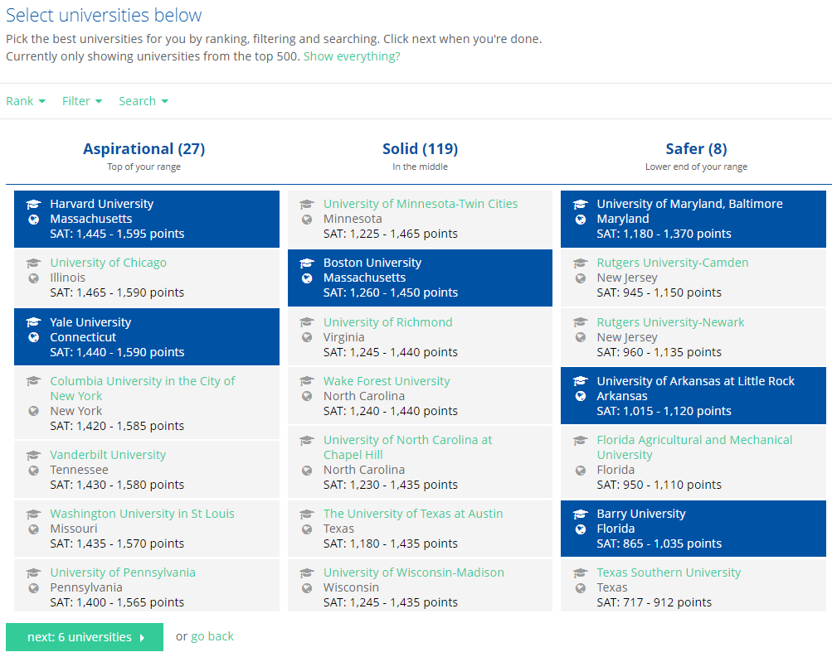
Explore university courses abroad

Slide 13
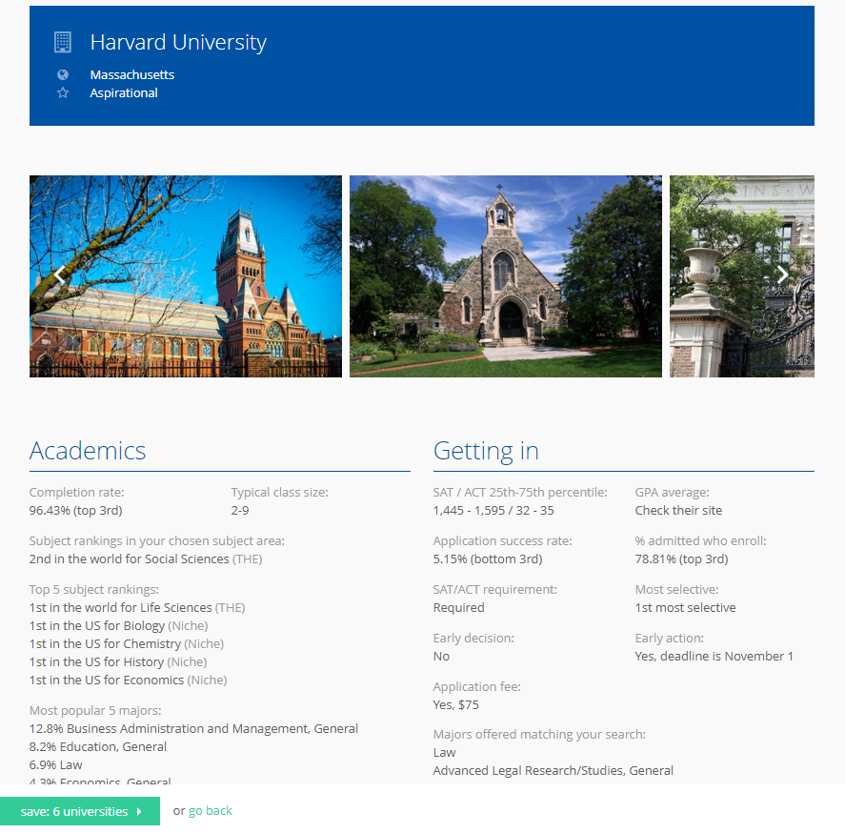
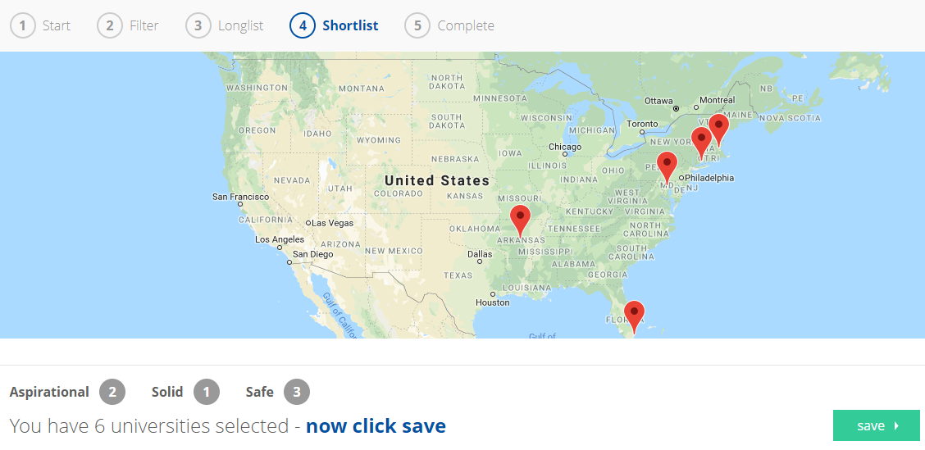
Start reading about the different universities and making shortlists

Slide 14
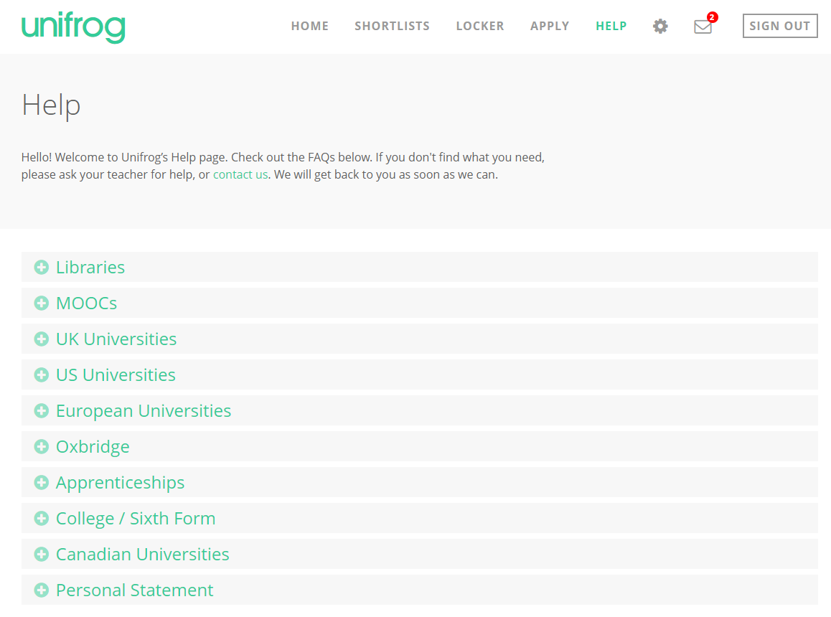
We hope you enjoy using Unifrog!
Use the help section if you need a guide or want some more information about the tools.
If you get stuck, ask your teacher for help!

Slide 15
How can Unifrog help me now?
Explore the subjects you would be interested in studying Post-18 and how these choices can lead to different career paths and further education
Discover and sign up to online courses in areas that you’re interested in
Support in writing a CV and Cover letter
Record key activities and achievements to use in your application

Slide 16
Creating your account
A link has been sent to your school email address (please check your junk/spam mailboxes)
Click the link and follow the instructions
Create a memorable password
Make a note of your password
Notes:
Delete this slide if you are using the form code method. These are instructions for the bulk upload method.

Slide 17
First time registration with Unifrog
When you sign in for the first time, you will use a Form Code which will link you with your Form Tutor.
Notes:
Delete this slide if you are using the student bulk upload method. These are instructions for the form code method.

Slide 18
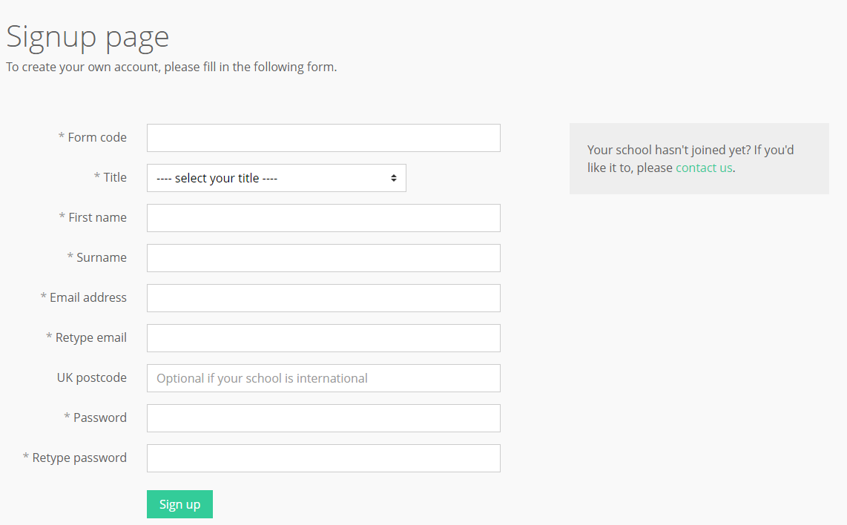
Complete the signup page
Enter your form code and use an email address that you access regularly
Notes:
Delete this slide if you are using the student bulk upload method. These are instructions for the form code method.

Slide 19
Every time you login to from now on, sign in here
If you forget your password, hit the link to reset (remember to check your junk/spam just in case!)

Slide 20
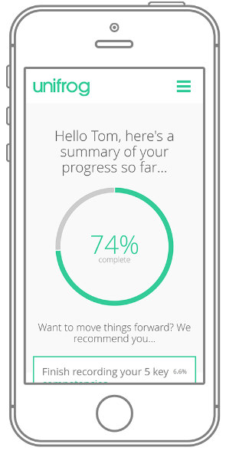
In summary
Unifrog can help you make decisions now about what you want to study and what career path you choose to take
It will help select the opportunities that are right for you
Be smart. Get ahead of the game!
Sign in now at www.unifrog.org/sign-in

