Slide 1
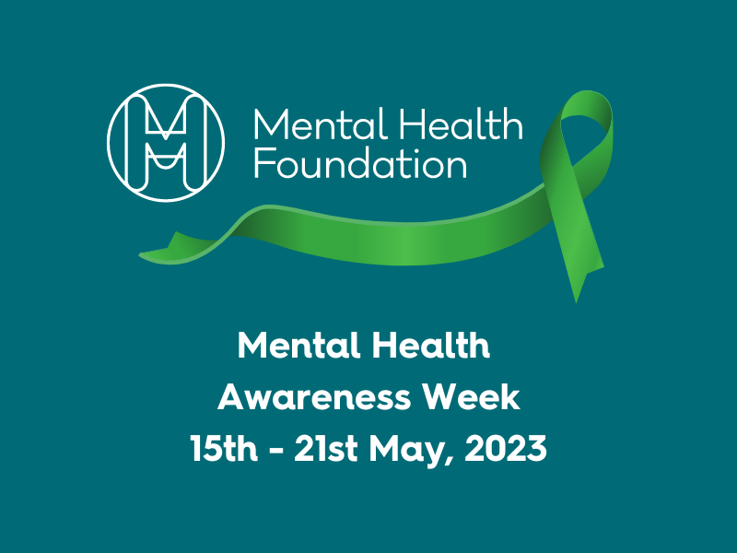
Mental Health Awareness Week 2023
Notes:
Please explain to the students that as part of Mental Health Awareness week, they will be completing some activities in tutor time to help with their general wellbeing.

Slide 2
Mental Health Awareness Week 2023
This week we will be talking about how to manage your emotions.
Sometimes we can experience strong emotions which can make us feel overwhelmed.
Experiencing emotions is all part of being human; it’s the way we manage the difficult ones that can have a huge impact on how we feel.
Let’s look at some techniques!
Notes:
The main message for students is to normalise the fact that we all experience different emotions and that if we experience difficult ones, there are ways of manage them which are very much in their control.
On the next slides you will find 3 ideas around managing emotions. Please choose the one you are most comfortable with the explore with your form. If you don’t feel comfortable or confident with breathing exercises, try the worry exercise instead. Emphasise to students that this is not a one size fits all thing. We all manage our feelings differently and as individuals.

Slide 3
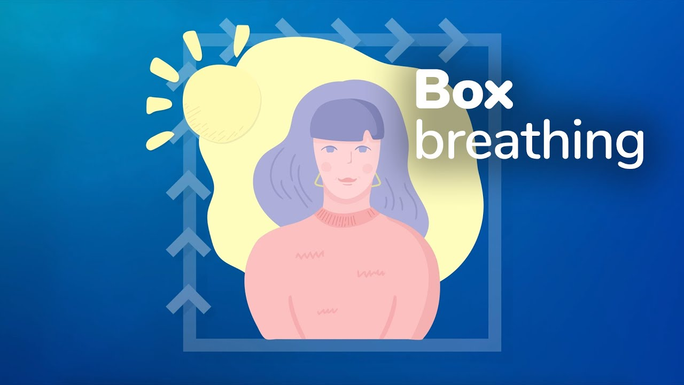
Technique 1: Box breathing
Box breathing is a technique lots of people use
to reduce feelings of anxiousness.
It can help to calm our thoughts and clear our minds in stressful situations such as tests, difficult conversations or trying new things which scare us.
Here is a video which explains how you can do box breathing for yourself ☺
Box Breathing
Notes:
Play the video to students and then encourage them to practise the breathing technique at some point during the week and get them to feedback to you.

Slide 4
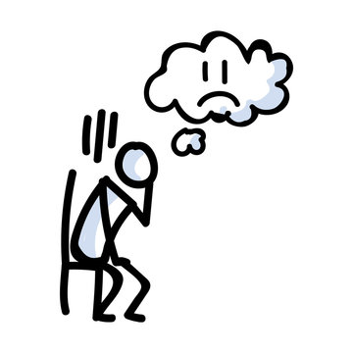
Technique 2: Exploring worries
We all get worried about different things.
Sometimes worries can build into a feeling of stress or overwhelm.
On your own or with a partner, complete the following steps to explore your worry and hopefully…make it feel more manageable!

Slide 5
Step 1: What is something you are worried about?
When you are worried about something, it’s easy to imagine the worst thing that could possibly happen. In reality, these worries may never come true.
What could happen isn’t the same as what will happen.
Notes:
Ask students to think on their own or in pairs about something they are worried about. They do not have to share this with the class. Alternatively, you could model a worry that you have as a teacher and get students to ask you the questions to help them go through a safe and non-threatening example.

Slide 6
Thinking about what will happen, instead of what could happen, can help you worry less. Whenever you start to worry, answer these questions:
What are some clues that your worry will not come true?
If your worry does not come true, what will probably happen instead?
If your worry does come true, how will you handle it? Will you eventually be okay?
After answering these questions, how has your worry changed?

Slide 7
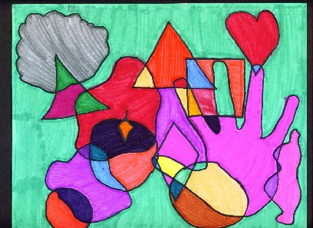
Activity 3: settling thoughts
Sometimes we need to distract our mind from
thoughts which are keeping our mind busy.
On a piece of A4 paper, draw five different shapes of your choice.
Next, draw five more shapes which overlap with the shapes you have drawn to make new shapes.
Finally, colour your shapes. You can do this at a pace that helps you feel settled. You don’t need to colour it all in, maybe you’d rather add patterns or leave parts empty.
While colouring, notice what happens to your thoughts.

Slide 8
Mental Health Awareness Week Competition
We are running a competition this week to increase our awareness around ways to manage our emotions.

Slide 9
Competition time!
You have two options
Create a piece of artwork of a place or of something that helps you feel calm, safe, happy, or you go to /use when you are feeling anxious and it helps to make you feel better
Write a poem about a place or of something that helps you feel calm, safe, happy, or you go to /use when you are feeling anxious and it helps to make you feel better

Slide 10
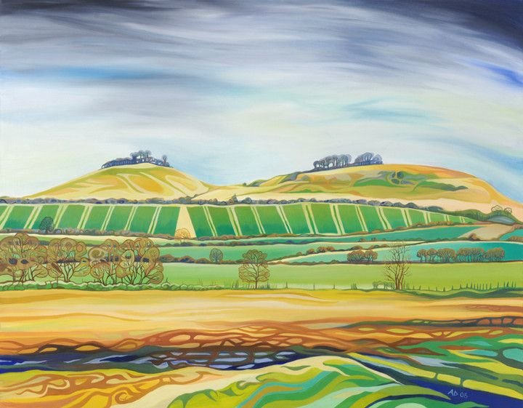
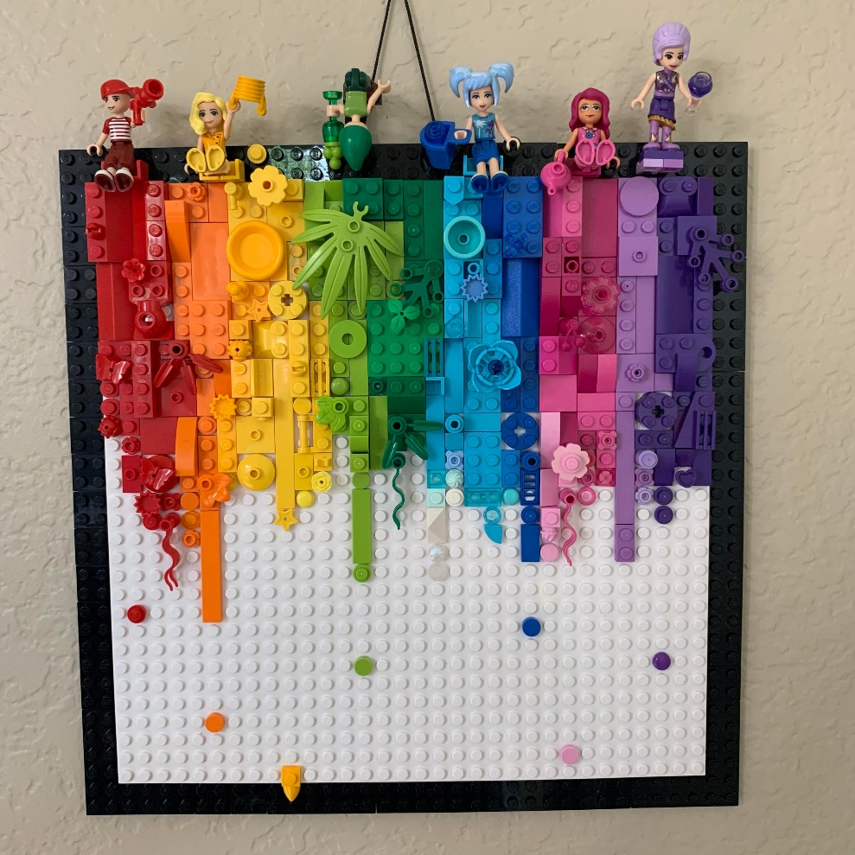
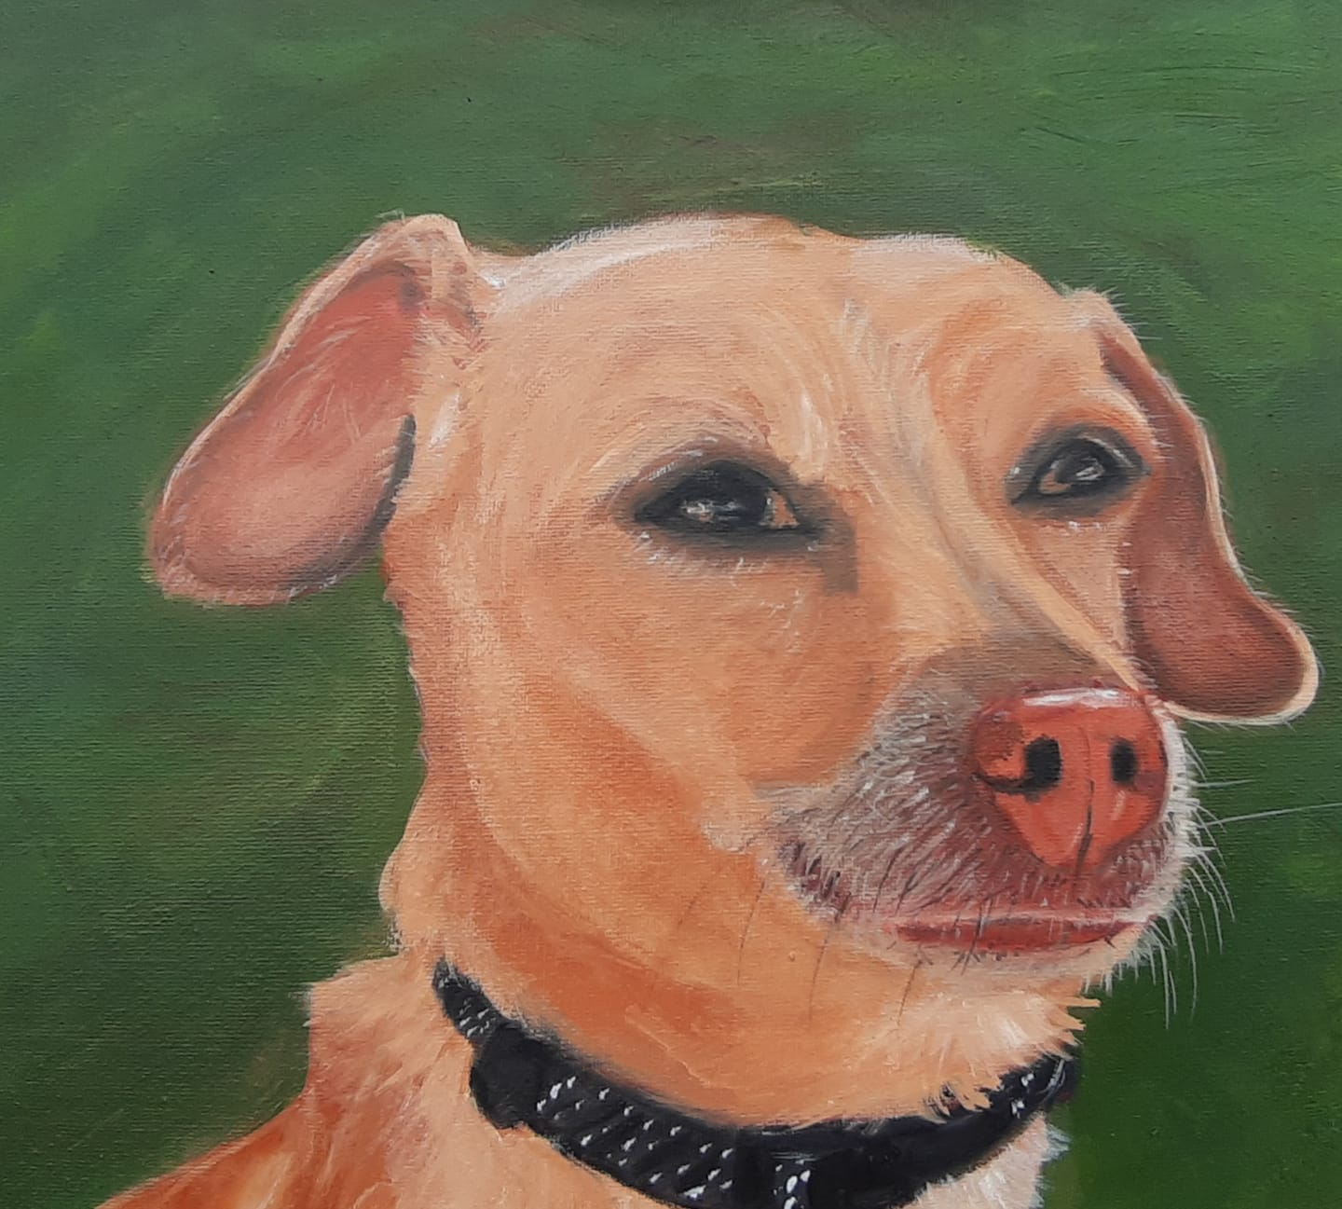
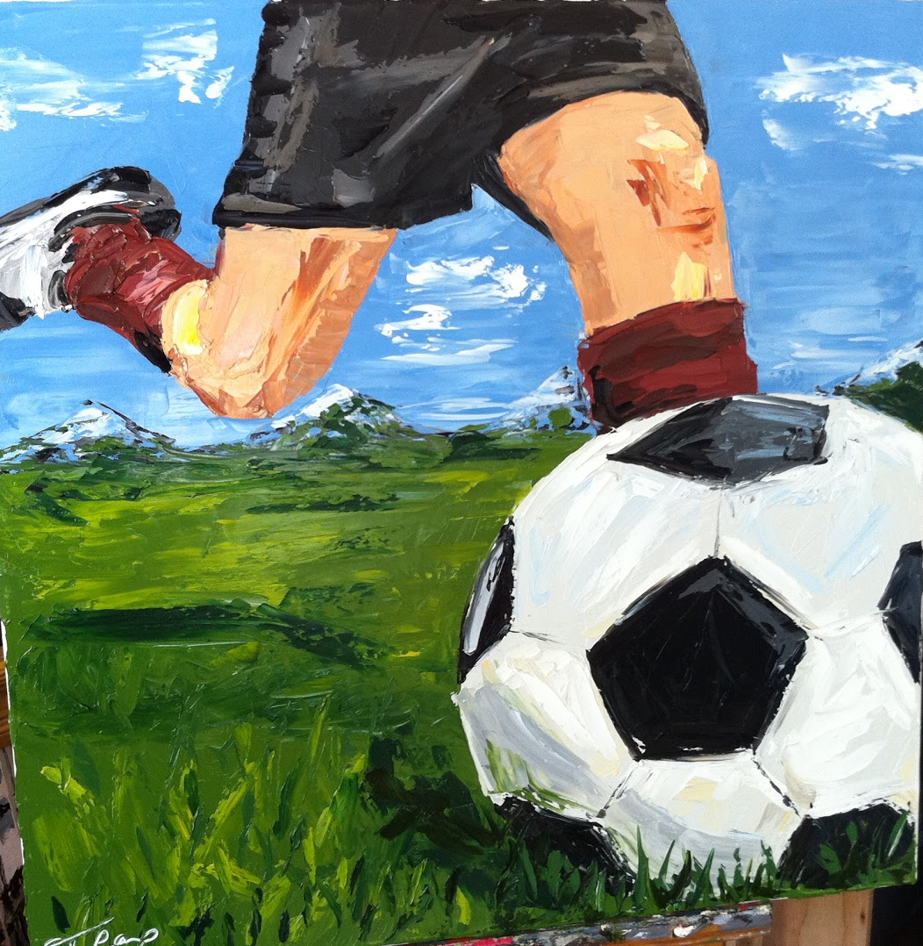
Here are some art work ideas

Slide 11
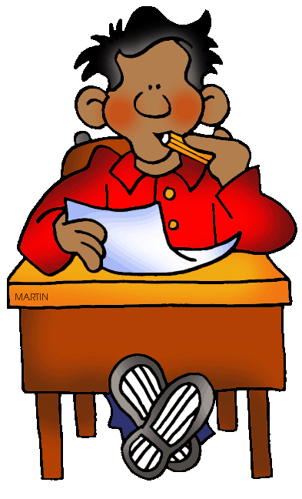
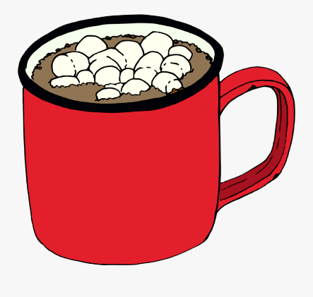
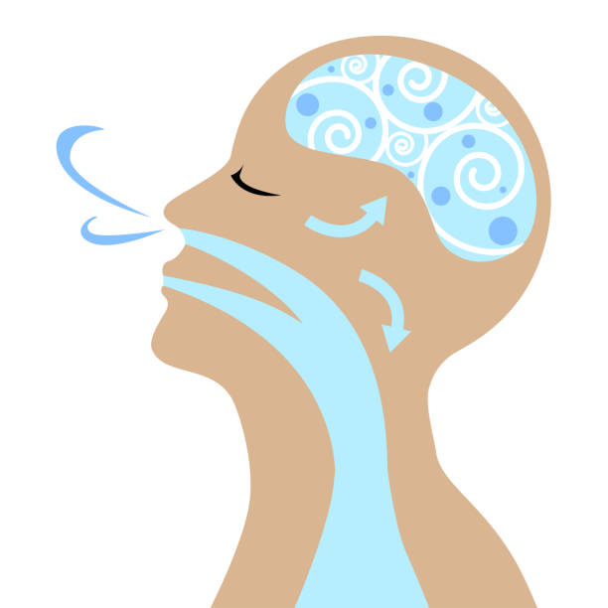
Here are some poem ideas
You could write a haiku – a poem that has 17 syllables in total, 5 in the first line, 7 in the second line and 5 in the third line
Nice hot chocolate | Breathe in through the nose, | Concentrating on
Stills my soul, especially when | One, two, three, four and five now | Seventeen syllable form,
It has marshmallows | Out through the mouth, aaaaah. | I forget worries.

Slide 12
Here are some more ideas
My new power
My heart is racing My breath is fast
I feel it rise inside me I know it’s coming
A tsunami of panic An ocean of fear
Huge breakers that will Crash down on me
Drowning me
But I can stop it
My head is speaking It says “Not Now!”
I breathe in slow, one, two, three And breathe out. Again.
A breeze of stilling An air of calm
The waves get smaller I have learned to
Overcome them
The Notebook
She spills her heart and soul into its pages Ink dapples the paper But it is not ink to her It is her memories and her joys Her fears and her dreams Her secrets and her sorrows One day she will look back on it and remember Until that day it is a time capsule Waiting to be opened.
Panda
Soft fur
squeaky and snuggly
it came from my great grandma.
It is a toy panda
I sleep with it all the time.
When I cuddle with it
I think of her.

Slide 13
Next steps
Submit your entries to Mrs Driscoll W1 by 19th May
House points for all entries
Prizes for winners

