Slide 1
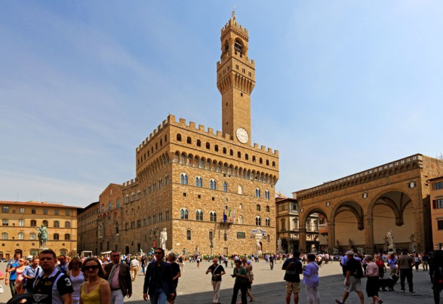
Florence - February 2014

Slide 2
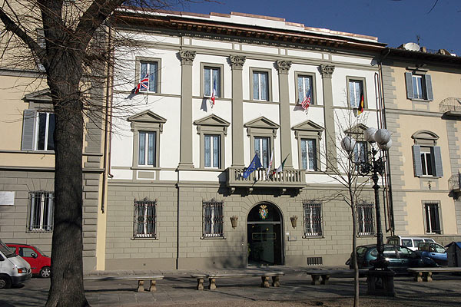
Key Information
When?
Depart Wallingford: Friday 14th February
Meet at 9am for a 9.15am leave
Arrive Wallingford: Tuesday 18th February
Approximately 20.30hrs

Slide 3
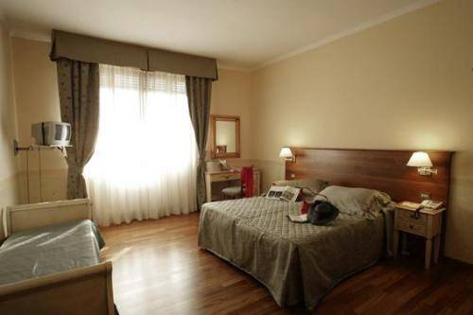
The Hotel
Bed and Breakfast (continental)
‘Multi-bedded rooms’ (3-4 students per room)
All rooms with en-suite facilities
(bath and/or shower, toilet, washbasin, hairdryer & TV)

Slide 4
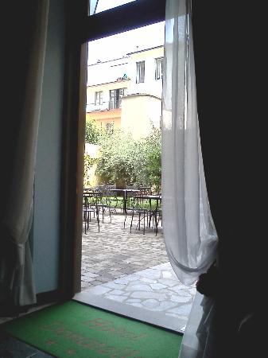
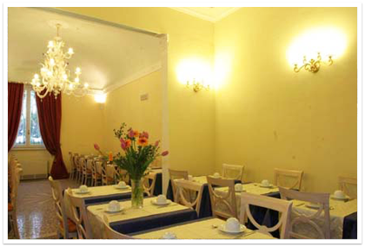
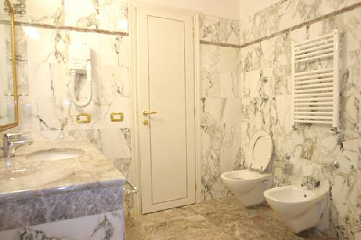
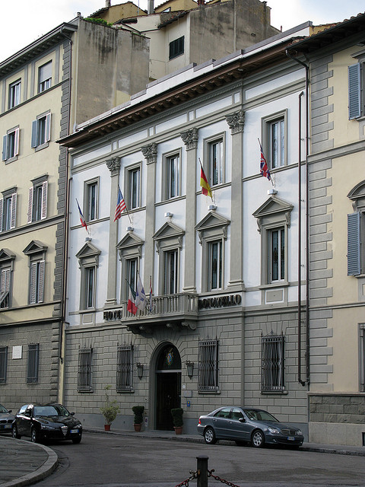

Slide 5
DAY 1 – Friday 14th February
09.15hrs – Coach transfer to Gatwick
11.30hrs - Meet our Tour representative and check in at 11:40hrs
Easyjet flight at 13.40hrs arrival in Pisa at 16.45hrs
Coach will meet group at Pisa (Tuscany) airport and proceed to the Hotel Donatello
19.30hrs - Evening meal in a local restaurant (Trattoria Il Porscopino)

Slide 6
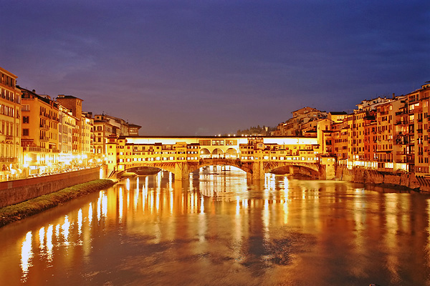
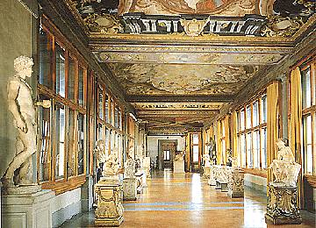
DAY 2 – Saturday 15th February
Breakfast at the hotel
AM
10am Duomo / Cathedral
Ponte Vechio / Shopping / lunch
AFTERNOON
2pm Uffizi Galleria
PM
Evening shopping / food / ice-cream
The group will arrange their own evening meal

Slide 7
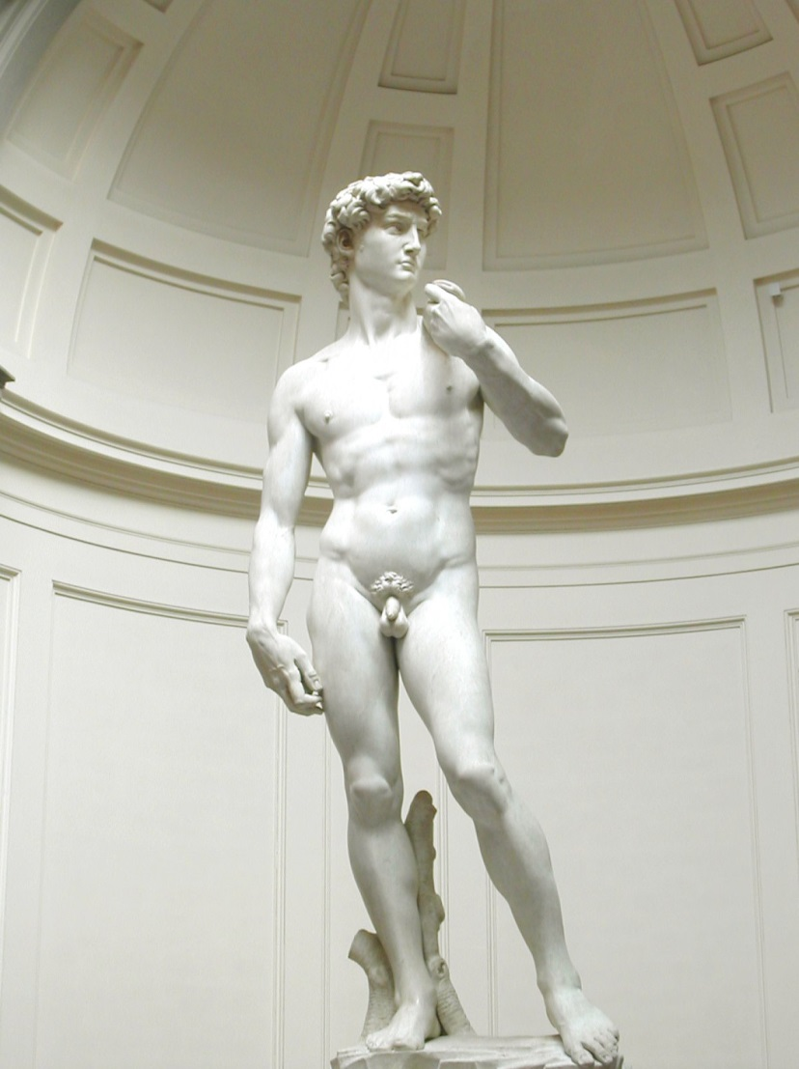
DAY 3 – Sunday 16th February
Breakfast at the hotel
AM
10am Academia Museum
San Lorenzo Market &
Piazza del Repubblica
Free time / lunch
AFTERNOON
2pm Pitti Palace & Gardens
S. Crocce Market
PM
Evening shopping / food / ice-cream
The group will arrange their own evening meal

Slide 8
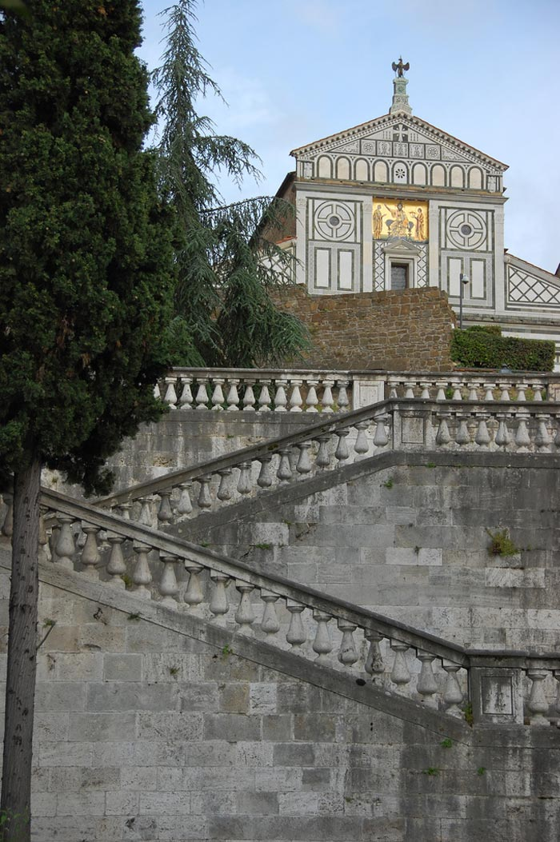
DAY 4– Monday 17th February
Breakfast at the hotel
AM
10am City Site-seeing Bus tour
Piazza Michelangelo (view)
Church di San Miniato al Monte
Fiesole for wander / lunch
AFTERNOON
TBC
PM
The evening meal in a local restaurant at 19.00
(Trattoria Il Porscopino)

Slide 9
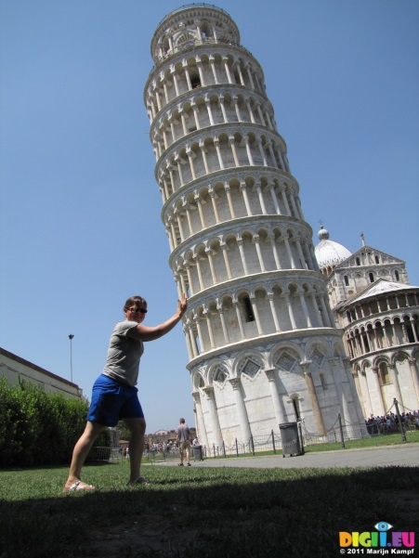
DAY 5 – Tuesday 18th February
Check out after breakfast
Luggage room available
TBC
Free time in Florence for the morning
14:20hrs - Coach transfer to airport.
OR
Early departure and time sight-seeing in Pisa for the morning. 09:00hrs – Coach to collect group from the hotel and transfer to Pisa.
Pisa (Tuscany) airport Check in at 15:20hrs for 17:20hrs flight.
Arrival at London Gatwick (South Terminal) airport at 18:35hrs
Coach transfer from Gatwick to arrive at Wallingford at approximately 20:30hrs

Slide 10
What should I bring?
No bedding required
COMFORTABLE shoes for lots of walking!
Clothes for 5 days to accommodate 3-12 ºC weather… rain / snow / sun
Toiletries (towels provided)
1 piece of big luggage, 1 piece of hand luggage
Spending money
Mobile Phones / Electronic devices ??
Day bag / rucksack

Slide 11
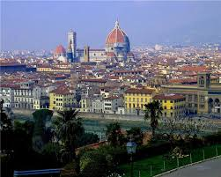
Rules & Regulations?
Minimising Risks
Pickpockets / Beggars
Getting Lost
Emergency Numbers
Passport / EHICs / Medical Forms
Medicines
Alcohol / Smoking
Hotel Rooms
Internet
Behaviour

Slide 12
This Evening?
Hand in Passport
Hand in EHIC Card
Hand in Medical Form
Ask any Questions
Collect Information Pack

