Slide 1
My emotions and Me
Ways we can respond to our emotions; instead of reacting to them

Slide 2
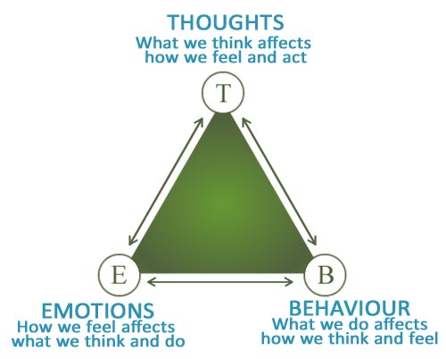
What have we done this year?
how to name our emotions
how to make links between our emotions and the thoughts they can create in our minds.
We have also looked at the Emotions Triangle, of thoughts, feelings and behaviours.
Next steps
4. tools to help develop ways of responding to our emotions, rather than reacting to them straight away. These tools can help us to understand and manage our emotions more effectively.

Slide 3
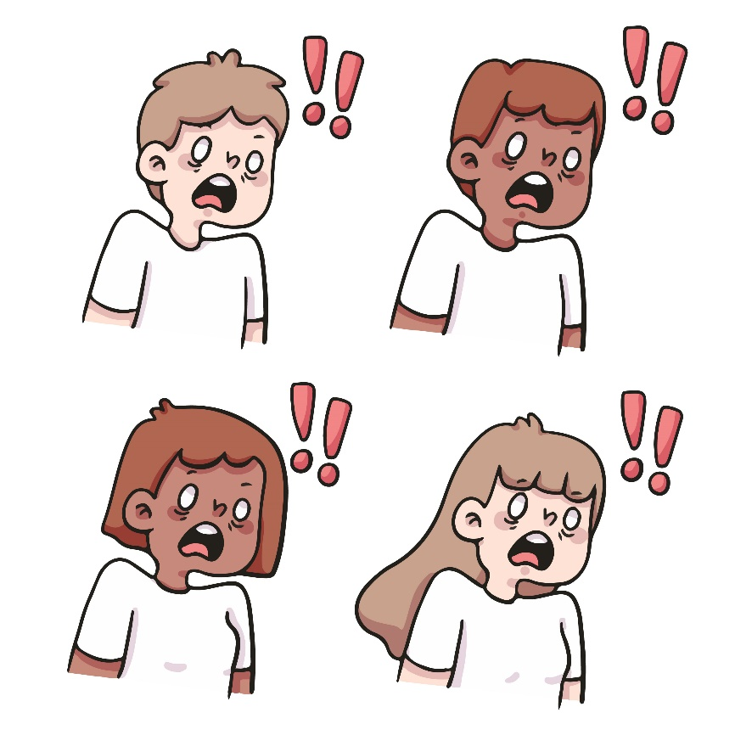
What is the difference between responding and reacting?
Reacting
– acting as soon as you feel an emotion
Responding
–when you feel an emotion, taking a deliberate pause and giving yourself time to choose an appropriate response for the situation you are in

Slide 4
We experience a lot of emotions every day
Some are comfortable emotions
Some emotions are more challenging
Some we may not be aware of while we are experiencing them
Some we “feel” very strongly while we are experiencing them

Slide 5
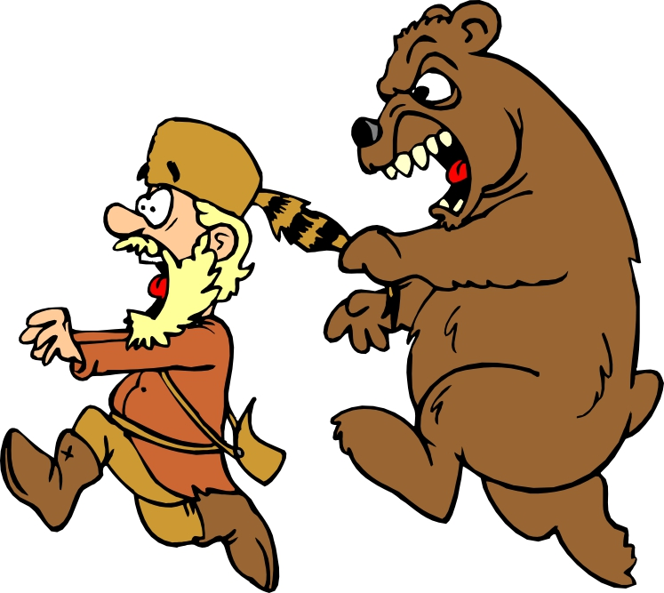
Responding and reacting
It is completely natural to feel a strong urge to react when we feel a strong emotion.
Sometimes this strong urge to react keeps us safe, for example if we are in danger and need to remove ourselves from a situation quickly.
However, sometimes a quick reaction to a strong emotion can have more negative consequences, for example, getting us into trouble because we didn’t take time to stop and think before we acted on how we felt in the moment.

Slide 6
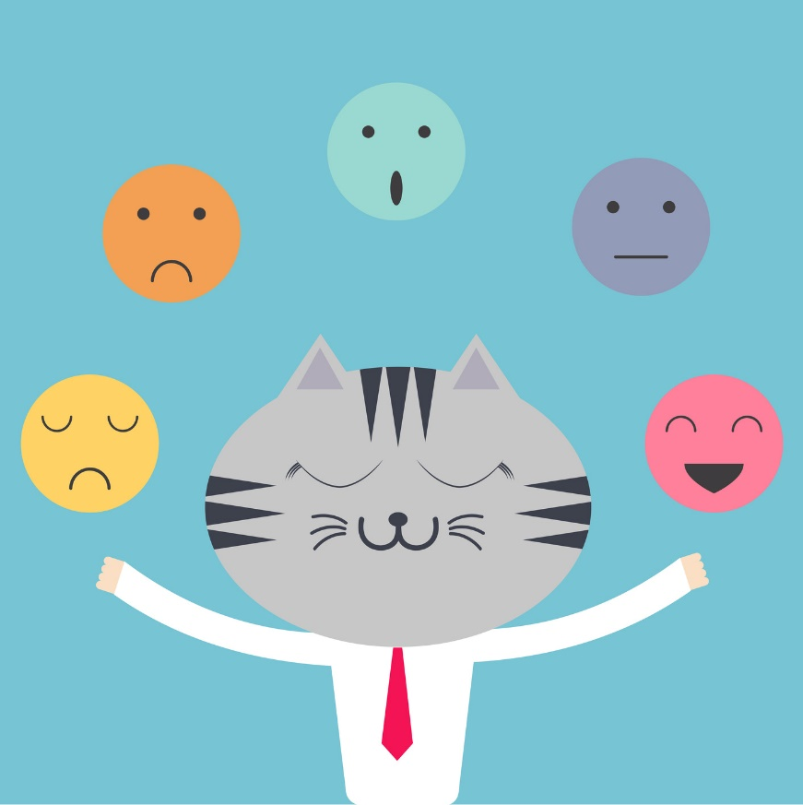
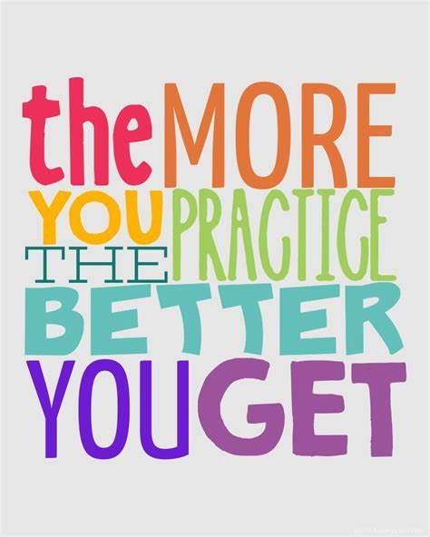
Being able to manage our emotions is called “emotion regulation”.
manage our emotional reactions in ways that work well in the long-term
grow our capacity to respond to emotions, rather than always react to them

Slide 7
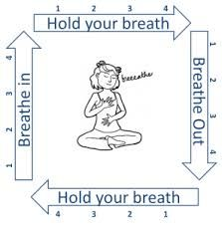
The Power of NOT Reacting - How To Control Your Emotions (youtube.com)

Slide 8
Some things we can do to grow our ability to respond rather than react are:
Counting slowly (1..2..3..)
Taking five deep breaths
Asking to take a break if you can
Asking to speak to an adult you trust if you can
Colouring or drawing
Getting a drink
Talking to a peer supporter at lunchtime
Listening to music
Can you think of any more of our own ways of calming your system so you can respond?

