Slide 1
Wallingford school
15th November 2019

Slide 2
Agenda
Who we are
Valeo Foods Goals
Internal Factors
External Factors
Q&A

Slide 3
Who we are

Slide 4
Who we are
Amy Robinson, Category Manager
Matthew Firth, Category Manager

Slide 5
Valeo Foods

Slide 6
Business Aims
3 year & Annual Goals
Sales value & volume
Profit
Department Goals:
Market Share / Number of Buyers
Customer satisfaction
Health & Safety Targets
Tracked & measured monthly

Slide 7
Foundations for Success
Developing our Teams
Keeping customers happy
Expertise in honey
Investing in our brands
Keeping Shoppers happy
Notes:
Ability to motivate, train, develop employees - AR
Delivering good customer service to our direct customers – measuring through delivering orders on time in full
Reviewing consumer satisfaction through monitor consumer complaints and queries and meeting consumers needs through launching new products
Over 80 years expertise in honey - MF

Slide 8
Internal Factors

Slide 9
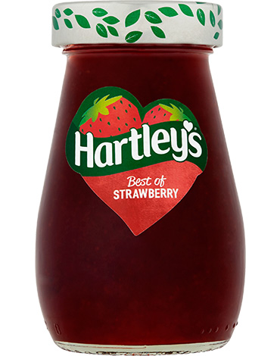
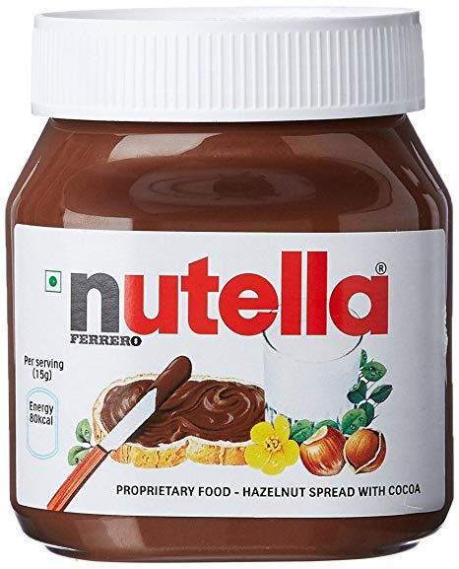
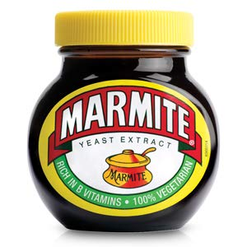
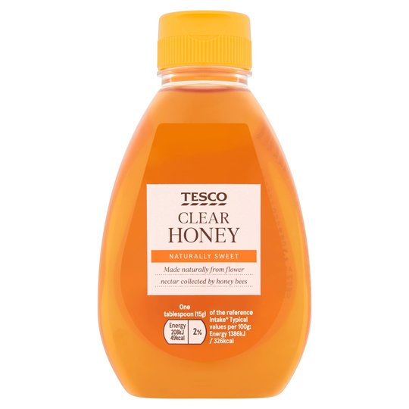
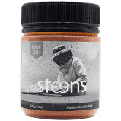
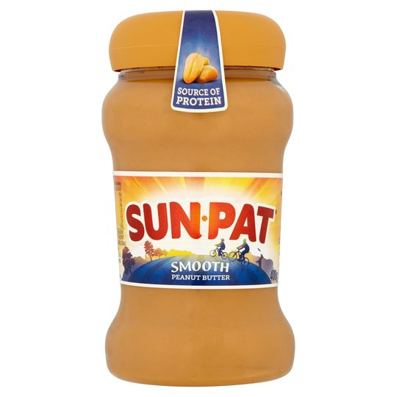
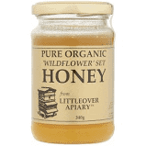
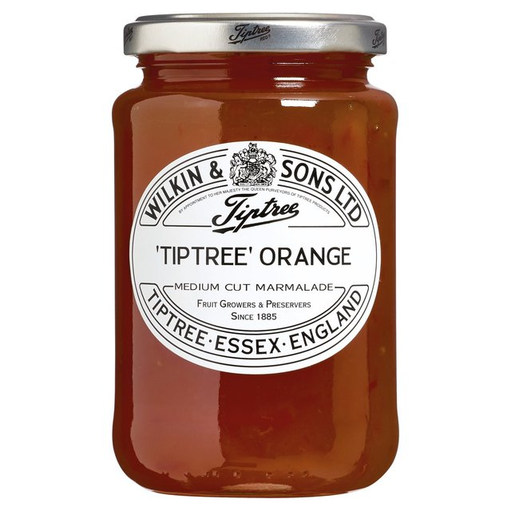
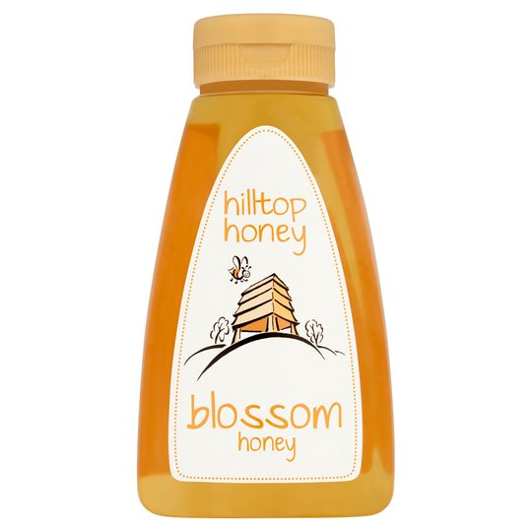
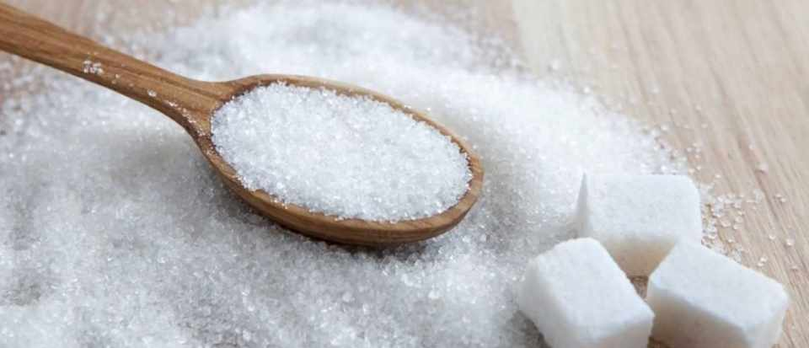
Our competitors
Honey
Breakfast
Notes:
Competitors – direct & indirect
New entrants > Hilltop launched into the market 5 years ago…as speciality honey…we did see some sales loss as a result
Changes by current competitors > Launch into new segments (Hilltop launched Manuka – after 12 months they then changed their range & product pricing = we need to keep close to changes as they could and do impact our own sales

Slide 10
Our customers
How we keep them satisfied:
Service Levels
Category Insight & Recommendations
Quality Control
Investment in promotions
Launching NPD
Communications Support
Brand growth

Slide 11
Planning
Matt to insert chart
3 year planning cycle
Category Vision

Slide 12
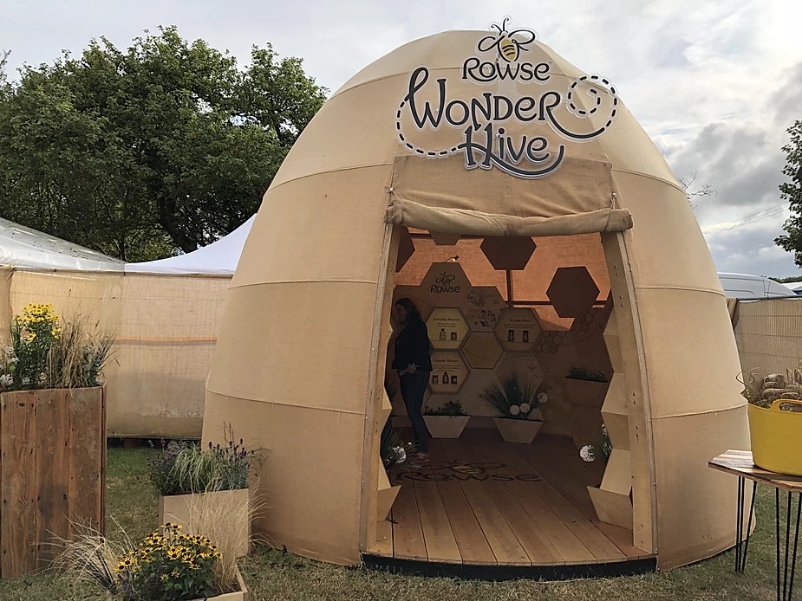
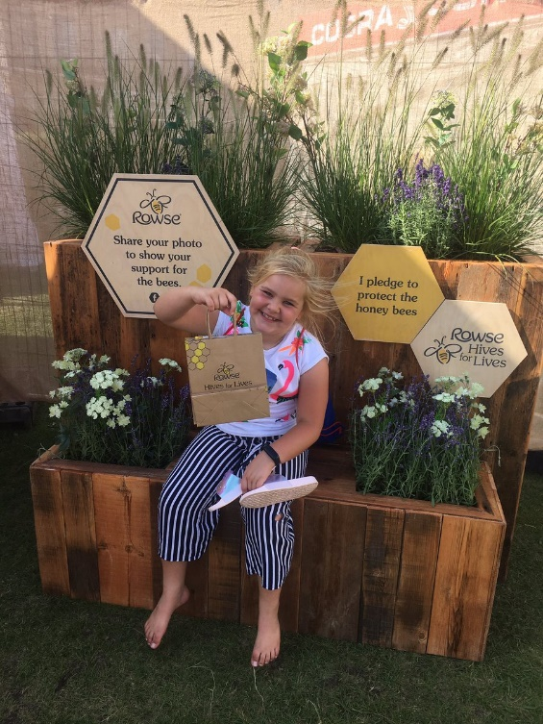
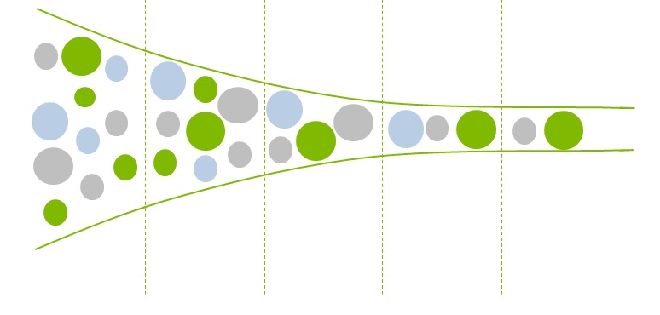
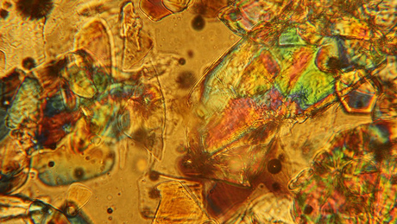
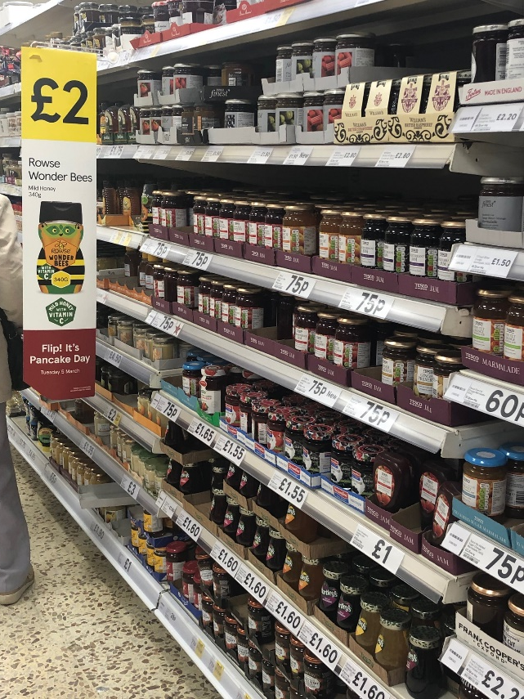
Rowse Brand – Drivers of Growth
Innovation Pipeline
Advertising & Promotional Support
Idea
Concept
Test
Refine
Launch
Notes:
Include Promotion & Advertising: CA
TV support
Social Media
Sampling
Price promotion to drive people to pick us up and helps us get out of aisle and onto end so more people see us and pick us up

Slide 13
External Factors

Slide 15
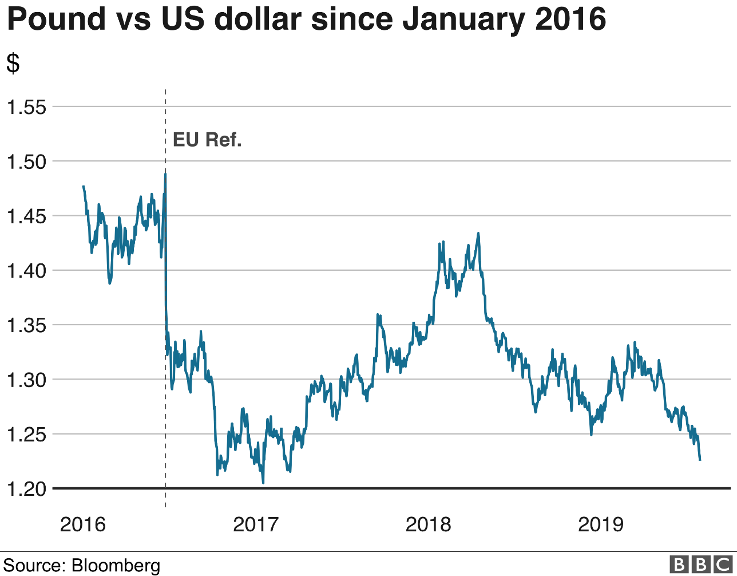
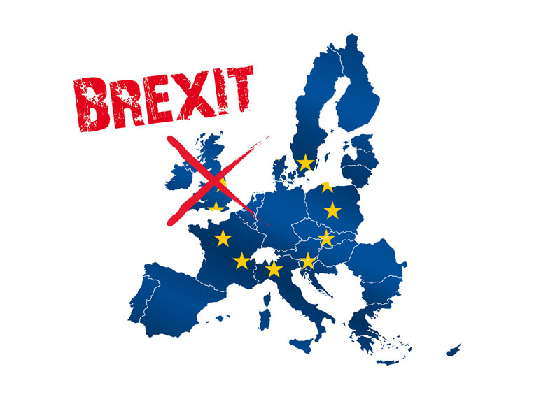
Political & Economic
Notes:
Why do you think Brexit has impacted our business?
Currency & Costs > Impact on raw materials – choice we absorb the cost (make less profit) or we pass it on – which would mean higher prices for consumers at shelf
We do a lot of work to understand what we think will be the best outcome (as just putting up prices will mean some people choose not to buy us – so volume drops)…and less profit

Slide 16
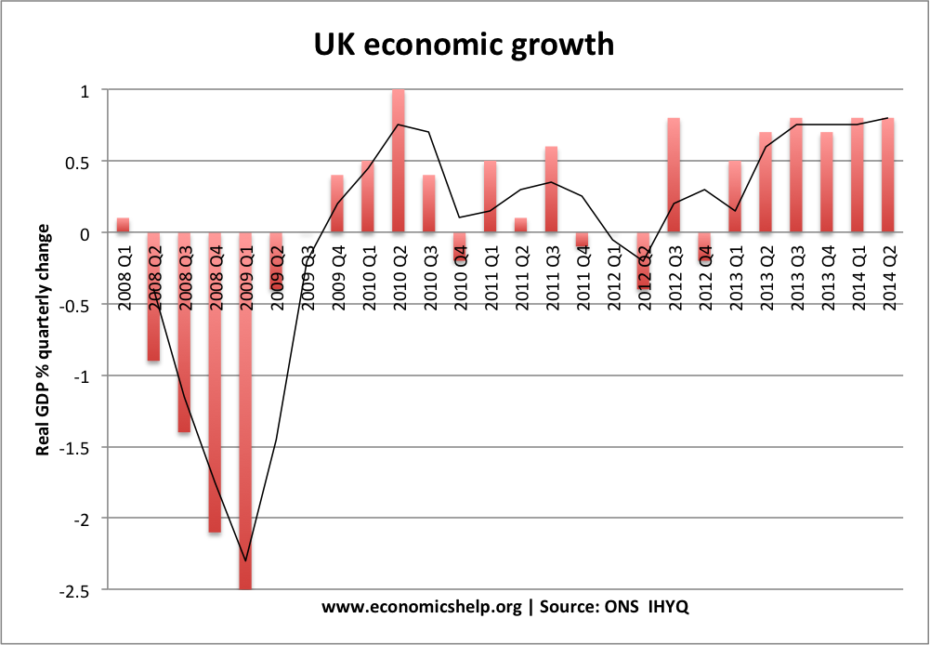
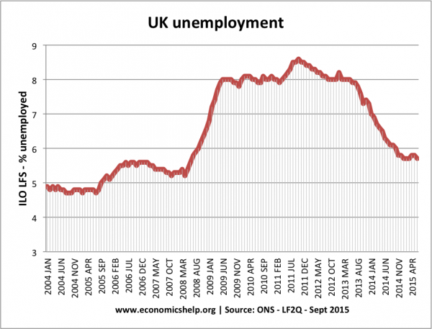
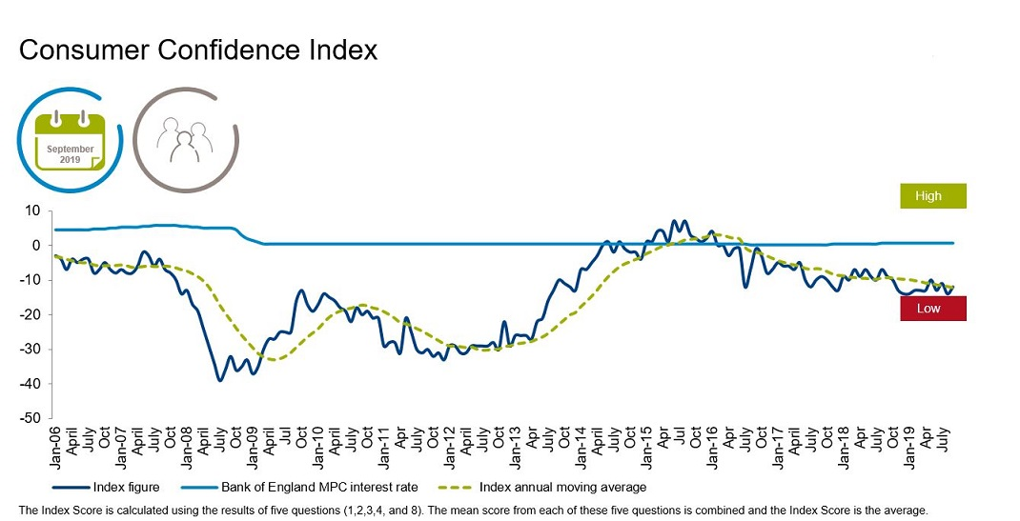
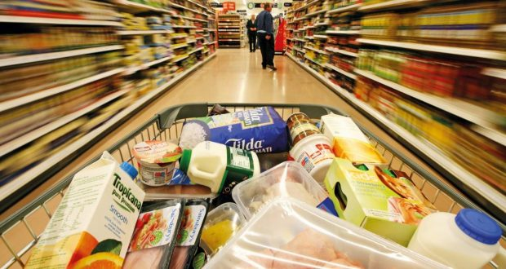
Social
Amy to add IGD charts
Notes:
Headline - Economic Growth & Unemployment levels and consumer confidence all impact people shopping habits
Impacts shopping behaviours (people may try to reduce amount they spend on grocery shopping – buying whatever is on promotion, swapping from brand to PL, cutting out non essential items)

Slide 17
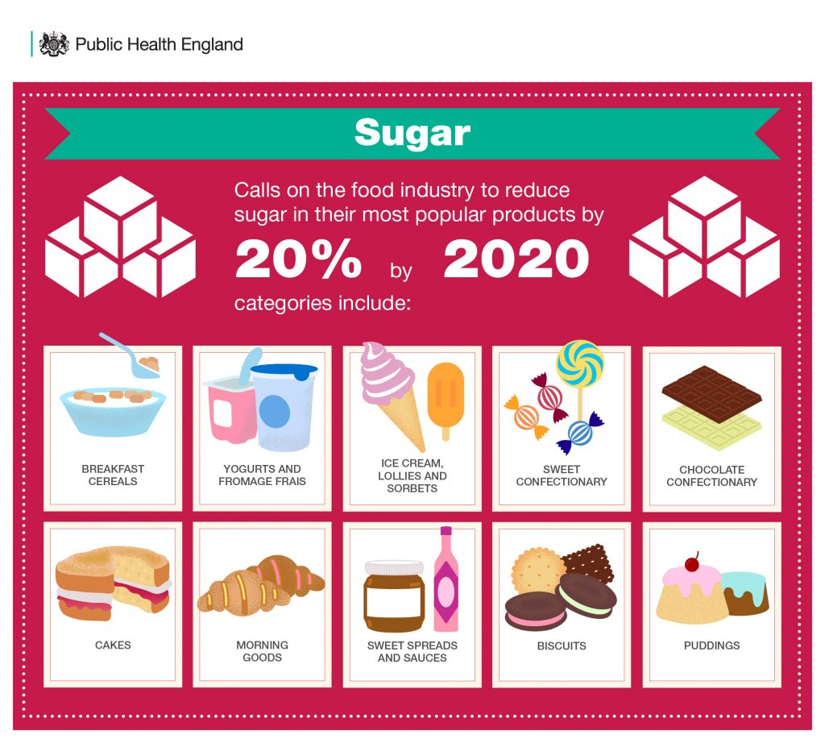
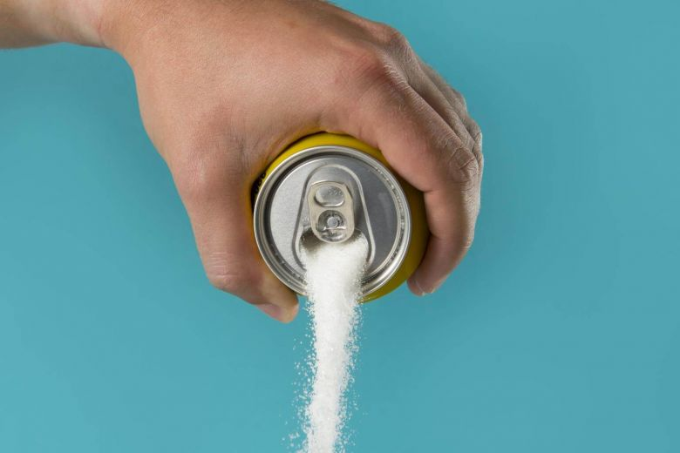
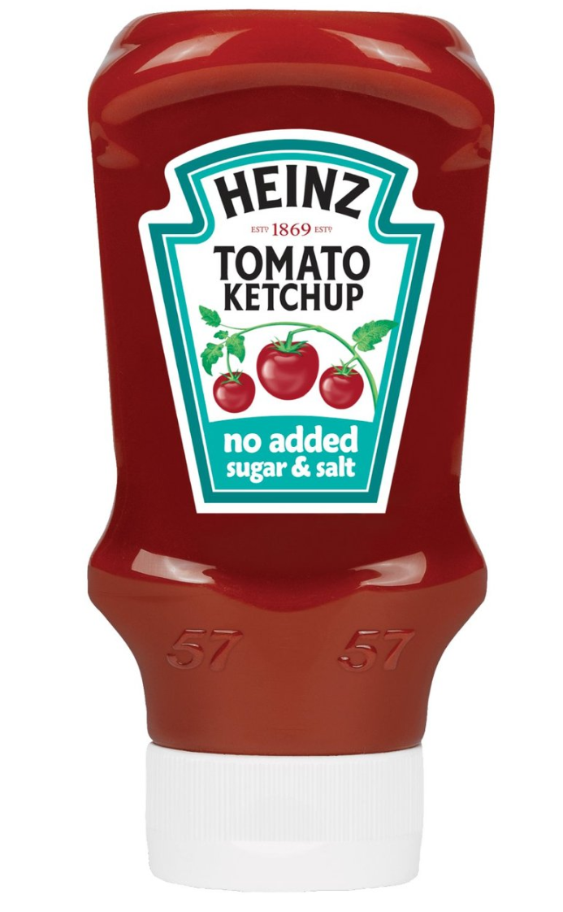
Social – Sugar trends
Notes:
Sugar reduction is a macro trend having huge impact on food and rink but not yet effecting spreads / honey category sales
Added sugar is the focus – with Public Health England setting targets for manufacturing to reduce sugar content.
Result has been manufacturing launching products such as Heinz bringing a no added sugar and salt ketchup and Cadburys launching Dairy Milk with 30% less sugar
Honey is a natural sugar – its natural product (we cant change how bees make this!) – it’s a bit like fruit in that way.
We need to keep in front of mind for driving our brand forward and anticipating consumers needs in our category.

Slide 18
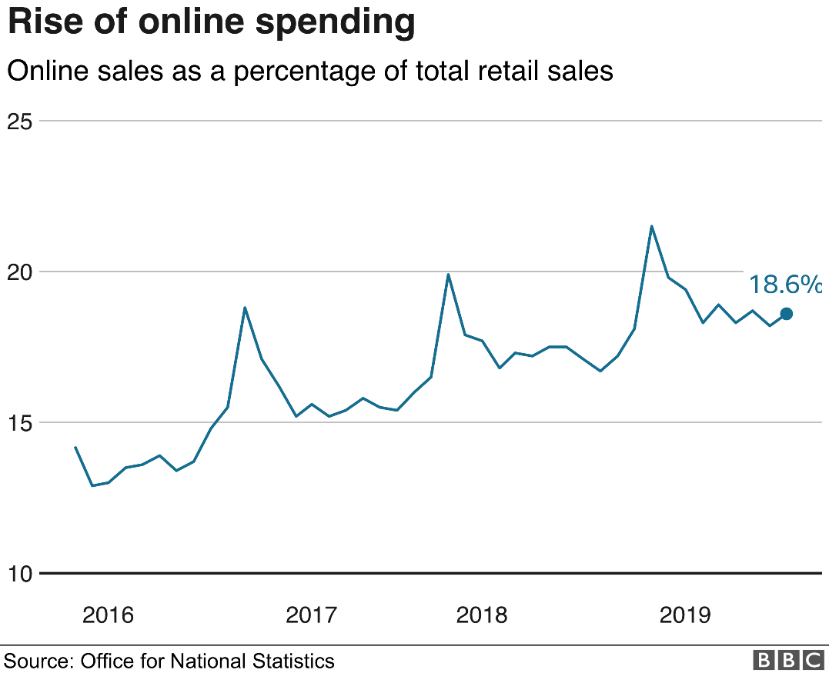
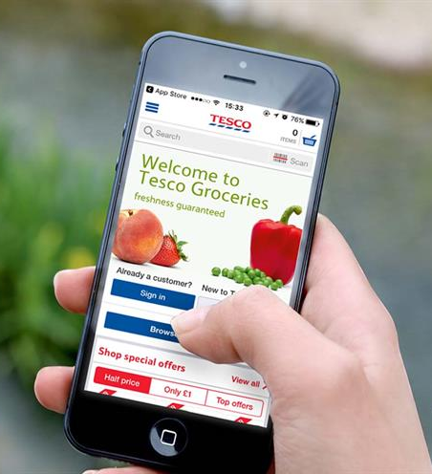
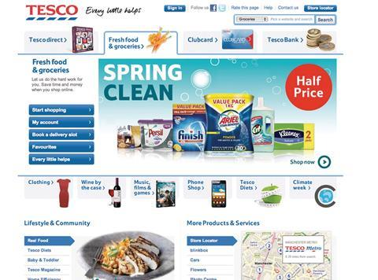
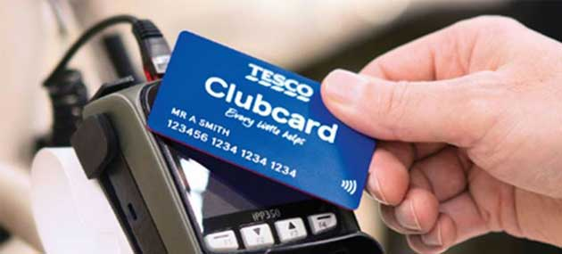
Technology
Growth of online shopping
Increasing ways to shop
Ocado – a technology company
Amy include Ocado – see themselves as technology company not a grocery retailer
Notes:
Growth of online impacts our business
There are now more ways than ever to buy honey….on your phone…on a website…and more ways to understand our shoppers too (through the likes of Clubcard data – which enables us to target shoppers and understand who is buying each of our products)
Ocado – consider themselves a technology company not a grocery retailer…this informs how they work and there expectations of how we work with them (Amy to expand)

Slide 19
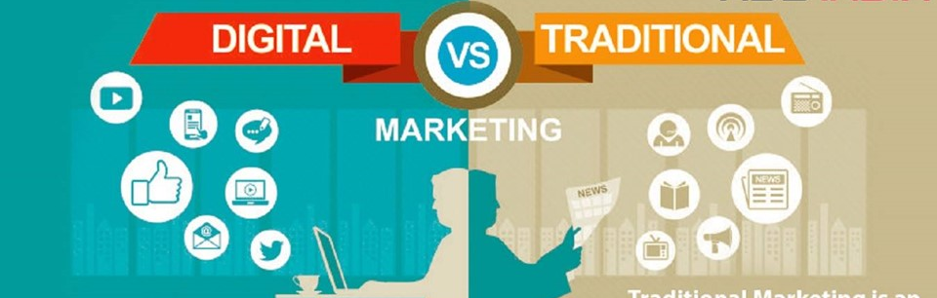
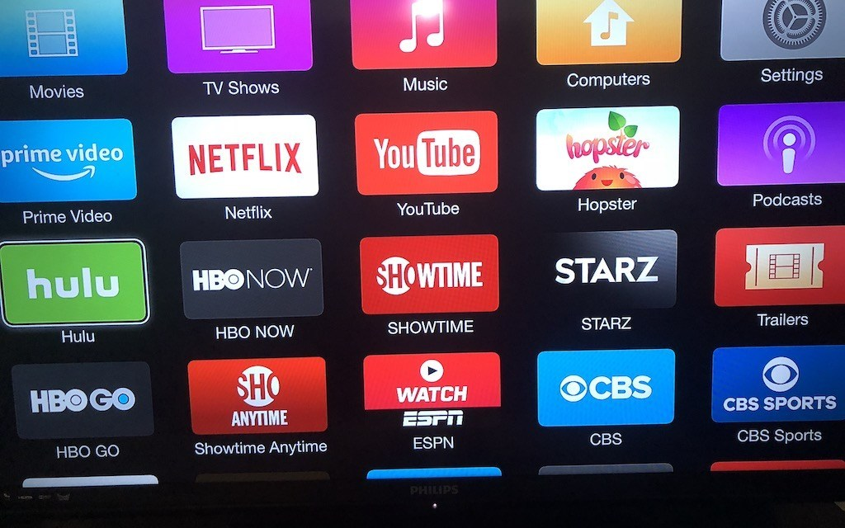
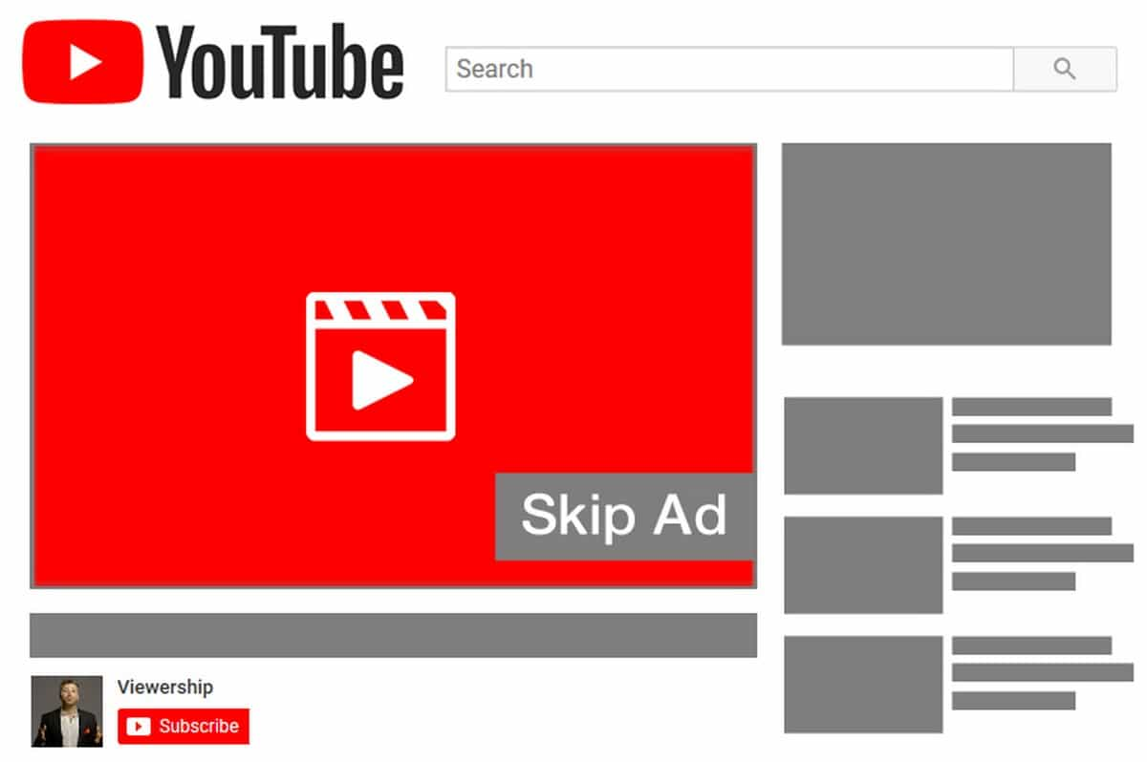
Technology: Increasing ways to talk to consumers
Notes:
Changing consumer media – twenty years ago traditional media was king (TV, radio, newspaper & magazines) – with the changes in technology we now have many more different ways to reach consumers (ie social media, digital ads – served on your mobile, laptop, email – targeted to you based on search terms or purchasing habits and Video on Demand – serving ads before on demand content such as ITV Hub or YouTube)
But we will need to see how TV habits change – with the growth of platforms such as Netflix which you cant current advertise on.
We work with media experts to monitor these trends and make recommendations of how we can best reach our target consumers

Slide 20
Legislation
Notes:
Suggestion to focus on two:
GDPR – treating peoples data correctly (impact on employees data, consumer data, supplier data etc)
Pension – auto-enrolment impacts benefits to employees and becomes a cost of business
Other examples:
Public Health England > Remove?
Product and Packaging
Brexit > Could drive new import and export tariffs and Dutys:
If HARD Brexit – we move to World Trade Tariffs which are higher than we have under the EU, so we’d pay more duty which means our costs of producing a bottle of honey go up > choice, increase cost or take hit on profit

Slide 21
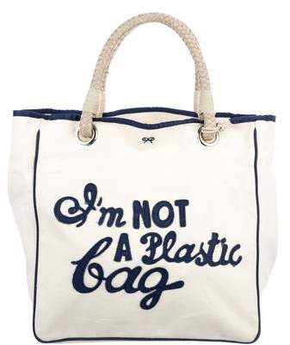
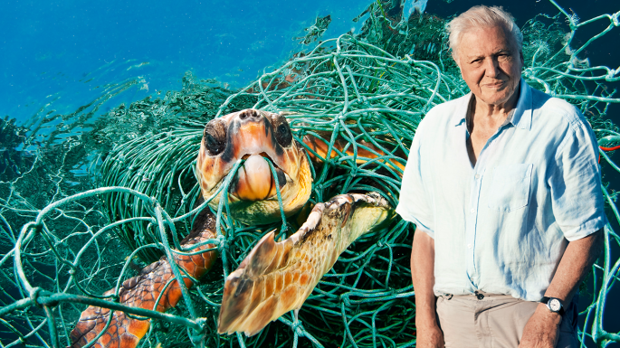
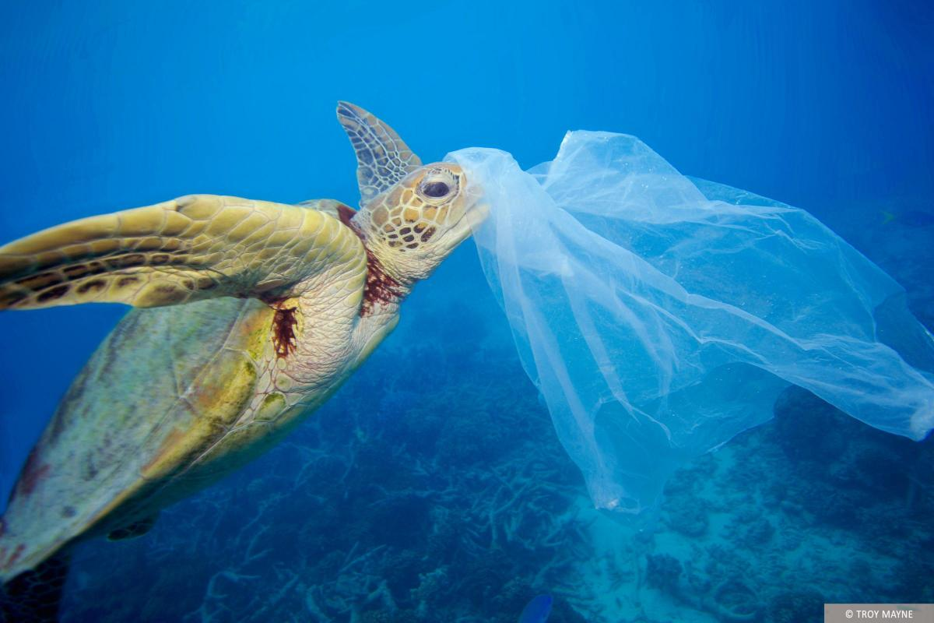
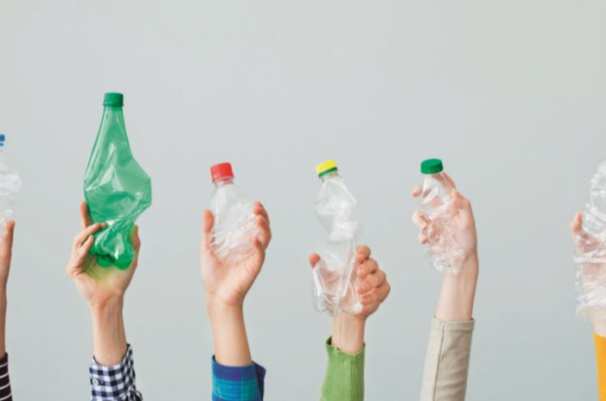
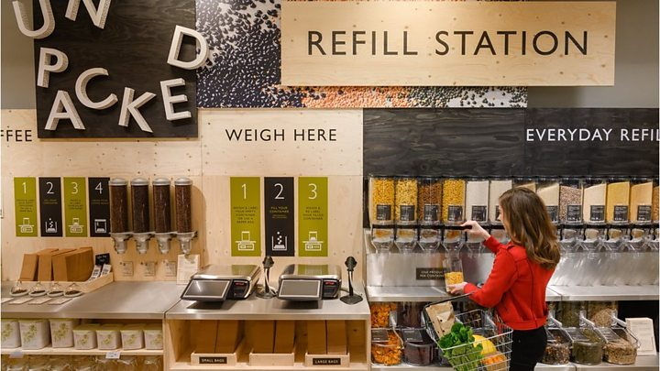
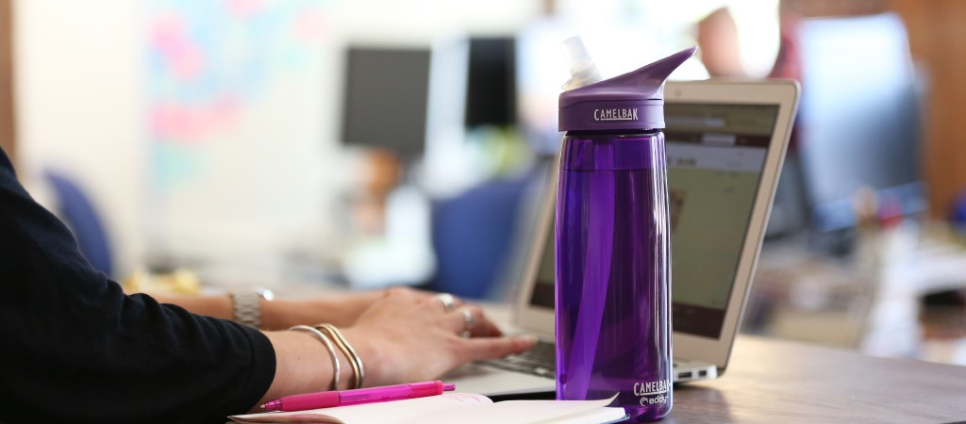
Environmental
Plastic
Notes:
Plastic is a key environmental factor facing all business > with growing focus from shoppers & customers to improve sustainability of packaging & products
Key habit changes we have seen the last couple of years:
Move away from plastic shopping bags – with being trying to have resuable bags
Many companies dropping the use of plastic straws – particularly hospital industry (restaurants and hotels etc)
Increase in the uptake of reusable water bottles – a switch from single use plastic bottles
We’ve also seen this week the introduction of Unpacked section in Waitrose Wallingford – helping shoppers to remove single use plastic from their shopping trips
Valeo Foods Headlines TBC:
Currently we recycle x%
We offer consumers a choice – glass and plastic bottle
Our plastic bottle is recyclable
We are removing PVC from tamper evidence on jars
Exploring how we can improve recyclability of our products
Zero to landfill?
Benefit of moving to Great Bear?

