Slide 1
We’ve heard a lot about Personal Statements…..
……..now we’re ready to write!

Slide 2
Personal Statements are important because…
For the majority of courses it is your only opportunity to speak directly to the person making admissions decisions
It can be used as a basis for an interview
It allows you to provide evidence of work experience and additional activities you’ve done to support your application
It will also be used when considering ‘near miss’ applications

Slide 3
Imagine you are being interviewed…
Why do you want to study this subject, and what makes you the right person for the course?

Slide 4
What do admissions tutors look for in the PS?
A rounded picture to show that you are a suitable candidate for the university both academically and socially
Reasons for choosing the course
Subject specific skills
Enthusiasm for your subject
Any work experience, placement or voluntary work
Career plans
Motivation and commitment
Gap year plans
Extra-curricular hobbies and interests
Why you? What can you offer?
Transferable skills
Notes:
Explain the job of an admissions tutor – ultimately to ensure that they get like-minded, motivated and passionate students who will enrich the academic community, or more cynically, to ensure they get students on their courses who will cope both academically and socially with University and that won’t drop out. Reputation is very important to prospective students and admissions staff wouldn’t want high drop out rates which would affect the course/institutional reputation.

Slide 5
Page 21 – fill in the top box
Eg.
Drama – practical work on Tennessee Williams/ Arthur Miller – inspired interest in American Writers

Slide 6
Now fill in the two boxes under

Slide 7
Page 22
School trips you have been part of
Trip to Florence, Rome, French/German exchange, ILYMUN…

Slide 8
Page 23

Slide 9
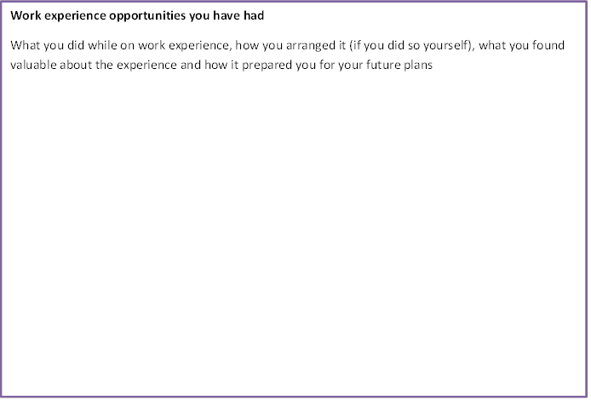
P24

Slide 10
Getting started - 47 lines, approx. 600 words
80 % Academic
Why do you want to study the course?
Academic interests
Your life/work experience, skills and achievements
Summarise why you will be a good choice
Notes:
Your statement can only be around 600 words long – 4,000 characters, or 47 lines.
Most RG/competitive Uni’s are looking at the majority of your PS to be about the academic side of things. Oxbridge prefer the whole statement to be academic.

Slide 11
University website
Visit Open Days
University prospectus
Staff
Why this subject?
Course brochure
Prior knowledge (A-Levels)
E-mail admissions tutors
UCAS
Notes:
Why do you want to study this subject – you may know you love it, but how do you start articulating it? Looking at websites, course brochures can be useful.
Don’t be scared to email admissions if you have queries or questions about the course. This may help you with decisions.
Try to visit Universities as much as you can – talking to current students may provide you with some ideas.
Talking to careers staff or subject teachers may give your some insight.
If it’s a subject your haven’t studied before, then thinking about similarities with your other A-Levels may get you thinking about why you want to study that subject, e.g. Philosophy.

Slide 12
Pick a course you want to do or might want to do.
History is the subject I love most; whether I am analysing interpretations of a totalitarian regime, such as Fascist Italy, or challenging the view of a united England during the blitz, I greatly enjoy analysing the past. In particular, my ability to write critically, as opposed to simply describing and accepting the general consensus of historians, makes me a strong history undergraduate because being able to challenge both primary and secondary sources is paramount to the understanding of the past.
I find it intriguing how information, and its transmission, plays such a vital role within society. Whilst studying Media Studies, I discovered the fascinating, media dominated world in which we live, and how psychology, politics and contextual factors merge to create media texts. Everything from political policy, to television adverts and magazine articles use language and technology in a way that attempts to win the attention and support of the consumer, and I am keen to pursue further studies in this field.
Bullet point at least 5 reasons why you want to do that course.

Slide 13
Getting started - 47 lines, approx. 600 words
80 % Academic
Why do you want to study the course?
Academic interests
What experience/skills do you possess that will make you a good student of the subject?
Your life/work experience, skills and achievements
Summarise why you will be a good choice
Notes:
Your statement can only be around 600 words long – 4,000 characters, or 47 lines.
Most RG/competitive Uni’s are looking at the majority of your PS to be about the academic side of things. Oxbridge prefer the whole statement to be academic.

Slide 14
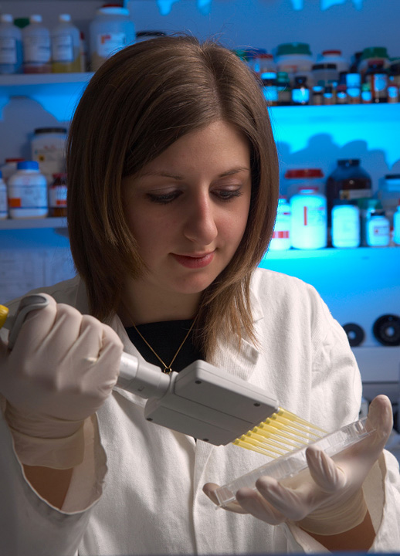
Show don’t tell
Rather than claiming to be enthusiastic or informed about the subject, demonstrate your interest and enthusiasm by describing:
The background to your interest in the subject
Ways in which you are currently following up this enthusiasm
What exactly you know about the subject
Don’t just list what you did, tell us what you learnt from it

Slide 15
Activity (what have you done)
Benefit (skills its given you)
Course (how it relates to the course)
Notes:
Each time you mention something that demonstrates you have the necessary skills/qualities/experiences – make sure you describe why! Use ABC…

Slide 16
Transferable skills
Self-awareness
Business acumen
Presenting
Networking
Communication
Time management
Response to a challenge
Flexibility
Proactivity
Intellectual flexibility
Team work
Enthusiasm
Decision making
Initiative
Commitment
Attention
to detail
Research Skills
Independent thinking
Problem solving
Analysis
Leadership
Motivation
Critical thinking
Foreign language
Numeracy

Slide 17
Additional experience and skills
Look at the things you wrote in the boxes at the start of the session:
Paid employment
Work experience
Volunteering
Travel
Extra curricular groups
For each one consider:
What did you learn?
Does it relate to your subject in some way?
What transferable skills did you gain?
Can they be useful to you in university life?
Student paper
Student Union
Prefect
Notes:
Not about a tick list. No matter what a student has done (travel, work experience, looking after a relative) its about drawing the skills from what they do and how it prepares them academically or socially for university.

Slide 18
Transferable skills
Self-awareness
Business acumen
Presenting
Networking
Communication
Time management
Response to a challenge
Flexibility
Proactivity
Intellectual flexibility
Team work
Enthusiasm
Decision making
Initiative
Commitment
Attention
to detail
Research Skills
Independent thinking
Problem solving
Analysis
Leadership
Motivation
Critical thinking
Foreign language
Numeracy

Slide 19
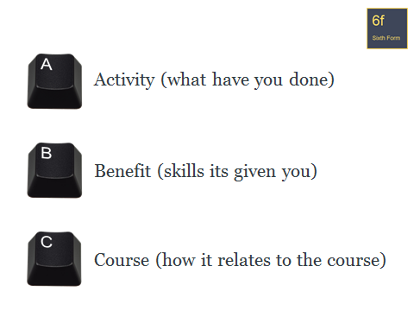
What skills do you possess that will make you a good student of the subject?
I also participated in the Oxfordshire Model United Nations General Assembly, representing China. This involved research into China’s policies in deforestation, sexual violence and democratic process. These experiences have helped boost my confidence in front of large groups, improved my ability to debate and taught me how to lead and be part of a team effectively. I hope to continue developing my abilities in these areas when studying Geography, working with others to share learning in seminars and debating some of the problems the geographical environment currently faces.
Bullet point 5 things you have done which have developed skills useful to the course. Don’t forget the ‘Golden Rule’:

Slide 20
Getting started - 47 lines, approx. 600 words
80 % Academic
Why do you want to study the course?
Academic interests
What experience/skills do you possess that will make you a good student of the subject?
Who or what has inspired you?
What aspects of the subject have you/do you want to explore further?
Your life/work experience, skills and achievements
Summarise why you will be a good choice
Notes:
Your statement can only be around 600 words long – 4,000 characters, or 47 lines.
Most RG/competitive Uni’s are looking at the majority of your PS to be about the academic side of things. Oxbridge prefer the whole statement to be academic.

Slide 21
Who or what has inspired you?
My interest was kindled whilst doing my AS Media Studies coursework . The task was to create and evaluate publications, which I enjoyed immensely. The creation of publications requires a meticulous attention to detail (each camera-shot, lighting effect and backing track has connotations for audiences), this taught me how to analyse the conventions of media institutions and the effects they have on audiences. An understanding of both digital technology and language was essential, thus uniting my interests and igniting a passion that I would like to pursue in the future.
Bullet point at least 2 events/people/things which have inspired you and say why.

Slide 22
What aspects of the subject have you/do you want to explore further?
Bullet point at least 2 aspects – what and why.
Molecular Biology is the basis for the building blocks for all life, and I find it intriguing to learn about the way that molecules interact with each other for life to be developed. This is because in order to understand this, you must first examine the reactions that have enabled the synthesis of the molecules, and then the mechanisms that they undertake; something that I have always wanted to explore in more depth.

Slide 23
Getting started - 47 lines, approx. 600 words
80 % Academic
Why do you want to study the course?
Academic interests
What experience/skills do you possess that will make you a good student of the subject?
Who or what has inspired you?
What aspects of the subject have you/do you want to explore further?
Your life/work experience, skills and achievements
Summarise why you will be a good choice
Notes:
Your statement can only be around 600 words long – 4,000 characters, or 47 lines.
Most RG/competitive Uni’s are looking at the majority of your PS to be about the academic side of things. Oxbridge prefer the whole statement to be academic.

Slide 24
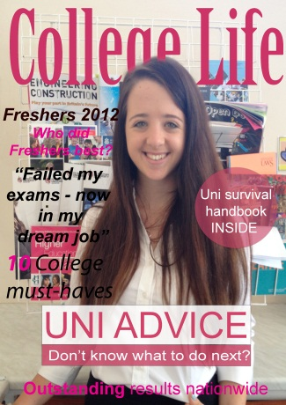
Work is not the only valuable experience!
Students should use their initiative to begin getting involved in what they love……………………………….. Why wait?
Public lectures
MOOCs
Extended Project/Essay
Student magazines
Creative writing
Political thoughts
Websites
Notes:
Work experience at your age can be quite passive and involve watching people do that job. 1 weeks work experience wont tell you much about a subject or job. You should look to engage with your chosen subject and find ways to demonstrate your interest.

Slide 25
Additional experience and skills
Additional accredited qualifications
Notes:
Feel free to use this slide if you would like to talk about additional accredited qualifications.

Slide 26
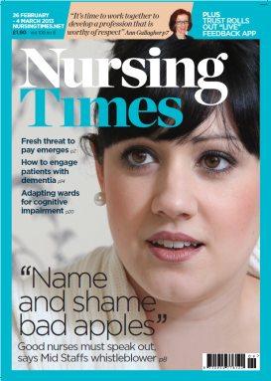
Enhancing Your Application
Reading outside the syllabus
University Websites
Newspapers
Journals

Slide 27
Skills gained from a part-time job
Skills gained from a part-time job:
Position of responsibility
Confident talking to new people
Became more financially independent
Excellent communication skills
Increased time management and organisational skills

Slide 28
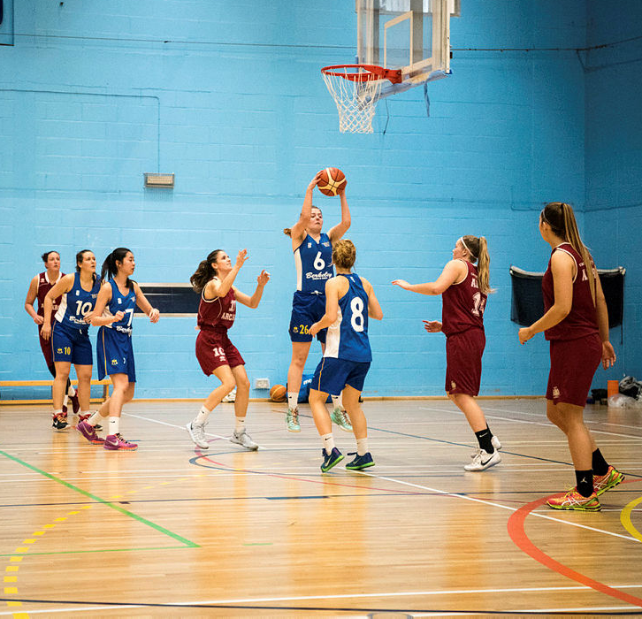
Skills gained from being a member of a sports team:
Skills gained from being a member of a sports team:
Learn to adapt quickly to a game plan
Excellent team working skills
Displayed strong leadership qualities
Demonstrated time management and organisational skills

Slide 29
What additional experience and skills do you have to offer?
I recently spend some time with the Environment Agency, working in their local Analysis and Reporting team. I helped process and identify some freshwater invertebrate samples, where I used a dissecting microscope and taxonomic keys. I learned about freshwater invertebrates sampling methods and how the data is used to classify rivers. This experience taught me some useful laboratory skills and showed me how biology can be applied. I plan to expand my skills and gain further experience in helping with field work.
Bullet point things you have done/are doing/would like to do to enhance your application (and then do them over the summer!)

Slide 30
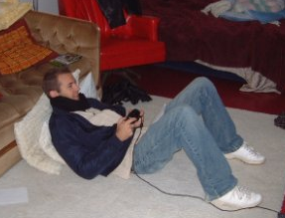
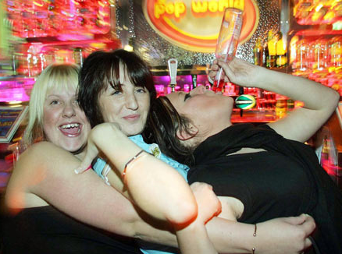
Hobbies and interests
Avoid a boring list of hobbies, e.g. ‘reading’, ‘socialising with friends’, ‘going to the cinema’.
Notes:
We are not looking for a “shopping list”. You may like doing these things, but how do they relate your application and/or course.

Slide 31
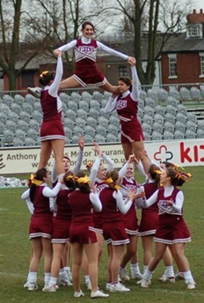
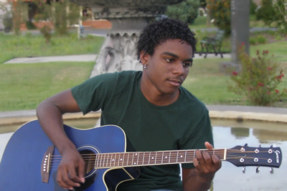
Fine to mention films, books that you like but make sure to mention genres, authors, artists etc. and mention why they interest you. Try to make it relevant.
Notes:
Better to try and be specific with hobbies. It is good if you can try make it relevant in any way to your course or the skills required for that course.

Slide 32
What are your hobbies and interests?
Bullet point your hobbies and interests – how can you make them relevant?
Outside of the academic world, I spend time teaching myself to play various musical instruments such as guitar, bass, and drums. The process of learning and exploring music on my own has been incredibly insightful, as it has helped me acquire the techniques and discipline required for independent learning.
I attend a Community Youth theatre group on a weekly basis; as a senior member I help supervise, motivate and focus the younger members. I also delight in a range of other subjects and consider myself to be an all-rounder which has to be essential to teach within Primary Education.
Other achievements have included winning Player of the Year twice for my local netball team. Although sport is not my strongest attribute, over time I have been able to gain considerable confidence, and have learnt the importance of being able to work effectively as a team, as well as an individual.

Slide 33
Getting started - 47 lines, approx. 600 words
80 % Academic
Why do you want to study the course?
Academic interests
What experience/skills do you possess that will make you a good student of the subject?
Who or what has inspired you?
What aspects of the subject have you/do you want to explore further?
Your life/work experience, skills and achievements
Summarise why you will be a good choice
Notes:
Your statement can only be around 600 words long – 4,000 characters, or 47 lines.
Most RG/competitive Uni’s are looking at the majority of your PS to be about the academic side of things. Oxbridge prefer the whole statement to be academic.

Slide 34
Summary paragraph
In conclusion, I believe that I will enjoy and excel at studying Biology, specifically the medical and neurological aspects, at university level. Personally, it is the subject which enthrals me the most and always leaves me wanting to learn more.
In these extra-curricular activities, I have both enjoyed, and been proud of, my approach to leading and managing situations; I have learnt how to make rational decisions and prioritise tasks and how to communicate this to group of diverse individuals with different understandings, all of which will be of benefit as I pursue a course, and ultimately a career, in Business Management.
Conclude your personal statement by briefly and concisely bringing it back to why you are a good choice for the course and the university.
Highlight how you are prepared both academically and socially for the challenge of Higher Education.

Slide 35
There are a load of resources on line to help you with writing a personal statement.
Some are out of date. Make use of the resources on Unifrog and the UCAS website

Slide 36
http://www.ucas.com/sites/default/files/personal-statement-full-size_0.pdf

Slide 37
Top tips
Start early
Make use of the resources on the UCAS website
Plan out the structure with bullet points and headings, then turn these into full sentences and paragraphs
Draft in Microsoft Word, spell checking AND proof reading it before you paste it into UCAS
Keep a copy in case you are called to interview
DO NOT plagiarise

Slide 39
Notes:
This person thinks they have been clever by plagiarising from three separate sources but the software shows that nearly 70% is not original. This isn’t about inventing a new language that beats the system, this is about specific sentences that have been plagiarised. The phrase “ during my free time…….” has probably been used lots of times, but it’s the fact it is used at the same time as the other two, very specific, quotes.

Slide 40
Teaching
Some final rules to remember
Research courses thoroughly
Be specific – don’t be vague
Be honest
Try to sound interesting and interested
Express yourself clearly
Don’t be negative
Organise your statement
Don’t repeat yourself
Check spelling and grammar
Don’t misuse words in an attempt to sound clever

Slide 41
What do admissions tutors look for in applications?
Accuracy
Exam results – GCSEs, AS Levels
Choice of A-Levels
Predicted grades
Academic reference from school/college
Personal statement
Motivation and commitment to the subject
Suitability to the course/institution
Nature of the competition – how do you compare?
Careful research to make sure the right courses are chosen is vital…
Notes:
Accuracy – be transparent and honest throughout, and make sure you don’t make silly spelling mistakes.
On the first sift, admissions tutors will make sure you meet or are very close to the entry requirements. If you are not studying maths and you want to do engineering, our admissions tutors won’t get as far as reading your PS. So make sure you have done the necessary research so that you are applying for the right course at the right institution.

Slide 42
Be original…
“I want you to tell me about you as a real, three-dimensional person.”
Dr Jon Scott, University of Leicester
“Be yourself; it's a pleasure (though a surprisingly rare one) to read a statement where the candidate's own voice comes over clearly.”
University of Southampton English Department http://www.southampton.ac.uk/english/undergraduate/ucas_application.page
“It is important that you write it in
your own style rather than trying to conform to what
someone else thinks is right.”
University of Bristol UCAS application dos and don’ts www.bristol.ac.uk/study/schools/factsheets
Notes:
The clue is in the name – it is a personal statement. Admissions tutor want to know why YOU want to study their course, what enthrals YOU about that particular subject, they want to hear YOUR voice. Not some unrealistic ‘model’ statement from a ‘perfect’ student that doesn’t exist. It should be personal to you and your experiences and motivations.

Slide 43
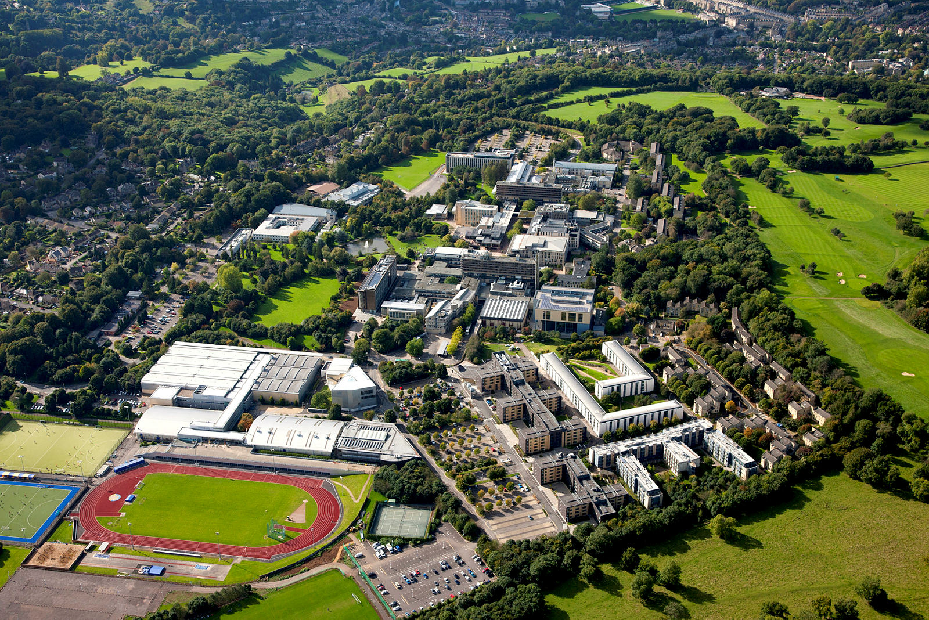
Personal Statements
Only place to focus on relevant skills, achievements and work experience
A personal statement is a maximum of 4000 characters, or around 47 lines
It may be read by two or more university staff at each university
Can make the difference between a ‘yes’ and a ‘no’

Slide 44
Any questions?
Now go and type up your notes into paragraphs in the personal statement section of Unifrog…………….by the end of the day!

Slide 45
Standing out from the crowd.
The importance of personal statements
So go away and type up your notes into paragraphs.
………by the end of the day!
Notes:
We are aware that this title is a cliché and during this talk we will be telling you to avoid this – it just shows how easy it is to fall into using cliched phrases.

