Slide 1
Why Uni and Researching your Course and University
Ruth Walton
Regional Student Recruitment Coordinator

Slide 2
WHY GO TO UNIVERSITY?
Notes:
DO NOT CHANGE THE FONT STYLE OR SIZE. COLOUR MUST BE BLACK OR WHITE, DEPENDING ON THE IMAGE YOU CHOOSE.
CHOOSE THE WHITE OR BLACK/GREY LOGO TO MATCH THE TEXT COLOUR
Replacing the image
1. Save the image you want to your desktop first.
2. All images MUST be on brand. They can be found and downloaded for free on the Marketing Portal at: www.marketing.port.ac.uk
3. To replace the background image, right click the image and select “Format Background”
4. On the right hand side click ‘insert picture from File> Desktop

Slide 3
MYTHBUSTERS
Universities only support you in your studies
A degree won’t make me stand out to employers
You have to be a confident person to enjoy the ‘university experience’
University = too much debt
Clubbing/drinking is basically a module for uni students
University doesn’t prepare you for the real word
Apprenticeships are better as I can learn and earn
People who go to university have to be good at exams
Student Unions are all about sport
Student make all their friends during freshers’ week
Students live on a diet of beans on toast
Notes:
To get you thinking…
90 seconds to have a look at these statements about university – how true do you think they are?
Listen in to students discussion but don’t feed back as a group.

Slide 4
WHAT ARE THE BENEFITS?
Academic
Become an expert in your subject
Personal
Develop and grow
Career-related
Enhance your employability
Notes:
There are lots – the 3 main factors that influence people’s decision whether to go to university are usually:
Academic –
you’ll spend 3, 4, 5 years surrounded by your subject and will really develop both your academic skills and knowledge of the subject area
you’ll be learning from academics who are leaders in their fields and many of whom have published papers, written books and regularly give their expertise on current topics in the media
The way you learn will be very different to school and college and you’ll be more in charge of your own learning[more on this later!]
you will have the opportunity to study something you love (hopefully!) You need to have interest in a subject. This could be something that you are already studying or something completely new. Depending on the degree you choose you could be studying for anywhere up to five years so it is essential you are studying something you are passionate about. The more you enjoy something the better you tend to perform.
You’ll graduate with unique expertise in your subject area (every student’s academic experience is different … different modules chosen, different experiences, different subject specialism/dissertation area
Personal
You will gain a whole load of transferrable skills (which will help you both in your career and in life!) [more on this later!]
Independent Living, many people go to university because they value the experience, they will be building up their independence, getting to know a new city, budgeting, cooking and cleaning, which is something you may not be used to.
University is a chance to meet people which under normal circumstances you would never have met. You will meet so many new people and you form a completely new social circle with people who have similar interests for you. Ask anyone who went to university and they will tell you they made friends for life.
Universities are really international environments – you’ll meet, make friends with and be taught by people from all over the world.
You can try new things
You’ll have opportunities to challenge yourself – including studying abroad
You’ll develop and grow at university – and it’s very likely that you’ll leave us having changed quite a bit! You’ll have grown in independence, confidence and you will have developed skills that will stay with you for life.
Career-related
Careers where a degree helps, for example you need a law degree to become a lawyer, or a degree in medical science to become a doctor. There are also careers where you need a degree in general, for example, a teacher.
There are many careers where a degree helps. More on this later, but transferable skills, graduate schemes, and maturing your skills all come into play
Potential to earn more money. There is a lot of research which shows that graduates earn more over their lifetime then non-graduates, and that graduate jobs and sectors on average pay higher salaries.
You’ll gain lots of skills and knowledge at university that will help you in your career. However, you’ll have lots of opportunities to gain practical skills and industry knowledge through your course, placement years and other opportunities.
University can enhance your employability and degrees are sought after by many employers. At Portsmouth, 97.5% of our graduates are working or are in further study within six months of graduating – and over 82% of those are in professional or managerial roles.

Slide 5
ACADEMIC
Become an expert in your subject
Notes:
DO NOT CHANGE THE FONT STYLE, COLOUR OR SIZE.
CHOOSE THE WHITE OR BLACK/GREY LOGO DEPENDING ON WHAT PHOTO YOU USE
Replacing the image
1. Save the image you want to your desktop first.
2. All images MUST be on brand. They can be found and downloaded for free on the Marketing Portal at: www.marketing.port.ac.uk
3. To replace the background image, right click the image and select “Format Background”
4. On the right hand side click ‘insert picture from File> Desktop

Slide 6
YOUR BEST BEGINS WITH DEVELOPING YOUR ACADEMIC EXPERIENCE
Adult Nursing American Studies Architecture Biomedical Science Computer Games Enterprise Criminology Creative Writing Dental Hygiene and Therapy Early Childhood Studies Civil Engineering Forensic Computing Geological Hazards Hospitality Management Human Resource Management Illustration Innovation Engineering International Relations Journalism Applied Languages Marketing Operating Department Practice Palaeontology Product Design Quantity Surveying Social Work Sport and Exercise Science Therapeutic Radiography Web Technologies
Notes:
- TITLE - DO NOT CHANGE THE FONT, COLOUR OR SIZE
- MAIN TEXT – DO NOT CHANGE THE COLOUR. SIZE SHOULD BE NO BIGGER THAN 24 AND NO SMALLER THAN 14
- KEEP ALL TEXT AND IMAGES TO WITHIN THE HEIGHT OF THE LINES ON EACH SIDE OF THE SLIDE

Slide 7
LEARNING AND TEACHING AT UNIVERSITY
IT’S DOWN TO YOU
WHAT DO LECTURERS DO?
I HAVE LOTS OF ‘FREE TIME’
Notes:
You will have a lecturer for each module you take and a personal tutor, who’ll be your go to throughout your time at university if you have any problems on your course. However, there’s lots of other support at university too which we’ll touch upon later.
Lecturers usually have two roles – ‘teacher’ and ‘researcher’. Each lecturer will have their own specialism and this is great for students as they are learning from experts in the field. Lots of really ground breaking research comes from universities…such as the research into plastic-eating enzyme happening at the University of Portsmouth.
However, at university you take responsibility for a lot of your learning. It’s your responsibility to make sure you attend all of your lectures and seminars, and to study outside of your classes. You’ll find that you might have quite a bit of ‘spare time’ – but time outside formal teaching is for self study (and socialising too!). You’ll end up being brilliant at time management, and you’ll need to be motivated too! You really do get out what you put in – and essentially, sometimes you are your own teacher.

Slide 8
TEACHING AND RESEARCH These pictures and subjects each link to a University of Portsmouth lecturer’s research – can you guess what it might be?
Wildlife crime
Nick, Principal Lecturer
Using forensics to combat the illegal trafficking and poaching of animals, including the pangolin – the world’s most trafficked animal.
Happiness and wellbeing in today’s society
Laura, Senior Lecturer
Examines people’s everyday experiences and perceptions of happiness.
Supporting an end to violence against women and girls
Tamsin, Professor of International Development Studies
Works across South Asia, Africa and the UK to gather research on women, work, violence and displacement.
Criminology
Sociology
International Development Studies
Notes:
These pictures and subjects each link to a University of Portsmouth lecturer’s research – can you guess what they might be?

Slide 9
YOUR BEST BEGINS WITH NEW WAYS OF LEARNING
LECTURES
GROUP WORK
SELF
STUDY
PRACTICAL SESSIONS
SEMINARS
LAB WORK
WORKSHOPS
FIELDWORK
TUTORIALS
Notes:
The ways in which you learn at university will be very different at school or college.
All students will have lectures (talks), seminars (classroom sessions) and most will have tutorials (going through topics in more detail with a lecturer on either a 1-1 basis or in a small group)
Alongside these you may have a combination of other learning experiences – such as practicals, workshops, lab sessions, group work or field work depending on which course you’re studying.
All students will have to do some self-study/independent learning – your week won’t be 9-5 in classes, and lots of your learning will take place outside of the classroom/
lecture theatre. …You’ll be in the library a lot!
I’m going to show you some of the ‘real-life’ learning we do at Portsmouth so you can get an idea of the variety that’s on offer. Knowing how you like to learn may influence your decision to choose a course, so it’s important to have an idea of your strengths and do your course research.
Cover ways of assessment too.

Slide 15
PERSONAL
Develop and grow

Slide 16
YOUR BEST BEGINS WITH A PLACE WHERE YOU CAN FIND YOUR PEOPLE
THE STUDENTS’ UNION
OTHER OPPORTUNITIES
SPORT AND EXERCISE
VOLUNTEERING AND FUNDRAISING
Clubs, societies and the Students’ Union
Try a new sport - competitively or just for fun
Join the gym
Volunteering programmes
RAG (Raising and Giving)
Learning outside the classroom
Work experience and internships
Student media groups
Projects
Lots more!
Notes:
The ‘student experience’ encompasses more than the time you’ll spend in lecture theatres and seminar rooms.
Your time at university is an opportunity to try new things and get involved with many of the things going on around campus.
The Students’ Union
Sports
The local community
Other opportunities

Slide 17
Acting
Entrepreneurs
Harry Potter
Cinema
AI and Robotics
Quidditch
Rock Society
Comedy
Poetry
Rugby
Portuguese
Ultimate Frisbee
Rounders
Dance
Vegan
LGBT+
Marvel
Amnesty
International
Political Union
ACS
First Aid
uspu.net/activities/societies
Gospel Choir
Softball
Cheerleading
Mathematics
Boxing
Cuban Salsa
Notes:
Just a small selection of from of the 150 societies we have a Portsmouth.
You are bound to find something you’re interested in – however, if your particular interest or hobby isn’t a society yet you can create one – you’ll just need to find a few fellow members!

Slide 18
YOUR BEST BEGINS WITH A UNI THAT IS THERE FOR YOU
REFLECTION, THOUGHT & PRAYER
REFLECTION, THOUGHT & PRAYER
ADDITIONAL SUPPORT & DISABILITY ADVICE
HOUSING SUPPORT
ADDITIONAL SUPPORT & DISABILITY ADVICE
HOUSING SUPPORT
WELLBEING
WELLBEING
ACADEMIC
CAREERS & EMPLOYABILITY
KEEPING HEALTHY
FINANCE & MONEY
ACADEMIC
CAREERS & EMPLOYABILITY
KEEPING HEALTHY
FINANCE & MONEY
Notes:
HELP WITH ACADEMIC WORK
Personal tutor
ASK – Academic Skills Unit
Maths café
ADDITIONAL SUPPORT
Additional Support and Disability Advice Centre (ASDAC)
WELLBEING
Student Wellbeing Service – workshops, courses, advice, mental health support and counselling
Weekly wellbeing café
Feel Good Fest
CAREERS
Part-time jobs and volunteering
Career planning and work experience
Placements
Support for up to 5 years after graduation
KEEPING HEALTHY
Easy access to health services
HOUSING SUPPORT
24/7 welfare support from Residence Life Teams
Support and advice in finding a home in the private rented sector
FINANCE AND MONEY
Information, advice and support on student loans, bursaries and additional funding
Money management and budgeting advice
Budget-friendly gym memberships at University sports centres
REFLECTION, THOUGHT AND PRAYER
Multi-faith Chaplaincy
Quiet room for reflection

Slide 19
CAREER
Enhance your employability

Slide 20
YOUR BEST BEGINS WITH EXPERIENCES THAT WILL PREPARE YOU FOR THE REAL WORLD
STUDY ABROAD
Broaden your cultural awareness
Learn language skills
Gain confidence
PLACEMENT YEARS
Earn while you learn
Develop good working practices
Gain experience relevant to your degree
Increase your industry knowledge
Network
Notes:
There are lots of opportunities available outside the classroom at university that will allow you to develop personally and improve your career prospects.
Some courses have the opportunity for students to spend a whole academic year or a semester studying abroad. The university will have partner universities around the world and you could go to some really exciting places. Study abroad is a fantastic challenge – you’ll be learning how to adapt in a new environment, often where English may not be the native language. You’ll gain confidence, meet lots of people from around the world – and broaden your cultural awareness. You may even learn a new language too! Where you go may depend on the partnerships the university has – at Portsmouth we’ve sent students to Europe, Australia, Brazil, Japan and the USA just to name a few. Find out more about if and where you could study abroad during your course research.
Lots of courses now offer a placement year – as do many we offer at Portsmouth. You’ll spend a year on a work placement (often salaried!) learning more about how your subject fits within industry and applied what you’ve learned in the classroom to real-world workplace situations. You’ll also develop transferrable skills and after your course finishes, you’ll be a graduate with a degree and a year’s worth of really valuable work experience. Often students see this as a great opportunity to network and it is sometimes the case that students are offered positions within the organisation after graduation. You can usually see where previous students have been on placement on the course web pages.
Both are fantastic experiences that will allow you to develop both personally and professionally and will really help to make you stand out to employers.

Slide 21
YOUR BEST BEGINS WITH LEARNING TRANSFERABLE SKILLS
Group projects, societies and sports clubs, volunteering and part-time work
Teamwork
Motivation to succeed on course, motivation to complete work to deadlines
Motivation
Researching a topic for a piece of work – using academic sources
Independent learning
Critical and analytical thinking
Research
Taking responsibility for your own learning – preparing for lectures, research, etc
Questioning sources of information and evaluating arguments
Sticking at something you need to work at – studies, a new skill, university!
Communication
Organisation
Commitment
Meeting new people – and working, living and studying with them
Juggling deadlines, lectures and social activities
Prioritising what you do
Time management
Problem solving
Using new ways to solve problems in academic and personal life

Slide 22
In 2018, the graduate employment rate (87.7%) was substantially higher than the employment rate of non-graduates (71.6%).
www.gov.uk, April 2019
Working-age graduates earned £10,000 more than non-graduates in 2018 and had higher employment rates.
www.gov.uk, April 2019

Slide 23
WHAT ABOUT NOW?
Universities only support you in your studies
A degree won’t make me stand out to employers
You have to be a confident person to enjoy the ‘university experience’
University = too much debt
Clubbing/drinking is basically a module for uni students
University doesn’t prepare you for the real word
Apprenticeships are better as I can learn and earn
People who go to university have to be good at exams
Student Unions are all about sport
Student make all their friends during freshers’ week
Students live on a diet of beans on toast
Notes:
Revisit – how do you feel about these statements now? Did anything surprise you? (you could ask a similar question and do a show of hands here).

Slide 24
CHOOSING THE RIGHT COURSE AND UNIVERSITY
Notes:
DO NOT CHANGE THE FONT STYLE OR SIZE. COLOUR MUST BE BLACK OR WHITE, DEPENDING ON THE IMAGE YOU CHOOSE.
CHOOSE THE WHITE OR BLACK/GREY LOGO TO MATCH THE TEXT COLOUR
Replacing the image
1. Save the image you want to your desktop first.
2. All images MUST be on brand. They can be found and downloaded for free on the Marketing Portal at: www.marketing.port.ac.uk
3. To replace the background image, right click the image and select “Format Background”
4. On the right hand side click ‘insert picture from File> Desktop

Slide 25
COURSE FIRST
UNIVERSITY LATER
Notes:
With over 50,000 courses to choose from in the UK alone, it’s important to take the time to research the right course for you, before you choose the university.

Slide 26
WHERE TO
START
Notes:
UCAS Timeline for 2022 Entry
The following is the UCAS timeline that you’ll follow in year 13/year 2. In year 12, you’ll have already started to research and make a shortlist of universities that interest you. You may have visited some Open Days during the summer between year 12 & 13 and there are autumn open days during the beginning of year 13.
15 October is the deadline for Oxford, Cambridge and Med, Vet & Dentistry (although your school/college deadline will be earlier)
15 January is the deadline for all other courses (although your school/college deadline will be earlier).
Offers can be made from October onwards
Most interviews are held between November & March
UCAS Extra open from Feb – Early July
You may be invited to an applicant experience day December – March
You can accept your offers at any time but should do before early May (Firm, Insurance)
If you’ve met the requirements of your conditional offer, your place will be confirmed. If you received (and accepted!) an unconditional offer, your place will be confirmed regardless of what happens on results day.
Clearing and adjustment

Slide 27
WHERE TO START
Make your own decision
What do you enjoy?
What are you interested in?
What are you studying now?
What are your career aspirations?
What are your predicted grades?
Notes:
UCAS Timeline for 2022 Entry
The following is the UCAS timeline that you’ll follow in year 13/year 2. In year 12, you’ll have already started to research and make a shortlist of universities that interest you. You may have visited some Open Days during the summer between year 12 & 13 and there are autumn open days during the beginning of year 13.
15 October is the deadline for Oxford, Cambridge and Med, Vet & Dentistry (although your school/college deadline will be earlier)
15 January is the deadline for all other courses (although your school/college deadline will be earlier).
Offers can be made from October onwards
Most interviews are held between November & March
UCAS Extra open from Feb – Early July
You may be invited to an applicant experience day December – March
You can accept your offers at any time but should do before early May (Firm, Insurance)
If you’ve met the requirements of your conditional offer, your place will be confirmed. If you received (and accepted!) an unconditional offer, your place will be confirmed regardless of what happens on results day.
Clearing and adjustment

Slide 28
RESEARCH
Taster days
Webinars
Subject talks
ABOUT THE COURSE
HE/Careers fairs
COMPARE UNIVERSITIES
University course pages
University Guide 2021
OTHER SOURCES

Slide 29
COMPARE
COURSES

Slide 30
SPOT THE DIFFERENCE: BUSINESS & MANAGEMENT
University X
BA (hons) Business and Management
BA (hons) Business and Management
YEAR ONE UNITS
Business Accounting
Business Operations and Systems Management
Economics for Business
Managing People in Organisations
Marketing Principles and Practice
Quantitative Methods and Data Analysis
Business Innovation Development Project
YEAR ONE UNITS
Developing Management Competencies
Global Business Environment
Introduction to Accounting
Organisational Behaviour and Responsible Management
Business Simulation
Fundamentals of Marketing
Overall assessment:
58% exams + 42% coursework
Overall assessment:
33% exams + 67% coursework
Notes:
When carrying out your research, it’s important to compare the title of the course you are interested in at different universities.
To use the example here, this is the structure for English Literature at the University of Portsmouth.
As you can see though, the structure at ‘University 1’ is quite different so it’s important not to let the course title mislead you.

Slide 31
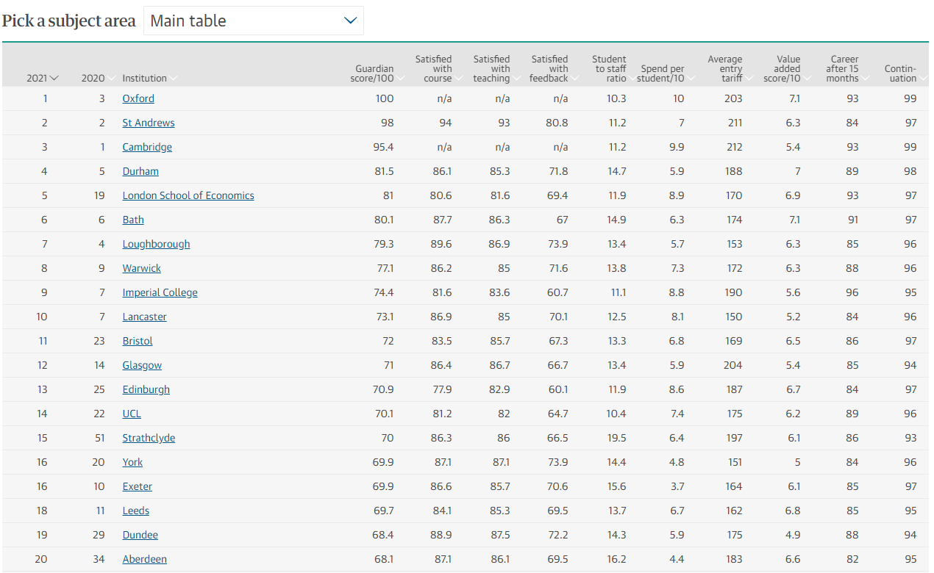
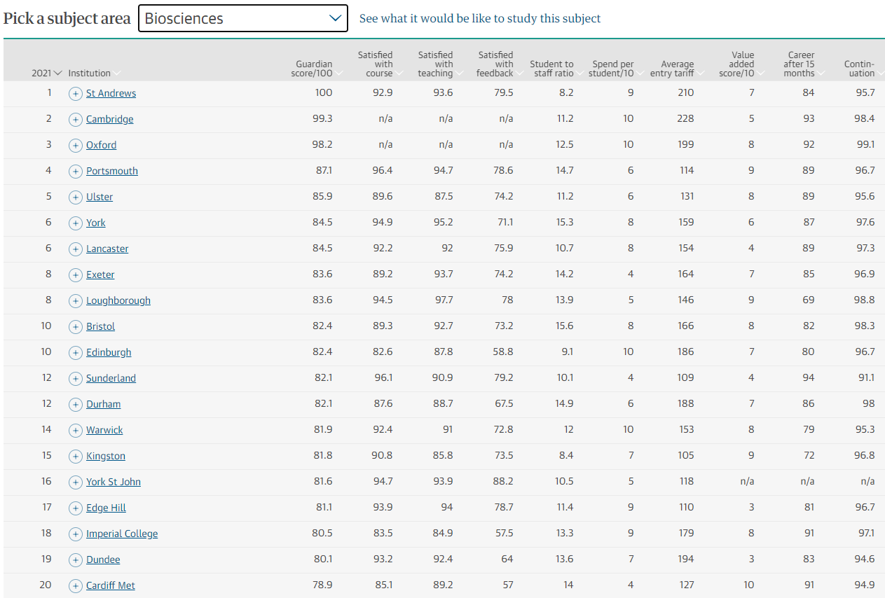
LEAGUE TABLES AND RANKINGS
OUR BIOSCIENCES
COURSES ARE
TOP 5
2021
OUR JOURNALISM
COURSES ARE
TOP 12
2021
OUR NURSING
COURSES ARE
TOP 12
2021
Notes:
Guardian University Guide 2021.
The first slide here is a generic league table, providing a comparison of different universities overall. It’s important to look at these league tables, but try not to let them blind you, only consider the factors that are important to you. Just because ‘University X’ is high in a particular league table, still doesn’t mean that it’s necessarily the right university for you.
The second slide is where you use the ‘Pick a subject area’ search bar at the top of the slide. This is a really interesting comparison which is course specific, rather than overall university rankings.
We’ve used the course example of Biosciences and you can see that the top ten list of universities is a different list compared to the previous slide.

Slide 32
KNOW HOW YOU
LEARN BEST

Slide 33
YOUR BEST BEGINS WITH NEW WAYS OF LEARNING
LECTURES
GROUP WORK
SELF
STUDY
PRACTICAL SESSIONS
SEMINARS
LAB WORK
WORKSHOPS
FIELDWORK
TUTORIALS
Notes:
The ways in which you learn at university will be very different at school or college.
All students will have lectures (talks), seminars (classroom sessions) and most will have tutorials (going through topics in more detail with a lecturer on either a 1-1 basis or in a small group)
Alongside these you may have a combination of other learning experiences – such as practicals, workshops, lab sessions, group work or field work depending on which course you’re studying.
All students will have to do some self-study/independent learning – your week won’t be 9-5 in classes, and lots of your learning will take place outside of the classroom/lecture theatre. …You’ll be in the library a lot!

Slide 34
LOOK AT THE
OPPORTUNITIES
ON OFFER

Slide 35
YOUR BEST BEGINS WITH EXPERIENCES THAT WILL PREPARE YOU FOR THE REAL WORLD
STUDY ABROAD
Broaden your cultural awareness
Learn language skills
Gain confidence
PLACEMENT YEARS
Earn while you learn
Develop good working practices
Gain experience relevant to your degree
Increase your industry knowledge
Network
Notes:
There are lots of opportunities available outside the classroom at university that will allow you to develop personally and improve your career prospects.
Some courses have the opportunity for students to spend a whole academic year or a semester studying abroad. The university will have partner universities around the world and you could go to some really exciting places. Study abroad is a fantastic challenge – you’ll be learning how to adapt in a new environment, often where English may not be the native language. You’ll gain confidence, meet lots of people from around the world – and broaden your cultural awareness. You may even learn a new language too! Where you go may depend on the partnerships the university has – at Portsmouth we’ve sent students to Europe, Australia, Brazil, Japan and the USA just to name a few. Find out more about if and where you could study abroad during your course research.
Lots of courses now offer a placement year – as do many we offer at Portsmouth. You’ll spend a year on a work placement (often salaried!) learning more about how your subject fits within industry and applied what you’ve learned in the classroom to real-world workplace situations. You’ll also develop transferrable skills and after your course finishes, you’ll be a graduate with a degree and a year’s worth of really valuable work experience. Often students see this as a great opportunity to network and it is sometimes the case that students are offered positions within the organisation after graduation. You can usually see where previous students have been on placement on the course web pages.

Slide 36
CHOOSE YOUR
UNIVERSITY

Slide 37
WHERE CAN I UNLOCK MY POTENTIAL?
Home or away?
City or campus?
Student opportunities
Accommodation
Graduate employability
Support available
Student life
Broad range of subjects or specialised?

Slide 38
THE STUDENT EXPERIENCE =
MORE THAN LECTURES

Slide 39
THE STUDENT EXPERIENCE
THE STUDENTS’ UNION
OTHER OPPORTUNITIES
SPORT AND EXERCISE
VOLUNTEERING AND FUNDRAISING
Clubs, societies and the Students’ Union
Try a new sport - competitively or just for fun
Join the gym
Volunteering programmes
RAG (Raising and Giving)
Learning outside the classroom
Work experience and internships
Student media groups
Projects
Lots more!
Notes:
The ‘student experience’ encompasses more than the time you’ll spend in lecture theatres and seminar rooms.
Your time at university is an opportunity to try new things and get involved with many of the things going on around campus.
The Students’ Union
Sports
The local community
Other opportunities

Slide 40
Central Portsmouth locations
All bills are included
Accommodation Guarantee
Make us your firm, first choice and guarantee your room
Majority are en-suite
Residence Life Team are there for help, advice and support

Slide 41
LOOK AT SUPPORT.
AVAILABLE

Slide 42
YOUR BEST BEGINS WITH A UNIVERSITY THAT WILL TRULY SUPPORT YOU
ADDITIONAL SUPPORT & DISABILITY ADVICE
HOUSING SUPPORT
REFLECTION, THOUGHT & PRAYER
WELLBEING
ACADEMIC
CAREERS & EMPLOYABILITY
KEEPING HEALTHY
FINANCE & MONEY
Notes:
SUPPORT WITH ACADEMIC WORK
Personal tutor
ASK – Academic Skills Unit
Maths café
ADDITIONAL SUPPORT
Additional Support and Disability Advice Centre (ASDAC)
CAREERS
Part-time jobs and volunteering
Career planning and work experience
Placements
Support for up to 5 years after graduation
WELLBEING
Student Wellbeing Service – workshops, courses, advice, mental health support and counselling
Weekly wellbeing café
Feel Good Fest
KEEPING HEALTHY
Easy access to health services
Budget-friendly gym memberships at University sports centres
HOUSING SUPPORT
24/7 welfare support from Residence Life Teams
Support and advice in finding a home in the private rented sector
FINANCE AND MONEY
Information, advice and support on student loans, bursaries and additional funding
Money management and budgeting advice
REFLECTION, THOUGHT AND PRAYER
Multi-faith Chaplaincy
Quiet room for reflection

Slide 43
NEXT STEPS
GET ONLINE
UCAS.com
University course pages – more detailed information
Comparison websites – Discoveruni, WhatUni, league tables
GET OUT THERE
Higher Education fairs – in school, UCAS fairs
Open days - get a feel for a university and course (visit/revisit)
Taster days/summer schools – try out a course/university
GET IN TOUCH
Speak to staff and current students– open days, taster days/summer schools, higher education/careers fairs, email
Notes:
Do some research
Leads here – keep in touch, we’ll let you know about events, information and advice

Slide 44
MAKE YOUR
SHORTLIST

Slide 45
NEXT STEPS : VISIT OUR PERSONAL STATEMENT HUB
Top tips on how to write a stand out personal statement
Download helpsheets
Access a range of videos
Submit a draft for feedback from one of the team
Register here: uni.port.ac.uk/PSHub

Slide 46
NEXT STEPS: BOOK ONTO A WEBINAR
Getting Started
27th July: Using clearing and adjustment
28th July: Parent and supporter talk – helping someone through clearing
Register here: port.ac.uk/getting-started

Slide 47
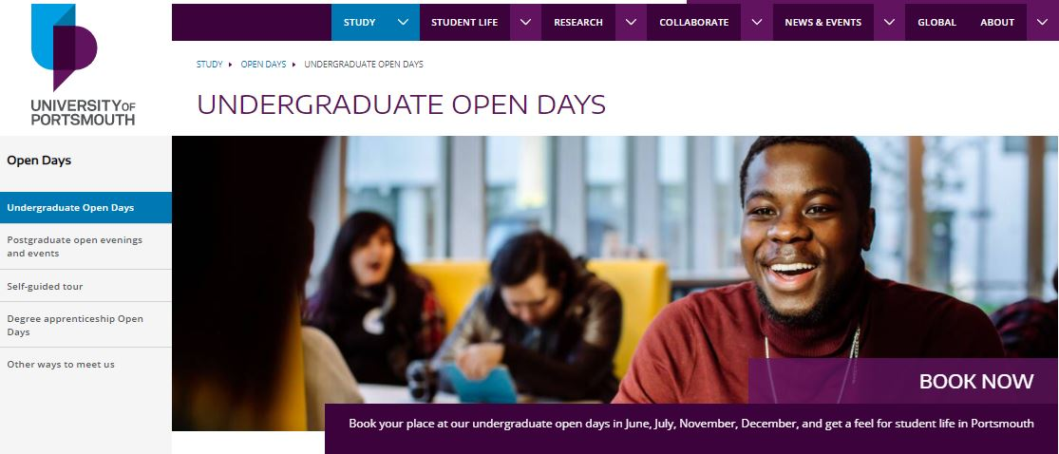
NEXT STEPS: BOOK ONTO AN OPEN DAY
Visit one of our Open Days* and get a taste for undergrad life in Portsmouth. We'll help you explore our island city, student life and the University.
Wednesday 22nd September
Saturday 6th November
Saturday 4th December
Book your place here: port.ac.uk/opendays
*We hope to hold some of these Open Day events on campus. Once you’ve booked, we'll let you know if circumstances change and we have to hold these events virtually.

Slide 48
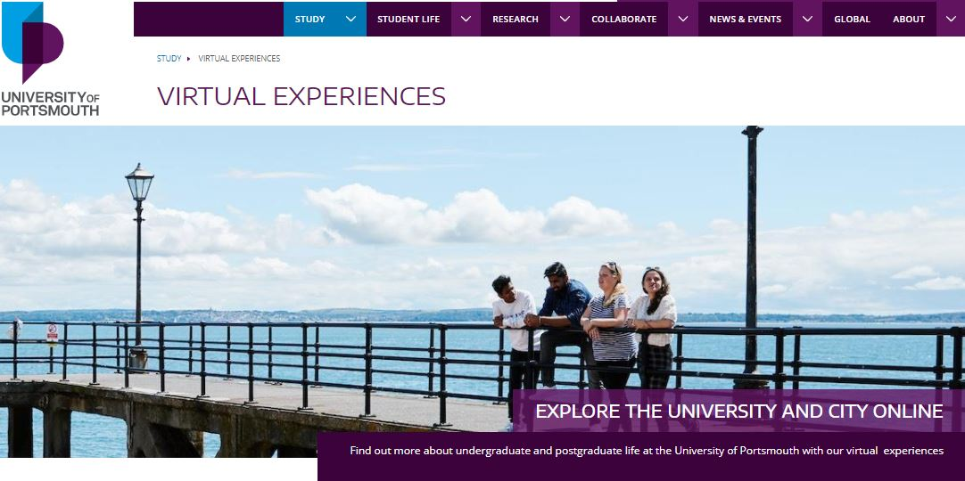
NEXT STEPS: VISIT OUR VIRTUAL EXPERIENCE HUB
Explore the city and the University via our online experience pages
Explore what student life in the city is really like: find the best places to eat, drink and socialise
Hear what our recent students and graduates have to say about their Portsmouth experience
Visit the hub here: port.ac.uk/VirtualHub

Slide 49
QUESTIONS?
.
UniversityofPortsmouth
Follow us:
@portsmouthuni
@portsmouthuni
Email us: rao@port.ac.uk

Slide 50
THANK YOU!

