Slide 1
Tools and Processes

Slide 2
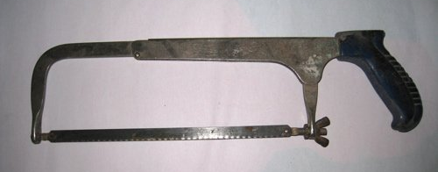
Saws
Ripsaw – for wood
Tenon Saw – for wood
Hacksaw – for metals and plastic
Coping Saw – for wood or plastic; for cutting curves

Slide 3
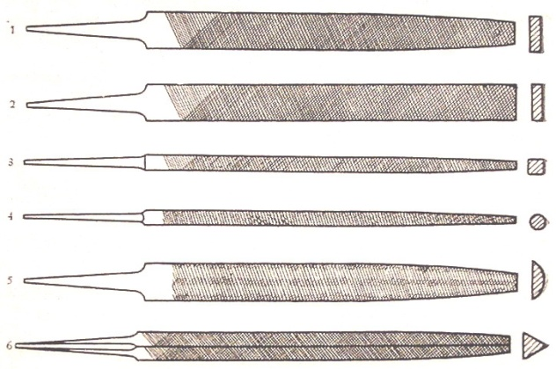
Planes and Files
Used for shaping and smoothing
Bench plane – angled blade, shaves off thin layer of material, used for wood
Files 100s of small teeth to cut away material
Dif ‘cuts’ make suitable for dif processes:
Rough – removal of material
Fine – finishing
Dif profiles – make dif shapes
Metals + plastics
Wood = cabinet rasps, v.sharp teeth

Slide 4
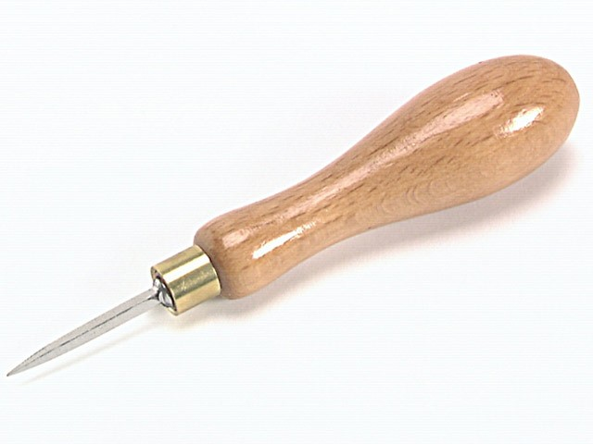
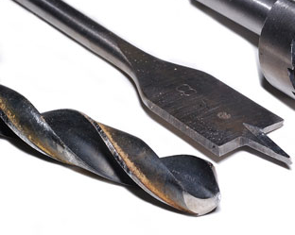
Drills
Pilot holes – use bradawl, help drill in right place
^Metal – use centre punch
Actual drilling – brace, hand drill or power drill
Drill bits:
Twist bits – small holes in wood, metal or plastic . High speed steel (HSS) twist bits – metals + plastics
Flat bits – large flat-bottomed holes in wood + plastic
Countersink bits – holes for screw heads to sit in

Slide 5
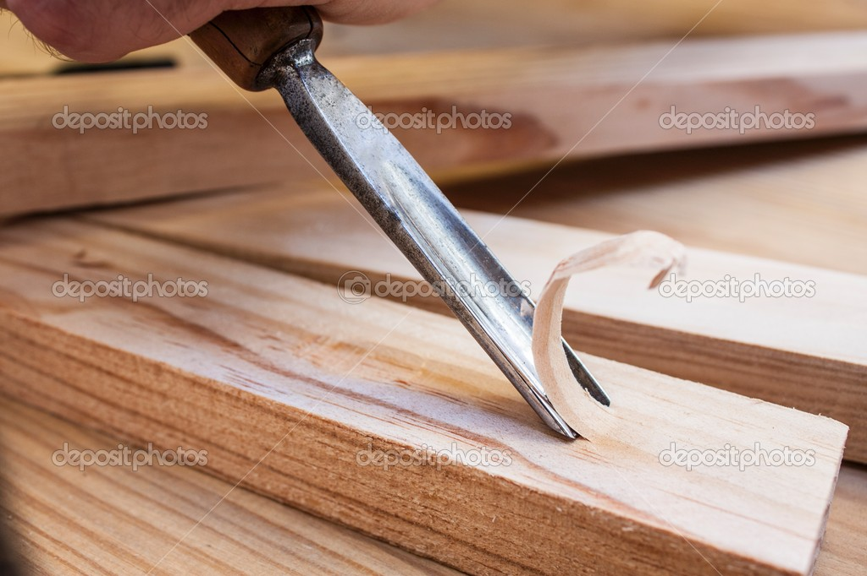
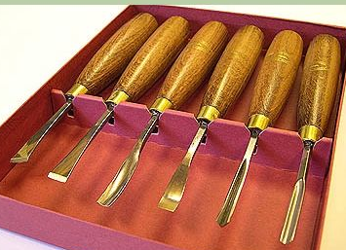
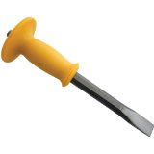
Chisels
Cut away + shape wood + metal
Wood chisels hit with mallet
Gougers used for sculpting
Metal = cold chisels
^ hit with hammer

Slide 6
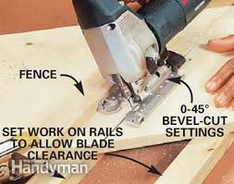
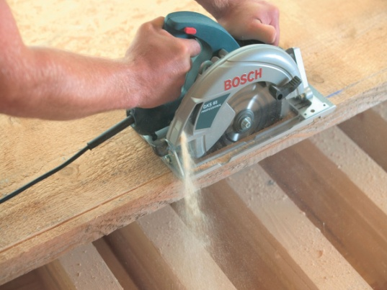
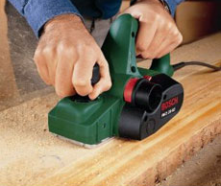
Power Tools
Jigsaw – interchangeable blades + variable speeds, straight or curved cuts, all materials, but quite slow
Hand held version of the circular saw – straight cuts v.quickly in wood
Planer – like a bench plane – remove shavings of wood, less effort + much faster, but not as accurate as bench plane

Slide 7
Machine Tools Safety
Most bolted to workbench or floor
Most used for wood are attached to dust extractor
Wear safety glasses
Hair tied back
Clothing tucked in
Red emergency stop button

Slide 8
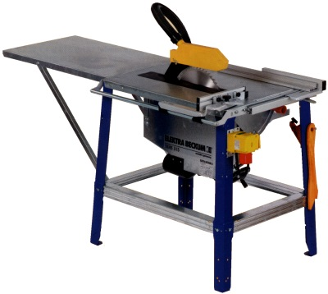
Circular Saw or Saw Bench
A round blade
Used to cut wood + boards like plywood
Straight cuts only

Slide 9
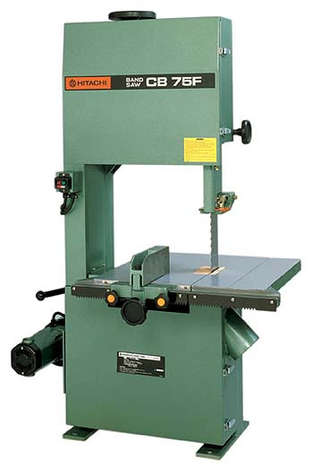
Band saw
Blade in long flexible loop
Normally to cut wood
Special blades can be bought for plastics + softer metals
Blades in dif widths
Straight or curved cuts

Slide 10
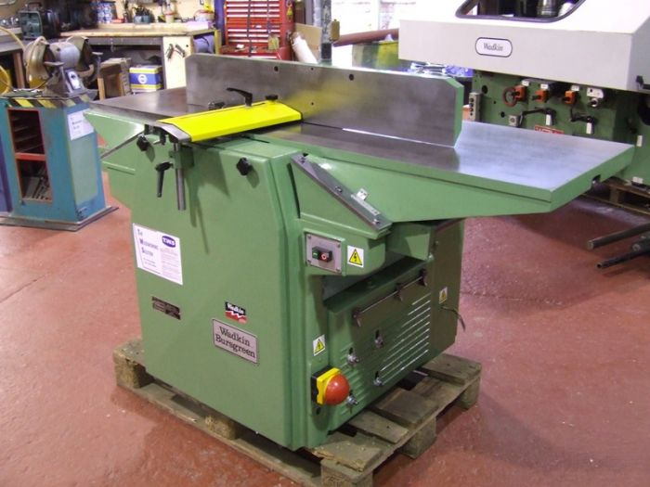
Planer and Thicknesser
Either separate or together
Used for flattening the surface of pieces of wood + reducing their thickness to specified measurements

Slide 11
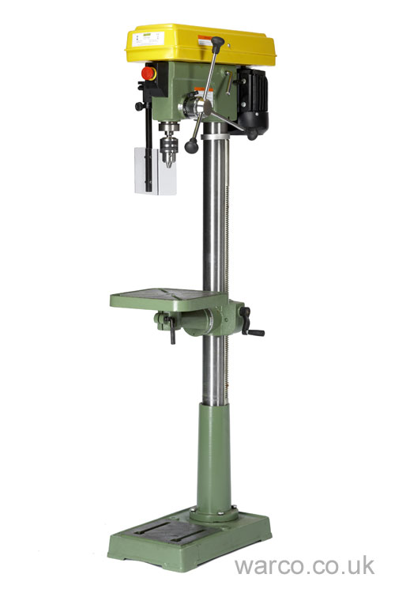
Pillar Drill or Pedestal Drill
Used to make round holes
Used on all kinds of materials
^ depends on drill bit used

Slide 12
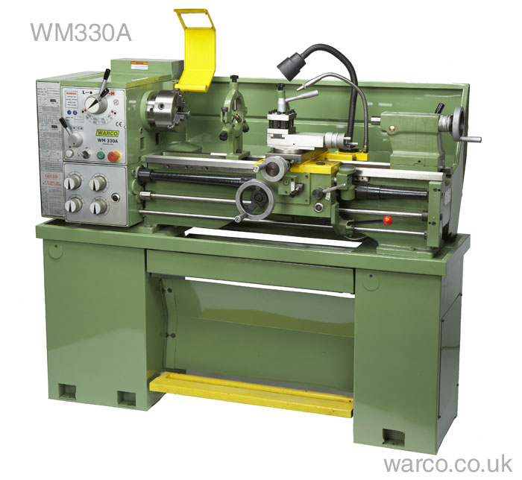
Lathes: Wood Lathes + Engineers’ Lathes
Material help + rotated by the lathe, while the turning tool or cutting bit is pressed onto the material to cut it
Used to produce round objects

Slide 13
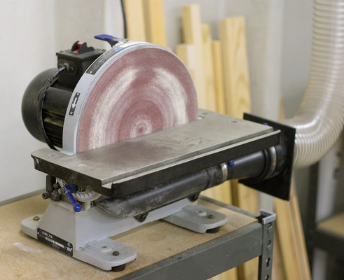
Sanding Disc
Spins a disc of abrasive paper – material pushed against this
Used for trimming accurately to line
Dif types of paper for wood, metal or plastics

Slide 14
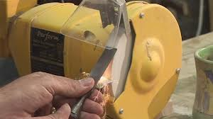
Bench Grinder
Contains abrasive wheels of dif grades
Used to remove metal for shaping or finishing
Sharpening edges tools i.e. chisels

Slide 15
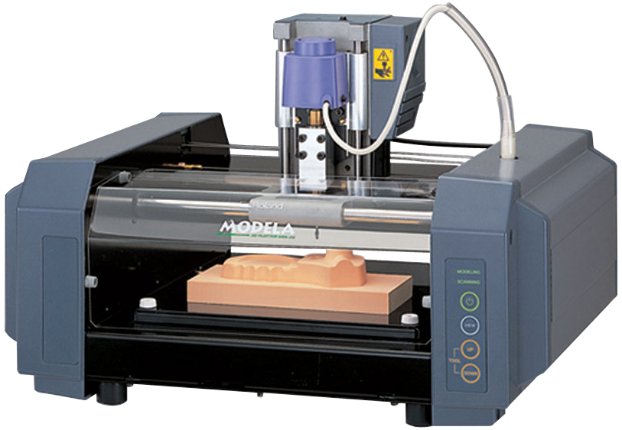
Milling Machine
Used to remove material one thin layer at a time
Also used to make a surface absolutely flat
Can produce v.accurate finish

Slide 16
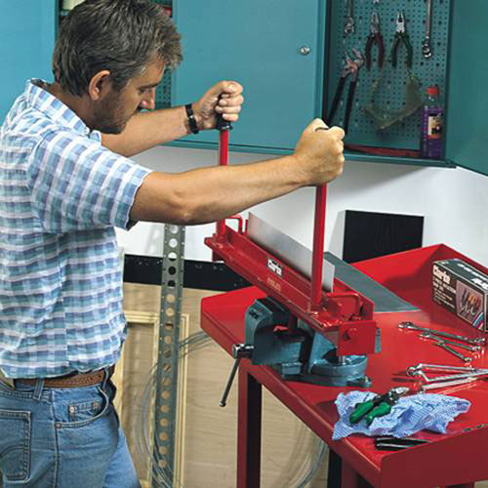
Sheet Metal Folder
Outline of product e.g. A box, is marked out + cut from a flat sheet of metal
Feed metal in flat, make one fold then move the material through for next fold
Corners can be joined with rivets or soldering, brazing etc.

Slide 17
Other methods
Some thin pieces can be bent cold on a jig or former
Thicker or harder have to be heated or annealed first + allowed to cool
^ makes them soft enough to bend easily but the annealing process may need to be repeated as bending makes them go hard again – ‘work hardening’
Iron + steel can be forged
^ a fire with air blown into the middle of it to produce a very hot flame
^then hammered into shape on an anvil

Slide 18
Laminating
Gluing thin strips of wood together
Thin strips of wood – usually 2-6 mm thick
Glued together + held in a jig
Keeps them in the right place till the glue has dried
Things that could be made this way: rocking chair runners, chair or table legs + roof beams

Slide 19
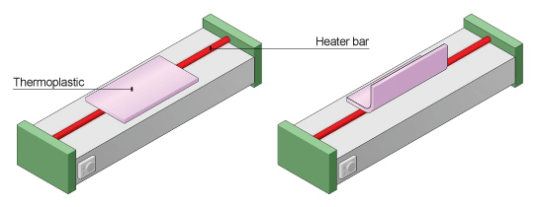
Line Bending
Ideal with acrylic sheets
Line bender or strip heater
Rest sheet on two bars
Element between heats the plastic

Slide 20
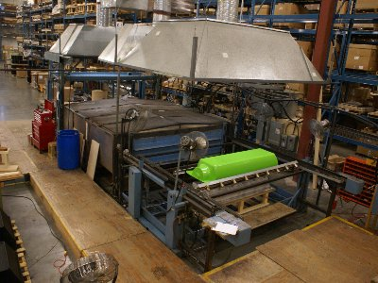
Press Moulding
Shapes thermosets
A ‘slug’ of thermosetting plastic powder is put into a ‘female’ mould
A former (‘male’ mould) is pressed onto it + pushes the plastic into the mould
V.high temps + pressures liquefy the powder + the plastic is set into permanent shape

Slide 21
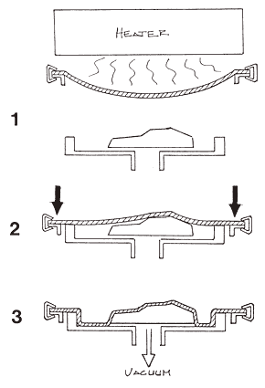
Vacuum Forming
Sheet of thermoplastic heated until goes soft
A mould then put onto the vacuum bed
Bed then lifted close to the heated plastic
Air is sucked out from under the plastic, creating a vacuum
Air pressure from outside the mould then forces the plastic onto the mould

Slide 22
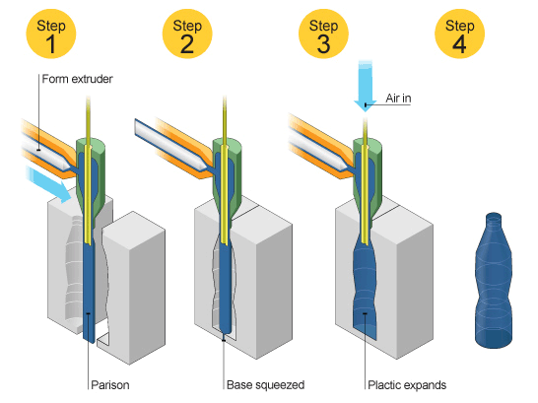
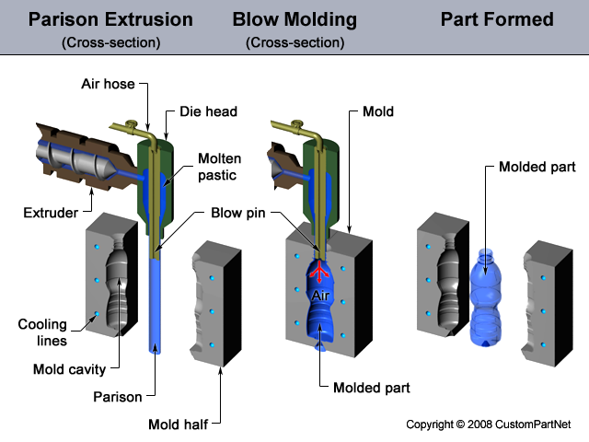
Blow Moulding
Tube of softened plastic is inserted into a solid mould
Air then injected which forces plastic to expand to shape of the mould
Method often used to produce bottles + containers

Slide 23
Die Casting
Used to mould metals + thermoplastics
Material is metal + poured into a mould (the ‘die’) which is the shape of the product
Some plastics resins can be cold-poured into moulds
^ they harden or set through a chemical reaction

Slide 24
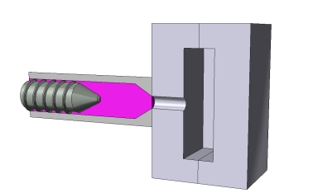
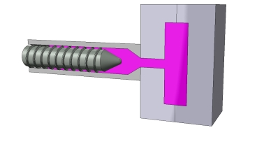
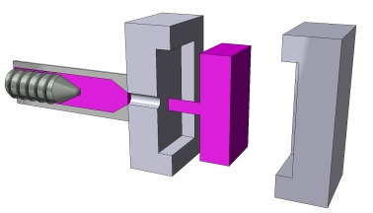
Injection Moulding
Similar to casting but molten material is forced into a closed mould under pressure
Moulds often made from tool steel = quite expensive
Plastic is often melted using built-in heaters
It’s an industrial process which is usually automatic + continuous

Slide 25
Extrusion
Produces long, continuous strips
Very similar to injection moulding
Used for some metals + thermoplastics
Material is melted + forced under pressure through a die
Produces long, continuous strips of the moulding exactly the same shape as the exit hole
Used for products like plastic-covered wire, + plastic + aluminium edgings

Slide 26
Assembly
If using permanent joining methods check with a ‘dry run’ that parts fit
Think of order i.e. if creating something with shelves don’t put top on before!
Before joining parts make sure the joint is clean, try not to then touch as fingerprints leave grease
Is it easier to clean up and apply a finish before assembly?
Don’t release clamps to early

Slide 27
Finishing
First remove any visible tool marks + blemishes (using files, emery cloths, glasspaper etc.)
Clean surface of dust etc. first (can use white spirit)
Use correct type of paint for material

Slide 28
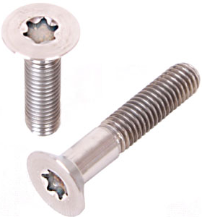
Screws + Bolts
Dif types for wood, metals + plastics
Woodscrews often need ‘pilot’ holes before
As screw turned with screwdriver the thread pulls it into the wood
Dif types of head for dif jobs
Self-tapping screws – hardened threads, designed to cut own threaded holes, hard materials; metals + hard plastics
Machine screws – straight shank, used with washers + nuts, heads vary, some use an Allen key some screwdriver
bolts are similar ^ but have square or hexagonal head + tightened with spanners
ALL: usually made from steel brass or stainless steel + are ‘self-finished’ or plated with zinc, brass, chrome, or black japan

Slide 29
Nails
Similar to woodscrews but have straight shank with no thread
Use hammer
Can use a nail punch so below surface + can’t see head
Only used in wood + wooden products
Much quicker than screws but joint isn’t as strong
Mostly made from steel but are special ones
Variety of head + shank shapes

Slide 30
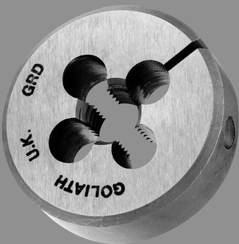
Threading
Method of fastening machine screws + bolts directly into a metal or plastic component without using nuts
A hole is drilled
‘tap’ used to cut a female thread hole
Screw inserted into it + tightened until stops
Can make a round rod fit a threaded hole by cutting a male thread onto the outside of the rod
^ cut using ‘split die’ or on a lathe
Lets you join components without using bolts or screws
Split Die

Slide 31
Joints

Slide 32
Knock-Down Fittings
Are non-permanent joints
Blocks, brackets which enable furniture to be assembled + taken apart again easily
Very fast to use
Not as strong as glued joints
Most assembled with screwdrivers or Allen keys
Usually for cheap ‘flat-pack’ furniture

Slide 33
Right Adhesive
Dif types for dif materials + dif jobs
E.g. PVA –wood, acrylic cement – plastics, contact adhesive + epoxy resin – lots of materials
Only work properly if choose right one + surfaces are really clean
Some plastics can’t be glued – too smooth + have a greasy texture which stops the glue from ‘keying in’

Slide 34
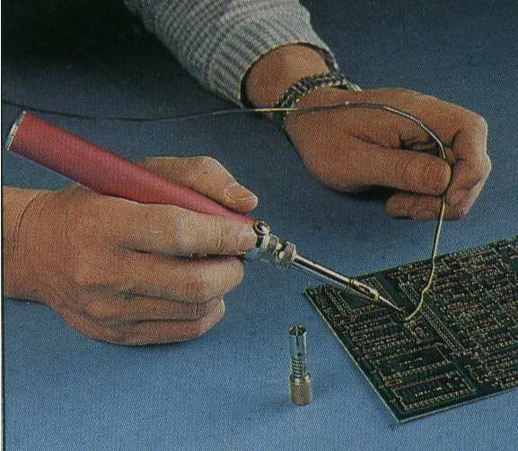
Soldering
Relatively low temp process
solder- - made from tin + other metals
^ melted onto the components to be joined
Sticks them together when it cools + solidifies
Soldering iron or blow torch used

Slide 35
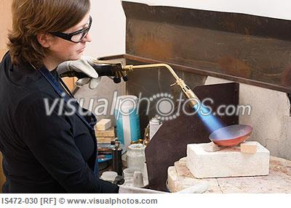
Brazing
Higher temp process
Joining material - brass spelter
Stronger than soldering
Gas brazing torch, blow torch, or a brazing attachment for an electric-arc welder is used to heat the joint

Slide 36
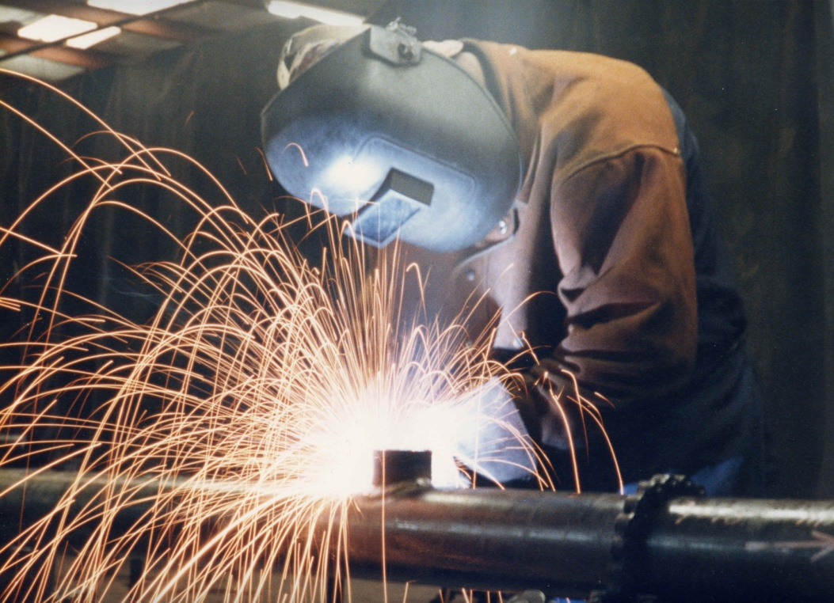
Welding
Strongest method
V.high temp
Oxyacetylene torch, electric-arc welder or a laser
Melt the edges of the joint so that they flow together
Fill in thinned metal or slight gaps
Metal from a welding rod is melted on

Slide 37
Joint Preparation
Joints have to be well-fitted – minimal gaps
V.clean + free from grease, fingerprints can stop solder or brass spelter from ‘taking’ – can use solvent i.e. White spirit to degrease
Flux – cleaning agent, stops air from oxidising surface of metal while heating (otherwise would also stop from ‘taking’)

Slide 38
Rivets
A metal peg with a head on one end
Mostly for joining pieces of metal
Hole drilled through both pieces of metal + rivet inserted with a set
Head held against the metal, other end is flattened + shaped into another head with a hammer
‘pop’ or ‘blind’ rivets are very common
Can be used where only access to one side of the material (hence blind)
Fast + easy method of joining sheet metal

Slide 39
Pop rivets

Slide 40
CAD/CAM
Computer Aided Design – use to draw designs in 2D + 3D
Computer Aided Manufacture – take info from the CAD drawing + manufactures the product
Machines used in CAM are Computer Numerically Controlled (CNC)
Can batch produce, copy + paste design

Slide 41
Subtractive + Additive
Subtractive – material is removed from a larger piece of material to create a product
E.gs of subtractive CAM systems = CNC routers, milling machines + laser cutters
Additive – adding material to build up the product rather than removing it, e.g:
3D printing – prints layers of molten plastic, powder or wax until full 3D shape is formed
Stereolithography – uses a laser bean to ‘cure’ liquid resin (turn solid) in thin layers, pricier + slower than 3D printing
Laser-sintering – similar, laser fuses powder together instead of curing liquid, quicker than stereolithography but not as good finish

Slide 42
CAD/CAM
Advantages | Disadvantages
Save money in long run | Very expensive to buy + set up
Easy to develop + edit from all angles – easy to experiment, materials + finishes | Computers can be affected by software problems, viruses + corrupted files – potentially slowing down production
Can produce very realistic designs quickly on screen – helps boss/client understand the proposition | Fewer workers = unemployment increase + traditional skills could be lost
Products can be machined at high speed + run 24hours a day = lots in short space of time | Traditional one off edge of product lost
Machines can work in human hazardous conditions i.e. paint spraying
High quality + more reliable finish (no human error involved)
Labour cost are lower

