Slide 1
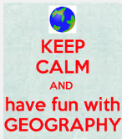
Yr 7 Geography Exam Revision
Go through these tasks and questions to help you to revise

Slide 2
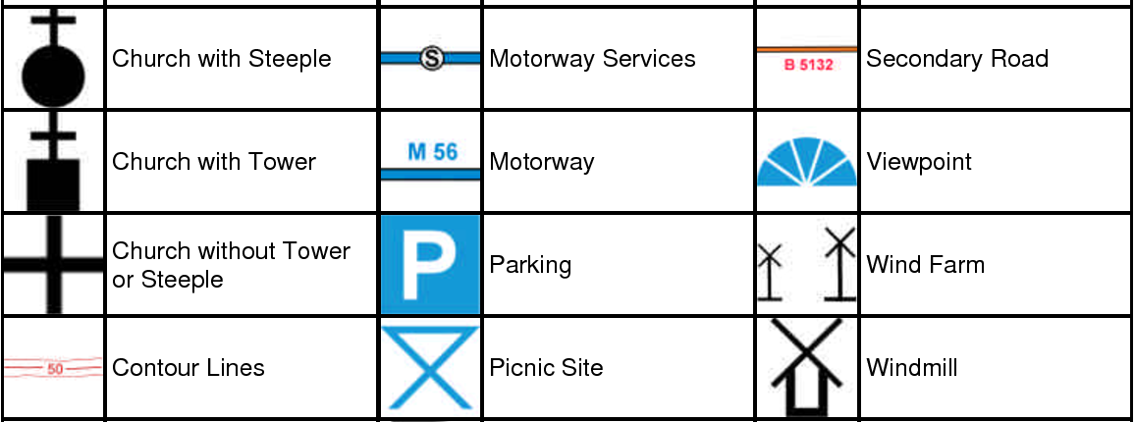
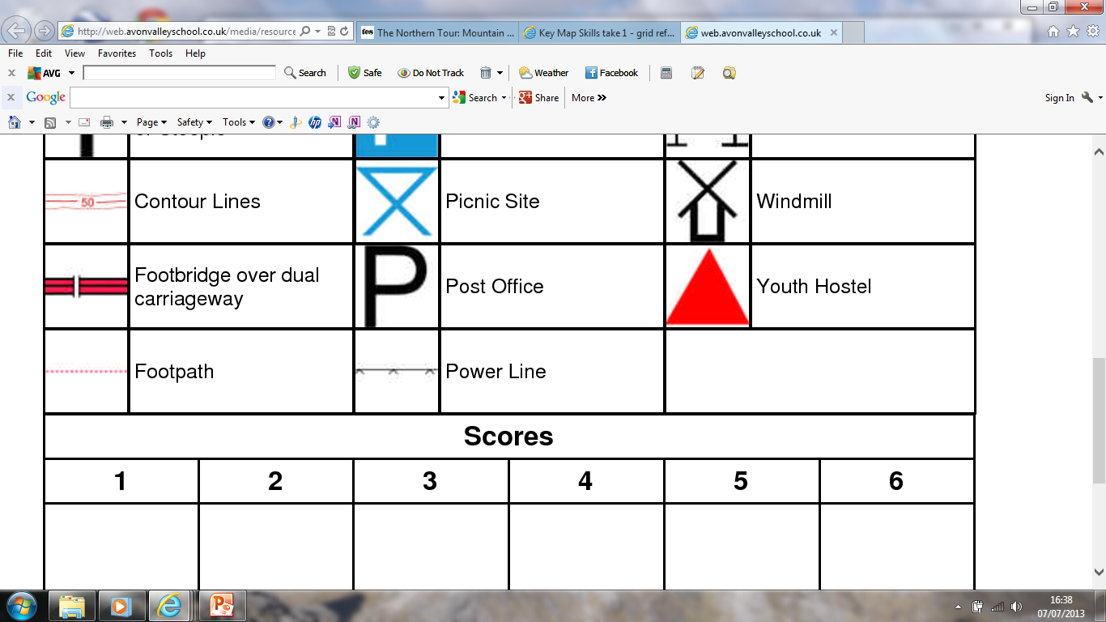
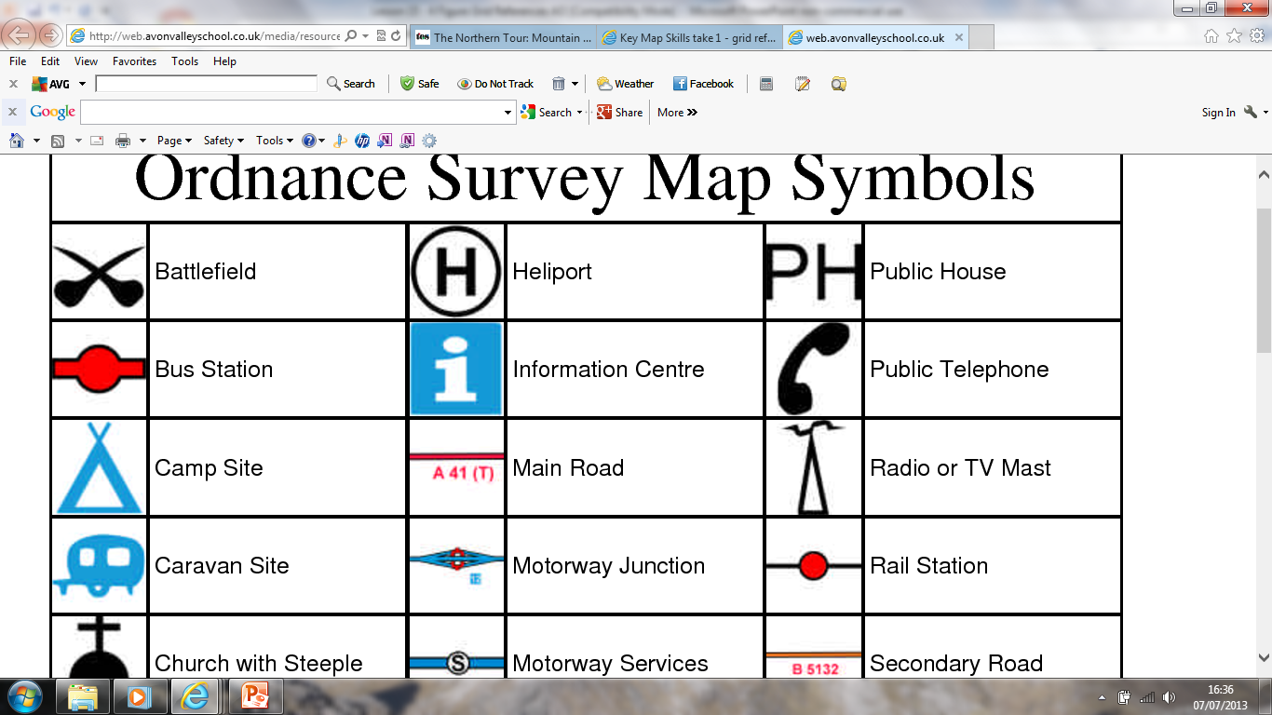
1
5
9
2
6
10
3
7
11
4
8
12
List the numbers 1-20 in the back of your book
See how many symbols you can correctly identify while I take the register ☺
13
17
14
18
15
19
16
20
Notes:
00:00-00:10 (+L.O.s)

Slide 3
What are the 4-figure grid references for each feature?
15
School =
Bridge =
Pub =
Windmill =
Church =
Post Office =
Bridge
14
School
Church
13
PH
Public
House
12
P
Post Office
Windmill
11
03
04
05
06
07
08
Extension:
Could you give the 6 figure grid reference for the ‘P’ and the ‘PH’
Notes:
Point out – they are just like taking co-ordinates in maths!

Slide 4
Map Skills
TASK: Explain how you would do the following skills/ what you need to know or look out for.
4 figure grid references
6 figure grid references
Compass Direction
Contour Patterns

Slide 5
Plate Tectonics
What are the names of the plate boundaries?
Can you remember the movement of the plates?
Could you label the structure of the earth, a volcano, a hot spot diagram and an earthquake diagram?
Could you explain what happens when a volcano erupts or an earthquake occurs?
What are the effects of a volcano or an earthquake?

Slide 6
Population
What are some of our key words?
Could you explain what some of these words mean?
What are push and pull factors?
Could you give examples of these?
Why are some areas of the UK growing in population?
Why are some areas of the UK shrinking in population?

Slide 7
Year 7 Geography Exam Revision
Create a revision page for these 3 topics. You will need words of advice, key words and some examples of sentences that you might write.
MAP SKILLS | PLATE TECTONICS | POPULATION

