Slide 1
Y11 Information Evening
Mr Keeling
keelingj@wallingfordschool.com
Assistant Headteacher Wallingford School

Slide 3
Y11 Information Evening
Important dates
Revision
Mock exams

Slide 4
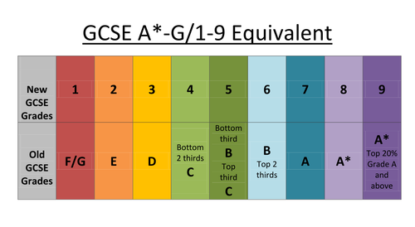
Y11 Information Evening

Slide 5
Y11 Information Evening
Important dates
Thursday 16th November - Y11 Parent’s Evening
Tuesday 21st and Wednesday 22nd November – English and Maths Mocks 1
Monday 11th December until Monday 18th December – Other Subject Mocks 1
Friday 12th January – Mock results envelopes
Monday 26th February – English and Maths Mocks 2
Monday 5th March until Monday 12th March – Other Subject Mocks 2
Friday 11th May – Y11 Celebration Day
Thursday 21st June – Founder’s Day
Thursday 23rd August – Result’s Day

Slide 6
Y11 Information Evening
Revision Myths True or False
Listening to music when you revise helps you to concentrate harder?
Revising in hour to two hour long sessions is the most effective?
Having to explain an idea to someone else is more effective than just writing notes?
Cramming the night before is just as good as revising in advance?
Highlighting notes is only effective if you then do something with the highlighted parts?

Slide 7
Y11 Information Evening
Revision Myths True or False
Listening to music when you revise helps you to concentrate harder - FALSE
Revising in hour to two hour long sessions is the most effective - FALSE
Having to explain an idea to someone else is more effective than just writing notes - TRUE
Cramming the night before is just as good as revising in advance - FALSE
Highlighting notes is only effective if you then do something with the highlighted parts - TRUE

Slide 8
Y11 Information Evening
Revision – Top tips
Plan your breaks
Have all the equipment you need before you start
Start early
Setting yourself up for revision
Make a realistic timetable
No distractions
Try to have a designated revision area

Slide 9
Y11 Information Evening
Revision – Top tips
Revisit stuff over and over again
Have a start time and end time
Vary the subjects
Doing the revision
Vary the activities
Jot down things you don’t understand and ask
Revise specific topics. ‘Chunk it’.

Slide 10
Y11 Information Evening
Revision – Top tips
Don’t listen to what your friends say
Leaving the hardest stuff to last
Phones, laptops, pads
Things to avoid
Cramming
Just reading the revision guide
Long study sessions
Study Tips

Slide 11
Y11 Information Evening
Revision – Top tips from students
“Ask for help when you are stuck. The teachers want to help and are on your side even though it doesn’t feel like it sometimes”.
“Start early!!! I wish I had, the year goes really quickly”.
“Do other things. Going for a run or doing exercise really helps. You can’t just work work work”.
“You’re going to have a GREAT Summer holiday. Try to remember revision isn’t forever”.
“I enjoyed making flashcards. I used to get my sister to test me on long car journeys”.

Slide 12
Y11 Information Evening
Mock exams
Tuesday 21st and Wednesday 22nd November – English and Maths Mocks 1
Monday 11th December until Monday 18th December – Other Subject Mocks 1
Friday 12th January – Mock results envelopes
Monday 26th February – English and Maths Mocks 2
Monday 5th March until Monday 12th March – Other Subject Mocks 2

Slide 13
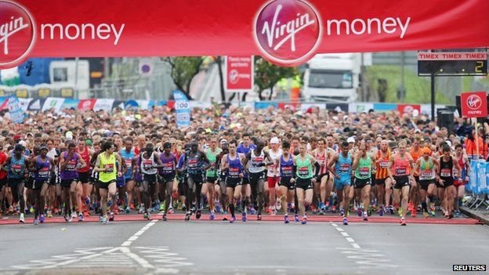
Work hard
Aim high
Run your own race

Slide 14
Y11 Information Evening
Mr Keeling
keelingj@wallingfordschool.com
Assistant Headteacher Wallingford School

