Slide 1

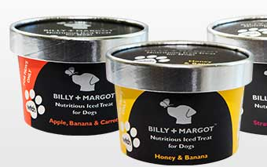

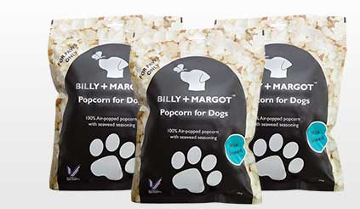

Principles and Purposes of Marketing
A1
The role of marketing
What are the similarities and differences between these 2 markets?

Slide 2
Principles and Purposes of Marketing
In this topic you will learn about
  Principles and purposes of marketing:
    Anticipating demand
    Recognising demand
    Stimulating demand
    Satisfying demand
  Marketing aims and objectives:
    Understanding customer wants and needs
    Developing new products
    Improving profitability
    Increasing market share
    Diversification
    Increased brand awareness and loyalty
  Types of markets
    Mass market
    Niche market
  Market segmentation
  Branding, brand personality, brand image, unique selling point (USP), implications of business size of marketing activity, budgetary constraints, availability of specialist staff

Slide 3
Marketing
Marketing is the identification, satisfying and revisiting of customer needs
Covers a number of activities including:
  Researching the market to identify customer needs
  Making decisions about the product, price, place and promotion in order to satisfy customer needs
  Keeping up to date with changes in the market in order to keep customers coming back and attract new customers
All with a view to making a profit

Slide 4
Principles and purposes of marketing
Demand is the amount of a good or service society is willing and able to buy at a set price at a given point in time.
The principles and purposes of marketing i.e. why do businesses carry out marketing, include:
  Anticipating demand
    Forecasting sales
    Identifying trends
    Primary and secondary market research
  Recognising demand
    Identifying a gap in the market
    Forecasting market trends
    Understanding customers’ wants and needs
    Primary and secondary market research
B Using information to develop the rationale for a marketing campaign will look at this in more detail.

Slide 5
Principles and purposes of marketing
The principles and purposes of marketing, include:
  Stimulating demand
    Informing existing and potential customers about the products
    Generating interest
    Developing brand recognition
  Satisfying demand
    Meeting customer needs
    Developing new products
    Changes to the marketing mix
C Planning and developing a marketing campaign will look at this in more detail.

Slide 6
Marketing objectives
Marketing objectives are likely to be informed by research and potentially constrained by budgets
They will be used to select the marketing strategy and develop a marketing campaign
Marketing aims and objectives may focus on:
    Understanding customer wants and needs
    Developing new products
    Improving profitability
    Increasing market share
    Diversification
    Increased brand awareness and loyalty

Slide 7
Marketing objectives
  Understanding customer wants and needs
    With a view to satisfying them
    Anticipating changing tastes and preferences
    Gaining a competitive advantage
  Developing new products
    Innovative products
    Extensions to existing products
    Responding to technological advancements
  Improving profitability
    Increasing revenue whilst maintaining costs e.g. more repeat purchases
    Charge higher prices as a result of brand loyalty

Slide 8
Marketing objectives
Increasing market share
  Market share is the proportion of total market sales that a firm has
  Market share can be calculated as:
    Business A sales/market sales x 100
  Wider brand recognition
Diversification
  Bringing out new products for new markets
  Spreading risk
  Building brand strength

Slide 9
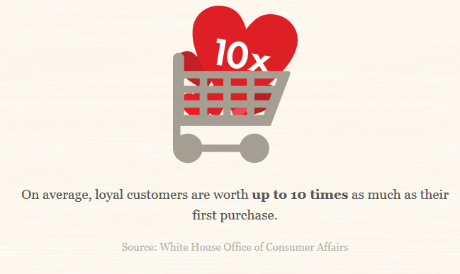
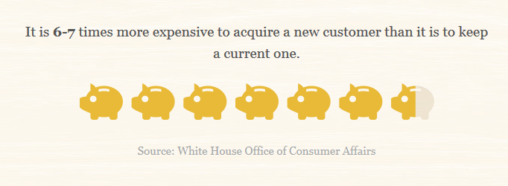
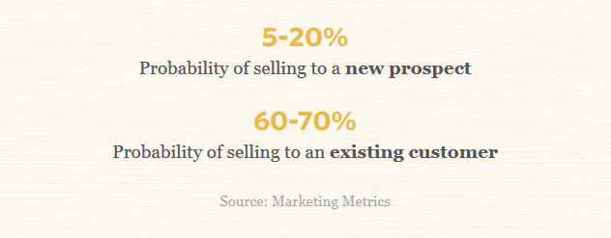
Marketing objectives
    Increased brand awareness and loyalty
  Brand loyalty exists when customers keep returning to buy a recognised brand
  Branding is a promotional method that involves the creation of an identity for a business that distinguishes it and its products from competitors

Slide 10
In pairs
Mondelez wins with share bags but Mars suffers after downsizing
Prepare a short presentation about the confectionery market
Show your understanding of all the terminology covered under marketing objectives
Notes:
http://www.confectionerynews.com/Markets/Top-10-UK-chocolate-brands
Mondelez wins with share bags but Mars suffers after downsizing

Slide 11
Types of markets
Mass markets
  A product is targeted at a wide range of people
  The market is not segmented i.e. the characteristics of types of customers are not an important factor
  Products appeal to a wide range of customers
  Products are widely available through a range of markets
  Mass media is used to advertise the products
How many of Nestlé's brands are in a mass market?
Draw a spider diagram of products that are sold in a mass market.
Notes:
http://www.nestle.co.uk/brands

Slide 12
Types of markets
Niche market
  Identifying small, currently unsatisfied, gaps in the market
  The target market is well defined with distinct characteristics
  Promotional activities will be targeted at just a small subsection of the whole market
  Can often charge higher prices
Visit the website and watch the video clip.
What are the characteristics of the “Billy + Margo “ market?
Niches are sometimes said to be created rather than to exist. To what extent do you agree with this?
Notes:
http://www.billyandmargot.com/

Slide 13
Mass markets and niche markets
Market size – this is the total value or volume of sales in the market. It can be measured in money terms e.g. £20 million or by the amount sold e.g. 1 million cars
  Calculated as: Number of units sold x price
Market share – this is the proportion of total market sales that a firm has
  Calculated as: Sales of one firm/Total market sales x 100
Use the terms market size and market share to explain the difference between a mass and a niche market.

Slide 14

market segmentation
Market segmentation occurs when the market is split into subgroups of consumers with similar characteristics
This helps to identify different types of consumer and different wants and needs
Segmentation methods include:
  Demographic
  Geographic
  Income
  Behavioural

Slide 15
Demographic segmentation
Identifies subgroups of the population based on their demographic profile or characteristics
  Age
  Gender
  Level of education
  Race
  Religion
  Family size
  Stage in life e.g. empty nesters
Demographics looks at the social and economic characteristics of individuals and households
Was Lego correct to segment the market by gender?
Notes:
http://www.bbc.co.uk/news/business-19439692
Lego Friends 'not stereotypical'

Slide 16
Geographic segmentation
Geographic segmentation defines market categories based on where people live e.g. regions, cities or neighbourhoods
People in different geographical areas display different characteristics and needs e.g.
  The South East of England is generally warmer than Scotland
  Tastes and traditions vary between countries
  Infrastructure in rural areas will differ from that of cities
How has McDonald’s had to reposition its products to meet the needs of the Indian market?
Notes:
http://www.bbc.co.uk/news/business-30115555
How McDonald's conquered India

Slide 17
Income segmentation
Identifying subgroups of the market based on their levels of income and profession
A common method uses socio-economic groupings
  A – Higher managerial such as chief executives and directors
  B – Intermediate managerial such as solicitors, accountants and doctors
  C1 – Supervisory, clerical or junior professional such as teachers and junior managers
  C2 – Skilled manual such as plumbers, electricians and carpenters
  D – Semi and unskilled workers such as refuse collectors and window cleaners
  E - Pensioners, casual workers, students and unemployed
Visit the Ford website – select 3 models of cars and explain which socio economic group each car would suit.
Notes:
http://www.ford.co.uk/Cars

Slide 18
Behavioural segmentation
Characterises subgroups based on the behavioural patterns of the consumer rather than their characteristics
  Reasons for making purchases e.g. needs, emotional, rewards
  Frequency of purchase e.g. heavy user or light user
  Time of purchase e.g. seasonal, weekly, late at night
  Brand loyalty
  Method of purchase e.g. online
  Triggers e.g. response to digital marketing
Are loyalty cards for the benefit of the consumer or the business?
Notes:
http://www.bbc.co.uk/news/business-32036916
Shoppers with reward cards see little point in loyalty

Slide 19
Impact of market segmentation
There are a number of benefits for businesses and customers of market segmentation:
  Advertising can be targeted at specific market segments so that advertising spend is more effective
  The most profitable and least profitable customers can be identified
  Least profitable markets can be avoided
  It becomes easier to identify and launch new products
  It helps the firm improve existing products and customer service
  Businesses are better able to meet the specific needs of groups of customers
  Greater variety of goods and services available in the market

Slide 20
In pairs
Select one industry e.g. watches, jewellery, mobile phones, hotels
Identify how the market is segmented
Produce a poster to illustrate the use of market segmentation in your chosen industry

Slide 21
Brand, brand personality, brand image
A brand is a product produced by one business using a specific name
Branding involves the creation of an identity for the business that distinguishes that firm and its products from other firms
Consumers have a perception of what to expect from a particular brand e.g. quality, satisfaction
A brand is a trademark that cannot be copied
Brands can be:
  Name
  Shape
  Symbol
  Colour
  Logo
Branding can add value to a product allowing firms to charge higher prices and also leads to brand loyalty whereby customers will continue to buy products from that firm
Competitive advantage is a feature of a business that allows it to perform more successfully than others in a market.

Slide 22
How many brands?
You have 30 seconds to write down as many brands as you can think of starting from NOW!
30
29
28
27
26
25
24
23
22
21
20
19
18
17
16
15
14
13
12
11
10
9
8
7
6
5
4
3
2
1
End
Who owns all the major brands?
Notes:
http://i.kinja-img.com/gawker-media/image/upload/s--iZEIMjGq--/794701813831831470.jpg

Slide 23
Sometimes a brand is so strong it changes our language!
Brand image is portrayed by a strong brand. Society identifies with, recognises and has specific expectations of a given brand.
Do you have a hoover at home?
Have you a biro in your bag?
When’s the last time you played with a frisbee?
Can you think of other examples?

Slide 24
Brand, brand personality, brand image
Brands help build loyalty and repeat business as well as adding value allowing businesses to charge higher prices
Other benefits include:
  Brand extension
    Adding new product ranges to a recognised brand name
    Consumers familiar with or loyal to the brand and more likely to be willing to try new products
      e.g. customers happy with the service provided by Virgin Media might be more willing to join Virgin Active
  Brand value
    The brand name itself adds value to the product. It is therefore said to have a money value and less has to be spent on advertising the brand once established
      e.g. what is the price of a jacket from Hollister compared to a similar non branded jacket – what are you paying extra for?
  Brand personality
    Brands almost take on a persona of their own, we associate them with certain human characteristics
      e.g. what do you think of when you think Google or Innocent

Slide 25
Unique selling point (USP)
Unique selling point (USPs)
  Creating a feature or characteristic within a brand that makes it stand out
    Logo or brand name e.g. Superdry
    Different ingredient e.g. SuperJam is sweetened by natural grape juice not sugar
    Product feature e.g. Ford’s heated front windows

Slide 26
Business size
The size of a business will impact on marketing
  Budgetary constraints
    The amount of money available to fund a campaign
    Ability to afford top agencies or celebrities
    Amount of coverage
  Specialist staff
    In-house specialists e.g. monitoring social media
    Experts in the field
“Here come the girls” one of the most successful campaigns. How was this made possible by Boots’ size?
Which companies do you think are in the billionaire club spending over a billion $ a year on advertising?
Notes:
http://theinspirationroom.com/daily/2010/boots-here-come-the-girls-for-christmas-2010/
https://www.theguardian.com/media/2008/nov/05/advertising-christmas

Slide 27
Principles and Purposes of Marketing
In this topic you have learnt about
  Principles and purposes of marketing:
    Anticipating demand
    Recognising demand
    Stimulating demand
    Satisfying demand
  Marketing aims and objectives:
    Understanding customer wants and needs
    Developing new products
    Improving profitability
    Increasing market share
    Diversification
    Increased brand awareness and loyalty
  Types of markets
    Mass market
    Niche market
  Market segmentation
  Branding, brand personality, brand image, unique selling point (USP), implications of business size of marketing activity, budgetary constraints, availability of specialist staff

