Slide 1
Developing the rationale
Respondent number | Price | Colour
001 | £25 000 | Blue
002 | £22 500 | Blue
003 | £30 000 | Red
004 | £27 500 | Black
005 | £30 000 | White
006 | £27 000 | Silver
007 | £26 000 | Blue
008 | £25 000 | Black
009 | £21 500 | Red
The following data was collected from a survey by a car manufacturer.
How useful is the data?
Assuming there was substantially more data how would you make it more meaningful?
B3
Developing the rationale

Slide 2
Developing the rationale
In this topic you will learn about
  Interpretation, analysis and use of data and other information to make valid marketing decisions
  Identification of any further sources of information that may be required
  Evaluation of the reliability and validity of the information obtained
  Product Life Cycle

Slide 3
Interpretation, analysis and use of data and other information to make
valid marketing decisions
Recap.
Can you distinguish between data and information?
Rationale is the reason for doing something
This identifies the reason for or the objectives of the research e.g. to inform new products development, to identify the best way to promote, to understand the target market
In order to analyse and interpret data a business is likely to use:
  Graphical representation e.g. charts and graphs
  Statistics e.g. mean and mode
  Transcriptions of recordings
  Collating data e.g. tally charts
  Displays of photographic evidence

Slide 4
The interpretation of marketing data
Inform decision making
Devising strategy
Understanding the market
Identify sales patterns
Realistic target setting
Keeping up to date with market changes
Review of competitors’ actions
Evaluation of past actions

Slide 5
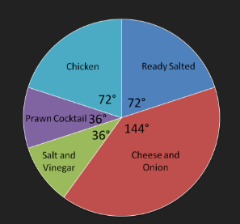
Activity
Crisps sold by a leading manufacturer in 2016.
What does this chart show? Identify 3 points of interest:
How could this information be used?
If the total sales of crisps in 2016 were 500 000 packets 40% of these were cheese and onion.
144/360 x 100 = 40%
500 000 * 0.40 = 200 000 packets sold were cheese and onion.
How many packets of ready salted, chicken, prawn cocktail and salt and vinegar were sold? How could this information be used to inform marketing decisions?

Slide 6
Identification of any further sources of information that may be required
Recap.
Can you distinguish between primary and secondary market research?
Research gathered may need to be supported by additional sources
Possible reasons for this include:
  To validate findings e.g. to back up with a second source
  To further investigate findings e.g. if an unexpected outcome is received this might change the focus of the research
  To fill in gaps in the research
  In response to changing external environment
  To increase the sample size to ensure greater reliability
Further sources may be either further primary or secondary research

Slide 7
Evaluation of the reliability and validity
of the information obtained
Recap.
What is the importance of validity, reliability, appropriateness, currency and cost?
Consider the research you carry out to complete your external assignment.
How reliable and valid are your findings?
Businesses will want to test the reliability and validity of the information obtained
It is important to identify and question any risk of bias
Sources should always be given on research findings and any assumptions made stated
Possible methods of evaluation include:
  Duplicating research and comparing results
  Test groups or placebo groups
  Self or group critique of research methods
  Identifying gaps in the research
  Consider sample size and method

Slide 8

Confidence Levels
Confidence levels reflect the degree of certainty with which a business believes a stated outcome will happen
  E.g. 90% confident that research findings are accurate and therefore 1 out of 3 customers will buy the new product
Confidence levels will be affected by factors such as the sampling technique, research method and expertise of the person carrying out and analysing the research

Slide 9
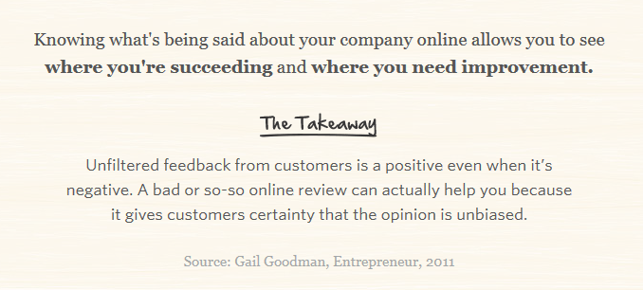
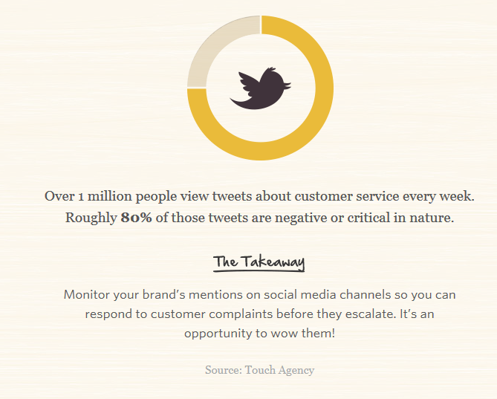
The value of technology
Discuss the reliability and validity of the information gathered from of social media.
Notes:
http://www.bbc.co.uk/news/business-33205905
Navigating the potentially murky world of online reviews

Slide 10
Product life cycle
Market research will help identify the needs and wants of customers at different stages of thee product life cycle as well as inform extension strategies and indicate the length of the life cycle.
Product life cycle is a technique used to track the stages a product goes through during its life
It tracks sales over time from the development stage of a product through launch and until it is removed from the market
Although a product life cycle relates to just one product business will want to have products at different stages
For example the revenue from a product that has reached maturity could be used to help develop a new product

Slide 11
Product Life Cycle
The stages that a product will go through in its lifetime are:
Development – negative cash flow due to market research and Research and Development (R&D). No sales revenue before launch
Introduction – production and promotion costs can be high
Growth – sales revenue increases but as more units are sold production costs also increase. However, there will be economies of scale
Maturity – sales stabilise and the product acts as a cash cow
Decline – at some point the product will start to lose sales.
Extension strategies - many products are adapted and given a new lease of life

Slide 12
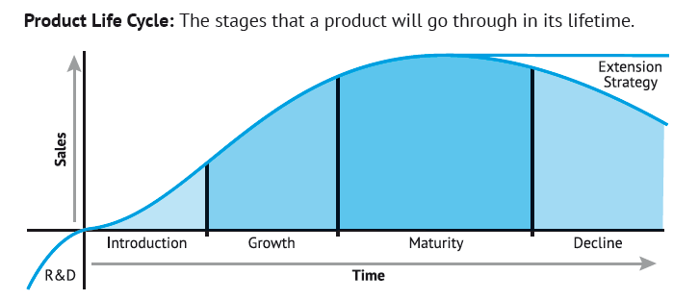
Product Life Cycle

Slide 13
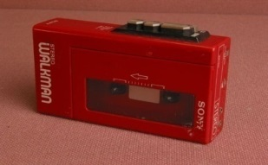
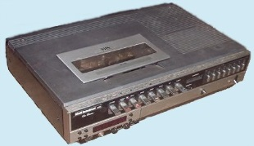
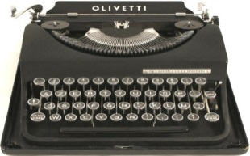
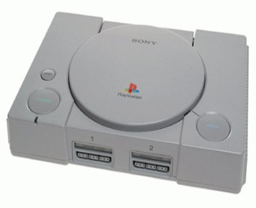
In pairs
Produce a product life cycle for a product of your choice. Use the internet to see if you can find the timeline of the product. Complete the time stages that the product went through during each stage of its lifetime:
Development
Introduction
Growth
Maturity
Decline
Extension strategy
If you are stuck look at some of the following: video recorders or cassettes, the Sony Walkman, vinyl singles or LPs, Playstation or any other similar type of product.

Slide 14
Developing the rationale
In this topic you have learnt about
  Interpretation, analysis and use of data and other information to make valid marketing decisions
  Identification of any further sources of information that may be required
  Evaluation of the reliability and validity of the information obtained
  Product Life Cycle

