Slide 1
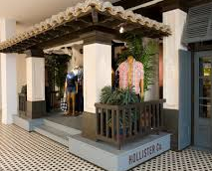
Marketing mix
C2
Marketing Mix
There are 7 elements of the marketing mix known as the 7Ps of marketing.
Can you work out what they are?
P _ _ _ _ _ _
P _ _ _ _
P _ _ _ _
P _ _ _ _ _ _ _ _
P _ _ _ _ _
P _ _ _ _ _ _
P _ _ _ _ _ _ _ / E _ _ _ _ _ _ _ _ _ _

Slide 2
Marketing mix
In this topic you will learn about
  Product development: form and function, packaging, branding
  Pricing strategies: penetration, skimming, competitor based, cost plus
  Promotional advertising, public relations (PR). Sponsorship, use of social and other media, guerrilla marketing, personal selling, product placement, digital marketing, corporate image
  Place, distribution channels: direct to end users (mail/online/auction), retailers, wholesalers
  Extended marketing mix: people, physical environment, process

Slide 3
the marketing mix
The marketing mix is the combination of elements through which a firm achieves its marketing objectives
Marketing Mix – the 7Ps
Product
Place
People
Price
Promotion
Physical evidence
Process

Slide 4
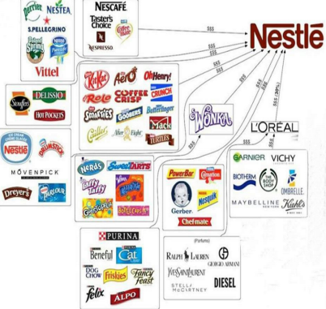
Product
Product is the goods and services that the firm provides
Product will be made up of core features and functions as well as additional aspects that can sway consumer behaviour e.g. brand or guarantees
  Goods are physical or tangible products e.g. a car or a television
  Services are non physical or intangible e.g. financial consultancy or teaching
Businesses will normally have a range of products in their portfolio
Recap: with the use of a diagram explain the product life cycle.

Slide 5
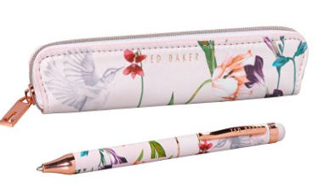
Product development
There are three fundamental elements of product or service design that must be taken into account during the research and development stage i.e. prior to launching onto the market
Function – does it do what it neds to do e.g. does the pen write?
Form – is it aesthetically pleasing creating a USP e.g. the Ted Baker "Oriental Bloom" Touchscreen Pen and Pouch.
Aesthetics/Form
Function
Cost

Slide 6
Product development
  Function
    The product or service has to be able to fulfil the primary purpose for which the consumer purchased it e.g. does the pen write? Is the car driveable?
    There may also be additional features and functions that add value to the basic product e.g. Is the oven self cleaning? Does the nail polish dry quickly?
  Form
    The look and the feel of the product, how our senses respond to the product e.g. can a laptop be pleasing to the eye and feel quality when working on it?
  Cost
    Whether or not it is possible to provide the good or service within a budget or at a cost point that will still allow the business to make a profit

Slide 7
In pairs
Write a list of 10 of your favourite products
Place each one in the triangle to show which element of the product design is most important to you
Are there any products that are bought just based on:
Form
Function?
Form
Function
Cost

Slide 8
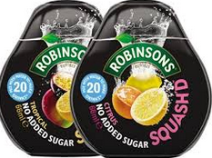
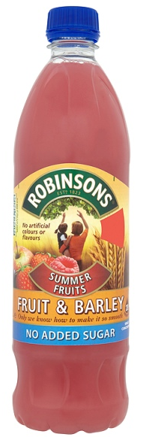
Activity
Write a list of the features and form of this product.
How does it differ from Robinsons’ traditional squash?
Why might these changes have been made?
Notes:
http://www.bbc.co.uk/news/technology-33151237
The e-bike without a chain

Slide 9
Packaging*
Packaging is the way a good is wrapped
However, it is also the way a good is presented to potential buyers and can therefore influence buying decisions
Aspects of packaging include:
  Product descriptions, images and contents e.g. ingredients
  Portrays an image e.g. luxury or health
  Warnings and safety information e.g. may include nuts
  Safety e.g. child proof caps on potentially dangerous products such as bleach
  Hygiene and protection
  Promotional offers
  Unique selling points
  Environmental concerns e.g. steps to reduce excess packaging or to recycle
Packaging can be governed by legislation
Can packaging create USP?
Should tobacco packaging be plain?
Notes:
https://www.quora.com/What-are-some-good-examples-of-funny-creative-product-packaging
http://www.bbc.co.uk/news/business-35058074

Slide 10
Branding
Is a brand a promise?
What happens if a brand breaks its promise?
What do you think are the top 10 brands in the world?
A promotional method that involves the creation of an identity for the business that distinguishes that firm and its products from other firms
Branding can add value to a product allowing firms to charge higher prices
Ultimately leads to brand loyalty whereby customers will continue to buy products from that firm
Organisations spend enormous amounts of time and money branding their company and products
Notes:
http://www.forbes.com/powerful-brands/
The World's Most Valuable Brands

Slide 11
Types of branding
Brand recognition comes in many forms including colour, logo, strap line and shape
Branding is traditional in business associated with giving a unique recognisable characteristic to a product or corporate image e.g. Toblerone’s unique shape or Heinz’s shade of green
This is corporate branding – it attaches a perception and promise to the goods and services associated with that brand e.g. quality, customer service, corporate culture
Other types of brand include:
  Personal – when a person brands themselves e.g. a sports personality or pop star
  Geographical brand – when a region, city, county or country creates a brand that epitomises the people and the lifestyle of that country, often used in tourism
Can you brand a landmark?
Is branding emotive?
Notes:
http://www.bbc.co.uk/news/uk-england-hampshire-33187732
Spinnaker Tower branding: New design revealed by council
http://www.yorkshiretea.co.uk/celebrate/

Slide 12
The benefits of a strong brand
Added value
Ability to charge premium prices
Reduced price elasticity of demand
Challenge:
All three of these are inter linked. Can you write a paragraph about the benefits of a strong brand, with reference to a company or product of your choice that links all three concepts.

Slide 13
Ways to build a brand
Unique selling point (USPs)/differentiation
  Creating a feature or characteristic within a brand that makes it stand out
    Logo or brand name e.g. Superdry
    Different ingredient e.g. SuperJam is sweetened by natural grape juice not sugar
    Product feature e.g. Ford’s heated front windows
Advertising
  Creating awareness of and desire for a brand by communicating a clear brand message
    Use of humour e.g. compare the meerkat
    Lifestyle/aspiration e.g. Its not just food, its M&S food
    Persuasive language e.g. BA the World’s favourite airline
Branding can therefore be place or promotion within the marketing mix.

Slide 14
In Pairs
Identify a top brand in each of the following markets:
  Ice cream
  Teenage fashion
  Sportswear
  Frozen food
  Technology
Explain how product development and branding are linked in each case
How strong is brand?
How the iPhone 7 should have been launched!
Notes:
https://www.youtube.com/watch?v=tsOXIj3Y3z8

Slide 15
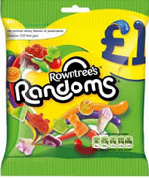
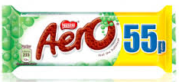
Price
Price is the amount of money that the customer has to pay to receive the good or service
Firms use different pricing strategies to price their products, taking into account a number of factors such as market research, competitors’ prices and the state of the economy
Prices can also be changed as part of a promotional campaign.

Slide 16
penetration pricing
Price penetration involves setting a low initial price for a new product in order to get a foothold in the market and gain market share
May be a suitable pricing strategy for a product in a mass market
A firm will release a new product at a low price with the aim of enticing people to buy
The aim is to gain an early customer base
Once the product has been launched and built up a customer base the firm may raise the price
Likely to be used with a price elastic product

Slide 17
Price skimming
Price skimming involves setting a high initial price for a new product in order to recoup costs
When a firm releases a new product it often charges a high price targeting a segment of the market known as ‘early adopters’
  These are customers who must have the product as soon as it is launched and are prepared to pay high prices to get it
Firms often base their initial promotional campaign around this idea, trying to create a ‘must have’ mentality amongst their target market
Once this market has been ‘skimmed off’ the company will lower price

Slide 18
In pairs
Identify 2 different products that use each of the following pricing decisions:
  Price skimming
  Price penetration
In each example explain why you think the firm made this pricing decision?
To what extent is price the only important aspect of the marketing mix for discount retailers?
Notes:
http://www.bbc.co.uk/news/business-33155628
The unstoppable rise of the discounters

Slide 19
Competitive pricing
Prices are based on the prices charged by competitors, maybe the same or slightly lower, firms will try to compete on other aspects of the marketing mix
Price leaders | Price takers
Firms that dominate a market with an existing product set the price and other firms in the market follow suit. It is illegal for firms to get together to set prices in order to increase the total value of the market. Smaller firms will sometimes look to the largest firm in the market to set the price and then follow this price lead. If the smaller firm were to lower their price below that set by the price leader it might start a price war that it has no hope of winning. | Smaller firms in the market who set their prices based on the market price. This might be the price set by the market leader or it might be in a very competitive market where firms sell similar products and customers find it hard to differentiate the product. If the small firm were to lower price in order to increase market share all other firms would have to follow suit and the customer, rather than the firm, would benefit from lower prices. A price leader is likely to respond to a smaller firm cutting prices by cutting prices themselves. The small firm would be unlikely to do this because it would retain the same market share but at a lower selling price.

Slide 20
Cost plus
Why might this method appear simple but be more complex for a business with a range of products?
Cost plus is when a percentage mark up is added to the cost of producing a good or service to calculate the selling price
Variable cost per unit + a proportion of total cost (total cost per unit) + a percentage mark-up
The percentage mark up is how much the business wants to achieve as profit
Example:
  VC per unit = £5.00
  TC per unit = £10.00
  Mark–up = 25%
  Selling price = (£5.00 + £10.00) x 1.25 = £18.75

Slide 21
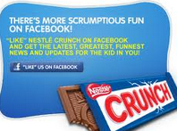
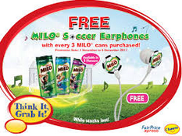
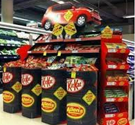
Promotion
Promotion is the activities designed to communicate with the market thereby increasing visibility and sales of a product
Firms use different promotional strategies to make their products more widely known to other businesses and the general public e.g. branding, advertising, sponsorship
Why will businesses use a range of promotional techniques?

Slide 22
Promotion
Advertising occurs when firms pay for the promotion of their product through the main media such as television, radio and the press
Advertising has two main purposes:
  Informative advertising explains to the customer details of the product and what it does e.g. a car does 0-60 mph in 10 seconds
  This increases consumer awareness regarding the attributes of the product
  Persuasive advertising tries to influence the customer to buy the product based on factors other than what the product does by appealing to the emotions and sensitivities of customers

Slide 23
Promotion
Merchandising is the way in which a firm promotes its product at Point of Sale (POS). Plenty of thought is put into the visual display of a product and the way that the product is presented within the selling location
Sales promotions are short term offers used by firms in order to increase sales for their products

Slide 24
Promotion
Public Relations (PR)
  Involves communicating with the media such as newspapers, television and radio in order to get favourable publicity for the organisation
Sponsorship
  Associating a brand name with an event to raise its profile in the public eye, a business pays to sponsor an event in return for visual coverage of the brand e.g. around a stadium, on literature, on sport kits etc.
The use of social media and other media
  Use of targeted newsfeeds e.g. Facebook newsfeeds based on searches on other webpages
  Traditional media e.g. newspapers, radio, TV (remember budget is a constraining factor)
How much does it cost to sponsor a top football team?
Is this a good use of promotional budget?
Notes:
http://www.independent.co.uk/sport/football/news-and-comment/the-biggest-football-shirt-sponsorship-deals-chelseas-40mayear-agreement-second-only-to-manchester-uniteds-10075431.html
The biggest football shirt sponsorship deals: Chelsea's £40m-a-year agreement second only to Manchester United's
https://www.branded3.com/blog/the-top-10-viral-marketing-campaigns-of-all-time/

Slide 25
Promotion
Digital marketing
  Viral marketing e.g. Evian rollerblading babies
    Use of social media to encourage the spread of promotional activities and increase brand awareness
    Uses blogs and online forums
  Electronic newsletters
  E-mail campaigns
  Customer relationship management e.g. through databases
  E-commerce and m-commerce sites
Corporate image
  The way in which customers and other interested parties view or perceive a business e.g. friendly, innovative, quality, quirky
How important are smart phones?
Top 10 viral marketing campaigns.

Slide 26
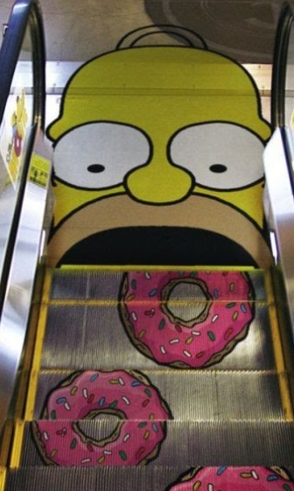
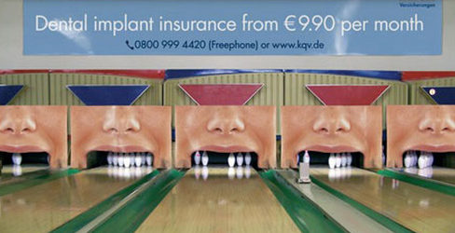
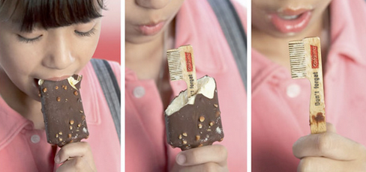
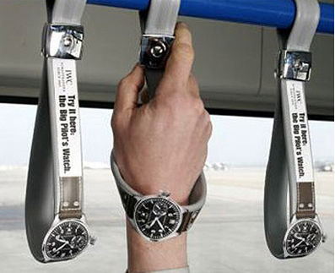
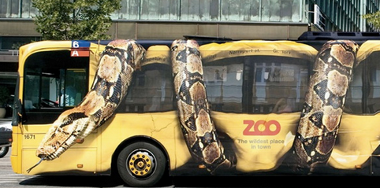
Promotion
Guerrilla marketing is a low cost approach to advertising using unconventional and often wacky methods
The aim is to get people talking about it and spreading the advert using social media
Notes:
http://www.gmarketing.com/

Slide 27
Promotion
  Personal selling is any marketing activity that engages directly with the customer. This takes a variety of forms:
    Door to door
    Via technology e.g. emails or telephones
    Trade fairs and exhibitions
  As businesses grow they can afford to pay for more expensive advertising that will This allows the seller to demonstrate the product and explain specific benefits to the customer. Although used in B2C this is also common in B2B markets
Product placement involves a business paying to have their product featured in a TV show or movie
  A highly visible due to choice of popular programs or box office hits
  However watchers might not notice it
  Can be expensive
Did you spot product placement in Austin Powers or Wayne’s World?

Slide 28
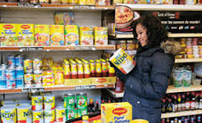
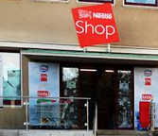
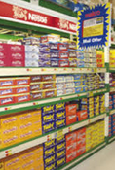
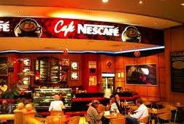
Place
Place defines both the physical location where a product is available as well as the distribution channel it has travelled through to get from the manufacturer to the customer
Place can be a physical market where buyers and sellers meet face to face or a virtual location i.e. over the internet
Increasingly firms are adopting a multi-channel approach to place

Slide 29
Distribution
Place is the term given to distribution
Distribution is the process of getting the firm’s product to the market
Distribution channels are the routes to market that a product takes from producers to the final customer
There are a number of distribution channels available to firms:
  Short distribution channels are where the producer sells either directly to the customer or through a retailer
  Long distribution channels are where there are more than one intermediary (middle person) between the producer and the customer

Slide 30
Types of distribution channels
Producers can use direct selling whereby they sell directly to the final consumer e.g. mail, online and auction
Often, producers use retailers who sell products on to the general public
Wholesalers buy large quantities of supplies from producers and sell them on in smaller quantities. For example, a corner shop might go to a wholesaler to buy their products
Increasingly, firms are using e-commerce benefiting from the power of the internet to sell on their products
Multi-channel distribution is when a firm chooses to use a combination of methods
With reference to Tesco explain what is meant by a multi-channel distribution strategy.

Slide 31
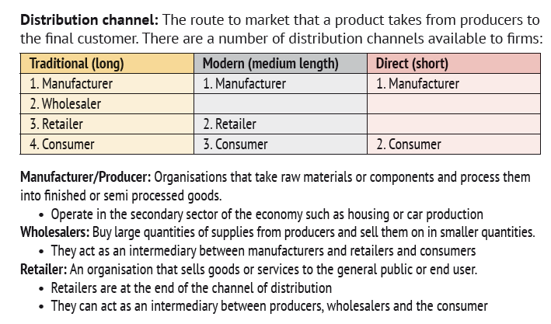
Types of distribution channels

Slide 32
The extended marketing mix – people, process and physical environment
People are the employees involved in dealing with customers before, during and after a sale
Process is the steps a customer goes through to actually complete a transaction
Physical environment is the design and features of the actual place where a transaction takes place

Slide 33
people
People are the employees involved in dealing with customers before, during and after a sale
Customer service is extremely important in today’s service sector in the UK
Staff must be appropriately trained, motivated and show good communication skills when dealing with customers
People are an important aspect of all business, they are the ones interacting with the customer

Slide 34
People
The role of people in the marketing mix will include:
  Providing information
  Supporting the customer in decision making
  Resolving problems
  Completing the transaction
Consider the role of the following people. How do they contribute to customer satisfaction?
Car sales person, personal shopper, check out assistant, waiter, hairdresser, dentist, doctor’s receptionist, call centre operator

Slide 35
Physical environment
Physical environment is the design and features of the actual place where a transaction takes place
This can directly influence the customers’ shopping experience and therefore their level of satisfaction as well as willingness to return
Aspects of the physical environment might include:
  Cleanliness
  Design e.g. ease of movement around the premises or ability to find what you are looking for
  Facilities
  Ambience

Slide 36
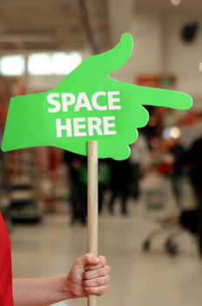
Process
Process is the steps a customer goes through to actually complete a transaction
The ease with which a transaction takes place will directly impact on customer’s perceptions of the business
This can include:
  The ease with which a product can be paid for e.g. credit card transactions
  The effort involved e.g. how many clicks when buying online
  The length of queues or number of people you have to transact with

Slide 37
People, Process, physical environment
To what extent is the physical environment more important than people or process at McDonalds?
Rank all 7Ps in order of importance for McDonalds
Notes:
http://www.examiner.co.uk/news/business/bary-sheerman-visits-new-look-mcdonalds-8473082
Barry Sheerman visits new-look McDonald's in Huddersfield
http://www.stokesentinel.co.uk/pictures/Inside-new-look-McDonald-s-Festival-Park/pictures-26502681-detail/pictures.html
Inside the new look McDonald's, Festival Park
http://www.thefranchisemagazine.net/page/mcdonalds/franchise-thats-streets-ahead.php
http://www.lincolnshireecho.co.uk/look-inside-Lincolnshire-8217-s-newest-McDonald/story-26734689-detail/story.html#7

Slide 38
Marketing mix
In this topic you have learnt about
  Product development: form and function, packaging, branding
  Pricing strategies: penetration, skimming, competitor based, cost plus
  Promotional advertising, public relations (PR). Sponsorship, use of social and other media, guerrilla marketing, personal selling, product placement, digital marketing, corporate image
  Place, distribution channels: direct to end users (mail/online/auction), retailers, wholesalers
  Extended marketing mix: people, physical environment, process

