Slide 1
Measuring Profitability
F3
Measuring profitability
Discussion:
Company A has sales of £1m and profit of £100 000.
Company B has sales of £500 000 and profits of £80 000.
Which one is the most profitable?
What is the difference between profit and profitable?

Slide 2
Measuring Profitability
In this topic you will learn about
  Calculation, interpretation, analysis and evaluation of:
    Gross profit margin: (gross profit/revenue) x 100
    Mark-up: (gross profit/cost of sales) x 100
    Profit margin: (profit/revenue) x100
    Return on capital employed (ROCE): (profit/capital employed) x 100

Slide 3
Ratio Analysis
Allows for a more meaningful analysis of published accounts
  Shows relationship between figures
  Used for comparisons over time
Inter and intra business comparisons
  Intra means between businesses e.g. to compare performance to competitors or to benchmark
  Inter means within a business e.g. over time within one organisation or between branches
What is meant by the term benchmark?
Why are numbers so important when understanding a business’ performance? View M&S key facts.
Notes:
http://corporate.marksandspencer.com/investors/key-facts

Slide 4
Measuring profitability
Gross profit margin (GPM) is a measure of a firm’s profitability by looking at the relationship between gross profit and revenue
If GPM is low or falling this may indicate that a firm
  is not managing its cost of sales effectively e.g. are the cost of raw materials increasing?
  sales are in decline
Calculated as:
  Gross profit x 100
  Revenue
Example:
  Revenue = £35 000
  Cost of goods sold = £15 750
  Gross profit = £19 250 (£35 000 - £15 750)
  Gross profit margin = £19 250/£35 000 x 100
      = 55%

Slide 5
Measuring profitability
Profit margin (or operating profit margin) is a measure of a firm’s profitability by looking at the relationship between operating profit and revenue
If OPM is low or falling this may indicate that a firm
  is not managing its expenses effectively e.g. wages are increasing or overheads are going up
  sales are in decline
Calculated as:
  Profit x 100
  Revenue
Example:
  Revenue = £35 000
  Gross profit = £19 250
  Expenses = £ 5 950
  Operating profit = £13 300
  Operating profit margin = £13 300/£35 000 x 100
      = 38%

Slide 6
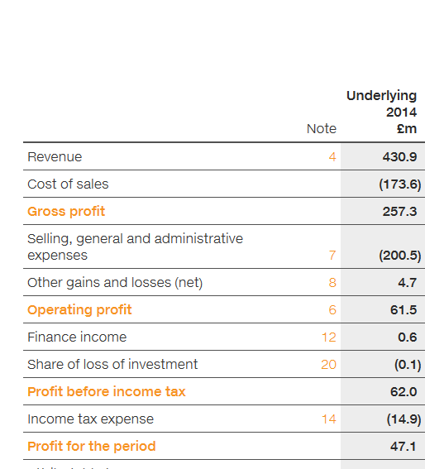
Practice question
Using the extract from SuperGroup Plc’s statement of comprehensive income calculate:
Gross profit margin
Profit margin
Comment on the financial performance of SuperGroup Plc.
View full statement of comprehensive income.
Notes:
http://annualreport2014.supergroup.co.uk/financial-statements/group-statement-of-comprehensive-income

Slide 7
Measuring profitability
Mark-up is a measure of a firm’s profitability by looking at the relationship between gross profit and cost of sales
If mark-up is low this may indicate that the firm
  is not managing its cost of sales effectively e.g. raw material costs are too high
  is in a highly competitive market where firms compete on price
Calculated as:
  Gross profit x 100
  Cost of sales
Example:
  Revenue = £35 000
  Cost of sales = £15 750
  Gross profit = £19 250 (£35 000 - £15 750)
  Mark-up = £19 250/£15 750 x 100
      = 112%
Cost of sales and cost of goods sold are interchangeable terms.

Slide 8
Measuring profitability
Return on Capital Employed (ROCE)
  A measure of how efficiently a business is using capital employed to generate profits
  Capital employed = total equity + non-current liabilities i.e. all the money invested in the business from:
      Share capital
      Reserves
      Long term loans
  Formula:
    Operating profit x 100
    Total equity + non-current liabilities
Challenge:
Capital employed can also be calculated as total assets minus current liabilities.
Can you explain why?

Slide 9
Return on capital employed
Statement of financial position £m
Non-current assets 19550
Inventories 2375
Trade receivables 1170
Cash & cash equivalents 2300
Total current assets 5845
Current liabilities (8160)
Net current liabilities (2315)
Non-current liabilities (6000)
Net assets 11235
Owner’s capital 6000
Reserves & retained earnings 5235
Total equity 11235
Statement of comprehensive income £m
Revenue 35400
Cost of sales (30100)
Gross profit 5300
Expenses (720)
Operating profit 4580
Finance income 300
Finance cost (260)
Profit before tax 4620
Taxation (1109)
Profit for the year 3511
Operating profit x 100 4580 x 100
Total equity + non-current liabilities 11235 + 6000
4580 x 100 = 27%
17235

Slide 10
Interpretation of ROCE
Why would it be meaningful to compare this
to the current rate of interest?
Why might a high street retailer compare
ROCE between individual stores?
Return on capital employed
Operating profit x 100
total equity + non-current liabilities
4580 X 100 = 27%
17235
For every £1 of capital employed in the business 27 pence is generated in operating profit.
NB
A statement of financial position may be presented showing capital employed in which case the bottom line of the formula is capital employed.
Capital employed = total equity + non-current liabilities.

Slide 11
Measuring Profitability
In this topic you have learnt about
  Calculation, interpretation, analysis and evaluation of:
    Gross profit margin: (gross profit/revenue) x 100
    Mark-up: (gross profit/cost of sales) x 100
    Profit margin: (profit/revenue) x100
    Return on capital employed (ROCE): (profit/capital employed) x 100

