Slide 1
Measuring Liquidity
F4
Measuring liquidity
IF I BORROW A MILLION POUNDS AM I A MILLIONAIRE?

Slide 2
Measuring Liquidity
In this topic you will learn about
Calculation, interpretation, analysis and evaluation of:
Current ratio: current assets/current liabilities
Liquid capital ratio: (current assets-inventory)/current liabilities

Slide 3
Measuring liquidity
Liquidity
A measure of a businesses’ ability to survive in the short term i.e. its ability to meet short term debts and day to day expenses
If a business can not meet current liabilities from current assets then it is at risk of failure if creditors demand immediate payment of debts
Liquidity is calculated using the:
Current ratio
Liquid capital ratio
Define current assets and current liabilities.
Why might a business be placed in administration?
Notes:
http://www.bbc.co.uk/news/business-36592776

Slide 4
Measuring Liquidity
Statement of financial position £m
Non-current assets 19550
Inventories 2375
Trade receivables 1170
Cash & cash equivalents 2300
Total current assets 5845
Current liabilities (8160)
Net current liabilities (2315)
Non-current liabilities (6000)
Net assets 11235
Owner’s capital 7000
Reserves & retained earnings 4235
Total equity 11235
Current ratio is calculated as:
Current assets
Current liabilities
Current assets : current liabilities
5845 : 8160
= 0.716 : 1
For every £1 of CL the business owes it owns
£0.716 (72 pence) in CA.
Do you think this business has enough short
term assets to meet its short term debts?

Slide 5
Measuring Liquidity
Liquid capital ratio is calculated as:
Current assets - inventories
Current liabilities
Current assets : current liabilities
(5845 – 2375) : 8160
= 3470: 8160
0.425 : 1
For every £1 of CL the business owes it owns
£0.425 (42 pence) in liquid assets.
The liquid capital ratio is a tougher measure of solvency as it excludes inventory. This is because stock is thought to be the hardest of the current assets to turn into cash quickly.
Statement of financial position £m
Non-current assets 19550
Inventories 2375
Trade receivables 1170
Cash & cash equivalents 2300
Total current assets 5845
Current liabilities (8160)
Net current liabilities (2315)
Non-current liabilities (6000)
Net assets 11235
Share capital 7000
Reserves & retained earnings 4235
Total equity 11235
Formula can also be shown as:
Liquid assets
Current liabilities

Slide 6
Measuring Liquidity
What is the relationship between cash flow and liquidity?
A business with low liquidity is in danger if short term creditors demand payment quickly e.g. the bank recalls an overdraft
Business may therefore seek to improve liquidity:
Increase current assets and/or reduce current liabilities
Sell assets that are no longer being used i.e. turn them from a non-current asset to a current asset (cash)
Move cash balances from current accounts to high interest bearing accounts so its value increases more rapidly
Switch to long term sources of finance
Monitor debtors to avoid bad debts

Slide 7
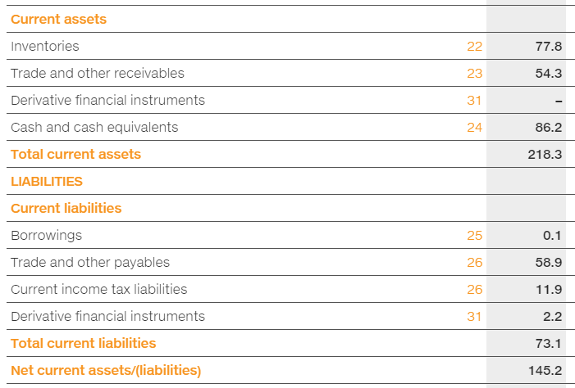
Practice question
Using the extract from SuperGroup Plc’s statement of financial position calculate:
Current ratio
Liquid capital ratio
Comment on the liquidity of SuperGroup Plc.
View full statement of financial position.
Notes:
http://annualreport2014.supergroup.co.uk/financial-statements/balance-sheets

Slide 8
Measuring Liquidity
In this topic you have learnt about
Calculation, interpretation, analysis and evaluation of:
Current ratio: current assets/current liabilities
Liquid capital ratio: (current assets-inventory)/current liabilities

