Slide 1
Unit 3: Personal & Business Finance

Slide 2
Learning Outcome A
Understand the Importance of Managing Personal Finance

Slide 3
Learning Outcome A1
Functions and Role of Money

Slide 4
The Functions and Role of Money
Functions of money
Role of Money
Planning expenditure & personal finances

Slide 5
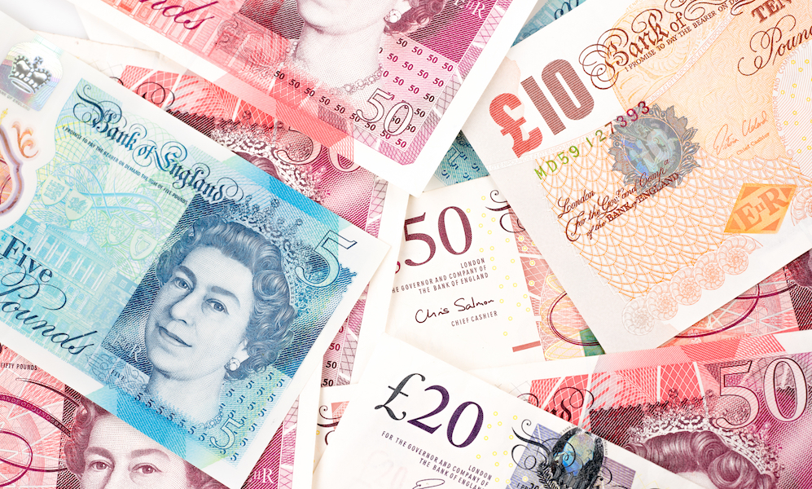
Activity 1 - What would the world be like without money?

Slide 6

Activity 2 – What are the Functions of Money?
Whilst watching the video complete the questions regarding the four functions of money.

Slide 7
Functions of Money – Can you describe them?
Unit of account
This refers to anything that allows the value of something to be expressed in an understandable way, and in a way that allows the value of items to be compared.
Means of exchange
Money allows goods and services to be traded without the need for a barter system. Barter systems rely on there being a double coincidence of wants between the two people involved in an exchange.
Store of value
This can refer to any asset whose “value” can be used now or used in the future i.e. its value can be retrieved at a later date. This means that people can save now to fund spending at a later date.
Legal Tender
Money that has a legal sanction by the government behind it is called legal tender means money under the law of land. It is the money issued by monetary authority or government which cannot be refused by any person in payment for transactions. The tender or payment of it constitutes by law the sufficient discharge of debt.

Slide 8
Activity 3 - The Role of Money
How is the role of money influenced?
External influences & trends
Culture
Life events
Life stages
Interest rates
Personal attitudes
The role of money is affected and influenced by a number of factors & personal attitudes towards risk, reward, borrowing, spending and saving.
Whilst we discus the role money plays complete the spider diagram with key points under each role.

Slide 9

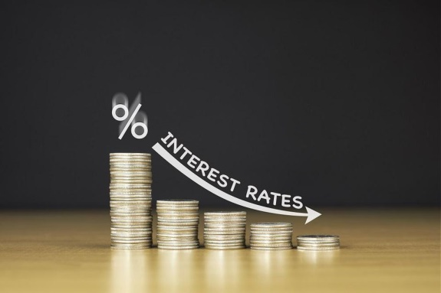
The Role of Money
Culture
Your religious beliefs or ethical principals may shape the role that money plays in your life and how you view and use it. For example there are certain banks that follow religious rules in terms of lending and borrowing money.
Life events
The importance of money may change depending on certain life events. For instance when you first buy a home, the role money plays in your life may now be more important. If you are made redundant then this also will impact your view of money.
External influences
The state of the economy and the jobs market may mean that money plays and bigger or less valuable part of your life. These external influences are out of your control but still impact the role money plays.
Interest rates
Interest rates may impact what you decide to do with your money. When interest rates are low this is a good opportunity for borrowing but not for saving as you receive less interest. However when interest rates are high it may be a good time to increase your savings but would not be a good time to borrow.

Slide 10
The Role of Money
Personal attitudes
The role of money is impacted by your own personal attitude. Individuals will have their own attitude to money such as:
Risk
Reward
Borrowing
Savings
Answer the following in your booklet:
Explain where your personal attitude to money has come from
If parents & guardians are the ones where financial education comes from, assess the limitations this has and what can be done to improve financial education.

Slide 11
Activity 4 - Life Stages & Financial Needs and Implications
Discuss what are the wants financially of people at each stage of their life?
Childhood
Adolescence
Young adult
Middle age
Old age

Slide 12
Financial Needs and Implications at Different Life Stages
Match the correct wants and needs with the correct life stage.
Life stage | Financial needs | Implications
Childhood | Limited needs Reliant on parents Purchases sweets & toys | Money from parents in the form of pocket money. Spent on non essentials May be encouraged to save
Adolescence | Want independence Less reliant on family Start socialising away from home | Still reliant mainly on money from parents May look for a job Get cash as gifts & save for larger purchases
Young adult | University / Early career More independent Buying cars, renting, buying homes Starting a family / getting married | Student loan Car finance and borrowing Job & mortgage Eligible for credit cards
Middle age | Support family Improve lifestyle Save for future | Paying a mortgage Paying into a pension High income & high expenses
Old age | Fewer dependants Fewer financial needs May downsize | No mortgage payments Income from pension not a salary
3
2
4
4
5
5
2
1
1
3

Slide 13
Life Stages Questions
Explain the financial needs of someone in the Childhood life stage
What are the implications of some in the old age stage of their life when it comes to finances?
Compare the needs of someone in the childhood stage of their life compared with the middle age stage.
Assess the needs and implications of someone in the childhood life stage.

Slide 14
Planning Expenditure and Personal Finances
Expenditure is money paid out. It is important when managing personal finance to consider some common principals.
Discuss what things you think are important in terms of planning your personal finances?

Slide 15
Activity 5 - Planning Expenditure and Personal Finances
In the table create a basic personal budget for a month and then answer the questions below regarding your personal finances.
Explain whether your finances are healthy or not
Explain the importance of having healthy finances
What are the consequences of not planning expenditure and personal finance?
Assess what would happen to you if any income you have stopped.
Suggest how your expenses and income will change as you progress through your life.

Slide 16
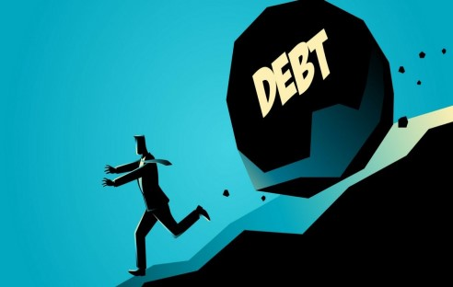
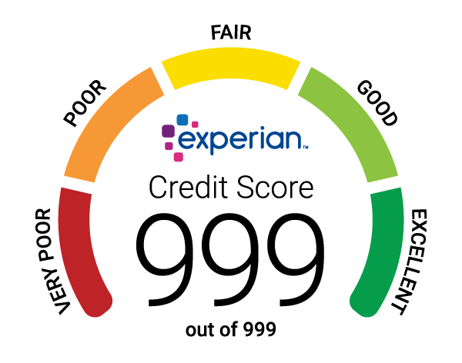

Common Principals when Planning Personal Finances
to avoid getting into debt
to control costs
avoid legal action and/or repossession
remain solvent
maintain a good credit rating
avoid bankruptcy
to manage money to fund purchases
generate income and savings
set financial targets and goals
provide insurance against loss or illness
counter the effects of inflation
Lets have a look at these in more detail

Slide 17
Activity 6 - Why Plan Expenditure?
While we cover why planning expenditure is important take notes on key points.
Avoid getting into debt
Knowing what money is coming in and going out is important as it ensures you are not overspending and therefore avoids debt. It also has means that you can save money for a rainy day therefore meaning you will not need to go into debt to pay for unexpected costs.
Control costs
By planning expenditure you are aware of your expenses and can control costs by making adjustments to your finances i.e. spending less on shopping or changing your energy supplier.
Avoid legal action/repossession
A consequence of not planning expenditure is that you could overstretch your finances and become unable to pay bills. This could then lead to legal action to reclaim the cost of unpaid items or repossession of that item. I.e. you may buy a car on finance and then become unable to pay the repayments. The card dealer will then reposes the car.

Slide 18
Why Plan Expenditure?
Remain solvent
This means that you have the ability to meet your financial obligations. In personal finance it means that you can basically cover any costs you have.
Good credit rating
A credit rating is how trustworthy you are in terms of paying off any debts you have. Planning expenditure well will mean that you are in control of your finances, pay off any debts on time and are a safe person to lend money to therefore you will have a good credit rating. This will help you borrow money more easily when you need it.
Avoid bankruptcy
Declaring bankruptcy means that you are unable to pay your debts. If you declare bankruptcy your debts will be cleared but this has severe consequences for you financially going forward. You will most likely loose any assets you have and it will be extremely hard to borrow money again.

Slide 19
Why Plan Expenditure?
Manage money to fund purchases
If you are managing you finances well this will allow you to avoid borrowing as you will be able to save instead of borrowing to fund purchases. For example if you are disciplined with your finances you will be able to save for a holiday instead of borrowing money to pay for the holiday and therefore not have to pay any interest.
Generate income and savings
Money you have saved from planning you finances can be put to work for you in the for of investments to generate you further income. This will allow you to set financial targets and goals and work towards them through good financial planning. If you can generate an income from savings and investments this will help you counter the effects of inflation (explained on next slide).
Provide insurance against loss or illness
By planning your expenses and having some set aside for unforeseen circumstances then you are providing yourself with peace of mind that if you lose your job or become seriously ill then you will have enough money to cover your expenses for a period of time.

Slide 20
The Effects of Inflation
By managing your personal finances well then you can counter the effects of inflation.
What does this mean?
Inflation is a decrease in the purchasing power of currency due to a rise in prices across the economy. In the year 2000 a Freddo was 10p and now costs around 30p.
Therefore if you had 10p in the year 2000 that had the purchasing power to buy you 1 Freddo. If you saved that 10p in cash and then wanted to buy a Freddo in 2020 it would only be able to buy you 1/3 of a Freddo.
This is the effect inflation can have but imagine this across every sector and the whole economy.
By managing you finances effectively then you can counter this impact by investing your money in something that outpaces inflation. i.e. if inflation is 2% and you invest in something that provides you a 4% return.

Slide 21
Activity 7 - Benefits and Risks of not Planning Finances
Using the benefits and risks evaluate the importance of managing personal finances
Benefits | Risks
Surplus money to save | Get in debt
Savings can provide security | Poor credit rating so cannot borrow
Good credit rating | No savings/security
Avoid debt | Unable to pay bills

Slide 22
Activity 8 - Knowledge Check A1
List the four functions of money
Describe unit of account
Describe 3 roles of money
Explain the financial needs & implications of someone at the middle age stage
Outline 2 common principals when planning personal finance.

Slide 23
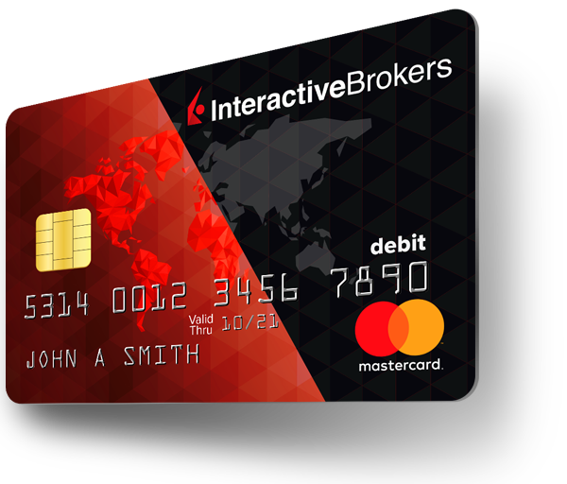
Learning Outcome A2
Different Ways to Pay

Slide 24
Ways to Pay
As we have discussed, one of the functions of money is means of exchange. This means using money to pay for things.
It’s not just physical notes and coins that are classified as money.

Slide 25
Activity 9 - How do you Pay for Goods and Services?
List as many methods of payment as you can
Which one do you use the most and why?
Explain what makes something an effective payment method.
Here are a few things that make an effective payment method:
Convenient
Widely accepted
Safe
Quick
Trust in the method of payment

Slide 26
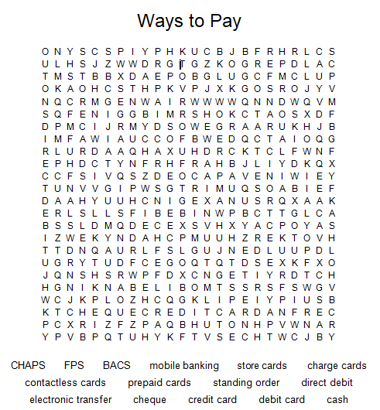
Activity 10 - Word Search Different Ways to Pay

Slide 27
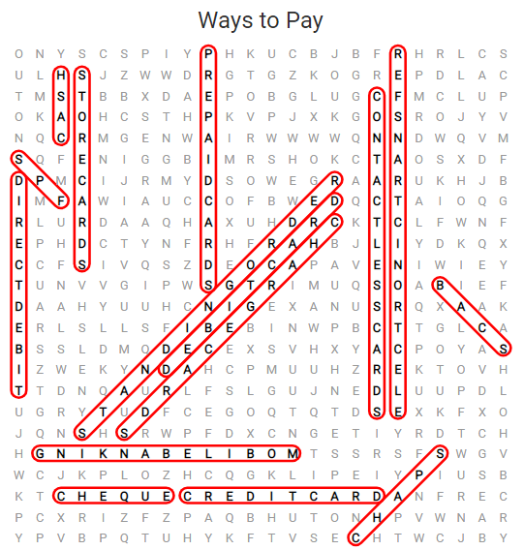
Activity 10 - Word Search Answers

Slide 28
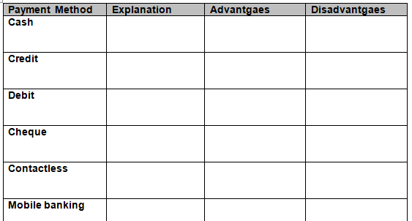
Activity 11 – Methods of Payment
If you have finished the word search for the methods of payment then start filling in the explanations of each payment method in the table.
If you are unsure then leave it and fill it in as we discuss the methods.

Slide 29
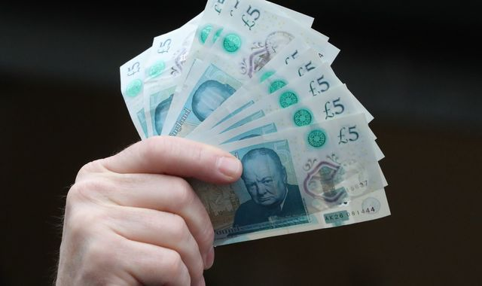
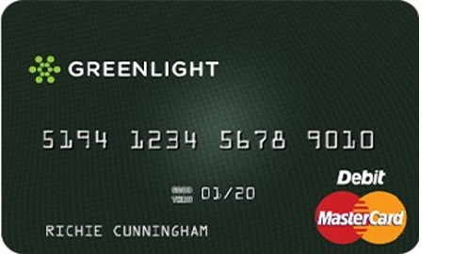
Explanation of Ways to Pay
Cash
Physical notes and coins. Available in a variety of amounts
Debit card
A debit card is a payment card that deducts money directly from a customers current account to pay for a purchase. Debit cards eliminate the need to carry cash.
What is the difference between a debit card and credit card?

Slide 30

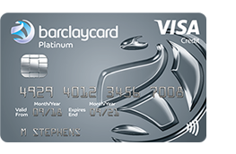
Debit vs Credit Card
A debit card is issued as part of your current account. Your current account has your own money in it. Wages are paid into this account and when you purchase items or pay bills from this account. Your own money that is in this account is used to fund that purchase.
A credit card is issued by a financial provider and you are provided with a credit limit (an amount you can spend on the card). This money is not your money, it is credit provided to you from the bank/institution and is a form of borrowing. Whatever you spend on this card is paid off (usually monthly) therefore you are delaying the payment of those purchases.
Basically one is your money, the other is borrowed money.

Slide 31
Explanation of Ways to Pay
Cheque
A written order to a bank to pay a stated amount from an individuals account to another.
Electronic transfer
Payment being electronically from one bank account to another without any paper money changing hands. One of the most widely used example of this is electronic transfer of wages from an employer to an employees bank account.
Direct debit
Simply, a Direct Debit is an instruction from you to your bank or building society. It authorises the organisation you want to pay to collect varying amounts from your account – but only if you’ve been given advance notice of the amounts and dates of collection.

Slide 32
Explanation of Ways to Pay
Standing order
A standing order is a way of setting up a regular, fixed payment from your bank account. You can set a payment to be taken at a certain frequency (for example, the 1st of each month) and for a set amount of time, such as six months. Your payments will consist of money set at an amount chosen by you.
Pre-paid card
A plastic alternative to carrying money around and are often called everyday cards. You load them with money when you first buy them and top them up when they run out.
Contactless card
Allows money to be transferred by touching the card on a contactless terminal.
Charge card
Are like credit cards in that you buy something now and pay for it later, but the big difference is that you have to pay it off in full every month. Whereas a credit card has a minimum payment option.

Slide 33
Explanation of Ways to Pay
Store card
Issued by retail outlets so that customers can purchase their products on credit. It is basically a credit card but can only be used in the store where it was issued.
Mobile banking
Carrying out financial transactions using a mobile device such as a mobile phone or tablet.
Banker’s Automated Clearing Service (BACS)
This is an electronic system to make payments directly from one bank account to another. They’re mainly used for Direct Debits and direct credits from organisations. The payments take 3 working days to clear, so money paid into your account on Monday will clear on Wednesday.
Clearing House Automated Payment System (CHAPS)
These are payments to UK accounts that are guaranteed to arrive on the day you make them, as long as you set up the payment in branch, by phone (Business customers only) before 3.30pm or online before 5pm.

Slide 34
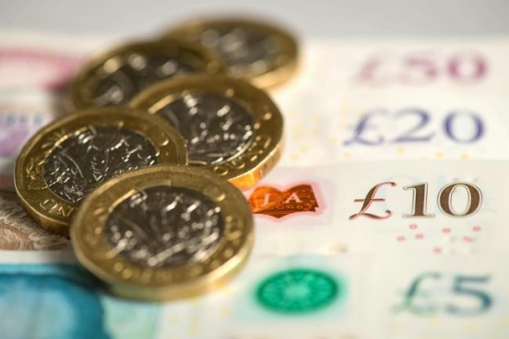
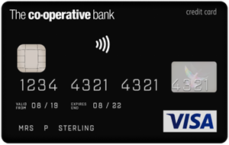
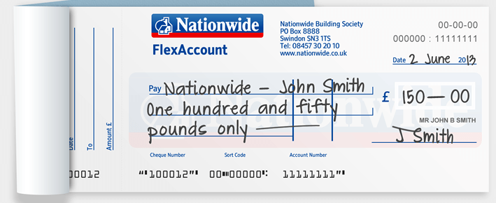
Activity 12 – Payment Advantages & Disadvantages
Continue with the table on the advantages and disadvantages of payment methods in preparation for a discussion.

Slide 35
 | Advantages | Disadvantages
Cash | Easy to budget Physical not digital Widely accepted Confidence | Easily lost Easy to steal Cannot be used online No good for large amounts
Debit card | Secure Low risk of theft Widely accepted Can be used online Widely accepted | May have minimum spend limits May overspend on card Potential to go into an overdraft
Credit card | Period of interest free credit Widely accepted Protection online Used online Loyalty schemes / cash back | Interest charged if not paid in full Encourage overspending and debt Charges on cash withdrawals Set amount of credit
Cheque | Safe Good for large transactions Good for postal transactions No need to carry large amounts of cash | Cheques may bounce Time delay between writing cheque and it being cleared Places are fazing out this payment method Error made easily when writing

Slide 36
Payment Methods Advantages & Disadvantages
 | Advantages | Disadvantages
Contactless | Very popular Quick Safe | Limited amount of daily transactions Can only be used for small amounts Not available everywhere
Mobile banking | Convenient Secure 24/7 | Limited features compared to internet banking and banking in branch
Direct debit | Quick & easy Convenient for paying bills Amount can vary depending on what the vendor requests Good way to stay on top of bills | Needs monitoring to ensure correct amounts are being collected
Standing order | Same amount is paid each time Easy for budgeting Easy to set up & cancel Provides piece of mind in terms of missing any payments. | Payments are taken regardless of customers bank balance which may result in being overdrawn Payments will continue until cancelled
Electronic transfer | Fast method of payment Free Easy to do Payment is recorded | Could transfer to the wrong person Risk of loss if incorrect No appropriate for purchases in person

Slide 37
 | Advantages | Disadvantages
Pre-paid card | Avoids overspending If lost can not be overdrawn Good way of controlling spending | May cost money to set up No protection if lost
Charge card | Get a short period of credit No need to carry cash Additional perks | Full payment required each month Annual fixed fee
Store card | Short period of interest free credit Special offers and promotions for that store | Can only be used in specified stores/places Interest is charged on balances Can encourage debt on consumer goods
BACS | Guarantees instant payment within 2 hours No additional costs Used in branch, phone or online | Limited amount in a single transaction Service not offered by all banks
CHAPS | No limit on the amount in a single transaction Same day transfer | Fixed charge for the transaction

Slide 38
Activity 13 – Knowledge Check A2
Using the explanation, benefits and drawbacks answer the following example exams questions.
Explain the difference between a debit card and a credit card
Explain the benefits of using BACS as a method of payment
Assess the benefits & drawbacks of using cash to pay for goods and services
Evaluate store cards as a method of payment
Jason’s goes on holiday next week and cant decide what payment method to use whilst on holiday. He has £1000 in spending money. Suggest whether he should use cash, debit card or credit card to pay for goods and services whilst on holiday.
Could you answer these questions for every method of payment?

Slide 39
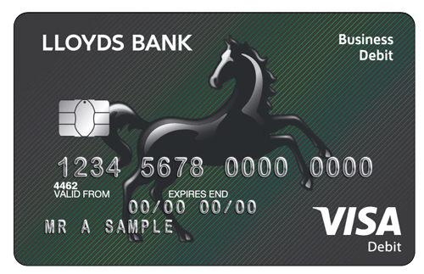
Learning Outcome A3
Current Accounts

Slide 40
Activity 14 - What are Current Accounts?
Research and explain what a current account is and the common features that form a current account.
A current account is a type of bank account that keeps your money secure and helps you manage your finances.
Current accounts facilitate the making of payments (direct debits, standing orders) and they let people, businesses and organisations pay you easily.
While you may use other money products, it’s your current account that joins the dots and enables our financial ecosystem to exist.

Slide 41
Common Features of Current Accounts
Paying money in (wages)
Paying money out (bills, direct debits)
Overdraft
Interest paid on positive balances
Interest charged on negative balances
Additional extras

Slide 42
The Different Types of Current Accounts
Standard
Basic
Premium/packaged
Student
Knowing the different features of these accounts is important.

Slide 43
The Different Types of Current Account
Standard
The most common account, it has standard features as you can pay in and withdraw money. You will receive a debit card, be able to pay for things online and set up a prearranged overdraft.
Basic
This current account is mainly used by people who have a poor credit rating and struggle to open a standard account. It has limited facilities and no overdraft available.
Premium/Packaged
This account has a monthly fee in return for additional benefits such as breakdown cover, cashback on purchases, home insurance and payment protection. These may not always be value for money.
Student
An account designed to benefit students. Especially useful for students attending university as they provide interest free overdrafts, rail cards and discounts off eating out.

Slide 44
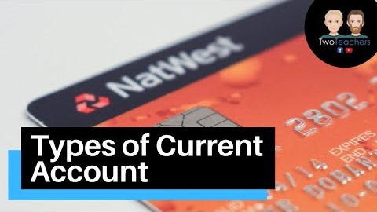
Activity 15 - Current Accounts
Whilst watching the video complete the explanation of the accounts and the pros and cons

Slide 45
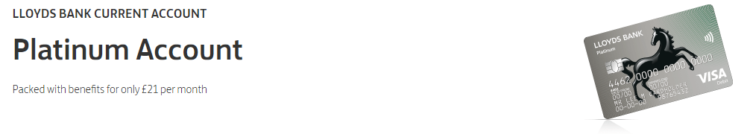
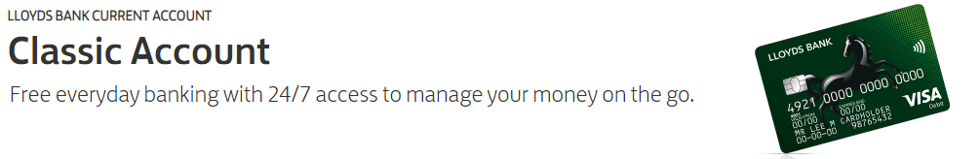
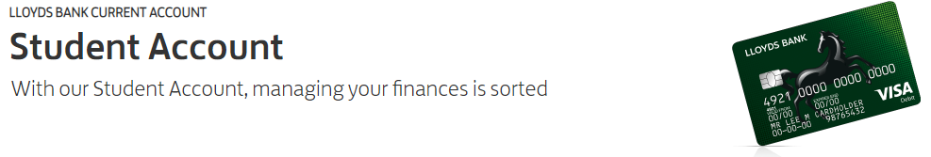
Activity 16 - Current Accounts and Scenarios
Read the information provided regarding a variety of accounts. Then for each scenario provide a justified recommendation of which account would be most appropriate for each scenario.

Slide 46
Activity 17 – Exam Question
Read the scenario and evaluate which account is appropriate for Yasmin.
Account | Interest paid on credit | Overdraft | Conditions | Perks
123 Student | None | £1000 year 1 £3000 year 2 £4000 year 3 | Must pay in £50 a month | Bose headphones Laptop Rail card
Student Smart | 1% | Up to £2000 a year | Online only | Food card Breakdown cover
Student Wise | 1% up to £500 2% up to £1500 3% £1500+ | £1500 maximum | Must pay in £250 | Food card Book club discount Rail card
UniWise | None | £4000 maximum | None | Laptop when signing up Rail card

Slide 47
Activity 18 – Knowledge Check A3
List the 4 types of current account
Describe who a basic current account would be suitable for
Outline 2 features of a premium/package current account
Explain the key features of a student current account stating why these are useful for students

Slide 48
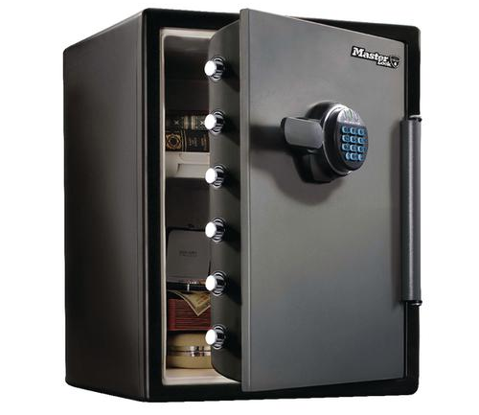
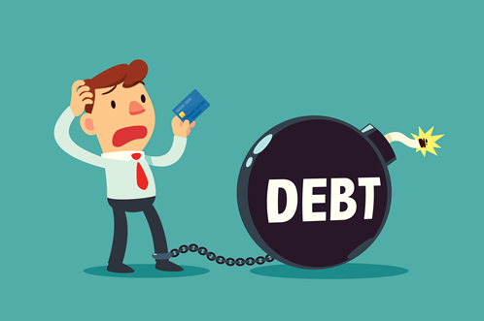
Learning Outcome A4
Managing Personal Finance

Slide 49
A4 Managing Personal Finance
• Different types of borrowing
Different types of saving and investment
Risks and rewards of saving versus investment
Different insurance products

Slide 50

Activity 19 - Borrowing
Before we discuss the types of borrowing available.
Assess how much you agree with this attitude to money expressed in the quote above (think about good and bad things that borrowing money may bring).
List the types of borrowing available.

Slide 51
Borrowing
Borrowing is probably one of the most important things you will learn about as borrowing can lead to serious consequences if not managed properly.
Banks and building societies are just like any other business as they create a variety of products to meet the individual needs of their customers.
There is numerous types of borrowing to meet the needs of the customer depending on what they need to borrow the money for and how long they want to borrow it for.

Slide 52
Different Types of Borrowing
Overdraft
Personal loans
Hire purchase
Mortgages
Credit cards
Payday loans
It’s important that you understand the advantages and disadvantages of each form of borrowing. Not only for your exam but for your financial life.
For example using a payday loan would not be advised in most circumstances however should certainly not be used to borrow money over a long period of time.

Slide 53
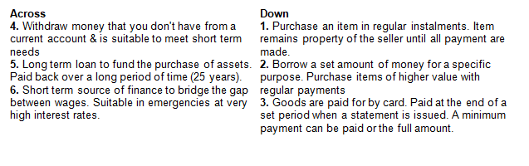
Activity 20 - Different Types of Borrowing Crossword
Complete the crossword by using the clues to identify the correct type of borrowing.

Slide 54
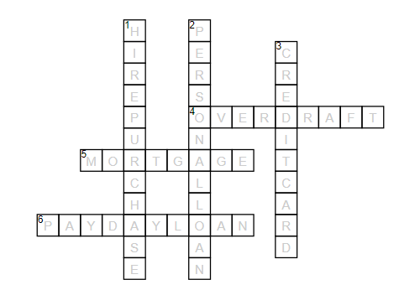
Answers - Different Types of Borrowing Crossword

Slide 55
What are the Different Types of Borrowing?
Overdraft
An overdraft lets you borrow extra money through your current account. For example, if you have no money left in your account and you spend £30, your balance would be -£30. This means you’re using an overdraft. An Arranged Overdraft could help you manage your money if you have to cover short-term expenses such as an unexpected bill.
Personal Loan
Allows you to borrow money for a specific purpose such as improving your home or buying a car. They are a longer term form of borrowing for higher priced items
Hire purchase
A hire purchase is an arrangement where a customer agrees to a contract to buy an asset by paying off the amount in regular instalments. The buyer repays the balance of the price of the asset plus interest over a period of time. The item remains the property of the seller until all payments have been made.

Slide 56
What are the Different Types of Borrowing?
Mortgage
This is a long term loan for example paid back over 30 years. The loan is secured against an asset such as a house.
Credit card
A credit card is a type of loan, where the money you spend is actually borrowed from the card provider. Instead of getting money in your bank account you get credit on your credit card. Your lender will set you a credit limit, and you’ll be able to spend as much of it as you need before paying back some or all of your balance each month.
Payday loan
A short term source of finance that is available over a very short period of time with very high amounts of interest. Used usually in an emergency in between paydays hence the term ‘payday loan’

Slide 57
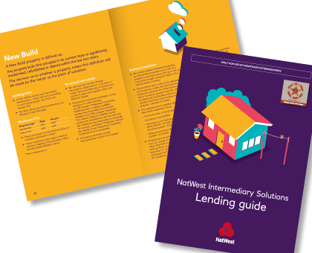
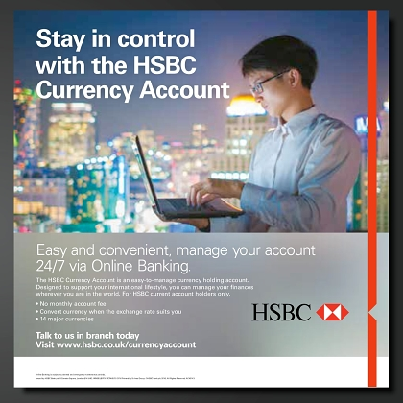
Activity 21 – Provide Pros and Cons of Borrowing Options
Imagine you are working for a bank and you have been asked by your manager to create a guide to different types of borrowing available at the bank.
This can be in any format you wish but should include at least the following:
An explanation of the type of borrowing
The positives of that type of borrowing
The drawbacks of that type
Examples of when it would be appropriate to use this form of borrowing.

Slide 58


Activity 22 – Case Study Payday Loans
Read the case study in your booklet and answer the questions that follow:
Why did Danny borrow from a payday lender?
What percentage did he have to pay back on top of his initial £100 loan?
Explain whether you think it is difficult to get approved for a payday loan
Over a decade how much has Danny paid back in interest?
And so on…

Slide 59
Activity 22 – Case Study Answers
Why did Danny borrow from a payday lender?
He needed a £100 when he was 19 at university
What percentage did he have to pay back on top of his initial £100 loan?
28%
Explain whether you think it is difficult to get approved for a payday loan
No, 90 seconds & possible via text
Over a decade how much has Danny paid back in interest?
£19,000
How long can it take to get approved for a loan via text?
90 seconds
What tactics are payday lenders using to gain more customers and get existing customers to borrow more?
90 second loan, extension of loan via text , bonuses for borrowing more, refer a friend cash back, automatic top ups.
Generally, Credit cards have an interest rate of around 19%. What are the standard interest rates for the firm Lending Stream?
1333%
If you borrowed £800 from Oakam how much would you have to pay back over 6 months?
£1502

Slide 60
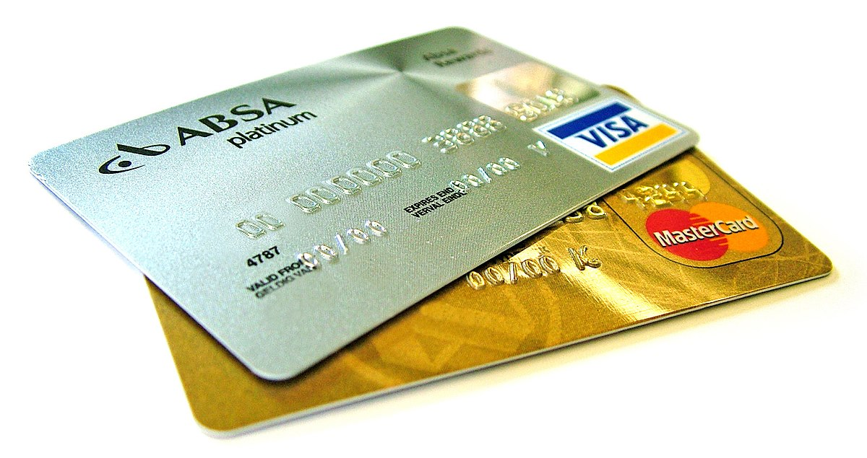
Activity 23 – Borrowing Exam Question
Assess the use of a credit card as a form of borrowing.
(think about the pros and cons and what it is used for)
Credit card | Period of interest free credit Widely accepted Protection online Used online Loyalty schemes / cash back | Interest charged if not paid in full Encourage overspending and debt Charges on cash withdrawals Set amount of credit

Slide 61



Saving and Investment

Slide 62
Different Types of Saving and Investment
When managing your personal finances knowing what options are available for saving and investing is vital. These options are necessary for any money left over after you have covered all your essential expenditure.

Slide 63
Activity 24 - What ways can you Save & Invest?
Whilst we discuss each type make notes in your workbook of key points.
Individual savings accounts (ISAs)
Deposit and savings accounts
Premium bonds
Bonds and Gilts
Shares
Pensions.

Slide 64
Savings
Individual Savings Account (ISA)
The main difference between an ISA and any other savings account is that it offers tax-free interest payments, so you could get more for your money.
There is a limit to how much money you can put into an ISA in each tax year, which is called the ‘ISA allowance’. The ISA allowance for the 2020/21 tax year is £20,000. You can only have one ‘active’ cash ISA every year.
Deposit and Savings account
A savings account is somewhere you can put your money so it can grow in value. The growth on your money, or savings, is called interest. Each savings account has an interest rate, which tells you how much you will make on your savings over time.
You can apply for a savings account with most banks, building societies and online savings providers, all have their own range of accounts.

Slide 65
Investments
If you want to make more from your money than the interest rates being offered on savings accounts then you have the option to invest.
Although there is potential for higher returns there is also higher risks in terms of losing the money you have invested.
Here are four options for investment, each come with different levels of risk and return:
Premium Bonds
Bonds and Gilts
Shares
Pensions

Slide 66
Investments
Premium Bonds
Premium Bonds are an investment product issued by National Savings and Investment (NS&I). Unlike other investments, where you earn interest or a regular dividend income, you are entered into a monthly prize draw where you can win between £25 and £1 million tax free.
All the money you put into Premium Bonds is secure.
There’s a very small chance you could earn a very high tax-free return.
You won’t earn regular income on your bonds.
Most people who buy Premium Bonds will earn only a small amount as a percentage of the money they contribute.
Unless you win one of the bigger prizes, your return is unlikely to beat inflation.

Slide 67



Investments
Shares
Shares give you part ownership of a business. This part ownership means that you also benefit from the businesses success in the form of payments called dividends. The value of shares can go up as well as down and you could potentially lose all of your investment if the business fails.

Slide 68
Investments
Bonds
A bond is a fixed income instrument that represents a loan made by an investor to a borrower (typically corporate or governmental). A bond could be thought of as an I.O.U. between the lender and borrower that includes the details of the loan and its payments. Bonds are used by companies, municipalities, states, and sovereign governments to finance projects and operations. Owners of bonds are debtholders, or creditors, of the issuer. Bond details include the end date when the principal of the loan is due to be paid to the bond owner and usually includes the terms for variable or fixed interest payments made by the borrower.
https://www.investopedia.com/terms/b/bond.asp
Gilts
Government bonds in the U.K., India, and several other Commonwealth countries are known as gilts. The term gilt is often used informally to describe any bond that has a very low risk of default and a correspondingly low rate of return. They are called gilts because the original certificates issued by the British government had gilded edges.
https://www.investopedia.com/terms/g/gilts.asp

Slide 69
Activity 25 - Why Should you Save or Invest?
Average monthly take-home pay £2,309
Average monthly mortgage payment £669 based on someone with a 30% deposit.
Average house price £231,855
30% deposit = £69,556.50
Average savings rate 1.4%
The average return for the S&P 500 index over the past 90 years is 9.8 percent
Compound interest calculator - https://www.thecalculatorsite.com/finance/calculators/compoundinterestcalculator.php
Using the calculator provided workout the following about saving and investing.
How much is a 30% deposit on a £231,855 house?
How long would it take you to save that amount if you saved £200 a month in a savings account that paid 1.4%?
How long would it take to save that amount if you achieved 9.8% return in an investment?
What would you earn in the investment in the same amount of time it took you to achieve the deposit in the savings account?
How much money would you have after 25 years if you doubled your contribution each month from £200 to £400 at 9.8% in an investment?

Slide 70
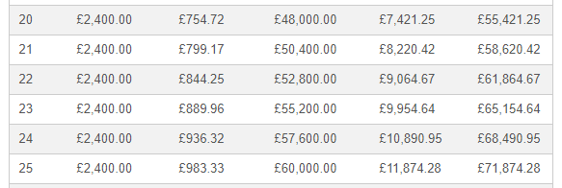
Saving for that House Deposit
Return on £200 a month at 1.4% (average savings rate)
Over 24 years to reach

Slide 71
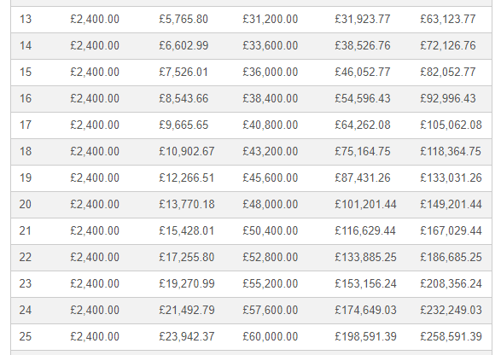
Saving for that House Deposit
Return on £200 a month at 9.8% (average interest on investing in the S&P 500 Index)
Over 13 years to reach goal of £69,556.50 for a deposit
However after 24 years instead of £232,000 compared to £69,556.50 in the 1.4 savings account.
The difference is risk… investments can lose you money. Higher risk but higher reward.

Slide 72

Activity 26 - Risks and Rewards of Saving Versus Investing.
Whilst watching the video answer the questions in the booklet.

Slide 73
Activity 27 – Which Account is Best?
Georgia has just been given £25,000 from her Grandfather and wants to use this money for a deposit on a house in roughly 5 years time. She is aware that interest rates are low and has found 4 accounts that she thinks might be suitable to put the money she has received from her Grandfather. She is wanting to also save an additional £100 a month towards the deposit.
Account | Interest & Charges | Features
TT Cash ISA | No charges 1.4% AER return | Minimum of £500 to open No withdrawal limits Fixed interest rate
ABC Regular saver | No charges 0.6% AER return | No minimum investment amount Instant access Fixed interest rate
DC Fixed Rate Bond | No charges 2% AER Return | Minimum investment £4000 Five year bond No withdrawls for 5 years
AN Stocks & Shares ISA | £50 annual account charge 0.5% dealing charge Average 8% return (not guaranteed) | Tracks the top 500 USA companies Withdraw investment anytime Minimum monthly investment of £50

Slide 74


Insurance

Slide 75
Different Insurance Products:
Products (car, home and contents, life assurance and insurance, travel, pet, health)
Different types of insurance policy for each product
Features of different types of insurance
Advantages and disadvantages of different types and features.

Slide 76






Types of Insurance
pet
car
Types of Insurance
travel
life
home
health

Slide 77

Activity 28 - Insurance Types
Once you have covered what each type covers. Research the advantages and disadvantages / features of each type.
Car

Slide 78
Insurance Types Explained
Car
Is a legal requirement in the UK and covers you in case of an accident, fire or theft depending on the level of cover purchased. Typical types of cover are third party, third party fire and theft and fully comprehensive.
Home and contents
Buildings insurance covers the physical building itself and in case of fire or structural damage. Contents insurance covers item within the house such as electricals, carpets and furniture. There is also the option to cover item when they are not at home.

Slide 79
Insurance Types Explained
Life
A policy that pays a lump sum upon death. Life insurance is usually required when purchasing a home to ensure the mortgage is covered if the homeowner dies.
Travel
Protects you while abroad. Typically covers illness, holiday and flight cancellations, theft and emergencies.

Slide 80
Insurance Types Explained
Pet
Protects the owners of pets from expenses associated with looking after a pet such as illness or injury of the animal.
Health
Covers individuals, families and employees via a payment plan that may include going to the dentist or opticians.

Slide 81
Activity 29 – Insurance Higher or Lower?
Together lets play higher or lower & then answer the questions on insurance.
Rhianna Legs
Miley Cyrus Tongue
Ronaldo Legs
Keith Richards Hands
Daniel Craig Whole Body
Kim Kardashian Bum
Mariah Carey Legs
$2 million
$1 million
$90 million
$2 million
$9.5 million
$21 million
$1 billion

Slide 82
Activity 30 – Knowledge Check A4
Identify two advantages of using credit cards
Provide two disadvantages of a mortgage
Describe what a bond is
List the advantages and disadvantages of ISAs
Explain the risks and rewards of investing
Discuss the advantages and disadvantages of travel insurance

Slide 83
Activity 31 – Learning Outcome A Kahoot Quiz
Attempt the Kahoot quiz to test your knowledge of Learning Outcome A of Unit 3: Personal and Business Finance. Once you have completed the quiz, answer the questions below to assess your strengths and areas for development.
Kahoot link:
https://create.kahoot.it/share/unit-3-personal-business-finance-outcome-a/06978734-f64a-4b53-aac7-eac44af345b9
What did you score on the Kahoot quiz?
/20

Slide 84
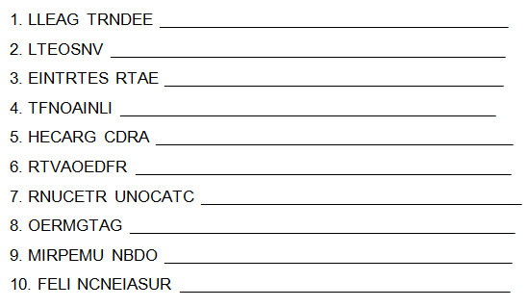
Activity 32 – Learning Outcome A Word Scramble

Slide 85
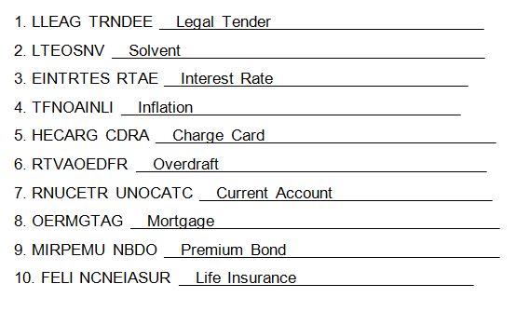
Activity 32 – Word Scramble Answers

Slide 86
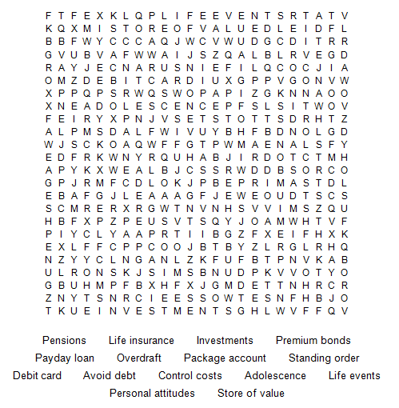
Activity 33 – Learning Outcome A Word Search

Slide 87

Activity 33 – Word Search Answers

Slide 88
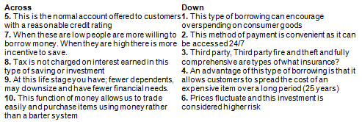
Activity 34 – Learning Outcome A Crossword

Slide 89
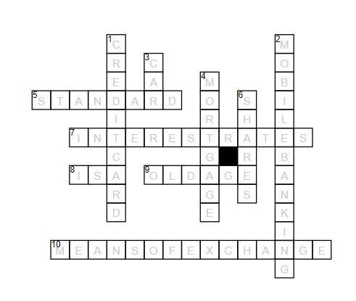
Activity 34 – Crossword Answers

Slide 90
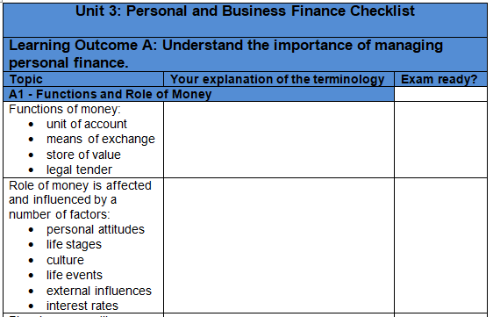
Activity 35 - Personal & Business Finance Outcome A Checklist
Well done, you have now completed the input and set activities for Learning Outcome A, you have one final task which is to complete the specification checklist below. First, you should explain the terminology and topic areas in the space provided and then tick the box in the last column when you feel exam ready with regards to that specific element of the specification.

