Slide 1
Unit 3: Personal & Business Finance

Slide 2
Learning Outcome B
Explore the Personal Finance Sector

Slide 3
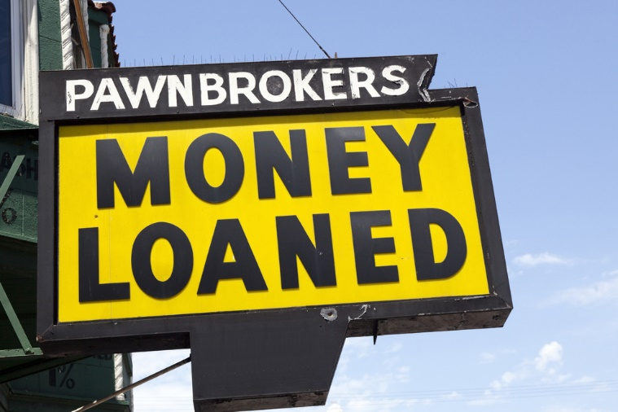

Learning Outcome B1
Features of Financial Institutions

Slide 4
What are Financial Institutions?
A financial institution is a company engaged in the business of dealing with financial and monetary transactions such as deposits, loans, investments and currency exchange. They may also offer advice on both business and personal financial matters.
There are a variety of financial institutions that offer different services.

Slide 5
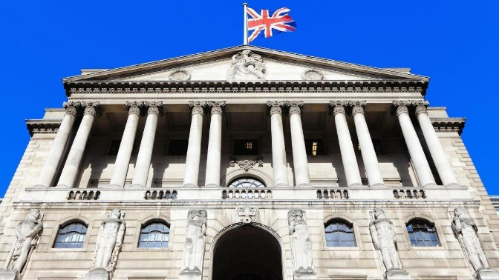
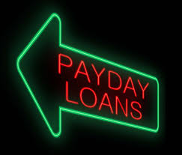
Types of Financial Institution
Bank of England
Banks
Building societies
Credit unions
National savings and investments
Insurance companies
Pension companies
Pawnbrokers
Payday loans

Slide 6
Activity 1 - Features of Financial Institutions
Whilst going through the different types of financial institutions add the key features of each to the spider diagram.
Bank of England
The UK’s central bank that ensures the financial stability of the UK. It sets interest rates for the country, prints bank notes and stores over 400,000 gold bars. It is not like a commercial bank and doesn’t lend to the general public.
Banks
A bank handles financial transactions and stores money on behalf of the general public. They allow individuals and businesses to make payments, access credit and save.

Slide 7
Features of Financial Institutions
Building Societies
Similar to banks these provide financial services to the public such as day to day banking, mortgages and credit. The key difference is that building societies are owned entirely by their members which means they can set rates that benefit their members and not shareholders.
Credit Unions
A member owned financial cooperative, controlled by its members and operated on the principle of people helping people, providing its members credit at competitive rates as well as other financial services.

Slide 8
Features of Financial Institutions
National Savings and Investments
A government backed organisation that offers a secure savings option. It offers a range of options including ISA’s, premium bonds and gilts.
Insurance Companies
These are for profit businesses that protect people against loss in return for a monthly premium (types of insurance were covered in outcome A).

Slide 9
Features of Financial Institutions
Pension Companies
Sell policies to individuals or companies that enable themselves or their employees to save for future retirement. Pension companies usually invest the money deposited by the individual in hopes of growing it for future use.
Pawnbrokers
Loan money to individuals and secure this loan against an asset. The most well known asset that is pawned is jewellery. If the item is not bought back then the pawnbroker will sell the asset to recoup the cost of the loan.
Payday loans
Short term loans that are intended to bridge the gap between one payday to another in the case of an emergency. Interest rates are extremely high and payday loans should be avoided where possible due to this.

Slide 10
Advantages & Disadvantages of Financial Institutions
Institution | Advantages | Disadvantages
Bank of England | Protect the financial stability of the UK economy Lend to banks Set interest rates | Do not lend to the general public Can raise interest rates making borrowing such as mortgages more expensive
Banks | Secure place to store money Pay interest on savings Variety of services | Savings only protected to £85,000 if the bank goes bankrupt Owned by shareholders therefore are designed to make a profit
Building Societies | Owned by members Variety of services Pay interest on savings Safe place to store money | May lack the business drive of commercial banks as banks are profit driven Savings only protected to £85,000
Credit Unions | Variety of services Owned by members Offer additional benefits to the community and charities | May lack the business drive of commercial banks as banks are profit driven Savings only protected to £85,000

Slide 11
Advantages & Disadvantages of Financial Institutions
Institution | Advantages | Disadvantages
National Savings & Investment | Savings are 100% secure as it is Government backed Various ways to save such as premium bonds | Variable rates Lack a high street presence Usually need to give notice on withdrawals
Insurance companies | Protect against unexpected losses/events Cover available on a variety of things Pay monthly so easier to budget | Premiums assessed on risk and the higher the risk the higher the premium Owned by shareholders therefore need to make a profit
Pension companies | Structured way to plan for retirement Matched contributions by employer Tax benefits | Poor investment decisions may mean a poor return on investment Cannot access money until the agreed term
Pawnbrokers | Quick way of acquiring short term cash Interest not charged Buy back pawned asset | Amount given for the asset is much lower than its worth Asset will be sold on if loan is not repaid
Payday Loans | Quick way of acquiring cash in a short period of time | Interest charged is very high which results in the amount being paid back being substantially higher

Slide 12
Activity 2 – Infographic on a Financial Institution
Using the features of the institution and the table of advantages and disadvantages in your student book, create an infographic for your given institution. It needs to cover at least the following:
Explain what the given institution is
Explain the features of that institution
Outline the advantages and disadvantages of the institution
Examples of the types of products/services they offer
Images that support the points made
Any other relevant information that will provide you with a better understanding of that financial institution.
You will present this back to the group (make sure you complete this professionally as these will be placed on the VLE for everyone to use and revise from).

Slide 13
Activity 3 – Evaluate a Financial Institution
You now have the key characteristics/features of the institutions and the advantages and disadvantages of each.
For one type of institution (other than the one you did in activity 2) use this information to evaluate the usefulness of that institution.
Ensure you make a balanced evaluation by using the advantages and disadvantages to make contrasting points.

Slide 14
Activity 4 - Knowledge Check B1 Features of Financial Institutions
List all 9 financial institutions
Describe two types of financial institution
Provide an advantage and disadvantage of the Bank of England
Explain the pros and cons of using a bank
Discuss the value of payday loans companies as a financial institution

Slide 15


Learning Outcome B2
Communicating with Customers

Slide 16
Communicating with Customers
Due to an increase in technology the ways in which banking is carried out has changed.
At one time banking in branch, face to face was the most commonly used method. Now there are many ways that customers can communicate with banks.
Online banking has increased however the increase in this method has meant that the service given to customers has become less personable.

Slide 17
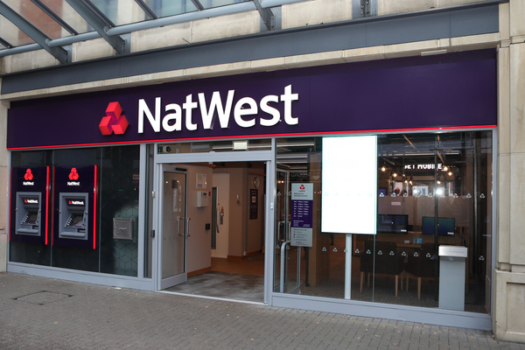
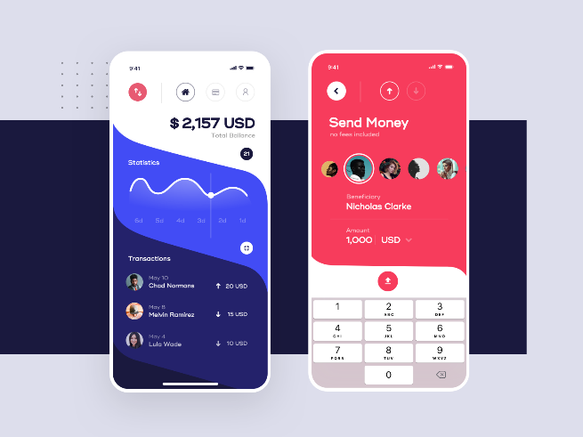
Methods of Communicating with Customers
Branch
Online banking
Telephone banking
Mobile banking
Postal banking

Slide 18
Activity 5 – Methods of Communicating with Customers
Create a spider diagram with each method of communication and what that method is.
Branch
A branch is a physical place where transactions are carried out face to face. Customers visit the bank to carry out their banking needs. This could be using self service machines or seeking advice from an employee at the bank. Banking is restricted to the hours that branch is open until.
Online
This allows customer the opportunity to manage their banking needs over the internet on a laptop or computer. They can do many of the same things that can be carried out in branch, however online does have its limitations as money cannot be paid in or drawn out. Banking online is not limited to opening hours and gives customers 24 hour access.
Telephone
Customers carry out banking transactions over the phone. This service is available 24/7 and is usually just for automated services like checking balances and paying bills. Some accounts do allow you to speak to an advisor.
Mobile
Similar to online banking but the service is accessed via a mobile device such as a smartphone or tablet and is available 24/7.
Postal
Paper based financial transactions. Many banks still send out paper copies of statements and some customers may still pay their bills by cheque.

Slide 19
Activity 6 - Advantages and Disadvantages of Communication methods
To fully asses the effectiveness of communication methods used by banks you need to know the advantages and disadvantages. This will help you answer this type of question in your exam in a balanced way.
As mentioned previously, a disadvantage of not using a branch to communicate with customers is that you lose that personal touch. However it is a method that customers have confidence in as they are dealing with human being rather than machines.
Using the table, provide advantages and disadvantages for each communication method.
Think about the benefits and drawbacks for both the consumer and the bank itself of offering this communication method.

Slide 20
Activity 6 – What I Have Got…
Communication Method | Advantages | Disadvantages
Branch | Ability to build relationships Encourages brand loyalty Additional services can be offered A method that customers have confidence in Transaction are carried out there and then | Only available during opening hours Takes considerably longer Need to travel to a branch Additional costs involved such as; fuel, parking, public transport etc.
Online | Extremely convenient 24/7 access Private | Cannot withdraw cash Possibility of being a victim of cyber crime May have limited facilities Takes time to register and set up
Telephone | No additional charges Convenient | Only available during set hours Limited service provided Automated services can annoy customers Risk of fraud/identity theft
Mobile | Convenient Easy to use Available 24/7 | May need to download an app Higher risk due to possibility of losing mobile device Possibility of being hacked
Postal | Traditional method that customer feel comfortable with No additional technology required | Post can be lost Takes significantly longer than other methods

Slide 21
Activity 7 - Exam Scenario Question
Isa is new to banking and isn’t sure which method of banking he should use to do his banking. He has a smartphone but no desktop computer. He also has a car so can possibly drive to a branch. He has a part time job at Greggs and his wages are paid into his account each month automatically. He very rarely uses cash as he pays for most things using apple pay.
Assess the benefits and drawbacks of the different methods available to Isa and recommend which method would meet his needs best.

Slide 22
Activity 8 - Knowledge Check B2 Communicating with Customers
List the 5 methods of communication with a bank
Describe Branch banking
Provide two disadvantages of mobile banking
Provide two advantages of postal banking
Assess telephone banking as a means of banking

Slide 23
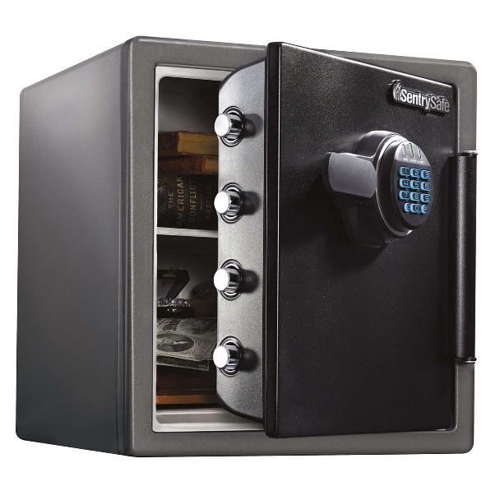

Learning Outcome B3
Consumer Protection in Relation to Personal Finance

Slide 24

Consumer Protection
If left to without no red tape or regulation it would be possible for banks and financial services to take advantage of consumers.
In order to stop financial institutions from taking advantage there are numerous organisations and laws in place to protect the rights of consumers and ensure that they are not treat unfairly or exploited.

Slide 25
Activity 9 - Function, Role and Responsibilities of Consumer Protection Bodies
Complete the worksheet that covers:
Function: What do they do?
Role: What are they there for?
Responsibilities: What do they have authority over?
Protection: How do they protect consumers?

Slide 26
Financial Conduct Authority (FCA)
The FCA is an independent organisation that is the conduct regulator for 59,000 financial services firms and financial markets in the UK.
It is funded via fees charged to the financial service providers and their work focuses on 3 key areas:
Authorisation
Supervision
Enforcement

Slide 27
Financial Ombudsmen Service (FOS)
Appointed by the government to protect and represent consumers who are in disputes with financial service providers. They only get involved if these disputes cannot be settled between the financial provider and the consumer.
Funded by compulsory fees charged to all regulated financial institutions.

Slide 28
Financial Services Compensation Scheme (FSCS)
An organisation that pays compensation to consumers when the financial service provider is unable to.
Protects savers up to £85,000 if the institution goes bust and the saver will be compensated by the FSCS.

Slide 29

Legislation – Consumer Credit
Laws that have been passed to regulate any business offering credit to consumers.
These laws are passed by the UK government to ensure consumers are protected and that financial providers do not take advantage.

Slide 30
Activity 10 – Financial Scenario
Mabel has £120,000 in inheritance in a savings account at a bank. The bank has just gone bankrupt and has announced that it will not be able to secure peoples savings.
Assess, using what you know about the consumer protection bodies what this means for Mabel and her savings.

Slide 31
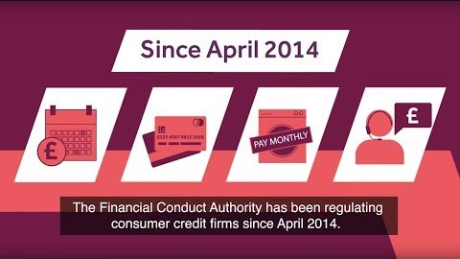
Activity 11 – Video on the Work of the FCA
Whilst watching the video take notes on the work the FCA has done in regulating consumer credit suppliers.
Does the Government need to regulate financial institutions?
Perform research and the video to argue whether you believe regulation is necessary or not.
Notes:
Video Link
https://www.youtube.com/watch?v=CS5y9SCeSOQ&t=2s

Slide 32
Activity 12 - Knowledge Check B3 Consumer Protection in Relation to Personal Finance
Create a 10 question quiz with answers regarding the consumer protection bodies covered. Ensure you know the answers as this will be given to one of your peers to complete. Be creative with your questions types; multiple choice & short answer etc.

Slide 33



Learning Outcome B4
Information Guidance and Advice

Slide 34
Information Guidance and Advice
Personal finance is extremely complicated and therefore it is imperative that all individuals have the opportunity to get clear advice and guidance on matters relating to personal finance.
There are a number of organisations and government agencies that can help with financial advice and guidance.

Slide 35
Information Guidance and Advice
Citizens Advice
Independent financial advisor (IFA)
Price comparison websites
Debt counsellors
Individual Voluntary Arrangements (IVAs)
Bankruptcy

Slide 36
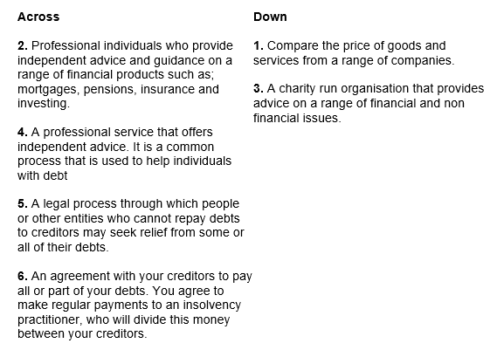
Activity 13 – Information Guidance & Advice Crossword

Slide 37

Activity 13 Crossword Answers

Slide 38
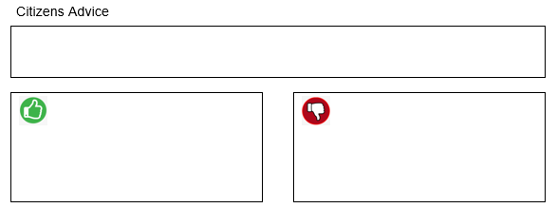
Activity 14: Information Guidance and Advice Table
Whilst we go through the various types of information and guidance available, complete the boxes in your student workbook with an explanation and the advantages and disadvantages.

Slide 39
Citizens Advice
A charity run organisation that provides advice on a range of financial and non financial issues. This can be done via a face to face appointment, over the phone or online.
Financial advice covers areas including, debt, benefits, banking, pensions and insurance.
Advantages | Disadvantages
Free | Trained volunteers not professionals
Covers a wide range of areas | Knowledge in finance may be limited
Face to face, online & telephone

Slide 40
Independent Financial Advisor (IFA)
Professional individuals who provide independent advice and guidance on a range of financial products such as; mortgages, pensions, insurance and investing.
They must be qualified and are regulated by the UK government.
Advantages | Disadvantages
Advice is offered by professionals Regulated | Charge fees
Advice based on individual need and circumstance | Dependant on the quality of the advisor
No commission

Slide 41
Price Comparison Websites
Advantages | Disadvantages
Access 24/7 | Could be bias
Free | Does not always cover all providers
Easy to compare
Price comparison sites do exactly what their name implies as they compare the price of goods and services from a range of companies.
This allows you to make sure you get a deal that's tailored to you at the best price.

Slide 42
Debt Counsellors
Debt counselling is a professional service that offers independent advice. It is a common process that is used to help individuals with debt settlement through education, budgeting and the use of a variety of tools with the goal to reduce and ultimately eliminate debt.
Advantages | Disadvantages
Professionals who specialise in debt | It isn’t free
Regulated by the FCA and FOS | Just focuses on debt

Slide 43
Individual Voluntary Arrangements (IVAs)
Advantages | Disadvantages
Help manage debts via regular payments | Fees are charged for the service
Unbiased as advice is independent | Impact on credit rating
An Individual Voluntary Arrangement (IVA) is an agreement with your creditors to pay all or part of your debts.
You agree to make regular payments to an insolvency practitioner, who will divide this money between your creditors.
An IVA can give you more control of your assets than bankruptcy.

Slide 44
Bankruptcy
Bankruptcy is a legal process through which people or other entities who cannot repay debts to creditors may seek relief from some or all of their debts. In most jurisdictions bankruptcy is imposed by a court order.
Advantages | Disadvantages
Suspends any debt collection | May get all assets repossessed
Debts are usually fully written off | Stays on your credit report for 7 to 10 years
 | Difficult to borrow in the future

Slide 45
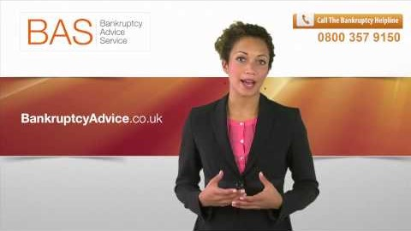
Activity 15 - Difference Between Bankruptcy & IVA
Whilst watching the video fill in the Venn diagram regarding the similarities & differences between both bankruptcy and IVAs. Perform further research if needed.
Notes:
Video link
https://www.youtube.com/watch?v=nUBChE1EKS4

Slide 46
Activity 16 – Scenario Question (12 marks)
Drake is married with a young family. He is a homeowner with a mortgage and has two personal loans and outstanding balances on three credit cards.
One of the personal loans is secured on his house. His personal circumstances have changed since he took on these debts. He now earns significantly less than he did and he can no longer afford the debt repayments.
As a result, he is in arrears on all of his debts. He has been served with default notices demanding repayment in full. Drake has been advised to either apply for an IVA (Individual Voluntary Arrangement) or to apply for bankruptcy.
Evaluate whether Drake should apply for an IVA or apply for bankruptcy.

Slide 47
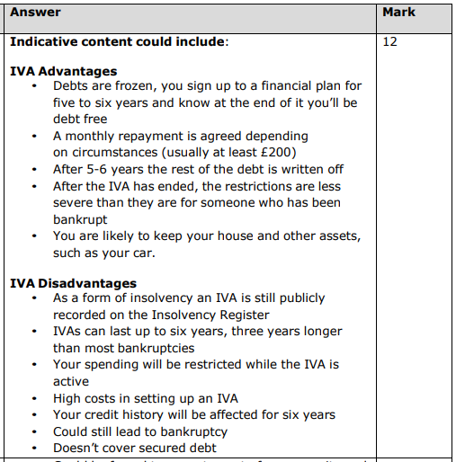
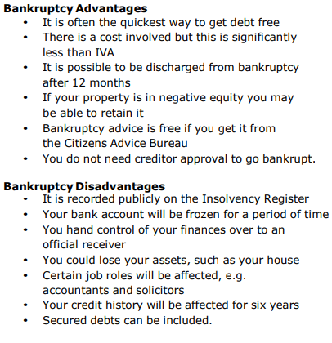
Activity 16 – Scenario Answer

Slide 48
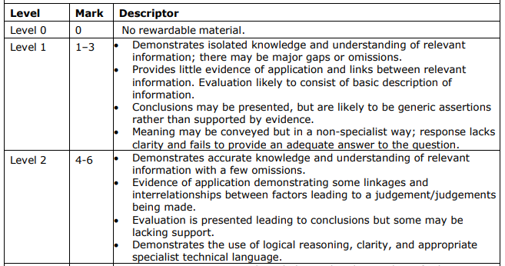
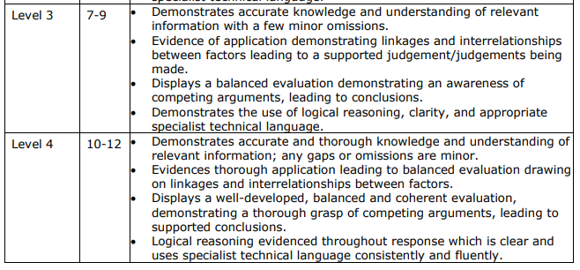
Activity 16 – Scenario Marking

Slide 49
Activity 17 - Knowledge Check B4 Information Guidance & Advice
List the 6 sources of information, guidance and advice
Explain the role of an Independent Financial Advisor (IFA)
Provide two advantages of using Citizens Advice service
Provide two disadvantages of using price comparison websites
Analyse the benefits and drawbacks of using a debt counsellor

Slide 50
Activity 18 – Learning Outcome B Kahoot Quiz
Attempt the Kahoot quiz to test your knowledge of Learning Outcome B of Unit 3: Personal and Business Finance. Once you have completed the quiz, answer the questions below to assess your strengths and areas for development.
Kahoot link:
https://create.kahoot.it/share/unit-3-personal-business-finance-outcome-b/ecc81b66-7f4f-4e05-9351-ff0bd8600713
What did you score on the Kahoot quiz?
/20

Slide 51
Activity 19 – Learning Outcome B Key Word Scramble
1. ICLNANFIA SITNUNTITOSI ____________________________
2. NBAK OF GADELNN ___________________________________
3. GLINDBIU TISOCYE __________________________________
4. DREITC IOUNN ______________________________________
5. HCNARB ____________________________________________
6. OMIEBL NGINBKA ____________________________________
7. AOSPLT BANNKGI ____________________________________
8. ACIIFANLN UNCCTDO TTUOYARHI _______________________
9. ILNCAAFIN NDSMOMBUE EERICVS _______________________
10. ZICIETSN IEACDV ___________________________________
11. DTBE CNLESOOLRUS __________________________________
12. CPRUNAYTKB ________________________________________

Slide 52
Activity 19 – Key Word Scramble Answers
1. ICLNANFIA SITNUNTITOSI __Financial Institutions____
2. NBAK OF GADELNN __Bank of England__________________
3. GLINDBIU TISOCYE __Building Society________________
4. DREITC IOUNN __Credit Union________________________
5. HCNARB __Branch____________________________________
6. OMIEBL NGINBKA __Mobile Banking____________________
7. AOSPLT BANNKGI __Postal Banking____________________
8. ACIIFANLN UNCCTDO TTUOYARHI __Financial Conduct Authority
9. ILNCAAFIN NDSMOMBUE EERICVS __Financial Ombudsmen Service
10. ZICIETSN IEACDV __Citizens Advice__________________
11. DTBE CNLESOOLRUS __Debt Counsellors________________
12. CPRUNAYTKB __Bankruptcy____________________________

Slide 53


Activity 20 – Learning Outcome B Word Search

Slide 54


Activity 20 – Word Search Answers

Slide 55
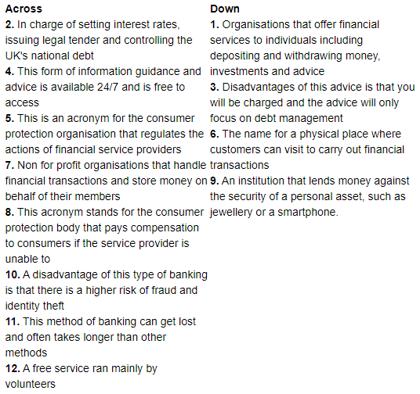
Activity 21 – Learning Outcome B Crossword

Slide 56

Activity 21 – Crossword Answers

Slide 57
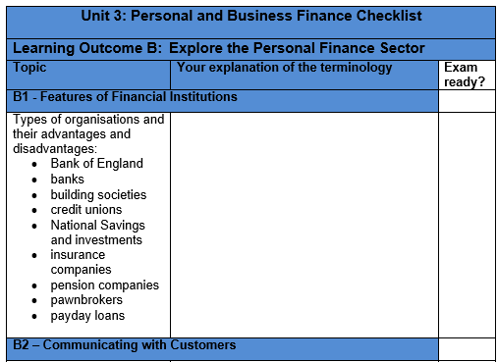
Activity 22 - Personal & Business Finance Outcome B Checklist
Well done, you have now completed the input and set activities for Learning Outcome B, you have one final task which is to complete the specification checklist below. First, you should explain the terminology and topic areas in the space provided and then tick the box in the last column when you feel exam ready with regards to that specific element of the specification.

