Slide 1


Slide 2
What is BBC micro:bit?
A pocket-sized codeable computer
It has 25 red LEDs that can light up, flash messages, create games, and invent digital stories!
Two programmable buttons. You can use the micro:bit as a games controller, and even pause or skip songs on a playlist!

Slide 3
What is BBC micro:bit?
It has an on-board motion detector (accelerometer) that can detect movement and tell other devices you’re on the go. You can light it up when something is moved, and use it for motion-activated games.
The built-in compass (magnetometer) helps to sense which direction you’re facing, your movement in degrees, and where you are.
Bluetooth Smart Technology can connect to the internet, connect to your friends’ micro:bits, phones, tablets, cameras. You can share creations, join forces, take a selfie, and even pause a DVD

Slide 4
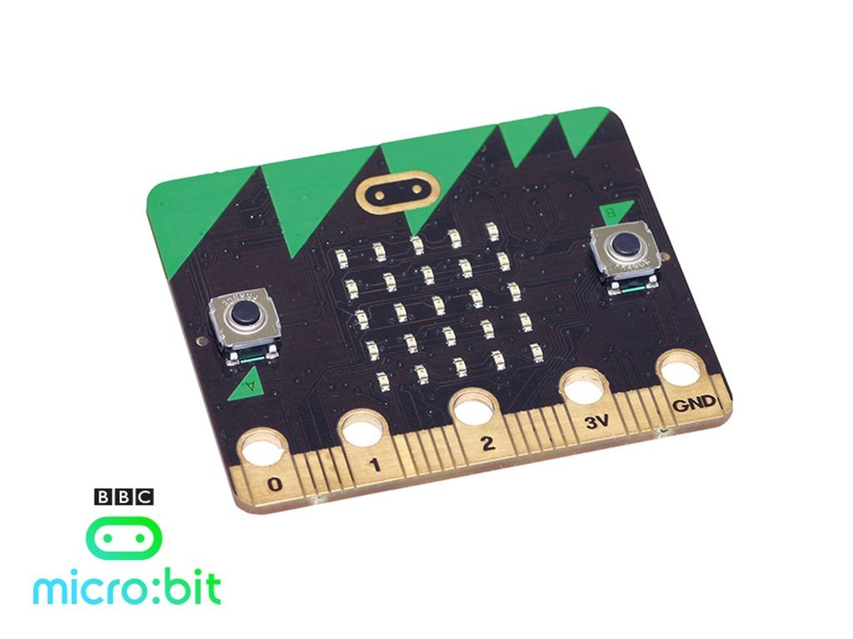
https://www.microbit.co.uk
Other colours are available!
http://www.bbc.co.uk/programmes/articles/4hVG2Br1W1LKCmw8nSm9WnQ/the-bbc-micro-bit
Notes:
Short video so the pupils can visually see existing creations including a football score count.

Slide 5
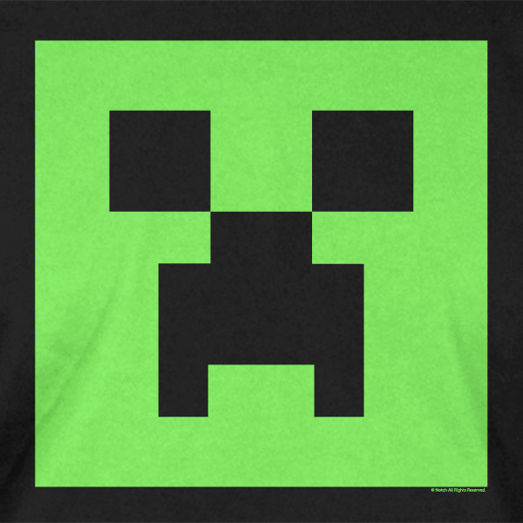
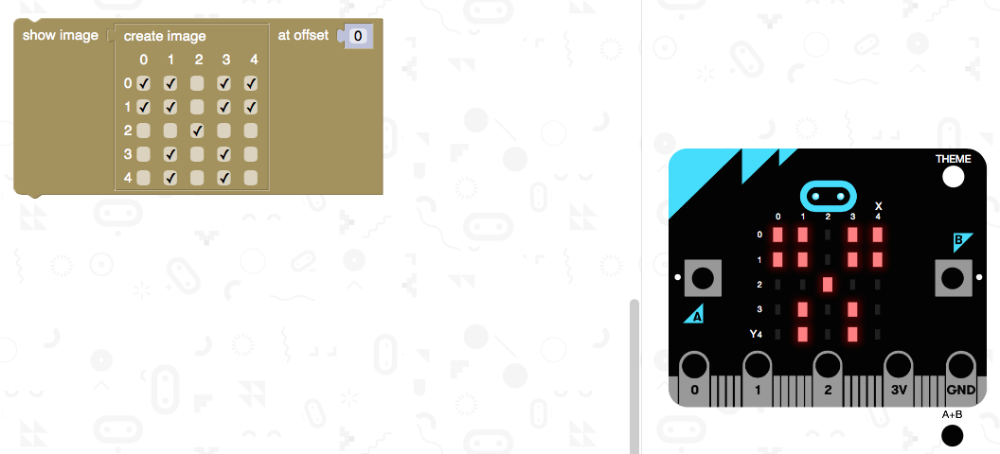
Minecraft Creeper Face
Notes:
The aim of the lesson

Slide 6
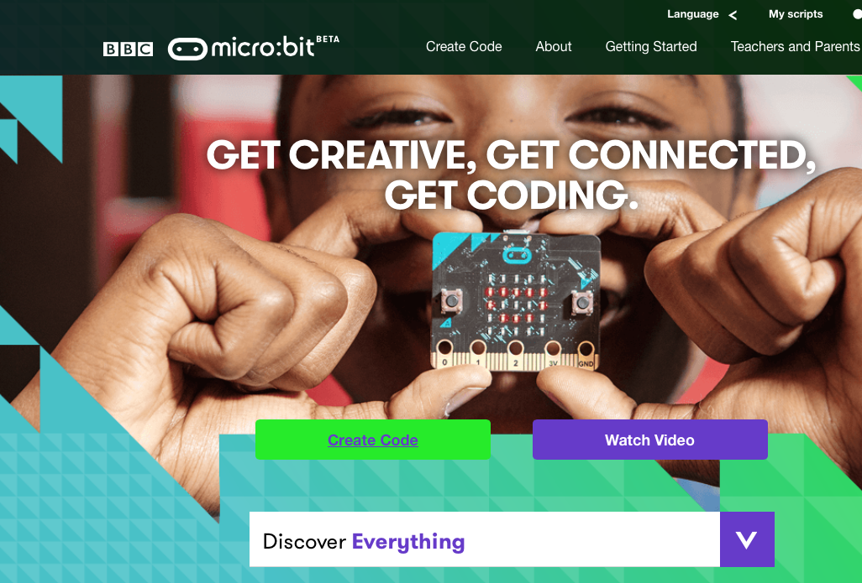
Minecraft Creeper Face

Slide 7
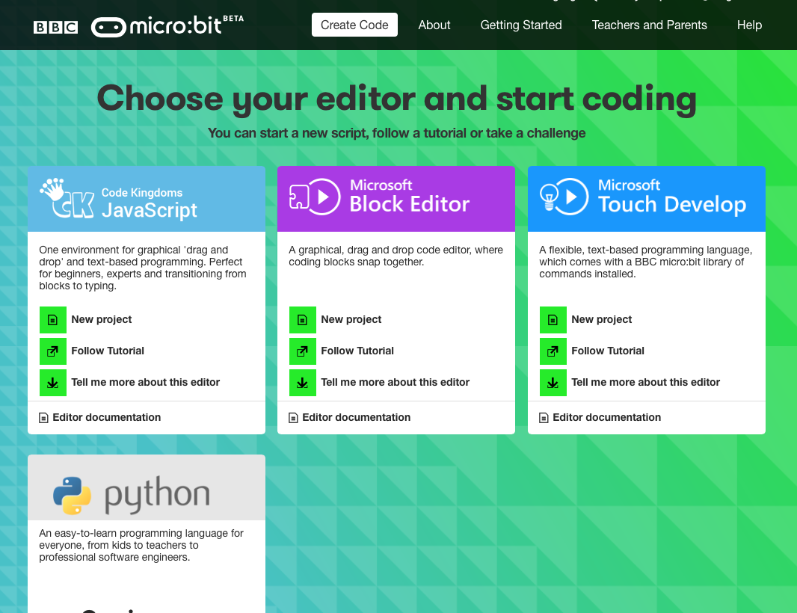
Minecraft Creeper Face

Slide 8
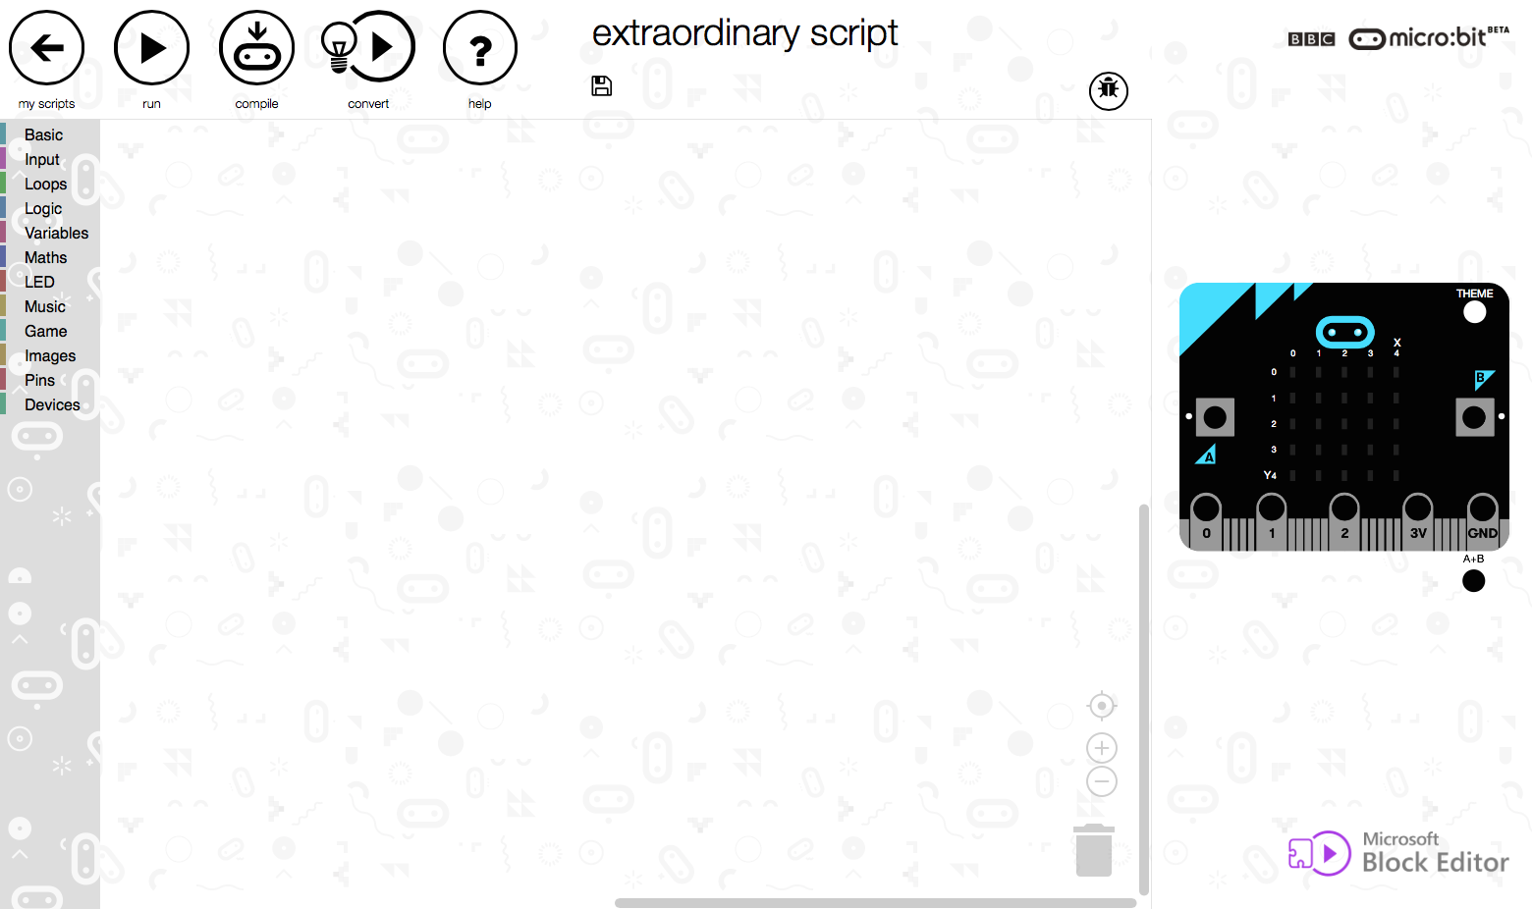
Minecraft Creeper Face

Slide 9
Go to Basic then select On Start

Slide 10
Minecraft Creeper Face
Step 1
Go to Advanced
Then select Images

Slide 11
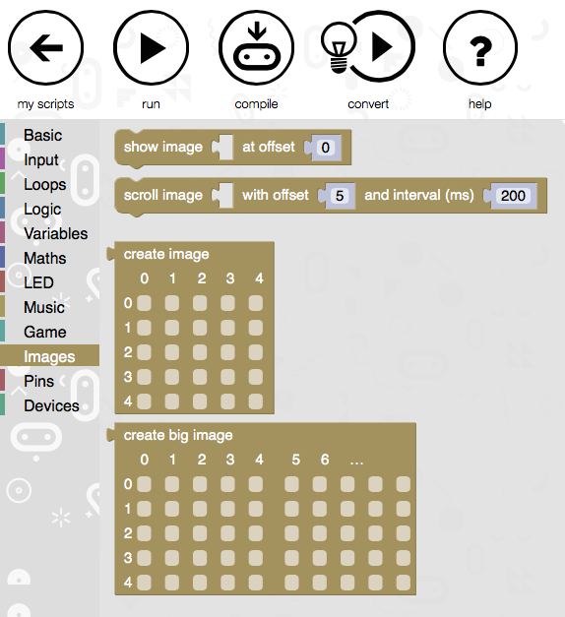
Minecraft Creeper Face
Step 2
We leave this at 0 so the image begins at 0, 0

Slide 12
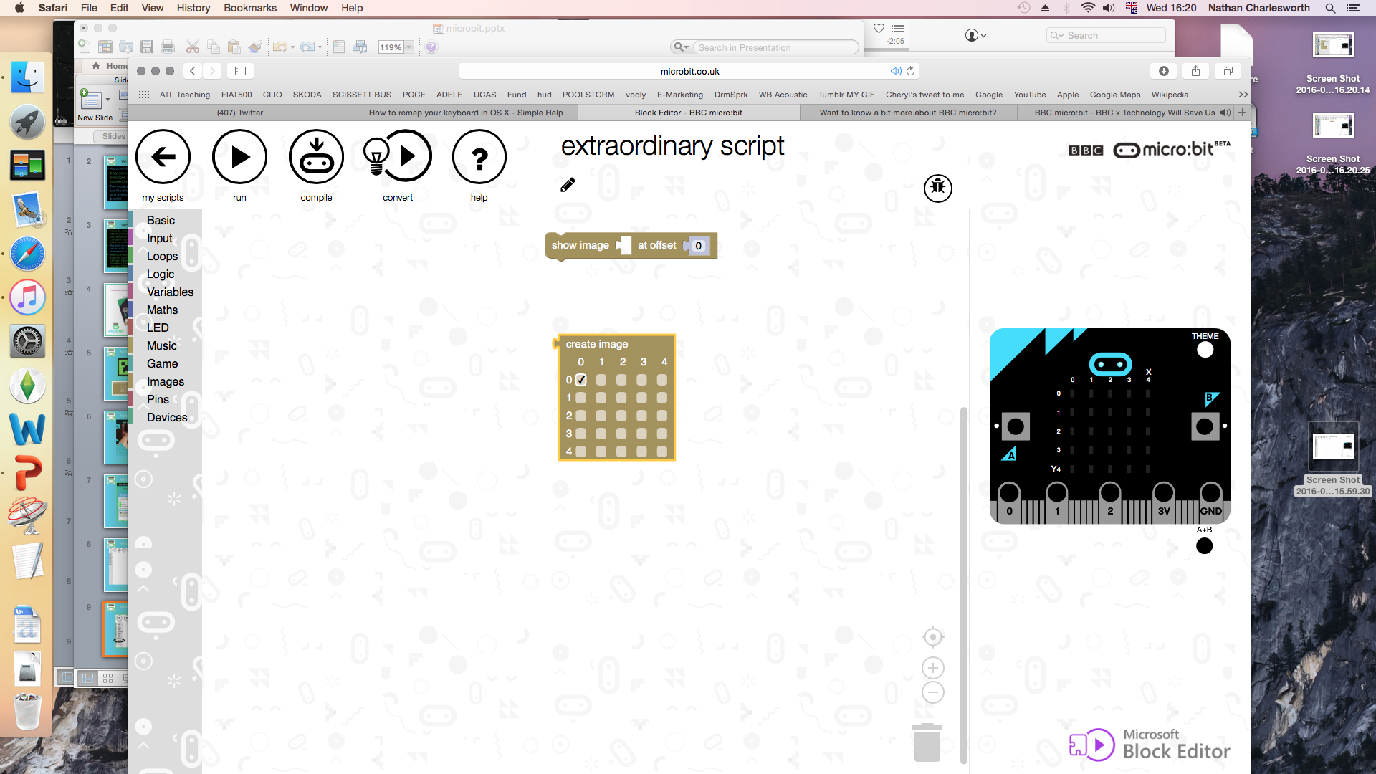
Minecraft Creeper Face
Step 3
Simply drag the block onto the blank space

Slide 13
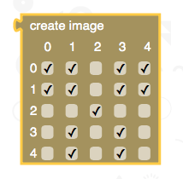
Minecraft Creeper Face
Step 4
Tick the boxes in the block to make the creeper face

Slide 14
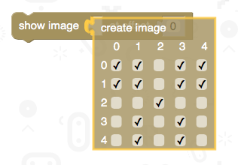
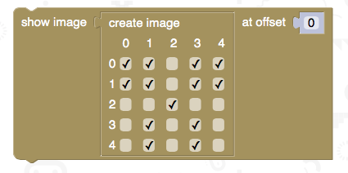
Minecraft Creeper Face
Step 5
Drag the ‘create image’ block into the white space of the ‘show image’ block

Slide 15
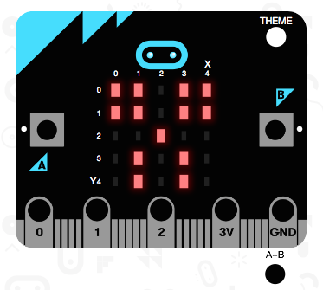
Minecraft Creeper Face
Step 6
Click the run button and the virtual micro:bit should display the creeper face

Slide 16


Your Turn!
Follow the previous instructions to create the creeper face and then:
Create a timer to pause for 3 seconds
From the basic menu, select the pause block.
The micro:bit uses milliseconds so ‘1000’ is equal to 1 second.
We want to pause for 3 seconds so
change the number to ‘3000’.
Reset the display to its original state: OFF
2. Click on the LED menu. Select the clear screen block and ‘snap’ it under the pause block. This will turn off all the LEDs after the Creeper face has displayed for 3 seconds.

Slide 17
Extension Task!
After completing all previous tasks:
Change the pattern in the create image block to show your own design.
2. Instead of clearing the display, add another show image block and pause block to create a simple two-state animation. Can you experiment with the brightness of the Creeper image between face changes?

