Slide 1

Lesson 3

Slide 2
Rock, Paper, Scissors!
We will be using the LEDs and the motion detector built in to the micro:bit (accelerometer) that can detect movement. This will tell the micro:bit when we have shook the micro:bit, and when to display the ‘rock, paper, or scissors’.

Slide 3
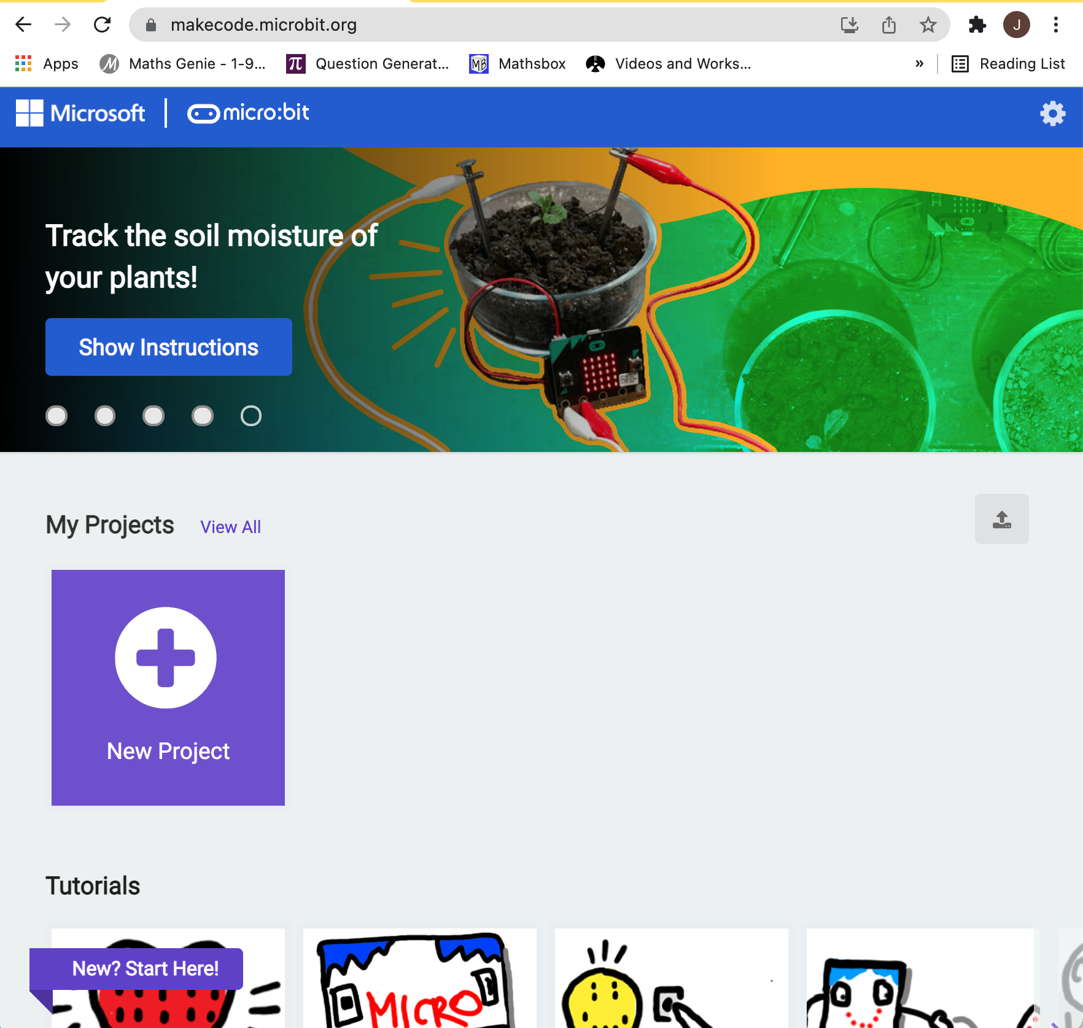
Rock, Paper, Scissors!
Click ”New Project”
Name it Rock, Paper,
Scissors.
www.makecode.microbit.org

Slide 4
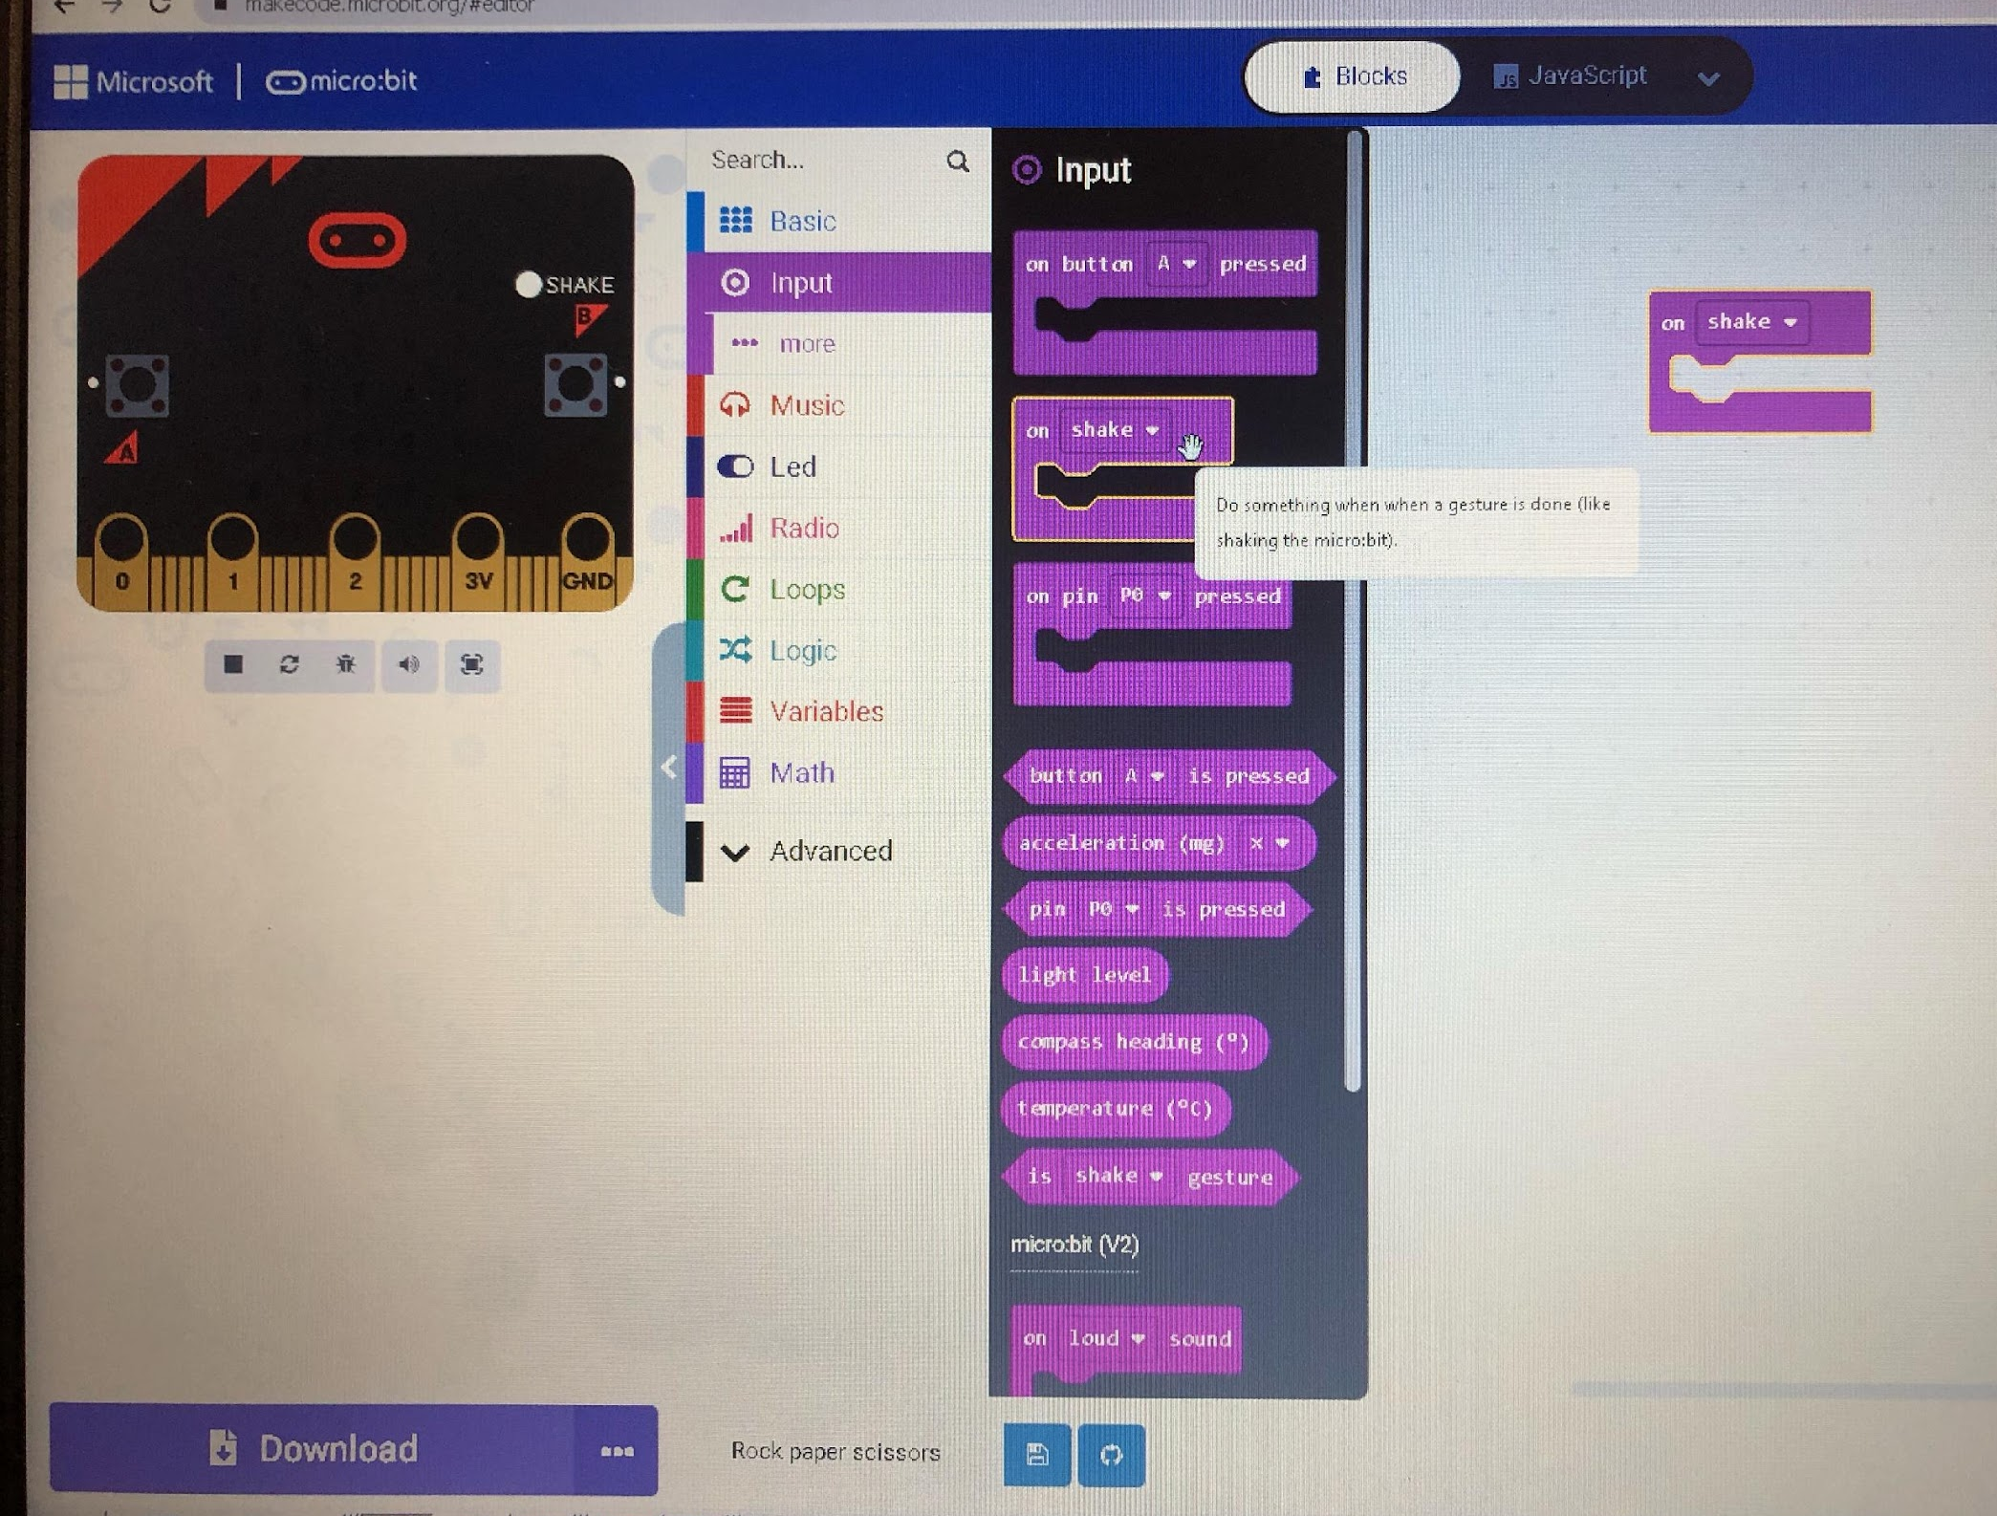
Rock, Paper, Scissors!
Go to input menu and select On Shake

Slide 5
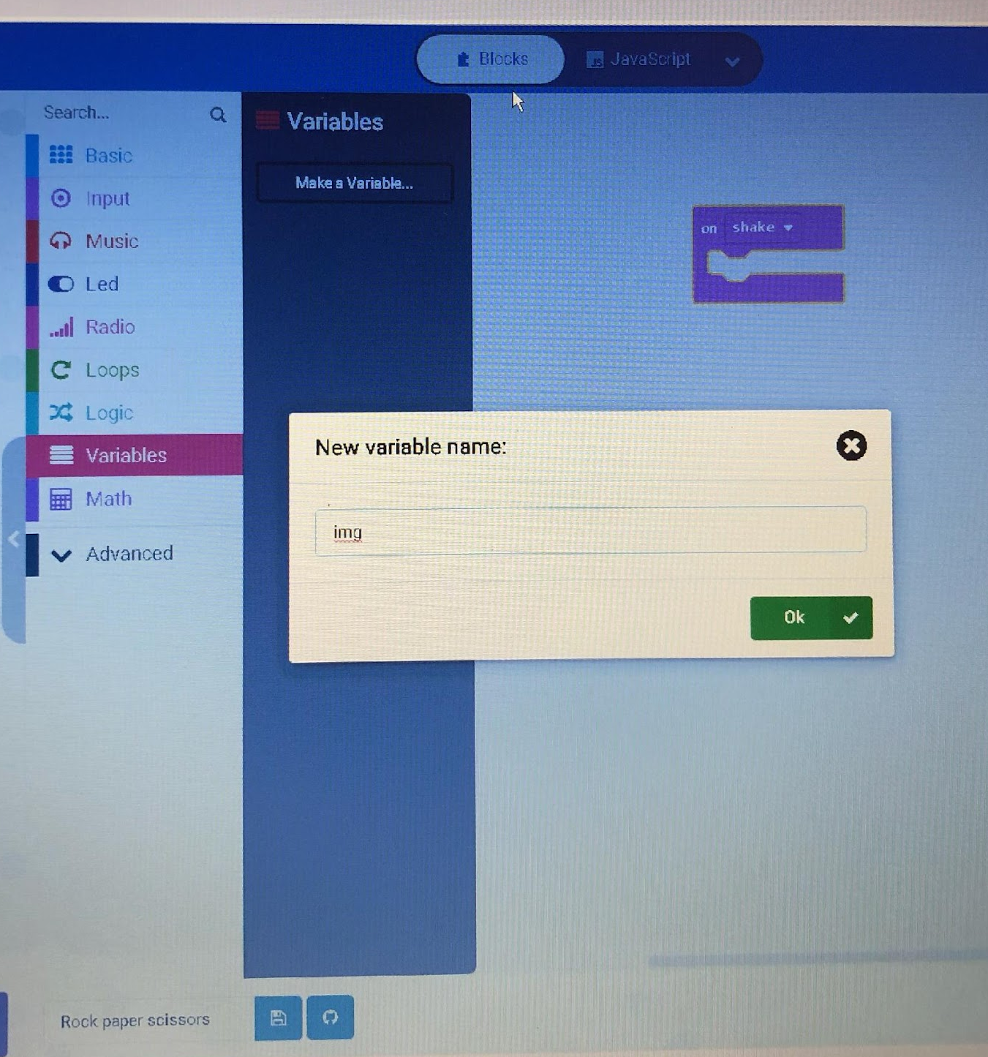
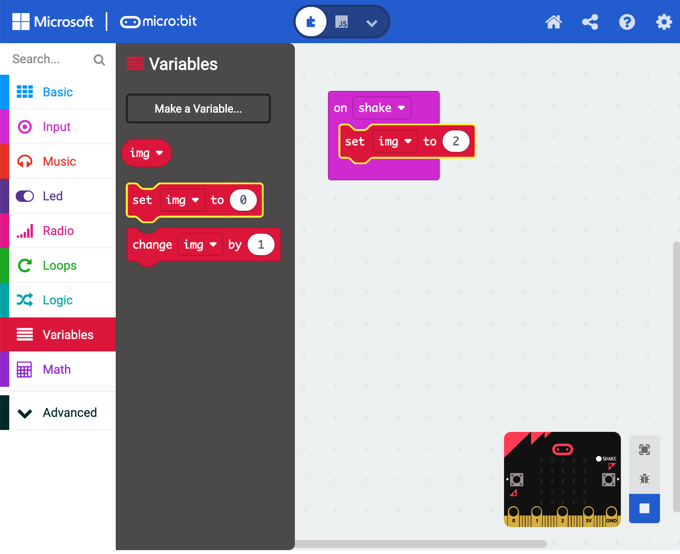
Rock, Paper, Scissors!
Drag set item to from the VARIABLES menu. Click on item and then click rename variable. Call it img

Slide 6
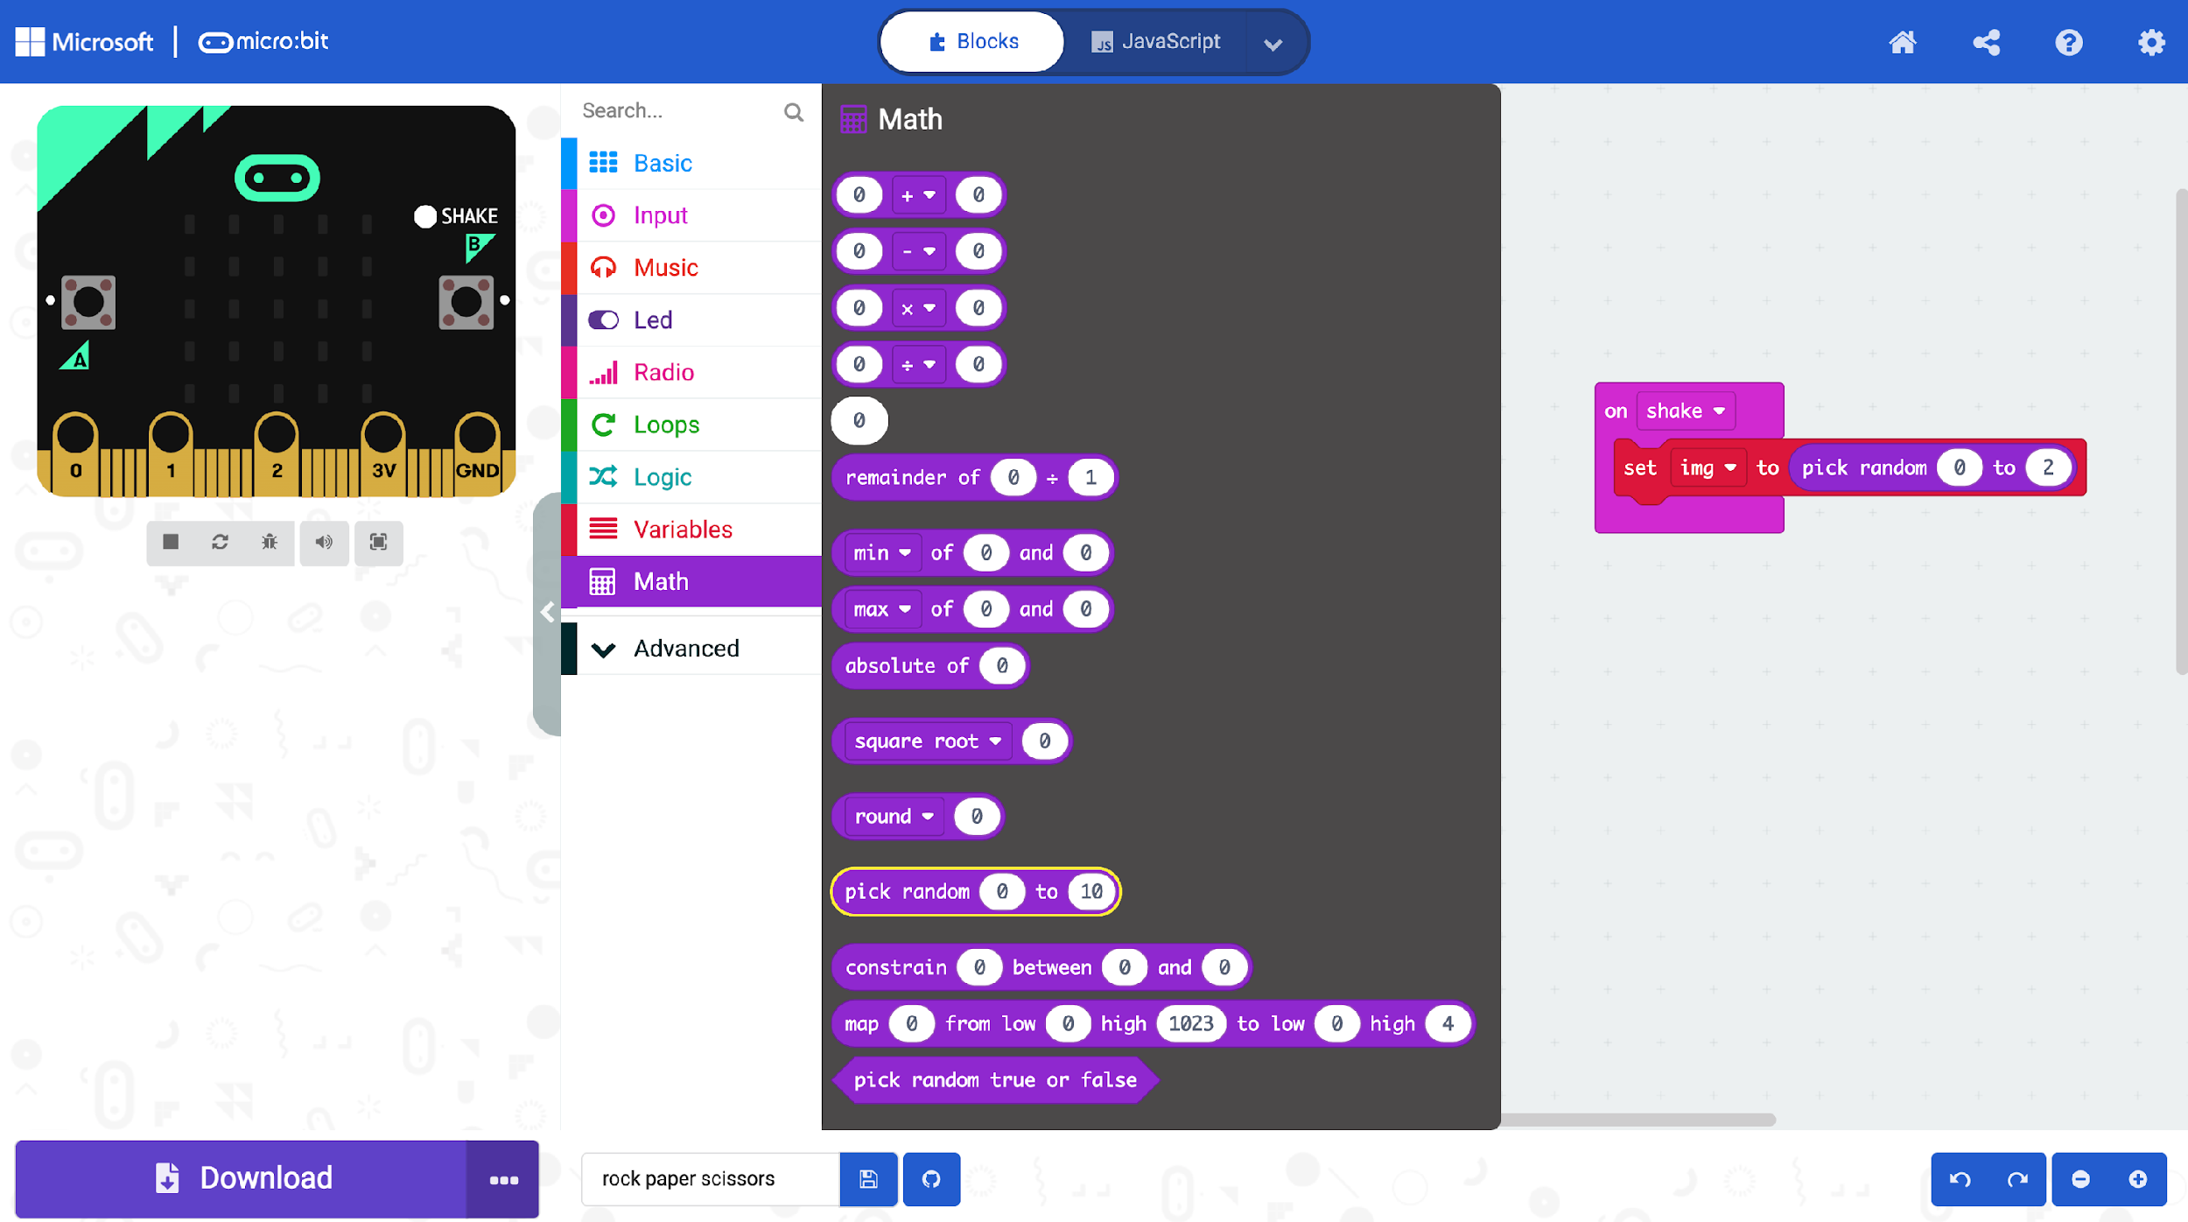
Rock, Paper, Scissors!
Pick random is in the MATHS. Change the last number to 2.

Slide 7
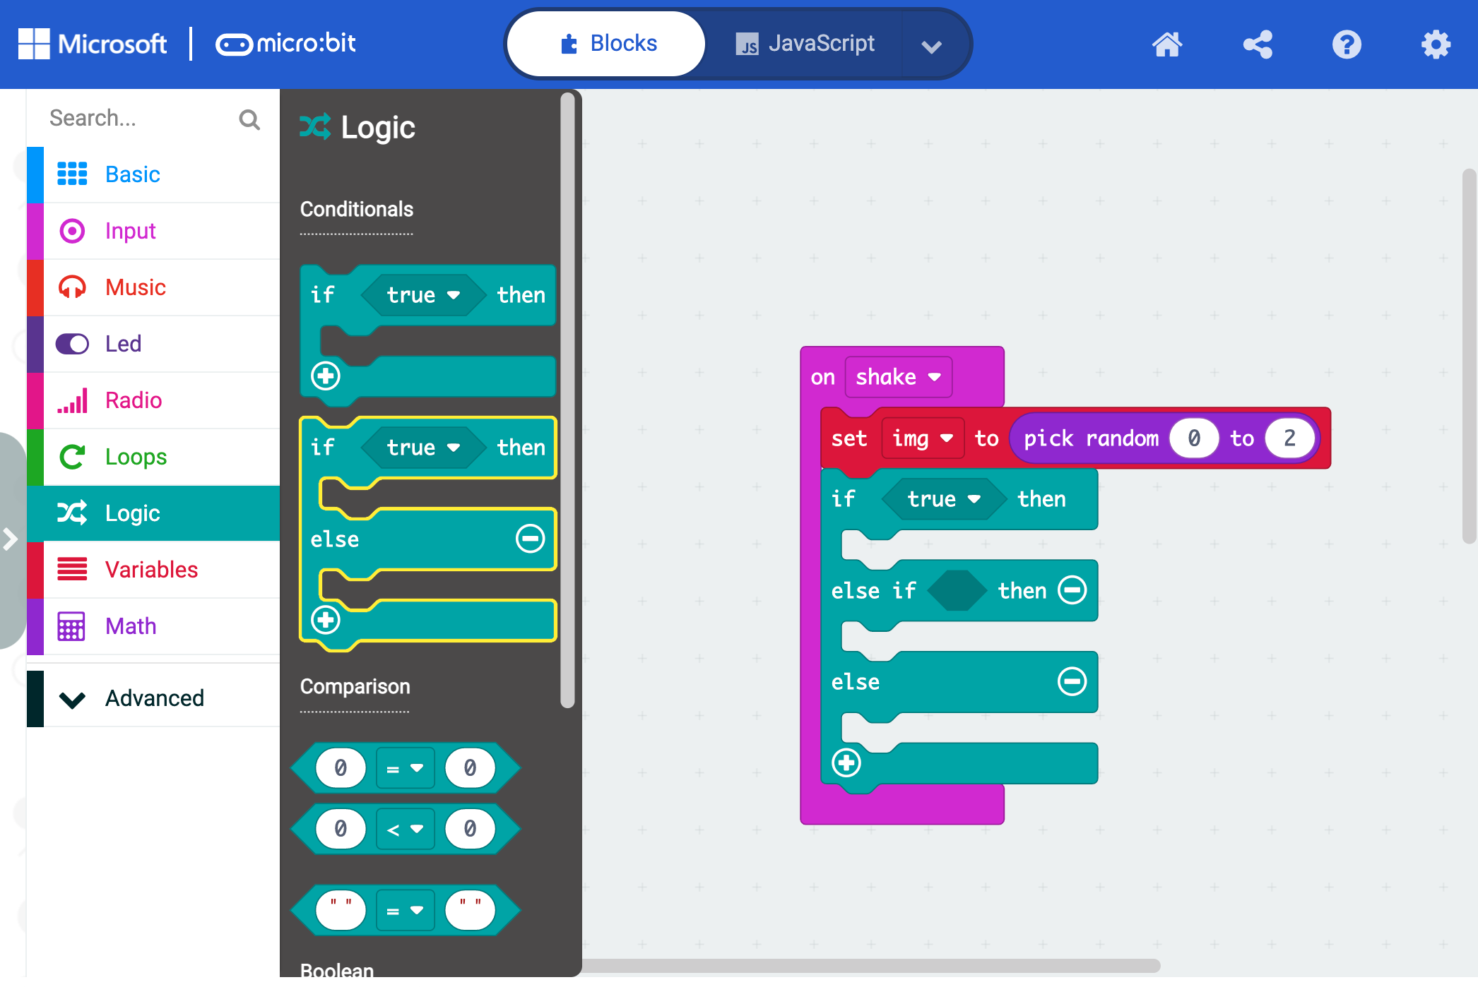
Rock, Paper, Scissors!
This is the hardest bit! This block comes from the LOGIC menu. It starts off as just IF and ELSE. You need to add in ELSE IF by clicking on the blue plus button

Slide 8
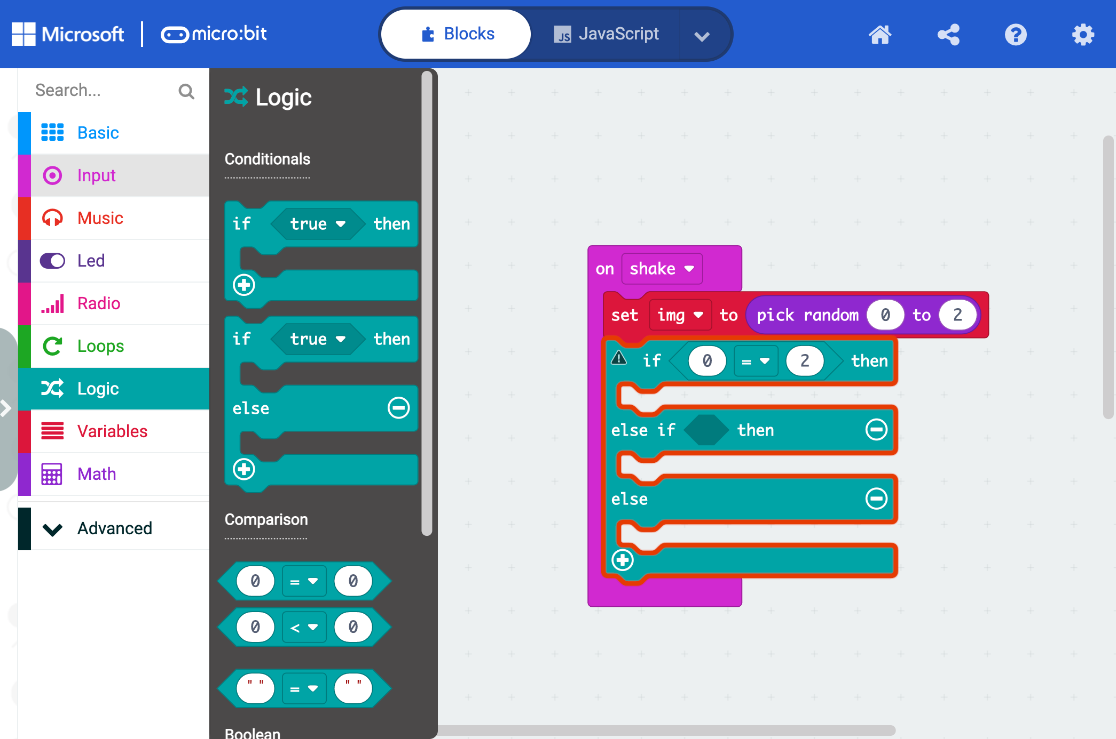
Rock, Paper, Scissors!
This block is in the LOGIC menu and starts off as 0 = 0. Change the last 0 to a 2.

Slide 9
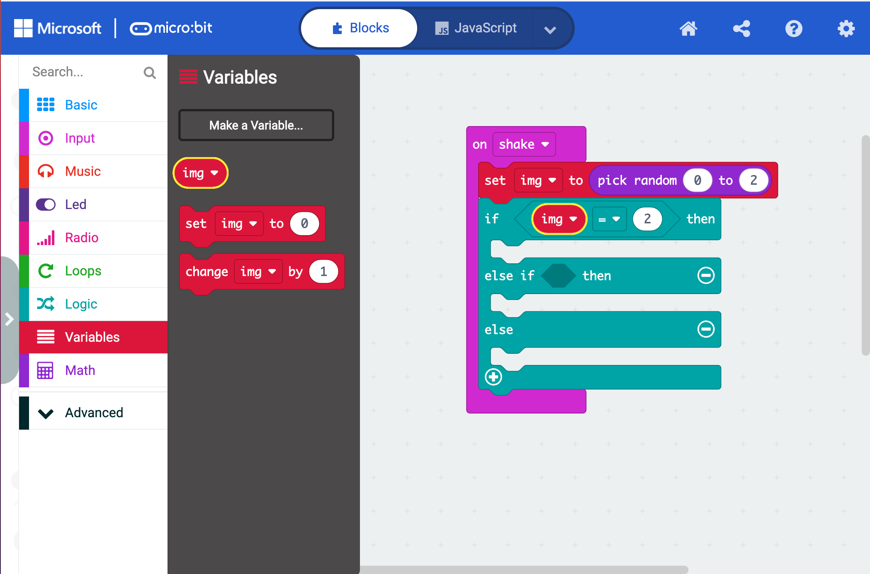
Rock, Paper, Scissors!
This block is in the VARIABLES menu drag it and drop it to replace the first 0.

Slide 10
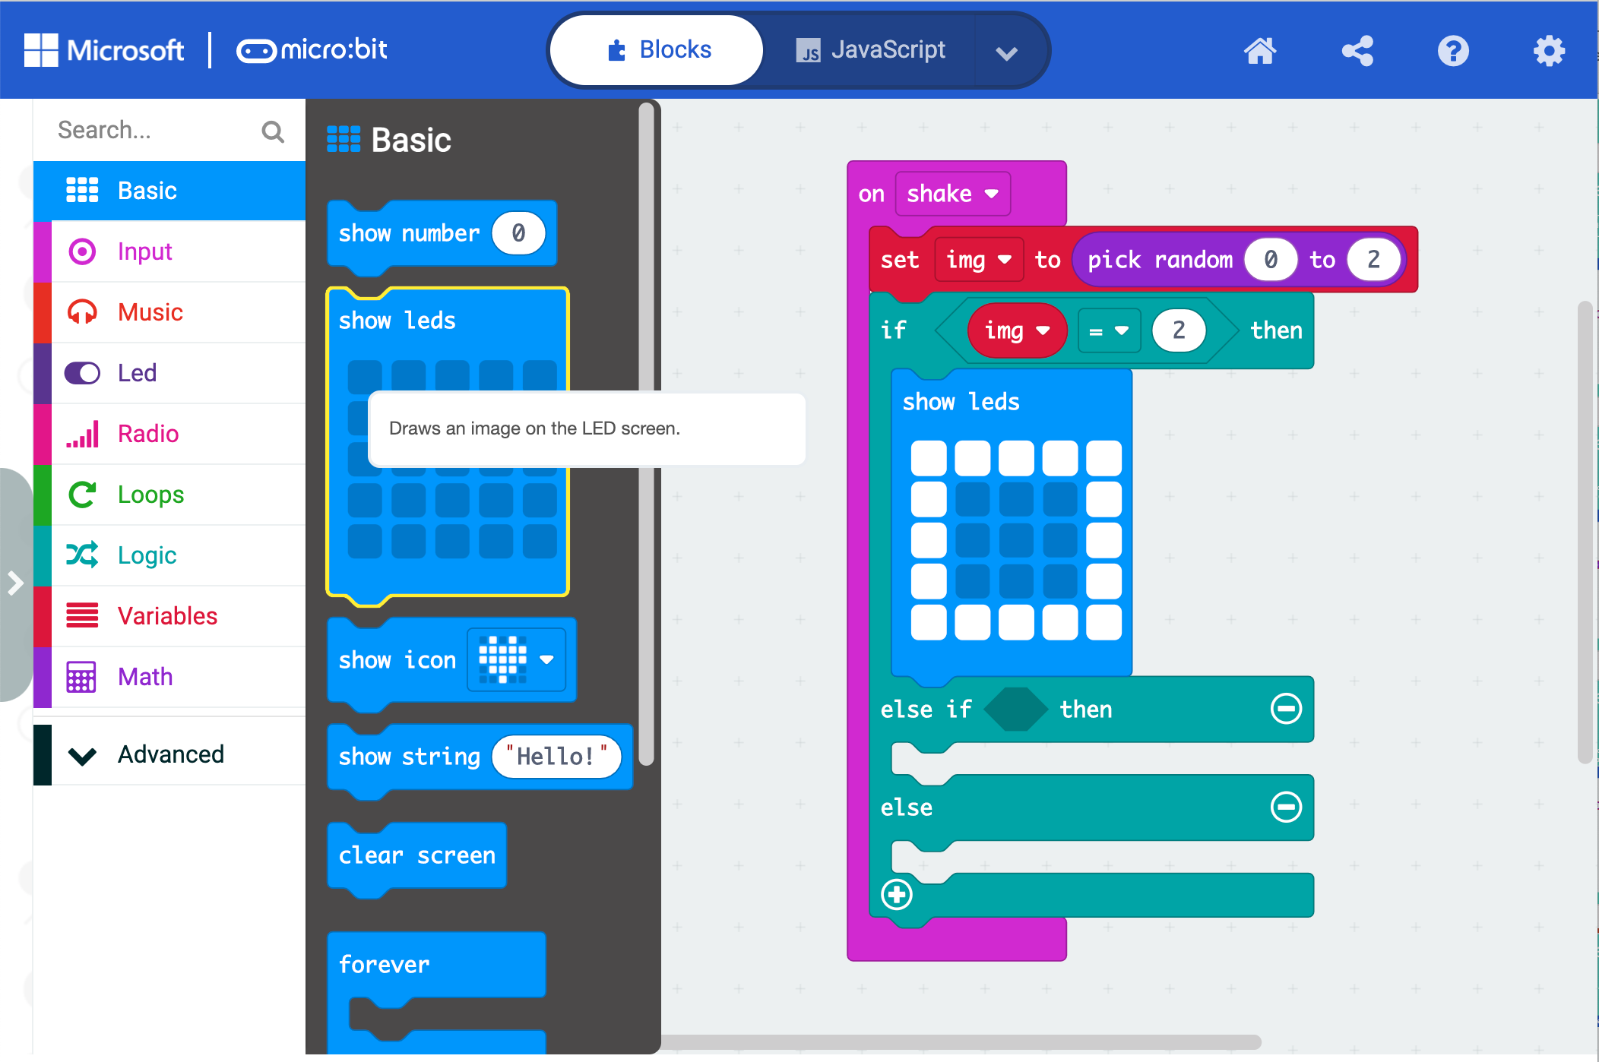
Rock, Paper, Scissors!
Show leds is in the BASIC menu. This first image looks like paper.

Slide 11
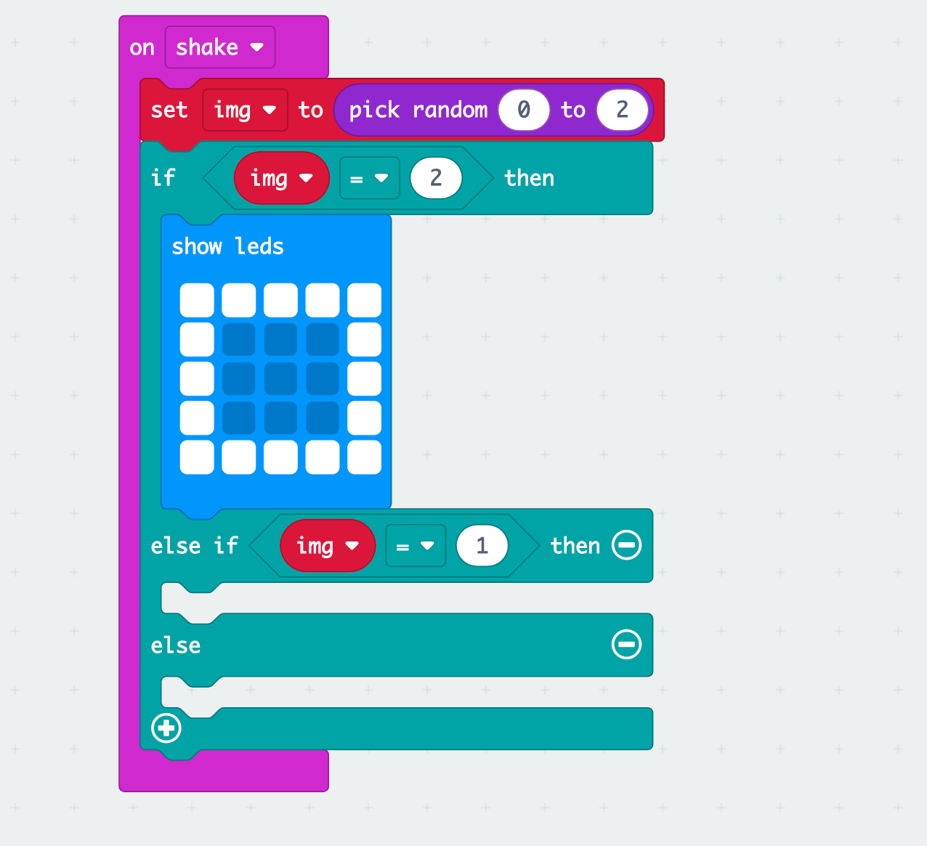
Rock, Paper, Scissors!
This is a repeat of the earlier block. It starts off as 0 = 0 in the LOGIC menu. Change the right hand 0 to 1. Get IMG from the VARIABLES menu and drop it over the first

Slide 12
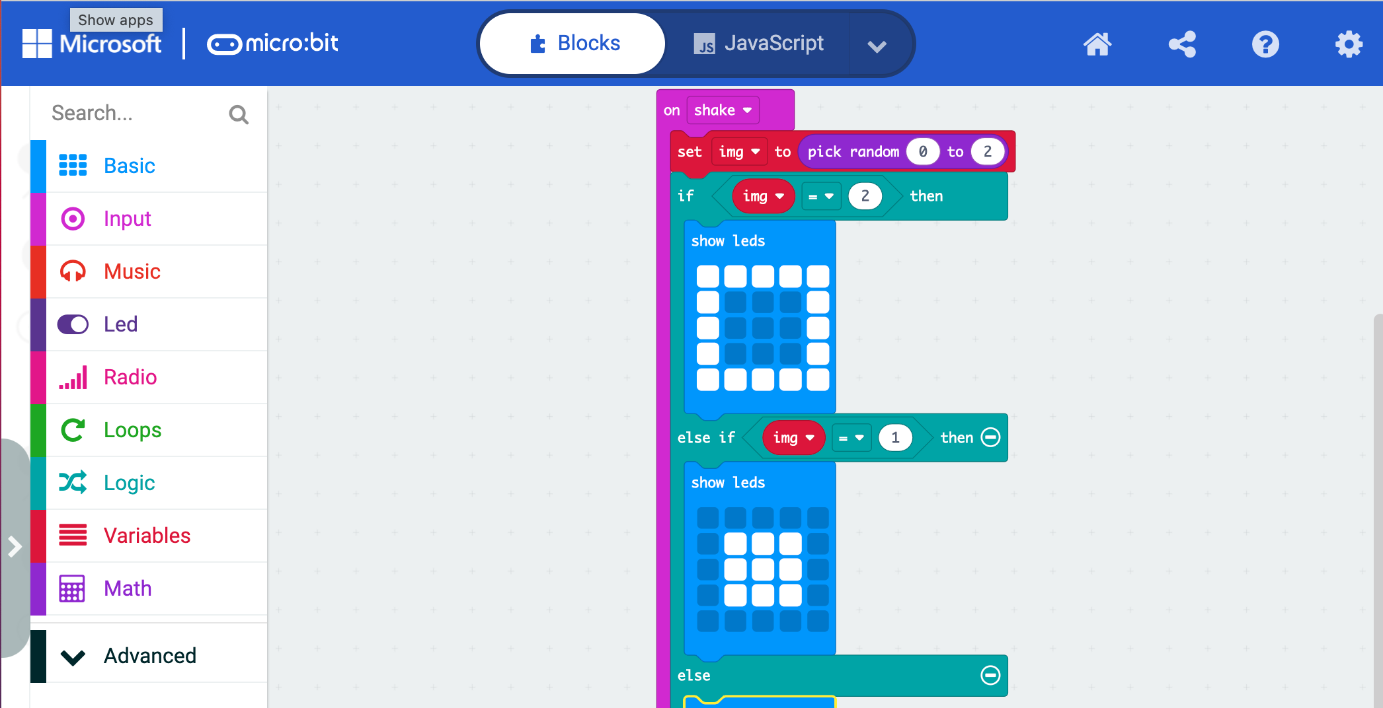
Rock, Paper, Scissors!
Show leds is in the BASIC menu. This image looks like a rock.

Slide 13
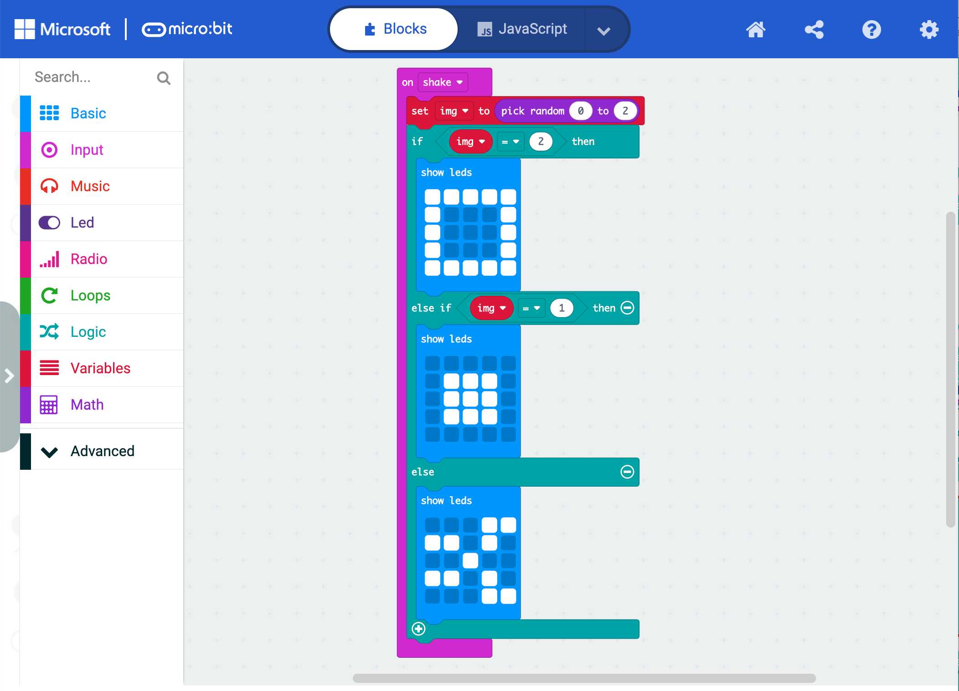
Rock, Paper, Scissors!
Show leds is in the BASIC menu. This first image looks like scissors.

Slide 14
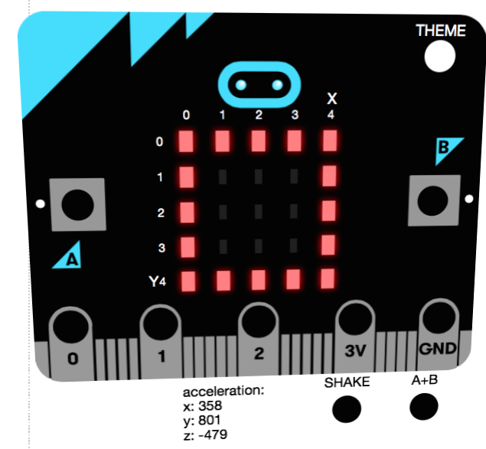
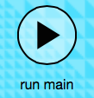
Rock, Paper, Scissors!
Run It!
Click ‘SHAKE’ button until you have seen that rock, paper, AND scissors all display on the micro:bit!

Slide 15
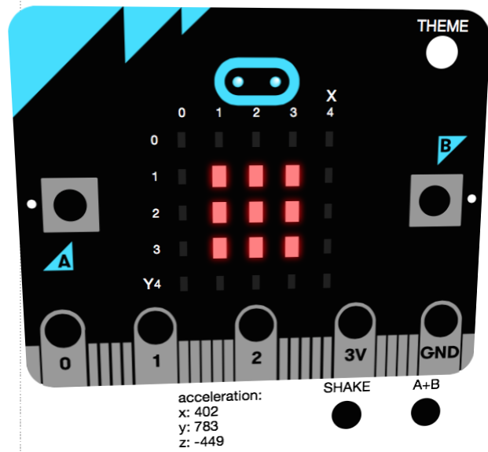
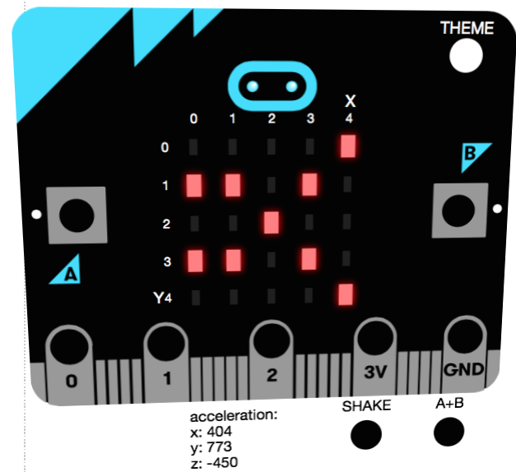
Your Turn!
Create the rock, paper, scissors game using the steps in this presentation!
If you finish – have a go at changing the design – whatever the micro:bit can display with the LEDs you can use!

