Slide 1
Revision Strategies Year 10
Say / Cover / Write

Slide 2
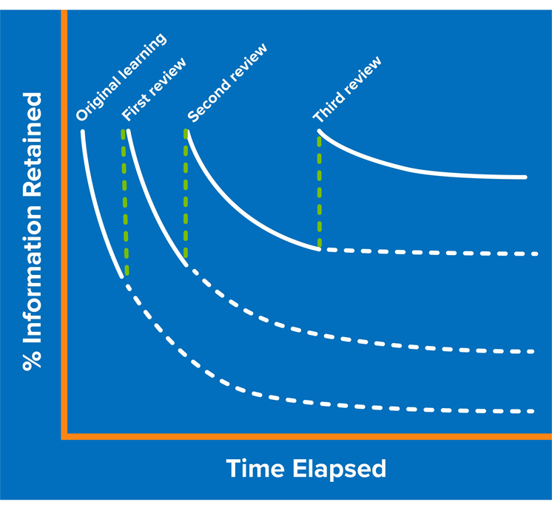
What’s the point in revising?
Notes:
Explain the forgetting curve to students – we know if we do not revisit topics, they will likely be permanently forgotten. We can overcome this by planning to revisit topics frequently. The sooner we start revisiting topics, the more successful we are in committing it to long term memory.

Slide 3
What is Say / Cover / Write?
Say the information (out loud or in your head)
Cover up the information
Can you write it out?
Check to see if you got it right
Keep repeating this process until you get it right

Slide 4
When is Say / Cover / Write useful?
It is really good for information you have to learn off by heart:
Equations
Diagrams
Spellings
Lists of facts

