Slide 1
Revision Strategies Year 10
Flash Cards

Slide 2
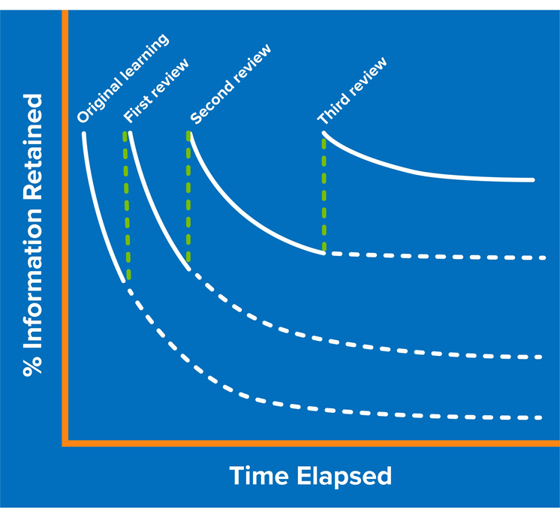
What’s the point in revising?
Notes:
Explain the forgetting curve to students – we know if we do not revisit topics, they will likely be permanently forgotten. We can overcome this by planning to revisit topics frequently. The sooner we start revisiting topics, the more successful we are in committing it to long term memory.

Slide 3
Why are flash cards useful?
Summarising information makes it more manageable to learn
Focuses you on the key information
Easy to carry around with you
Your parents/friends/siblings can quiz you

Slide 4
What not to do!
DON’T overload with information
DON’T just repeat information you already know

Slide 5
A much better flashcard
How about putting reverse questions on the back of the flashcard?

