Slide 1
Revision Strategies Year 10
Mind mapping

Slide 2
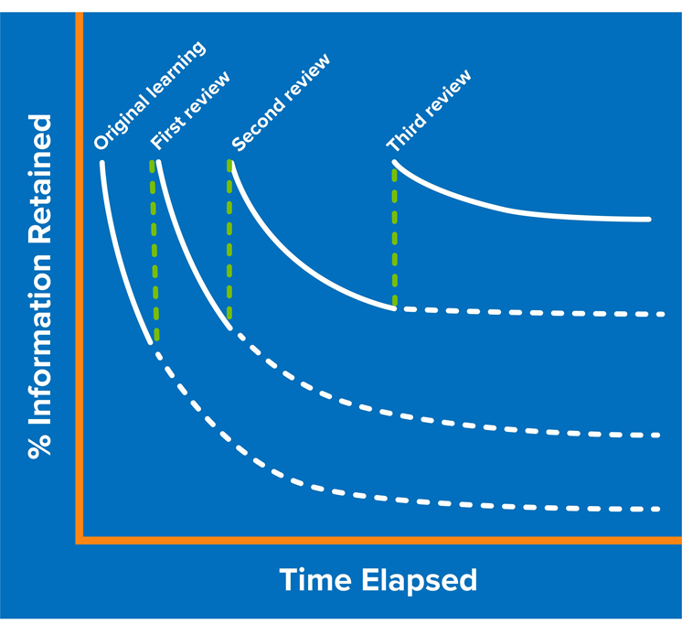
What’s the point in revising?
Notes:
Explain the forgetting curve to students – we know if we do not revisit topics, they will likely be permanently forgotten. We can overcome this by planning to revisit topics frequently. The sooner we start revisiting topics, the more successful we are in committing it to long term memory.

Slide 3
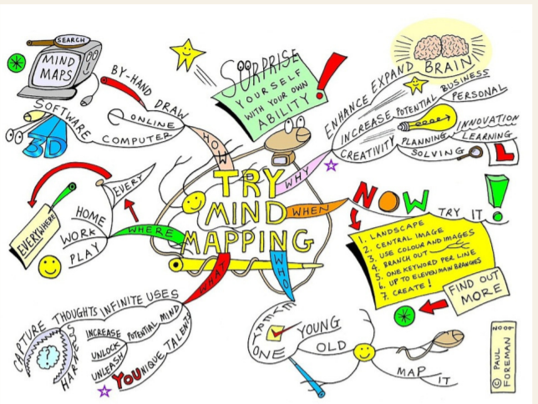
Why is mindmapping useful?

