Slide 1
Year 10 Tutor Evening
Wallingford School
‘Able and Qualified’

Slide 2
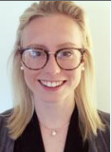
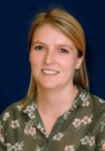
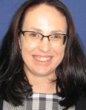
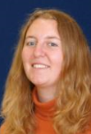
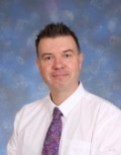
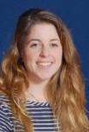
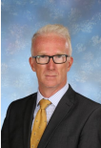
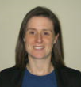
The Y10 Team
Ms C Dudding- Head of Year 10 – duddingc@wallingfordschool.com
Ms T Lee –Assistant Headteacher & Raising Standards Leader – leet@wallingfordschool.com
Tutors ​
Ms T Ward - Careers advisor – wardt@wallingfordschool.com​

Slide 3
This evening
Who we are – the year 10 team
Important parts of the year
Curriculum information
Success, Forgetting and Revision
Able and Qualified
Meet the tutors

Slide 4
Important parts to the year (in no particular order)
School production
Assessment windows in Oct, Jan and March (mocks)
Feedback Evening (Dec)
House matches
#GetReading
Curriculum trips and visits
Work experience
Prefect opportunities

Slide 5
Year 10 Important Dates for 2022/23
Monday 14th November – Progress Report 1
Wednesday 14th December - Y10 Feedback Evening 1
Monday 9th January until Friday 20th January – Assessment week 1
Monday 6th February Progress Report 2
Monday 20th March until Friday 31st March – Mock Exams
Tuesday 2nd Mock exam report
Monday 12th June until Friday 23rd June – Assessment week 2
Monday 10th July End of Year report

Slide 6
Curriculum Information
High Quality teaching and learning
Retrieval and recall
Homework set regularly using Satchel:One
Targets
Progress Reports
Reflection on progress

Slide 7
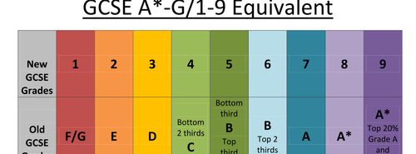
Qualifications & Grades
Vocational (L2)
D* Distinction Star
D Distinction
M Merit
P Pass
L1P Level 1 Pass
f

Slide 8
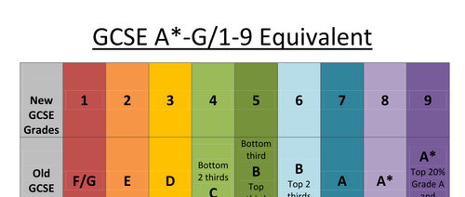
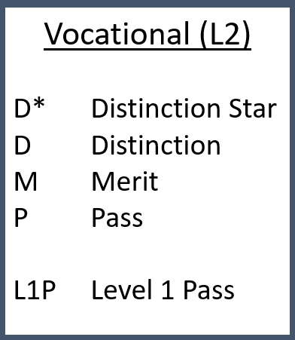
Qualifications & Grades
Considerations:
English and Maths
4s or 5s – BTECs
6s – A Levels
Subjects that I didn’t study at GCSE
Other colleges
If I don’t get 4s

Slide 9
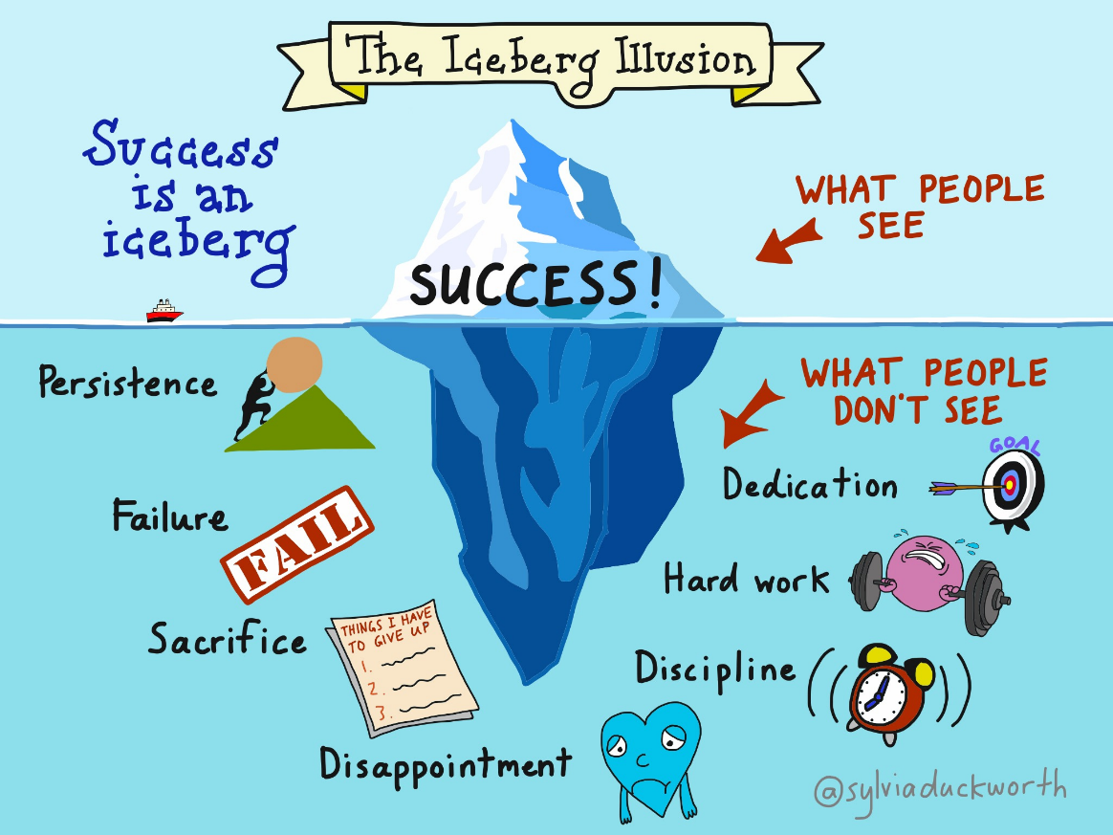
A note on success

Slide 10
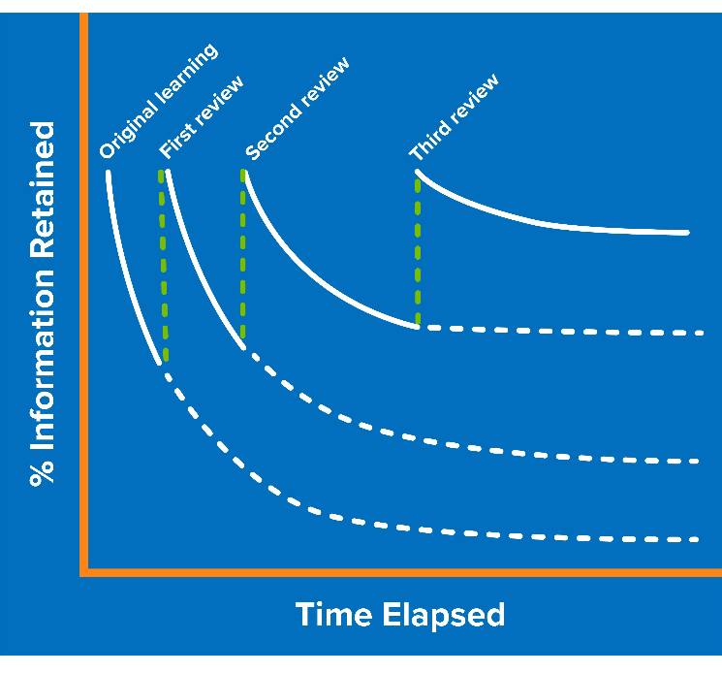
A note on forgetting
How to overcome the forgetting curve:
Plan to revisit topics (this is called revision!)
Revise topics shortly after learning them
Spaced learning
Reduce your cognitive load

Slide 11
A note on revision
Setting yourself up for revision
Doing the revision
Things to avoid

Slide 12
What should my child be doing?
Attend school regularly
Complete all work to the best of their ability
Ensure all ‘coursework’ is completed and handed in on time
Revise and try their best for the mock exams
Tell someone if things aren’t going according to plan

Slide 13
But it’s not just about the exam results…
Post 16 Pathways
Careers Advisor - Mrs Ward
Work Shadowing
Open Days at Colleges
Apprenticeships
6th Form Taster Days
University Summer Schools
Further support
PSHE program
Trips and visits
Celebration events (end of KS4 prom!)
General wellbeing support

Slide 14
The Y10 Tutor Team
Ms Hughes S4 Ms Sutton N6 Ms Gibson M13 Ms Beaumont K8
Mr Bowen B1 Ms Shine K5 Mr Keppel-Compton K4 Ms Ward M8

