Slide 1
Year 8 Tutor Evening
Wallingford School
Able and Qualified
Head of Year 8: Mr Choi
choif@wallingfordschool.com

Slide 2
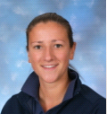
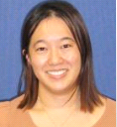
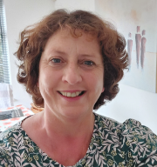
Welcome to Year 8!
Mr Jackson
Mr Pring
Miss Hedges
Miss Cheng (formerly 7THU)
Ms McGowan and Mr Luke
Mr Hinchcliffe
Mr Warren
Miss Pratt

Slide 3
Important Parts to the Year
School production
KS3 assessment weeks (Dec and end of year)
Celebration evenings
House matches
Boulogne / Aachen Trip
#GetReading
Mental Health support for students and workshops for parents

Slide 4
Wallingford School
All students will receive a first class education and leave us ‘able and qualified’
We believe every student deserves to be challenged and inspired and our teachers deliver our knowledge rich curriculum.
We place great emphasis in supporting our young people to find their place in society and encourage them to play an active party in our school community – through house competitions, enrichment activities and a variety of trips.

Slide 5
Curriculum Information
Broad and balanced
Maths and Language sets; rest is mixed ability
Homework set regularly using Satchel:One
Targets
Progress Reports
Preparation for assessments
Reflection on progress

Slide 6
Assessment, Feedback and Reflection
Feedback
Reflection
Assessment

Slide 7
Assessment, Feedback and Reflection
Feedback
Reflection
Assessment
Progress Reports
Feedback Evening
End of Year
Assessment Scores

Slide 8
Assessment, Feedback and Reflection
Feedback
Reflection
Assessment
Progress Reports
Feedback Evening
End of Year
Assessment Scores

Slide 9
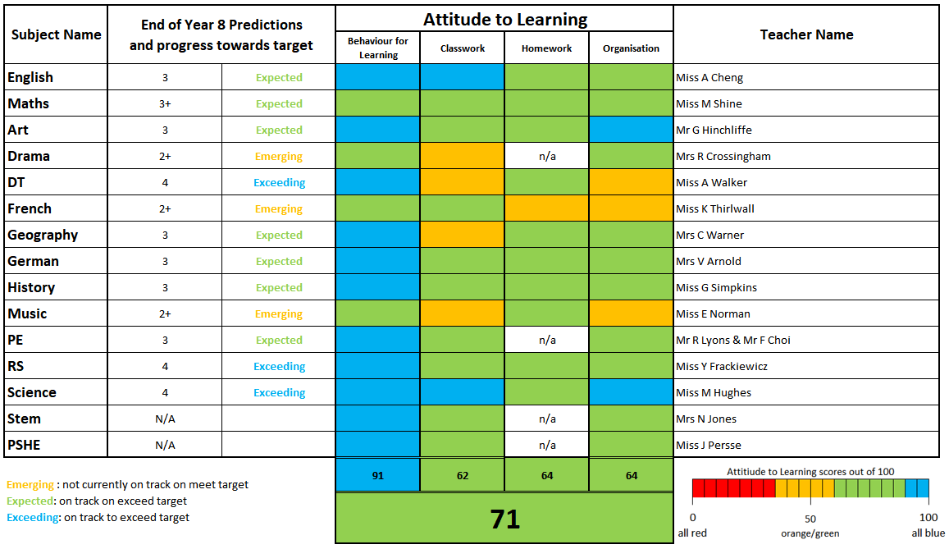
Progress Reports

Slide 10
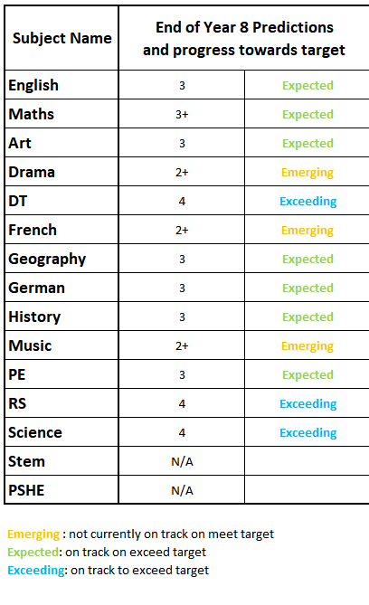
Progress Reports
*End of Year Predictions for each subject
*Indication of Progress made

Slide 11
Targets: how are these calculated?

Slide 16
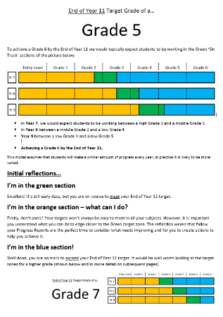
Individual End of Year 11 Targets:
Maths Target – Grade 6
English Target - Grade 7
Other Subjects – Grade 6

Slide 18
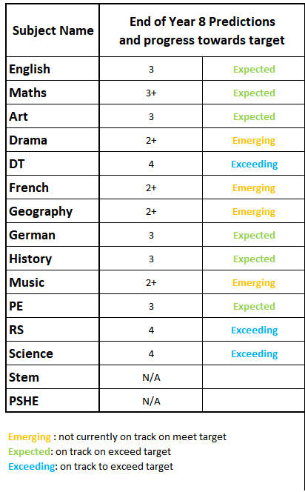
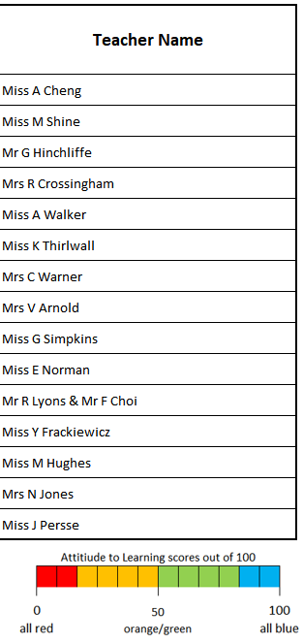

Slide 19
Individual End of Year 11 Targets:
Maths Target – Grade 6
English Target - Grade 7
Other Subjects – Grade 6

Slide 20
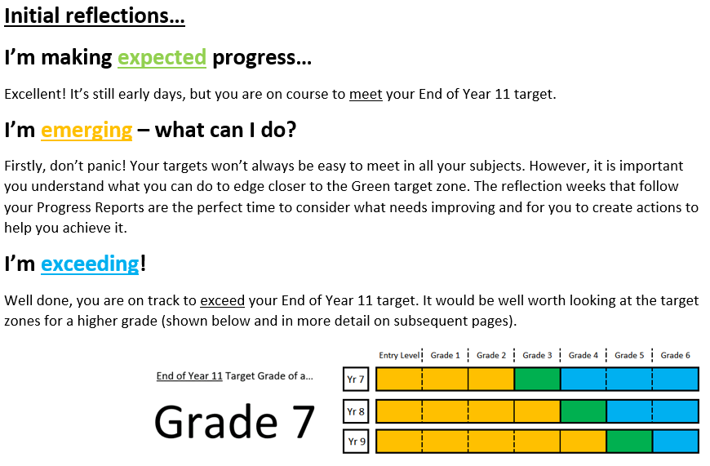

Slide 22
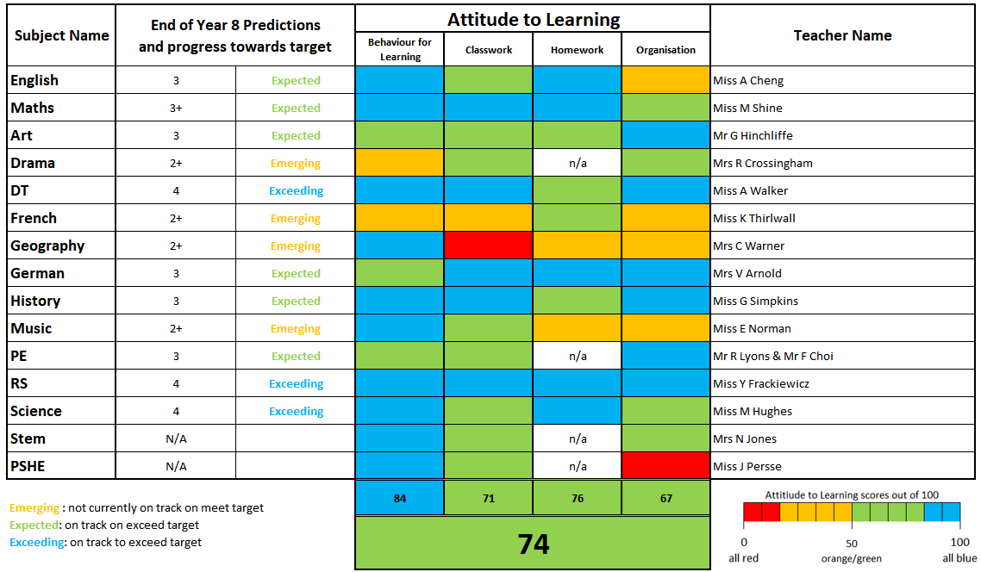

Slide 23
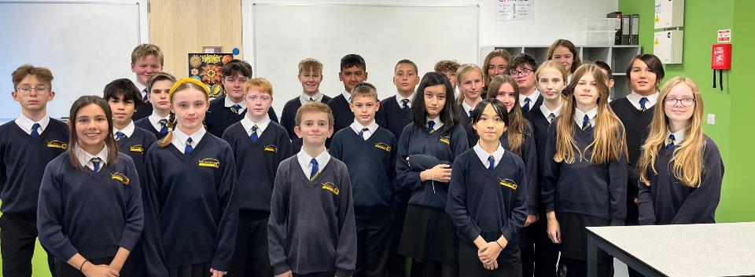
Welcome to 8TWR
Name of tutor – Mr Warren
Email address – warrant@wallingfordschool.com

Slide 24
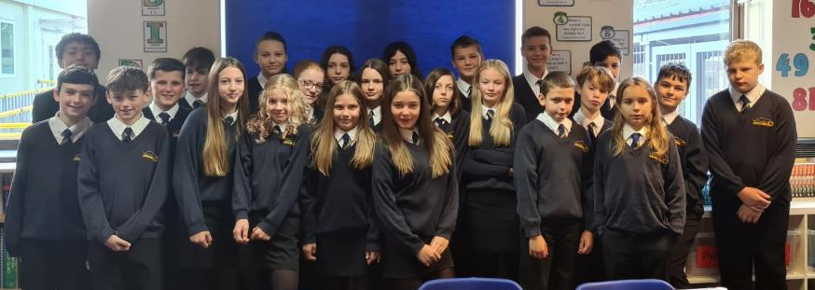
Welcome to 8KPR
Name of tutor – Miss Pratt
Email address – prattk@wallingfordschool.com

Slide 25
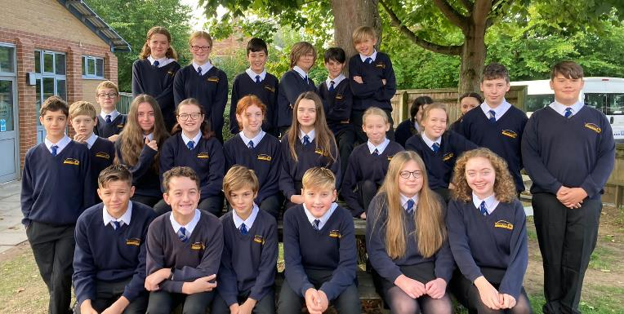
Welcome to 8EH
Name of tutor – Miss Hedges
Email address – hedgese@wallingfordschool.com

Slide 26
Welcome to 8ACH
Name of tutor – Miss Cheng
Email address – chenga@wallingfordschool.com

Slide 27
Welcome to 8JJC
Name of tutor – Mr Jackson
Email address – jacksonj@wallingfordschool.com

Slide 28
Welcome to 8OP
Name of tutor – Mr Pring
Email address – pringo@wallingfordschool.com

Slide 29
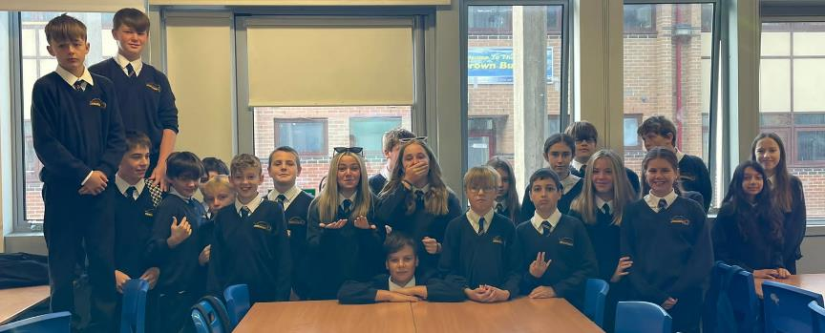
Welcome to 8GHI
Name of tutor – Mr Hinchliffe
Email address – hinchliffeg@wallingfordschool.com

Slide 30
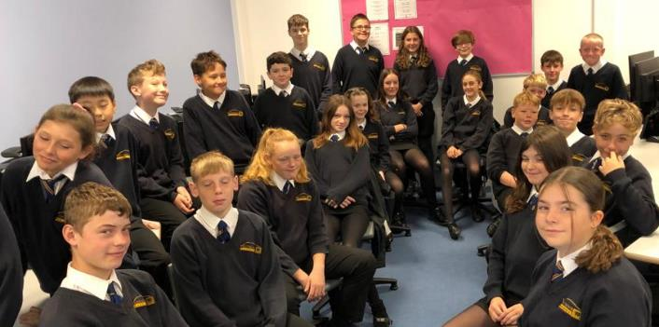
Welcome to 8EMC/DL
Name of tutor – Ms McGowan and Mr Luke
Email address – mcgowane@wallingfordschool.com & luked@wallingfordschool.com

Slide 31
The role of the form group
Tutor time – a good start to the day
#GetReading
First point of contact
PSHE
Reflection on progress report
Support and challenge

Slide 32
Healthy habits
Attend school regularly and on time
Get into a term time routine
Limit devices in bedrooms / overnight
Encourage your child to complete and hand in homework on time
Talk to your child about what they are learning

Slide 33
Our expectations
Attendance – at least 95% (did you know 90% attendance means you end up missing a whole half term over 2 years?)
Punctuality – school starts at 8.35am
Uniform

Slide 34
What do I do if there is a problem?
Contact me!
Contact the head of year (Mr Choi) – choif@wallingfordschool.com
Use the get help button on the school website
Encourage your child to talk to a member of staff at school

