Slide 1
Year 11 Tutor Evening
Wallingford School
Able and Qualified
Head of Year 11: Ms Dudding
duddingc@wallingfordschool.com

Slide 2
This evening
Who we are – the year 11 team
Important parts of the year
Trips & Experiences
Expectations
Curriculum information
Meet the tutors

Slide 3
The Year 11 Team Ms C Dudding - Head of Year 11 – duddingc@wallingfordschool.com Mr N Lamb – Deputy Headteacher & Raising Standards Leader – lambn@wallingfordschool.com Ms Ward – Careers Advisor – wardT@wallingfordschool.com
11SGI
Miss S Gibson
M13
11JWR
Ms J Ward
M8
11MHG
Miss Hughes
W6
11CSU
Miss Sutton
S4
11SBO
Mr Bowen
S9
11CFE
Mrs Franchina-Emery
M11
11SKC
Mr Keppel-Compton
K4
11NBE
Mrs Beaumont
K8

Slide 4
Year 11 Important Dates for 2023/24
Monday 25th September KS5 Course Information Week
Monday 16th October Progress Report 1
Thursday 9th November Y11 Feedback Evening
Monday 4th December Mock exams begin
Monday 22nd January Progress Report 2
Monday 26th Feb - Friday 8th March Assessment week
Thursday 14th March Y11 Feedback Evening
Friday 3rd May Y11 Celebration Day & Prom
Early May GCSE Exams begin

Slide 5
Trips – whole school
Year 7 | Year 8 | Year 9 | Year 10 | Year 11 | Year 12 | Year 13
Geography Trip to Kew Gardens | Caen Trip (France) | The Year 9 Residential | Duke of Edinburgh Silver | World Challenge | World Challenge | 6th Form trip to Barcelona
Restart a Heart Day | Aachen Trip (Germany) | Duke of Edinburgh Bronze | World Challenge | Ski trip 2025 | Duke of Edinburgh Gold | Year 13 Revision trip to The Lakes
Talk the Talk Workshop | RAF Benson Inspirational Event | Ski trip 2025 | Ski trip 2025 | Geography trip to Sorrento | 6th Form trip to Barcelona | Year 13 Biology trip (Genetic Fingerprints)
Maths Challenge | Maths Challenge | Geography Trip to Swanage | Work Experience | Geography trip to Iceland | German Exchange to Bad Wurzach | Y13 Geog Trip to South Wales
STARS trips | STARS trips | RAF Benson Inspirational Event | German Exchange to Bad Wurzach | History Trip to Berlin | French Exchange to Genoble | A Level History Trip to London
KS3 Williams Racing STEM Enrichment Day | KS3 Williams Racing STEM Enrichment Day | MFL at Oxford University | French Exchange to Genoble | A Christmas Carol theatre trip | Y12 Safe Drive Stay Alive | Hamnet theatre trip
KS3 Oxford Philharmonic Orchestra Strings Day | KS3 Oxford Philharmonic Orchestra Strings Day | Maths Challenge | Poetry Live | Poetry Live | KS5 Winter Wonderland Trip | A View From the Bridge theatre trip
A Midsummer Night's Dream theatre trip | Macbeth Theatre trip | STARS trips | GCSE Textiles trip to Botanical Gardens | GCSE Computer Science Trip | KS5 Politics Trip | Medea theatre trip
History of Wallingford Walking Tours | Human Careers Library | KS3 Williams Racing STEM Enrichment Day | KS4 Brightsparks Music trip | GCSE Textiles trip to Bath Fashion Museum | Merchant Taylors' Livery Awards | KS5 Winter Wonderland Trip
Scholars trip | Scholars trip | KS3 Oxford Philharmonic Orchestra Strings Day | GCSE BBC Good Food Trip | KS4 Brightsparks Music trip | A Level Languages Day at Oxford University | KS5 Politics Trip
Tilsley Park District Athletics | Tilsley Park District Athletics | Blood Brothers theatre trip | Business & RM IKEA NEA trip | Leavers Day & Prom | Oktoberfest Languages Trip | A Level Languages Day at Oxford University
Maths Challenge | Maths Challenge | Scholars trip | GCSE History Trip to Cannock | Art Exhibition | Hamnet theatre trip | A Level Food Trip
Art Exhibition | Art Exhibition | Tilsley Park District Athletics | GCSE Geography Fieldwork in Christchurch | STARS trips | A View From the Bridge theatre trip | Sixth Form Christmas Ball
Music Recitals & Spring Concert | Music Recitals & Spring Concert | Maths Challenge | Prefects (leadership role) | Music Recitals & Spring Concert | Medea theatre trip | Enrichment lectures
Sports Day | Sports Day | Art Exhibition | Art Exhibition | Sports Day | A Level History trip to London | Extended Project Qualification
Year group social events | Year group social events | Music Recitals & Spring Concert | STARS trips | Tilsley Park District Athletics | Safe Drive Stay Alive | Leavers Day & Ball
School Production | School Production | Sports Day | Music Recitals & Spring Concert | Year group social events | KS5 Winter Wonderland Trip | Art Exhibition
Merchant Taylor Photography competition | Merchant Taylor Photography competition | Year group social events | Sports Day | School Production | KS5 Politics Trip | STARS trips
 |  | School Production | Tilsley Park District Athletics | Merchant Taylor Photography competition | STARS trips | Music Recitals & Spring Concert
 |  | Merchant Taylor Photography competition | Year group social events |  | A Level Food Trip | School Production
 |  |  | School Production |  | A Level Geog Fieldwork in Birmingham | Year group social events
 |  |  | Merchant Taylor Photography competition |  | A Level Biology trip to Sutton Courtney | Merchant Taylor Photography competition
 |  |  |  |  | Students Leaders
Plus termly house events, lunchtime enrichment clubs and after school sports clubs and fixtures throughout the year |  |  |  |  | Sixth Form Christmas Ball
 |  |  |  |  | Enrichment lectures
 |  |  |  |  | Art Exhibition
 |  |  |  |  | Music Recitals & Spring Concert
 |  |  |  |  | Sports Day
 |  |  |  |  | Year group social events
 |  |  |  |  | School Production
 |  |  |  |  | Merchant Taylor Photography competition

Slide 6
Trips – Year 11
Year 11
World Challenge
Ski trip 2025
Geography trip to Sorrento
Geography trip to Iceland
History Trip to Berlin
A Christmas Carol theatre trip
Poetry Live
GCSE Computer Science Trip
GCSE Textiles trip to Bath Fashion Museum
KS4 Brightsparks Music trip
Leavers Day & Prom
Art Exhibition
STARS trips
Music Recitals & Spring Concert
Sports Day
Tilsley Park District Athletics
Year group social events
School Production
Merchant Taylor Photography competition
Plus termly house events, lunchtime enrichment clubs and after school sports clubs and fixtures throughout the year
Please check the School Calendar on the website for even more!

Slide 7
Our expectations
Attendance
Punctuality – school starts at 8.35am
Homework & Coursework
Behaviour
Uniform
Mobile phones
Punctuality
Detentions
Home School Agreement

Slide 8
Curriculum Information
High quality Teaching & Learning
Continue using Satchel:One
Qualifications & Grades
Targets
Progress Reports
Preparation & Revision
Support & Communication

Slide 9
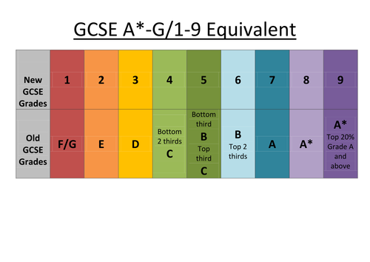
Qualifications & Grades
Vocational (L2)
D* Distinction Star
D Distinction
M Merit
P Pass
L1P Level 1 Pass
f

Slide 10
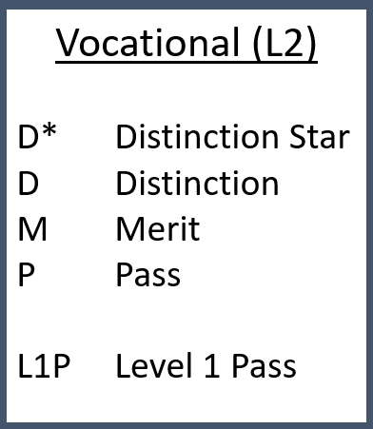
Qualifications & Grades
Considerations:
English and Maths
4s or 5s – BTECs
6s – A Levels
Subjects that I didn’t study at GCSE
Other colleges
If I don’t get 4s

Slide 11
Targets: how are these calculated?

Slide 16
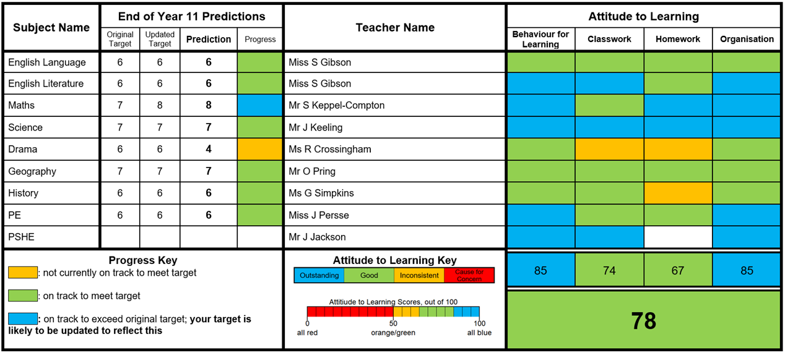
Progress Reports

Slide 17
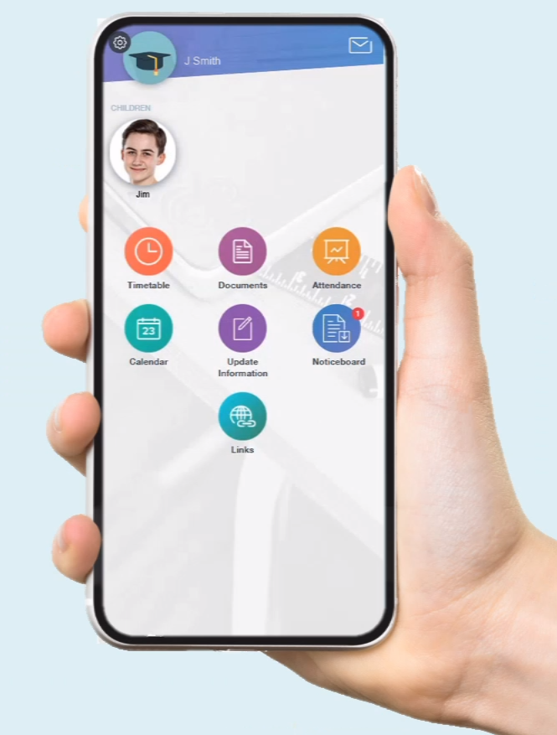
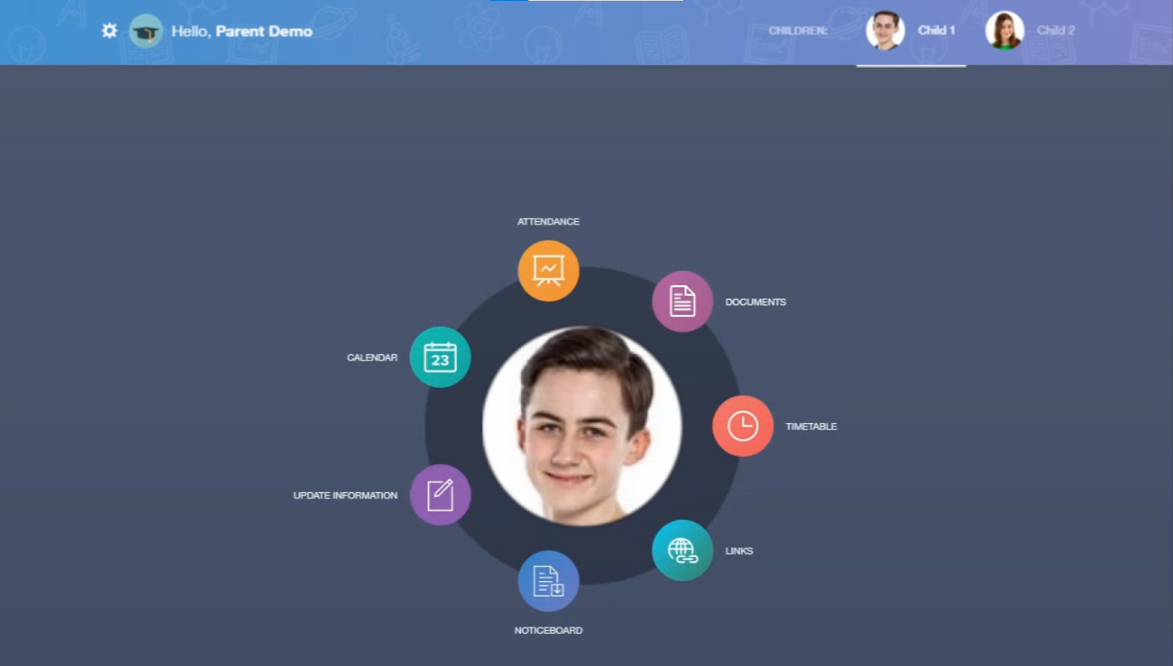
Coming Soon…Edulink

Slide 18
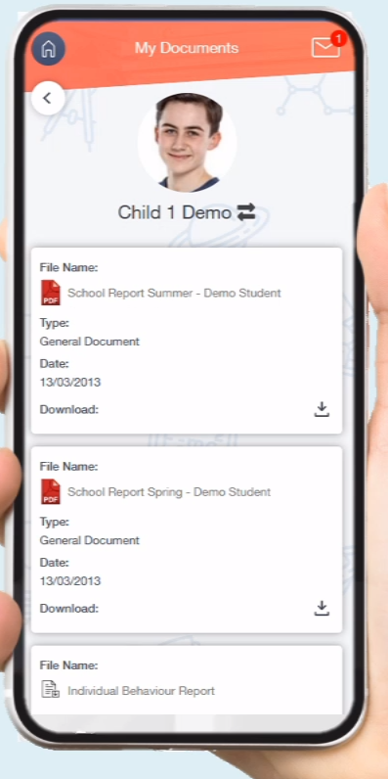
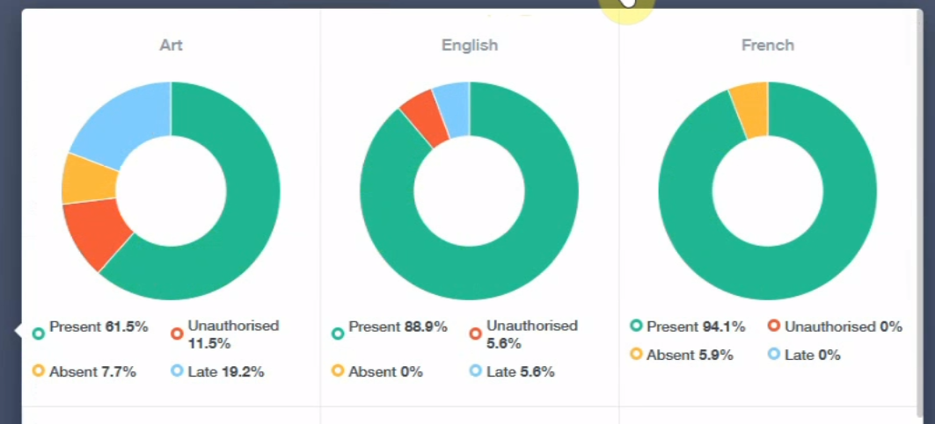
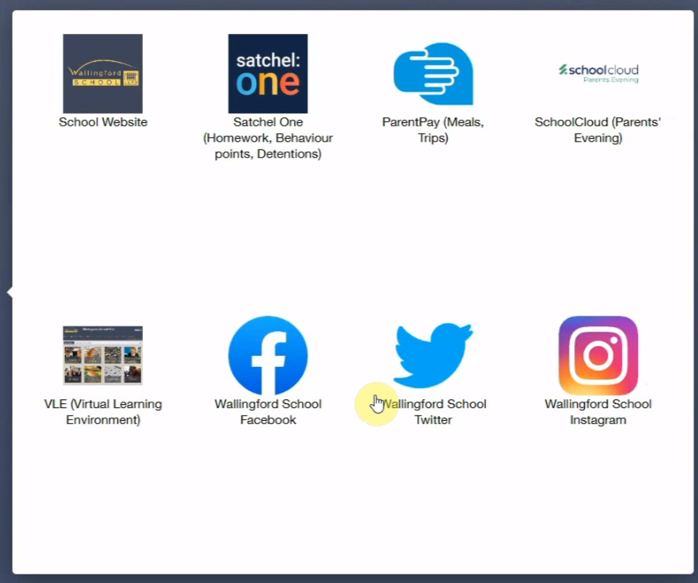
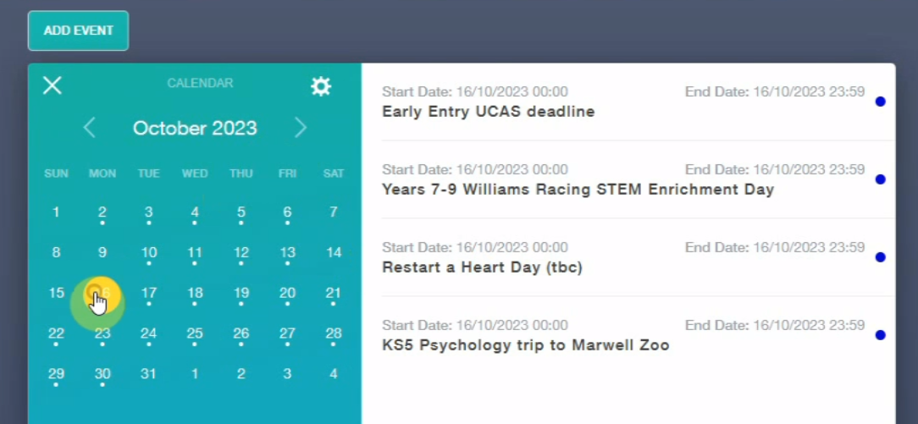
Edulink

Slide 19
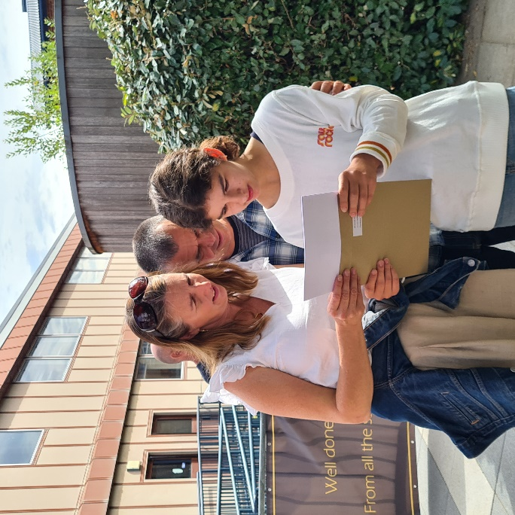
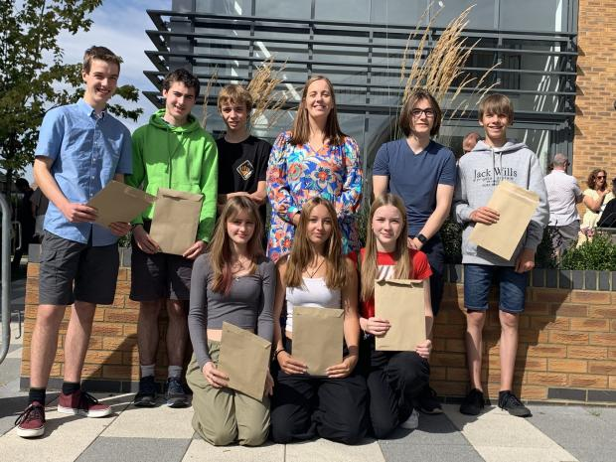
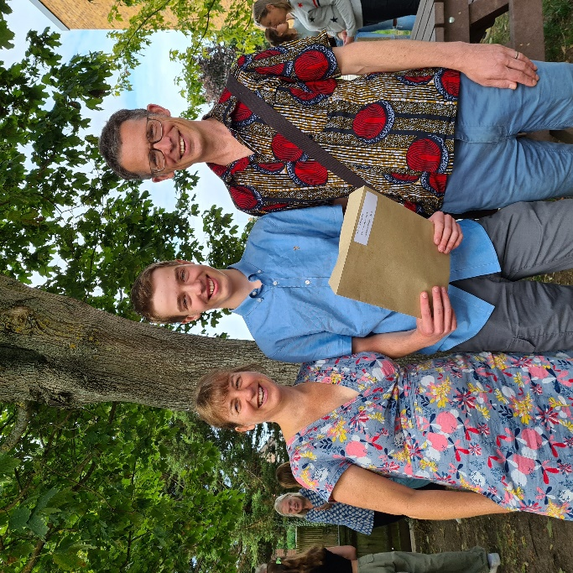
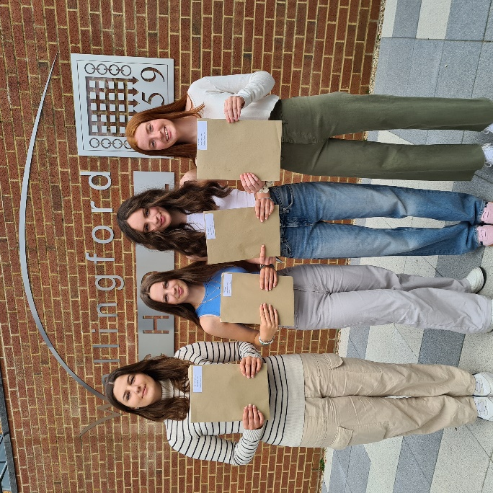
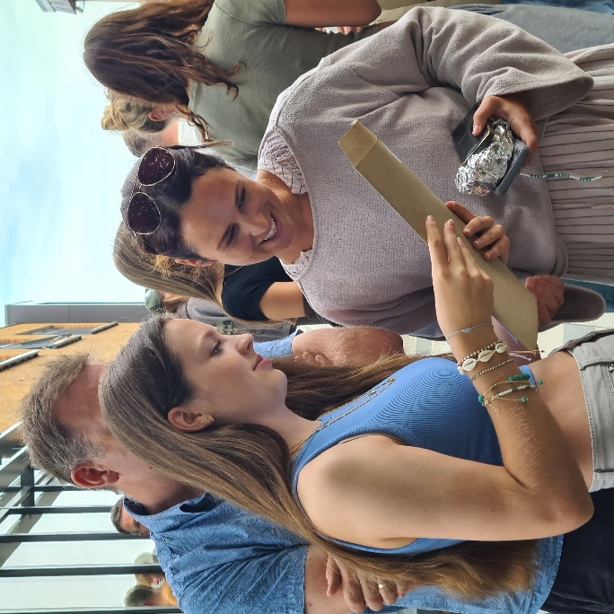
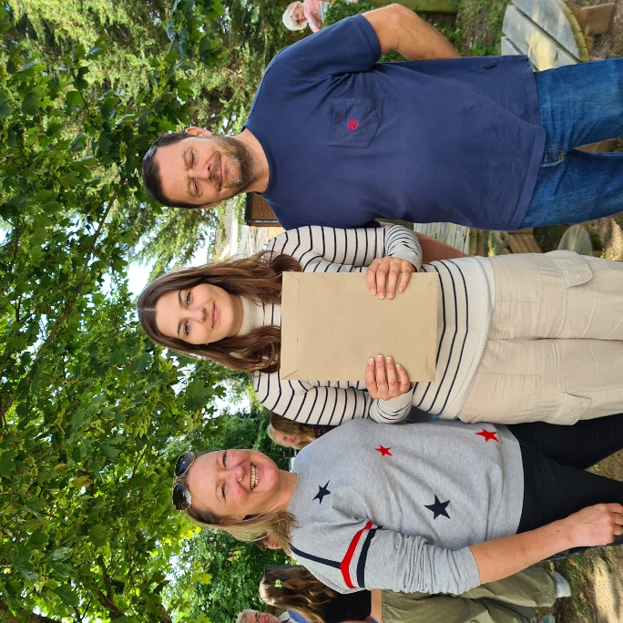

Slide 20
A note on success

Slide 21
Preparation & Revision
PSHE
Tutor Periods
Classroom Teachers’ input
Parent Presentation
Course Information & Resources Pack
Pastoral Support

Slide 22
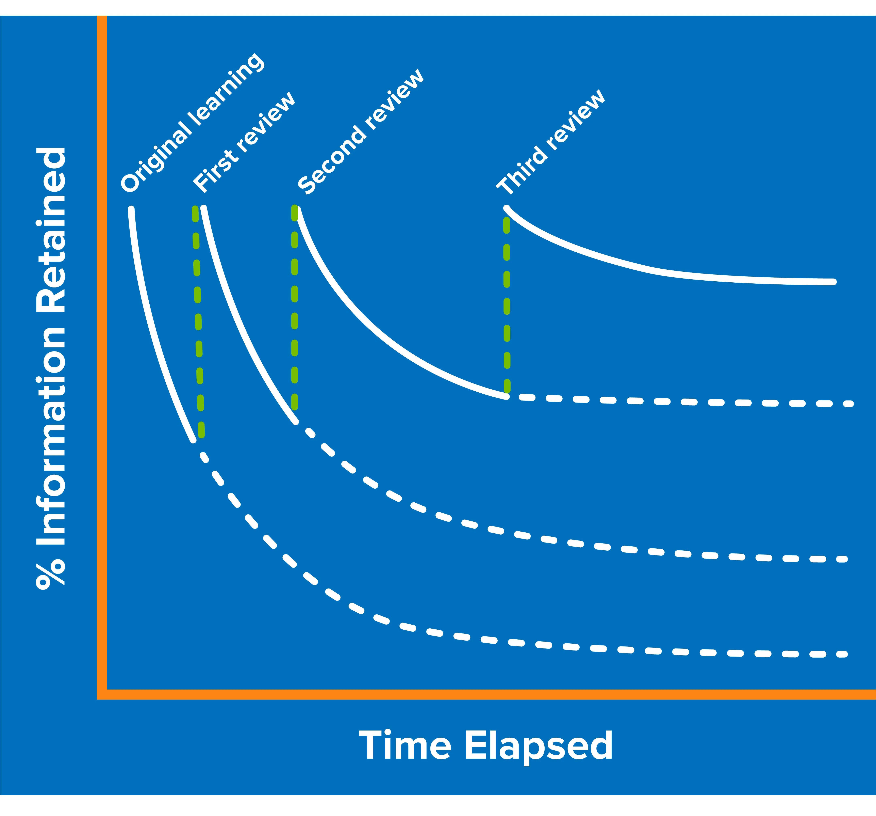
A note on forgetting
How to overcome the forgetting curve:
Plan to revisit topics (revision!), especially the weak areas
Revise topics shortly after learning them
Spaced learning
Regular testing / quizzing

Slide 23
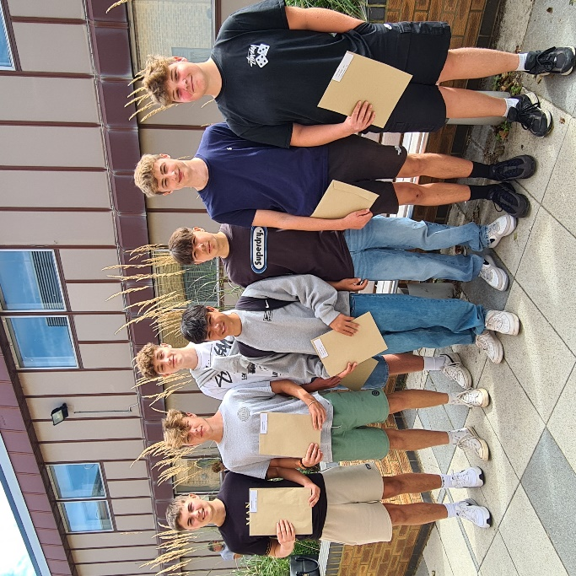
What should my child be doing?
Attend school regularly
Complete all work to the best of their ability
Ensure all ‘coursework’ is completed and handed in on time
Revise and try their best for the mock exams
Tell someone if things aren’t going according to plan

Slide 24
What can parents be doing?
Communicate with teachers, HOY, tutor – email is often best in the first instance
Read through information provided by school and reinforce at home
Encourage your child to talk about how they are feeling, listen to any concerns, reassure them that their feelings are not unusual
Ensure there is a distraction-free space to study
Encourage healthy routines – sleep, nutrition, exercise, relaxation, socializing
Reinforce your child’s own realistic goals, rather than comparing to others
Reassure them that exam results are far from the only measure of success – you are proud irrespective of results!

Slide 25
But it’s not just about the exam results…
Post 16 Pathways
Careers Advisor - Mrs Ward
Work Shadowing
Open Days at Colleges
Apprenticeships
6th Form Taster Days
University Summer Schools
Further support
PSHE program
Trips and visits
Celebration events (end of KS4 prom!)
General wellbeing support

Slide 26
The Year 11 Team
11SGI
Miss S Gibson
M13
11JWR
Ms J Ward
M8
11MHG
Miss Hughes
W6
11CSU
Miss Sutton
S4
11NBE
Mrs Beaumont
K8
11SBO
Mr Bowen
S9
11CFE
Mrs Franchina-Emery
M11
11SKC
Mr Keppel-Compton
K4

Slide 27
Welcome to 11SGI
Miss Gibson
gibsons@wallingfordschool.com
Welcome!
What you need to know about me
Q&A opportunity
Home School Agreement

Slide 28
Welcome to 11JWR
Miss Ward
wardja@wallingfordschool.com
Welcome!
What you need to know about me
Q&A opportunity
Home School Agreement

Slide 29
Welcome to 11MHG
Miss Hughes
hughesm@wallingfordschool.com
Welcome!
What you need to know about me
Q&A opportunity
Home School Agreement

Slide 30
Welcome to 11CSU
Miss Sutton
suttonc@wallingfordschool.com
Welcome!
What you need to know about me
Q&A opportunity
Home School Agreement

Slide 31
Welcome to 11SBO
Mr Bowen
bowens@wallingfordschool.com
Welcome!
What you need to know about me
Q&A opportunity
Home School Agreement

Slide 32
Welcome to 11CFE
Mrs Franchina-Emery
franchina-emeryc@wallingfordschool.com
Welcome!
What you need to know about me
Q&A opportunity
Home School Agreement

Slide 33
Welcome to 11SKC
Mr Keppel-Compton
keppel-comptons@wallingfordschool.com
Welcome!
What you need to know about me
Q&A opportunity
Home School Agreement

Slide 34
Welcome to 11NBE
Mrs Beaumont
beaumontn@wallingfordschool.com
Welcome!
What you need to know about me
Q&A opportunity
Home School Agreement

Slide 35
The role of the form tutor
Tutor time – a good start to the day
#GetReading
PSHE
Reflection on progress report
Support and challenge
First point of contact

Slide 36
How do I make contact with school?
Contact me first!
Contact the head of year (Ms Dudding)
Use the ‘get help’ button on the school website
Encourage your child to talk to a member of staff at school

