Slide 1
BTEC Level 3 in Business
Unit 1: Exploring Business

Slide 2
Learning Aim A
Explore the Features of Different Businesses and Analyse What Makes them Successful

Slide 3
Learning Aim A1
Features of Businesses

Slide 4
Features of Businesses
Every single business that exists has its own set of unique features which could also be referred to as characteristics.
The core features of any business typically encompass:
The ownership and liability of the business.
The purpose of the business.
The sector the business operates within.
The scope of business activities.
The size of the business.

Slide 5
Features of Businesses
Activity 1: Features of Businesses.
Before we investigate each one of these business features in more detail, select two contrasting businesses of your choice and place them in the table located in your workbook.
We will revisit the remainder of this activity once we have discussed each feature.
When we revisit this activity, you will apply each feature discussed to your two chosen businesses and make comparisons between them both.
Ensure you take notes during the following slides and clearly explain the key differences in relation to the features of your chosen businesses when we revisit this activity.

Slide 6
Ownership and Liability:
Private
Public
Not-for-profit
There are three ways in which a business can be owned:

Slide 7
Ownership and Liability:
Before we take a look into each type of business ownership in greater detail, it’s important to understand the term ‘liability’ and its importance in business.
Dependent on the type of business ownership, the owners will either have limited or unlimited liability.
With limited liability, the liability of the owners for any losses, debt, or claims the business faces is limited to the amount of money they have invested into the business and their personal assets are not at risk.
Whereas, with unlimited liability, the owner of the business is personally responsible for any losses, debts, or claims that the business experiences and their personal assets such as a house or a car etc. are at risk should the business have insufficient funds to cover any of these liabilities.
To protect the business against the risk of being sued or being legally held responsible, business owners can purchase insurance in a similar fashion to a person purchasing car or home insurance which can provide cover for the business against damages and legal costs that may be made against the business.

Slide 8
Ownership and Liability:
First of all, let’s take a look at privately owned businesses.
Private businesses are owned by people with the aim of making a profit.
However, in exchange for this they are liable for all aspects of the business and are likely to take many risks.
Private businesses range in size from just one person to multiple partners across many different types of ownership which include:
Sole trader
Partnership
Private limited company
Public limited company
Cooperative

Slide 9
Ownership and Liability:
Activity 2: Ownership and Liability.
Watch the video on the various types of business ownership on the following slide and complete the tasks below in your activity workbook:
Sole Trader vs Partnership Starting a Business Scenario.
Becoming a Limited Company Scenario: Private vs Public.
Finding out about Franchises.
Extension task: types of business ownership wordsearch.

Slide 10
Ownership and Liability:
Video link: Types of Business Ownership
Notes:
Video link: https://www.youtube.com/watch?v=BN2cQNNvg_4&t=275s

Slide 11
Ownership and Liability: Private – Sole Trader
A sole trader is the most popular type of ownership and is often referred to as self employed or sole proprietor and describes any business that is owned and controlled by one person.
In 2020, 76% of businesses in the UK were registered as sole traders, which accounts for approximately 4.6million businesses (Startupdonut, 2020).
A business owner can still register as a sole trader even if they have employees and are often individuals who provide a specialist service like plumbers, hairdressers or photographers.
Easy to set up
Owner has complete freedom over business decisions
Low start up costs
Owner retains 100% of the profits
No separate business entity
Unlimited liability
Long working hours, which can be lonely and very pressurised
Additional responsibility i.e. admin, bookkeeping, and marketing
Notes:
https://www.startupdonut.co.uk/set-up-a-business/registering-as-a-sole-trader/13-things-you-should-know-about-being-a-sole-trader

Slide 12
Ownership and Liability: Private – Partnership
Partnerships are similar in nature to a sole trader but are legally owned by two or more people.
Typical examples of partnerships are skilled people and professionals who decide to set up a business together such as trades people, dentists, and solicitors.
A partnership agreement is a key legal document which is agreed and signed by all partners of the business and covers all the key legalities of the business such as how management decisions are made and how profits are shared.
There are also two other versions of business partnerships, these are limited partnerships and limited liability partnerships.
Shared expertise
Shared workload and responsibility
Low start up costs
Greater borrowing power
Potential for disagreements
Profits have to be shared
Unlimited liability shared between partners
Additional responsibility i.e. admin, bookkeeping, and marketing
Notes:
https://www.startupdonut.co.uk/set-up-a-business/registering-as-a-sole-trader/13-things-you-should-know-about-being-a-sole-trader

Slide 13
Ownership and Liability: Private – Private Limited Company
A Private Limited Company is owned by its shareholders who are typically the directors of the business and shares cannot be offered to the general public.
The business is actually classed as a company (LTD) and has its own separate legal entity in the eyes of the law.
The ownership of a limited company is divided up into equal parts called shares and the owners are now classed shareholders.
Common examples of a Private Limited Company are local retailers, such as a high street shop or a restaurant.
Separate legal entity
Limited liability
Supports professional reputation and builds trust in the business
Tax efficient
Any assets belong to the business rather than the owners
Getting paid can be more complicated for a shareholder
Increased admin costs and legal requirements
Legally the company has to publicly disclosure key information
Notes:
https://www.startupdonut.co.uk/set-up-a-business/registering-as-a-sole-trader/13-things-you-should-know-about-being-a-sole-trader

Slide 14
Ownership and Liability: Private – Public Limited Company
A Public Limited Company is owned by its shareholders and run by its directors, often being referred to as a PLC.
Public Limited Companies are often seen as a more prestigious company but are less common, only making up approximately 5% of all limited companies in the UK.
It is common for a Private Limited Company to make the decision to go public through a process of flotation.
Once a business goes public, it has the opportunity to receive investment through the sale of shares commonly from investment banks, pension funds, and wealthy individuals, but essentially anyone can become a shareholder.
Expensive to set up
Increased legal requirements
More complex accounting and reporting requirements
Increased public scrutiny
Shareholders have limited liability
Increased capital by offering shares to the public via the stock exchange
Increased negotiation opportunities (economies of scale)
Brand prestige and assurance
Notes:
https://www.startupdonut.co.uk/set-up-a-business/registering-as-a-sole-trader/13-things-you-should-know-about-being-a-sole-trader

Slide 15
Ownership and Liability: Private – Cooperative
Co-operatives are businesses which are owned and run by their members.
Common ‘members’ of a co-operative include customers, employees, and local residents, with each member having a chance to express their views and share the business’ profits.
There are currently over 7,000 co-operative businesses across the UK owned by more than 17 million members, operating across a range of sectors from agriculture to social enterprises, sports initiatives to retail and education, with the number people looking to either start a new business as a co-operative or convert their existing business into a co-operative predicted to increase further.
The Co-op group who run a wide range of businesses ranging from funeral care to food retail and the John Lewis Partnership who own one of the UK’s most successful department stores amongst many other businesses are two of the biggest examples of Co-operatives which operate within the UK.
Democratic business model
Easy to set up
Limited liability for members
Limited funding opportunities
Not suitable for all types of business
Can lack clearly define roles and responsibilities

Slide 16
Ownership and Liability: Private - Franchise
Franchising arises when a franchisor grants a licence (franchise) to another business (franchisee) to allow it trade using the brand / business format.
The franchisor is the business whose sells the right to another business to operate a franchise – they may run a number of their own businesses, but also may want to let others run the business in other parts of the country.
A franchise is bought by the franchisee. Once they have purchased the franchise they have to pay a proportion of their profits to the franchiser on a regular basis. Depending on the business involved, the franchiser may provide training, management expertise and national marketing campaigns. They may also supply the raw materials and equipment.
Buying a franchise a good way of an individual setting up a business because:
They do not have to establish themselves in the same as a sole trader might have to.
They will have the support of a tried and tested business model, often with a national marketing campaign behind them.

Slide 17
Ownership and Liability: Public
Activity 3: Public businesses.
Research 3 different public businesses and create a poster which covers the following about each one:
How long they have been established.
Why they exist.
What types of products or services the business offers.
The yearly turnover of the business.
The number of employees in the business.
The target audience of the business.
Any other key information about the business.

Slide 18
Ownership and Liability: Public
Public businesses are owned by the government with the purpose of benefitting the public.
These businesses can either be set up by the government or the government may acquire private businesses for a variety of reasons.
For example, in 2007, the UK government purchased Northern Rock in a £37bn bailout, protecting the UK public’s savings and mortgages before selling off most of Northern Rock’s asset, which were mainly mortgages on houses all over the country, successfully recouping most of its £37bn of funding it made available when it acquired the bank.
The picture on the right shows customers queuing to withdraw their money from Northern Rock during the 2007 crisis.

Slide 19
Ownership and Liability: Public
Businesses owned by the government are often referred to as ‘public sector businesses’ and are funded through a variety of taxes which include: Income Tax, National Insurance, and VAT etc.
Once taxes are collected, the government allocates the funds to various budgets which are associated with public sector businesses.
Some examples of public sector businesses include: the Bank of England (BoE), the British Broadcasting Corporation (BBC), and Network Rail.

Slide 20
Ownership and Liability: Not for profit
Just because a business is classified as a not-for-profit organisation doesn’t mean it cannot make a profit.
Infact, most not-for-profit organisations will aim to create a profit or at least generate enough revenue to cover their running costs e.g. staff and overheads just like any other business.
However, they are not set up with the intention of making a profit, they typically operate with the intention of providing a public service or helping people.
In comparison to a private business, a not-for-profit business reinvests any surplus revenue (profits) into the business rather than rewarding shareholders.

Slide 21
Ownership and Liability: Not for profit
For example, a charity such as the RSPCA is classified as a not-for-profit organisation, it is the oldest welfare charity and is mainly funded by donations and grants, with any surplus money being reinvested into the charity so the organisation can fund campaigns to “raise standards of care, and awareness of issues, affecting animals today”.
Alongside charities, voluntary organisations (set up and run by people solely on a voluntary basis e.g. MacMillan Cancer Support) and social enterprises (which aim to help society by selling products or services and utilising those profits to benefit select segments of society e.g. The National Trust) are both further examples of not-for-profit organisations.

Slide 22
Ownership and Liability
Activity 4: Start your own Not-for-profit Organisation.
Your task is to start your own not-for-profit organisation, it can be to support any cause you’d wish to support e.g. the RSPCA is a charity based around animal welfare and exists to “raise standards of care, and awareness of issues, affecting animals today”.
Once you have an idea, create a pitch (in any format you wish) which could be used to raise funds for your not-for-profit organisation (paste screenshots of the pitch in the box provided in your workbook), it should include the following:
The name of your not-for-profit organisation.
A logo and slogan.
An explanation of what cause your not-for-profit is set up to support and why.
The USP of your not-for-profit organisation.
Where you will operate (physical store or online etc.).
How you will raise money for your chosen cause.
The target market.
Short, medium and long term aims.
A justification of why you think it will be successful.

Slide 23
Purposes
Alongside the type of ownership, it’s also important to understand why businesses exist i.e. what is their purpose?
Every business exists for a purpose whether this be to supply products such as Currys PC World who sell electronical goods such as TVs and PCs or to provide a service such as a barber shop.
However, many businesses now offer a hybrid approach to maximise the value and experience they provide to their customers aswell as to boost their profit margins.

Slide 24
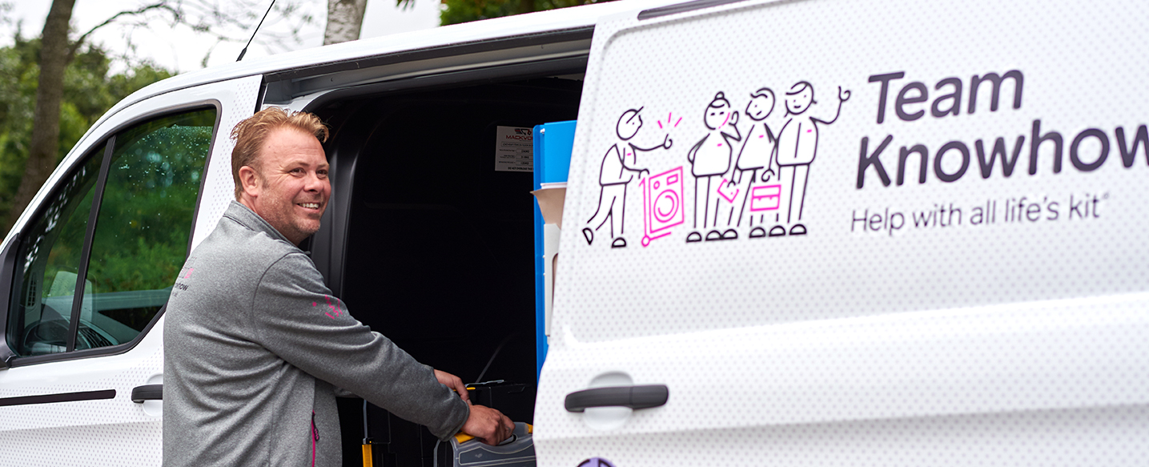
Purposes
Within this hybrid approach, businesses which predominately supply products offer services in addition.
For example, Currys PC World offer services to their customers which compliment the products they purchase such as the opportunity to have a PC set up or a cooker delivered and fitted through their ‘Knowhow’ team.

Slide 25
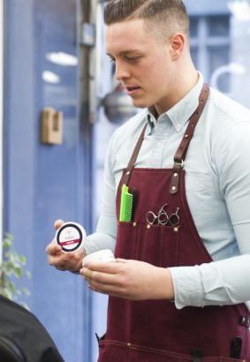
Purposes
In comparison, businesses which predominately provide services offer customers the opportunity to purchase products which complement the service.
For example, it’s common for a barber to offer customers hair care products to purchase such as gel and wax following a hair cut.

Slide 26
Sectors:
Businesses operate within sectors related to their nature and the products or services it provides.
Within business, there are four main sectors which outline the key stages that a product goes through, right from the initial sourcing of raw materials to the final product being ready for the customer.
Primary
Secondary
Tertiary
Quaternary

Slide 27
Sectors: Primary
The primary sector is essential and provides the foundations for the majority of businesses across all sectors and industries.
Businesses that operate within the primary sector extract and harvest natural products from the land to collate raw materials and natural resources which are then sold on to other businesses who manufacture products or provide services.
Common examples of the types of businesses in the primary sector include: fishing, farming, mining, and agriculture.

Slide 28
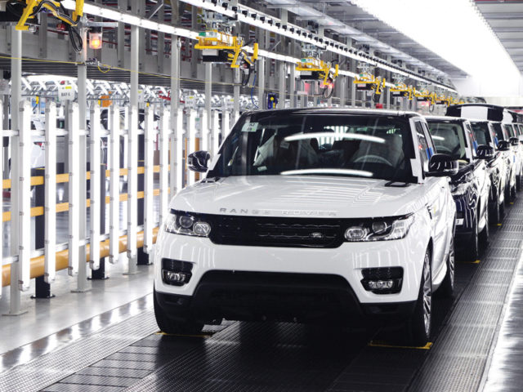
Sectors: Secondary
The secondary sector involves businesses who use the raw materials from the primary sector and turn them into products.
Essentially, businesses in the secondary sector are manufacturers such as those in the car industry e.g. Jaguar Land Rover, Audi, and Vauxhall.
However, any business which utilises raw materials and coverts them into new products through the manufacturing and assembly process would classify as operating within the secondary sector.
Alongside car manufacturers, other examples of businesses which operate in the secondary sector include food production businesses such as a baker or clothes manufacturers.

Slide 29
Sectors: Tertiary
Businesses which operate within the tertiary sector provide services to other businesses or people.
On a B2B basis, these services typically support the production and distribution processes of other businesses such as advertising and marketing, transport, or healthcare etc.
Alternatively, services can also be provided on a predominately B2C basis, examples include cinemas, supermarkets and beauty salons.

Slide 30
Sectors: Quaternary
The quaternary sector is similar in nature to the tertiary sector as businesses in this sector also provide services.
Infact, 76% of the UK’s workforce is employed across the tertiary and quaternary sectors (BBC, 2021).
However, businesses which provide services in the quaternary sector typically provide information services such as consultancy, research and development, data collection, specialised financial services, or professional bloggers.
Notes:
BBC (2021): https://www.bbc.co.uk/bitesize/guides/zx3vtyc/revision/1

Slide 31
Sectors:
Activity 5: Sectors Explained.
In small teams, you are required to create a TikTok style video which explains the four different types of sectors in business that we have just discussed (Primary, Secondary, Tertiary, and Quaternary).
The TikTok style video should explain the key characteristics of each sector and provide examples of businesses which exist in each one.

Slide 32
Scope of Business Activities:
The owners of a business decide where they choose to sell their products and/or services, it can do this on either a local, national or international basis.
Activity 6a: before we investigate each option in more detail, provide an example of businesses which operate locally, nationally, and internationally?

Slide 33
Scope of Business Activities: Local
Business which operate on a local basis are based either in their own town, city or the vicinity of their geographical area.
Selling goods or products on a local basis is very common for sole trader businesses such as a hairdressers, newsagents, or a fruit and veg shop where the owner offers their products and/or services to the local community i.e. via a shop on the local high street.

Slide 34
Scope of Business Activities: Local
Local businesses can find it difficult to compete with larger nationwide and international businesses due to weaker buying power and smaller margins etc.
However, local businesses often have the key advantage of truly understanding the needs and wants of the local community and their service is tailored to the target market, rather than a generic and standardised offering which is found with most nationwide and national businesses.

Slide 35
Scope of Business Activities: Local
Activity 6b: Identify 3 businesses which operate in your local area only and answer the following questions for each one:
What is the core product or service that they sell?
How much competition have they got from other local businesses?
Why do you think this business only operates at a local level?

Slide 36
Scope of Business Activities: National
Business which are classified as operating on a national basis conduct trade within their own country.
Therefore, they are bigger than a local business and are likely to have multiple stores across the country and/or the ability to deliver to various locations across the country, but do not trade in any other countries across the world.
In a similar sense to businesses that operate on a local basis, businesses that operate on a national basis have the advantage of understanding the culture and trends of the nation which supports them to satisfy the needs and wants of their target audience more accurately in comparison to a competitor who operates on a global basis.
Because national businesses often have more locations and more customers, they also have greater buying power than local businesses which then typically allows them to be more competitive with the pricing of their products and services.

Slide 37
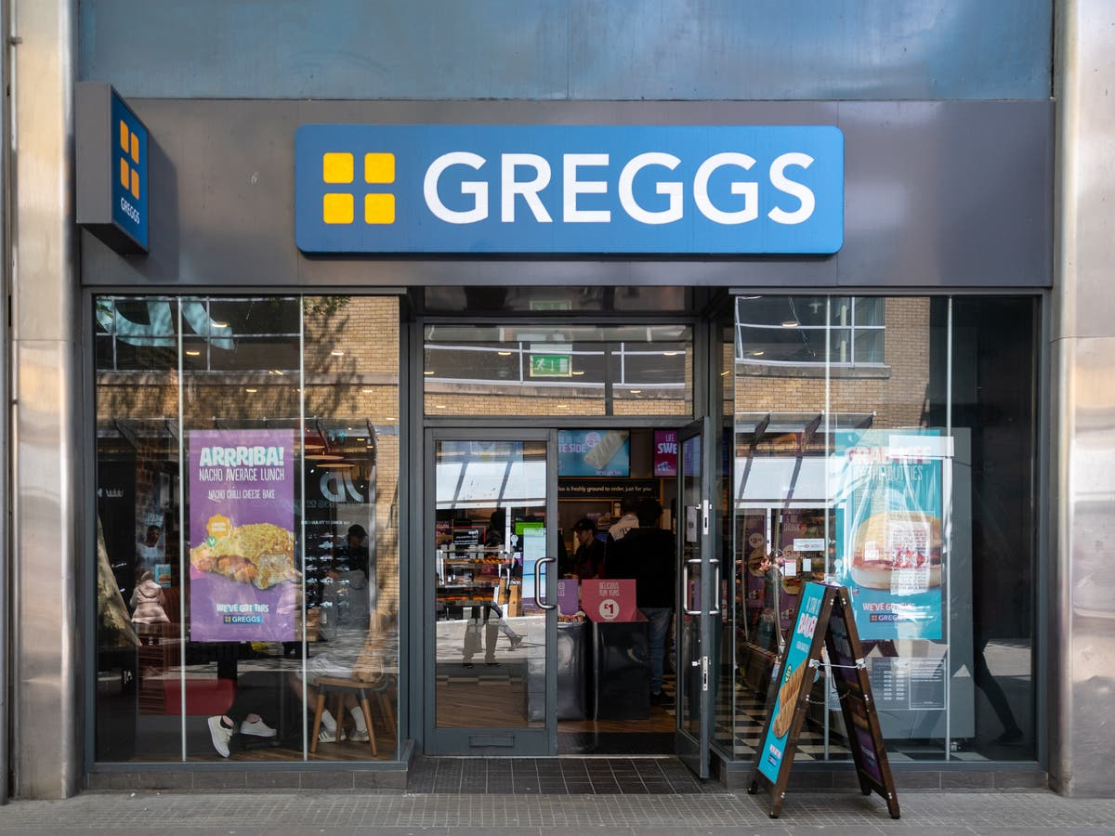
Scope of Business Activities: National
Greggs bakery is a perfect example of a national business which started locally. “Eighty years ago, John Gregg started out with one goal, to deliver (by pushbike) fresh eggs and yeast to the families of Newcastle, today they have over 1,950 stores nationwide.
Over the years, Greggs opened more shops across the country and looked for ways they could make the business even better. Their menu changed with the nation’s taste - who’d have thought of freshly ground Fairtrade Espresso from Greggs, they also added calories to their menu (before they had to) and provided free Wi-Fi – that’s been voted the best on the high-street.” (Greggs, 2021)
The above statement taken form Greggs site is a great example of a business which has been able to grow by understanding the wants and needs of its target audience, by adapting their menu over time to the nations taste and adding in demand features such as calories to their menu and Wi-Fi in their stores.
Notes:
https://corporate.greggs.co.uk/at-a-glance/our-history

Slide 38
Scope of Business Activities: National
As Greggs has grown as a business and added more locations etc. it has increased its buying power, so when it buys raw materials such as the ingredients to make its pastry products, it is able to do so in greater quantities and therefore for a reduced amount per unit. This enables Greggs to offer a competitive price to its customers whilst achieving respectable profit margins.
Infact, in 2019 Greggs made record profits, in the same year that it launched its vegan snack range, another indication of strong margins but also the bakery chain listening to the wants and needs of the nation and a growing market in the UK.
Notes:
https://corporate.greggs.co.uk/at-a-glance/our-history

Slide 39
Scope of Business Activities: National
Activity 7: Trading Nationwide and Expanding Internationally
Pick just one of the local businesses you identified in the previous task and write a letter to the owner to convince them to expand the business and trade on a national basis. Ensure you justify how this could be achieved with supporting examples and why you think this would be good strategic move for the business, alongside analysis of the potential drawbacks for the business.
Could Greggs go international? Scenario: you are a business consultant and the owners of Greggs are considering expanding the business and opening stores in the USA. Analyse the benefits and drawbacks of the bakery chain expanding internationally. Then conclude with a justified recommendation for the business to either remain in the UK only or expand into the USA.
Notes:
https://corporate.greggs.co.uk/at-a-glance/our-history

Slide 40
Scope of Business Activities: International
Businesses which are classified as operating on an international basis, essentially operate in more than one country.
McDonald’s, Subway, and Starbucks are famous examples of businesses which have expanded their operations over the years to trade internationally.
They have grown their operations from being national businesses to one where they have 1000s of stores across 100s of countries in the world.
Whilst trading internationally is great for brand awareness, an increased customer base, and sales revenue etc. operating internationally can be very complex.

Slide 41
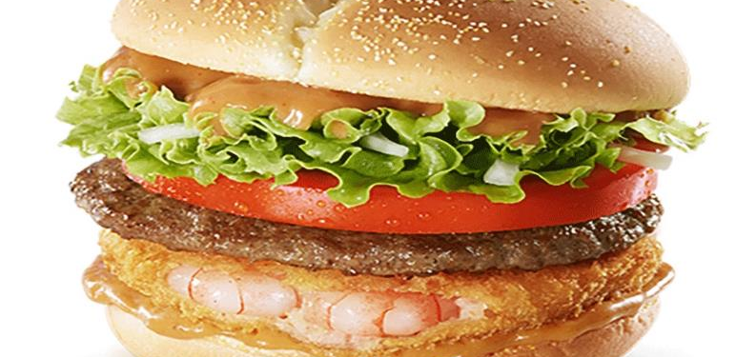
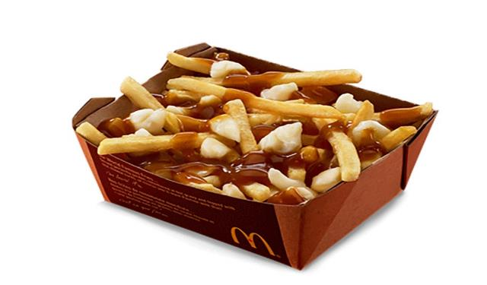
Scope of Business Activities: International
When a business such as McDonald’s opens a store in another country outside of the USA, it has to make significant changes in its marketing mix to adapt to the countries' culture and the wants and needs of its residents.
For example:
In Canada, McDonald’s serves ‘French Fries in Gravy and Cheese Curds’ (known as Poutine) which is a Canadian staple.
In Korea, McDonald’s serves a ‘Shrimp and Beef Burger’ to satisfy the wants and needs of Korea’s McDonald’s customers.
In China, McDonald's serves ‘Ham N' Egg Twisty Pasta’ on its breakfast menu, which is quite different to the ‘Bacon Roll’ served in the UK.
However, it’s not just cultural differences which a business must consider when operating internationally, the law is often different in every country.
Therefore, it’s crucially important that the business is clearly aware of these rules and regulations when it expands into a new country.

Slide 42
Scope of Business Activities: International
Activity 8: watch the video on the next slide (Why Starbucks Failed in Australia) and complete the following tasks:
What did Starbucks do wrong when they opened stores in Australia and what were the key factors which led to them closing 61 Australian stores in 2008?
Why have Gloria Jean’s Coffee Shops been so successful in Australia when Starbucks failed?
Do you think targeting tourists in Australia is a good strategy for Starbucks?
Australia has one of the biggest and most competitive coffee shop markets in the world. Your task is to design a coffee shop brand which you believe would be able to compete in this competitive market. Ensure you include the following factors as a minimum:
The name of your coffee shop
A logo and slogan
The USP of your coffee shop
The range of products you would sell
The target market
The experience customers would get in store

Slide 43
Scope of Business Activities: International
Video link: Why Starbucks Failed in Australia
Notes:
https://www.youtube.com/watch?v=_FGUkxn5kZQ

Slide 44
Size
One of the clearest ways we can differentiate businesses is by their size.
Businesses range in size from micro-businesses where the owner might be the only person who works for the business right through to large multinational corporations with thousands of employees across the world.
Over the next few slides we are going to investigate the key factors of each with supporting examples for the following business sizes:
Micro
Small and Medium Enterprises (SMEs)
Large

Slide 45
Size: Micro
99.9% of all business are classed as small to medium sized, meaning they employ between 1 and 249 people with a staggering 96% of these being classed as microbusinesses (SMELoans, 2021)
To be classified as a microbusiness, the business must meet the following criteria:
a turnover of £632,000 or less
£316,000 or less on its balance sheet
10 employees or less
One in five (18 per cent) of micro businesses across the UK operate on a turnover of less than £50,000.
However, there are more than 23,500 micro businesses in the UK with a turnover of more than £1 million – showing success is not necessarily tied to size and the average turnover of the UK’s microbusinesses currently stands at £286,879. (Experian, 2021)
Notes:
https://smeloans.co.uk/blog/micro-business-statistics-uk/
https://www.experian.co.uk/blogs/latest-thinking/small-business/micro-business-business-one/

Slide 46
Size: Micro
Microbusinesses are the largest type of British businesses based on size, with further growth in the sector expected due to the changing way we work, live and do business.
Infact, SME Loans (2021) conducted a survey to reveal the business aspirations of the UK and it found that 64% of the workforce wants to set up their own business, mainly to either earn more money or be their own boss.
Due to technological advancements, it is now possible for most people to set up a microbusiness as their full time occupation or to even start what can be referred to as a ‘side hustle’ outside of the workplace.
Literally, a microbusiness can be started with a laptop or even just a smartphone with an internet connection.
Notes:
https://smeloans.co.uk/blog/micro-business-statistics-uk/
https://www.experian.co.uk/blogs/latest-thinking/small-business/micro-business-business-one/

Slide 47
Size: Micro
Activity 9: Starting your own Microbusiness
You have decided to start up your own microbusiness whilst studying for your business qualification with the aim of making an income to support you whilst at college/school and for it to become your full-time occupation once you achieve your qualification. Ensure you include the following factors as a minimum:
The name of your microbusiness.
A logo and slogan.
An explanation of what your microbusiness is.
The USP of your microbusiness.
Where you will operate (physical store or online etc.).
The range of products or services you would sell.
The target market.
Short, medium and long term aims.
A justification of why you think it will be successful.
Notes:
https://smeloans.co.uk/blog/micro-business-statistics-uk/
https://www.experian.co.uk/blogs/latest-thinking/small-business/micro-business-business-one/

Slide 48
Size: Small and Medium Enterprises (SMEs)
In the UK, small and medium enterprises (SMEs) operate with fewer than 250 employees.
More specifically, small businesses are those with between 10 and 49 employees and medium businesses are those with between 50 and 249 employees.
In addition to the number of employees, the amount of turnover the business does will also determine its size.
To be classified as a small business, the turnover must be under £10 million and can be anything up to £50 million for a medium sized business.

Slide 49
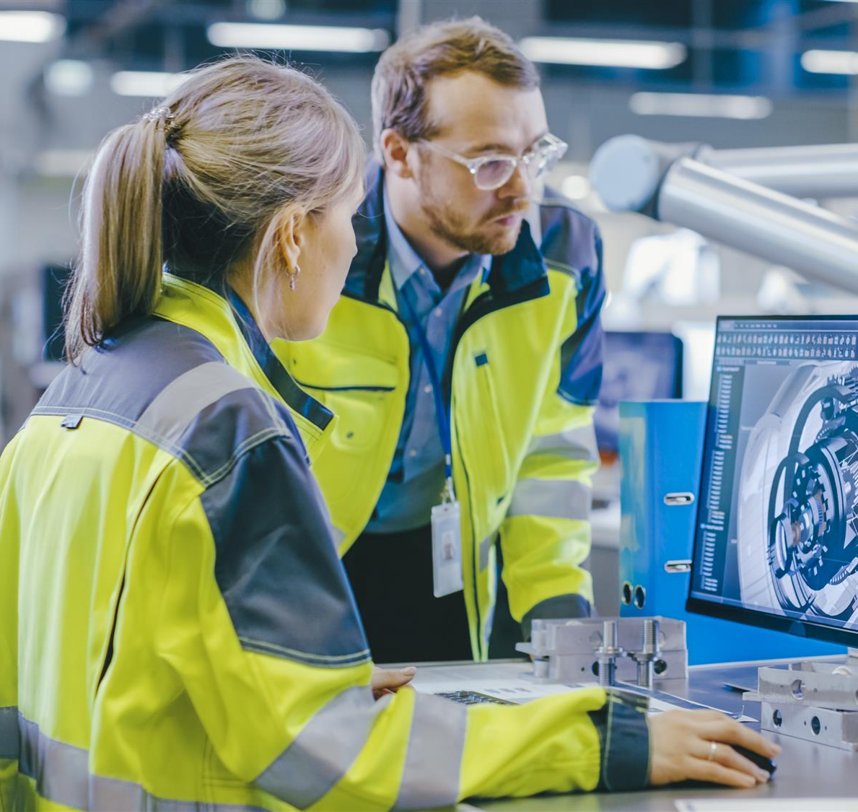
Size: Small and Medium Enterprises (SMEs)
In the UK’s private sector, SMEs account for 60% of the total employment and there are now two million more SME’s today than there were in 2000, showing clear evidence of growth in businesses of this size.
There are examples of SMEs across all business sectors and industries in the UK, with just under 1 million SMEs in the construction sector alone and sectors such as wholesale, retail and manufacturing also having a strong representation of SMEs (10% each).

Slide 50
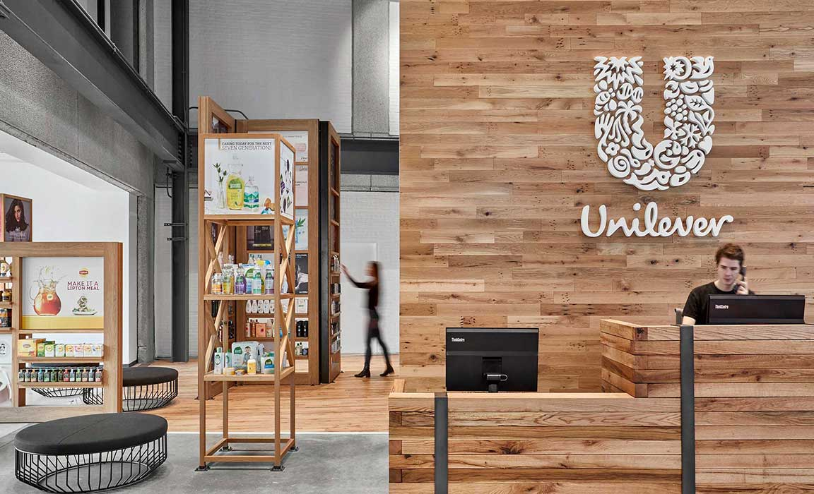
Size: Large
At the start of 2019, there were 5.9 million private sector businesses in the UK but only 7,700 of those were classified as large businesses, yet they still account for 40% of the UK’s employment and more than half of the turnover (Gov, 2020).
To be classified as a large enterprise, a minimum of 250 people must be employed.
Large enterprises are extremely important to the UK’s economy due to the sheer amount of people they employ and the vast amount of revenue they generate.
However, it’s important to acknowledge that the owners of more than 25% of UK’s large businesses are based overseas in countries such as the USA and Germany.
Notes:
https://www.gov.uk/government/statistics/business-population-estimates-2019/business-population-estimates-for-the-uk-and-regions-2019-statistical-release-html

Slide 51
Size: Large
Quick discussion: have a think (no researching allowed) and choose 3 companies you believe would feature in the top 10 largest in the UK by market capitalisation.
Once you have chosen 3 companies, be prepared to justify your thought process as we will have a quick discussion as a group.
Following this, we will then look at a table on the following slide which shows the top 10 largest UK companies by market capitalisation (as of December 2020) and which sectors they operate within to see how may you got correct.

Slide 52
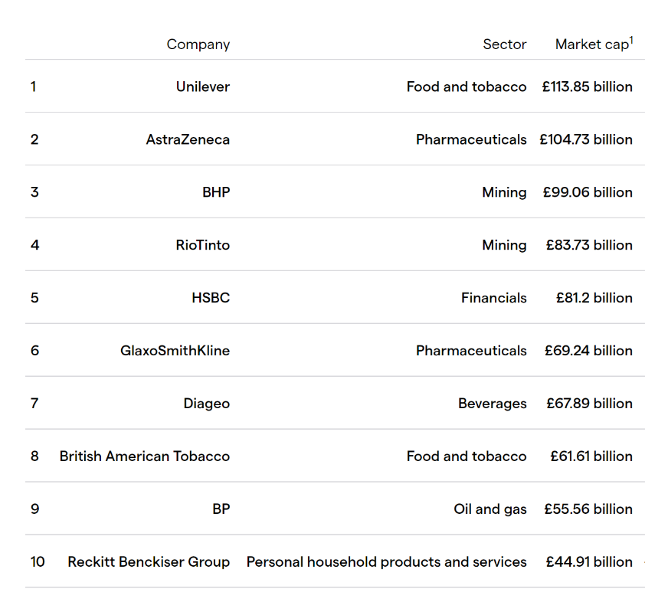
Size: Large
Notes:
https://www.gov.uk/government/statistics/business-population-estimates-2019/business-population-estimates-for-the-uk-and-regions-2019-statistical-release-html
ig.com/uk/news-and-trade-ideas/top-10-largest-uk-companies-by-market-cap-190715

Slide 53
Size
Activity 10: Size
Unilever are the largest company in the UK, but what do they actually sell and have you purchased any of their products before? Conduct research into Unilever to identify who they are and what brands make up their portfolio.
Create an information leaflet which compares the key differences between microbusinesses, SMEs and Large businesses for students who are brand new to Business Studies. (Either open a new word document, search for ‘brochure’ designs and use a template to complete the task, then paste your design into the box provided or design the leaflet by hand in the box provided).

Slide 54
Reasons for Success
As we discussed earlier in the unit, not every business exists just to make a profit and they don’t all measure success by the numbers on their balance sheet.
Whilst many businesses are profit seeking, many others are non-profit seeking businesses.
Regardless of the reason the business exists, the way every business measures success depends on its:
Aims and objectives - which are extremely important for any business as they typically link directly to the reason it exists and essentially provide a clear purpose and outcome for everyone involved in the business.
The clarity of vision - which is essential to ensure the business is focused on its direction by ensuring the vision of the business is clear and market forces are taken into account as and when they influence change in the business etc.
Innovation of its products and processes – in the modern business world, it is crucial for businesses to be innovative in relation to both its products and processes. Having a culture where processes are continually evaluated and improved in terms of quality and efficiency, whilst investment into the research and development of its products is taken seriously is critical to support the business to be innovative and ultimately increase the likelihood of the business being successful.

Slide 55
Features of Businesses
Activity 1 revisited: Features of Businesses.
Now we have discussed each feature in detail, you can now apply each one to your two chosen businesses and make comparisons between them both. Ensure you clearly explain the key differences in relation to the features of your chosen businesses.

Slide 56
Learning Aim A2
Stakeholders and Their Influence

Slide 57
Stakeholders
Every business has stakeholders, it doesn’t matter whether they are large multinational corporations or microbusinesses.
Quick discussion: what is a stakeholder and how does a stakeholder differ to a shareholder?
It’s also important to understand that there are two types of stakeholder, these are:
Internal – stakeholders within the business.
External – stakeholders outside of the business.
Let’s have a look at these in greater detail and how they impact businesses.

Slide 58
Stakeholders
Activity 11: Stakeholders
Watch the video about stakeholders on the next slide and complete the following tasks in your workbook.
Explain the term stakeholder.
Compare the key differences between internal and external stakeholders with examples and justify how they impact businesses differently.
Identify the internal and external stakeholders covered in the video and complete the table by describing the key characteristics of each stakeholder and the objectives each stakeholder has.
Assess which two stakeholders at McDonald’s will be negatively impacted the most by increasing the wage of employees to £15 an hour.
Argue which stakeholder has the greatest impact on a business such as McDonald’s.

Slide 59
Stakeholders
Video link: Stakeholders
Notes:
https://www.youtube.com/watch?v=tZGol4xtY3g&t=175s

Slide 60
Internal Stakeholders
Internal stakeholders are those within the business.
Businesses within every sector and of every size will have at least one internal stakeholder as they all have an owner.
The key internal stakeholders of any business include:
Owners/ Shareholders
Managers
Employees
Let’s have a look at these in greater detail and their influence on the success of the business.

Slide 61
Internal Stakeholders: Owners/ Shareholders
The owners or shareholders of a business have the overall responsibility for the business.
They are one of the most influential stakeholders for any business as they have the final say on how the business operates.
If the business has just one owner then they will make all of the decisions as they have 100% ownership, whereas shareholders can be classified as part-owners who have the right to input their thoughts or vote on the decisions of a business based on their equity in the business.
Owners and shareholders have an interest in the business doing well as the more profit it makes, the greater the return on their investment over time.

Slide 62
Internal Stakeholders: Owners/ Shareholders
The owners and shareholders of a business can influence the success of a business by investing more money into the business or withdrawing their capital or selling their equity.
In smaller businesses, the owners and shareholders may also be the managers of the business. However, as the business grows the owners and shareholders may hire managers to run the business on their behalf.
As a business grows, it will also increase the amount of employees its recruits, thus the bigger the business, the more internal stakeholders the business will typically have.

Slide 63
Internal Stakeholders: Owners/ Shareholders
Shareholders want to see a benefit in return for purchasing and holding shares in the business which can be known as shareholder value, essentially they want the value of their shares to go up so they become more valuable to them.
If a business is a Public Limited Company (PLC) and on the London Stock Exchange, then it is likely to have a lot of shareholders who get to vote on the proposals put forward about the way the business is run.
However, the general shareholder in a PLC has very minimal voting power due to the sheer amount of shares available once it goes public.
Whereas, a business which isn’t public is likely to only have a few shareholders who have greater voting power and influence on the business.

Slide 64
Internal Stakeholders: Owners/ Shareholders
Either way, shareholders influence the success of a business as they want to ensure there investment is worthwhile and have shareholder value which can create tension between those who run the business and those who have an interest in the business.
It’s also common for the owners and managers of a business to be conflicted when making key business decisions as they have to balance the pressure from the business’ stakeholders who want to see a return on their investment with the wants and needs of every other stakeholder.
For example, the employees of the business may want better working conditions and pressure groups may want the business to change the way it operates to positively impact the environment.
Essentially, the wants and needs of every other stakeholder are likely to reduce the return on investment for the business’ shareholders, particularly in the short term.

Slide 65
Internal Stakeholders: Managers
The managers of a business are another important internal stakeholder as they make the day to day decisions of the business as they are employed by the owners to run their business.
Managers also have a huge influence on the employees of the business, who are again another key internal stakeholder of the business.
A managers role requires them to develop a motivated and productive workforce which provides excellent service (if customer facing) with the aim of increasing revenue and profit for the business, which the managers would then report to the owners.

Slide 66
Internal Stakeholders: Managers
As stakeholders, managers have a genuine interest in the business succeeding as it can lead to additional pay such as bonus or commission, increased job prospects such as a promotion to a more senior role, and increased job security.
Managers can influence the business they work for in many ways such as coaching employees the skills and knowledge required to do their role, hiring the right people for the job and firing the underperforming employees, making good decisions on a daily basis, and developing effective and efficient processes.

Slide 67
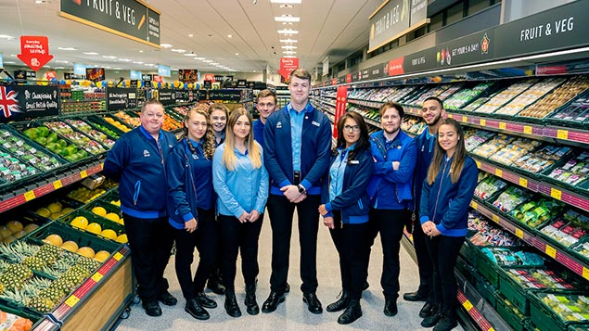
Internal Stakeholders: Employees
Employees are another extremely important internal stakeholder, they are typically the people who represent the business in a customer facing role if the business sells products and/or services to the public or they are the people who produce the products in a manufacturing business.
Either way, employees influence the success of the business, if employees aren’t competent enough or motivated enough to meet the standard required it can have devastating impacts on the business.
For example, just one bad interaction in store with a customer or a customer receiving a faulty product could lead to them telling lots of their friends or leaving a very negative comment on social media for other potential customers to see which could lead to them shopping with competitors of the business.

Slide 68
Internal Stakeholders: Employees
Just like managers, employees have a genuine interest in the business succeeding as it can lead to additional pay such as bonus and commission, and increased job prospects such as a promotion to a more senior role and increased job security.
However, the way in which employees can influence a business is clear and can also impact other stakeholders not just the business itself.
If employees are feeling demotivated and don’t perform i.e. they decrease their productivity levels or provide customers with a bad service, it won’t just impact them, it will also impact the manager, as managers target’s are based on employee’s performance and ultimately it will impact the owner and shareholders if the businesses performance is impacted aswell.
Therefore, it is crucial that the owners and managers ensure that employees are competent and content in their role to avoid poor performance initially and good employee’s don’t leave the business etc.

Slide 69
Internal Stakeholders
Activity 12: it’s time for a debate!
You can only choose one, which internal stakeholder is the most important?
Collate a series of reasons to justify why your selected internal stakeholder is the most important for a business in your opinion.
You will then debate this as a class.

Slide 70
External Stakeholders
External stakeholders are those outside of the business.
Every business has external stakeholders, without them it simply wouldn’t be a business.
The key external stakeholders include:
Suppliers
Lenders
Competitors
Debtors
Creditors
Customers
Government Agencies and Departments
Communities
Pressure Groups
Interest Groups

Slide 71
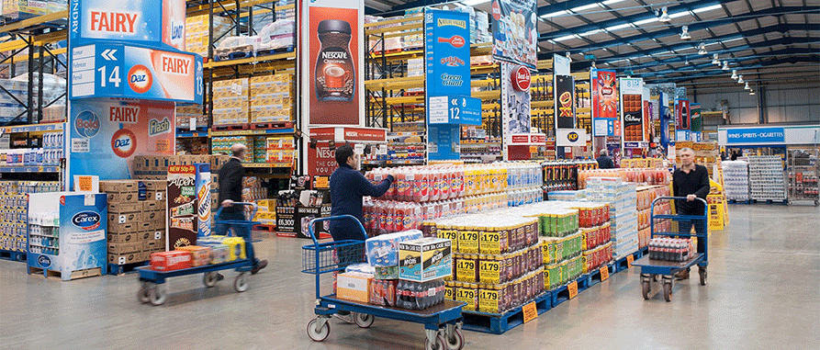
External Stakeholders: Suppliers
A business will use multiple suppliers to purchase raw materials which are then used to manufacture products or they may purchase finished goods to sell onto their customers.
Having a supplier which is reliable and delivers the required quantity of high quality goods on time and at the right price is essential for any business.
If a business has a supplier which isn't reliable, it in turn would let its customers down through either having no stock or poor quality products, which would lead to a loss of customers to competitors.

Slide 72
External Stakeholders: Suppliers
Suppliers have a vested interested in the business doing well as the more successful the business is using its materials and products, the longer they are likely to supply them.
Also, if a business is performing well, it’s likely to pay its invoices on time etc. which also helps the cashflow of the supplier.
Suppliers are a very influential external stakeholder for a business, for example if the supplier increased their prices the business would either make less profit or would have to increase its own selling price.

Slide 73
External Stakeholders: Lenders
Lenders are the external stakeholder who lend the business money and can be essential for business start-ups or when a business is wanting to expand and grow.
There are various types of lenders available to businesses such as: banks, credit unions, peer-to-peer lenders, the government, or even family and friends would classify as a lender.
Once a lender has provided a business with money i.e. through a loan, they have a vested interest in that business being successful so they receive their money back in full and on time.
However, lenders have a lot of power over the lending process, they choose who they lend money to, how much they lend, how much interest is charged and how long the business has to repay.

Slide 74
External Stakeholders: Lenders
Activity 13: Lenders.
A friend has approached you and asked you for some advice about lenders. They are looking to start up a small business but need to raise some funds to make it possible, ideally they need £5,000 to get started.
Your task is to conduct research about the various types of lenders that are available to businesses and choose the top three you would recommend to your friend to support their small business start-up.
Once you have identified your top three lenders, you are required to create a PowerPoint presentation which contains the key characteristics, benefits and drawbacks of all three options. The presentation should finish with an overall rank of the three lenders you have chosen, from your most to least recommended option with justification.
You can choose any type of lender which you feel is suitable, here is a list of possible choices to get you started:
Banks
Peer-to-peer
Angel investors
Crowdfunding
Family and friends.
Paste screenshots of your PowerPoint presentation (with speaker notes if applicable) in the box provided in your workbook.

Slide 75
External Stakeholders: Competitors
Nearly every business has some form of competitor as an external stakeholder.
It is crucial for businesses to understand their competition to ensure they can be competitive in the market they operate within.
Competitors are very influential in business, every business can directly or indirectly affect the performance of its competition.
Just a simple price drop or promotion can literally draw customers away from the competition, just think about the supermarket industry and the price wars and intense competition which exists.
Essentially, businesses in any industry should conduct regular competitor analysis to analyse what their competitors sell, how they sell it, and for what price etc. which allows the business to make more informed business decisions, attract customers, and influence their business positively.

Slide 76
External Stakeholders: Debtors
Debtors of a business, are those people or organisations which owe the business money from a previous agreement such as the sale of goods in which the buyer of those goods has a set amount of time to repay e.g. 30 days after receipt. In this case, the buyer would become a debtor of the business.
In business, it is common for money not be exchanged at the point of sale.
In the B2C world, many businesses often offer credit terms for customers such as a ‘buy now pay later’ credit agreement, often giving the customer 3, 6 or 12 months to pay for the goods they purchased.
In the B2B world, many businesses offer credit terms for their business customers such as the ability to pay through invoice, giving the business purchasing goods a set amount of time to repay them without penalty.
However, offering credit to customers was originally for big ticket items but you can now take credit out on small items and spread the cost of most purchases i.e. for a pair of trainers.

Slide 77
External Stakeholders: Debtors
Activity 14: Debtors.
Research and explain 3 different types of credit which are offered to customers that would them make them a debtor after the sale of goods.
Why do businesses offer credit and would you recommend it? Ensure you compare the advantages and disadvantages of a business offering credit to its customers and justify your decision.
Identify a business which you are a customer of and find out what credit options they offer. Are these credit options suitable for the customers of the business?
Customers can now get credit on low ticket items which could be considered ‘luxuries’ not ‘essentials’ such as fashionable trainers and headphones, do you consider this to be ethical?

Slide 78
External Stakeholders: Creditors
Creditors are the people or organisations which money is owed to.
If a business has debtors, then by default it is a creditor itself as it is owed money by its customers e.g. for goods it has supplied.
However, many businesses rely on creditors to support their cashflow and it is very common for suppliers to be a creditor of a business.
For example, if a supplier offers a business the option to pay for their goods in 30 or 45 days after purchase, it allows the business to sell some of these goods or produce goods from raw materials to generate additional cash before paying the supplier.

Slide 79
External Stakeholders: Customers
Customers are the people or organisations which purchase the products or use the service offered by the business.
It’s also important to understand that customers can be either internal or external.
Internal customers are those who are directly related to the business such as the employees of the business, who are often given staff discount as a benefit for working for the business.
External customers are those who don’t have any direct connection to the business and bring revenue into the business in exchange for a product or service.
Without customers a business cannot be successful nor can it survive over the long term, It could be argued that customers are one of the most influential when it comes to the success of the business and should be viewed as a long term asset.

Slide 80
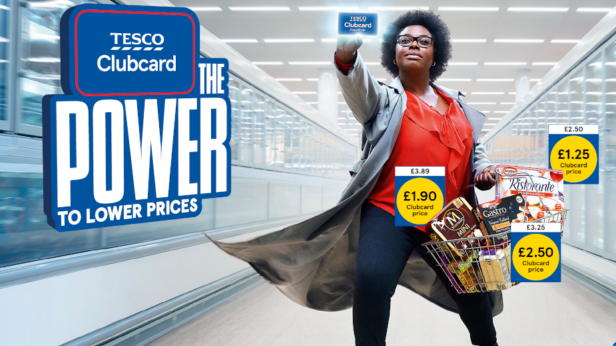
External Stakeholders: Customers
Therefore, If a business fails to satisfy the wants and needs of its customers, then customer retention will decrease as they choose to shop with competitors who offer similar products and services or they may choose to leave negative reviews/ word of mouth.
Therefore, in an ideal world, businesses would retain every customer as they become loyal because they are satisfied with the customer service they receive and the quality of the products purchased etc. which leads to positive word of mouth through reviews etc. supporting the business to attract even more customers.
If customers are loyal, they have a vested interest in the business doing well as they want to keep purchasing the products or using the services the business offers as they are happy with the quality and price etc. in comparison to what its competitors offer.

Slide 81
External Stakeholders: Government Agencies and Departments
As an external stakeholder, government agencies and departments can be:
Local e.g. County, City or Parish Councils
National e.g. Department for Business, Energy and Industrial Strategy or HM Revenue and Customs
International e.g. Foreign and Commonwealth Office or Department for International Trade
Government agencies and departments are formed by the UK government to benefit the general population and support businesses to invest and create jobs through their financial and economic policies.

Slide 82
External Stakeholders: Government Agencies and Departments
The government can be a very influential external stakeholder for any business as the laws which are set by the government lay the boundaries that businesses must operate within which can often hinder businesses and leave the owners of the business feeling restricted and frustrated etc. especially as government rules and regulations are constantly changing, businesses can find it difficult to keep up to date.
However, it is in the interest of the government for businesses to do well as it is good for them and the economy in general e.g. the more successful a business is, the more tax the business is likely to pay from its profits and the more employees the business is likely to hire, which in turn means more wealth for the general population and more spending power which boosts the economy further etc.
The furlough scheme used during the coronavirus pandemic is a perfect example of the government using its power to support businesses in the UK to survive during very difficult trading conditions. Whilst at the same time, their own regulations during the same pandemic made it extremely difficult for most businesses to trade successfully even if they were allowed to open their doors to the UK public.

Slide 83
External Stakeholders: Communities
The local community involves the people who live in the local area of the business, you could refer to them as neighbours of the business.
Essentially, anyone who is impacted or potentially impacted by the actions of the business and vice versa i.e. the business would also be interested in anyone in the local area who is impacting or could potential impact the business.
In general terms, the local community is concerned with the impact which businesses in their local area are having on jobs and prosperity, aswell as their impact on the local environment and infrastructure.

Slide 84
External Stakeholders: Communities
For example, if a business was providing hundreds of jobs across a local community, this would be seen positively across the community. However, if the same business was damaging the local environment through its operations, this would be seen negatively and may cause unrest across the community.
If the community is generally happy with a selected business, they are likely to shop with this business and provide positive word of mouth etc.
However, if the community is unhappy with the actions of a business, they may initially stop shopping with the business but this could lead to protesting and petitioning over the long term if issues aren’t resolved.

Slide 85
External Stakeholders: Communities
Activity 15: The Impact of Communities.
Read the case study ‘Starbucks drive thru at Windle Island gets the green light’ and answer the questions below.
Why were members of the local community concerned about the opening of a Starbucks drive thru?
What did members of the local community do and how did it impact the opening of the Starbucks drive thru?
What potential benefits would the Starbucks drive thru provide the local community?
Do you agree with the decision to allow the Starbucks drive thru to go ahead with set conditions? Justify your answer either way.

Slide 86
External Stakeholders: Pressure Groups
Pressure groups exist to put pressure on businesses to influence their actions in what they deem to be a positive and progressive manner.
Pressure groups can be formed for any reason where a collective group of people share the same values and beliefs with the aim of influencing change.
There are thousands of pressure groups which exist across the world and it’s important to be aware that they don’t exist to take power away from businesses or want any power themselves, they just want to influence those in power.
For example, the typical pressure group will aim to influence businesses to act in a more ethical manner and environmentally friendly way.
There are many ways in which a pressure group can influence change in a business such as: physically protesting and organising demonstrations, running marketing campaigns against the business, and writing formally to MPs and the press so the business receives negative publicity and scrutiny with the hope that this pressures the business to change according to the focus of the campaign.

Slide 87
External Stakeholders: Interest Groups
Interest groups are a collection of members (people and/or organisations) who have a shared interest or concern e.g. about a particular business or an entire industry.
Collectively the members of an interest group aim to influence factors such as public policy or regulators to benefit themselves or their cause.
They aim to influence change by lobbying against the policy makers e.g. a collection of farmers might lobby against the government to increase the subsidies farmers receive.

Slide 88
Stakeholders
Activity 16: Stakeholder Conflict Scenario.
A UK car manufacturer is planning to move its production overseas to reduce the labour costs involved in making its cars.
Evaluate all the possible conflicts that may occur between stakeholders over this issue.

Slide 89
Stakeholders and CSR
Corporate Social Responsibility (CSR) is a business’ commitment to society and the environment.
In today’s business world, it is crucial that businesses have a CSR strategy and many stakeholders will be involved in this strategy, either influencing its direction or required to execute the strategy.
Here’s a few examples:
Employees are commonly involved in a business’ CSR strategy e.g. through volunteering in community projects and working with community groups.
Pressure groups and interest groups typically influence the direction of corporate CSR strategies, highlighting issues in the industry they operate within or directly targeting an issue within the business itself which the business can then acknowledge and aim to rectify in its CSR strategy.
The community or local council situated in the area of the business may highlight some critical issues on a local level which the business can address in its CSR strategy.

Slide 90
Learning Aim A3
Effective Business Communications

Slide 91
Effective Business Communications
Activity 17: Effective Business Communications
Apply the following tasks to your workplace or place of study.
Why is being able to communicate effectively important in your workplace or place of study? List and explain all the possible reasons with supporting examples.
How can you communicate effectively in your workplace or place of study? List and explain all the possible methods which can be used with supporting examples.

Slide 92
Effective Business Communications
If a business is able to communicate effectively with both internal and external stakeholders it helps to develop the relationship with them and is a key characteristic of any successful business.
For example, if a business communicates effectively, it is likely to experience:
Faster and more effective decision making, which helps the business to take advantage of opportunities and solve problems more efficiently.
Improved employee satisfaction, which ultimately leads to increased productivity and reduced employee turnover.
Customers clearly understand why the business exists and marketing messages are clearer and more persuasive leading to increased sales and brand awareness.

Slide 93
Appropriate Presentation and Delivery of Information to a Given Audience
Therefore, it’s crucial that businesses have the resources to appropriately present and deliver information to a given audience on both a formal and informal basis, which is typically done through either written or oral communication methods.
It is very common for businesses to use written communication, both on a formal or informal basis.
Written communication is the use of written words to deliver information and in business, written communication is often used between a wide variety of stakeholders e.g. between the owners and employees or between managers and suppliers.

Slide 94
Appropriate Presentation and Delivery of Information to a Given Audience
There are many advantages for a business using written communication, these include:
There is evidence of the communication which can help the parties involved to settle any disputes at a later date.
The message communicated is consistent as everyone who is sent the written communication receives the same message.
Often very cost effective.
However, it’s important to be aware of the potential disadvantages of written communication, these include:
Dependent on the method used, there can be a delay in the intended recipient reading the written communication.
Sometimes there is no proof that the recipient has read the message.
The message may be seen by others who it wasn’t intended for e.g. a letter maybe left out or emails maybe left unlocked in an open office.

Slide 95
Appropriate Presentation and Delivery of Information to a Given Audience
Importantly, the recipient of written communication doesn’t have body language or tone of voice to judge the manner of the written communication which can sometimes lead to a misjudgement in the message being sent.
Therefore, it is crucial that the sender pays fine attention to detail and has sufficient skills in written communication which typically relies on grammar and punctuation.
Whilst the choice of words and terminology used are essential to ensure the written communication being sent is received accurately.

Slide 96
Appropriate Presentation and Delivery of Information to a Given Audience
Common methods of written communication used in business include:
Reports – which are mainly used to communicate formal information and data about a business and its associated performance on either a financial or non-financial basis.
For example, a report may be produced which provides analysis of the business’ annual financial performance for the relevant stakeholders.

Slide 97
Appropriate Presentation and Delivery of Information to a Given Audience
Common methods of written communication used in business include:
Letters – which are commonly used to communicate important information and messages on a formal basis between a wide range of stakeholders.
For example, this could be a letter sent from the HR department to an employee to confirm the outcome of a disciplinary or a letter which is sent to a customer to confirm the details of their insurance agreement.

Slide 98
Appropriate Presentation and Delivery of Information to a Given Audience
Common methods of written communication used in business include:
Blogs – which are typically used by businesses to engage their target audience with the brand by writing about topics related to the business’ activities, the industry it operates within, or its audiences interests.
An effective blog can help to develop the knowledge of its readers whilst at the same time build trust in the business.

Slide 99
Appropriate Presentation and Delivery of Information to a Given Audience
Common methods of written communication used in business include:
Text - which is an area of growth for business communication. It is commonly used to communicate with the employees of a business regarding key information or changes i.e. a business may text its employees to inform them that the business is going to be closed due to adverse weather.
Text messaging is also a highly effective marketing tool which allows the business to communicate offers and promotions directly to the mobile phones of customers who agree to receive them with much higher conversion rates in comparison to emails which can often get filtered into spam and junk folders.

Slide 100
Appropriate Presentation and Delivery of Information to a Given Audience
Common methods of written communication used in business include:
Email – which is used by the majority of UK businesses, whether this is to formally communicate with a supplier or informally send a message to an employee, it’s a very quick and easy method of communication which is accessible for the majority of stakeholders.
Emails are often a primary choice of communication for most businesses when interacting with external stakeholders.

Slide 101
Appropriate Presentation and Delivery of Information to a Given Audience
Common methods of written communication used in business include:
Bulletins or newsletters – which are often used for internal communication purposes, providing employees of the business with key updates about the businesses activities, celebrating success stories, and sharing important information.
Bulletins are often shared on colleague notice boards and via the business’ intranet.

Slide 102
Appropriate Presentation and Delivery of Information to a Given Audience
Common methods of written communication used in business include:
Employee handbooks – which are used to communicate all of the key information and documentation which employees of the business need to know, this would typically include information about the business’ policies and processes, alongside the values of the business and the realistic expectations of its employees.
Employee handbooks are essential for building a positive workplace culture and employee loyalty.

Slide 103
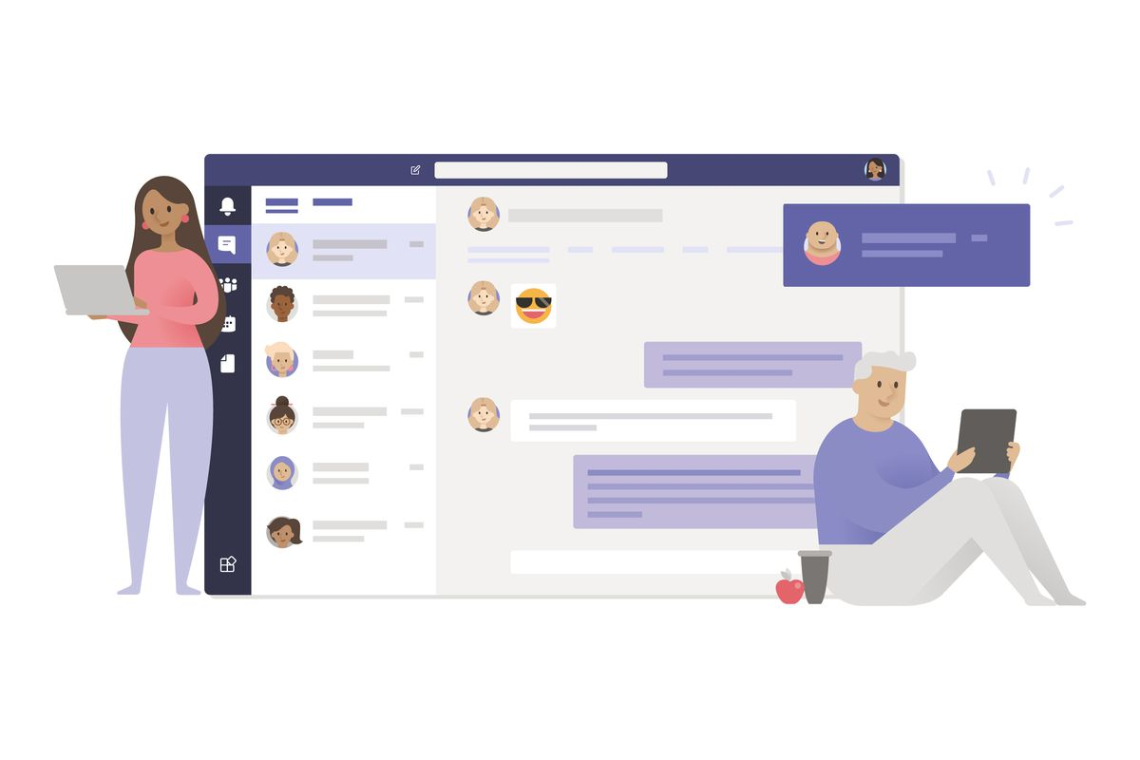
Appropriate Presentation and Delivery of Information to a Given Audience
Common methods of written communication used in business include:
Online digital applications - which have revolutionised communication in business as it’s extremely quick and efficient.
For example, many businesses now offer an online chat function for their customers which allows their customer service staff to have multiple conversations at once, whilst saving its customers the time and stress of a telephone call.
The use of online digital applications has increased for internal written communication, especially after the coronavirus pandemic, online digital applications such as Teams are now a staple part of a wide range of businesses approach to internal written communication.

Slide 104
Appropriate Presentation and Delivery of Information to a Given Audience
Activity 18: Written communication
You have been presented with several business scenarios in the table which can be found in your workbook.
Each scenario requires you to use written communication. Once you have selected the most appropriate method of written communication, you should justify the reasons for your choice in the final column.

Slide 105
Appropriate Presentation and Delivery of Information to a Given Audience
Another type of communication used in business is oral communication which includes any use of spoken words to exchange information or ideas between members of a business and its various stakeholders.
Essentially, oral communication is used in person on a face to face basis or electronically.
Oral communication is crucial in business and relies heavily on the speaking and listening skills of those involved to be effective.

Slide 106
Appropriate Presentation and Delivery of Information to a Given Audience
There are many advantages of using oral communication in business, these include:
The message is communicated instantly which allows the stakeholders involved to save time and action to be taken immediately after the communication has been made if necessary.
The message being communicated is often easier to gauge as the receiver can utilise additional information such as the tone of voice and body language etc. (if face to face) to judge the manner of the message being sent which reduces the likelihood of any misjudgements.
The majority of oral communication methods are often free, therefore extremely cost effective and at the same time very flexible as formalities are not required and any errors in communication can be rectified instantly.
However, it’s important to be aware of the potential disadvantages of oral communication, these include:
Unless formally recorded or notes taken during conversation, there is often no record of the communication which can lead to difficulties if related actions weren’t taken or related targets weren't achieved.
It is easy for the recipient to misinterpret the message being communicated and for inconsistencies in the message being communicated to occur if it is being communicated to more than one person.
Oral communication is often not taken as seriously as written communication which can lead to inaction by the recipient and cause the message to become meaningless.

Slide 107
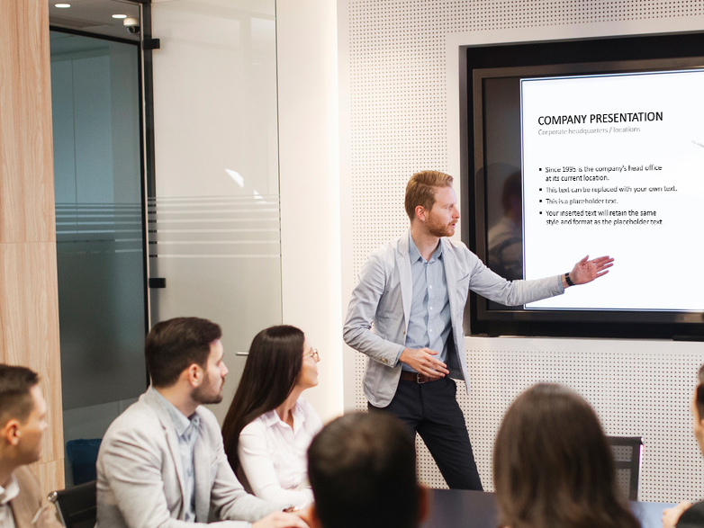
Appropriate Presentation and Delivery of Information to a Given Audience
Common methods of oral communication used in business include:
Presentations are often used in business to verbally deliver key information to both internal and external stakeholders of the business.
A well designed and delivered presentation can truly engage its audience and capture their attention.
For example, the managers of a business might present key information about the business’ performance to the employees they manage and set out clear goals for the future, this could be even be done on a weekly basis in some businesses and maybe yearly in others.
Alternatively, the owners of a business may be trying to raise capital to support growth in the business within which they are required to present key information about their business to potential investors.

Slide 108
Appropriate Presentation and Delivery of Information to a Given Audience
Common methods of oral communication used in business include:
Face to face communication is one of the most common forms of oral communication used.
In the majority of businesses people interact on a face to face basis whether this be for general conversation or about more serious issues.
Face to face communication is also very effective for building relationships in business and is often used between employees and with the business’ customers, especially in retail.

Slide 109
Appropriate Presentation and Delivery of Information to a Given Audience
Common methods of oral communication used in business include:
Phone calls are a very effective and efficient method of oral communication.
By utilising a mobile phone or landline, people in business can communicate with a wide range of stakeholders.
For example, a quick phone call to a supplier will often provide the business with an answer about a query much quicker than an email would.
Alternatively, by offering customers the opportunity to communicate directly via phone call, the business maybe able to answer queries, generate extra revenue, improve customer satisfaction levels and even handle after sales services efficiently without seeing the customer face to face etc.
However, it’s important that staff are trained and have the skillset to communicate orally via phone call as what is said and in what tone is really influential and the receiver can easily misjudge the conversation which isn’t typically formally recorded.

Slide 110
Appropriate Presentation and Delivery of Information to a Given Audience
Common methods of oral communication used in business include:
Online digital applications have been used in business for a number of years for video conferencing and making video calls.
However, the recent coronavirus pandemic has led to a vast increase in the use of online digital applications such as Teams and Zoom which have become a normal working practice in a very short space of time for the majority of businesses.
This is because people can effectively communicate verbally whilst visually seeing each other virtually without the need for travel or for face to face in person interaction.
These online digital applications have made business more accessible for the masses and were critical during lockdown when employees of many businesses had to work from home.
Providing a digital platform for business communications to continue in people’s homes, not only could the employees of a business communicate with each other, but these online digital applications also allowed employees to orally communicate with a wide range of external stakeholders when required.

Slide 111
Appropriate Presentation and Delivery of Information to a Given Audience
Common methods of oral communication used in business include:
Meetings – which provide a formal setting for people in business to communicate verbally and are often recorded via meeting minutes.
Meetings can be conducted face to face or via alternative methods such as online digital applications i.e. Teams or Zoom.
Meetings can also be utilised for a wide range of business scenarios and may involve a wide range of business stakeholders.
For example, a business may hold regular meetings between its employees to communicate key information etc.
Alternatively, meetings may be set up to verbally communicate with a wide range of external stakeholder such as customers, suppliers, or even the local council.

Slide 112
Appropriate Presentation and Delivery of Information to a Given Audience
Activity 19: Oral Communication Games.
Oral communication can be surprisingly difficult even though many people do it daily. To test your oral communication skills and ability to follow instructions which are communicated verbally, you will now play a series of oral communication games with your peers.
Once you have completed each game, in the box provided, explain how it went i.e. did you and your peers communicate effectively or not? and what have you learnt for future communication tasks from playing the game?

Slide 113
Appropriate Presentation and Delivery of Information to a Given Audience
Oral Communication Game 1: Communicate the Object
In teams of two or three, choose one person who will be the speaker for your group.
Your teacher will then provide the speaker with a piece of paper which has an object written on.
The team’s speaker is required to describe this object to the other members of their team.
However, you only have 30 seconds to communicate key features of the object to provide your teammates with clues.
Importantly, team members only have 1 attempt at correctly guessing the object which is being communicated.

Slide 114
Appropriate Presentation and Delivery of Information to a Given Audience
Oral Communication Game 2: Draw it Blindly
In teams of two or three, choose one person who will be the dedicated artist for your team.
Your teacher will then provide the other team members with a piece of paper which has a series of shapes on it (do not share this with the dedicated artist).
The dedicated artist needs to sit with a blank piece of paper and a pen with their back to the other members of their team.
The other members of the team now have two minutes to verbally communicate what is on the piece of paper as they see fit and the dedicated artist must draw it.
You should then compare the original series of shapes to the one drawn by the teams dedicated artist.
Vote as a class to agree which team wins this round.

Slide 115
Appropriate Presentation and Delivery of Information to a Given Audience
Oral Communication Game 3: Pass the Message on
As a class, you need to split into two groups and each group needs to form a circle.
Your teacher will pass a piece of paper which has one short sentence written on it to the first person in each group.
This short sentence will then be whispered into the ear of each student in turn until it reaches the last person in the circle who will say the sentence out loud and it will be compared to the original sentence written on the piece of paper.

Slide 116
Importance of Communication to aid Business Success
In today’s business world, social media and virtual communities have become extremely important methods of communication.
Virtual communities are often referred to as online communities and they are made up of people who collaborate virtually over the internet due to a shared interest, ideas, or motivations.
Virtual communities are hosted by a ‘creator’ which could be the business itself which has created the virtual community to support its members to collaborate and build meaningful relationships with one another.
Social media is often used as a gateway for virtual communities such as the ‘Facebook Groups’ function which is a very effective platform to grow a virtual community without the barriers that typically prevent people collaborating in the real world such as geographical and political boundaries etc. with a staggering 1.8 billion people currently using Facebook Groups each month.

Slide 117
Importance of Communication to aid Business Success
Social media is the collective term used to define the computer based technology which allows users to create and share content or to participate in social networking (Oxford Languages, 2021).
It doesn’t matter if it’s a small high street shop or large nationwide retailer, having a social media presence has become an expectation for most stakeholders of a given business.
Without a strong social media presence, trust maybe lost between the business and its stakeholders, especially for customers.
Having a strong social media presence allows businesses to connect and communicate effectively with its target audience, which in turn supports the business to boost brand awareness, resulting in increased leads and sales.
Currently, there are more than 3 billion people around the world using social media which is set to increase over time, if a business is able to use platforms such as Instagram, Twitter, and Facebook etc. to communicate with its target audience it can truly support its success.

Slide 118
Importance of Communication to aid Business Success
Communicating with a business via social media is now standard practice and an expected behaviour for many consumers and customers. For example, if a potential customer has a query about a business’ product or service, it is common for their first action to be contacting the business via social media.
Therefore, it is very important that the business has knowledgeable people who are available to respond to any queries as soon as possible (within the day ideally).
If a business doesn’t take its customer service through social media seriously e.g. it takes a week to respond to messages, the customer may feel like they have been ignored and not valued by the business.
This may result in the customer having already taken their custom to a competitor by the time a response has been sent by the business.

Slide 119
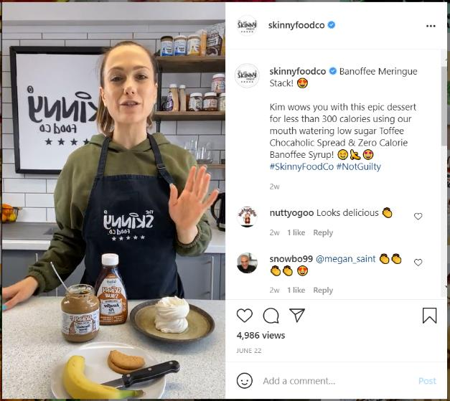
Importance of Communication to aid Business Success
A great example of a business who uses social media to communicate effectively with its target audience is ‘The Skinny Food Co.’ they post content related to their target audiences interests consistently and use the stories function on Instagram very effectively to communicate and answer questions from their followers.
This has led to the brand having over 355k followers on Instagram alone and supported the business to grow into a very well known established brand since it launched in 2018.

Slide 120
Importance of Communication to aid Business Success
Activity 20: Social Media and Virtual Communities.
Select a business and analyse its use of social media and virtual communities to communicate with its target audience and aid business success.
You should identify as many examples as possible for your chosen business and analyse how effective you believe each one is, making justified recommendations where possible.

Slide 121
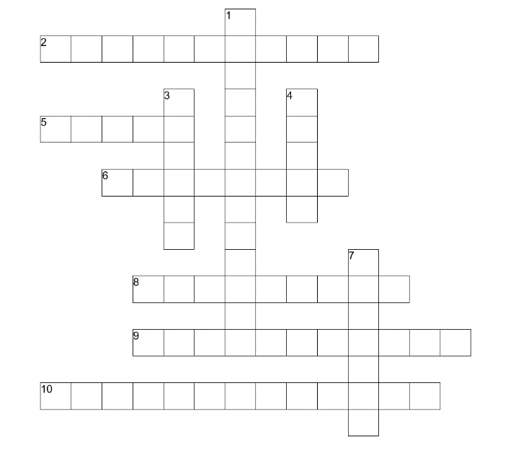
Activity 21: Learning Aim A Crossword
You have 10 questions in your workbook focused on key terminology from Learning Aim A. See if you can use your knowledge to figure out the answers and complete the crossword in your workbook.

Slide 122
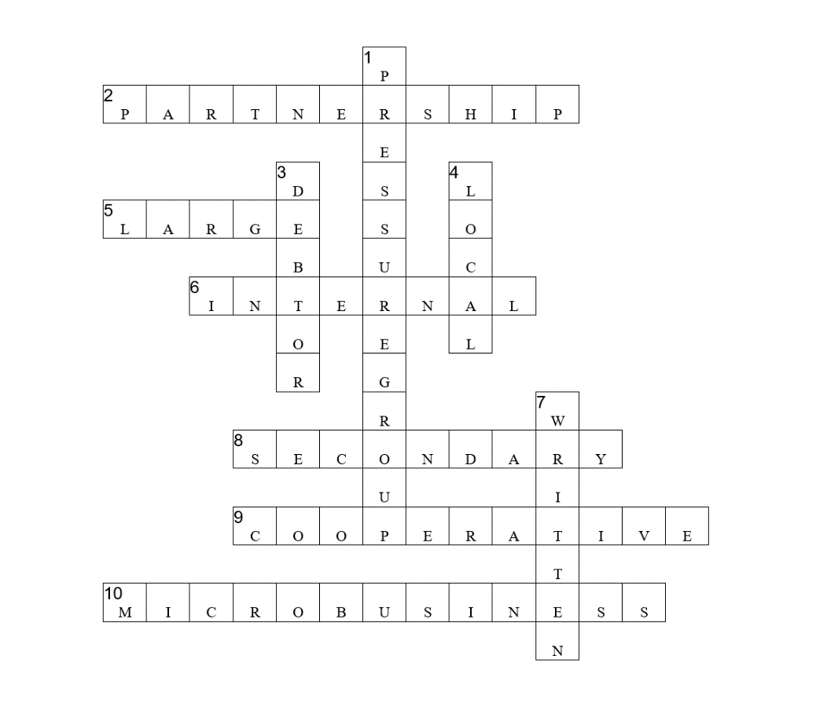
Activity 21: Learning Aim A Crossword Answers

Slide 123
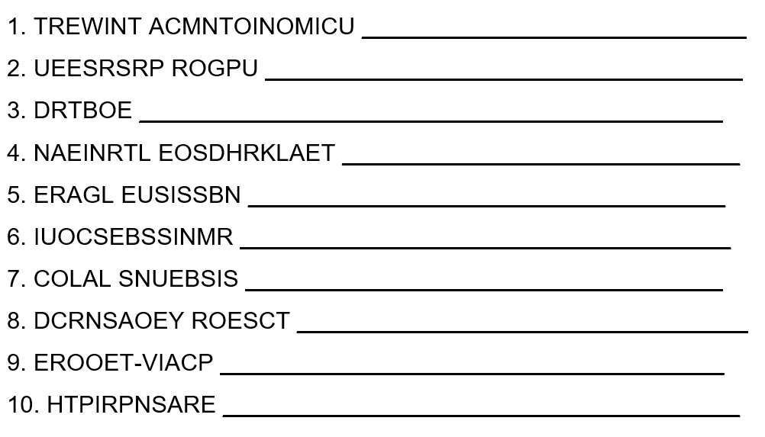
Activity 22: Learning Aim A Word Scramble
Below are 10 key words from Learning Aim A which have been scrambled. See if you can figure out the key words in your workbook.

Slide 124
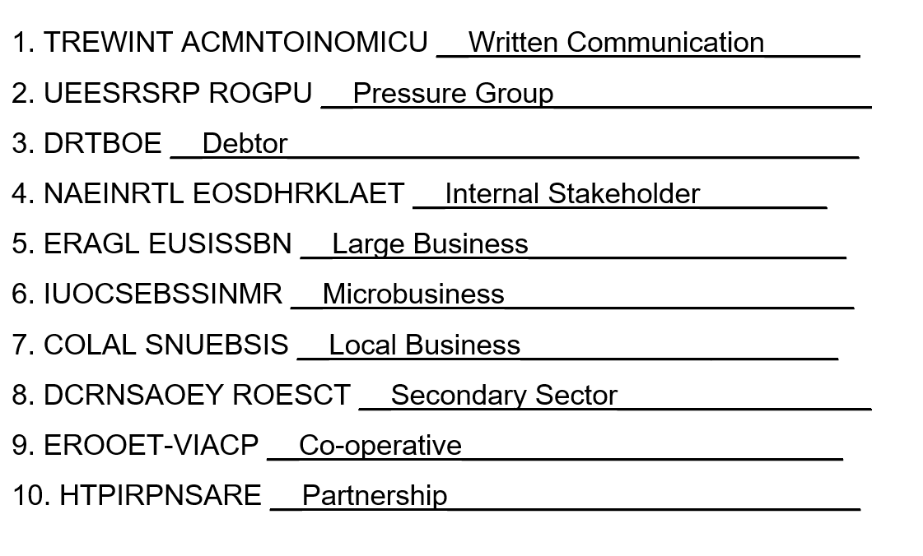
Activity 22: Learning Aim A Word Scramble Answers

Slide 125
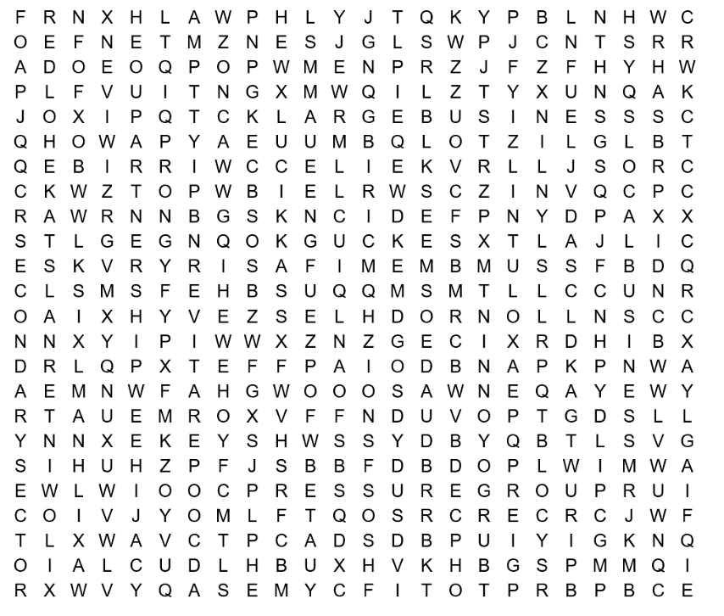
Activity 23: Learning Aim A Word Search
Below is a wordsearch which contains 10 key pieces of terminology from Learning Aim A. See if you can find all 10 listed in your workbook.

Slide 126
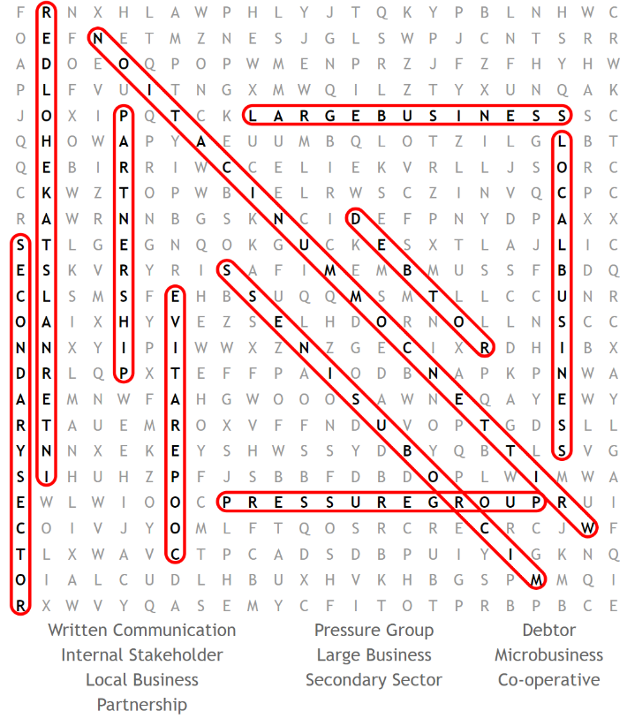
Activity 23: Learning Aim A Word Search Answers

Slide 127
Activity 24: Kahoot Quiz Learning Aim A
Notes:
https://create.kahoot.it/share/btec-business-unit-1-exploring-business-learning-aim-a-quiz/89be51cd-c681-4a15-8d30-e4c2e561b96a

Slide 128
Activity 25: Specification Checklist
Now you have completed the input and the set activities for Learning Aim A, you have one final task which is to complete the specification checklist in your workbook.
First, you should explain the terminology and topic areas in the space provided.
Then tick the box in the last column when you feel assessment ready with regards to that specific element of the specification.

