Slide 1
L0: COM 1 SEC A
Introducing the Media Studies Framework
LO: to begin to develop understanding of the Media Studies Framework

Slide 2
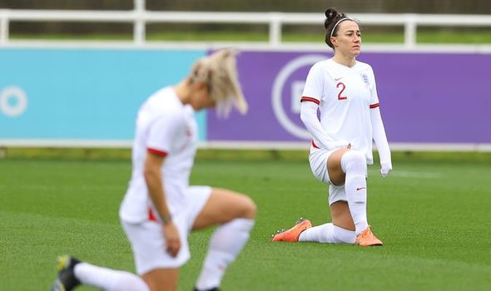
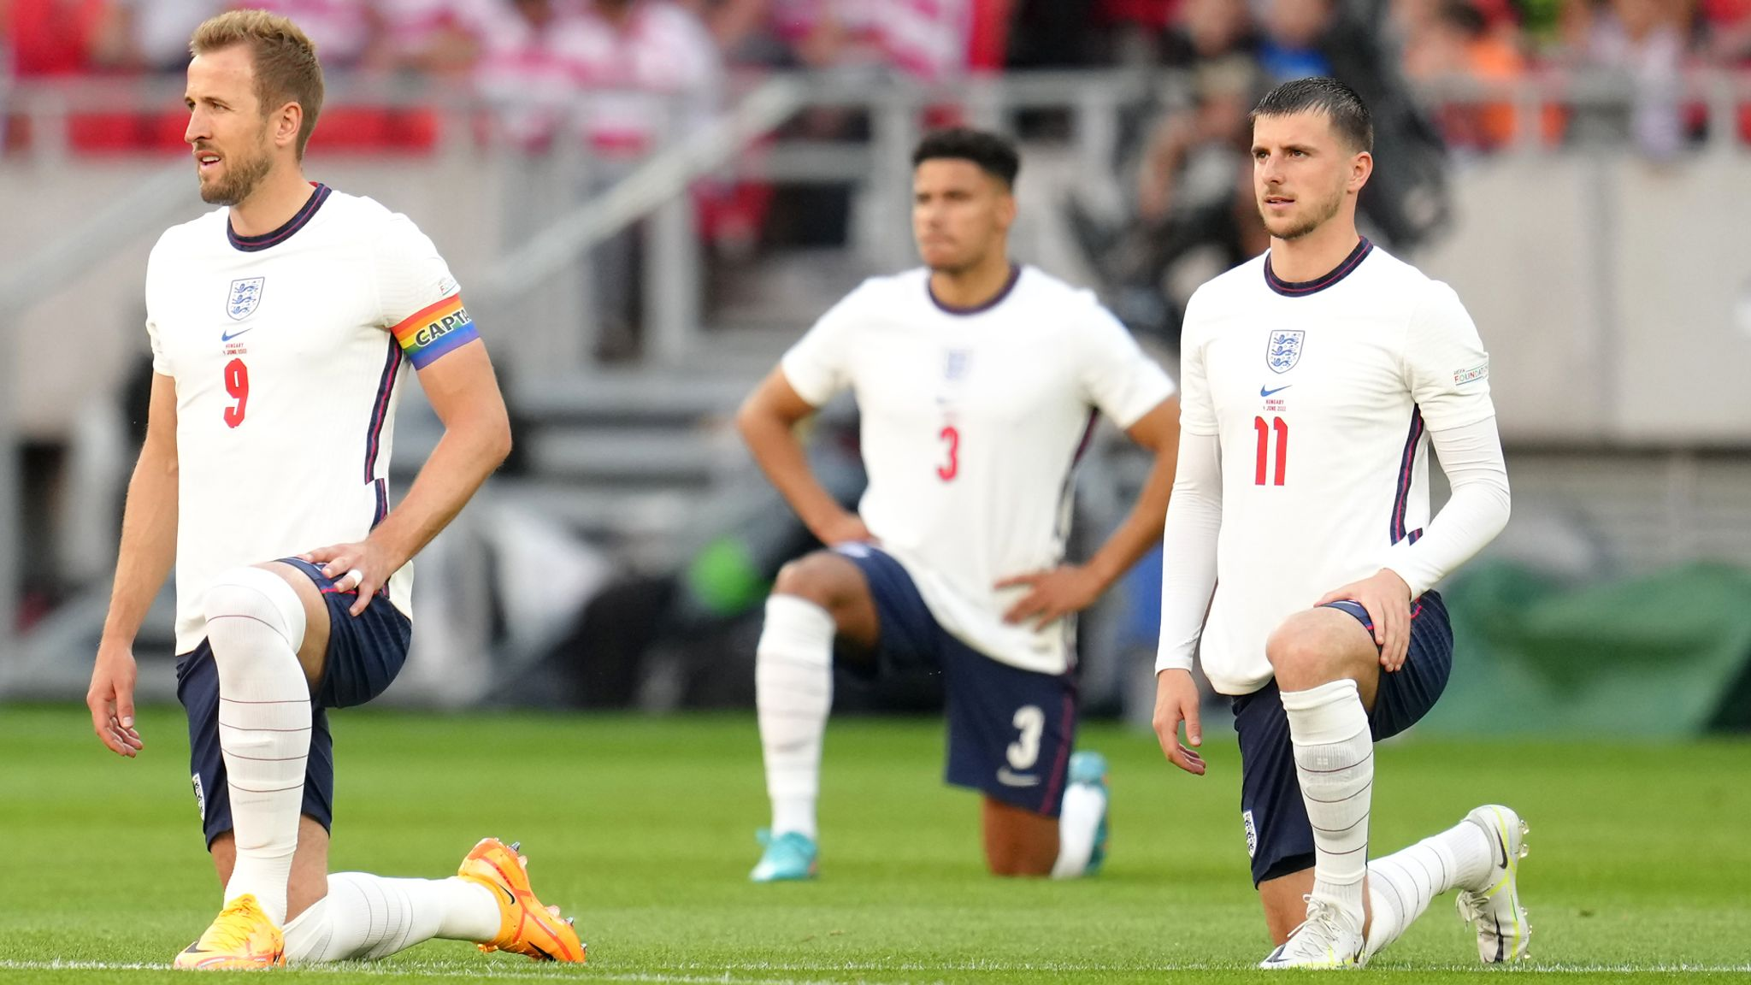
What is happening here?

Slide 3
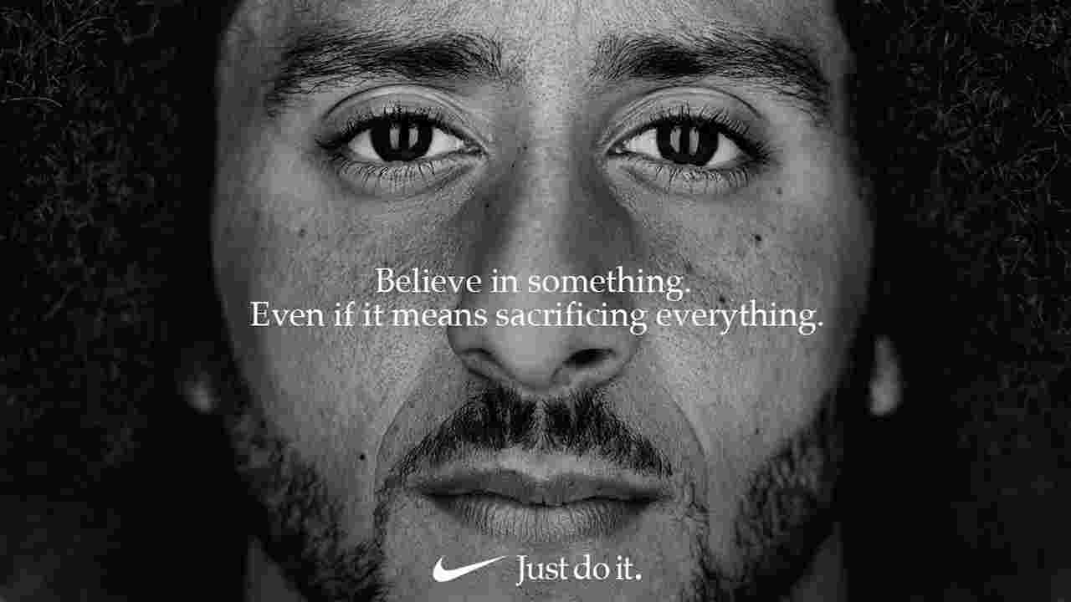
What do you already know about this advert (released Sept 3rd 2018)? What guesses can you make about it?

Slide 4
Today
We will use one advert to trace the complex interweaving of:
These are the four key areas of media studies A-level. Together they are known as THE MEDIA FRAMEWORK.
LANGUAGE
REPRESENTATION
AUDIENCE
INDUSTRY

Slide 5
This year, I will teach the bulk of the syllabus. On Thursday, you will have Miss Cheng. She will begin with theoretical approaches and then she will focus on revision lessons, consolidating and applying the learning you have done so far.
On Friday, you will receive a Media Handbook
A note about folders and organisation
This lesson will be an introduction for the MEDIA FRAMEWORK, using one advert as a case study
Take great notes!

Slide 6
MEDIA LANGUAGE Media language is the language in which media products communicate through their forms, codes and conventions and techniques. It includes colour choices, design choices, symbolic codes of clothing, gesture etc.
LANGUAGE
REPRESENTATION
AUDIENCE
INDUSTRY

Slide 7
REPRESENTATION How does the media production represent people, places, social groups and events? Does it leave certain people or places out? If so, what is the effect of that?
https://www.youtube.com/watch?v=mreQsQrDF-A
How is media language used to help create some of these representations? (Zoom in on the young wrestler)
LANGUAGE
REPRESENTATION
AUDIENCE
INDUSTRY

Slide 8
CONTEXT
2018, America
Colin Kaepernick
https://www.youtube.com/watch?v=rwlopXMTzS4
Black Lives Matter
Nike
American Politics

Slide 9
INDUSTRY AND AUDIENCE
https://www.youtube.com/watch?v=fini0Y5VwxE
LANGUAGE
REPRESENTATION
AUDIENCE
INDUSTRY

Slide 10
Do you think the gamble paid off for Nike?
Despite the backlash in the wake of Nike’s endorsement deal with Colin Kaepernick, the sportswear company has reported a 31% increase in sales.
Nike sales grew 31% from Sunday through Tuesday over the Labor Day holiday that year compared with the previous year, according to Edison Trends. (Published Saturday 8th Sept)

Slide 11
Task
Go back to the original print advert. Now that you know the whole story, make more notes around it. Try to include ideas about:
Context
More media Language
Audience
Industry
Audience
If time, visit other people’s work and get more ideas to add to your own.

Slide 12
Final thoughts:
Without looking, can you remember the four areas of the media framework?
How does this one media event link with the world we live in today, five years later?
Homework:
read the ‘model’ answer for an essay question based on this advert.
go online and see if you can find five examples of media texts that could be considered ‘seminal’. Put an image of the text into a word doc and explain underneath why you have chosen it – what is the significance of the text?
Source a ring binder folder and begin to file things away. On Friday, when I give out the handbook, we will spend some time organising

