Slide 1
Introducing the Media Studies Framework
L11: COM 1 SEC A
LO: To apply THEORIES to ‘Turntables’ by Janelle Monae and practise quick note-taking for Q1

Slide 2
Admin
Don’t forget homework for next Tuesday: create a FFF for ‘Turntables’.

Slide 3
Starter: what do you remember?
Name the four areas of the media framework.
Which of those are tested in COM 1 Section A?
What is NON-DIAGETIC SOUND?
What is the difference between an ICON, an INDEX and a SYMBOL?
How many questions will you have in your COM 1 SEC A exam?
What SET TEXTS have we studied already in COM 1 SEC A?

Slide 4
1 : Name the four areas of the media framework.
Media Language
Media Representation
Media Audiences
Media Industries
BONUS: What is the FIFTH AREA that links to everything? (Begins with ‘C’)

Slide 5
2: Which of those are tested in COM 1 Section A?
Media Language
Media Representation

Slide 6
3: What is NON-DIAGETIC SOUND?
Non-diegetic sound - Sound that comes from outside the fictional world, for example a voiceover, romantic mood music etc.

Slide 7
4: What is the difference between an ICON, an INDEX and a SYMBOL?
Icon: a sign that resembles the thing or idea being represented or signified
Index: a sign that has a link with the thing being represented or signified
Symbol: a sign that has no obvious connection with the signified

Slide 8
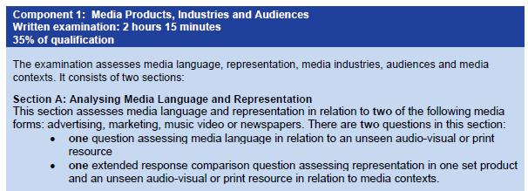
5: How many questions will you have in your COM 1 SEC A exam?
So, TWO questions.
One will be shorter, on an unseen text (audio-visual or print). 15 marks
One will be a longer, comparative question. You will compare one of the set texts (products) to an unseen resource (audio-visual or print) 30 marks

Slide 9
6: What SET TEXTS have we studied already in COM 1 SEC A?
Tide print advert
Super. Human. Audio-visual advert
Janelle Monae: Turntables music video
Still to go:
Sam Fender, Seventeen Going Under (music video)
The Mirror front page and article (newspaper)
The Times front page from the same day (newspaper)

Slide 10
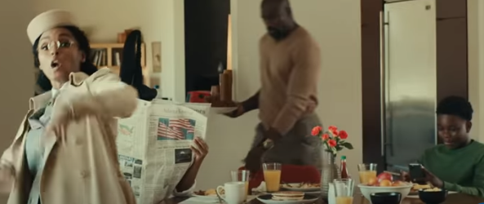
Theory application – what does it look like?

Slide 11
Imagine you have been asked to answer this question in an exam:
How do visual elements create meaning in this music video? [15 marks – 20 (24) mins]
Brainstorm for this frame:
Codes of clothing? Codes of colour?
Symbols – hair = power, honouring roots, wholesome foods, flowers = care, hope, growth
Mise en scene – domestic, family, relatable
Theory – bell hooks – Monae’s active use of platform to challenge gender norms through visual codes
Gilroy – challenges post-colonial representations of blackness by making it relatable through the mise-en-scene etc. Undoes the binary opposition of ‘them’ and ‘us’. Also, powerful through symbolic use of hair, gender subversion etc.
A ‘galaxy of signifiers’. So much to say! So little time! – what advice could you give yourself to ensure you manage your time well for this question?

Slide 12
Writing it down
At about 1 minute in the audience see a domestic scene in which the visual elements combine to create a relatable yet powerful portrayal of a black family. Monae uses her platform as a music artist to challenge gender stereotypes: the father is putting the food on the table having cooked it in a previous shot and this symbolic reversal suggests that Monae is an activist when it comes to feminism, which according to bell hooks is a more authentic form of feminism.
Monae is also exploring intersectionality as the family is black. The mother has a very striking hairstyle, symbolising pride and the importance of black hair: the portrayals of both gender and ethnicity intersect here in a way that is both powerful and positive with this particular visual code. bell hooks asserts that race and class as well as sex determine the extent to which individuals are exploited, and Monae explores this through the representation of this family.
Notes:
Not enough terminology, doesn’t really answer question in a focused enough way. Too much theory, not enough analysis.

Slide 13
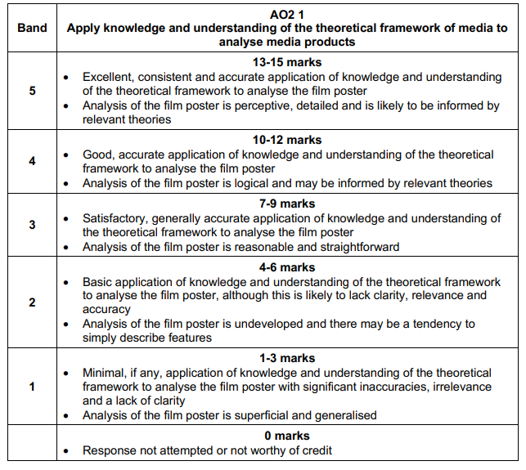

Slide 14
How is this possible if it’s an unseen text?
Writing a response under calm, prepared conditions is one thing.
Doing it under exam conditions with a text you have never seen requires practice!
The following slides suggest methods that might work for you. Tweak to suit your style of writing.
Note: the exam board are very clear that PLANNING is a key element of success when writing a response.

Slide 15
Printed texts: a suggested method
Step 1 – circle all the important signifiers (elements that create meaning). Briefly note what meaning they create
Step 2 – link related ideas together. So, if you have circled the pink dress and the black cloak, these are both ‘codes of clothing’ and ‘codes of colour’. You will start to see what you can write the most about.
Step 3 – choose three linked ideas to write about e.g: codes of clothing, codes of colour, mise-en-scene. These are now your three paragraphs.
Step 4 – start writing, using the three linked ideas to create your opening sentence for each paragraph. E.G ‘One way that meaning is created in the KOTV poster is through the use of codes of clothing. For example…(describe in detail, using adjectives for precision). This connotes…Another example is…’
Step 5 – keep an eye on time. Remember to use terminology and theory (if appropriate). Words like ‘signifier’ and ‘connote’ are very useful, alongside tentative language (this might suggest…this could connote…it could be argued that…). If you feel like you aren’t writing enough, find another signifier in the text to write about. There’s plenty of them.

Slide 16
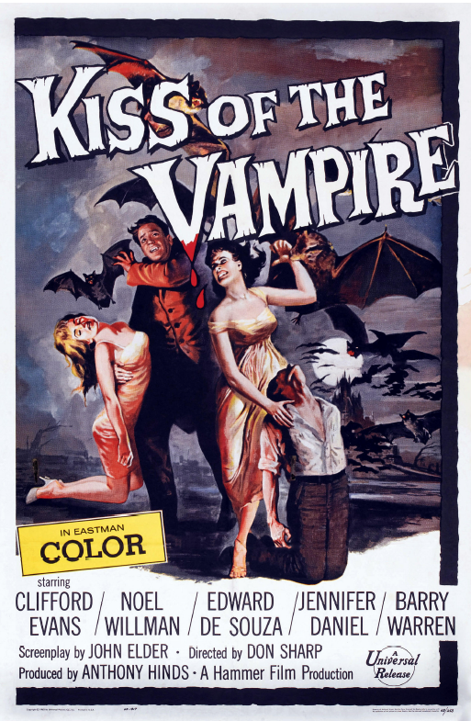
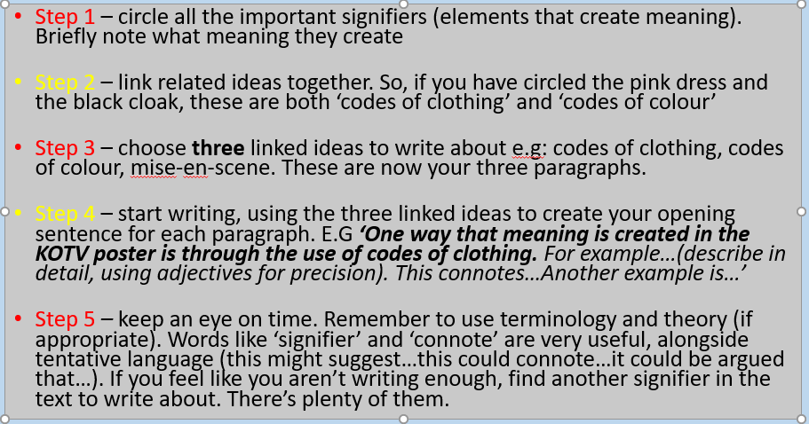

Slide 17
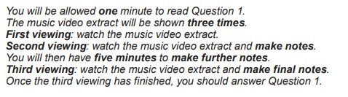
Audio-visual texts are harder as you don’t have the text in front of you for the whole time. Here is what the exam will say:
Notice the word ‘extract’. It might be the whole video, it might be an extract. We will practise using whole videos and then extracts will seem very easy…
What is the best way to use the first minute where you are reading the question?
What is the best way to use the first viewing?
What is the best way to use the second viewing and the next five minutes?
What is the best way to use the third viewing?
Notes:
Think about the requirements of the question. Jot down ideas of the types of things you might want to look for – perhaps even create a note-taking chart before you see the video – has to be flexible. Decide how many examples you are going to need to have enough material for an 18 minute question. It’s only going to be 2 – 3 paragraphs.

Slide 18
Audio-visual texts: a suggested method
Read question and create a note-taking chart that focuses on the demands of the question. Make sure the chart has ample space so you can include things you might not have anticipated. Remind yourself of ‘allowed’ theories for this type of text. Write them down
Watch video, absorb the narrative, have clever thoughts about the best bits to write about and why (no pens)
Watch video again trying to pick out 3 key moments that will help with answering the question. Have pen in hand and note chart ready
In the five minutes after the video, write about the 3 key moments, trying to rough out some paragraphs, thinking about theory that might be appropriate
In the third watch, check your ideas work, jot down any final thoughts that might be useful to you

Slide 19
Sam Fender - Seventeen Going Under (Official Video) - YouTube
Question 1 is based on the unseen audio-visual resource Sam Fender’s 17 Going Under music video.
How do visual elements create meaning in this music video? [15 marks – 20 (24) mins]

