Slide 1
Introducing the Media Studies Framework
L13: COM 1 SEC A
LO: To explore David Gauntlett’s theory of IDENTITY

Slide 2
Admin
Hand in Sam Fender homework please – I have madly ambitious plans to get this back to you next week via Mrs. Atkins. I’m not entirely sure when this epic marking event will happen, given that I am visiting many relatives this weekend, so expect teacher failure
Next term I plan to start giving you marks for all your longer pieces as you are now at the stage where this is unlikely to crush your hopes and dreams; instead I’m hoping you will be spurred on to make small accretional gains in a methodical and resilient fashion
Holiday work – during assessment week next term (3 weeks in I think), you will do a complete COM 1 paper across the lessons. Use the holidays to review your notes for both SEC A and SEC B and fill in any gaps. For example, you might not have completed the Five Frames From for all of the audio-visual texts. Check you have all the fact sheets. Re-test yourself using the kahoot quiz and use this quiz as a model to create new quizzes for yourself. Revise imaginatively

Slide 3
Revision ideas
Re-write notes using the Cornell system (do not just copy out but prettier – this is a complete waste of your brain power)
Create quizzes for all of the texts. This forces revision
Apply the theories to random media texts. Practise the ‘game’ of analysis.
Buddy up. Test your friend. Do they really know what they claim to know? What are they avoiding?
Write down your worst nightmare question. Revise this area first
Look back over all homeworks and remind yourself of the feedback and your targets. Plan what reminders you will write at the top of your assessment paper (e.g. ‘DON’T FORGET TERMINOLOGY!!!’)
Google great revision techniques. Do some of them
Go back over the ppts. They are all lined up beautifully on my google classroom. Use today’s lesson to join up: part of this lesson requires you to do so

Slide 4
Quick WCF from last week
Look at individual meanings for each element, but also think about how these elements combine (well done to those of you who you used this exact phrase)
Some language that might help:
This feature reinforces the earlier message of…
This signifier supports the overall tone of…
When combined with the codes of clothing previously discussed, the codes of colour compound the theme of…

Slide 5
Here’s the theory
Mrs Fisher's guide to Gauntlett

Slide 6
Today:
You will research this theory by applying it to yourself.

Slide 7
Your task: choose three media texts that you have chosen to be a regular audience for. Make connections between them and your own identity. Present your findings in a powerpoint. Explore the dangers of your media consumption as well: what are you missing?
Here’s mine
Short form media ‘choices’: Tova Leigh, Brad Mondo, Freeda En, Howard Lee, Daniel LaBelle, The Independent, England Football Team, Dr. Karan, Jonathan Pie, Shannypants
The Guardian
Private Eye

Slide 8
Dangers: echo chambers, filter bubbles, cognitive bias
Cognitive bias - why our brains love fake news
We often choose media that bolsters our identity and values and doesn’t challenge our ideology and world view in any way. Questioning and testing your own beliefs is crucial.

Slide 9
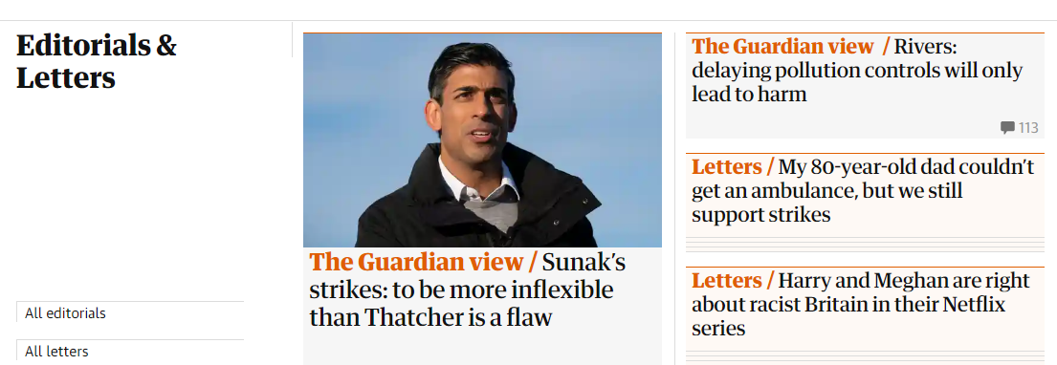

Slide 10
When you are finished, post your powerpoint to the assignment in the Google classroom
Once you have done that, you can start the revision homework

Slide 11
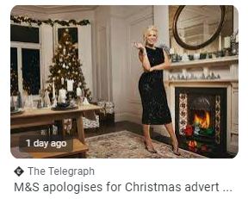
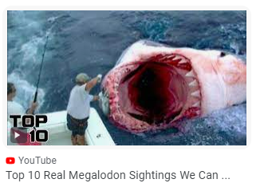
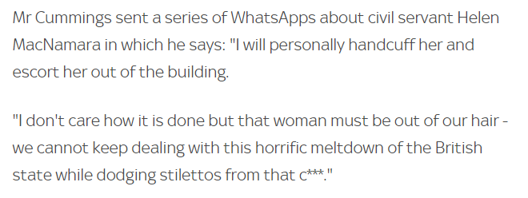
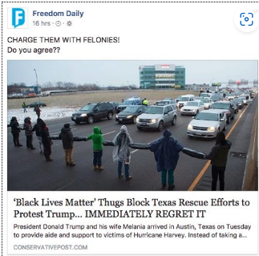
Real or Fake?
This shows a headline from the Telegraph. It relates to a story that M&S supported Palestinian Genocide in their latest Christmas advert
This shows a headline from ‘Conservative Post’. It relates to a story that BLM protesters blocked the road, stopping rescue workers from getting through during a serious hurricane.
Did a serving government minister really say this???

