Slide 1
Working with the media studies framework
L16: COM 1 SEC A
LO: To explore the way media language incorporates viewpoints and ideologies in newspapers

Slide 2
TODAY
LO: To explore the way media language incorporates viewpoints and ideologies in newspapers

Slide 3
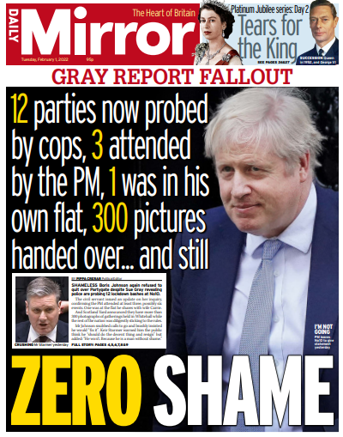
TASK: key vocabulary for newspapers
Masthead
Slogan
Headline
Strapline
Plug
Sub-headings
Caption
Anchoring
Editorial
Double Page Spread
Redtop – what this is!
Pullquote
Tabloid – what this is!
Standfirst
Double page spread
Red top
Tabloid
Pull quote
Standfirst
TASK: on the set texts, find and label as many of the technical terms as possible. Research the terms on your phones if you don’t know them. This work will form the reference sheet for this vocabulary, so don’t miss any of them out.

Slide 4
TASK: key vocabulary for newspapers
What is Anchorage?
Where the meaning of a media text is fixed or stabilised by a caption, shot type, costume or so on
Often, the elements of a media product, for example pictures in a newspaper, a camera angle in a TV programme, or a setting in a videogame tell us very little. Without the producer anchoring the image into a particular ideology, an audience could interpret a text in any way they choose.
However, producers often have a point of view that they wish to disseminate to the audience, so they choose to fix a particular meaning. The most pertinent example of anchorage is where meaning is anchored by newspaper captions.

Slide 5
TASK: key vocabulary for newspapers
What is a plug/puff? This is where a magazine puts an advert for a giveaway or competition so to grab the attention of the reader.
What is a standfirst?
A standfirst often summarises the article that follows, usually appearing soon after the main title or headline, with a font size that falls in-between that of the title and the main feature’s text.
What is a tabloid? – it’s a newspaper that is traditionally smaller, and focuses on gossipy, sensational reporting. More focused on celebrity and more pictures. ‘The redtops’ are a collection of tabloids characterized by their red mastheads.

Slide 6
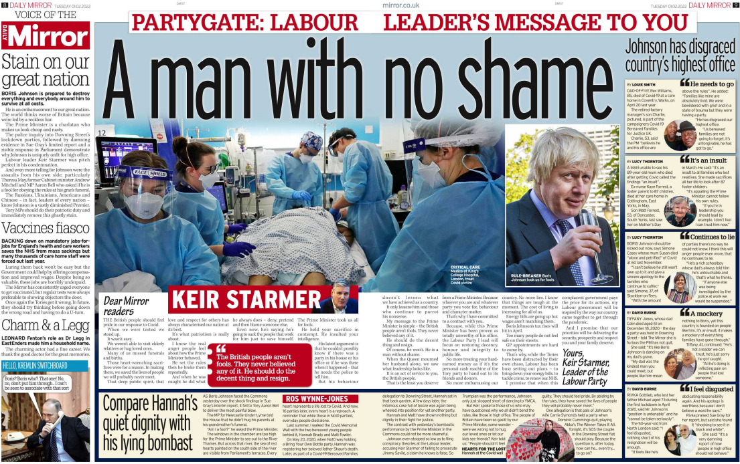
Editorial
Anchoring strapline
Standfirst
Double Page Spread
Pull quote

Slide 7
Key words
Media language - The specific elements of a media product that communicate meanings to audiences, e.g. visual codes, audio codes, technical codes, linguistic codes
Viewpoints – points of view
Ideology – a set of messages, values and beliefs that may be encoded into media products.
Anchorage - The words that accompany an image (still or moving) contribute to the meaning associated with that image. If the caption or voice-over is changed then so may the way in which the audience interprets the image. An image with an anchor is a closed text; the audience are given a preferred reading.

Slide 8
To find out a media producer’s ‘ideology’ it can be worth looking for a mission statement, or a statement of values. Go to the website…
‘Politically the Mirror sits left of centre. It has backed the Labour Party in every election since 1945.’
‘Our mission is to make sense of a rapidly changing world for our readers. To challenge wrongs where we see them. To stand up for the underdog against authority. And to entertain.’

Slide 10
Admin
Welcome to Tapiwa!
Tips for catching up?
Homework

Slide 11
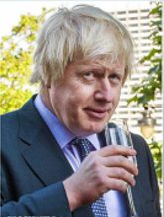
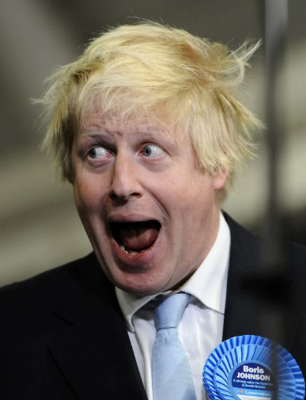
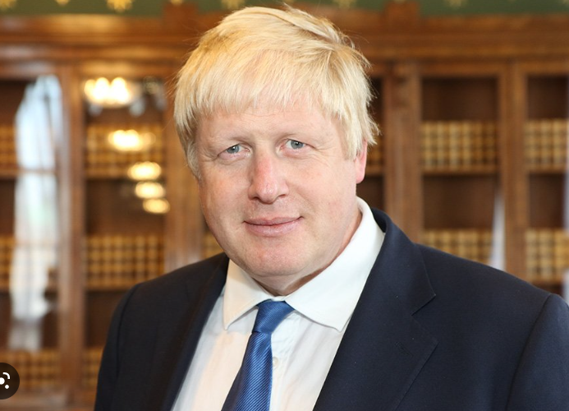
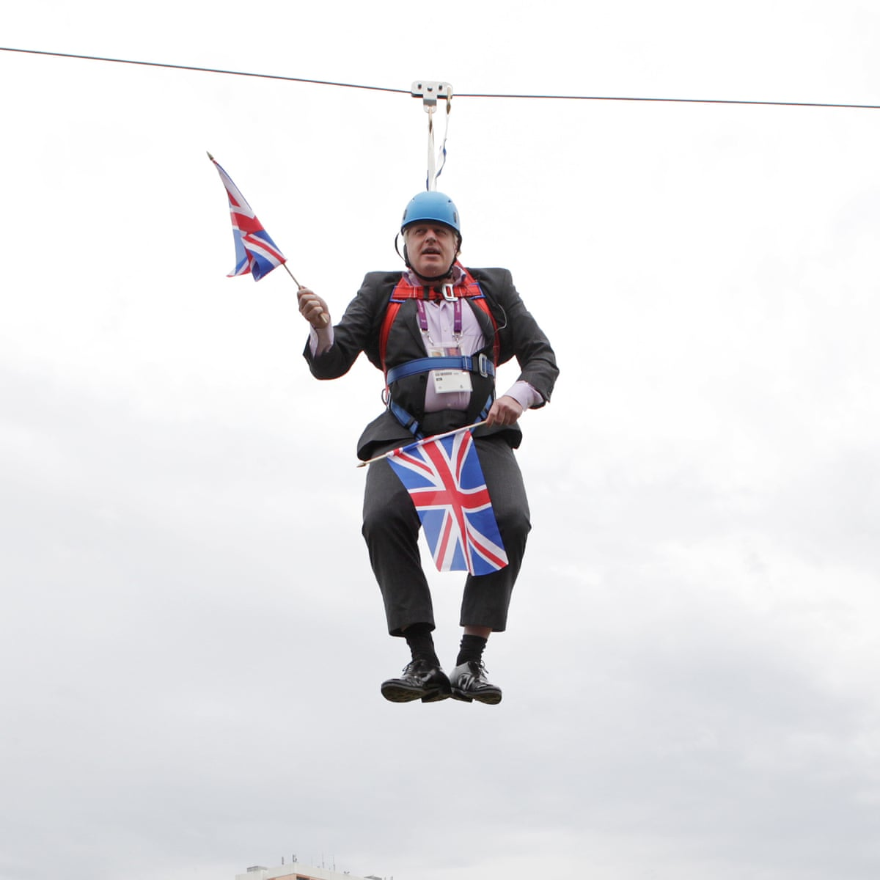
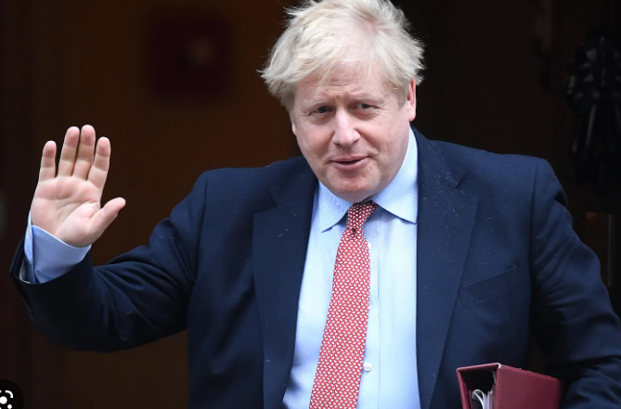
Media language: images
Statesman-like
Idiotic
Intellectual
Profligate
Hedonistic
Risible
Affable
Competent

Slide 12
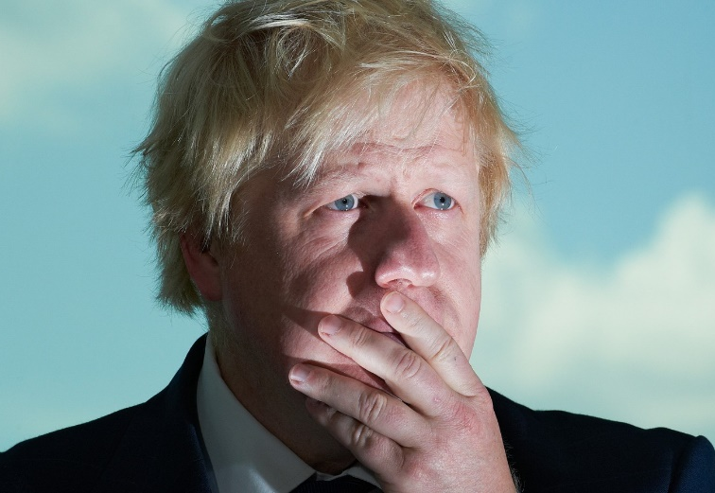
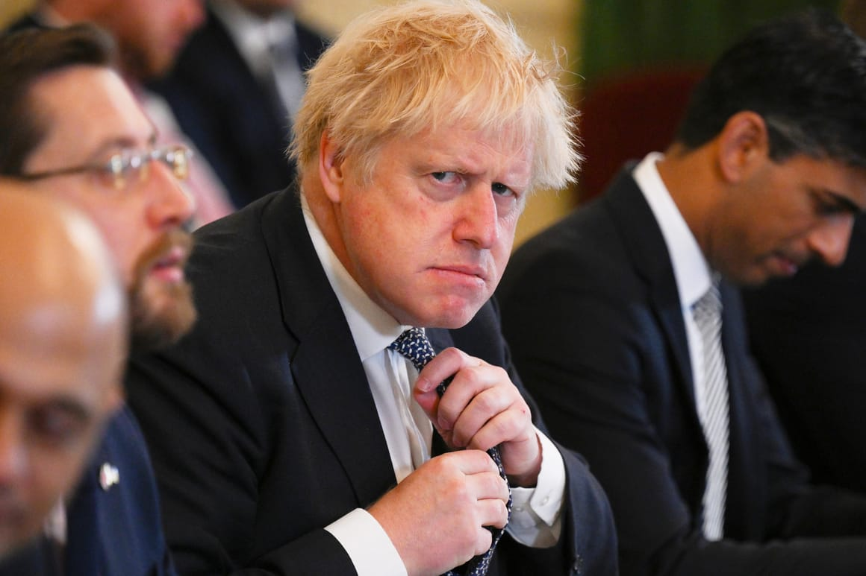
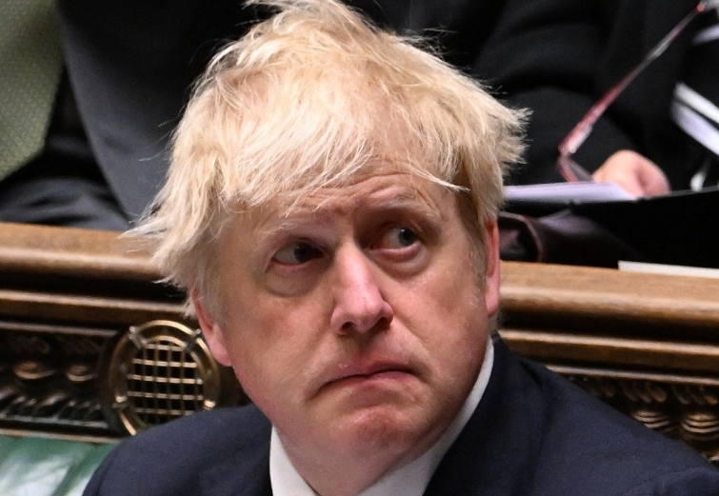
Media language: anchorage
‘What is the point of Boris Johnson?’ The Atlantic
‘Boris Johnson: the billionaires useful idiot’ Middle East Eye
‘Sorry is the hardest word for Boris Johnson’ POLITICO

Slide 13
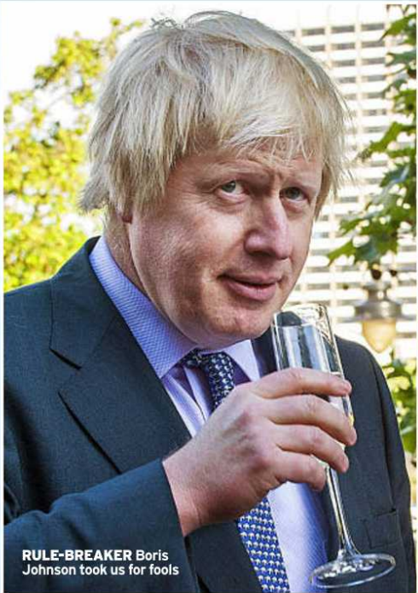
Captions as anchorage

Slide 14
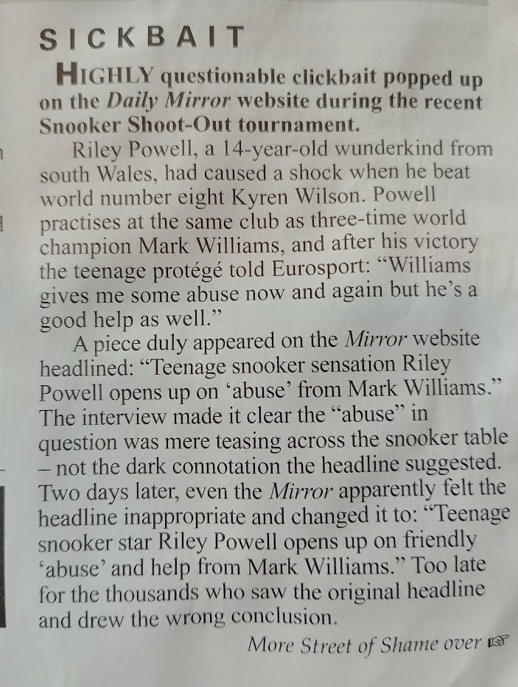
Media language: linguistic codes When anchorage goes wrong…
Newspaper headlines are a rich source of encoded ideology, often using playful puns and sensational, emotive language to point the reader towards a particular opinion. Online news is often funded by advertising and clicks on headlines increase the exposure of advertising. Therefore, the more the headline encourages readers to click on it, the more revenue the publication will receive. This has given rise to ‘clickbait’ – headlines that are designed to draw you in with their promise of sensational news.

Slide 15
Headlines from the day Boris Johnson resigned – can you put them on the left wing/right wing spectrum?
It’s (almost) over
Johnson quits, defiant to the end
Clinging on for one last party
Johnson throws in towel
PM’s long goodbye leaves UK ‘in state of paralysis’
What the hell have they done?
Thank you Boris…you gave Britain back its freedom
KISS GOODBYE…and thanks for Brexit, Boris
Worst PM ever

Slide 16
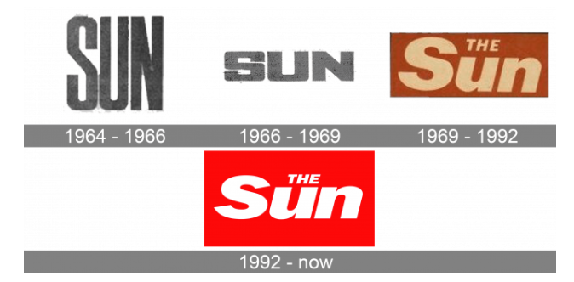
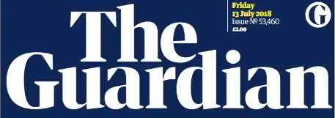
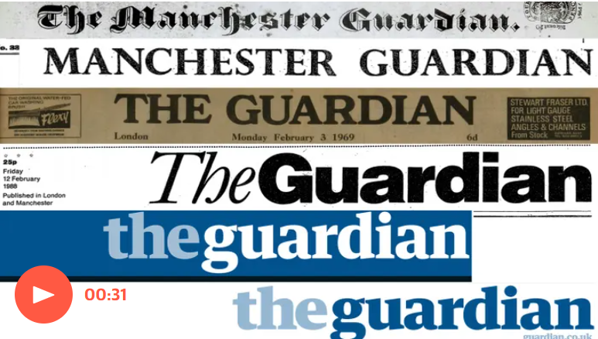
Media language and mastheads

Slide 17
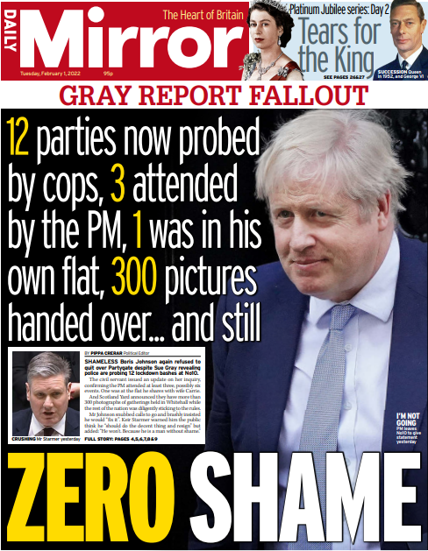
Task: answer the following
How does the media language on the front page of the Mirror reflect the viewpoints and ideologies of the newspaper?
Use What, how, why

Slide 18
How does the media language on the front page of the Mirror reflect the viewpoints and ideologies of the newspaper?
Use What, how, why for each paragraph
What:
One way that media language reflects the left-wing ideology of The Mirror is through the choice of linguistic codes.
How:
(find clear examples)
Why:
Explain why the examples you have picked have been included. What are their function and purpose? How do they link to the paper’s ideology?

