Slide 1
Working with the media studies framework
L16: COM 1 SEC A
LO: To explore the way media language incorporates viewpoints and ideologies in newspapers

Slide 2
Admin
Half term homework (due next week) – any questions?
Exam returns – let me know if there are any mistakes
Message from Mrs. Atkins: I did set Q3 and Q4 before half term; I’ve re-posted it on Satchel. Please can you complete before tomorrow but only spend 30 mins (plus extra time for those who need it).

Slide 3
Homework: listen/watch and take notes that might be relevant
Word of Mouth: The Language of Advertising (radio: 27 mins). You will learn a lot of technical language here – perhaps keep a list of useful vocabulary.
The Media Show: reporting on Andrew Tate - the ethics behind the news (radio: 30 mins). This show examines the tricky ethics behind reporting on an influencer such as Tate: how much air space should he have?
OPTIONAL
BBC iPlayer - Fight the Power: How Hip Hop Changed the World - Series 1: 1. The Foundation (1 hour). This is episode 1. An in-depth look at a key cultural moment in music. Ties in with our set texts and provides useful context and food for thought. Does contain strong language.

Slide 4
Feedback from exam
The big one – it was really obvious who had revised. All of you should have been able to write some good things about ‘Turntables’. This was patchy. It was clear who had done revision on this.
Some of the structuring of paragraphs didn’t work well for you, so I’ll go through some strategies today that should help.
Really pleased to see knowledge or understanding of theory emerging.
Very well done to those of you who got into band 3, or even band 4 in some cases.

Slide 5
Introductions

Slide 6
Teaching from exam: Structuring intros for the 30 mark question
Provenance (title, date, producer etc.)
Purpose (why it was produced – to advertise, to promote a cause, to disseminate information to a specific audience etc.)
Link to question and set up a comparative line of argument (something like: both texts represent blah in a similar way because…, but there are differences because… But do it better.)

Slide 7
Teaching from exam: provenance and purpose of texts in introductions
‘Turntables’ by Janelle Monae was produced by her as a response to the electoral reforms in America that disenfranchise black voters and it was commissioned to appear in the 2020 documentary ‘All In: The Fight For Democracy’. To that end, its purpose is to serve as a theme tune for a whole movement, which is rather different to the 2017 ‘Compton Cowboys’ audio-visual text, whose primary purpose is to increase sales of Guinness. Both texts represent ethnicity in a positive and uplifting way, however, there are differences in approach. Monae confronts racism head-on in her video, showing a desire to change things on a national scale, whereas the Guinness advert doesn’t advocate anything so radical: instead the text shows how young black men ‘cope’ with racism in their everyday lives.

Slide 8
Main paragraphs: a structure
WHAT
HOW
WHY

Slide 9
‘WHAT’ – your ‘topic’ sentence
Use the question to explain to your reader WHAT you are going to explore in this paragraph.
Compare the representations of ethnicity in this television advertisement and the music video you have studied.
In both texts, ethnicity is often represented in a positive way.
Or
In both texts, ethnicity is often represented in a positive way, but Monae’s text is much more about avoiding stereotypical representations.

Slide 10
‘HOW’ – give examples, precisely described
Then give clear examples of whatever you said in your topic sentence
Compare the representations of ethnicity in this television advertisement and the music video you have studied.
In both texts, ethnicity is often represented in a positive way. For example, in ‘Turntables’ the family is depicted as well-educated through the symbol of the newspaper and forward-thinking as suggested by the non-traditional gender roles where the father is serving the breakfast.
Or
In both texts, ethnicity is often represented in a positive way, but Monae’s text is much more about avoiding stereotypical representations. In the ‘Compton Cowboys’ advert, the setting is urban and a police car is in the background of a shot of a black man riding a horse.

Slide 11
‘WHY’ – explain why these examples are like this
Explain why the examples you have picked have been included. What are their function and purpose? How do they link to the context?
This is where you can gain lots of marks. It’s the key part of your paragraph where you show off your ability to analyse and develop your thinking, linking it to relevant context.
Compare the representations of ethnicity in this television advertisement and the music video you have studied.
In both texts, ethnicity is often represented in a positive way, but Monae’s text is much more about avoiding stereotypical representations. In the ‘Compton Cowboys’ advert, the setting is urban and a police car is in the background of a shot of a black man riding a horse. This more stereotypical depiction of young black men, whereby criminality and police brutality are hinted at might reflect the purpose of the advert, which is to sell a product. The message is more familiar and less challenging and there is no mission to change the political and social landscape, unlike Janelle Monae... (Develop by comparing this to an example from the other text and then analysing that)

Slide 12
Say WHAT, say HOW, say WHY

Slide 13
TODAY
LO: To explore the way media language incorporates viewpoints and ideologies in newspapers

Slide 14
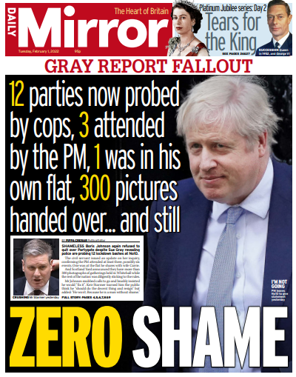
TASK: key vocabulary for newspapers
Masthead
Slogan
Headline
Strapline
Plug
Sub-headings
Caption
Anchoring
Editorial
Double Page Spread
Redtop – what this is!
Pullquote
Tabloid – what this is!
Standfirst
Double page spread
Red top
Tabloid
Pull quote
Standfirst
TASK: on the set texts, find and label as many of the technical terms as possible. Research the terms on your phones if you don’t know them. This work will form the reference sheet for this vocabulary, so don’t miss any of them out.

Slide 15
TASK: key vocabulary for newspapers
What is Anchorage?
Where the meaning of a media text is fixed or stabilised by a caption, shot type, costume or so on
Often, the elements of a media product, for example pictures in a newspaper, a camera angle in a TV programme, or a setting in a videogame tell us very little. Without the producer anchoring the image into a particular ideology, an audience could interpret a text in any way they choose.
However, producers often have a point of view that they wish to disseminate to the audience, so they choose to fix a particular meaning. The most pertinent example of anchorage is where meaning is anchored by newspaper captions.

Slide 16
TASK: key vocabulary for newspapers
What is a plug/puff? This is where a magazine puts an advert for a giveaway or competition so to grab the attention of the reader.
What is a standfirst?
A standfirst often summarises the article that follows, usually appearing soon after the main title or headline, with a font size that falls in-between that of the title and the main feature’s text.
What is a tabloid? – it’s a newspaper that is traditionally smaller, and focuses on gossipy, sensational reporting. More focused on celebrity and more pictures. ‘The redtops’ are a collection of tabloids characterized by their red mastheads.

Slide 17
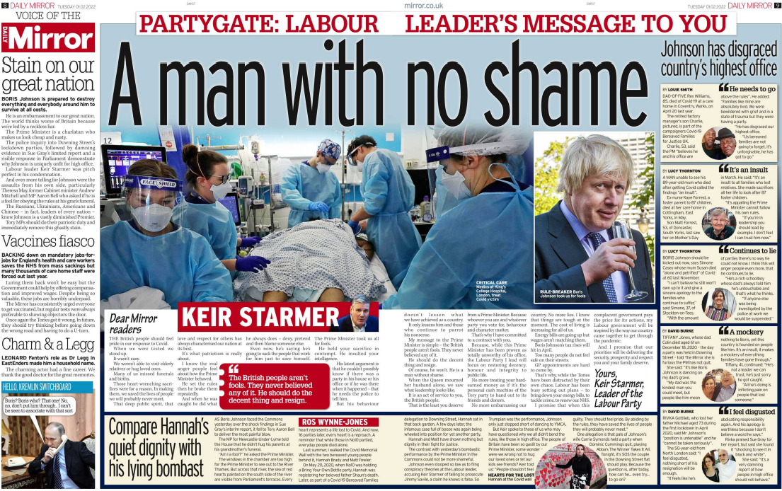
Editorial
Anchoring strapline
Standfirst
Double Page Spread
Pull quote

Slide 18
Key words
Media language - The specific elements of a media product that communicate meanings to audiences, e.g. visual codes, audio codes, technical codes, linguistic codes
Viewpoints – points of view
Ideology – a set of messages, values and beliefs that may be encoded into media products.
Anchorage - The words that accompany an image (still or moving) contribute to the meaning associated with that image. If the caption or voice-over is changed then so may the way in which the audience interprets the image. An image with an anchor is a closed text; the audience are given a preferred reading.

Slide 19
To find out a media producer’s ‘ideology’ it can be worth looking for a mission statement, or a statement of values. Go to the website…
‘Politically the Mirror sits left of centre. It has backed the Labour Party in every election since 1945.’
‘Our mission is to make sense of a rapidly changing world for our readers. To challenge wrongs where we see them. To stand up for the underdog against authority. And to entertain.’

Slide 21
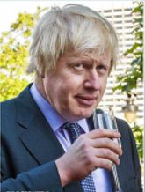
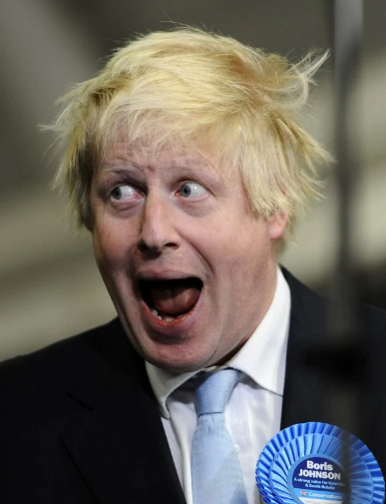
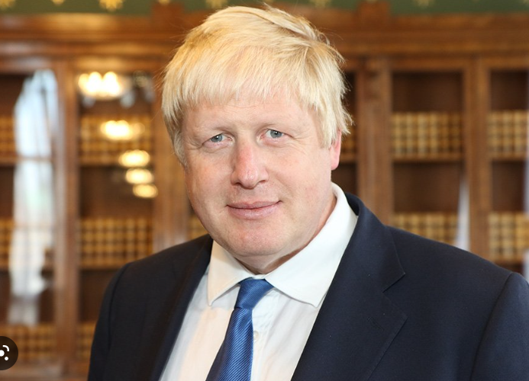
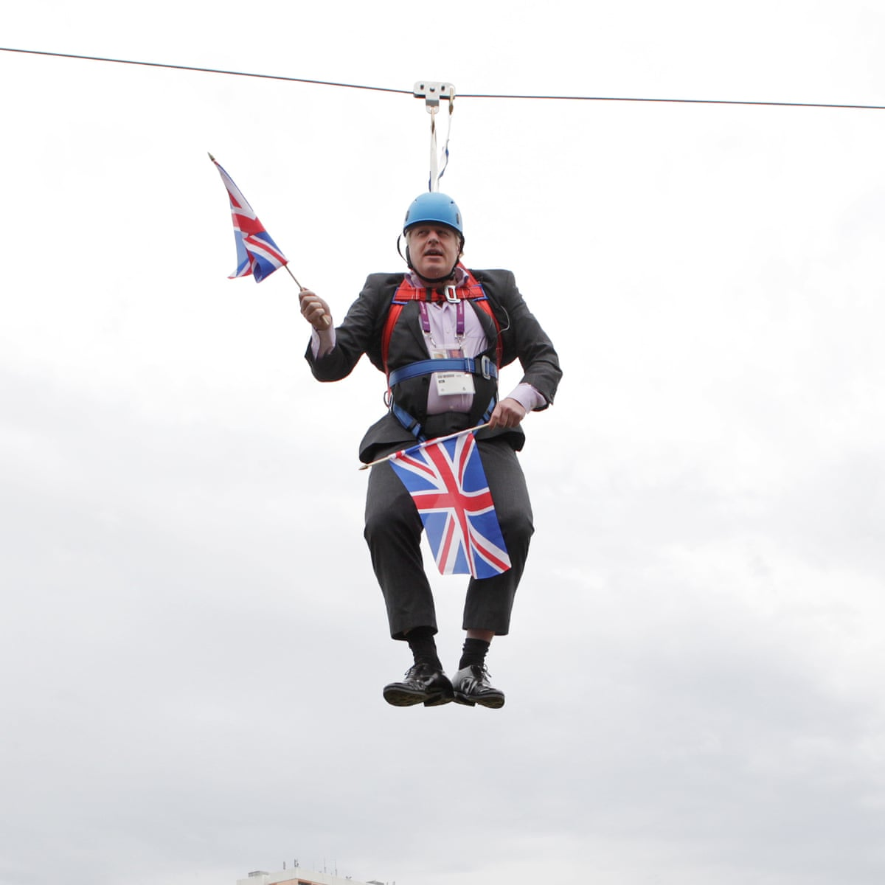
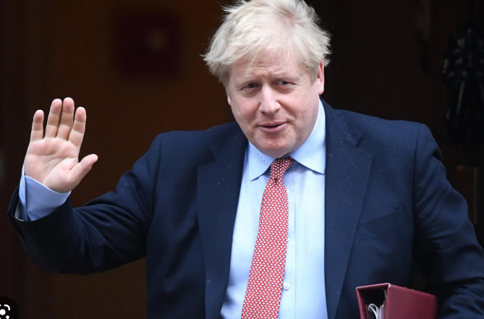
Media language: images
Statesman-like
Idiotic
Intellectual
Profligate
Hedonistic
Risible
Affable
Competent

Slide 22
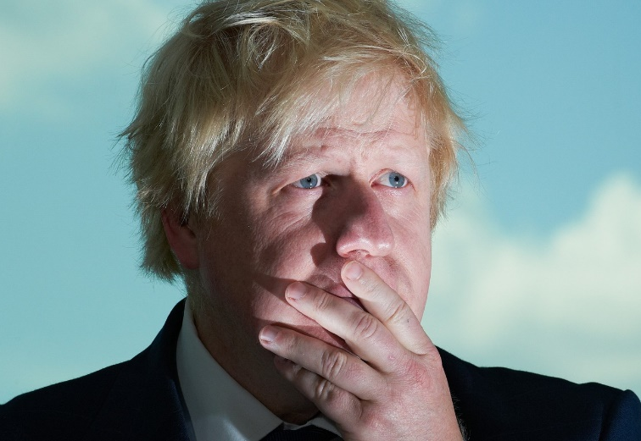
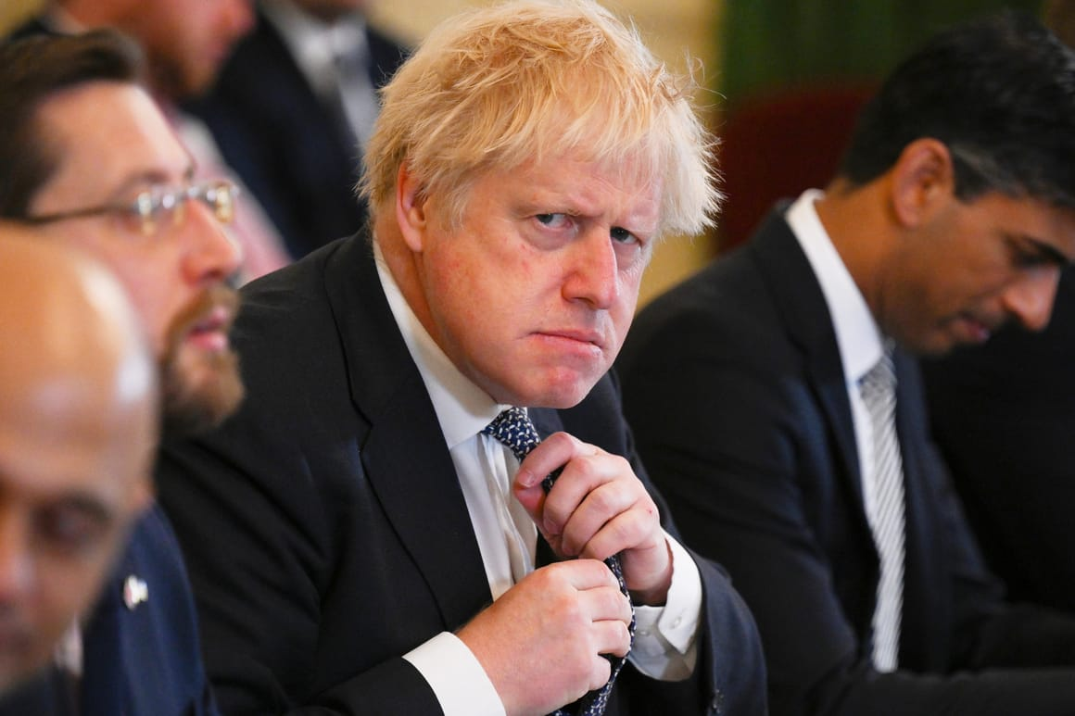
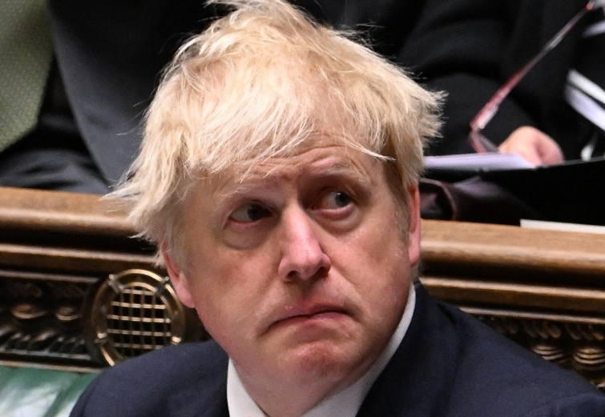
Media language: anchorage
‘What is the point of Boris Johnson?’ The Atlantic
‘Boris Johnson: the billionaires useful idiot’ Middle East Eye
‘Sorry is the hardest word for Boris Johnson’ POLITICO

Slide 23
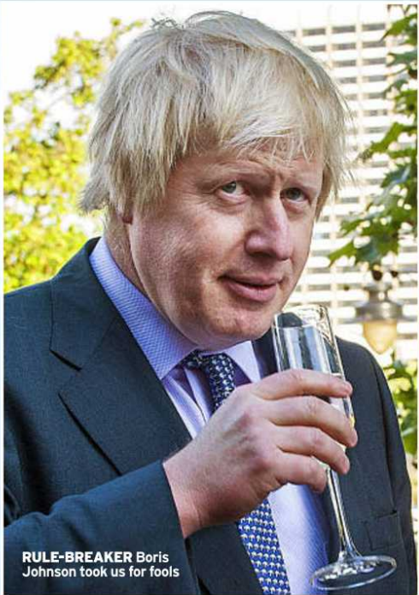
Captions as anchorage

Slide 24
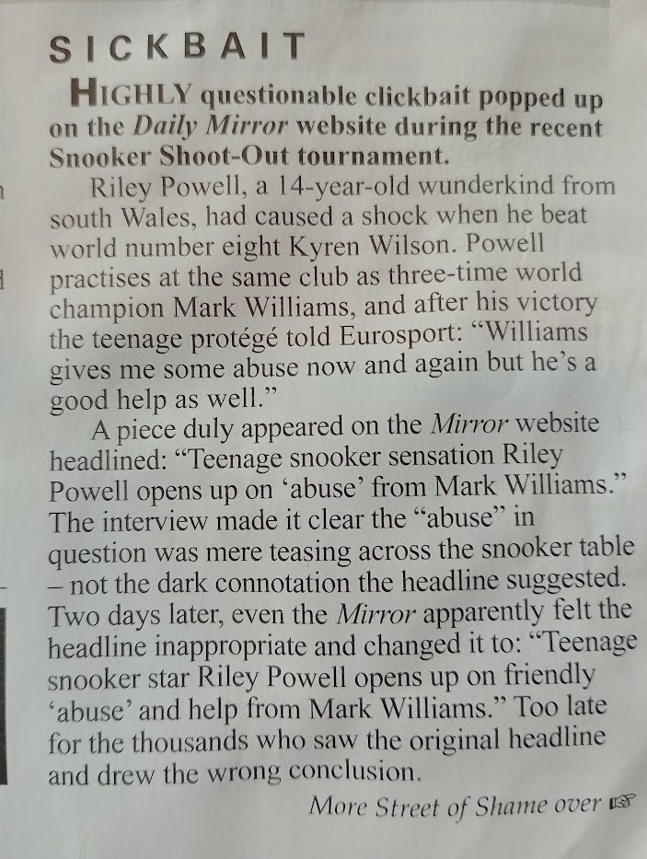
Media language: linguistic codes
Newspaper headlines are a rich source of encoded ideology, often using playful puns and sensational, emotive language to point the reader towards a particular opinion. Online news is often funded by advertising and clicks on headlines increase the exposure of advertising. Therefore, the more the headline encourages readers to click on it, the more revenue the publication will receive. This has given rise to ‘clickbait’ – headlines that are designed to draw you in with their promise of sensational news.

Slide 25
Headlines from the day Boris Johnson resigned – can you put them on the left wing/right wing spectrum?
It’s (almost) over
Johnson quits, defiant to the end
Clinging on for one last party
Johnson throws in towel
PM’s long goodbye leaves UK ‘in state of paralysis’
What the hell have they done?
Thank you Boris…you gave Britain back its freedom
KISS GOODBYE…and thanks for Brexit, Boris
Worst PM ever

Slide 26
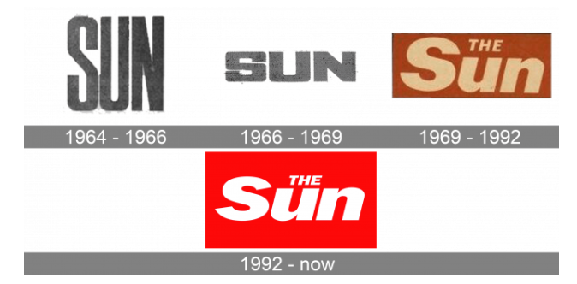
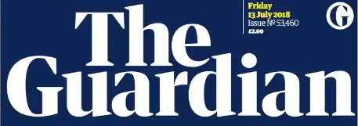
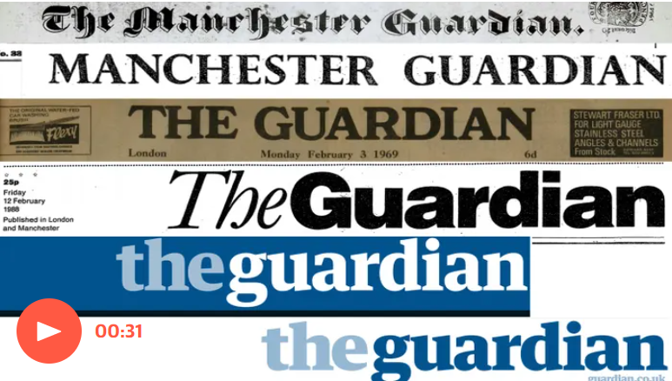
Media language and mastheads

Slide 27
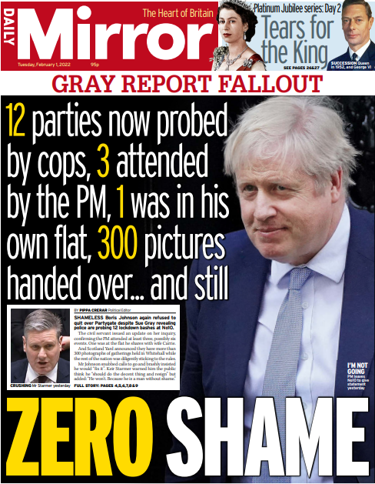
Task: answer the following
How does the media language on the front page of the Mirror reflect the viewpoints and ideologies of the newspaper?
Use What, how, why

Slide 28
How does the media language on the front page of the Mirror reflect the viewpoints and ideologies of the newspaper?
Use What, how, why for each paragraph
What:
One way that media language reflects the left-wing ideology of The Mirror is through the choice of linguistic codes.
How:
(find clear examples)
Why:
Explain why the examples you have picked have been included. What are their function and purpose? How do they link to the paper’s ideology?

