Slide 1
Newspaper analysis task

Slide 2
Media language : Analysing Newspaper front pages
Although you will be required to study more than the front page of one newspaper, it is a good place to start
The front page will give information about the brand identity and attitudes and beliefs of the paper
The newspaper industry is very competitive and what the newspaper gatekeepers put on the front page will be essential in attracting an audience
The main conventions of a newspaper include :

Slide 3
The masthead /slogan
The masthead is the name of the paper, which can signify the paper’s ethos
How does the DM masthead reflect the brand identity , ethos and values of the paper ?

Slide 4
The plug/ puff
the puff or pug usually runs across the top of the paper and advertises what else is in the newspaper
How does the pug for the Daily Mirror reflect any social or cultural context ?

Slide 5
strapline
The strapline is usually placed at above or below the headline and provides information or anchors the meaning of the central image .
How does the strapline :
Link to the DM’s brand identity ?
Link to the political values of the paper ?
What do the ellipses indicate ?

Slide 6
Headline
This will be in a larger font than the rest of the story – Why ?
Tabloid newspapers often use dramatic language to convey meaning
Tick what techniques are used in the DM headline
Alliteration
Hyperbole
Puns
Rhyme
Humor
Colloquialism

Slide 7
Central Image
The central image for tabloids is essential for selling the paper .
How is meaning created in the central image of the Daily Mirror – consider anchorage

Slide 8
Standfirst and by-line
a standfirst is a block of text that introduces the story in a different style from the rest of the text
Identify the standfirst in this headline by indicating it with an arrow
What is a by-line ?
Produce a definition and indicate where it is in the DM cover

Slide 9
Copy /splash
a splash is a sensational story
Copy is a term used to describe the written text in printed products .
how does the mode of address in the copy here differ from the headlines ?
How does the combination of images anchor to the splash ?

Slide 10
Copy
Copy is a term used to describe the written text in printed products .
The standfirst is a block of text , normally in a different typeface/style from the story it introduces .
how does the mode of address in the copy and standfirst here differ from the headlines ?

Slide 11
The Central Image
for popular/tabloid newspapers the central image is essential in selling the paper.
It may often be of a well known person or a dramatic image of an event.
Images may be indistinct if taken by paparrazi photographers. This can emphasise the exclusivity of the story for the paper
Why have the DM chosen that particular shot of the Prime Minister when they had many others to choose from ?

Slide 12
Subdeck
lines below the splash are called subdeck
( think of a submarine underwater )
What function do you think it serves ?
Think of anchorage

Slide 13
Representation in Newspapers

Slide 14
Representation in Newspapers
All newspapers have access to the same stories but they will select those that are the most appropriate for their audience
Their choices about how to represent an issue can be influenced by the attitudes, values and beliefs of the newspaper
The way the paper constructs representations will affect the way in which audiences respond to and interpret the issue or event
The focus of the representation : The way in which the newspaper is mediated encourages the audience to focus upon a particular aspect of the story and encourages them to make assumptions and draw conclusions

Slide 15
How representation is constructed
Representation is constructed through a process of selection, mediation and combination
*selection – what ever ends up on the front page – a lot more is left out. How might this impact on the way audiences interpret a story
The mode of address and choice of language ( formal ,informal, colloquialism / language devises ( alliteration, assonance, rhyme, puns, humour )
Visual codes ( gesture, clothing, expression )
Audio codes in moving image
Technical codes ( shot type and angle)
Anchorage ( no longer polysemic)

Slide 16
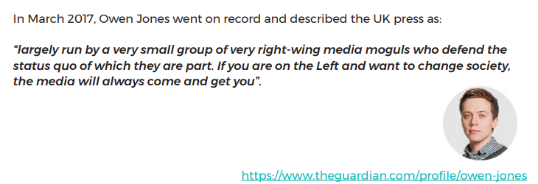
Newspaper bias
Not all bias is deliberate. But you can become a more aware news reader or viewer by watching for the following journalistic techniques that allow bias to “creep in” to the news:
Bias through selection and omission
Bias through placement
Bias by headline
Bias by photos, captions and camera angles
Bias through use of names and titles
Bias through statistics and crowd counts
Bias by source control • Word choice and tone

Slide 17
Remind yourself of representation in the DM

Slide 18
Comparison task
Compare representation of the party gate scandal in the right-wing newspaper The Daily Mail ( 30)
Compare how these pages from the Daily Mail and the Daily Mirror construct versions of reality.
In your answer you must: •
consider the choices media producers make when constructing versions of reality
• consider the similarities and differences in the representations
• make judgements and draw conclusions about how far the representations relate to relevant media context

Slide 19
Past paper example and mark scheme

Slide 20
Stretch and challenge – pick your own paper to compare with the set edition of The Times

