Slide 1
Working with the media studies framework
L17: COM 1 SEC A
LQ: How do representations of Partygate position audiences in the DPS of the Daily Mirror?

Slide 2
Admin
Please hand in homework
Homework for this week
Assessment next week
Revision tips:
Revision: understanding your subject | Resources | Net Sixth Form

Slide 3
Homework: listen/watch and take notes that might be relevant
Word of Mouth: The Language of Advertising (radio: 27 mins). You will learn a lot of technical language here – perhaps keep a list of useful vocabulary.
The Media Show: reporting on Andrew Tate - the ethics behind the news (radio: 30 mins). This show examines the tricky ethics behind reporting on an influencer such as Tate: how much air space should he have?
OPTIONAL
BBC iPlayer - Fight the Power: How Hip Hop Changed the World - Series 1: 1. The Foundation (1 hour). This is episode 1. An in-depth look at a key cultural moment in music. Ties in with our set texts and provides useful context and food for thought. Does contain strong language.

Slide 4

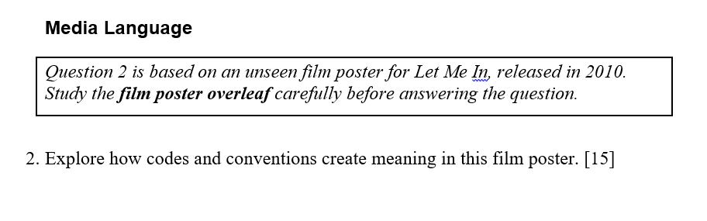
You’ll get between 30 and 40 mins depending on extra time
You will get a fresh copy of the question

Slide 5
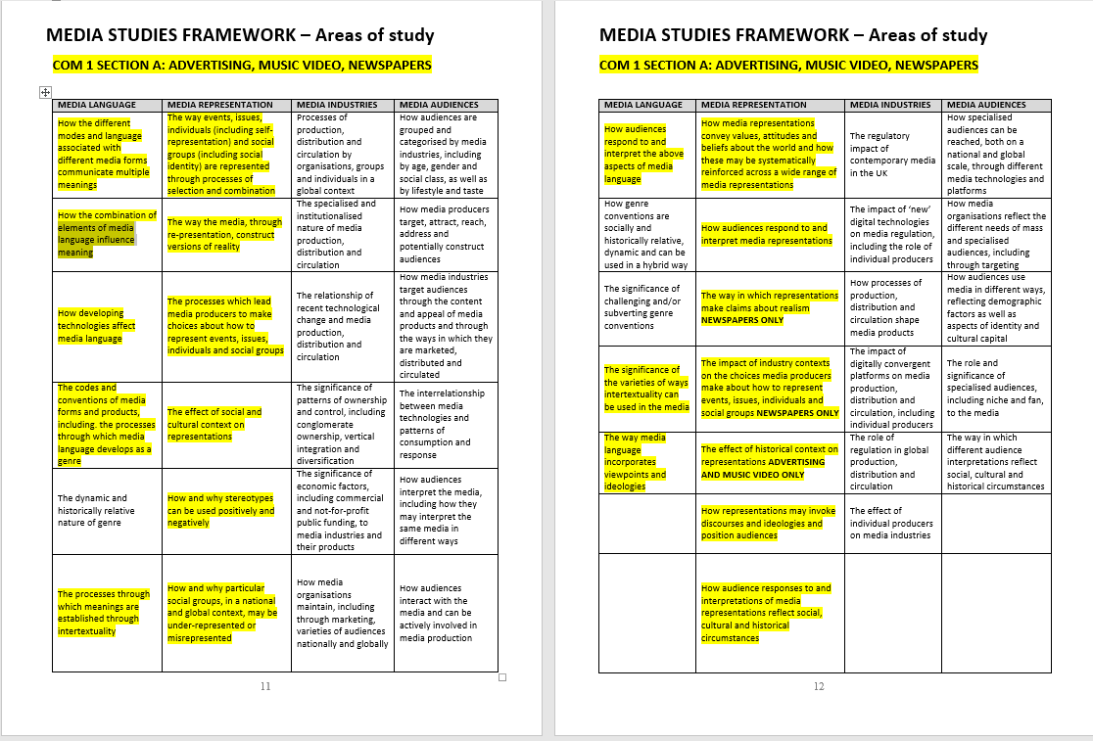
Where am I getting these fancy LOs from?

Slide 6
You can use these pages to design exam style questions for both the 15 and 30 mark questions. Only use the ones highlighted. There is a page like this for every section of every component. If you want practice questions, this is where you go.

Slide 7
How to generate exam questions
First of all, find the relevant ‘Area of Study’ for the component you are studying. For COM 1 Sec A, this appears on pages 11 and 12 of the handbook. COM 1 Sec B appears on pages 29 and 30. See if you can find the rest.
Then, take note of the highlighted boxes. These are the relevant areas of study for that Component and section.
Choose one of them.
Use a command word to change it from a statement to a question.
Add in any relevant details such as names of texts and so on.

Slide 8
How to generate exam questions
First of all, find the relevant ‘Area of Study’ for the component you are studying. For COM 1 Sec A, this appears on pages 11 and 12 of the handbook. COM 1 Sec B appears on pages 29 and 30. See if you can find the rest.
Then, take note of the highlighted boxes. These are the relevant areas of study for that Component and section.
Choose one of them.
Use a command word to change it from a statement to a question (see handout).
Add in any relevant details such as names of texts and so on. Make sure that you use ‘compare’ if you are doing a comparative question (e.g. COM 1 Sec A 30 mark question)
COMMAND WORDS
Analyse
Compare
Consider
Define
Evaluate
Explain
Give
How far/ how valid/ how useful etc.
Identify
Outline
State
To what extent
What
Which
Why

Slide 9
Let’s try…
15 marks (media language):
Analyse how the combination of elements of media language influence meaning on the DPS of the Daily Mirror
30 marks (representation):
Compare how ethnicity/ reality/ gender/ masculinity/politics etc. is represented in text 1 (unseen) and text 2 (set text)
You could cover:
How the representation of ethnicity etc. reflects a particular ideology
How the representation of ethnicity etc. influences an audience
Area of study descriptor:
MEDIA LANGUAGE COLUMN
‘How the combination of elements of media language influence meaning’
REPRESENTATION COLUMN
‘How representations may invoke discourses and ideologies and position audiences’

Slide 10
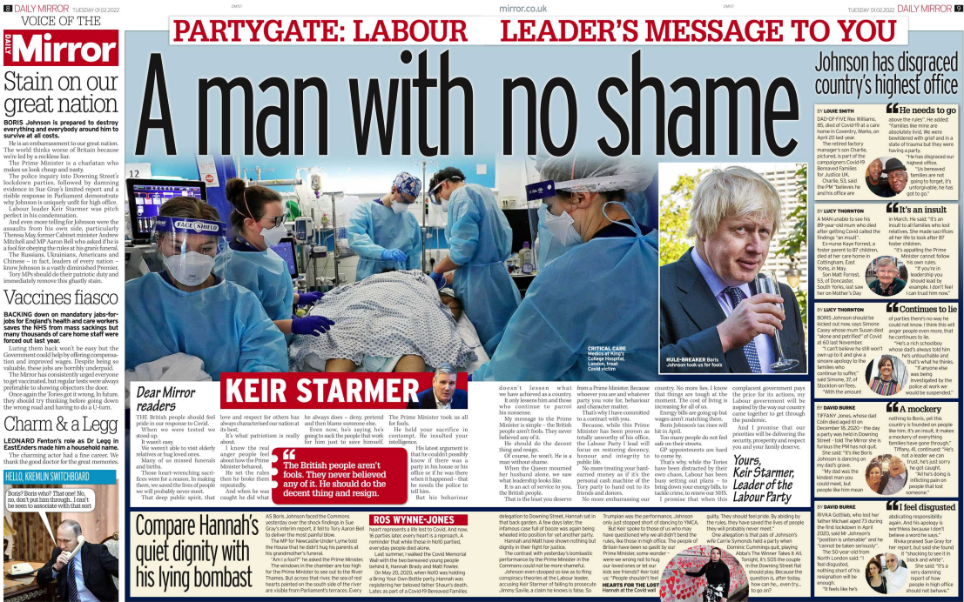

Slide 11
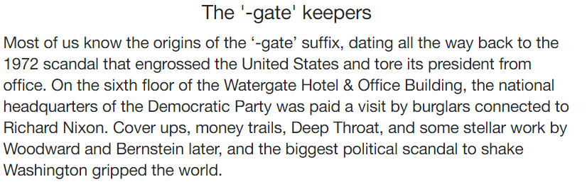
What is ‘Partygate’? Why a ‘gate’???
https://www.youtube.com/watch?v=vB9JgxhXW5w
And so ‘Partygate’ refers to the scandal of the parties at Downing Street during Covid lockdowns.

Slide 12


Slide 13
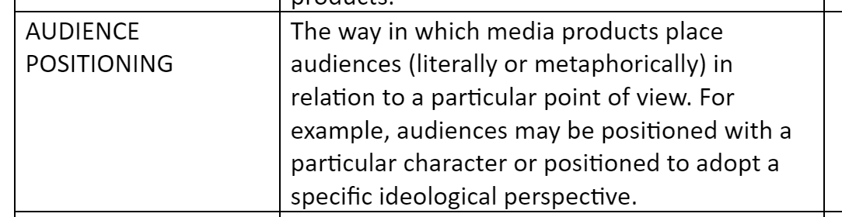
Question for all: how does the double page spread use representation to position its audience?
Audience positioning:
In other words, how do we push an audience towards a particular point of view or perspective? How does a producer get you to see things the way they want you to see them?
Examples: camera angles in films can limit an audiences’ ability to see everything. The audience might be forced to focus on one thing only.
Newspapers might bombard an audience with repeated messaging, eventually persuading them towards a particular point of view.

Slide 14
Follow on question for all: What is the audience position the Mirror hopes to achieve? What point of view does it want you to have?
Audience positioning:
In other words, how do we push an audience towards a particular point of view or perspective? How does a producer get you to see things the way they want you to see them?

Slide 15
Task: choose the statement from below that best describes the audience position that the Mirror is aiming for in this DPS
The Mirror positions the audience to feel that Boris Johnson is a fool who is not fit to run the country
The Mirror positions audience to feel outrage and indignation that Boris Johnson partied during lockdown
The Mirror positions the audience to feel admiration for Kier Starmer, who is presented as calm and responsible
The Mirror positions the audience to trust Boris Johnson and feel sympathy for everyone who is ganging up on him
The Mirror positions the audience to feel outrage and indignation that Boris Johnson partied during lockdown
Can’t decide? Write your own. Use the sentence starter: The Mirror positions its audience to feel…

Slide 16
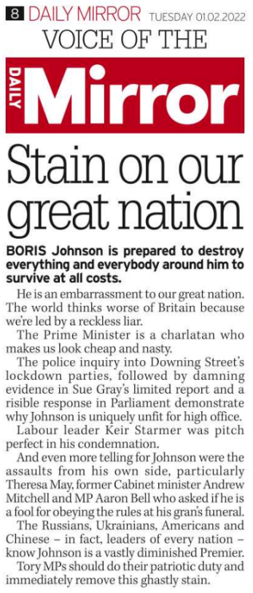
The editorial
Voice of the Mirror: signifies it’s an editorial
Mini masthead: also signifies it’s an editorial – primes audience for an opinion
An editorial is an article written by the editor of a newspaper expressing their views on a topical issue. It has to be clearly signposted as an editorial rather than news reporting.
Red connotes left-wing values – signals anti-government postioning
Headline combines the linguistic codes of disgust (‘stain’) and patriotism (‘great nation’) positions the audience to feel that Johnson should be removed and is polluting and corrupting something that should be a source of pride
Standfirst uses more emotive language (‘destroy’, ‘at all costs’) to position the audience to feel that Johnson is ruthless and damaging

Slide 17
Carousel task
On your A3 sheet, answer this question:
How do representations of Partygate position audiences in the DPS of the Daily Mirror?
Start with developed annotations – see previous slide
Then work up some What, How, Why paragraphs from your annotations
I will be photographing your work for others to use.
Don’t forget theory: Levi-Strauss is very appropriate.
If you are stuck, use the set text factsheet to give you some prompts.
This ppt and the set text fact sheet are both on Satchel, along with the homework.

