Slide 1
Working with the media studies framework
L18: COM 1 SEC A
LQ: How do the combination of elements of media language on the front page of The Times help to reflect the paper’s ideology?

Slide 2
Revision starter questions: verbal answers
How do I generate my own practice questions for each section of each component?
What does DPS stand for?
Is the Daily Mirror left wing or right wing?
What does ‘ideology’ mean?
Explain ‘audience positioning’

Slide 3
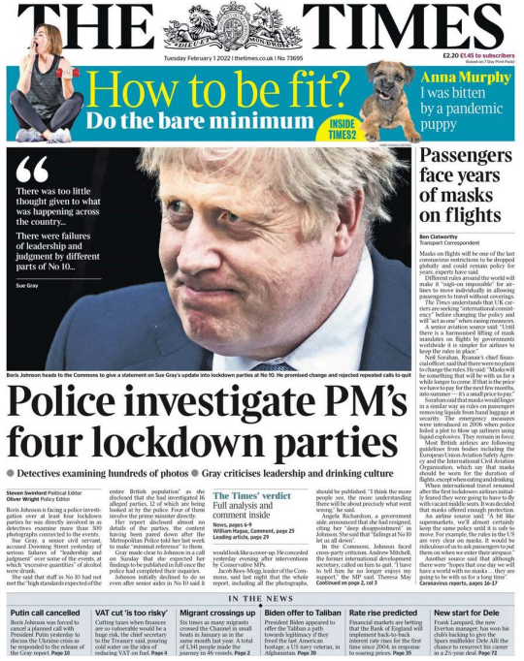
Task 1
Use your set text fact sheet to annotate this front page for media language and representation
Do not simply copy all of the ideas – summarise and select the best ones.

Slide 4
Task 2 if time
As this is your last text for Com 1, now would be a good time to look at all of the Com 1 texts together.
Begin the homework revision tasks
Organise your folders: make sure you have all the factsheets for each Com 1 text. If not, go through Satchel and print them out. File them in a logical place in your folder.
Check that you have great annotations for each text. Use the ‘Five Frames For…’ format for each one. If it’s a print text, use ‘Five Ideas For…’ instead.
If you have time, start creating possible exam questions for each text.

