Slide 1
Working with the media studies framework
L19: COM 1 SEC A
LQ: How do I approach the 30 mark question?

Slide 2
COM 1 SEC A
30 mark question
Compare how newspapers represent reality in different ways. Refer to The Mirror and the Times to support your points
Consider how each text constructs representations
Consider the similarities and differences in the way the newspapers represent reality
Consider how far the representations relate to relevant contexts by making judgements and drawing conclusions
Date: Tuesday 28th Nov 2023

Slide 3
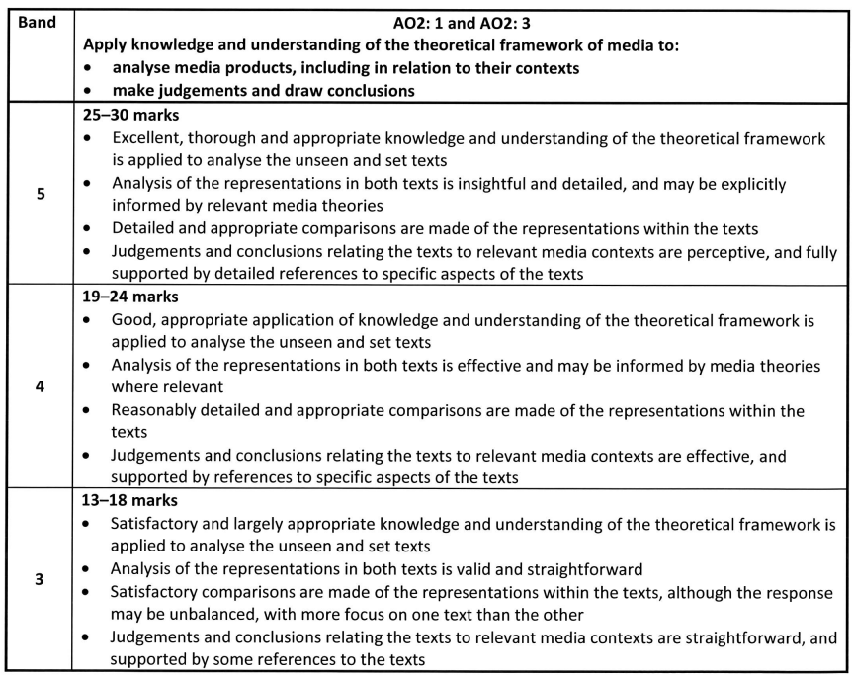
What does the mark scheme say?

Slide 4
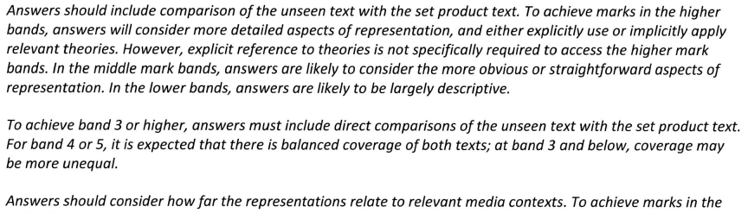
What does the mark scheme say?

Slide 5
WWW: setting things up
Both the Daily Mirror and The Times have represented the reality of ‘Partygate’ in very different ways. As a left-wing paper that claims to ‘stand up for the underdog against authority, the Mirror would be expected to use representation to position the audience into viewing Johnson’s behaviour as reprehensible and unforgiveable. The Times, however, as a right-leaning, broadsheet newspaper, would wish to represent Partygate in a more neutral, less emotive way. This is largely, how the representations are portrayed, although it is possible to see that The Times also reveals subtle reservations about Johnson’s behaviour through their representation, despite their broadly right-wing ideology.
Both papers use images and anchorage to convey their different positions. The Mirror…

Slide 6
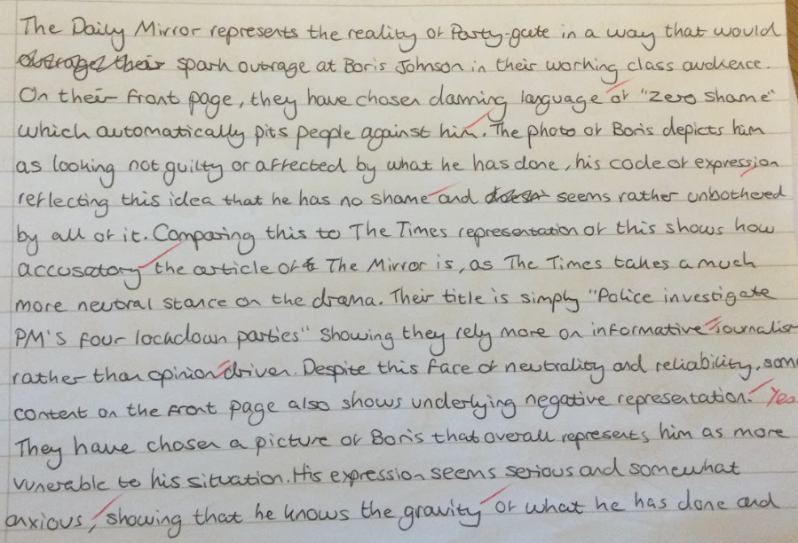
WWW: vocabulary

Slide 7
Knowledge and vocabulary to revise
Context for both papers
Terminology
Appropriate theory

Slide 8
Key development questions
What do they mean by ‘reality’?
What do they mean by a ‘direct comparison’ and how do I achieve that?
How much should I analyse the media language, given that it is a representation question?

Slide 9
What do they mean by reality?
They mean ‘this thing that happened’ or ‘this real event’.

Slide 10
What do they mean by a ‘direct comparison’ and how do I achieve that?
It means that when you make a point about one element in one text, you then have to look at the other text and find something that you can compare it to.
There should be a regularity about your comparisons – don’t wait for a whole paragraph to go by before you make a comparison. Regularly link the two texts together.
Use comparative language to ensure you make connections. Then make sure you EXPLAIN WHY there are those sims and diffs. In this case, you would link to the paper’s ideology.

Slide 11
Comparative discourse markers
Comparing Similarities
Similarly
Likewise
… is common in…
Equally noticeable is…
Furthermore
Both authors take the same approach in…
A common feature of all the texts are…
This is mirrored in…
This can also be observed in…
… is equally important in both texts.
Contrasting Phrases
Unlike
The texts are different in the area of…
On the other hand
This is contrasted in…
On the contrary…
However, the opposite is seen in…
In contrast/contrastingly…
Nothing like this occurs in…
Whereas
Quite the reverse is seen in…
This is the only text where we notice…

Slide 12
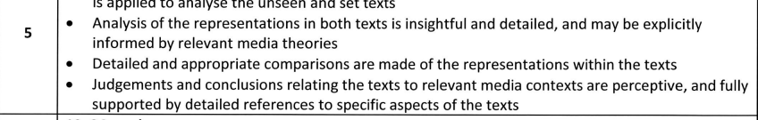
How much should I analyse the media language, given that it is a representation question?
To keep it focused on representation, identify the representation first. Use this sentence structure if it helps:
In this …, … is represented as … and … .
In this image, Boris Johnson is represented as smug and shameless.
Then show how that is achieved by picking out some relevant examples. Keep using phrases that show the examiner you are focused on representation

Slide 13
Let’s look at this attempt.
Both papers use images and anchorage to convey their different positions. The Mirror uses a picture of Boris Johnson to represent him as smug and shameless, whereas the Times has a picture of him that represents him more as anxious and embarrassed. The Mirror shows Johnson holding a glass of champagne, an index for partying and celebration and this picture is in binary opposition to a wide shot of a vast team of health workers tending to a very sick patient. This invites comparisons between the pictures: Johnson is irresponsible and self-serving, whereas the health workers are dedicated and altruistic. By way of contrast, the Times uses a picture of Johnson that is a lot less emotive and is not juxtaposed with any other images that anchor the meaning in a particular way. Instead, Johnson looks professional yet anxious, perhaps suggesting that there is some remorse. Unlike the Mirror, the Times is broadly supportive of the Conservative party, which explains the difference in representation suggested by the pictures.
It is a similar story for linguistic codes. The Mirror’s strong left-wing ideology prompts the writers to represent Johnson very negatively indeed through phrases such as ‘zero shame’ and ‘stain on our nation’. The word stain suggests something unwanted, disgusting and permanently damaging to our nation. The Times, however, adopts much more neutral and factual language, suggesting that they are representing the situation fairly. The headline is ‘Police investigate PMs four lockdown parties’, which seems neutral, but it is telling that they select the word ‘party’ rather than the government’s own preferred word: ‘gathering’. Subtly, The Times is also representing a negative view of the reality of Partygate, but, for ideological reasons, the paper is unwilling to go to the same lengths as the Mirror. They know that a lot of the readership will admire Boris Johnson, despite the scandal.

Slide 14
Task: evaluate the model answer on the sheet (not complete)
Does it have comparative language? Highlight.
Does it compare the representations directly, appropriately and regularly? Highlight.
Is there detailed analysis of the right kind? Highlight.
Is there a clear and sustained line of argument? Could you summarise it in one sentence? E.g this response argues throughout that… (you might find this harder as the line of argument is usually set up in the introduction)
Where is the theory for the top band? Highlight.
Can you say what could be improved?
What wording or phrasing are you going to steal to improve your own expression?
We’ve had a paragraph on images and a paragraph on linguistic codes. What might the next paragraph compare?

Slide 15
You do
TASK 1
Write the final paragraph.
When you have finished, evaluate your own work in the same way.
Then:
TASK 2: source print adverts that would be interesting to compare to the TIDE print advert
TASK 3: source film posters that would be interesting to compare to the KOTV film poster
TASK 4: create a typical 30 mark question to go with both pairs of texts (see slide 2 for an example. Make sure you do bullet points as well)
TASK 5: answer one of your questions

