Slide 1
Introducing the Media Studies Framework
L2: COM 1 SEC A
LO: to understand and apply a MEDIA LANGUAGE CHECKLIST: AUDIO CODES

Slide 2
5 mins starter: write this statement about Beyonce’s ‘Jealous’ in your books. Using your notes from this lesson, annotate it with evidence from the video, either proving or disproving Mr Feeney’s assertion.
"It's not a breakup anthem, nor is it a declaration of undying love. It's angry, it's introspective, it's regretful, it's playful, it's loving, and it's everything in between."
Note: you can adjust this for a song you love. Find a quote about it and then prove or disprove it.
Feeney, Nolan (March 13, 2014). "Revisiting Beyoncé: Could 'Jealous' Be Its Most Important Song?". The Atlantic.
Remember to sound like a media studies student. Use the terminology from the VISUAL CODES sheet.

Slide 3
ADMIN
HOMEWORK return
Assessment week:
This will be next Tuesday, lesson 1.
You need to revise visual codes (p86) and technical codes (p82).
You will applying both of these aspects of media language to a text – it will be an image you have already seen.
The question will be: How do the camera work and visual codes create meaning in this screenshot? Why is the meaning created this way?
The first part of the question encourages detailed analysis and the second part requires you to give a reason and a purpose.

Slide 4
Audio Codes Checklist: p86
Key words:
Diegetic Sound - Sound that comes from the fictional world, for example sound of a gun firing, the cereal being poured into the bowl in an advert, etc.
Non-diegetic sound - Sound that comes from outside the fictional world, for example a voiceover, romantic mood music etc.

Slide 5
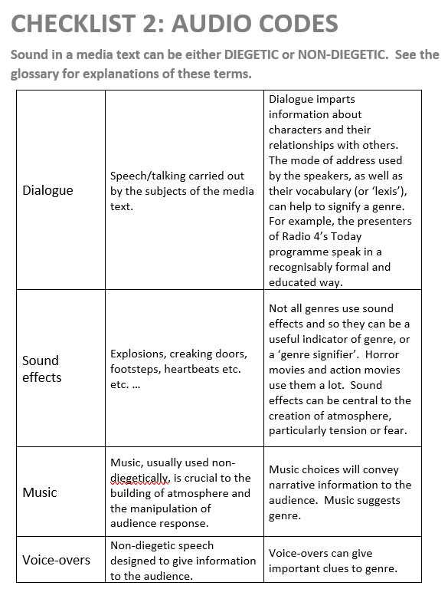

Slide 6
Focus on MUSIC
Music has huge potential to create meaning.

Slide 7
Think of sounds that match the following emotions:
6
Happiness
Anger
Fear
Shock
Disgust
Pride
Hatred
Love
Sadness
SOME IDEAS…
A violin playing in the distance
Children laughing
A heartbeat getting faster

Slide 8
Music can influence the narrative, in other words, it can make the same thing feel like a completely different story. Here is an example of storytelling, or narrative, through music.
6
https://www.youtube.com/watch?v=mndDbN60Eiw
‘In the first version, I think that the non-diegetic codes of sound created by the music suggest that three heroes are desperately running, trying to rescue their friends.’
There are four more versions. Can you match them with the suggested ‘story’ or narrative? Task: write your own ‘story’ to describe what is going on.

Slide 9
Musical elements that help to create meaning.
PACE
PITCH
VOLUME
INSTRUMENT CHOICE (including the human voice)

Slide 10
Focus on Sound Effects
https://www.youtube.com/watch?v=jDy5j0c6TrU
What’s the effect of the music in this clip? Is it diagetic or non-diegetic? Any other sound effects that you could comment on? Warning – this is the scene I warned you about!
https://www.youtube.com/watch?v=XIMg2Xw4_8s

Slide 11
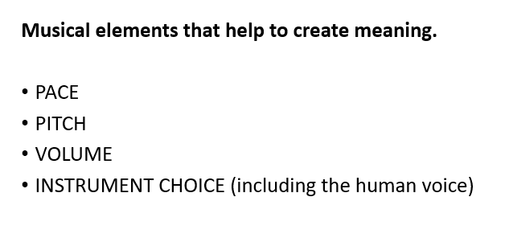
Case study: the opening sequence of Bodyguard (BBC1 Sunday nights)
https://www.youtube.com/watch?v=oz7P7t4yEfA
Before we start, turn to page 83 of your handbook
As we watch, make notes on the four sections. If you find no examples of any of the four sections, then write that down and have a think about why that feature has not been used.
I will talk it through as we go.

Slide 12
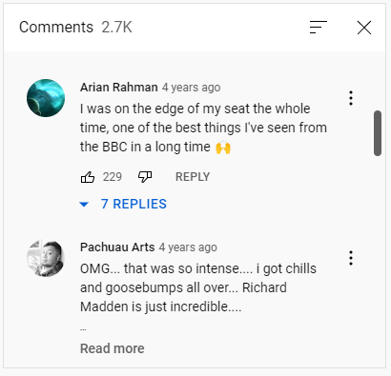
Question
Give three examples of sound being used to create tension in this clip
Explain how each of your examples creates a particular effect (consider pace, pitch, volume, instrument choice to help)
https://www.youtube.com/watch?v=oz7P7t4yEfA

Slide 13
How to extend, step-by-step
The diagetic sound of the brakes creates tension.

Slide 14
How to extend, step-by-step
The diagetic, high-pitched, screeching sound of the brakes creates tension.

Slide 15
How to extend, step-by-step
The diagetic, high-pitched, screeching sound of the brakes creates tension as it is reminiscent of a human scream and it is very uncomfortable to listen to.

Slide 16
How to extend, step-by-step
The diagetic, high-pitched, screeching sound of the brakes creates tension as it is reminiscent of a human scream and it is very uncomfortable to listen to. It also lasts a long time, prolonging the discomfort.

Slide 17
How to extend, step-by-step
The diagetic, high-pitched, screeching sound of the brakes creates tension as it is reminiscent of a human scream and it is very uncomfortable to listen to. It also lasts a long time, prolonging the discomfort. Towards the end of this sound, it becomes distorted and it blends into a non-diegetic overdub, acting as a sound track that the characters can no longer hear.

Slide 18
How to extend, step-by-step
The diagetic, high-pitched, screeching sound of the brakes creates tension as it is reminiscent of a human scream and it is very uncomfortable to listen to. It also lasts a long time, prolonging the discomfort. Towards the end of this sound, it becomes distorted and it blends into a non-diegetic overdub, acting as a sound track that the characters can no longer hear. This adds to the mounting tension as the audience are now given further, unsettling sound cues, which go on to suggest that what might be perceived as normal by the characters (a braking train) is in fact not normal at all.

Slide 19
How to extend, step-by-step
The diagetic, high-pitched, screeching sound of the brakes creates tension as it is reminiscent of a human scream and it is very uncomfortable to listen to. It also lasts a long time, prolonging the discomfort. Towards the end of this sound, it becomes distorted and it blends into a non-diegetic overdub, acting as a sound track that the characters can no longer hear. This adds to the mounting tension as the audience are now given further, unsettling sound cues, which go on to suggest that what might be perceived as normal by the characters (a braking train) is in fact not normal at all. The effect of switching from diagetic to non-diagetic also has a disturbing effect on how the audience perceives itself to be positioned in the narrative as they lurch from being inside the story, experiencing the same sounds as the characters, to outside of the narrative where they are observing the events unfolding.

Slide 20
How to extend, step-by-step
Add theory!
Add context!

Slide 21
How to extend, step-by-step
The diagetic sound of the brakes creates tension.
The diagetic, high-pitched, screeching sound of the brakes creates tension.
The diagetic, high-pitched, screeching sound of the brakes creates tension as it is reminiscent of a human scream and it is very uncomfortable to listen to.
The diagetic, high-pitched, screeching sound of the brakes creates tension as it is reminiscent of a human scream and it is very uncomfortable to listen to. It also lasts a long time, prolonging the discomfort.
The diagetic, high-pitched, screeching sound of the brakes creates tension as it is reminiscent of a human scream and it is very uncomfortable to listen to. It also lasts a long time, prolonging the discomfort. Towards the end of this sound, it becomes distorted and it blends into a non-diegetic overdub, acting as a sound track that the characters can no longer hear.
The diagetic, high-pitched, screeching sound of the brakes creates tension as it is reminiscent of a human scream and it is very uncomfortable to listen to. It also lasts a long time, prolonging the discomfort. Towards the end of this sound, it becomes distorted and it blends into a non-diegetic overdub, acting as a sound track that the characters can no longer hear. This adds to the mounting tension as the audience are now given further, unsettling sound cues, which go on to suggest that what might be perceived as normal by the characters (a braking train) is in fact not normal at all.
The diagetic, high-pitched, screeching sound of the brakes creates tension as it is reminiscent of a human scream and it is very uncomfortable to listen to. It also lasts a long time, prolonging the discomfort. Towards the end of this sound, it becomes distorted and it blends into a non-diegetic overdub, acting as a sound track that the characters can no longer hear. This adds to the mounting tension as the audience are now given further, unsettling sound cues, which go on to suggest that what might be perceived as normal by the characters (a braking train) is in fact not normal at all. The effect of switching from diagetic to non-diagetic also has a disturbing effect on how the audience perceives itself to be positioned in the narrative as they lurch from being inside the story, experiencing the same sounds as the characters, to outside of the narrative where they are observing the events unfolding.

Slide 22
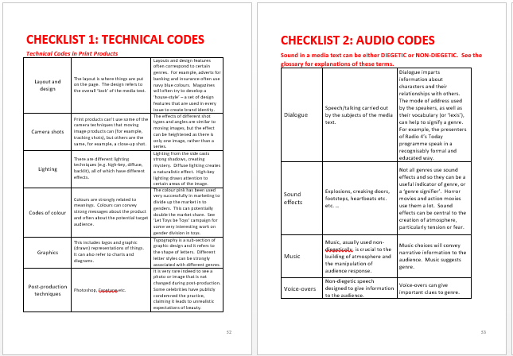
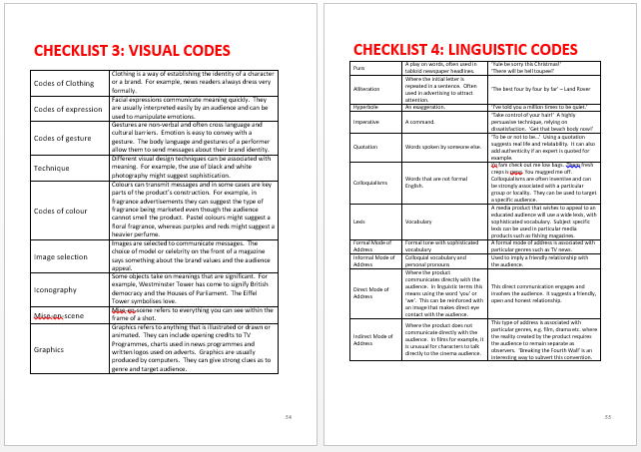
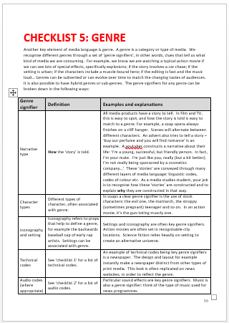
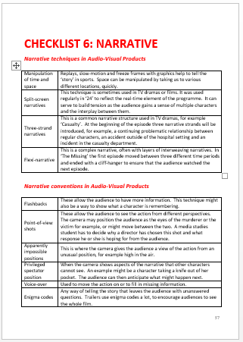
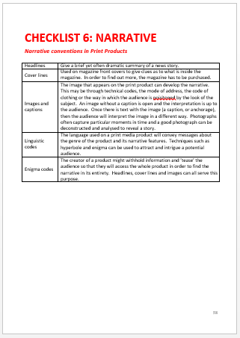
Plenary – a reminder of what’s not been done!

Slide 23
A set text that uses audio codes
Super. Human. Advert
Homework for next week (Tuesday): complete the work you did on the Bodyguard extract

