Slide 1
Working with the media studies framework
L20: COM 1 SEC A
LQ: How do I approach the 30 mark question?

Slide 2
Key things from yesterday – can you answer these TRUE or FALSE questions?
This question is worth 45 marks
It is a question that requires a short answer
The focus is media language
I don’t need to include theory
I need to compare the texts regularly
Getting into a level 5 is also partly about the power of vocabulary and phrasing

Slide 3
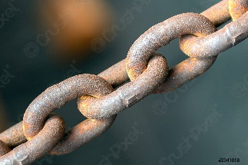
Is there a ‘method’ that I can use every time?
PEA or what/ how/ why
What am I writing about (point)
How is this demonstrated in the text (example)
Why is this done in this way (analysis)
One way that the Daily Mirror demonstrates its ideology is through its use of linguistic codes. In the editorial, Boris Johnson is described as a ‘stain on the nation’. The word ‘stain’ suggests something disgusting, out of place and permanent, which this reflects the Mirror’s desire to represent Johnson as completely unsuitable for public office. This ties in with the Mirror’s left-wing ideology and the interests of the readership who may also share feelings of disgust for Boris Johnson.
Think about a ‘chain of whys’ – every time you explain something, ask yourself again – why is it like this? Can you see the ‘chain of whys’ in the paragraph above? If you chain your ‘whys’ together in this way, you develop and broaden your analysis.
What’s the problem with this method for this question? What is missing?

Slide 4
Tasks
TASK 1: source print adverts that would be interesting to compare to the TIDE print advert. Print the best one out in colour.
TASK 2: source film posters that would be interesting to compare to the KOTV film poster. Print the best one out in colour.
TASK 3: create a typical 30 mark question to go with both pairs of texts (see below for an example. Make sure you do bullet points as well). On the next slide are some tips
TASK 4: answer one of your questions (see homework as well)
Compare how newspapers represent reality in different ways. Refer to The Mirror and the Times to support your points
Consider how each text constructs representations
Consider the similarities and differences in the way the newspapers represent reality
Consider how far the representations relate to relevant contexts by making judgements and drawing conclusions

Slide 5
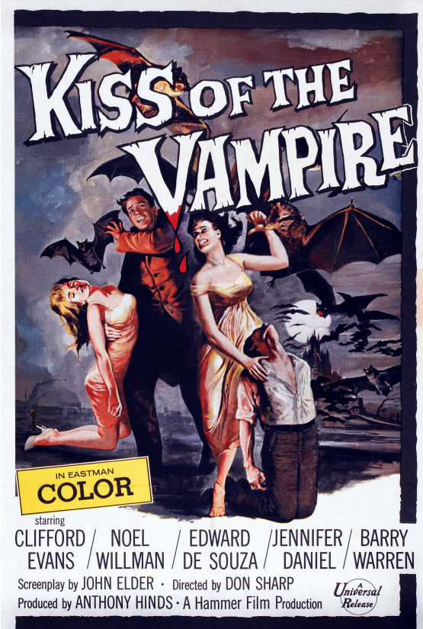
Some thoughts about constructing questions.
What ‘representations’ could you investigate in KOTV?
Gender?
Masculinity?
Femininity?
The supernatural?
Evil?
If you go for ‘the supernatural’, your question might be:
Compare how film posters represent the supernatural in different ways. Refer to the unseen text and KOTV in your answer.
Consider how each text constructs representations of the supernatural
Consider the similarities and differences in the way the film posters represent the supernatural
Consider how far the representations relate to relevant contexts by making judgements and drawing conclusions

Slide 6
Homework this week
Please hand this in next WED 6th DEC – put reminders on your phone if you need to!
For homework, finish writing the 30 mark question that you have just constructed. Make sure you hand in a print out if you are typing and can you also include a copy of the unseen text. Aim to spend 45 mins on writing it. Do any research, revision and planning before writing it up.
Continue to organise folders – see homework from last week for more detailed instructions.
This is all on Satchel!

