Slide 1
Introducing the Media Studies Framework
L5: COM 1 SEC A
LO: to explore, understand and apply Stuart Hall’s REPRESENTATION THEORY

Slide 2
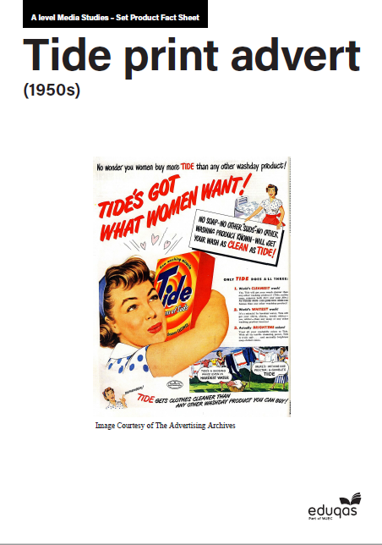
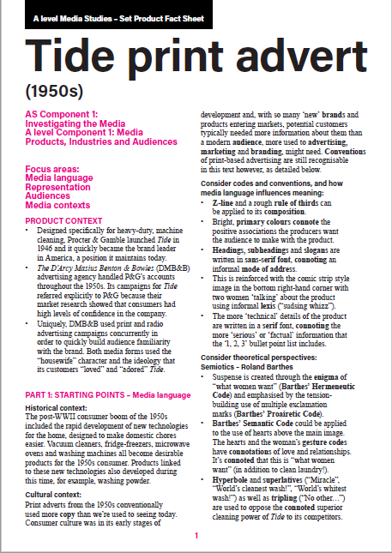
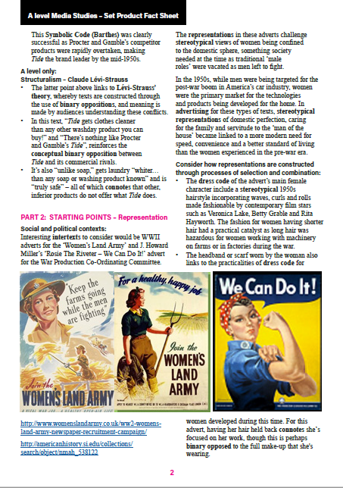
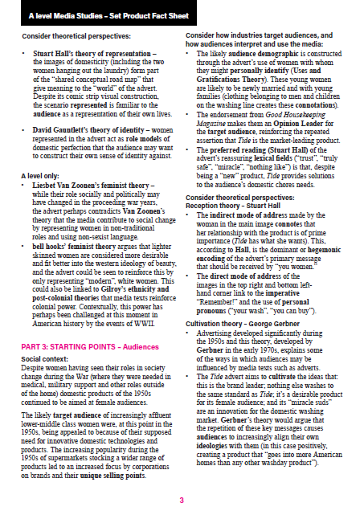
Admin and Homework reminder
Jim Crow/This is America essay is to be handed in THIS week
This week, armed with a smattering of Media Language teaching, a lesson’s worth of representation, one finished essay and one theory, we might start looking at the set texts. Your knowledge will grow as we do so.
Homework: prepare for a test next week on the set text factsheet.

Slide 3
Starter – here are some groups that are often stereotyped. Can you add some more?
Americans
Teenagers
Old people
Drummers in bands (‘How do you know if the stage is level? Check that the drummer is dribbling out of both sides of his mouth.’)
Women under 25
Women over 45
Men under 25
Men over 45

Slide 4
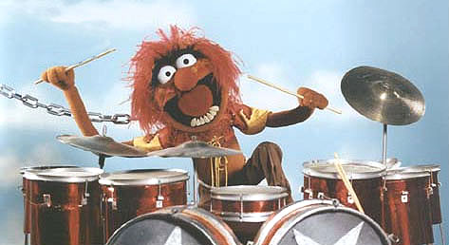
Pick one of these stereotypes. Pick out the ‘essence’ of this stereotype. Here’s an example:
DRUMMER

Slide 5
But actually…
"Drummers," writes Jordan Taylor Sloan at Mic, "can actually be smarter than their less rhythmically-focused bandmates." This according to the findings of a Swedish study (Karolinska Institutet in Stockholm) which shows "a link between intelligence, good timing and the part of the brain used for problem-solving." As Gary Cleland puts it in The Telegraph, drummers "might actually be natural intellectuals."

Slide 6
Question – where do the stereotypes come from?
‘Picture a high-school dropout. Now, think about what occupation that person is likely to hold. If “fast-food worker” came to mind, you would be correct: High-school dropouts are overrepresented in the fast-food industry.
In the Journal of Personality and Social Psychology, IPR social psychologist Alice Eagly and the University of San Diego’s Anne Koenig, a former IPR graduate research assistant, investigate how people come to form stereotypes based on these types of inferences about social roles.
They are the first to explore how “social role theory,” which has been mainly used to understand gender stereotypes, might explain why people believe, for example, that typically MBAs are competitive and senior citizens are kind. The theory proposes that as people observe a group overrepresented in certain roles—for example, women as caregivers—they extrapolate from the traits they believe are enacted in these roles, such as being more nurturing, and ascribe them to the entire group—that is, to women in general.’
‘…if enough members of a stereotyped group manage to break into new fields—whether men into nursing or women into math and science—prevailing stereotypes about them would likely change.’
How Do Stereotypes Form and Can They Be Altered?: Institute for Policy Research - Northwestern University
Another question: is it just this? Or are there other mechanisms at work?

Slide 7
Theories of representation - Stuart Hall
the idea that representation is the production of meaning through language, with language defined in its broadest sense as a system of signs
the idea that the relationship between concepts and signs is governed by codes
the idea that stereotyping, as a form of representation, reduces people to a few simple characteristics or traits
the idea that stereotyping tends to occur where there are inequalities of power, as subordinate or excluded groups are constructed as different or ‘other’ (e.g. through ethnocentrism).

Slide 8
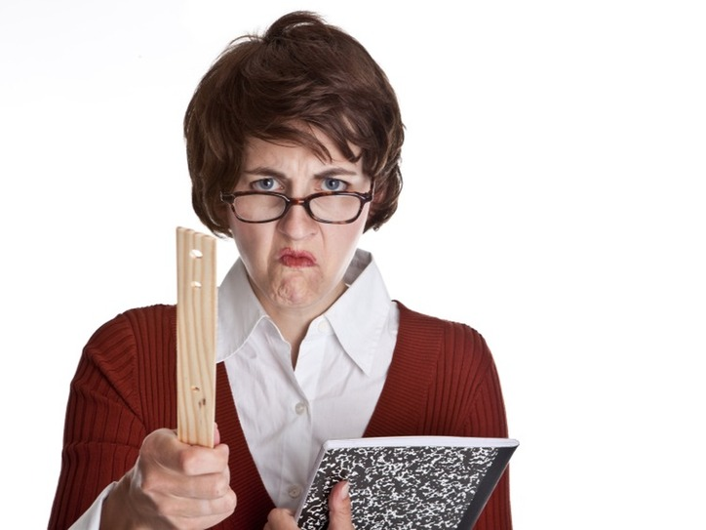
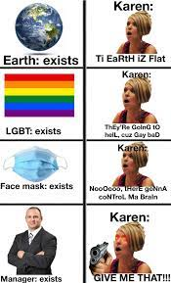
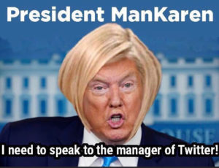
Let’s get personal – how might this affect you?
Female
Middle aged
Mother
Teacher
White
English
British

Slide 9
Representation of Women in Advertising: one woman’s ‘take’.
Jean Hibbert – Representation of Women (16 mins)
https://www.youtube.com/watch?v=Uy8yLaoWybk

Slide 10
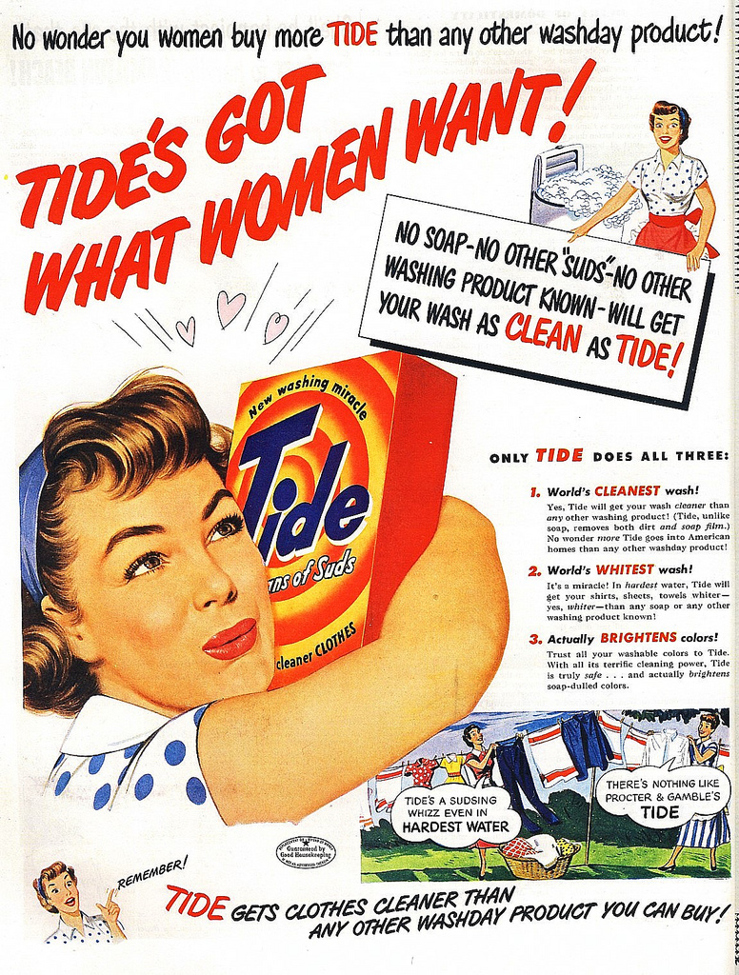
Applying it to set texts
the idea that representation is the production of meaning through language, with language defined in its broadest sense as a system of signs
the idea that the relationship between concepts and signs is governed by codes
the idea that stereotyping, as a form of representation, reduces people to a few simple characteristics or traits
the idea that stereotyping tends to occur where there are inequalities of power, as subordinate or excluded groups are constructed as different or ‘other’ (e.g. through ethnocentrism).
SET TEXT: Janelle Monae, Turntables

Slide 11
What about others?
https://www.theguardian.com/us-news/2018/jul/20/muslim-terror-attacks-press-coverage-study
‘Terror attacks by muslims receive 357% more press attention’
Question: how does this feed in to Stuart Hall’s theory?

Slide 12
More theories of representation.
https://www.slideshare.net/jphibbert1979/representation-7259964
Jean Hibbert – Representation of Women
https://www.youtube.com/watch?v=Uy8yLaoWybk

